Slide 1
Registrar of Voter’s Conference
September 21, 2018

Slide 2
Party Switch
Voter switches from Republican Party to Democratic Party to vote in the Democratic primary. Voter changes their mind at the last minute and wants to switch back to the Republican Party to vote in the Republican primary.
CGS 9-59. There is a three month waiting period for both an erasure and a transfer. An erasure is when a voter elects to leave a party and a transfer is when a person elects to leave a party and enroll in a different party.
So even if the voter above elected to simply leave the Republican Party and before enrolling in the Democratic Party changed their mind, there would still be a three month wait before the voter could re-enroll in the Republican Party.

Slide 3
The loophole!
Voter thinks they can game the system and in an effort to avoid a three month waiting period, switches from the Republican Party to Unaffiliated and then the next day enrolls in the Democratic Party.
CGS 9-59. There is a three month waiting period for an erasure. An erasure is when a voter leaves a particular party. So even though the voter registers as an Unaffiliated voter, the three month waiting period still applies. So the voter would not be eligible to enroll in a new party until three months after they left the Republican Party.

Slide 4
I forced a primary!
Local candidate wants to run for Board of Education and attends the caucus. At the caucus the candidate does not receive the endorsement but obtains at least 15% of the votes at the caucus.
CGS 9-391. There does not exist an opportunity to achieve a primary for municipal office by receiving at least 15% of the votes at a caucus. For a municipal office, the only way to achieve a primary is to circulate primary petitions issued by the Registrar of Voters.

Slide 5
I swear I registered to vote…
Voter registers to vote by mail before the voter registration deadline. The Registrar of Voters office is closed on the day the mail is delivered and the Registrar doesn’t process the registration card until after the voter registration deadline.
CGS 9-23g. As long as an application for voter registration is post-marked before the registration cut-off, the application can be accepted by the Registrar of Voters and the voter can be added to the registry list.

Slide 6
I want to save money!
Municipality wants to hold a referendum on the same day as an election.
CGS 9-369d. A municipality is allowed to hold a referendum on the same day as an election. In most cases, the municipality files the question with our office so that the question can be included on the official ballot. However, if non-resident property owners are also allowed to vote on the question, a separate location must be established using separate poll workers. A system must also be worked out so that a registered voter does not vote on the question using the official ballot and then again at the separate location as a property owner.

Slide 7
My polling place is ruined!
Two weeks before the election, a pipe bursts and floods the gym which is used as a polling place in the municipality.
CGS 9-169. If the Municipal Clerk and Registrar of Voters of a municipality unanimously find that any polling place within the municipality has been rendered unusable within a period of 31 days before the election, they shall forthwith designate another polling place to be used in place of the one so rendered unusable and shall give adequate notice that such polling place has been so changed.

Slide 8
What happened?
On election day morning a tabulator jams.
Note the machine counter and try turning the machine off, and try to push/feed the ender card through the back of the machine to unlock the read head. Turn the machine back on and check the ballot count. If the ballot count does not match then turn the machine off and switch to the back up machine. If the counter does match have the next voter insert their ballot. If this does not solve the problem, then retire that machine for the duration of the election and switch to the back up OS machine.
If the OS machine partially takes the ballot and then spits it back first note the machine counter and check that the vertical bar in the throat of the ballot box is in the horizontal position and that the ballot box security plate has been removed. Usually the vertical bar is in the vertical position and it needs to be horizontal. If the ballot count does not match then turn the machine off and switch to the back up machine. If the counter does match have the next voter insert their ballot. If this does not solve the problem, then retire that machine for the duration of the election and switch to the back up OS machine.

Slide 9
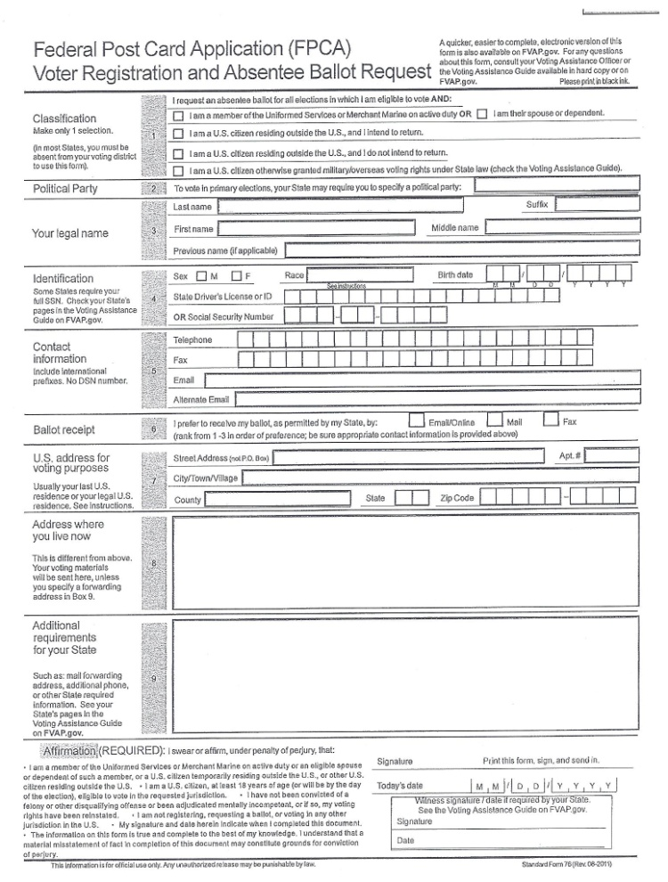
FPCA – what is that?
Voter submits a FPCA and selects either (1) I am a US citizen residing outside US and my return is not certain or (2) I am a US citizen have never resided in the US, what do I do?
FPCA is the Federal Post Card Application. This is a federally mandated form that can be used as both an application for absentee ballot and an application for voter registration. There are several different choices a voter can make on the application and depending on the selection made by the voter, different actions need to be taken.
If a voter selects either of the two options above, the application is not a request for voter registration. It is a request for an overseas ballot which contains federal offices only.

Slide 10
Vote early and often!
A ballot containing write-in votes has not been machine counted so they must be run through the machine a second time.
Ballots containing write-in votes have been counted by the machine. When the tabulator recognizes a ballot as having a write-in vote, the machine will count all of the marked votes, record that a write-in vote bubble was selected and divert the ballot into the write-in bin of the ballot box. At the close of the polls the write-in ballots are reviewed to attribute any of the write-in votes to the candidate whose name has been written on the ballot. All other votes have already been counted.

Slide 11
How can I get on the ballot?
An individual wants to run for office but cannot get the endorsement from the local town committee. What are the other ways to get on the ballot?
The individual can obtain a primary petition from the Registrar of Voters and if they circulate and obtain the proper number of signatures they can force a primary for the office in question.
The individual can obtain a nominating petition from the Secretary of the State and if they circulate and obtain the proper number of signatures they will be placed on the ballot in November.
The individual can register as a write-in candidate.

Slide 12
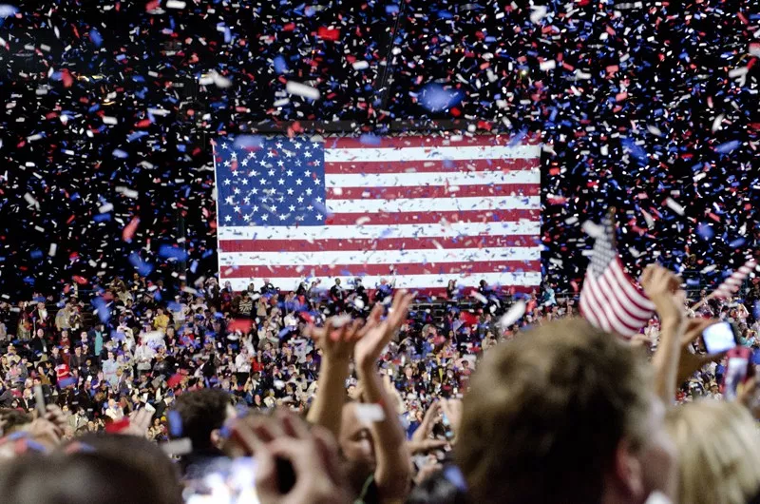
Did I win?
Candidate who lost wants to know if there will be a recount.
CGS 9-311 & 9-311a. A recount (recanvass) is conducted as follows:
When the margin of the winning candidate over the losing candidate is less than a vote equivalent to one-half of one percent of the total number of votes cast for the office but not more that 2000 votes, OR
Less than 20 votes
The moderator can call a discrepancy recount if they suspect a discrepancy in the return or any part of the return of any voting district

Slide 13
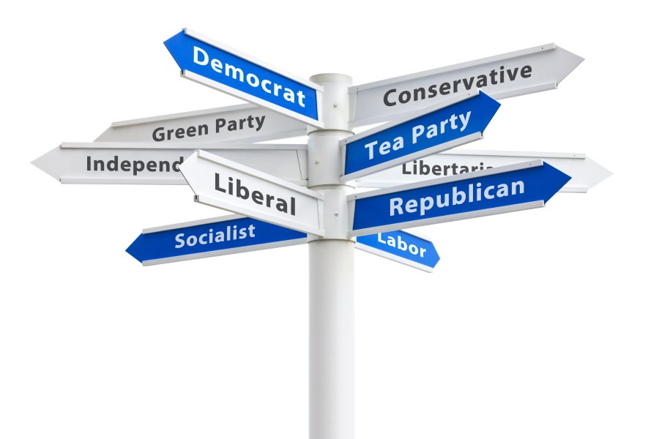
How do I start my own party?
CGS 9-453 et al. A minor party in Connecticut is started in only one way, by nominating petition. There are a few separate steps that need to be taken:
A candidate needs to first file a reservation of party name with the Secretary of the State. This contains the signatures of at least 25 people who think it is a good idea to start the party. It also designates two individuals to be “representatives” of the party and who are eligible to complete the statement of endorsement.
A candidate then applies for a nominating petition using the party name. If the candidate successfully circulates the nominating petition there is still one more step.
The “representatives” need to file a statement of endorsement. Only after all of these steps are complete does the candidate appear on the ballot.
If the candidate in question receives at least 1% of the total votes cast for the office in question, the party becomes a recognized minor party of the office in question.
If the party then files party rules with the Secretary of the State, they can nominate a candidate for the office in question the next time it appears on the ballot.

Slide 14
Thank You! Questions?

