Slide 1
BEST PRACTICES
FOR
RECORDS
RECONCILIATION

Slide 2
PART ONE:
Lisbeth Becker,
Glastonbury

Slide 3
HOW NEW AND CHANGE REGISTRATIONS ARE RECEIVED
In person
Online through SOTS
In person at DMV
DMV via Tumbleweed System

Slide 4
Types of Transactions:
TYPE | REGISTRATION STATUS | OPTIONS
New Voter in your Community | Never Registered OFF in Your Town OFF in a different municipality | No match. New Voter. OFF in own Town. Find card. Confirm same person. SELECT. DMV and Online – No Match – New Voter. Same DOB, First Name, Last Name, Regardless of Status – SELECT.
Already a Voter in your community | A= Active I = Inactive | Potential match will appear. When a prior name is entered, system will match. Verify by reviewing card on file.
Active, Inactive and OFF in a Different Community | A= Active I= Inactive O= Off | System will match when you are entering cards under ACTIVITIES or when you are registering online voters via SOTS or DMV. Uncertain – go back, go to INQUIRIES statewide and enter FIRST NAME and DOB

Slide 5
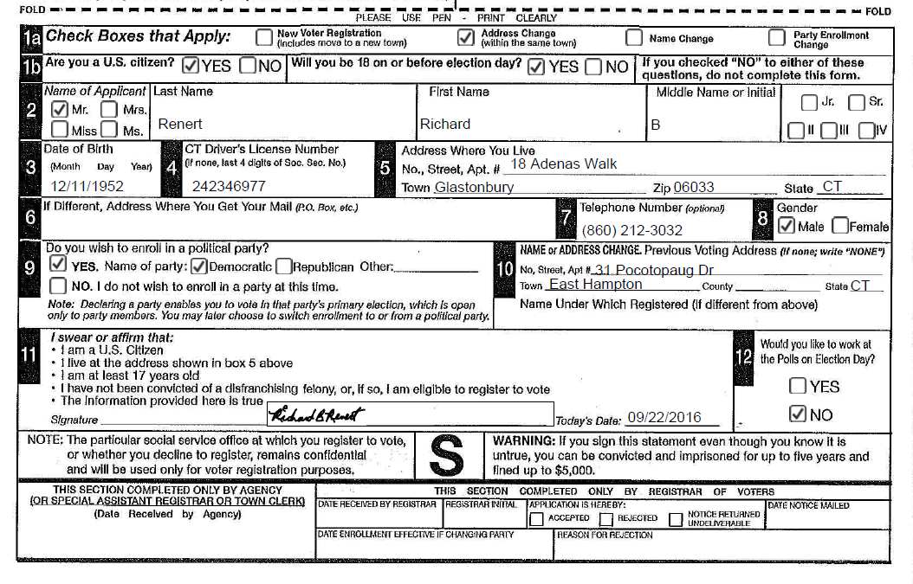
The overlooked BOX 10
Is there a previous voting address indicated?
Is there a different name under which registered?

Slide 6
Keep in mind, GOAL is to have one record for each voter and that is why MATCHING voters on the system is IMPORTANT!
WHY is FIRST NAME and BIRTHDATE
MATCH So IMPORTANT

Slide 7
Is person on CVRS already?
Do Statewide search on CVRS
Inquiries
Enter First Name and Date of Birth
No Match
Try with previous last name
No Match – Return to ACTIVITIES and create new voter
MATCH – Return to ACTIVITIES and SELECT; History as CT Voter preserved!

Slide 8
Online or DMV Queue
Registrar signs on to CVRS.
The Voters’ registrations will be accessible on the REMINDERS Page.
Click on Review button.

Slide 9
Registration PROCEDURE
After clicking on the review button, next to the person’s name, click on Go to VR which stands for Voter Registration

Slide 10
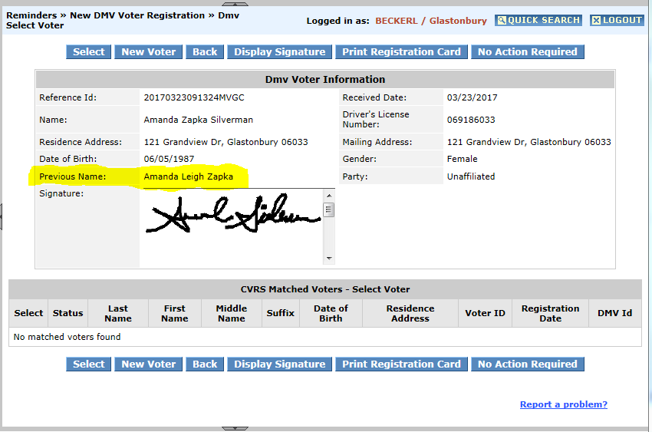
No matched voters found?? Then choose
New Voter
OR

Slide 11
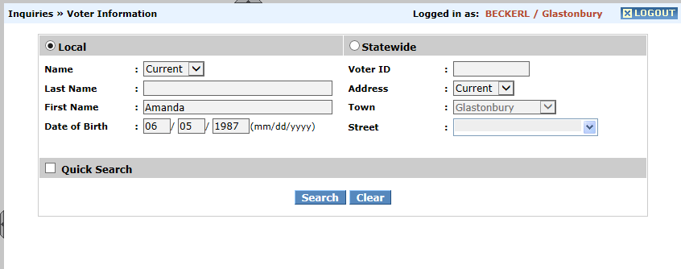
Last Names change more frequently – unusual to change first name

Slide 12
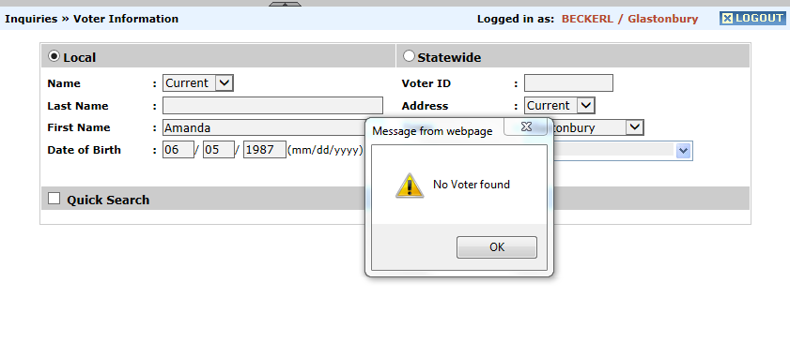
Works as a Statewide search.

Slide 13
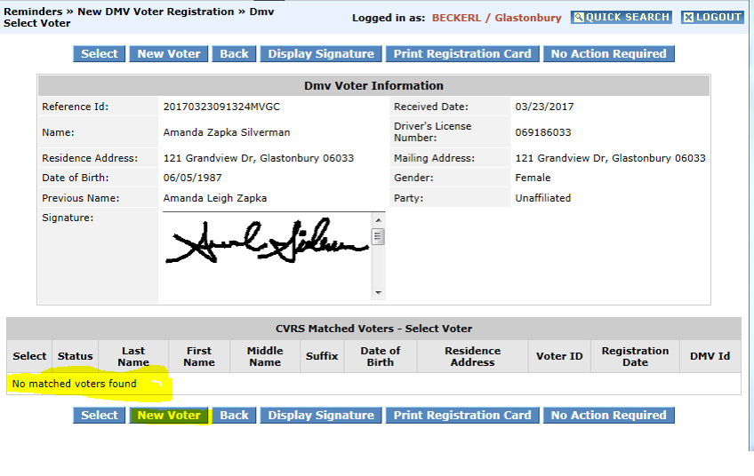

Slide 14
New or
Change Voter
If from DMV,
Retype address
Verify and Enter Party Selection
Remove mailing address if same as residence address
See Box 5
Select print now or print later for voter notification letter
ACCEPT!
Things to remember with DMV
Required to re-type address. DMV does not have drop down street menu
Required to verify party selection

Slide 15
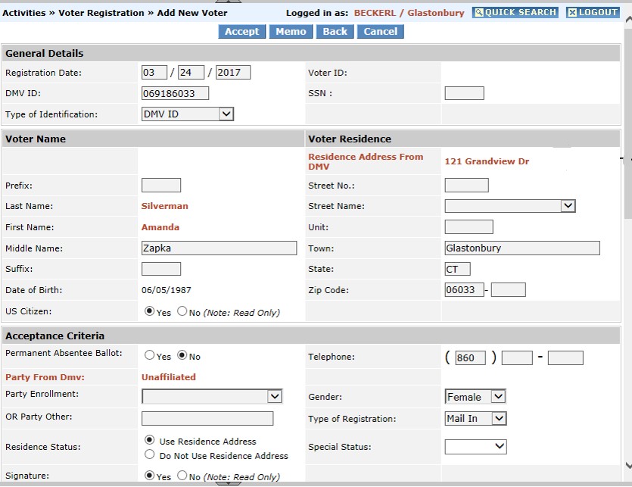

Slide 16
Accept the registration
Print the Registration Card
Print the Letter
Compare
VERIFY

Slide 17
NAME ENTERED CORRECTLY
ADDRESS ENTERED CORRECTLY
DATE OF BIRTH MATCHES
PARTY AFFILIATION MATCHES THE CARD

Slide 18
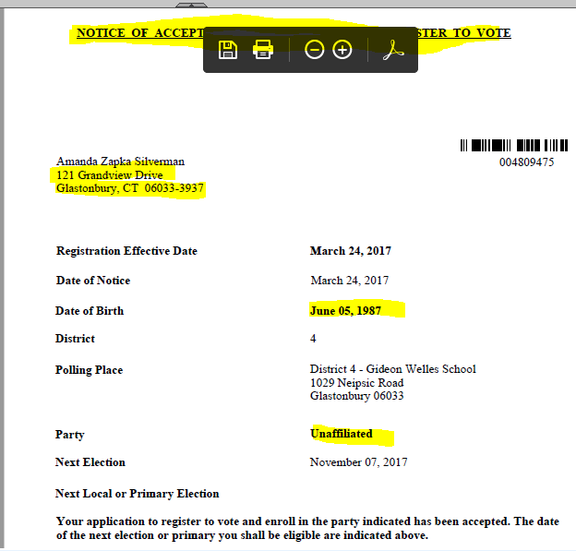

Slide 19
1
Register new voters
Verify information correct on letters
2
Set aside cards for reconciliation
Send out letters
3
Print Change Detail Report
Review each card in detail comparing to the Change Detail Report

Slide 20
PART TWO:
Carole Young-Kleinfeld,
Wilton

Slide 21
The Change Detail Report is Your Friend

Slide 22
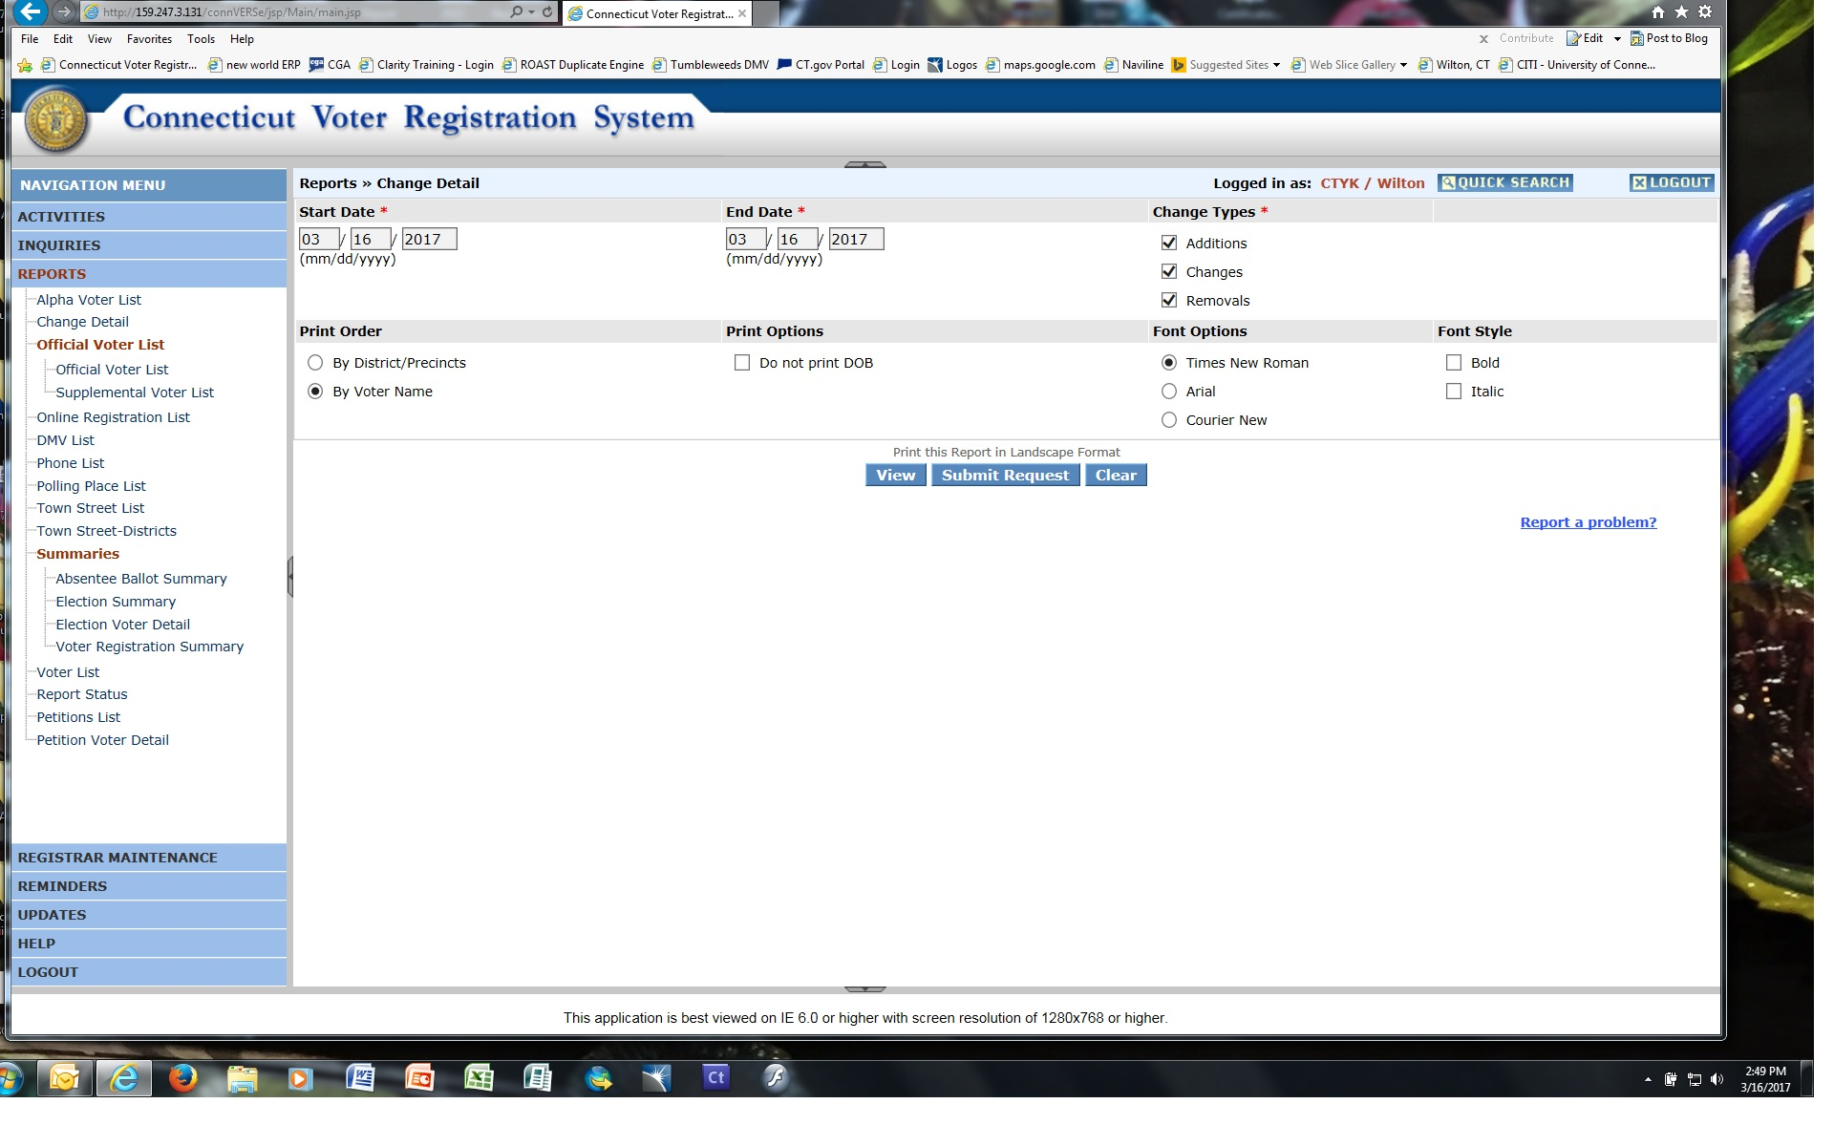
Sample
Find it here…
CVRS will generate 3 Change Types of reports—Additions, Changes, Removals—with totals for each. Choose all 3… or pick and choose—as needed.

Slide 23
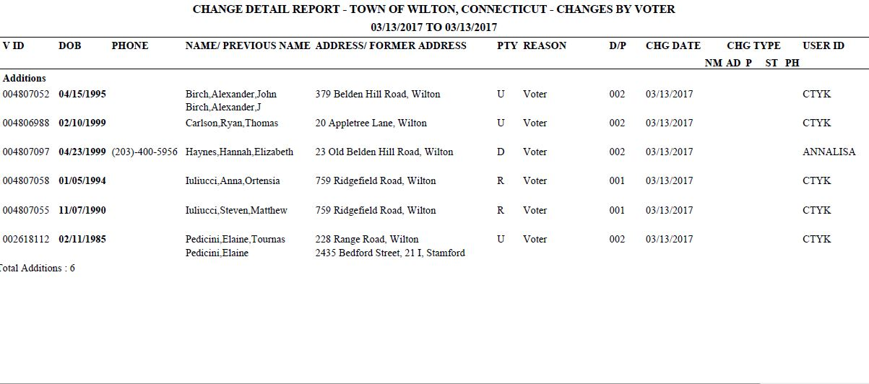
Sample
ADDITIONS
VOTER ID DOB PHONE
√
Voter ID, DOB, Phone
will be
filled in
on your report.
√
√
√
√
√

Slide 24
Ways This Report Can Help You
Daily/weekly? Use it as a worksheet to check the accuracy of your work
Before sending Acceptance/Change letters
Before filing your new/changed voter registration cards
Processing removals
Monthly?
Send (e-mail) to your legislators or local officials
Quick Canvass check
Quarterly or Annually?
Track your workload. Compare with similar time periods. Use this information to support your budget request.

Slide 25
How Does Your Town Use This Report ?????????

Slide 26
PART THREE:
Sharon Krawiecki,
Bristol

Slide 27
Check the accuracy of each entry with a side by side comparison.
VOTER’S REGISTRATION CARD
to
VOTER’S INFORMATION IN CVRS

Slide 28
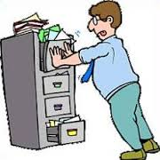
By State Statute Registrar’s are to maintain
Voter information for active electors.
Sec. 9-5a. Towns to supply registrars with office space and supplies. Records. Each town shall provide the registrars of voters with office space, supplies and equipment, including facilities for the safe storage of the official records of such registrars. Such records shall be accessible to all registrars of voters in such town and they shall be jointly responsible for their safekeeping.
Sec. 9-5b. Retention of records by registrars. When the registrars of voters are required by law to maintain, have on file or retain any document, record, list or other paper, the same shall be kept in their office or, if they do not have a permanent office, in the office space provided under section 9-5a.

Slide 29
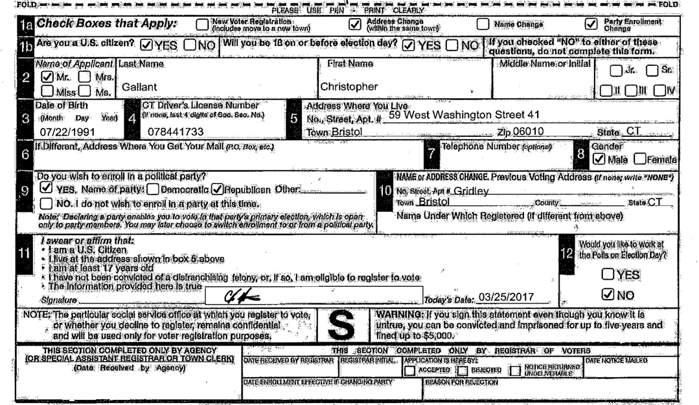
Example 1:

Slide 30
Search Voter by Last Name:

Slide 31
Verify Name, Date of Birth, Voter ID, Address, Party and Gender
004810043
Also, permanent absentee ballot status should be NO if transferred from another town.
(VOTER’S responsibility to file updated Dr.’s letter & ABS application!)

Slide 32
Example 2:
DUPLICATE RECORD CREATED! !
Search for original card to confirm correct birthdate.
Per SOTS, if any of the duplicates have an “on-line” record,
the correct/latest voter registration must be preserved.
See ROVAC handbook Chapter 6, Page 36.

Slide 34
Example 3:

Slide 35
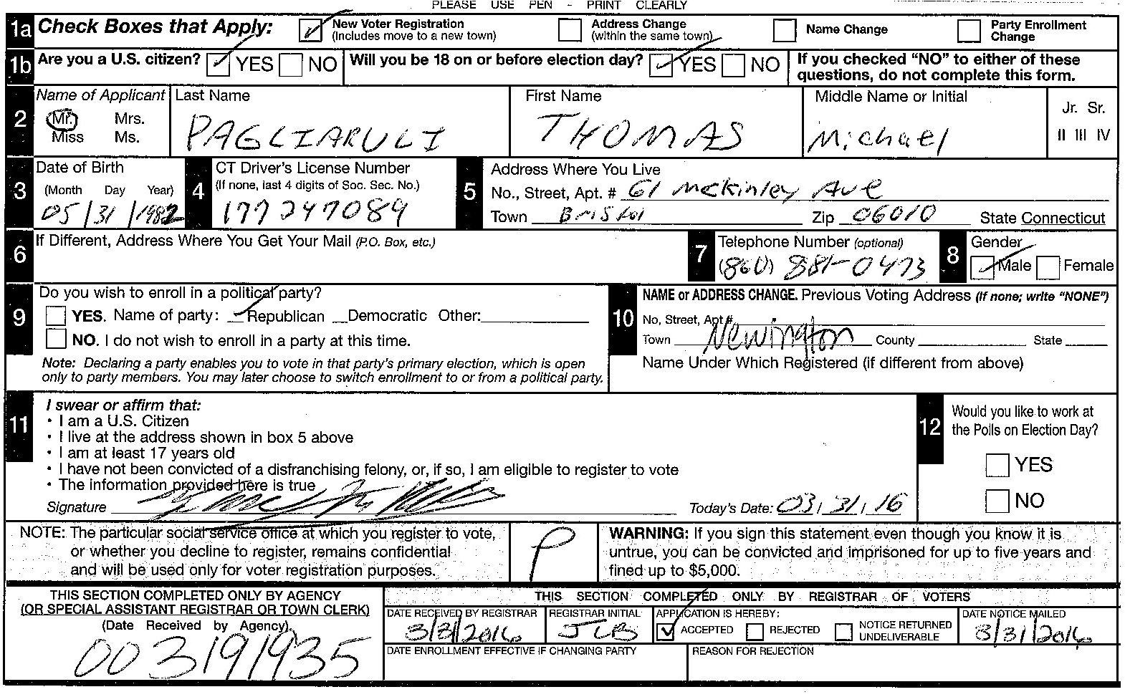
PARTY is incorrect!! Voting privilege could be lost during a Primary, resulting in an unhappy Voter!!

Slide 36
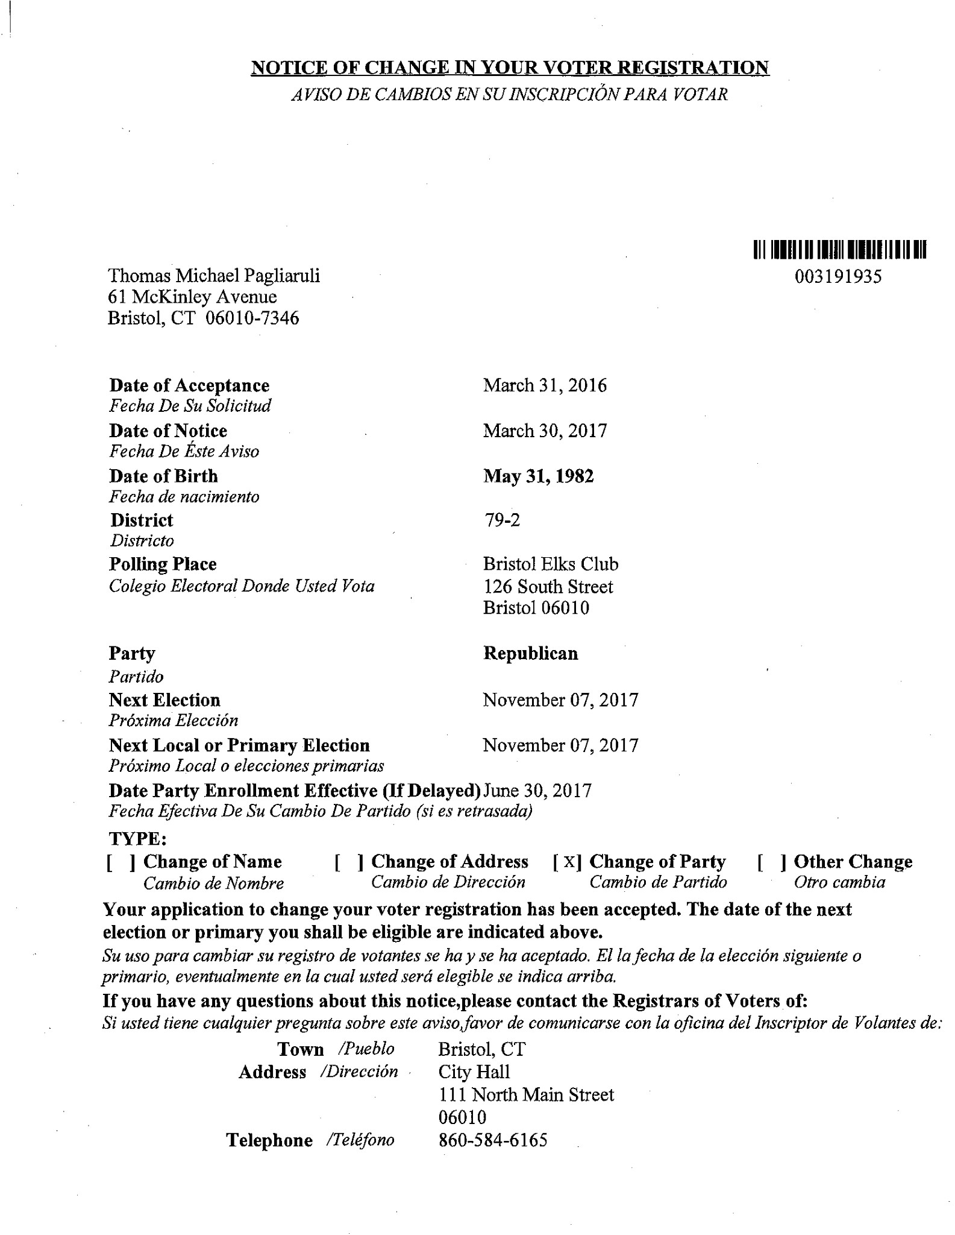
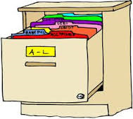
Acceptance letter is now ready to be sent to the Voter and the Voter’s card
can be filed!

Slide 38
QUESTIONS

