Slide 1
Title 9 of the CT General Statutes
Navigating the statutes online and hitting the high notes

Slide 2
cga.ct.gov
“Browse Statutes”

Slide 3
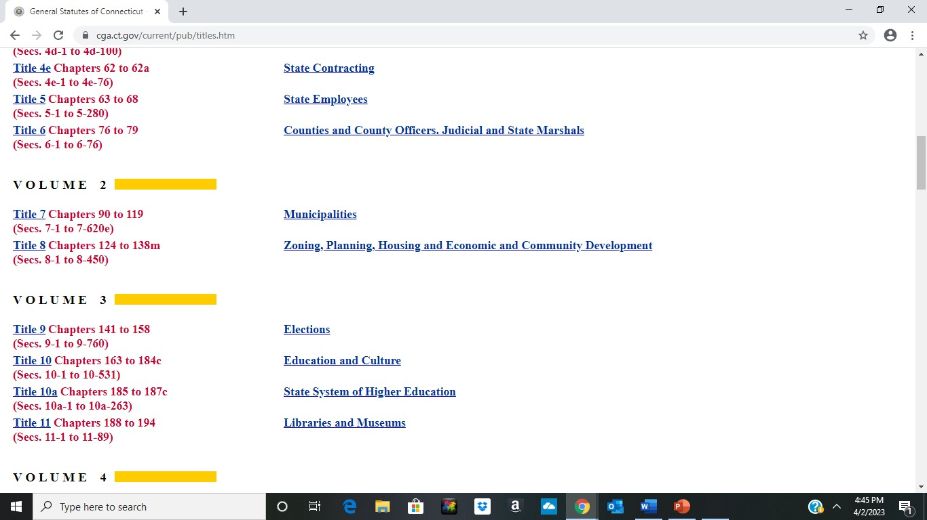

Slide 4
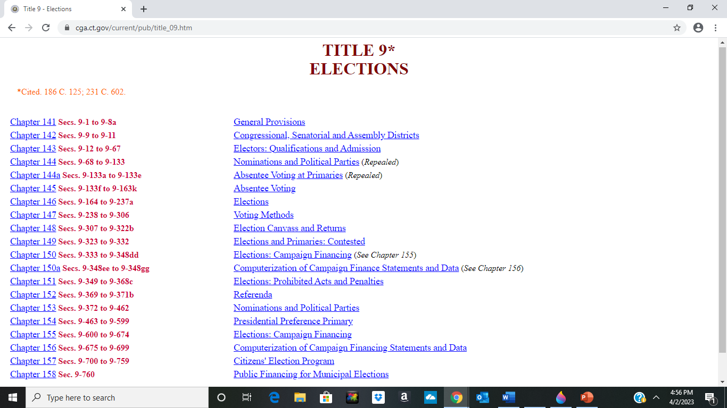

Slide 5
CGS 9-3; any directives from the SOTS office is presumed to have correctly interpreted election law.

Slide 6
CGS 9-12 through 9-67: Electors: Qualification and Admission (Chapter 143)
9-12; Who may be admitted
9-17; Notification of sessions and distributing info at public schools
9-19j; Election Day Registration
9-23; Posting of public hours
9-46 and 9-46a; Forfeiture and restoration of electoral rights due to incarceration and release
9-50d; Nondisclosure of certain voter registration information
9-51 through 9-53; Enrollment sessions and notifying the public of those sessions

Slide 7
CGS Chapter 146; Elections
9-190b; Temporary relief of a registrar by SOTS
9-190c; Removal of a registrar
9-192; Deputy registrars, registrar vacancy
9-192a; Certification committee and program

Slide 8
CGS Chapter 147; Voting Methods
9-255a; Certifying to SOTS the number of ballots ordered
9-261; Describes the types of ID accepted, curbside voting, and electors who need assistance

Slide 9
CGS Chapter 152; Referenda
9-369; Procedure for holding a referendum
9-369c; Absentee ballots for referendum voting
9-370a; Recanvass on close question vote
9-371b; Complaints to Superior Court

Slide 10
CGS Chapter 154; Presidential Preference Primary
9-464; Sets the date for the primary
9-467; SOTS issues petitions for candidates to get on the ballot
9-476; Conduct of primary, including election officials at the polls

