Slide 1
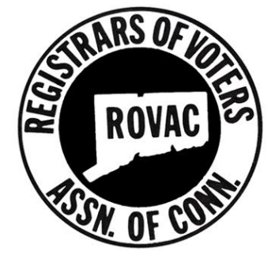
Poll Worker Training & Recruitment
Matthew R Katra
Registrar - Naugatuck, CT
ROVAC Conference - Spring 2023 Tuesday - April 4th, 2023
Notes:
There will be a QUIZ at the end of this session...be sure to pay close attention!

Slide 2
INTRODUCTION
Matthew R Katra
Registrar of Voters since 2014
Before being Registrar:
Zoning Commissioner
Finance Board
Ambulance Review Commission
Burgess Candidate
How did I become a Registrar?

Slide 3
Contents
1.
EVOLUTION OF TRAINING
IN NAUGATUCK
2.
HOW WE TRAIN TODAY
3.
4.
POLL WORKER RECRUITMENT
QUIZ and Q&A

Slide 4
EVOLUTION OF
TRAINING
In Naugatuck

Slide 5
HOW IT STARTED
2015-17
Myself and my fellow registrar would stand up in front of poll workers and take turn reading from our manual. We had nothing to hand out or follow along as we took turns talking.
No Handouts to follow along with
Nothing to reference, No presentation
No natural flow from topic to topic
Small, poorly ventilated room
Dry, Boring
Hard to Follow along
Notes:
Mention Actor name from Mr Bean, Rowan Atkinson

Slide 6
EDUCATION 2.0
2018-2021
We made some improvements to better engage our workers....with the help of ROVAC... to deliver more effective training.
Printed ROVAC Training Guide
Segmented training (Moderator, ARV, Checker....)
Still lots of reading directly from a paper.
Located still in a crowded and cramped room in our town hall
ROVAC Poll Worker Training Guide http://rovac.org/index.php?page=pollworker

Slide 7
HOW WE TRAIN
TODAY

Slide 8
What gave me the idea!
We should do a presentation for training!!!

Slide 9
EDUCATION 3.0
New Presentation
Handouts
We created a new PowerPoint presentation that can be displayed during training and easy to follow along. Used the ROVAC poll worker guides to create most content.
We kept the handouts as we had before. Poll workers can follow along for their hired position plus used as reference material at home or on election day.
P.A. System
Larger Location
Now they can hear us! Play some light music as our workers are arriving.
Moved to the Naugatuck Event Center for the 70+ poll workers we hire.
Notes:
- Ill be going though the new presentation in a few slides
- Location: we are losing the Event center and looking to move to our Senior Center building or in the High School Auditorium

Slide 10
PICTURES

Slide 11
WHAT WE REVIEW
Welcome
Oath
Introductions (Registrars and Moderators)
General Info
Payroll Requirements
Naugatuck Polling Districts and Locations
Ballot Overview
General Instructions
Voter Rights
Arrival and Setup
Dress and Breaks
Who is (not) allowed in polling place
Assisting Voters with Disabilities
Closing of the Polls
Absentee Voting
Emergency Plan
Tips and Tricks
Duties of the:
Greeter
Checker
Ballot Clerk
Tabulator Tender
Assistant Registrar of Voters
Moderator
Special Topics
Reports
Write In Candidates
Curbside Voting
Tabulator Overview
Submitting Results @ Town Hall
IVS Overview
Voter CheckList Overview
Election Day Registration
Voter CheckList Demo (Optional)

Slide 12
PRESENTATION TIPS
Move Around, Do Not Sit
Keep moving, look around the room.
Speak Clearly / Loudly
Do not mumble.
Purchase a Pointer/Clicker
As low as $9.99 on Amazon. It allows you to move around as recommended in TIP 1.
Engage the poll workers
Ask questions, take polls, etc....
Do not read verbatim from slides
Your poll workers can read! You dont need to read to them.
Notes:
Have notes to remind you of points to make not directly written on the slides.

Slide 13
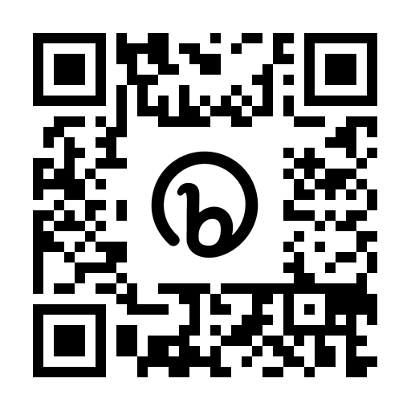
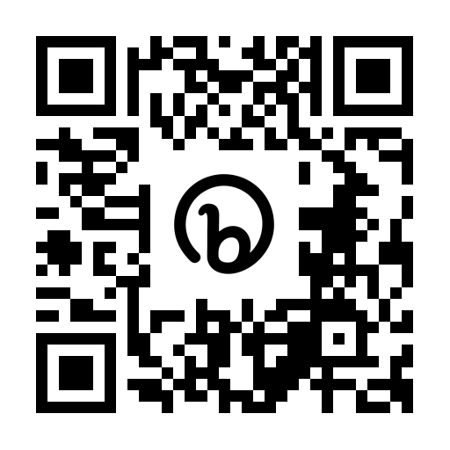
RESOURCES
Poll Worker Training
Guide
CT SotS Handbooks
Provided by Sec. of the State Office, includes:
Head Moderator/Moderator Handbook
RoV Handbook
Poll Worker Manual
Other Training
ROVAC has created an excellent document that covers all poll worker positions in detail with step by step instructions.
Naugatuck Training PPT
Norwalk Poll
Worker Videos
PowerPoint deck covering all required training topics and more!
Will be posted on ROVAC.org soon!
Created by Norwalk Registrar of Voters
Individual videos for each worker position

Slide 14
POLL WORKER
RECRUITMENT
My Tips and Tricks

Slide 15
POLL WORKER RECRUITMENT
ASK FRIENDS AND NEIGHBORS
ADVERTISE ON TOWN WEBSITE
Many workers we recruit are people we already know and trust. We simply asked them if they would like to be a poll worker, 80-90% will say yes!
Less effective, but you can have a contact email/phone or online form that someone can fill-out if they are interested in working.
REFERAL FROM CURRENT WORKERS
TOWN HALL EMPLOYEES
Ask your current workers for people they know that they believe will make a good poll worker.
We have 3 or 4 workers, including 2 moderators, that will use vacation time of their full time position and then work the election to earn a few extra dollars.
Notes:
Friends and neighbors: Talk about Marleen
Referral : If just 20% of your workers could refer one other person.....
Town hall employees: You already know many of them and if they can be trusted to be non-partisan.
Town website: Its free, can’t hurt to have it up on the site.

Slide 16
POLL WORKER RECRUITMENT
Continued...
SECRETARY OF THE STATE LISTS
PEOPLE NAMED RON WHITE
We all receive the Secretary of the State poll worker volunteer lists.
We have more then one!
LOCAL TOWN COMMITTEE MEMBERS
LOCAL TOWN COMMITTEE MEMBERS
HIGH SCHOOL JUNIORS AND SENIORS
Members of your local town committees have already proven interest in the electoral process. Many would be glad to help out on election day in a non-partisan manner.
Students that are 16 and 17 can work certain positions and what student would not want to make $300 for a days work.
Notes:
SotS Lists: Naugatuck has hired 2 or 3 ppl from these lists in the past. Ask by show of hands who has hired from the SotS list.
Town Committee: Screen carefully, some may not be a great fit as they may have a tough time being non partisan. Talk about ‘making sure my guy was doing”. (we dont hire her any more)
High School: Some of our best workers are high school and college students. We have one moderator that requests mostly students when possible.
Ron White: Tell the story, before clicking.

Slide 17
OTHER RECRUITMENT TIPS
Remind people they get paid (tax free)!
Starting this year Naugatuck pays election workers starting at $16.00/hr for Tabulator Tenders and Greeters going up a $1/hr with Moderators making $21.00/hr. Including paid training.
Provide food/drinks
If in your budget, offer free water and/or food for workers on election day. We provided water last year and finally (for now) some budget for food for poll workers.
Be Polite
Notes:
Greeter and Tabulator Tenders - $288 / day
Moderators - $399 day
who wants to work for a curmudgeon

Slide 18
POP QUIZ

Slide 19
QUIZ
What was the name of the actor that played Mr. Bean as referenced in an earlier slide?
Rowan Atkinson
QUIZ QUESTION #1

Slide 20
QUIZ
Which municipality am I the Registrar for?
Naugatuck
QUIZ QUESTION #2

Slide 21
QUIZ
In the training PPT (pg 24), what was written on the picture of the large red button?
Dont Panic!
QUIZ QUESTION #3

Slide 22
QUIZ
Fill in the blank....
If a person is named __________________, you should hire them!
Ron White
QUIZ QUESTION #4

Slide 23
QUIZ
How many polling districts in Naugatuck?
Nine (9)
QUIZ QUESTION #5

Slide 24
THE END...
THANK YOU

