Slide 1
The 2023 Legislative Session
Presentation for ROVAC Spring Conference
April 2023

Slide 2
Overview
This presentation includes information about:
Legislature Make-up
Key Elected Officials
Post-2022 Election Leadership Changes
Bills of Importance to ROVAC
How to Make a Difference in the Legislative Process

Slide 3
The 2023 Legislative Session
The 2023 Session convened January 4th and adjourns on June 7th.
The legislature alternates between “long sessions” and “short sessions.”
A “long session” (odd numbered years) runs from January to June, providing appropriate time for the legislature to craft its biennial budget and bigger initiatives.
A “short session” (even numbered years) runs from February to May, and is meant to consider only budget-related items.
2023 is a “Long Session,” so at this point we are approximately 1/2 of the way through the Regular Session.

Slide 4
Legislative Timeline
Committee Phase:
Public hearings throughout February and early March
Meetings to debate and vote on legislation throughout March
Smaller committees have a deadline to act on bills by late March
Appropriations and Finance committees work through April.
“Regular Session:”
Bills passed out of committee queue up for action by House/Senate.
“Go into session” throughout April until the June 7th deadline.
“Special session,” called for unfinished business at their discretion.

Slide 5
The Make-up of the Chambers

Slide 6
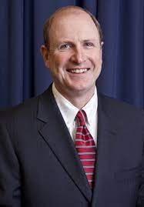
Senate Leadership
Democratic Leaders:
Sen. Martin Looney
Senate President Pro Tempore
Sen. Bob Duff
Senate Majority Leader
Republican Leader:
Sen. Kevin Kelly
Republican Senate Minority Leader

Slide 7
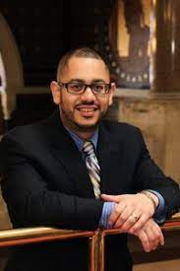
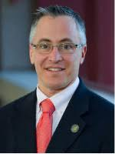
House Leadership
Matthew Ritter (D - Hartford)
Speaker of the House
Jason Rojas (D – East Hartford)
House Majority Leader
Vincent Candelora (R – North Haven)
House Minority Leader

Slide 8
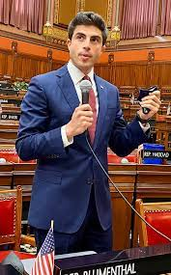
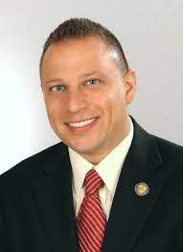
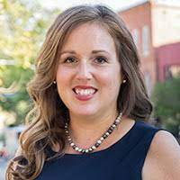
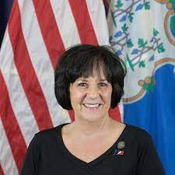
Key Committee: Government Administration & Elections
Committee Chairs:
Sen. Mae Flexer (D - Killingly)
Rep. Matt Blumenthal (D - Stamford)
Ranking Member:
Rep. Gale Mastrofrancesco (R- Wolcott)
Sen. Rob Sampson (R - Southington)

Slide 9
Key Committee: Government Administration & Elections
Democrats:
Vice Chair’s: Sen. Derek Slap, Rep. Morrin Bello
Sen. McCory, Sen. Marx, Rep. Berger-Girvalo, Rep. Haddad, Rep. Khanna, Rep. McCarthy-Vahey, Rep. Parker, Rep. Rosario, Rep. Santiago
Republicans:
Rep. Bronko, Rep. Carpino, Rep. Hoxha, Rep. Labriola

Slide 10
Elections Bills of Interest (Priority Bills)
BILL # | BILL TITLE | STATUS
SB 1057 | An Act Concerning the Secretary of State and Early Voting | SENATE FLOOR
SB 1064 | An Act Concerning the Implementation of Early Voting | SENATE FLOOR
HB 5004 | An Act Concerning Implementing Early Voting | HOUSE FLOOR
SB 1190 | An Act Concerning Regional Election Advisors and a Task Force on Election Administration in Municipalities | SENATE FLOOR
HB 6871 | An Act Concerning Election Recanvass Procedures | HOUSE FLOOR
SB 1150 | An Act Concerning the Recommendations of the Risk-Limiting Audits Working Group | SENATE FLOOR
SB 1226 | An Act Concerning State Voting Rights in Recognition of John R. Lewis | SENATE FLOOR

Slide 11
How You Can Make a Difference: The Grassroots
Contact Your Representatives
Establish & Build Working Relationships

Slide 12
Any Questions?

