Slide 1
Electronic Endorsement Form for Municipal Office of Registrar of Voters
Endorsement period is May 17 – May 24, 2022

Slide 2
What you need
Your email address, remember it’s public information.
Name & Email address for the chair
Device (computer, phone or tablet) with internet access

Slide 3
What to do
After receiving the endorsement – click the link on our website. I’m not sure where it will be, but you will get an email.
https://na4.docusign.net/Member/PowerFormSigning.aspx?PowerFormId=56c10304-f8c3-48d3-b965-d9c3f5f4dc83&env=na4&acct=b765b78e-2f85-4470-a9d3-d2e2921c42b9&v=2

Slide 4
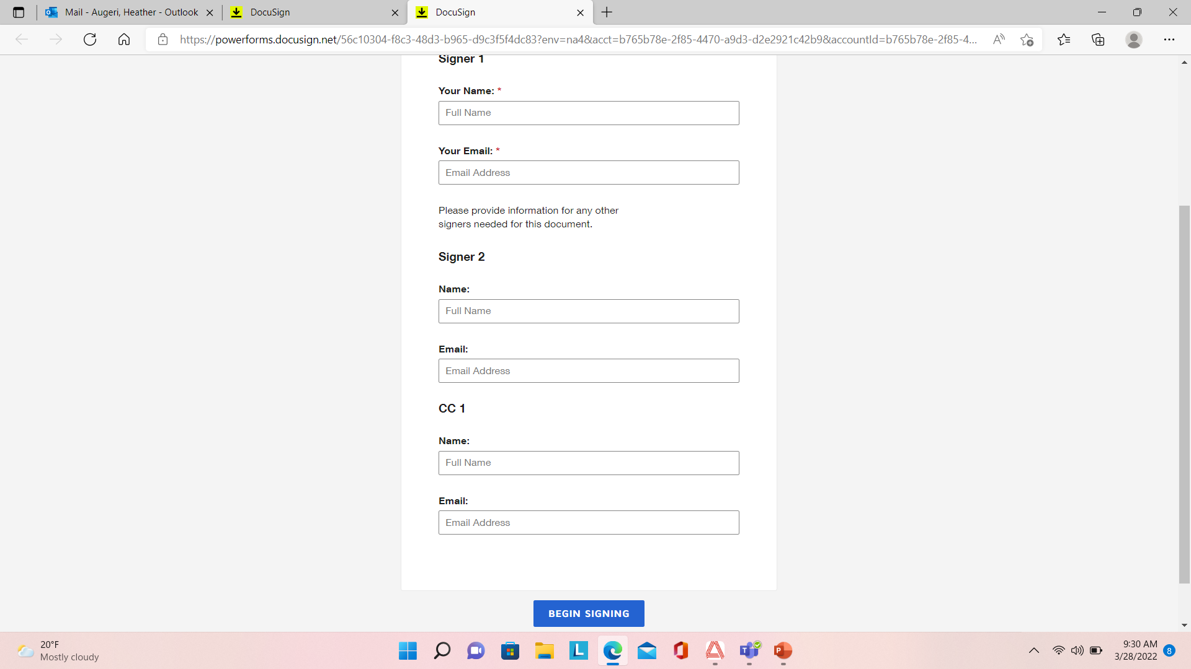
Step 1 – Enter your name & email as signer 2, enter the chair email as signer 1. Click Blue Button “Begin Signing” at bottom of screen.

Slide 5
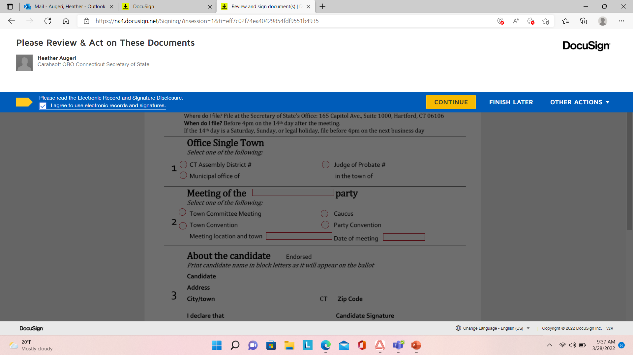
Step 2 – Acknowledge signing electronically & Click Continue

Slide 6
Chair to complete sections 1,2 & 4 Candidate to complete section 3. When you complete your section click “Finish”

Slide 7
You can download or print a copy for your records.

Slide 8
You are done !!

Slide 9
When candidate & town chair have finished the form, SOTS will receive a complete document. Below Town Chair sections are completed

Slide 10
Completed Form

