Slide 1
Absentee Ballots 2020 Presidential Election
September 9, 2020
ROVAC Conference

Slide 2
Absentee ballots
90 Day Blank Ballot – Issued due to Military Contingencies.
45 Day Blank Ballot – Issued to Military, Spouses & dependents; electors temporarily living or traveling overseas.
Overseas Ballot – Available to non-registered citizens & dependents residing overseas.
Regular Ballot – Issued to registered voters 31 days prior to the Election
Emergency Ballot – Available on Election day only to an elector who becomes ill or was a hospital inpatient 6 days prior.
Presidential Ballot – Available to a prior resident who has moved 30 days before the election and after their new location cut-off date to register.

Slide 4
90 day Blank Ballot
ED-81a Blank Ballot – Supplied to Military electors, spouses or dependents with the servicemen, by mail or electronically.
Inner ED-9 Ballot envelope, if mailed or E-Certification form should be included in the returned packet. Required to be properly executed, otherwise ballot may be rejected.
If issued through the mail it will have the Elector Label for reference. If sent electronically the voter information will be written on the envelope by the Town Clerk staff once received.

Slide 5
Blank Ballot Form
Voter must write candidate selections on the form from supplied list.

Slide 6
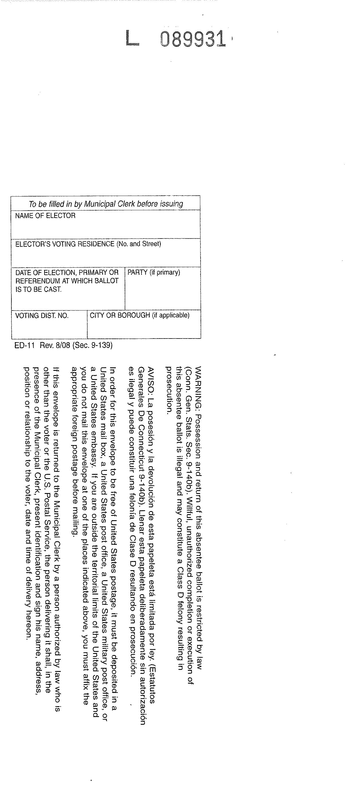
Voter to Clerk Return Envelope
Used for Military, spouses, dependents & traveling voters.

Slide 7
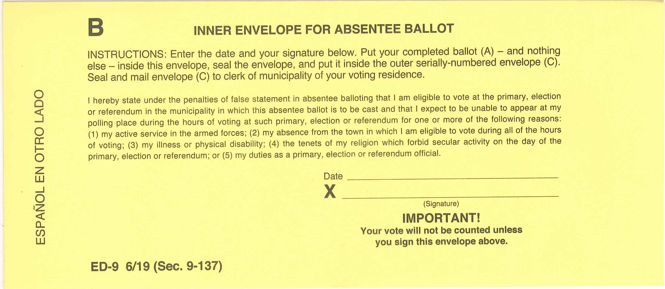
Inner Envelope (Certification)
Certification or envelope must be executed for ballot to count.

Slide 8
45 day blank ballot
ED-81a Blank Ballot – Supplied to electors until official scan optical ballots are available. Can be issued by mail or electronically up to 45 days prior to the election.
Available to military, including spouse and dependent(s) with serviceman, and to electors temporarily living or traveling overseas.
Inner ED-9 Ballot envelope, if mailed or E-Certification form must be returned in the packet. Required to be properly executed, otherwise ballot may be rejected.
If issued through the mail it will have the Elector Label for reference. If sent electronically the voter information will be written on the envelope by the Town Clerk staff once received.

Slide 9
Blank Ballot Form
Voter must write candidate selections on the form from supplied list.

Slide 10
Voter to Clerk Return Envelope
Used for Local and traveling voters.

Slide 11
Inner Envelope (Certification)
Certification or envelope must be executed for ballot to count.

Slide 12
Overseas ballot
Supplied by SOTS for use in a Primary or Election.
Federal Offices ONLY. May use FPCA or ED-70 Overseas App.
Available to non-registered citizens residing permanently overseas. Available from last town of residence prior to moving. If minor child, address of parent prior to moving is utilized to determine voting district.
Can be issued by mail up to 45 days, unless the Primary is advanced, then 40 days prior to the election. (§9-158C & §9-376)
Inner ED-72 Ballot envelope supplied when mailed. Required to be properly executed, otherwise ballot may be rejected.
Issued through the mail it will have the Overseas Voter information completed for reference.

Slide 13
Official Overseas Ballot supplied by SOTS (Federal Offices Only)

Slide 14
Overseas Voter to Clerk Return Envelope
Used for non-registered citizens & dependents.

Slide 15
Overseas Inner Ballot Envelope
Envelope information must be filled in by overseas voter and executed for ballot to be counted.

Slide 16
regular ballot
Prepared and Printed by the Town Clerk.
Available to all registered electors upon proper application.
Can be issued by mail and in-person up to 31 days prior to the election.
Inner ED-9 Ballot envelope supplied when mailed. Required to be properly executed, otherwise ballot may be rejected.
Replaces the 45 Day Blank Ballot when requested during the 31-day election period. Can be sent to any registered elector world-wide.

Slide 17
Official Absentee Ballot

Slide 18
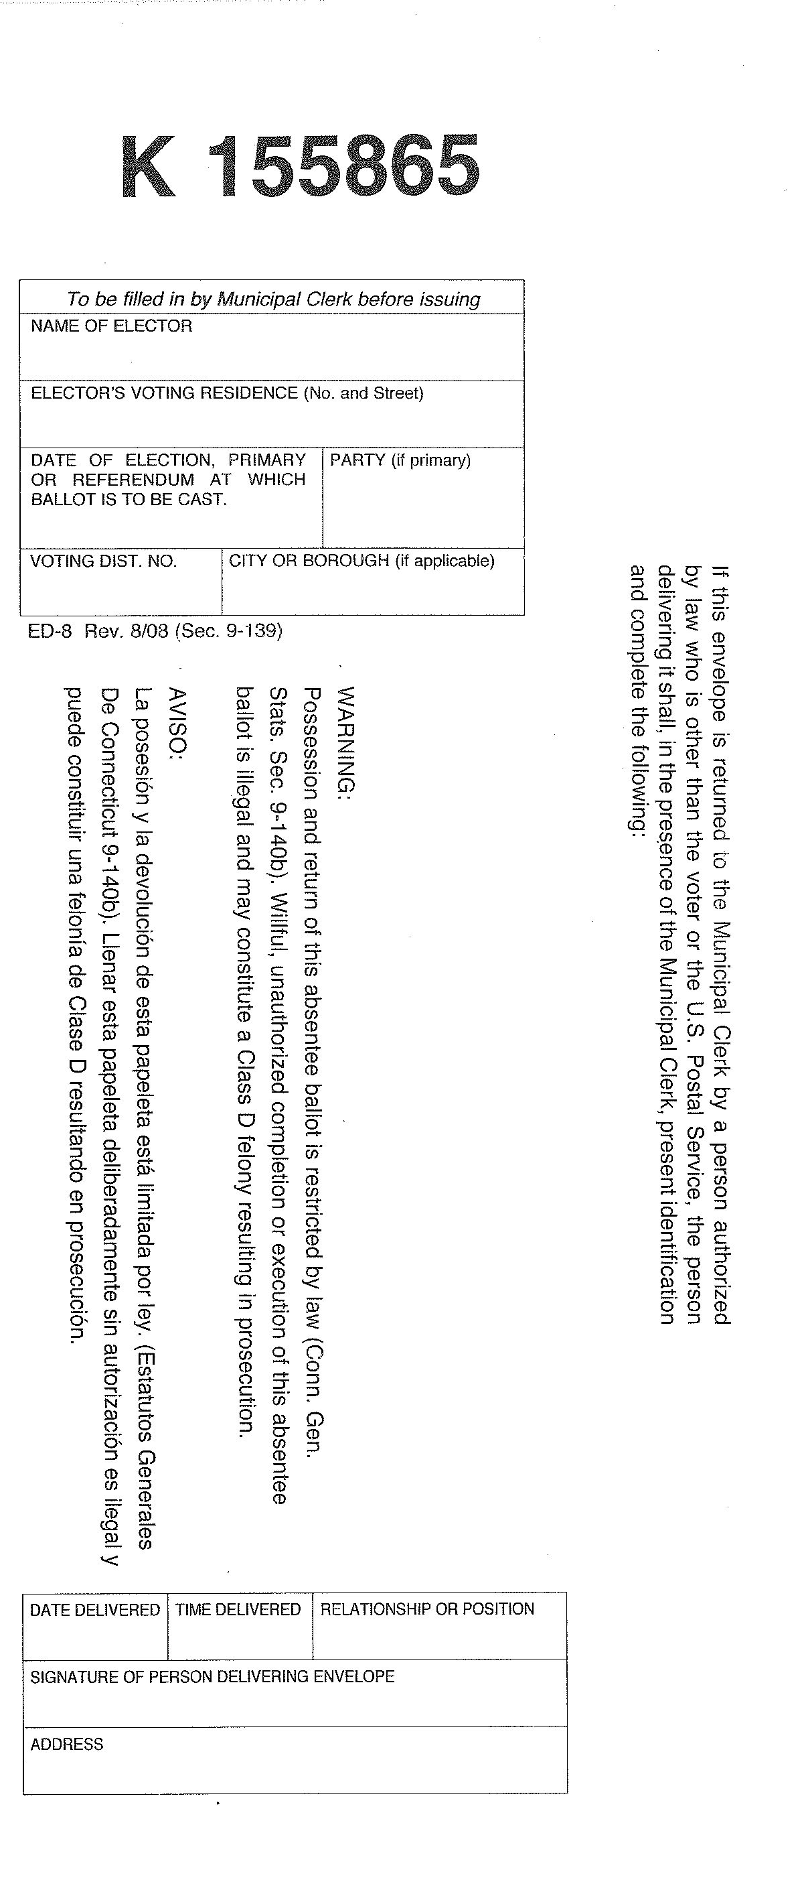
Voter to Clerk Return Envelope
Used for Local, Military and traveling voters when requested within 31 days of the election.

Slide 19
Inner Envelope
Envelope must be properly executed for ballot to be counted.

Slide 20
Election day emergency ballot
Only ballot which may be issued to a designee on Primary/Election Day.
Same as the Regular Absentee Ballot.
Only available to an elector who suffers a sudden illness or disability within 6 days of the close of the polls; or if they are a hospital inpatient anytime within 6 days of the close of the polls.

Slide 21
Presidential ballot
Available to a former town resident that has moved outside of Connecticut, and the deadline to register in their state has passed.
May not be issued earlier than 45 days prior to the election
This should not be issued to a Connecticut resident. They MUST register if they want to vote, even if it is only for President & Vice-President.
Town Clerk will supply the necessary form to issue a ballot.

Slide 23
Federal post card application
May be used to register as an elector, enroll in a party and to apply for 90-Day, 45-Day, Overseas or Regular Absentee Ballot.
Used primarily by Military personnel, spouse or dependent. May be used electors living outside of the United States to request a ballot.
Each FPCA is valid for 1 year.

Slide 24
These individuals are registered electors and will receive a full ballot with all offices.
These individuals, if a registered elector prior to leaving the country, will receive a full ballot otherwise they will receive the Overseas Ballot (Federal Only).
These individuals will only receive the Overseas Ballot (Federal Only). They have either never resided in the States or been a registered elector. They should not be added as a registered voter.

Slide 25
Federal write-in ballot
Connecticut requires that an elector has already registered and requested an Absentee ballot.
If a request for an Absentee Ballot has not been received the Town Clerk must mail the application and full Absentee Ballot set. The FWAB will be counted as an Overseas Ballot, only if the required application request (FPCA or ED-3) is on file, and the full packet is not received back by Election day.
May be mailed only from outside of the United States or from APO/FPO address.
When counting as an Overseas Ballot, the Voter Declaration must be completed and enclosed.

Slide 26
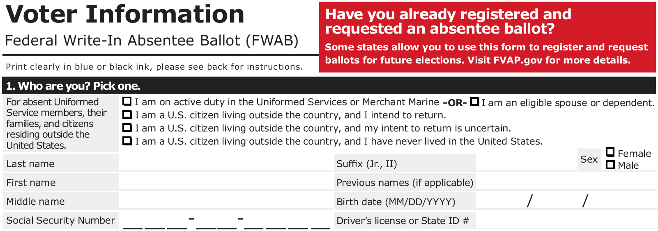
While similar to the Federal Postcard Application (FPCA), the elector must have already registered and requested an Absentee ballot, prior to completing this form and utilizing the Official Backup Ballot packet for voting.

Slide 27
Thank you for your time and attention.

