Slide 1
Records Retention
Do I have to keep ALL this stuff?
ROVAC CONFERENCE SPRING 2018
Notes:
CGS

Slide 2
What we feel

Slide 3
Pop Quiz
Permission to destroy records is given by:
Secretary of the State
FOI (Freedom of Information)
CT State Library

Slide 4
Where to start?
Connecticut State library
Municipal Records Retention Schedule
Electors and Election Records
https://ctstatelibrary.org/wp-content/uploads/2015/05/M6.pdf
Notes:
Where did you go when you needed information before the internet? The Library? Now you go to the Library on the internet!

Slide 5
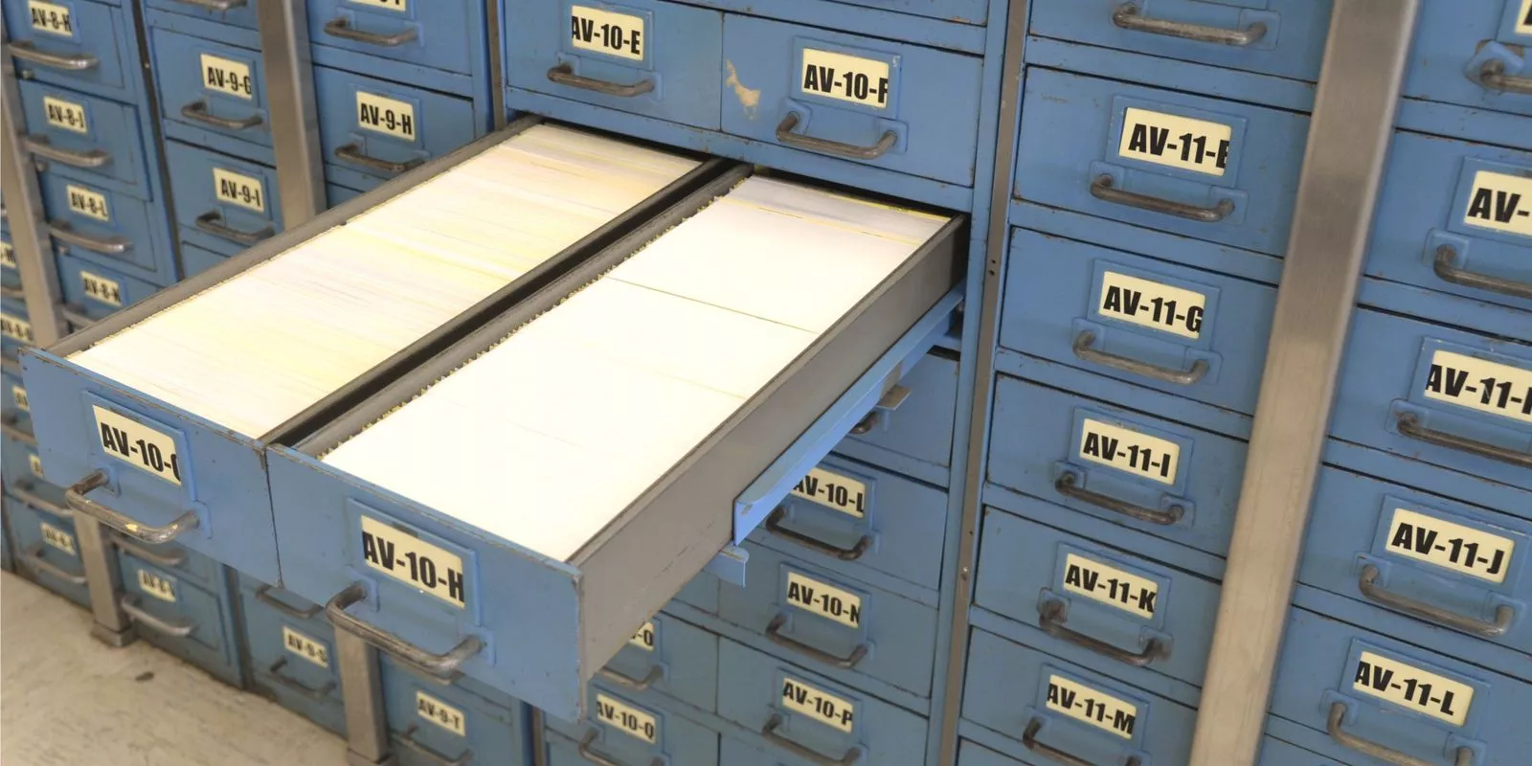
What records do we retain?
Official record copy only
Incudes: Paper, electronic
Pertains to Retention NOT disclosure of records.

Slide 6
OBSOLETE RECORDS
Records designated as “OBSOLETE” or “SERIES CLOSED”
no longer created or received in the normal course of business.
BUT…Records custodians should request approval for the appropriate disposition of any records so designated as soon as the retention period has passed.

Slide 7
Required paperwork https://ctstatelibrary.org/publicrecords/municipal

Slide 8
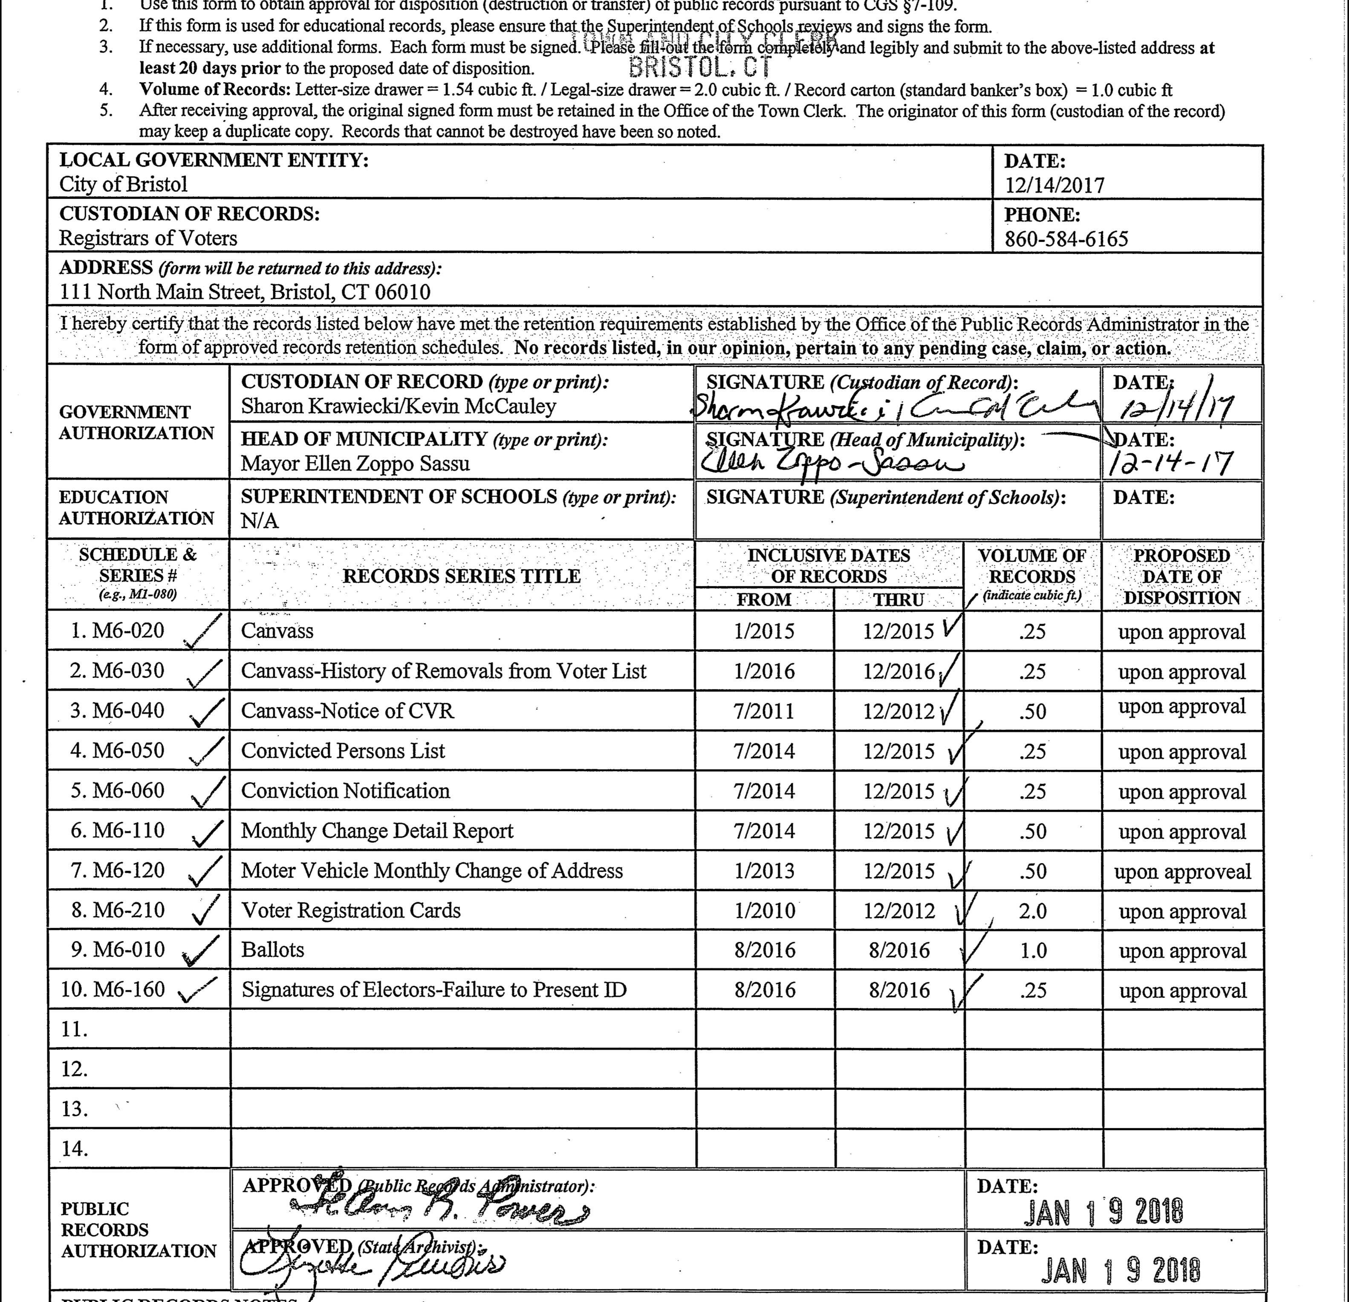

Slide 9
Ballots Pop Quiz
Unvoted ballots may be destroyed:
(14) days after an uncontested election.
After 22 months
After 60 days
LEAD Communication May 18, 2017
http://portal.ct.gov/SOTS/Election-Services/LEAD-Communications/2017-LEAD-COMMUNICATIONS

Slide 10
Ballots (M6- 010)
Includes:
machine test ballots
spoiled/abandoned ballots
executed optical machine ballots
Notes:
We save with retained with election materials—either with ROV or TC

Slide 11
Ballots (M6-010)
180 days after a state or local Election, if not contested [CGS §9-302]
22 months after a federal Election [42 USC 1974]
60 days; per SOTS 5/16/17,see LEAD Communications
RC-075 not required
Notes:
After 10 calendar days and SOTS has chosen audited towns, you may open the ballot transfer case. Package and label boxes for disposition

Slide 12
Canvass

Slide 13
Pop Quiz --Canvass
Canvass records retention is obsolete.
TRUE
FALSE

Slide 14
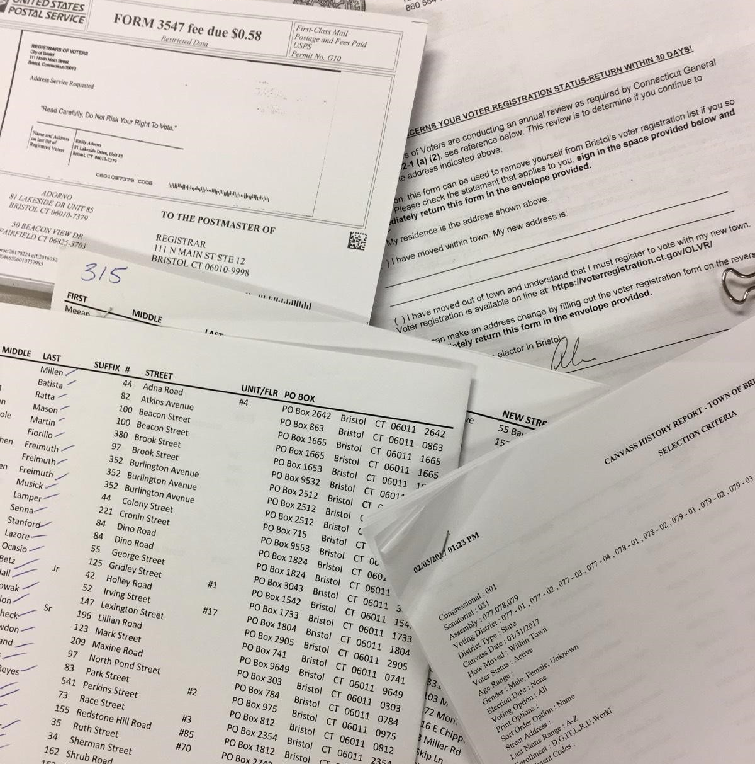
Canvass (M6-020)
Retention:
Current year plus 1
RC-075 required
Includes:
National Change of Address notification
Department of Motor Vehicles (DMV) Tumbleweed system notifications
other related records, such as those documenting mail, telephone, and door‐to‐door inquiries.

Slide 15
Canvass –
History of Removals from Voter List (M6-030)
Consists of the list of removals from voter list. Also known as “Offs.”
Current year plus 1 year
Destroy after receipt of signed Form RC‐075
Notice of Confirmation of Residence (M6-040)
Moving voter to inactive status.
Until elector omitted from registry list for 5 years
[CGS §9‐35 and §9‐58]
Destroy after receipt of signed Form RC‐075

Slide 16
Convicted Persons, list of (M6-060)
Retention:
2 years after notification of removal
Destroy after receipt of signed Form RC‐075

Slide 17
Emergency Contingency plan (M6-070)
Public Act 11‐46
Plan developed for elections, primaries and referenda.
Until superseded [Public Act 11‐46 §2(a)]
Form RC‐075 needed

Slide 18
Emergency Plan, cont.
Including but not limited to:
solutions for ballot shortages, and strategies to implement in the event of a shortage
absence of poll workers, loss of power
fire or the sounding of an alarm within a polling place
voting machine malfunctions
a weather or other natural disaster
the need to remove a poll worker or moderator and to replace such worker or moderator
disorder in and around the polling place.

Slide 19
Lists (M6-070- M6-170)

Slide 20
Pop Quiz: Lists
A Registry list and Enrollment list are the same.
True
False

Slide 21
Enrollment Lists
Corrected and Supplemental M6-080
List of voters’ party affiliations as of 45 days before a primary election.
Until new list printed [CGS §9‐55(e)]
Destroy after receipt of signed Form RC‐075
Notice of Intent to Erase Party Affiliation M6-090
List of individuals who are removed from party membership.
Until elector omitted from registry list for 5 years
Destroy after receipt of signed Form RC‐075
CGS §9‐60, §9‐62, and §9‐63.

Slide 22
Registry Lists
Final and Supplementary – Registrar’s Copy (M6-140)
List of registered voters.
2 years [CGS §9‐39]
Destroy after receipt of signed Form RC‐075
See M6‐490 for Town Clerk’s requirements.
Preliminary List (M6-150)
Obsolete
Notes:
Talk briefly about party rule petions and list of poll

Slide 23
Pop Quiz
We must keep our jury lists for five (5) years.
True
False
M6-100 is obsolete

Slide 24
Pop Quiz
Monthly change reports must be kept:
2 years
never
5 years

Slide 25
Monthly Reports
Monthly Change Detail (M6-110)
Obsolete
You can still use but no requirement for disposition.
Motor Vehicle Monthly Change of Address List (M6-120)
List of individuals who checked off the voter registration section on driver’s license or motor vehicle registration.
2 years [42 USC 20 §1973gg‐ 6(i) (National Voter Registration Act of 1993)]
Destroy after receipt of signed Form RC‐075
CGS §9‐35(c).
Notes:
DMV: daily but if you have old reports your must use RC -075

Slide 26
Other lists
(M6‐470) Petition for Call to Amend Town Party Rules Petition for caucus or convention to amend existing party rules.
3 years
signed Form RC‐075 needed
M6‐130 Polling Place Officials, List of List of workers,
certified and signed by the registrar, for both general and primary elections
Includes oaths. 14 days after election
If not contested Destroy after receipt of signed Form RC‐075 CGS §9‐258 and §9‐436.
If attached to moderator’s return, retain for same period as the return.

Slide 27
Misc. Paperwork
Signatures of Electors – Failure to Present ID (M6-160)
Sign‐in sheet for electors who did not present identification at polls.
180 days - state or local
22 months- federal
RC-075
Unofficial Checkers – Request for Appointment
Requests from persons seeking appointment as unofficial checkers for elections, referendum, and primary candidate checkers.
14 days after election, if not contested
Destroy after receipt of signed Form RC‐075
CGS §9‐235 and §9‐436a.

Slide 28
Voter Registration Records

Slide 29
5 YEARS FROM WHEN?
“UNTIL VOTER HAS BEEN OMITTED FROM REGISTRY FOR FIVE (5) YEARS.”
4 YEARS INACTIVE AND 1 YEAR OFF
OR OFF 5 YEARS
CGS 9-35e and CGS 9-58
Notes:
CGS 35e: “name is placed on inactive registry list for 4 years. At the expiration of the 4 years on inactive voter shall be removed from registry list.”
CGS 9-58 except that any such application of an elector whose name has been removed from the registry list for a period of at least five years may be placed on microfilm, destroyed or otherwise disposed of, in the manner provided in section 7-109, by such registrars.

Slide 30
Relevant statutes
CGS 35e: “name is PLACED on inactive registry list for 4 years. At the expiration of the 4 years on inactive voter shall be REMOVED from registry list.”
CGS 9-58 “except that any such application of an elector whose name has been REMOVED from the registry list for a period of at least five years may be placed on microfilm, destroyed or otherwise disposed of, in the manner provided in section 7-109, by such registrars.”
Notes:
7-109 deals with destruction of records/public record laws

Slide 31
Voter Registration--M6-180 & M6-190
Cancellation of M6-180
From former town to new town
Most done on CVRS (99%)
Keep until elector omitted from registry for five (5) years.
CGS 9-21
Continuance of M6-190
Response of voter to any inquiry regarding voter’s residence.
Canvass, ERIC, Monthly letters
Until elector omitted from the list 5 years
Notes:
CGS 9-21 Within 48 hours f receiving a voter registration admitting official must transmit notice to previous town or state. SOTS will notify us.

Slide 32
Voter Registration – Removal for non-Residence (M6-200)
When Registrars are NOT in agreement
All evidence kept permanently
CGS 9-43

Slide 33
Registration Cards

Slide 34
Voter Registration Card (M6-210)
Application for admittance
Change of party
Change of name
Change of address
DMV or other agency registrations
Keep until elector omitted from registry list for five (5) years

Slide 35
Pop Quiz
We must retain rejected cards until elector reapplies or for five (5) years.
True
False

Slide 36
Voter Registration Card (M6-210)
Rejected Applications
No Signature, date, birthdate
citizen unchecked
Ineligibility (not old enough)
RETURN CARD**
Exact Duplicates
EXACT
DMV and agencies
Disposal is at registrars’ discretion once verified.

Slide 37
Incomplete Cards
FOI Questions:
Despite retention schedule it is suggested the we keep the card.
Contact voter; ask him/her to fill out new card per Ted.

Slide 38
Card: application for retention on voter list (M6-220)
Permanent; kept in Municipality
Consists of an application by an elector challenged as non‐resident or a transfer of registration / enrollment within town. CGS 9-43

Slide 39
Federal Card (M6-230)
Includes FPCA/members of armed forces
Same five (5) years

Slide 40
Voter Registration Information Requests (M6-080)
Name and address of person requesting information
Or to whom notice of registration status was sent
2 years ( NVRA 1993)
No form required

