Slide 1
Registrars of Voters
Fall Conference
September 29, 2017

Slide 2
Election Management System (EMS)
EMS offers ROV’s an effective communication tool to provide the mandated election reports, questions on the ballot approval, and candidates/Questions results to SOTS.
EMS also delivers to the public and the media, transparent elections results as they are provided to SOTS.

Slide 3
EMS Cheat Sheet…..steps 1, 2…
Select role: Registrar of Voters
  Log-in
  (passwords expire in 90 days)

Slide 4
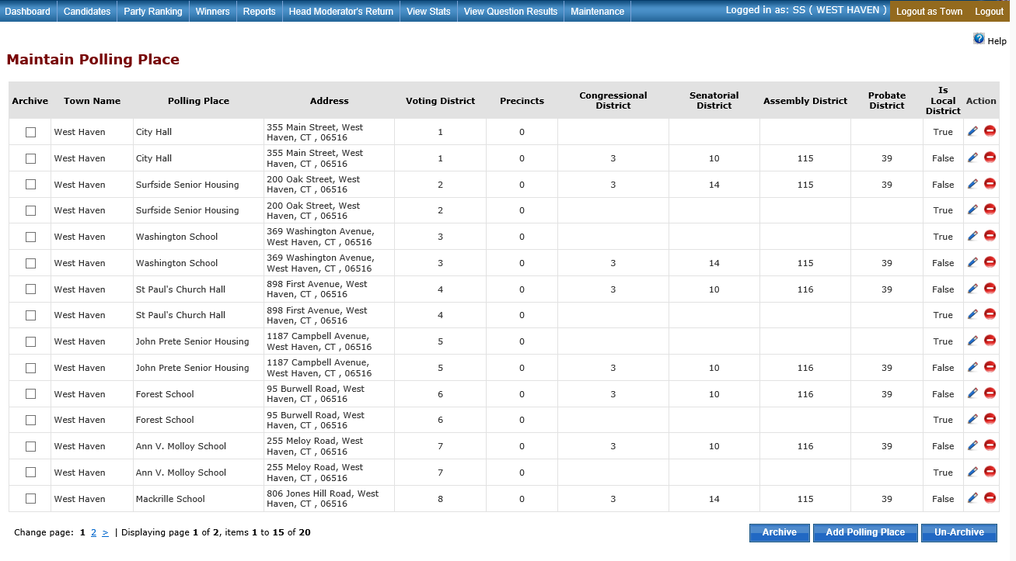
1. Maintain…
1a. Maintain Polling Place
(Review polling places)

Slide 5
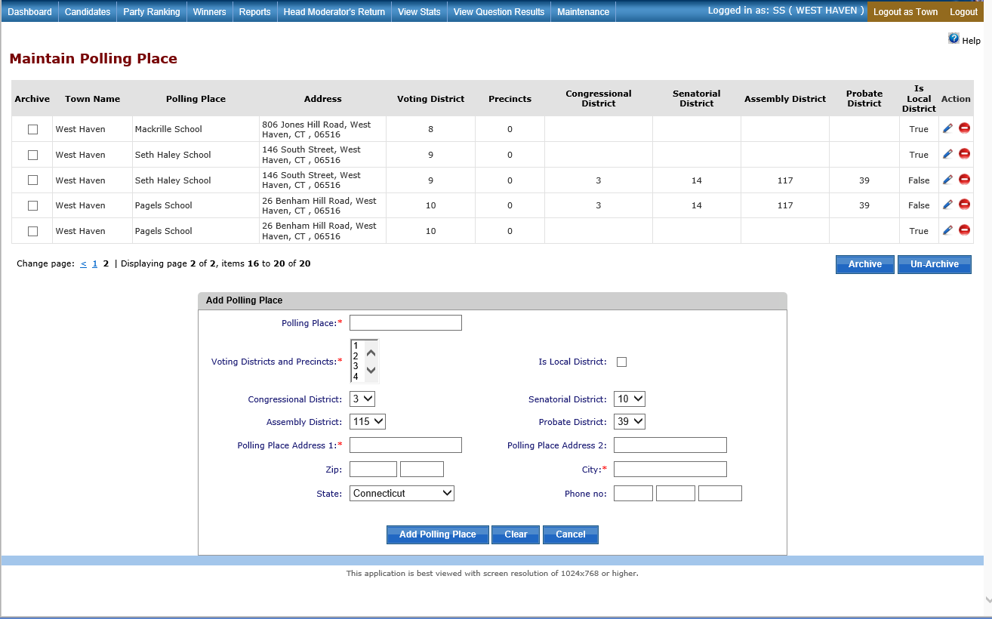
2. Maintenance
2a..Maintain Polling Place
(Edit/add/
archive/
unarchive polling place… if needed)

Slide 6
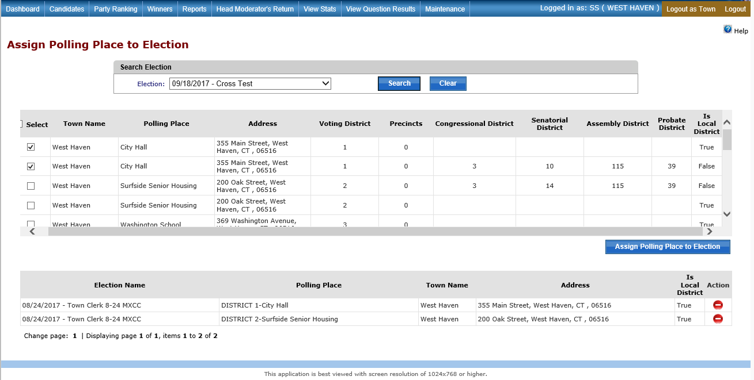
3. Maintenance…
3a. Assign polling place to the election
(to place polling place locations on HM Return)

Slide 7
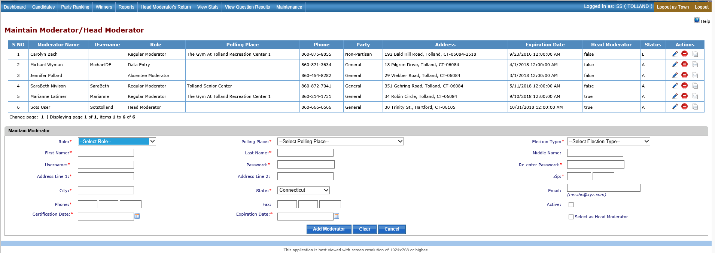
4. MAINTENANCE
4a .MAINTAIN HEAD MODERATOR/MODERATOR
( Add/edit Moderator, Head Moderator, Data Entry users)
Retain your election officials information and can be used for reporting)

Slide 8
5. Candidates
5a. Add/search candidate(s)
(View candidates name for accuracy - entered by Town Clerk or SOTS…on HM Return)

Slide 9
5. REPORTS
Head Moderators Return Template (Tally Sheet)
(Tally Sheet to view candidates order and accuracy)

Slide 10
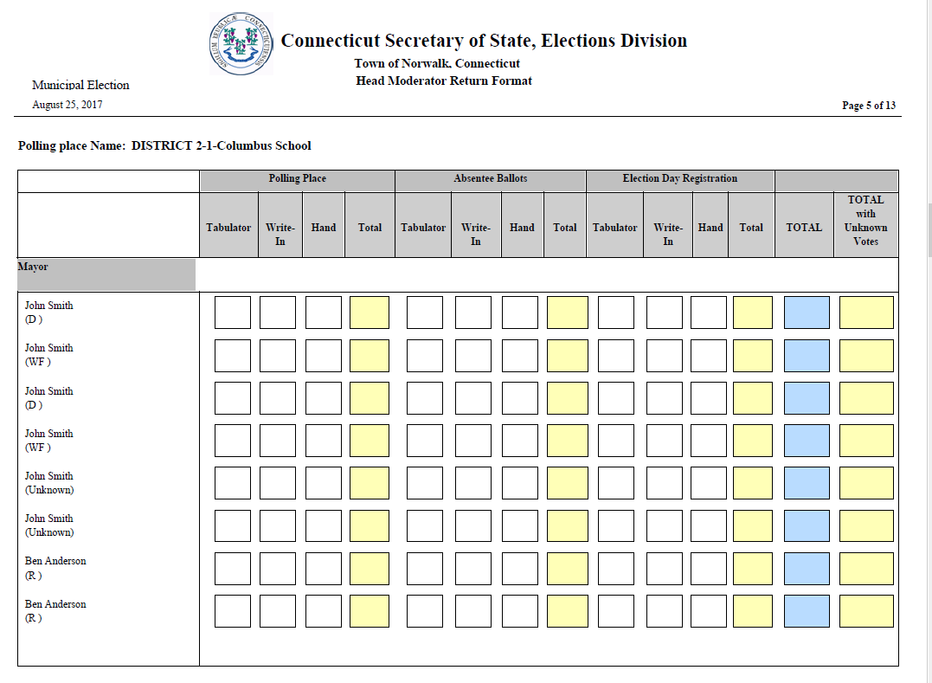
5. REPORTS
Head Moderators Return Template (Tally Sheet)
(Tally Sheet to view candidates order and accuracy)

Slide 11
Head Moderator’s cheat sheet
  Rov’s maintain Head Moderator/Data Entry user Name and Password
  Select Role
  (passwords expire in 90 days)

Slide 12
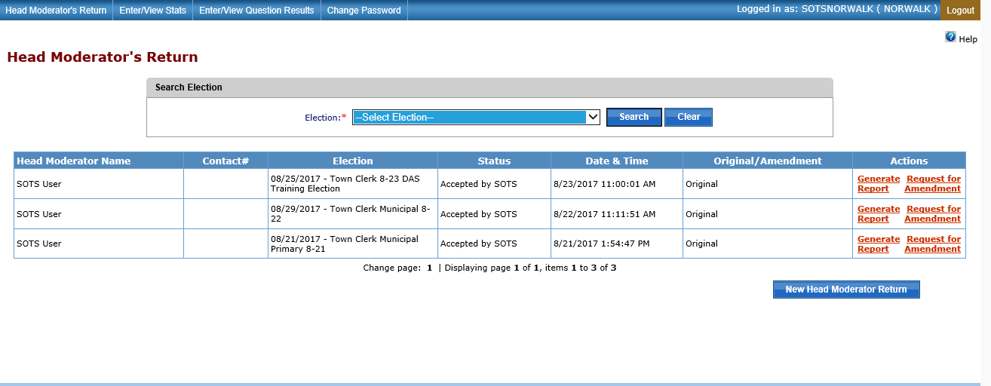
1. HEAD MODERATOR’S RETURN
Dash Board

Slide 13
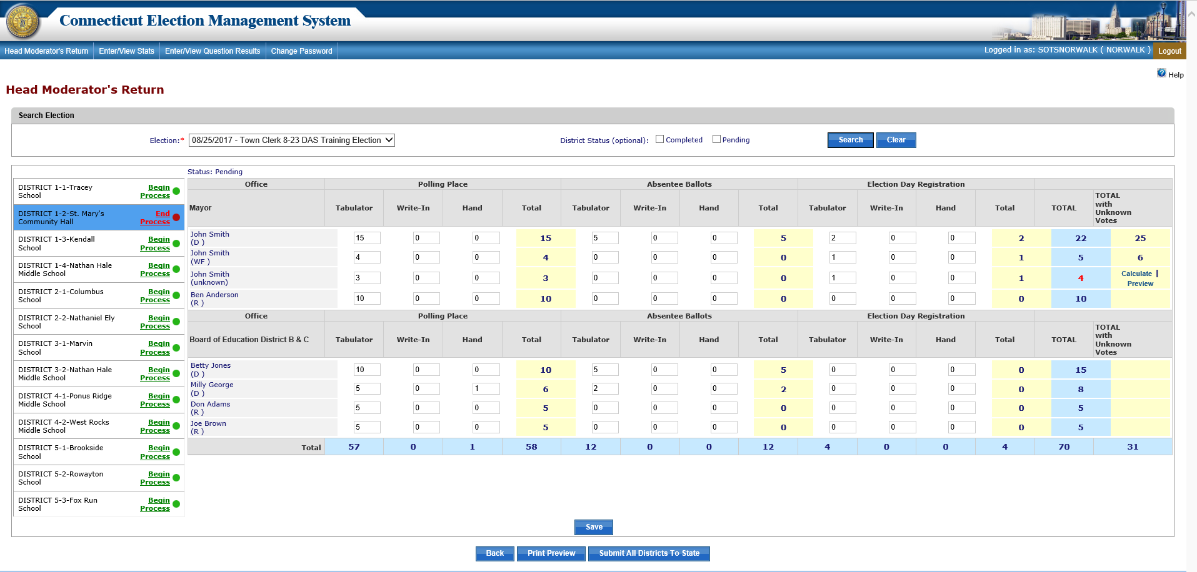
2. HM Results Entry
(Candidates results are entered here)

Slide 14
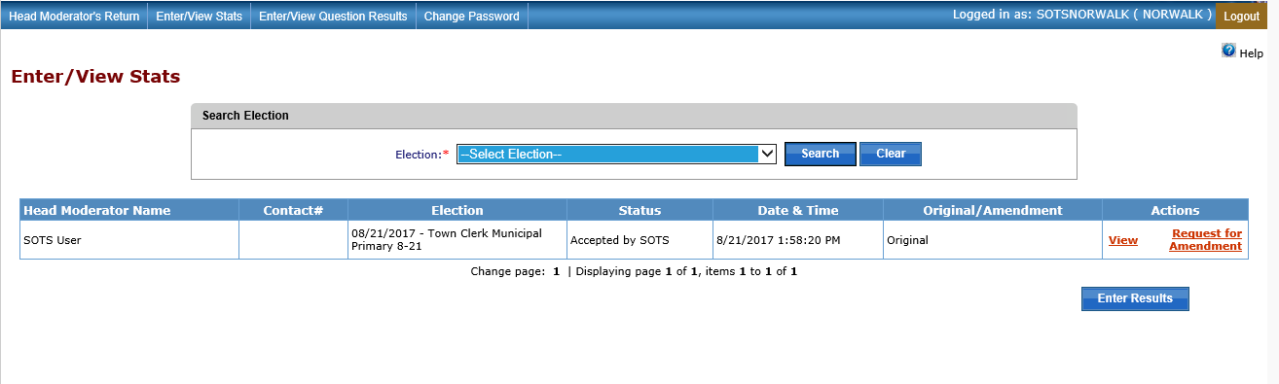
3. ENTER/VIEW STATS

Slide 15
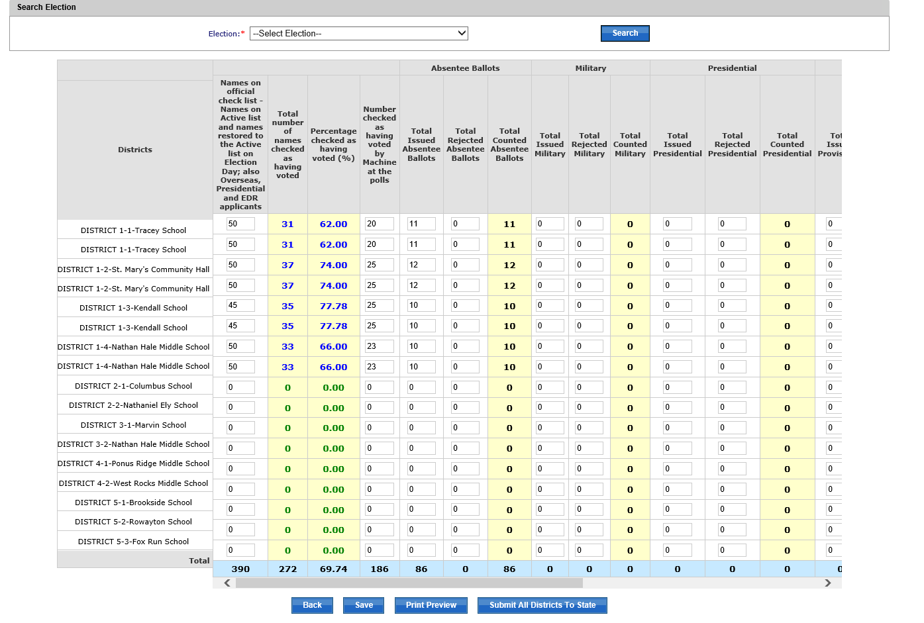
3a. Enter/View Stats
(How many names on official List, how many AB’s , EDR were counted, rejected, etc….)

Slide 16
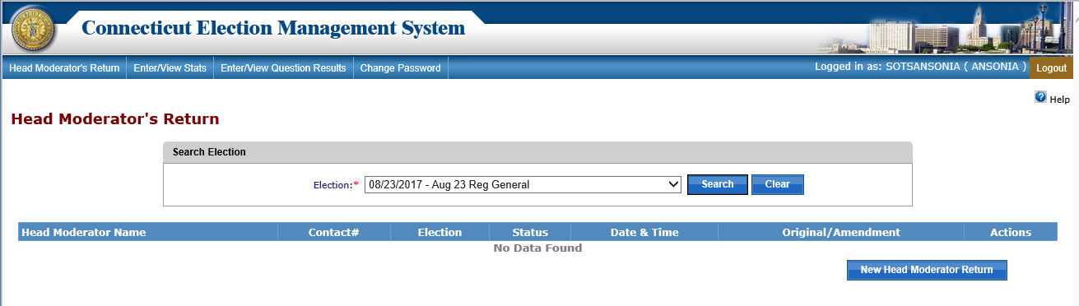
4. Enter/View Question Results
(Question results are entered here)

Slide 17
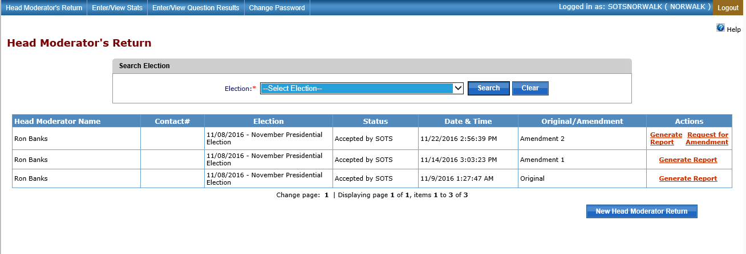
Moderator Return
Generate Report

Slide 18
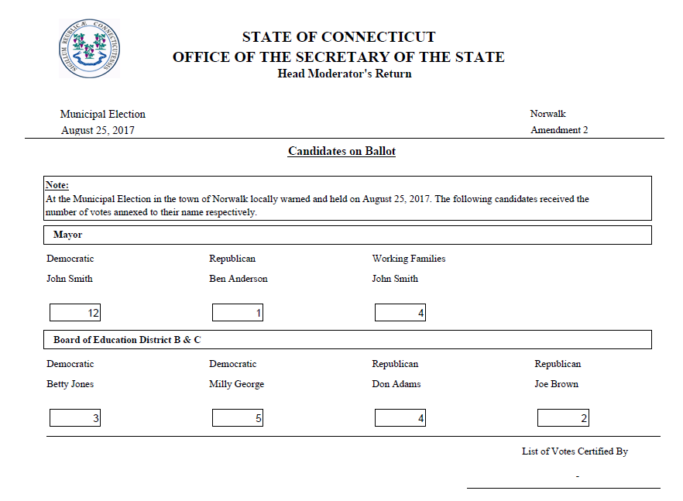
HEAD MODERATOR’S RETURN
1st Page- Candidate Results
(Due to SOTS by midnight
election/primary night)

Slide 19
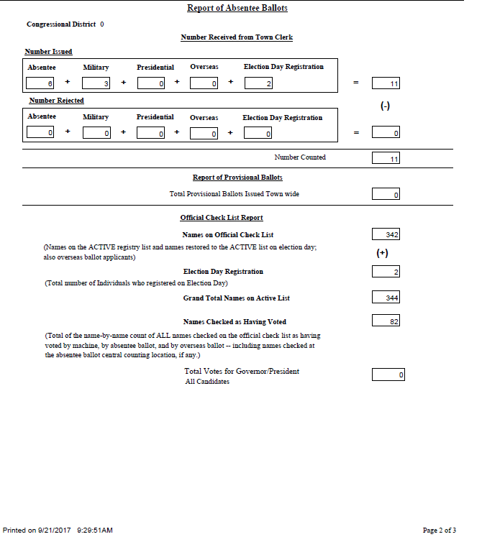
HEAD MODERATOR’S RETURN
2nd Page – (information from view/stats)

Slide 20
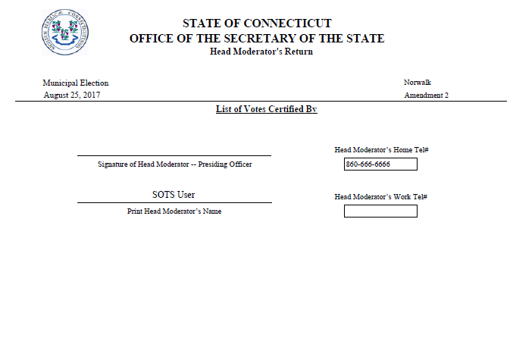
HEAD MODERATOR’S RETURN
3rd Page
Signature Page
A COMPLETE HM’s Return = Results, STATS & Signature

Slide 21
REPORTS
Reports
ROV’s can generate reports in PDF, EXCEL OR CSV
(printed and signed and mailed to SOTS)

Slide 22
MAINTENANCE
Ballot Ordered
Input data screen

Slide 23
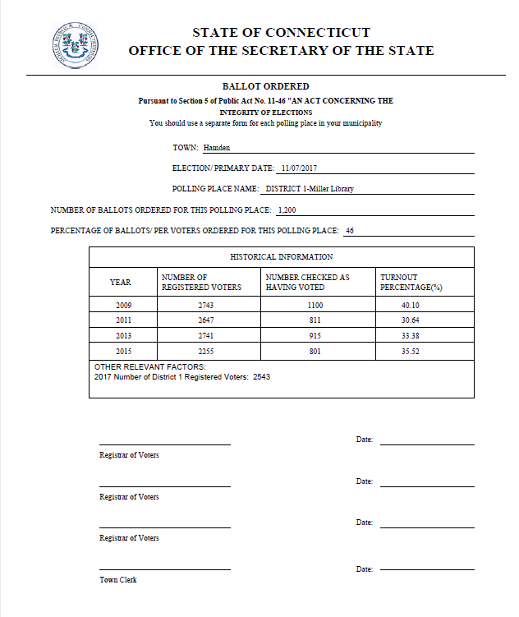
1. REPORTS
1a. Reports
Ballot Ordered Report

Slide 24
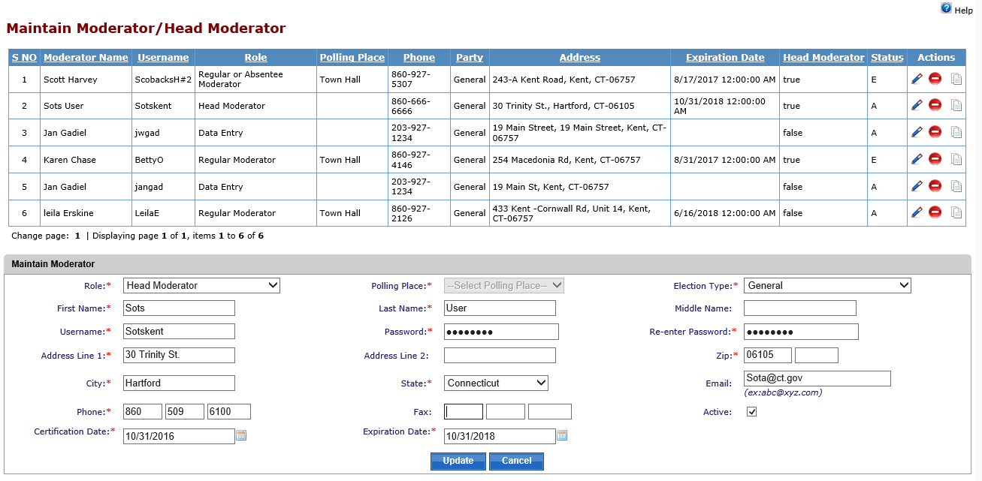
2. Maintain Moderator/ Head Moderator

Slide 25
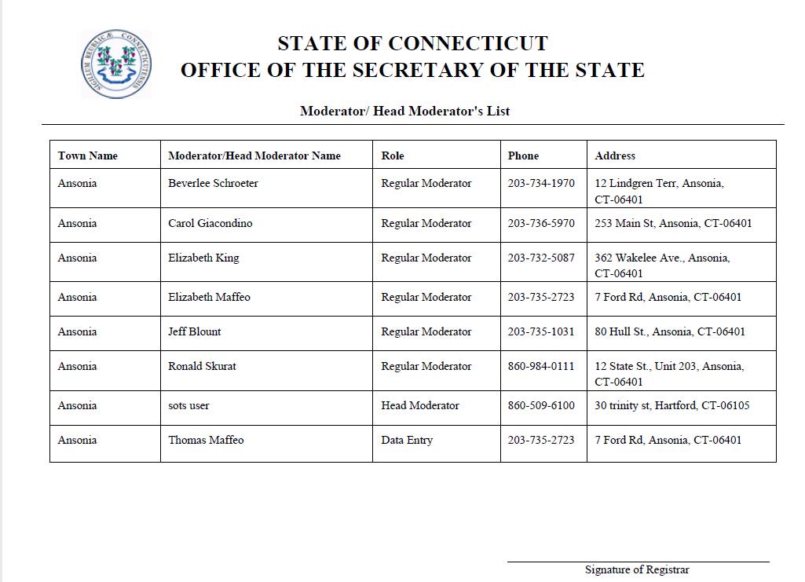
Moderators/Head Moderator Report

Slide 26
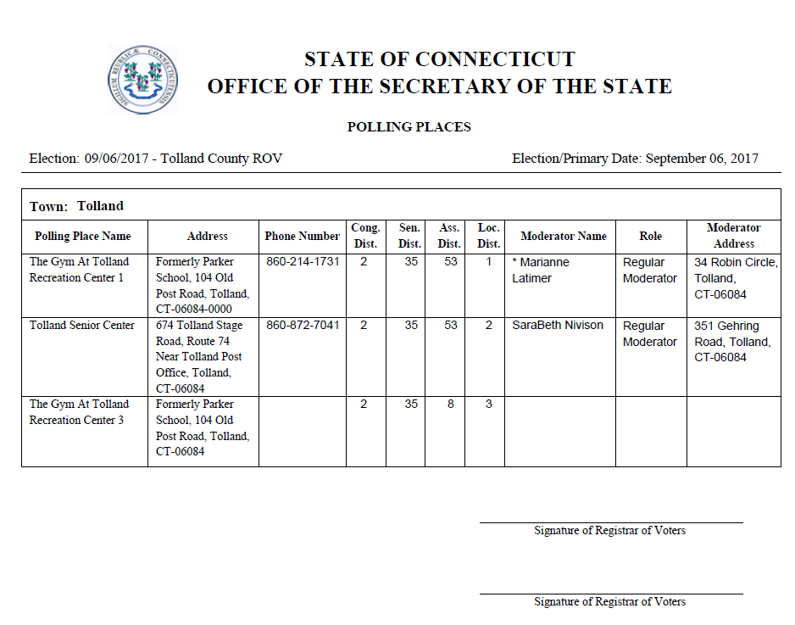
Polling Place Report
This report is available after you have Assigned Polling Places, and added your Moderators. (slide 6)

Slide 27
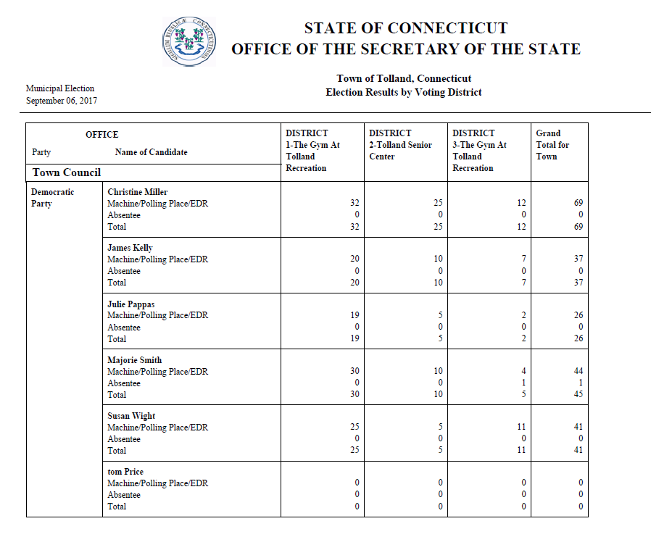
Election Results by Voting District
(Tabulator machine, EDR & AB’s candidate results)

Slide 28
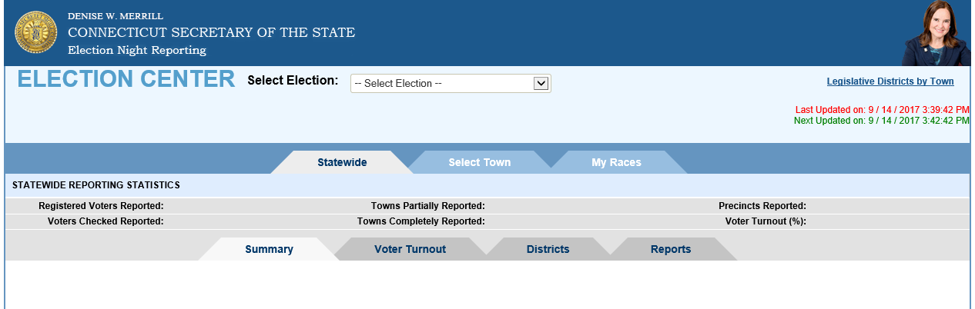
EMS Public Portal http://ctemspublic.pcctg.net

Slide 29
Tips…
  Begin/End process
      Begin process to enter data (lock out other users)
      Input
      ALWAYS SAVE
      End Process (Open process for others to enter data)
        Data Entry User needs to END process in order for the HM to be able to submit/certify to state.
  One Browser session only…per computer
  Do not share User I.D.

Slide 30
Tips…
  Ballot Ordered
    ROV or Town Clerk can input, but all must verify…If ROV create Town Clerk submit to SOTS
      When ROV or Town Clerk certify the election Ballot Ordered a BALLOT ORDER REQUEST is sent to the other respective Dash Board.
  Plan “B”….Print hard copy of HM’s Return
  HM submit candidates election results by midnight….no more faxing!
    Too tired…..Next day—enter STATS
      Candidates Results + STATS = Completed HM Return
    SOTS within 48 hours: Print and mail Head Moderator’s Return with wet signature

Slide 31
Reminder
  Two elections are setup on EMS
    11/07/2017 November Municipal
    11/07/2017 Judge of Probate Vacancy Election 3rd, 16th, 20th, 33rd & 38th
  Polling Places should be assigned for both elections.
  Ballot Ordered for both elections
  Head Moderators will need to enter results for both elections.
    Two completed Head Moderator Returns submitted to SOTS

