Slide 1
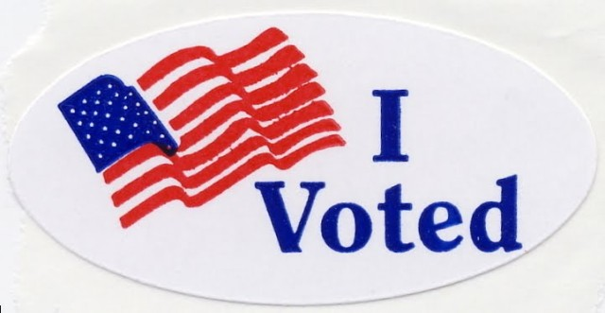
Registrar of Voters
New Registrar Class
Spring 2022
Tim De Carlo - Waterbury

Slide 2
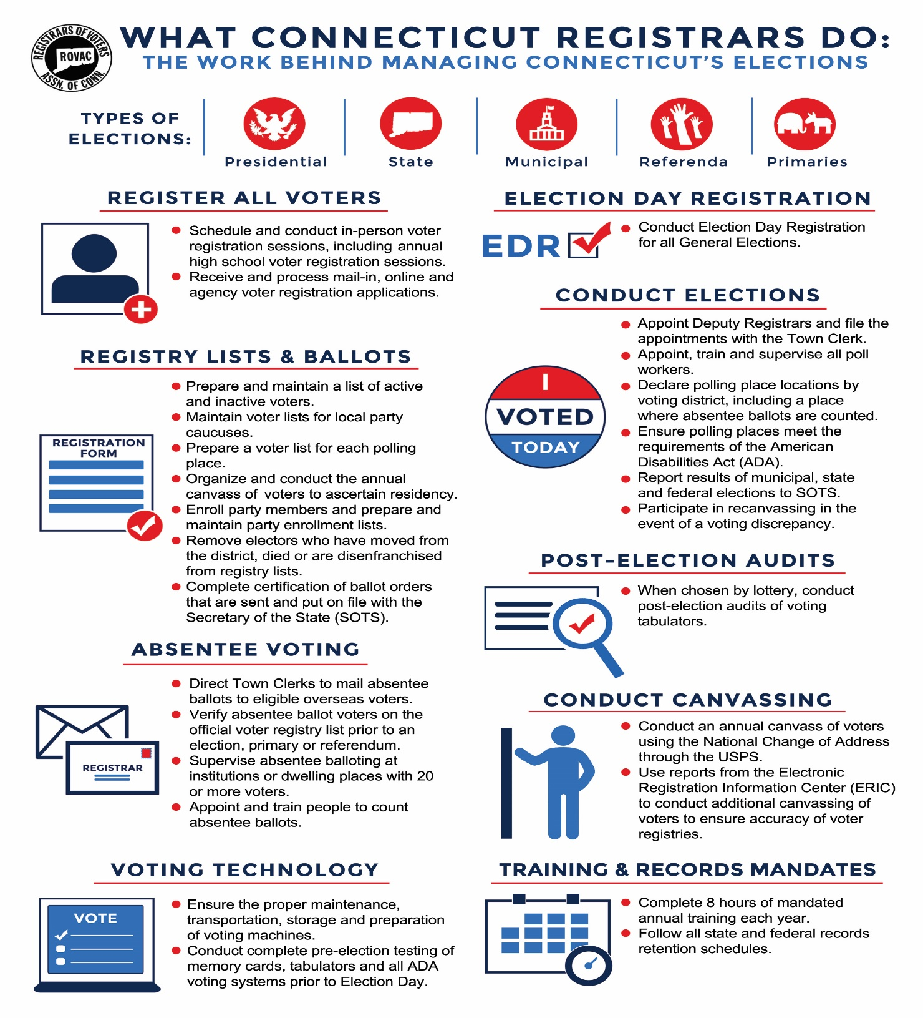

Slide 3
Resources available to Registrars
ROVAC
ROVAC is the statewide association of Registrars of Voters in Connecticut. We work as a group to
help educate fellow Registrars in executing clean, organized and impartial democratic elections.
This is done through semi-annual educational conferences as well as on the county level.
Secretary of the State
The Secretary of the States office oversees the CVRS System, online registration system,
supplies Registrars with election supplies (voter registration cards, posters, envelopes, etc.)
and provides training to Registrars.

Slide 4

ROVAC Board of Directors
Executive Board:
Chris Prue (Vernon) – President
Annalisa Stravato (Wilton) – Executive Vice-President
Karen Buck (Wilton) – Vice-President
Lauren Olson (Ashford) – Secretary
Peter Goston (New Britian) – Treasurer
Full Board (includes Executive Board plus):
Melissa Russell (Bethlehem) – Litchfield County Chair
Fred DeCaro (Greenwich) – Fairfield County Chair
Darlene Burrell (Suffield) – Hartford County Chair
Bonnie Andersen (Cromwell) – Middlesex County Chair
Timothy De Carlo (Waterbury) – New Haven County Chair
Jeff Rogers (Montville) – New London County Chair
Christine Psathas (Willington) – Tolland County Chair
Loreen Hegan (Canterbury) – Windham County Chair

Slide 5

ROVAC Committees and Chairmen
Conference – Lauren Olsen Legislation – Tim De Carlo
Education – Melissa Russell Ways & Means – Sue Burnham
Technology – Lisbeth Becker Handbook – Darlene Burrell
Audit – Ann Kilby Budget – Annalisa Stravato
Certification – Ann Marie Mastroianni

Slide 6


Connecticut Secretary of the State
State of Connecticut
165 Capital Ave
Hartford CT, 06106
Phone Number: (860) 509-6200
State Election Enforcement Commission, (SEEC)
55 Farmington Ave
Hartford, CT 06105
(860) 256-2940

Slide 7
Certification UConn
Complete a required certification program no later than two years from their first day in office. Once certified, each registrar is required to complete at least 8 hours of training per year.
Effective 7/1/2020: The ROV Certification Program is now available online. We now have Sections 1, 3 & 8 available. To register, please click on a Section listed below. We expect the other sections to be available online over the next 8 weeks. CITI anticipates the release of the ROV Cybersecurity Training Course later this summer.
NOTE: The ROV Certification Exam is also available online. Please click the link below to sign up.
https://citi.uconn.edu/registrarofvoters
Section 1: Election Administration, Laws, and Regulations
Section 2: Voter Registration, Maintaining Voter List & Service to Voters
Section 3: Registrar’s Office Management
Section 4: Preparing for Elections, Primaries, Referenda and EDR
Section 5: Conducting Elections, Primaries, Referenda, and EDR
Section 6: Absentee Voting & Supervised Absentee Voting
Section 7: Post-Election Audits & Recanvasses
Section 8: Petitions

Slide 8
Deadlines
June 14 Deadline for Primary Petitions to be filed with SOTS for State and District Office.
July 8 Last day to determine the location of polling places. Certification of polling places to SOTS.
July 8 Registrars must have certified the location of polling places with SOTS.
July 18 Last day for candidates to submit a list of desired party moderators and primary day officials.
July 18 Last day for ROVs to designate in writing to the Town Clerk the central location for counting Abs.

Slide 9
Deadlines
July 19 Registrars and Town Clerk must certify with SOTS the ballot order.
July 11-20 Notice of the July 26th Registration Session must be noticed in the newspaper at least once during this time.
July 26 Mandatory enrollment session must be held on this date (14th day before primary day) for the purpose of registration and/or enrollment of electors entitled to vote in state, district or municipal office primary. At least two consecutive hours required, between the hours of 12:00 noon and 9:00 p.m.
July 26 If state, district or municipal primary will be held in your town and if your town's population is over 25,000, mandatory registration session must be held on this date. Hours: any two hours between 5:00 p.m. and 9:00 p.m.

Slide 10
Deadlines
August 2 ROVs may begin the cross-off of Absentee Ballots
August 4 REGISTRATION AND ENROLLMENT CUT-OFF - STATE, DISTRICT AND MUNICIPAL PRIMARY. Deadline for registering and/or enrolling for voting in primary for state, district or municipal office unless register in person with town clerk or registrar or unless file application for enrollment in person with registrar of voters.
(§§ 9-23g, 9-56 and 9-57)
Mail-in application of new voter must be received by registrar of voters of the town of residence by this day, except that a mail-in application of new voter postmarked by this day or received by a voter registration agency or the Department of Motor Vehicles by this day may be received by the registrar of voters until 12:00 noon of August 8, 2022. (§ 9-23g(c) and (d)).

Slide 11
Deadlines
However, enrollment application of unaffiliated voter must be received by this day by registrar of voters of the town of residence unless unaffiliated voter files application for enrollment in person with registrar of voters by 12:00 noon of August 8, 2022. (§ 9-56)
August 8 Deadline for supervised balloting to be completed.
August 8 In Person Registration Cut-Off at 12:00 PM for anyone who wishes to register or affiliate themselves with a political party, (D or R).
August 9 Primary Day
August 12 Last day for Head Moderator to declare a discrepancy recount.
August 16 Last day for a recount to take place.

Slide 12
Methods of Registering Voters & Letters Sent to Voters
Online Voter Registration
DMV / Tumbleweed
In person / mail in registrations
High Schools
Permanent Absentee Letter
Acceptance / Change Letter
Disenfranchisement Letter
DMV Letter
ED 683 / CVR Letters
Rejection Letter

Slide 13
CVRS System / Reports
The Centralized Voter Registration System, CVRS is the system that you will use to process and make changes to a voter’s profile.
CVRS is where you will find your daily online voter registrations as well as changes through the DMV / Tumble Weed systems.
Make sure when you process a new voter to write down the voter ID# on the card. While not mandatory, this will help you locate the voter should they be taken in error.
The CVRS System also generates several reports that you will need. These reports are also allowed to be given to the public upon request.
Change in Detail Report
Disk file (entire voter file in text format)
Alpha List
Street Guide

Slide 16
DMV / Tumbleweed
TUMBLEWEED – is the DMV ‘s secure server which registrars of voters and tax collectors have access to records showing address changes made by residents of your town by the residents. (§9-19i).

Slide 18
Removal of a Voter from the rolls
There are only two ways that a voter can be removed without incident.
A voter can be removed via a CVR Notice (ED-642)
A voter cancelation form signed by the voter
Per the Secretary of the States Office, at this time Registrars can currently include non-active voters in the Canvas, however, there is a current federal court case that could change this rule. When using this option always make sure to check with SOTS first!

Slide 19
Yearly Canvas of Voter Residence
Section 9-32 requires the registrars of each town to conduct a canvas of electors in person by mail or National change of Address(NCOA) system of the U.S. Postal System by Telephone or a combination of any of these.
ED-683 letters are sent to those who have moved within town.
CVR letters are sent to those who are moved out of town.
A certificate of completion is filed with SOTS once the canvas in completed.
Those towns who have May elections are excused from the canvas only during the May General Election.

Slide 20
Primary Petitions
Two types of petitions that are given out:
Nominating petitions are given out by the Town Clerk.
Primary petitions are given out by the Registrar of Voters for local or single district offices.
Primary petitions for multi-town district or statewide office are given out by the Secretary of the State.
Primary petitions are to be made available the day following a caucus or convention, or once the window to hold a caucus or convention has closed.
A candidate must obtain the signatures of 5% of the total enrolment of those enrolled in the political party.
Only members of that political party may circulate petitions on the candidates behalf.
Petitions are to be notarized and submitted back to the Registrar or SOTS within the allotted time period for circulating.

Slide 21
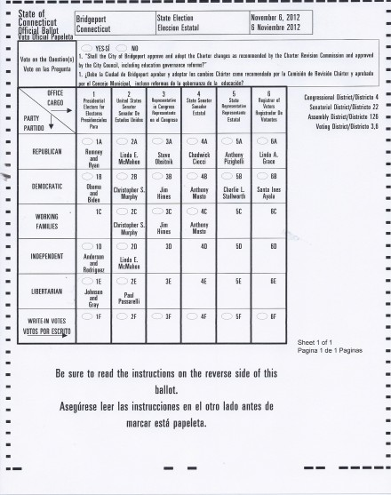
Ballot Access
A candidate has several ways that they can gain access to a ballot.
Nomination from a major party, or minor party with ballot access.
Successfully petitioning onto the ballot via a Nominating Petition.
Obtaining at least 1% of the total vote for an office in a
General Election.

Slide 22
Emergency Plans
In June of 2011 the General Assembly passed legislation requiring that all towns put in place, an Emergency Plan for Election Day issues.
The plan is to be agreed upon by both Registrars and the Town Clerk and to be passed by the local governing body of the town.
When was the last time that you reviewed your emergency plan to see if updates are needed?

Slide 23
Sec. 9-174a. Emergency contingency plan for elections
Sec. 9-174a. Emergency contingency plan for elections. Model plan. (a) For each municipality, the registrars of voters, in consultation with the municipal clerk, shall create an emergency contingency plan for elections, primaries and referenda to be held within such municipality.
Such plan shall include, but not be limited to, (1) solutions for ballot shortages, and (2) strategies to implement in the event of (A) a shortage or absence of poll workers, (B) a loss of power, (C) a fire or the sounding of an alarm within a polling place, (D) voting machine malfunctions, (E) a weather or other natural disaster, (F) the need to remove a poll worker or moderator and to replace such worker or moderator, and (G) disorder in and around the polling place

Slide 24
Poll Worker Training
It is your responsibility to make sure that all poll workers receive adequate training before each election.
Moderators certification must be up to date. If their certification has lapsed make sure they attend a certification class prior to Election Day.
Make sure that your poll workers are aware of your Emergency Plan should an issue arise at the polls, i.e. ballot shortage, poll workers who fail to arrive, loss of power, fire, etc.

Slide 25
Election Equipment
ALL POLLING LOCATIONS HAVE TWO TABULATORS (One is a back-up)
IT IS UP TO THE REGISTRARS TO TEST VOTE THIS EQUIPMENT AND SEND THE CORRECT MEMORY CARD TO EACH POLLING LOCATIONS ALONG WITH THE APPROPIATE BALLOTS FOR THAT ELECTION.
THE IVS/AVS BALLOT MARKING EQUIPMENT MUST BE AVAILABLE AT ALL POLLING LOCATIONS FOR ANYONE WHO WISHES TO USE THEM REGARDLESS OF DISABILITIES.

Slide 26
Maintenance of Election Equipment
LHS is contracted to maintain the voting tabulators and ballot boxes.
There are three different service contract tiers available make sure to know which tier your town has purchased.
It is your responsibility to make appointments to have equipment serviced by LHS yearly.
Make sure that all ballot boxes are checked to make sure write-in baffle is in working order.
IVS is contracted to maintain the AVS equipment.
IVS/AVS system will be a download from IVS
Your town is responsible for the cost for programing the AVS equipment for elections and referenda.

Slide 27
Polling Place Pre-Election Check
Early Permission and Site Check
Check with those in charge of your polling place well in advance of the election to make sure that the location will be operational on the day of the election. Make sure to conduct a site visit prior to the election to make sure everything will be operational for the Primary.
Pre-Election Organization Meeting
Prior to every election you should consider calling a meeting in which everyone who would have some kind of roll be present. For example, are your polling places owned by the municipality or are they rentals? Who will be delivering your election equipment and who will be accepting delivery? Are the local authorities prepared to assist you should you lose power or have an emergency at the polls? Is everyone aware of what your Emergency Plan entails and are they ready to assist your office should a problem develop?

Slide 28
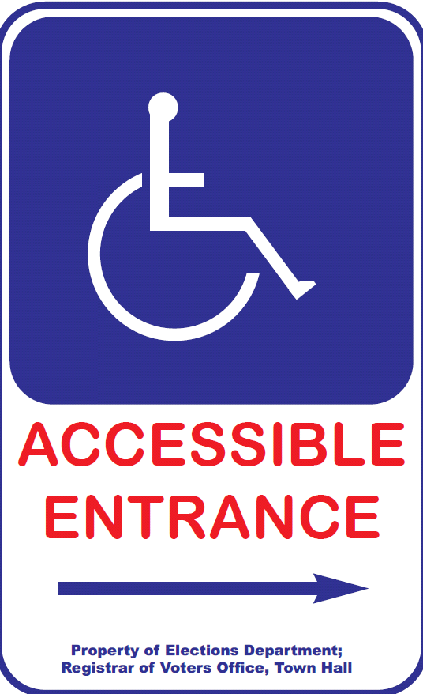
Polling Place Must Be“Accessible”
Moderator (or designee) should :
  Check parking lot signs.
  Post signs to accessible entry, if applicable.
  Clear all accessible pathways in polls
  Set up wheelchair-accessible privacy booth.
  Set up seating for tired voters.
  Review curbside voting process.
Confirm presence/set-up of IVS accessible voting equipment –ready to go at 6 am!

Slide 30

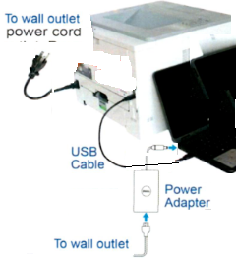
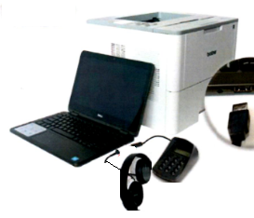
BALLOT MARKING SYSTEM - SET-UP
BEFORE POLLS OPEN ELECTION MORNING
Follow Instructions on pages 5-6 of the Election Day Manual
Printer & computer plugged into power outlet.
USB cable plugged in from computer to printer.
Key pad and headphone plugged into computer.
Ensure paper tray is open, extended & tray sleeve installed.
Load 1 plain piece of paper onto paper tray
Turn “On” Printer and Computer
Press “Print” on computer screen.
  A startup report will print.
Press “No” on computer screen
Access Code 9630

Slide 31
Polling Place Signage
At Federal Elections
3 Easy Steps to Voting
ID Requirements for Voters with Asterisks “*” (per HAVA)
Sample Ballots
Voters Bill of Rights
Instructions for Provisional Ballots (Federal Only)

Slide 32
PROVISIONAL BALLOTS
Provisional Ballots are for Federal Offices only and are given to voters who cannot be found as registered.
You must send Provisional Ballots in the amount 1% of the total number of enrolled electors. 1000 Registered Voters = 10 Provisional Ballots
The moderator gives the voter a Provisional Ballot Envelope, Provisional Ballot, and records the voters information on the Provisional Ballot Inventory Form, (Form 9).
The voter completes application on the Provisional Ballot Envelope, seals and returns the envelope to the Moderator.
Registrars have ????? Days to determine whether or not to count.
In a General Election a voter should be going to EDR
For the August 2022 Primary, Republicans will be the only party that can use Provisional Ballots due to the fact that there is a federal primary for U.S. Senate.

Slide 33

HAND COUNTING
From Auxiliary Bin only
Voter intent determines result.
Two election officials from different parties or factions count votes. If disagreement, moderator decides.
Ballots with write-in votes—count only votes for registered write-in candidates or for a candidate on the ballot in correct box on ballot.
Multiple votes for same candidate in same race count as just one vote.
Record on tally sheets.
DO NOT Put the ballot back through the tabulator!

Slide 34
Elections Management System (EMS)
This system is used to report end of night election results to SOTS.
Town Clerks, Registrars and Head Moderators all have a roll in this system.
Training on this system comes from the Secretary’s office.
This is an online system to report all election results.

Slide 35
EMS Setup
Town Clerks & SOTS
Primary Created in EMS by SOTS
Offices assigned to Primary by SOTS
Candidates added to Primary by SOTS
Certification of Ballot Ordered this can to be done by both Town Clerk or ROV’S for primaries. Email to: jessica.gelin@ct.gov
ROVS
Assigned Polling Places to Primary
  Add or change polling locations if necessary. Make sure to notify SOTS.
Assign a Head Moderator to the Primary
  You may assign moderators, data entry, etc., and provide password
Email your List of Moderators & List of Polling Places to Jessica.gelin@ct.gov

Slide 36
Head Moderator & Head Moderator’s Return
  Head Moderator must “Submit All Districts to the State” the results to SOTS
    A certification screen with a box to check for electronic signature will appear
  Tabulator results are to be submitted by midnight
  Next day Wednesday the return must be completed !!!
    Head Moderator to confirm results and enter any hand counts
    Head Moderator to enter statistics (number on the list, number checked as having voted, etc.)
      Submit to SOTS and a certification screen will appear with a box to check for electronic signature.
  Print the 2 copies of the return, one for Town Clerk, one for SOTS.
    Sign both copies and forward one to SOTS – should be received by close of business Friday
  Amendments – any changes that you enter into EMS, require that you generate an amended return.
  Print 2 copies for Town Clerk & SOTS
  Recounts – if you have a recount, the Head Moderator should amend the return and at the Certification Screen check both boxes (signature & recount)

Slide 37
To Do List
At Least a Week before a Primary
Review & Print your Tally Sheet Template under reports.
  Check that polling places are correct
  Offices are correctly assigned
  Candidates are correct order & have * for endorsed (this for local primaries only)
Review & Print a blank Head Moderator’s Return under reports
  This is a just in case, if something goes wrong on primary night

Slide 38
Recanvas Procedures
A recanvas of an election can take place if either The moderator (or head moderator in towns divided into voting districts) may call for a recanvas of the machine counted ballots, and/or the hand counted ballots, and/or absentee ballots and/or write-in ballots if he determines there is a discrepancy in the returns of any voting district in an election or primary. (§ 9-311)
Or
After any election or primary, when the plurality of the winning candidate for an office is one half of 1 percent or less than twenty votes are separating both the winning and defeated candidate for office.

Slide 39
Recanvas Cont.
In a District / Statewide recanvas, the Secretary of the State will notify the Town Clerk who will in turn notify the Head Moderator.
In a municipal or Single District race the Town Clerk will inform the Head Moderator.
It is the Head Moderator who will notify the candidates, town chairmen and recanvas officials that are needed that a recanvas will be conducted. This is to be done in writing.
RECANVAS OFFICIALS
Recanvas officials are: the moderator, the registrars of voters (or the registrar of voters, in a primary); at least two official checkers of opposing political parties (or opposing sides, in a primary); at least two absentee ballot counters of opposing political parties who served at such election (or opposing sides in a primary); and at least two ballot clerks of opposing political parties. Although not a recanvas official, the town clerk may be involved to ensure the appropriate materials (that have been in the possession of the town clerk) have been delivered for use during the recanvas.

Slide 40
Recanvas Cont.
Require Town clerk and / or registrar of voters to bring (dependent on who has the material):
i. the tabulators with a memory card still sealed in them.
ii. the sealed ballot transfer cases for each voting district, which contain:
all machine counted ballots,
the sealed depository envelopes containing the hand-counted absentee ballots; notes, worksheets and other written materials used in the absentee ballot counting procedures; and the Moderator’s Record of Absentee Ballot Count for Candidates;
the sealed depository envelopes containing the counted ballots from the auxiliary bin; notes, worksheets and other written materials used in counting the ballots from the auxiliary bin (if any);
the sealed depository envelopes containing the counted ballots from the write-in bin; notes, worksheets and other written materials used in counting the ballots from the write-in bin;
iii. the sealed depository envelopes containing rejected absentee ballots and discarded inner and outer envelopes;
iv. the absentee ballot applications;
v. the list of absentee ballot applicants as provided in §9-140;
vi. the check list;
vii. the moderator's returns, including the central absentee ballot counting moderator's return, if applicable;
viii. replacement seals;
ix. challenge ballots, provisional ballots, presidential ballots and all other materials.

Slide 41
Post Election Audit
The Secretary of the States Office will conduct a lottery after the election. Those polling places selected will need to have a post election audit conducted.
The audit may be conducted either by manual or automated form. All automated audits take place in the Office of the Secretary of the State.
Regardless of the type of audit you perform it must still be noticed locally.
To conduct the audit manually make sure to reference the audit manual which is located on the SOTS website.

Slide 42
Links to Manuals & websites
Absentee Counting
Audit
Recanvas
Moderator
http://portal.ct.gov/SOTS/Election-Services/Handbooks/Handbooks-Moderators-Absentee-Ballot-Counters-Recanvass-and-Audit
ROVAC handbook
http://rovac.org/index.php?page=Handbook

Slide 43
ROVAC website: http://rovac.org/
SOTS: http://portal.ct.gov/SOTS/Common-Elements/V5-Template---Redesign/Elections--Voting--Home-Page
SOTS LEAD Communications: http://portal.ct.gov/SOTS/Election-Services/LEAD-Communications/LEAD-Communication
SOTS Election Calendar: http://portal.ct.gov/SOTS/Election-Services/Calendars/Election-Calendars
LHS Associates: http://www.lhsassociates.com/ 1(888) 547-8683
IVS: https://ivsllc.com/indexWelcome.html 1(855) 730-6161
Adkins Printing http://www.adkinsinc.net/ 1(800) 228-9745 x 125
UConn CITI https://citi.uconn.edu/registrarofvoters

Slide 44


