Slide 1
Recanvass Procedures & Tips
By Cindy Bruno & Darlene Burrell
9/28/2017

Slide 2
This presentation on
Recanvass
is meant to
PREPARE not SCARE you.

Slide 3
However if you have not been involved in a Recanvass we would be remiss if we didn’t tell you that a Recanvass can be intense.
The outcome of the candidate’s race is at stake.

Slide 4
A Recanvass is like an expanded election night that lasts several hours.
Like most of what we do as Registrar’s it is very detailed. A few highlights:

Slide 5
1) Prepare all documents in advance.
2) Hire sufficient help.
3) Chain of custody of voted ballots is
critical.
4) The public will be observing.
More detail will be shared throughout this presentation.

Slide 6
Recanvass = Recount
What we refer to as a Recanvass the public refers to as a recount. They are the same thing.

Slide 7
We recanvass the votes that were counted or canvassed on election night.

Slide 8
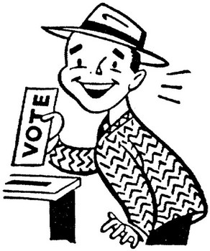
A recanvass will most likely occur in a multi opening office in an election with a low turnout

Slide 9
The difference between a
Recanvass and an Audit
Keep this in mind:

Slide 10
Throughout the process of a Recanvass you will look for Voter intent on a ballot. *
*(the vast majority of the ballots will be marked correctly and go through the tabulator)
In an Audit you look for how the tabulator would read the ballot. *
Examples will be given later in this presentation.

Slide 11
Prior to Election Day:
Determine a date to conduct Recanvass,
if one is necessary,
with Co Registrar and Head Mod.
It must be within 5 days of the election.
Reserve a Room to conduct Recavass in.

Slide 12
Recanvass Procedure Manual Print copies from Secretary of the State of CT website
Refer to the manual for:
more details
Forms
Summons
Notice of Recanvass in Case of Discrepancy
Notice of Recanvass on Close Vote
Return of Delivery of Notice
Primary Recanvass/Provisional Ballot Return Form
Return of Service Form
Also, refer to §§9-311, 9-370a, 9-445 & 9-446

Slide 13
Determine if a Recanvass is necessary:
This determination must be made within 3 days of the Election or Primary.

Slide 14
3 ways a Recanvass May Occur:
(Election or Primary)
(Reg 9-242a-28

Slide 15
#1 -
Discrepancy (§9-311)
Moderator determines there is a discrepancy in the return of any district. Moderator summons recanvass officials & notifies town chairmen.
May be limited by moderator to area of discrepancy

Slide 16
#2 -
Close Vote(§9-311a, 9-445)
(3 possibilities)
When the difference between the winning candidate and the defeated candidate is less than ½ of 1% of the total votes cast for a single opening office
OR

Slide 17
½ of 1% of the number of electors as having voted in a
multi opening office. OR
less than 20 votes separate the winner from the defeated candidate, there is
automatically a Recanvass.

Slide 18
#3 -
Tie vote for any office
When there is a tie vote in any office

Slide 19
Question
Difference between the “Yes” and “No” vote is less than ½% of total votes cast for the question but not more than 2,000 votes.
(§9-370a)

Slide 20
Who notifies who in a Recanvass:
State &/or District offices
Close vote or tie vote Recanvass
called by SOTS who notifies Clerk, Clerk notifies Moderator, Moderator summons recanvass officials & notifies
town chairmen & candidates

Slide 21
Municipal offices or Town Committee
Recanvass called by Clerk who notifies Moderator, Moderator summons recanvass officials & notifies
town chairmen & candidates

Slide 22
Multiple-Opening Offices
The returns for all candidates in contest will be recanvassed
RECANVASS must be done
Within 5 business days of
Election or Primary

Slide 23
Once it is determined that there will be a Recanvass of votes:
Town Clerk impounds the official check lists, the moderator’s returns and the executed Absentee ballots.

Slide 24
ROV impounds sealed ballot transfer cases with all executed ballots from the polling places, tabulators with memory cards sealed in place and any other election material used on Election Day including notes and work sheets.

Slide 25
Basically you will need to recreate Election Day with all the material you used that day.
This is why it is important to train your Election Day poll workers well and with detail. The more organized everyone is on Election Day and during the original canvass of votes the smoother your Recanvass will go.

Slide 26
Do not alter your official list by making changes in CVRS until after the Recanvass.
Should your Recanvass end in a tie and you will be conducting an Adjourned Election where only the electors on the “Election Day” official voters list will be allowed to vote.

Slide 27
Of course you can back date your list before you print it however any changes will be able to be viewed on the SOTS website in the voter look up.
Easier to wait to make changes.

Slide 28
If you have unused and
set up/back up tabulators,
impound them as well for use at the Recanvass.

Slide 29
Notice of Recanvass to Town Chair
The Town chairs of every party involved in the Recanvass also receives written notice,
stating the date, time and place where the Recanvass will take place.
Each chair may send representatives to be present to observe but not participate in the Recanvass.

Slide 30
Notice to Candidates
In a close or tie vote Recanvass in an election or primary for municipal office or election of members of a Town Committee each candidate is also given written notice of the day, time and place of the Recanvass.
Each candidate subject to the Recanvass is permitted to have two representatives present.

Slide 31
Notice to the public
The ROV should ensure that the location of the recanvass is identified by sufficient signage to enable any member of the public to easily locate the building and room where
the recanvass is taking place.
It would be wise to notify the Press, post details on the Town’s web site and the ROV’s website.

Slide 32
Recanvass Day
Arrive early and rested it’s a long day.
Have beverages and snacks for your workers. Providing lunch helps keep the day running smoothly.
Recanvass officials should arrive before the official start of the recanvass for instruction.

Slide 33
Setting up the Recanvass officials in teams prior to their arrival will make the start smoother. You will know their party affiliation and can set up the teams to represent different parties in an election or different candidates in a primary.
Swear in the Recanvass Officials.

Slide 34
At the start of the Recanvass instruct the Public Observers as to what they are allowed and not allowed to do.
Observers may be close enough to:

Slide 35
Observe but not interrupt the process
See ballots as they are counted
See tally sheets being marked and counted
See report forms
Verify seal numbers
They should present any questions they have to the ROV or Moderator not the Ballot counters

Slide 36
Recanvass
CHAIN-OF-CUSTODY
Removing ballots, memory cards & tabulators from secure storage
under supervision of two election officials of opposing parties (or candidates in a primary)
until locked into secure storage
--Never Leave Unattended

Slide 37
Ballot Counting Rules
Voter Intent Governs
Run properly marked ballots through tabulator
Work in teams of at least 2 officials (not of same party affiliation)
Double check work done by other official (at least two sets of eyes)
Count only the votes for the contests subject to recanvass
Impartial judgement
Moderator makes final decision when voter intent is not clear.

Slide 38
Basic Ballot Counting Rules
Examine ballots - determine whether markings for the office being recanvassed are clear to be read by tabulator
Stack properly marked ballots into groups of 25/50 (recommended)
Process properly marked ballots through tabulator
Hand Count mismarked or improperly marked ballots
(including stickered ballots)
o Follow Hand Counting Ballots Procedures
Reseal into transfer bags and/or depository envelopes

Slide 39
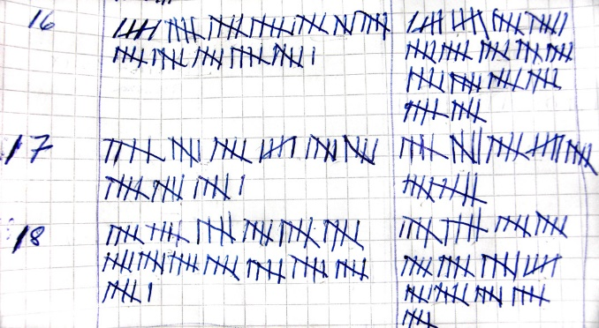
Basic Hand Counting Ballots Improperly Marked Ballots
Hand count the votes for the office(s) or question(s) subject to recount
Interpreting ballot markings for voter intent
Hash marks on tally worksheet indicating votes received
Reconcile hash mark sheets jointly
Record # of votes onto tally sheet
Reseal in labeled depository envelopes.

Slide 40
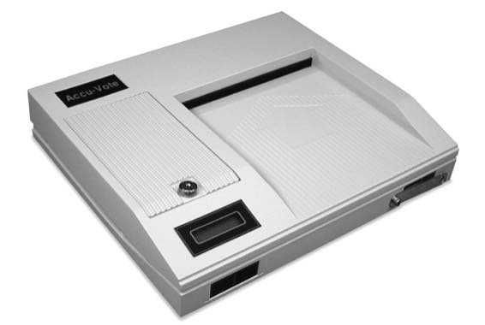
TABULATOR Counted Polling Place Ballots
Break the seal of the ballot transfer cases carrying the tabulator counted ballots.
Working with one ballot bag at a time, remove the ballots from the ballot transfer case
ABANDONED Ballots – Simply consider abandoned ballots when tying out ballots cast to number checked as voting.
SPOILED Ballots – Keep in depository envelope. Do nothing with them.
Follow “Basic Ballot Counting” Instructions

Slide 41
Absentee Ballot Handling (1 of 2)
Open depository envelope with discarded outer and inner envelopes & rejected absentee ballots
In the presence of the moderator and town clerk
Check all outer envelopes against:
inner envelopes
Verify that quantity of them is the same.
Clerk’s check list
Verify postmarks & addresses
Official check list markings
Verify that # of outer & inner envelopes is same as # of persons checked as having voted by absentee ballot.
Regarding Rejected Ballots – Simply ensure that they have been accounted for.

Slide 42
Absentee Ballot Handling (2 of 2)
Open depository envelope(s) containing tabulator counted absentee ballots
Follow Basic Ballot Counting Rules
Open depository envelope(s) containing hand counted absentee ballots
Follow Hand Counting Ballot Instructions

Slide 43
EDR Ballot Handling
Handle as closely as possible to Absentee Ballots

Slide 44
Write In Bin Ballots (1 of 2)
Open depository envelopes containing Election Day write-in bin ballots.
Look at ballots for any defects or marking errors which might cause the tabulator to incorrectly read the ballot for the offices to be recanvassed.
If any marking error or defect is found in the office being recanvassed the ballot should be set aside so it can be hand-counted.
If there is a write-in for recanvassed contest set the ballot aside so it can be hand-counted.

Slide 45
Write In Bin Ballots (2 of 2)
Feed all other ballots from the write-in envelope into tabulator, so non-write-in votes can be tabulated.
Record votes on tally sheets
Reseal write-in ballots in labeled depository envelope

Slide 46
AUXILIARY Bin Ballots
Open depository envelopes containing the ballots from the auxiliary bin
Hand count the votes for the contests subject to the recanvass
Follow Hand Counting Procedures
Record votes on tally sheets
Reseal in labeled depository envelope.

Slide 47
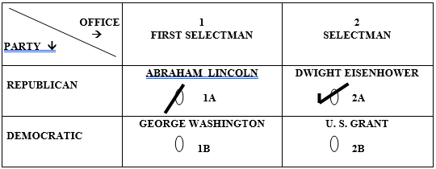
Interpreting Ballot Markings (1 of 7)
Slash Marks Through Ovals - Hand Count - Count Vote for Lincoln & Eisenhower

Slide 48
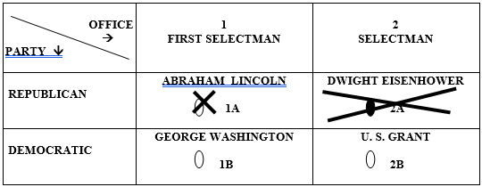
Interpreting Ballot Markings (2 of 7)
Invalid Correction – Hand Count – Count vote for Lincoln

Slide 49
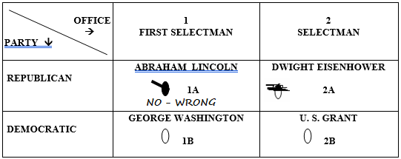
Interpreting Ballot Markings (3 of 7)
Invalid & Written Correction – Hand Count – Count Vote for Eisenhower

Slide 50
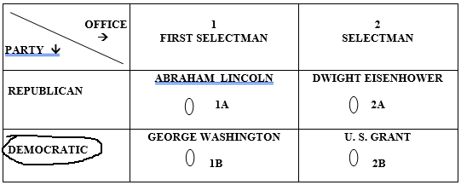
Interpreting Ballot Markings (4 of 7)
Party Designation is Disregarded/Ignored – NO Votes Counted
(NOTE: There is one exception - Party Designation is considered on Official BLANK Absentee Ballots)

Slide 51
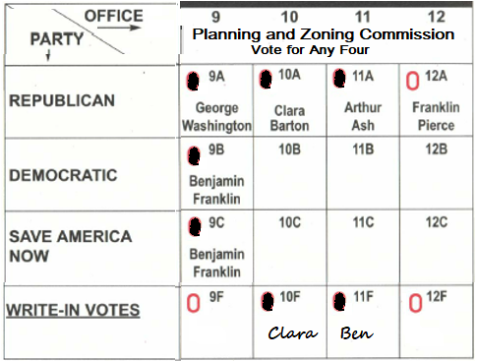
Interpreting Ballot Markings (5 of 7)
Determine if a True Overvote
More candidates selected than allowed?
This ballot is NOT a true Overvote
7 ovals filled in
4 candidates selected
Count Vote for
Washington, Barton,
Ash & Ben Franklin

Slide 52
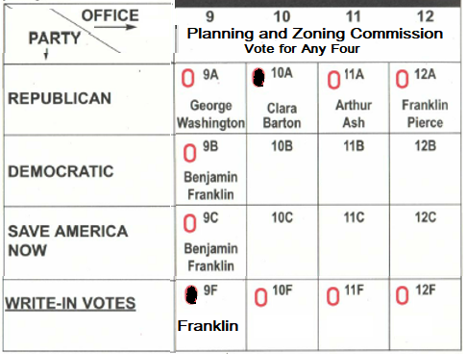
Interpreting Ballot Markings (6 of 7)
Intent of Voter Must be Clear
(Ben Franklin or Franklin Pierce), the write-in vote would not be counted
Clara Barton is the
only clear vote

Slide 53
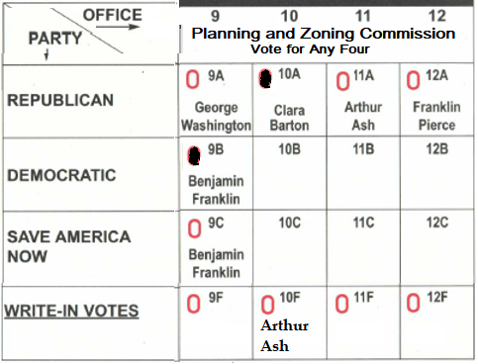
Interpreting Ballot Markings (7 of 7)
Consistency is important when determining voter’s intent.
Ovals are correctly filled in on ballot.
Oval not filled in for write-in
Count vote for
Clara & Benjamin

Slide 54
Closing Recount (1 of 3 )
For Each Voting District
Print and sign 2 elections results tapes
1st tape connected to Zero tape
attach to Recanvass Moderator’s Return.
Announce tabulator results for contests subject to recanvass
Ignore results for offices not subject to recanvass
Post 2nd result tape for observers to view

Slide 55
Closing Recount (2 of 3 )
After all votes subject to recanvass are counted:
Record results on proper tally sheets
Complete “Certificate of Closing Polls” form with moderator & at least two officials’ signatures.
Record seal numbers from tabulator and ballot transfer cases
Any additional memory card containers must be listed on certificate
Complete Moderator’s Returns for each office subject to recanvass
Announce results for contests subject to recanvass

Slide 56
Closing Recount (3 of 3 )
Put in ballot transfer case all tabulator counted ballots and sealed depository envelopes like they were on election night
Attach new seal
Record seal number on Moderator’s Return
Put tabulator w/recanvass memory card into tabulator case.
Attach new seal
Record seal number on Moderator’s Return

