Slide 1
REGISTRARS OF VOTERS CONFERENCE
CANVASS
APRIL 21, 2017

Slide 2
CANVASS REQUIREMENT
Conn. Gen. Stat. Sec. 9-32 requires the registrars of each town holding a November 7, 2017 election to conduct a canvass of electors (1) in person, (2) by mail, or the National Change of Address (NCOA) system of the U.S. Postal Service, (3) by telephone, or (4) a combination of such methods.
Under Conn. Gen. Stat. Sec. 9-32, the Towns of Andover, Bethany, Union and Woodbridge need not conduct a canvass in 2017 because they hold town elections in May. All other towns must conduct a canvass in 2017 because they hold town elections in November.
The Towns of Griswold, Groton, Killingly, Litchfield, Milford, Newtown, Old Saybrook and Stonington must conduct a canvass in 2017, but because they have boroughs or cities which have May elections, we suggest that they wait until May 1, 2017, the last day allowed in Conn. Gen. Stat. Sec. 9-35, to mail out their notices of Confirmation of Voting Residence. In this way, the canvass will be effective only for the town election in November.

Slide 3
TIME OF CANVASS
Conn. Gen. Stat. Sec. 9-32 requires that the canvass be conducted between January 1st and May 1st. However, if you choose a canvass-by-mail, the canvass-by-mail should be conducted between January 1st and April 1st because Regs. Conn. State Agencies, Secs. 9-32-3 and 9-32-4, allow voters thirty days to contact you, and under Sec. 9-35, May 1st is the last day to send out a Notice of Confirmation of Voting Residence.

Slide 4
TIME FOR CONFIRMATION OF VOTING RESIDENCE
May we remind you that under Conn. Gen. Stat. Sec. 9-35, in 2013 the Notice of Confirmation of Voting Residence may only be sent out between January 1, 2017 and May 1, 2017 on the basis of information obtained in the canvass.
Of course, Notice of Confirmation of Voting Residence may be sent anytime during the year if your Notice of Acceptance (ED-672) of a Mail-in Voter Registration Card is returned undeliverable.

Slide 5
REGULATIONS
The following is a list of all present regulations relating to canvass of electors in Connecticut:
§§9-32-1 thru 4 - Canvass-by-Mail
§§9-32-6 thru 8 - Canvass by Telephone
§9-32-9 - Removal of Name (canvass by mail or telephone)

Slide 6
REGULATIONS
Sections 9-32 and 9-35 supersede the canvass regulations as follows:
1. Registrars no longer need to perform two checks before sending a Notice of Confirmation of Voting residence on the basis of a canvass.
2. Registrars cannot, on the basis of a canvass, remove a name completely from a registry list for non-residence unless the elector confirms in writing that he has moved out of town.
3. If the canvass shows by positive information (for example, if the canvass-by-mail comes back marked "undeliverable" by the Post Office) that the elector no longer lives at the address (and there is no indication that he moved within town), and if the Registrars determine that he moved out of town, the Registrars send a Notice of Confirmation of Voting Residence, and after thirty days, place the name on the inactive registry list for four years. (A Notice of Confirmation of Voting Residence may not be sent when the only information that you have concerning whether a person has moved is a failure to respond to a canvass-by-mail which was delivered by the Post Office.)
Example:
- Canvass-by-mail mailed before April 1st
- Notice of Confirmation of Voting Residence sent May 1st
- Removal to inactive list on June 1st for the period June 1, 2017 - June 1, 2021
- On June 1, 2021, if name is still on the inactive list, it is removed completely.

Slide 7
CANVASS IN PERSON OR BY TELEPHONE
If you choose to canvass in person, please see Regs. Conn. State Agencies Sec. 9-32-9 and Conn. Gen. Stat. Secs. 9-32 and 9-35.
With regard to canvass by telephone, please study Regs. Conn. State Agencies Secs. 9-32-6 through 9-32-9.
We remind you that, effective 2000, Sec. 9-32 was amended to delete the authorization for the registrars to request Social Security numbers during the canvass; therefore, registrars may not ask for Social Security numbers during the canvass. Section 9-32 further provides that no Social Security number obtained by the registrars during the canvass prior to 2000 may be disclosed to the public or to any governmental agency.

Slide 8
CANVASS BY TELEPHONE REGULATION
Sec. 9-32-6. Telephone canvass. Applicability of provisions. In any municipality where the registrars of voters cause a canvass of the electors to be made by telephone pursuant to subdivision (3) of section 9-32 of the general statutes, such telephone canvass shall be conducted in accordance with these regulations. (Effective January 31, 1989)
Sec. 9-32-7. Telephone canvass - general provisions. (a) A telephone canvass shall be made by the registrar or his designee making a telephone call to the residence of the elector listed on the registry list. If there is no published telephone number or no telephone number in service for the residence of an elector, the registrar or his designee shall note such fact as part of his canvass by telephone.
(b) A telephone call shall qualify as one of the two methods of canvass required before the name of an elector may be removed from the registry list, only when it is made to the household of an elector that has both a published telephone number and a number which is in service at the time the call is made. A call to a changed telephone number provided by the telephone company shall be deemed a published number provided the changed number is identified as relating to the former number. Unlisted numbers shall be deemed published only if they are made available to the registrars of voters by the telephone company. A telephone number of an elector provided to the registrars of voters or town clerk by such elector shall be deemed published; a telephone number of an elector provided to the registrars of voters or town clerk by a person other than such elector shall be deemed not published. If during a telephone canvass a telephone call is made to a telecommunications device for the deaf I n an elector's household, said telephone call shall not qualify as one of the two methods of canvass required before the name of an elector may be removed from the registry list unless the registrar or designee uses a similar device or uses a message relay center.
(c) The information solicited by a registrar or designee in a canvass by telephone shall confirm the following information with respect to each elector living within the household: the elector's name and bona fide residence address; whether the elector has recently moved, and, if so, such elector's new residence address, if known; whether the elector is in the military service; and whether the elector's name has changed, and, if so, the elector's new name. An elector's mailing address and date of birth may be similarly solicited but such information shall not be required of the individual providing the information.
(d) The registrar of voters or his designee shall sign a written memorandum of each telephone call made as part of a telephone canvass which shall include the date and time of the telephone call, the telephone number called and, if possible, the name of the person giving the information, which may be anyone answering the telephone and shall not be limited to the elector. In the event that the individual giving the information is speaking Spanish, such fact shall also be recorded. In the event that the number is not published or not in service that fact shall also be made a part of this memorandum.
(e) If the registrars of voters are not able to obtain positive information that an elector is still a bona fide resident of the household called in a telephone canvass, or if the registrars of voters do receive positive information that an elector is no longer a bona fide resident of the household called in a telephone canvass, they shall take such action with respect to the removal of the elector's name from the registry list as they shall deem appropriate subject to the requirements of Section 9-32-9. Such action may be based on other information which they may have received concerning the elector.
(Effective January 31, 1989)

Slide 9
CANVASS BY TELEPHONE REGULATION
Sec. 9-32-8. Telephone canvass. Bilingual assistance. In affected municipalities, as defined by section 9-32-3, the registrars of voters shall use a Spanish-speaking person to communicate with Spanish-speaking electors or persons in a telephone canvass. Failure to communicate in such manner to Spanish-speaking electors or persons shall mean that the telephone call does not qualify as one of the two methods of canvass required before the name of an elector may be removed from the registry list.
(Effective January 31, 1989)

Slide 10
CANVASS BY MAIL
If you choose to canvass by mail, please see Conn. Gen. Stat. Secs. 9-32 and 9-35, and regulations related thereto, especially Secs. 9-32-1 through 9-32-4 and Sec. 9-32-9.
Use of the Notice of Canvass is mandatory with respect to any canvass-by-mail and it must be printed in English and Spanish in those municipalities which have 1% or more Hispanic population. Please note the following regulation (Sec. 9-32-2) relating to this notice which requires that the Notice of Canvass be sent by first-class mail, and provides: "The registrars shall include with the notice a postage paid envelope for the return of the notice, or the notice may be in the form of a post card which is returnable postage paid [emphasis added]." You are free to use either method as long as the substance of the notice is included on your form and the postage is prepaid.

Slide 11
CANVASS BY MAIL
The language of the Notice of Canvass, used in a canvass-by-mail, may not be altered since it is prescribed by regulation. Therefore, if you wish to include information concerning voting districts and/or location of polling places as a part of your canvass, such information may only be included in the nonpartisan literature which our office provides to registrars of towns holding November elections.
Please note that the Post Office Box and Date of Birth are optional. If you choose to enter each voter's Date of Birth and/or Post Office Box, we recommend that you have the printer include each phrase, but omit the word "optional" from the text. If you choose not to use Post Office Box and/or Date of Birth, we recommend that you omit each entirely, including omission of the word "optional".
All municipalities in which 1% or more of their total population, but no less than 500 persons, as reflected on the latest known extrapolations from the Director of the Census, are of Hispanic origin (hereinafter referred to as municipalities with a significant Hispanic population) must print the Notice of Canvass in English and Spanish, in accordance with Regs. Conn. State Agencies Sec. 9-32-3. All other municipalities may use the English version only.

Slide 12
CANVASS BY MAIL REGULATION
Sec. 9-32-1. Applicability of provisions. In any municipality where the registrars of voters cause a canvass of the electors to be made by mail pursuant to subdivision (2) of section 9-32 of the general statutes, such canvass shall be conducted in accordance with these regulations.
(Effective April 23, 1981)
Sec. 9-32-2. Notice of canvass - general provisions. The registrars shall send to each elector a notice of canvass by first class mail to the residence of such elector as shown on the last completed registry list for the municipality. The notice of canvass shall be on a form on which the elector may furnish information to enable the registrars to correct the registry list as it pertains to such elector. The registrars shall include with the notice a postage paid envelope for the return of the notice, or the notice may be in the form of a post card which is returnable postage paid. For purposes of these regulations, "last completed registry list" means the registry list for the municipality including any changes, additions and deletions made on or before the date when the notice of canvass is sent to the elector.
(Effective April 23, 1981)
Sec. 9-32-3. Notice of canvass-form. (a) The notice of canvass shall be in both the English and Spanish languages in affected municipalities; in non-affected municipalities, the notice of canvass may be in the English language only. For purposes of this section, affected municipalities shall mean all municipalities in which 1% or more of their total population, but no less than 500 persons, as reflected on the latest known extrapolations from the Director of the Census, are Hispanic-Americans, including all persons of Mexican, Puerto Rican, Cuban, Central or South American, or other Spanish culture or origin, regardless of race. The notice of canvass in affected municipalities shall be in substantially the following form:
Sec. 9-32-4. Notice of canvass - failure to return. If the registrars of voters do not receive the notice of canvass from an elector, completed and signed, within 30 days after the date the notice was mailed to such elector, they shall take such action with respect to the removal of the elector's name from the registry list as they shall deem appropriate, subject to the requirements of section 9-32-9. Such action may be based on other information which they may have received concerning the elector.
(Effective January 31, 1989)

Slide 13
NOTICE OF CANVASS

Slide 14
REMOVAL OF NAME FROM REGISTRY LIST REGULATION
Sec. 9-32-9. Removal of name from registry list. Telephone canvass or canvass by mail. If, on the basis of either a canvass by mail or a canvass by telephone conducted pursuant to section 9-32 of the general statutes and these regulations, the registrars determine that the name of an elector should be erased from the registry list because of his or her removal from the municipality, they shall proceed as provided in section 9-35 of the general statutes only after having made two (2) attempts during the canvass to contact the elector using at least two (2) of the following methods: by mail, telephone or in person, and only after making a written memorandum of the two methods used and the dates of the two attempts. The canvass by telephone must comply with the provisions of subsections (b) through (e) of Section 9-32-7 and the provisions of Section 9-32-8.
(Effective January 31, 1989)

Slide 15
NATIONAL CHANGE OF ADDRESS
Sec. 9-32 provides that, upon agreement of both registrars, the National Change of Address system of the U.S. Postal Service may be used instead of the canvass-by-mail. The U.S. Postal Service developed the NCOA system to reduce undeliverable mail. The system uses a computerized file (updated nightly) containing change of address records from the Post Office. The registry list may be submitted to the licensee in virtually any electronic medium (disk, tape, etc.) and in virtually any format. The licensee (l) standardizes and Zip+4-codes all addresses submitted, (2) electronically compares the registry list against its changes of address, and (3) returns a computer tape of all changes of address; this computer tape can be processed to carry out a mailing (for example, to send Notices of Confirmation of Voting Residence to persons who moved out of town).

Slide 16
NATIONAL CHANGE OF ADDRESS
If you make a change of address on the registry list within town solely on the basis of NCOA, the NVRA and Conn. Gen. Stat. §9-35 require that you send the elector a Notice of Change by forwardable mail and a postage prepaid pre-addressed return form by which the elector may verify or correct the address information. Form ED-683 is only required to be sent if you use the NCOA System and the NCOA System notifies you that there is a change of address within your town.

Slide 17
CONFIRMATION OF VOTING RESIDENCE
The prescribed form for the Notice of Confirmation of Voting Residence is form ED-642.
We remind you that during the canvass, if you mail a canvass-by-mail between January 1st and May 1st and receive back nothing from the Post Office and nothing from the elector, such person's name must be left on the active registry and enrollment lists, unless you receive additional information from a canvass in person, or a telephone canvass, during such period that he has moved, in which case you can then send a Notice of Confirmation of Voting Residence between January 1, 2017 and May 1, 2017.

Slide 18
NOTICE OF REMOVAL
We also remind you that when the Department of Motor Vehicles notifies you that an elector of your town has moved out of your town, you may, on any day except the day of a primary or election, send the Notice of Removal (ED-684) to such elector and immediately remove such name from both the active and inactive registry and enrollment lists.

Slide 19
REMOVAL FROM REGISTRY LIST WITHOUT NOTICE
We also remind you that whenever you have information that an elector has died, whenever an elector confirms in writing that he has moved out of your town, or whenever you receive a cancellation form, you may remove such elector from both the active and inactive registry and enrollment lists without sending any notice, and this may be done on any day except election or primary day. (Some registrars send informal letters requesting confirmation of a move, and if this results in a written response by the elector admitting that he no longer resides in town, his name is removed from the registry lists.)

Slide 20
CVRS – START CANVASS
The Start Canvass Process entails the following steps:
1. Login to the CVRS as a Registrar
2. Click on the “Canvass” tab from the “Activities” menu.
3. Click on the “Start Canvass” tab from the expanded canvass menu and you will be navigated to the “Start Canvass” screen.
4. Enter Canvass Date, Canvass Type (NCOA, Mail etc.) and District to start the canvass.
5. Click on the “Start Canvass” button to start the process and set the canvass date.
6. System will display prompt stating “The update to Canvass was successful”. Click on the “Start Canvass” button displayed on the prompt and system will navigate the user back to the Start Canvass screen.
7. To generate the letters to mail out, user must click on the “Submit Request” button. System will generate the letter for user to view and print it from the Report Status screen.

Slide 21
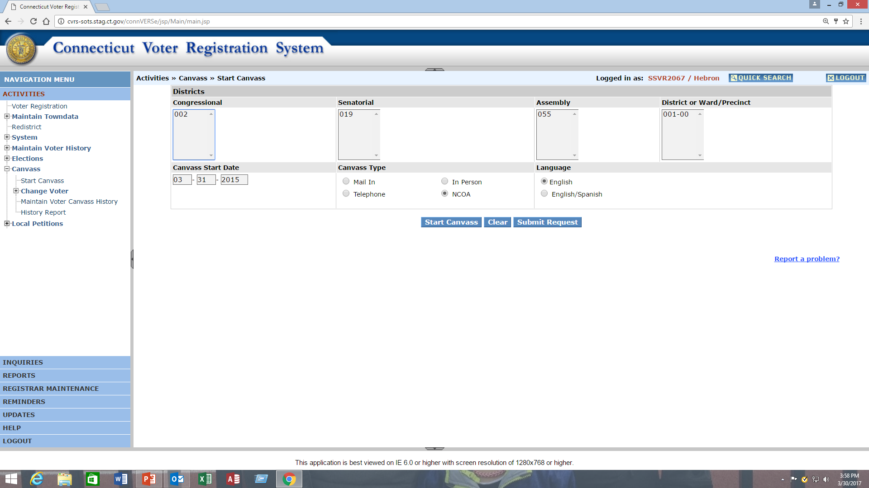
CVRS – START CANVASS

Slide 22
CVR PROCESS
The CVR update process entails the following steps:
1. Login to the CVRS as a Registrar
2. Click on the “Canvass” from the “Activities” menu and expanded menu will be displayed.
3. Click on the “CVR” from the expanded “Change Voter” menu.
4. System will navigate you to the “Voter Search” screen.
5. Enter the search criteria and click on the “Search” button to generate the search results.
6. System will display searched results, Select the voter you would like to update by selecting the radio button at front of the searched voter list. System will navigate the user to the “Change Voter” screen.
7. To record and update the change:
  a. NCOA Returned Canvass: Select “Print CVR Notice” and Reason as “Moved out of Town” to print the letters. Mail it to the voters and wait for their notice response. Do the required changes once the notice response is returned or if no response within 30 days move voter in inactive list.
  b. Voter Returned Canvass: Make the changes to the voter address and click on the “accept” button to update and save the changes.
8. To print the letters select “Print Now” or “Print Later” option.

Slide 23
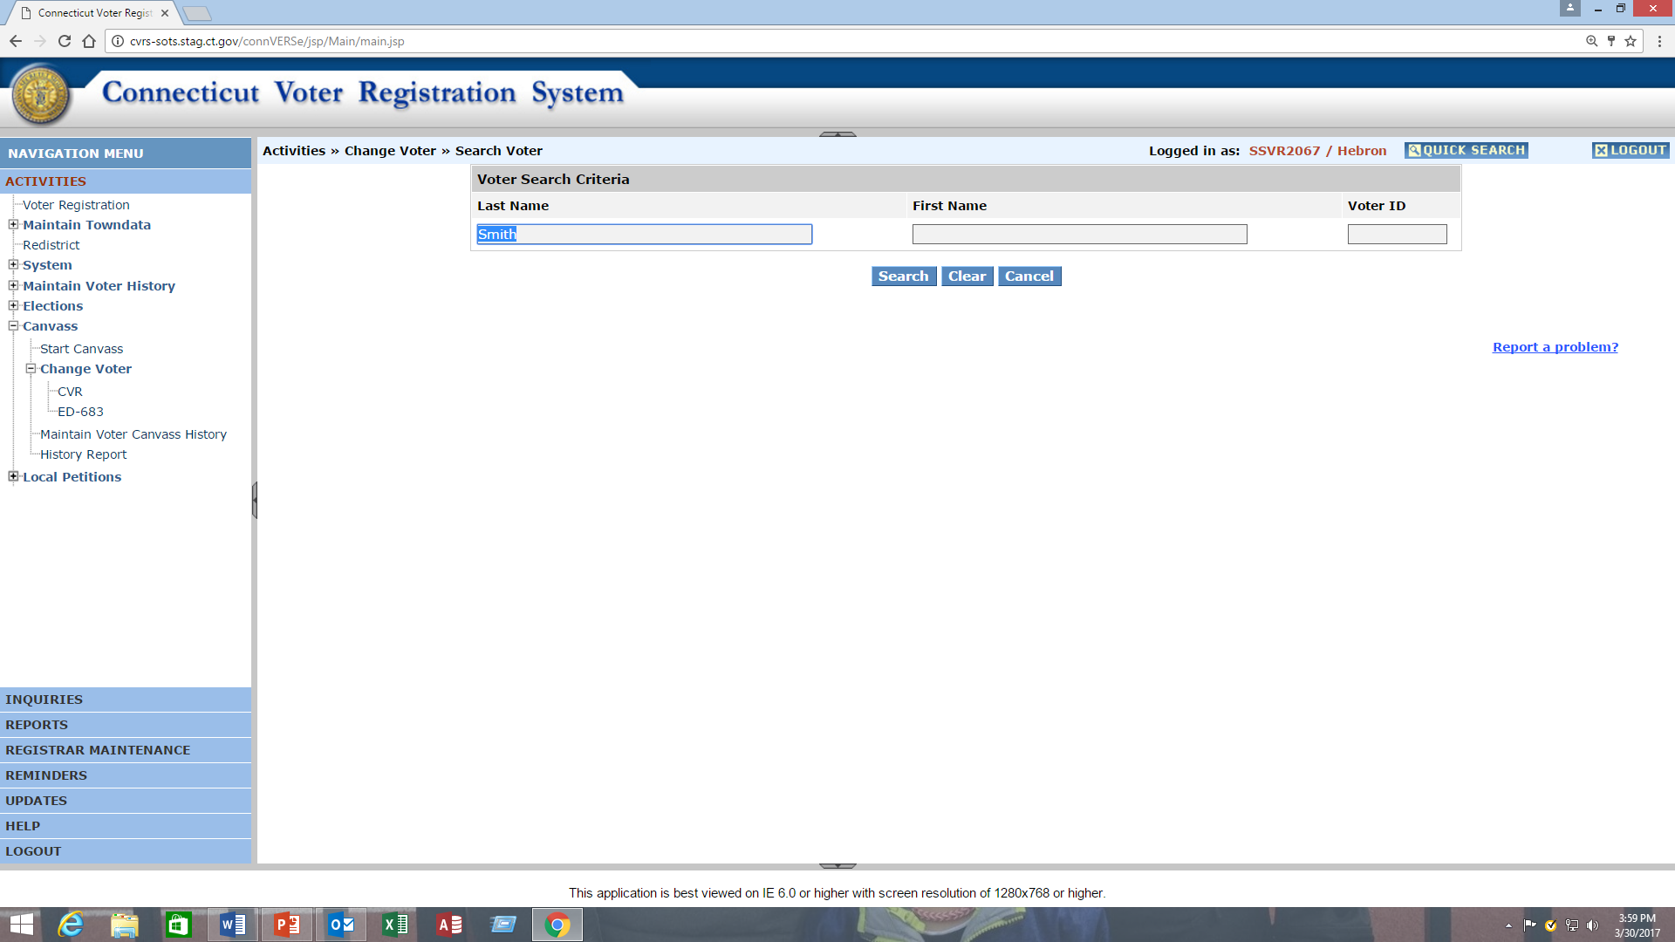
CVR PROCESS

Slide 24
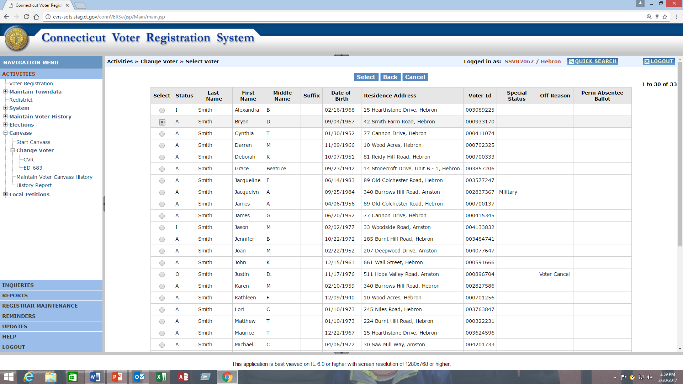
CVR PROCESS

Slide 25
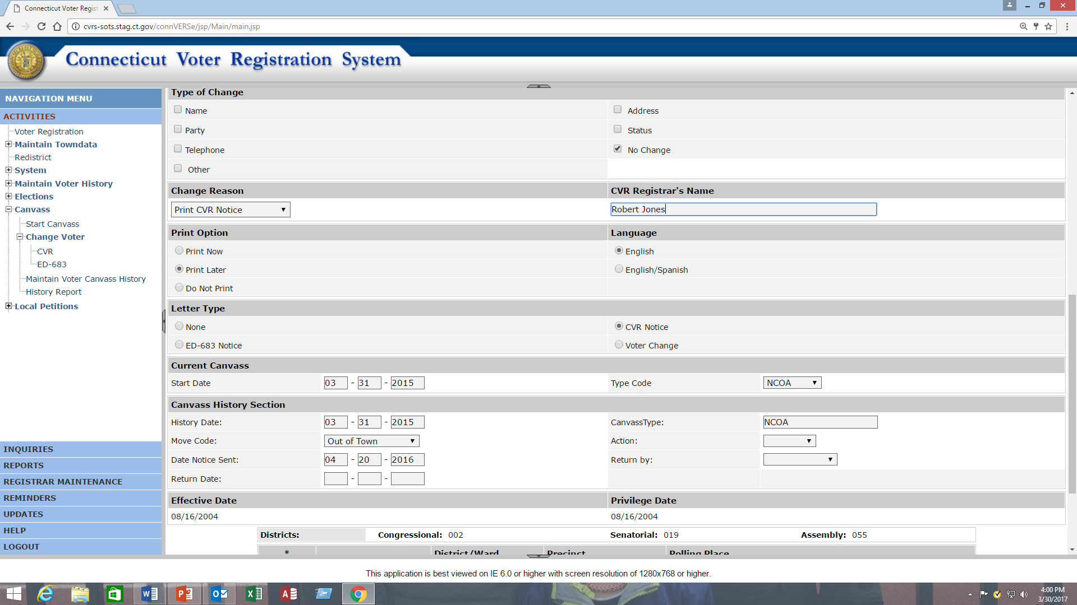
CVR PROCESS

Slide 26
MOVE WITHIN TOWN – ED 683
The ED 683 update process entails the following steps:
1. Login to the CVRS as a Registrar.
2. Click on the Canvass” from the “Activities” menu and expanded menu will be displayed.
3. Click on the “ED 683” from the expanded “Change Voter” menu.
4. System will navigate you to the “Voter Search” screen.
5. Enter the search criteria and click on the “Search” button to generate the search results.
6. System will display searched results, Select the voter you would like to update by selecting the radio button at front of the searched voter list. System will navigate the user to the “Change Voter” screen.
7. To record and update the changes:
a. NCOA Returned Canvass: Change new address in Voter record. Select “Print ED 683” and reason as “Moved within town”. Click on “accept” button to record changes and to print the letter. Mail out the ED 683 letter. User must make any new changes based on the Notice response by the voter.
b. Voter Returned Canvass: Make the changes to the voter address and click on the “accept” button to update and save the changes.
8. To print the letter either select “Print Now” or Print Later” option.

Slide 27
MOVE WITHIN TOWN – ED 683

Slide 28
MOVE WITHIN TOWN – ED 683

Slide 29
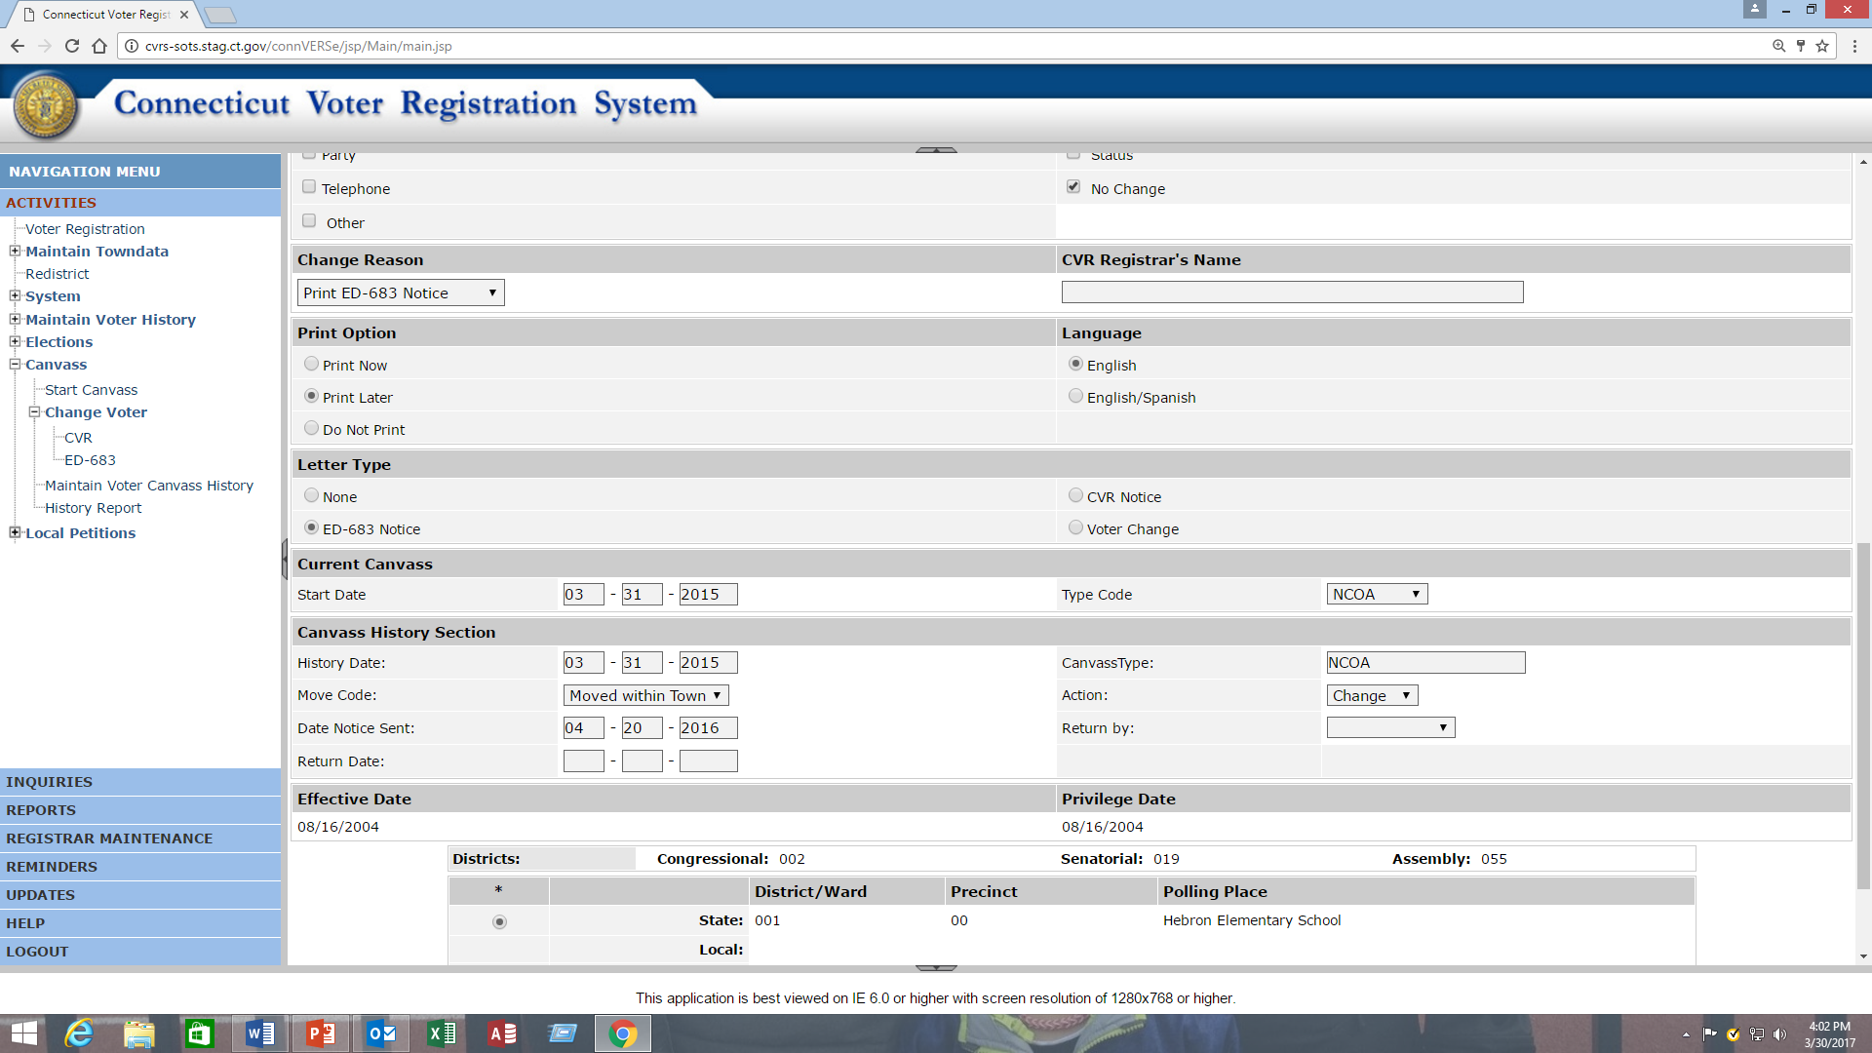
MOVE WITHIN TOWN – ED 683

