Slide 1
Election Day Registration ROVAC Fall Conference September 2018

Slide 2
What we will cover
EDR 101, (The Basics of EDR)
ID Requirements
What size staff should you have
Getting Prepared for the worst case scenarios
Informing the Public of how EDR works and when it concludes
Preparing for the 8:00 PM shut-off
What has been working for you and what hasn’t

Slide 3
Election Day Registration 101
Election Day Registration takes place only during General Elections.
Citizens will need to prove both identity as well as residency on the day of the election.
Only voters who are unregistered, registered in a different town or in off status in your town may register that day. You may want to use a greeter to redirect registered or inactive voters to the proper polling place.
The EDR location is not a polling place, however the 75ft rule still applies.
All voting stops at 8:00 pm.
An IVS machine must be set-up and ready to use that day.
Make sure your EDR location can handle a large turnout on Election Day. Also, make sure your location has access to CVRS.
Contact SOTS to find out how many connections to CVRS you are allowed.
You will need to have an educated guess on what your turnout will be that day. Do you have a college in town, or an active organization that will try to turn out the vote?
Make sure that you have given SOTS the correct phone number so that towns can cross check during the day.
Completed ballots are to be brought to your counting location by members of opposing parties.
Check to make sure that your location ADA compliant.

Slide 4
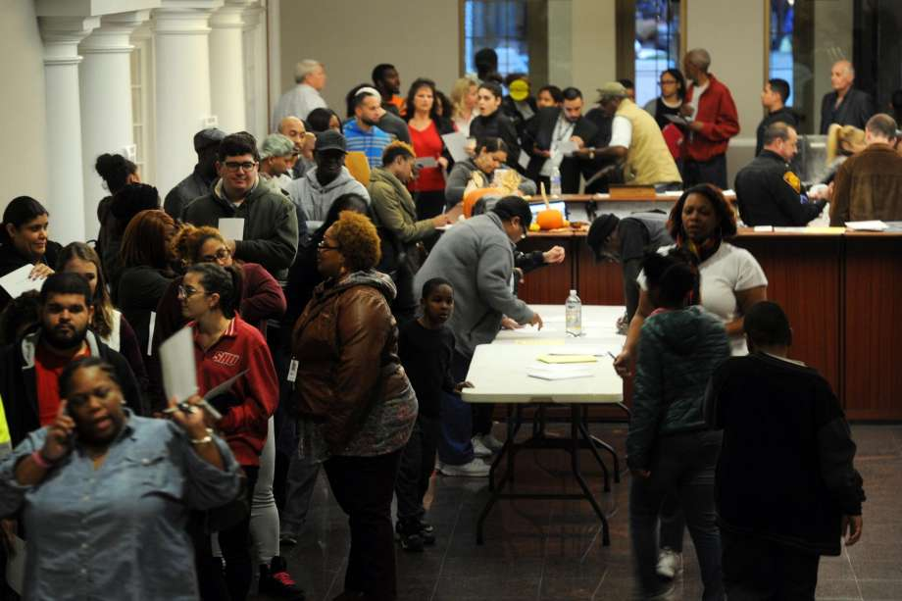
Election Day Registration 101 Cont.
Make sure to have a dedicated phone line for incoming calls from other towns.
Revisit your EDR plan each year as you may not need the same amount of staff for a Presidential Election vs. a Municipal Election.
The goal is to be prepared for this

Slide 5
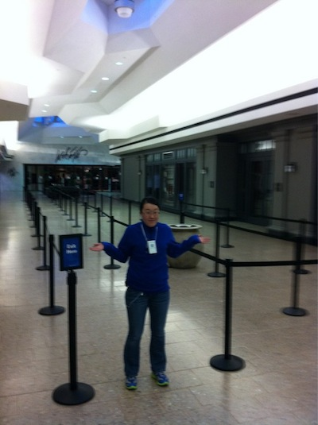
While hoping for this

Slide 6
What size EDR Staff should your location have?
Make sure to look back at what your town processed for EDR in past elections. Remember that EDR has been in place since 2013.
Small towns may not need to change what they have been doing, however medium sized towns and large cities will need to adjust.
For example, in Waterbury:
During the 2016 Presidential Election 26 people were hired to staff the EDR location
However during the 2017 Municipal Election only 6 people were needed
In 2018 we will need somewhere around 18 to 20 in order to prevent long lines

Slide 7
EDR IDENTIFICATION REQUIREMENTS
Those citizens who register to vote on Election Day MUST prove both Identity as well as residency in your town.
A current Connecticut Driver’s License or State ID issued by the Connecticut DMV that lists the citizen’s current address would be an example of an ID that proves both the citizens Identity as well as residency. If a citizen lacks this they may present the following.
The following items are acceptable proof of Identity:
Birth certificate
Driver's license
Social Security card
College and university students may present a current photo identification (ID) issued by their higher education institution in lieu of a birth certificate, driver’s license, or Social Security card
Testimony of another elector
Other satisfactory proof to the registrar of voters

Slide 8
The following items are acceptable proof of Residency:
The additional identification may include, but is not limited to a motor vehicle learner's permit, utility bill due no later than 30 days before the election, a copy of a residential lease, library card with residential address, paycheck, property tax bill, naturalization documents or passport (assuming it is recent and includes residential address).
For a college or university student, a current college or university registration or fee statement.

Slide 9
Getting Prepared for any worst case scenarios
Be aware of any hot local races that might impact your EDR operation. Campaigns could give rides to the EDR location.
Make sure your EDR staff is large enough to handle any anticipated surge of citizens coming in to vote.
Do you have a college in your town or off campus college housing? This alone could cause a long line of citizens looking to register.
Social Media pushes like Facebook could cause a last minute rush to your EDR location.
Remember that it is likely that a statewide campaign could bring in a big name celebrity or elected leader that may draw last minute citizens to your EDR location.

Slide 10
Be prepared in the event that these guys come to town

Slide 11
Informing the Public about the EDR Process / Preparing for the 8:00 PM shut-off.
It is important to inform the public ahead of time as to how the EDR process works on Election Day.
Using social media such as the towns Facebook page can let people know the hours as well as who is eligible to register to vote at the EDR location.
Medium towns and large cities may want to reach out to the media to better inform the public as to the hours and who is eligible to register that day.
You may want to hang posters at the location informing people ahead of time that all voting stops at 8:00 PM.
Larger municipalities may want to consider having a plan for security if there are large crowds throughout the day.
The better informed the public are, the less the Registrars will have to worry.

Slide 12
Example of a poster that you can display in your EDR location.

Slide 14
What’s working and what’s not?

