Slide 1
Voter List Clean-up
&
Canvass

Slide 2
Identifying Deceased Electors
Town Clerk
CVRS / Google
Social Security Death Index
Funeral Home website
Nursing Home Canvass

Slide 3
Town Clerk
Town Clerks from large towns sometimes compile a weekly death index for their town. These lists are generally emailed out.
If you have a hospital or several nursing homes in a neighboring town you may want to ask if you can be included in their weekly email blast.
Here is a copy of the weekly death index complied by the Waterbury Town Clerk. Waterbury has two hospitals and over 20 nursing homes that are populated by all of Greater Waterbury.

Slide 5
CVRS / Google
CVRS allows for you to search locally by year of birth. This option allows you to narrow down voters for online searching.

Slide 6
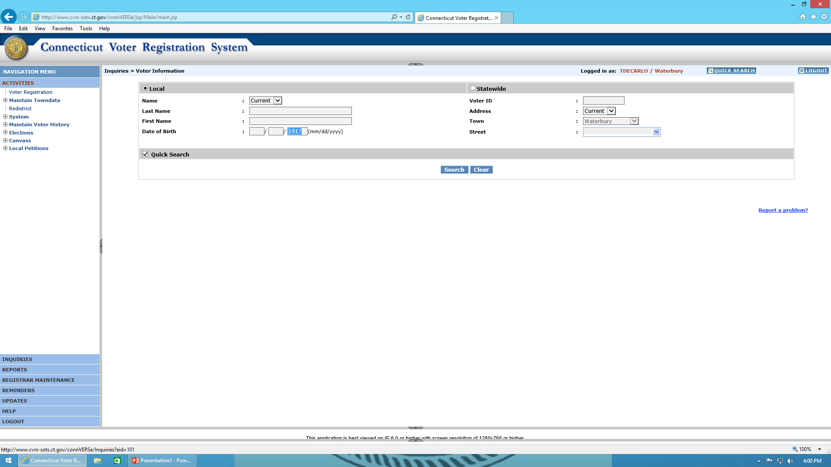

Slide 7
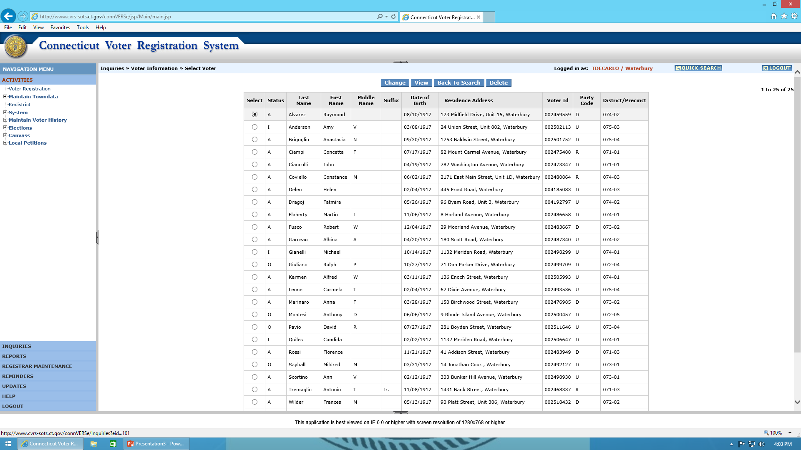

Slide 8
A quick look at the voter record will indicate if the voter is active or not.
If a voter is not active you might want to enter their name in a Google search.
Many times a quick Google search will uncover an obituary in a newspaper from another town or state.
If you’re not 100% sure you can always add the name to your next Canvass.

Slide 9
Social Security Death Index
The Social Security Death Index is a free index that you can use to search for electors.
An individual will only appear after a three year waiting period has past.
Many old voter registration cards required a full social security number.
If you find someone who passed away in another town you can always contact the Town Clerk of that town to double check.
Free access can be found here: https://www.genealogybank.com/explore/ssdi/all

Slide 10
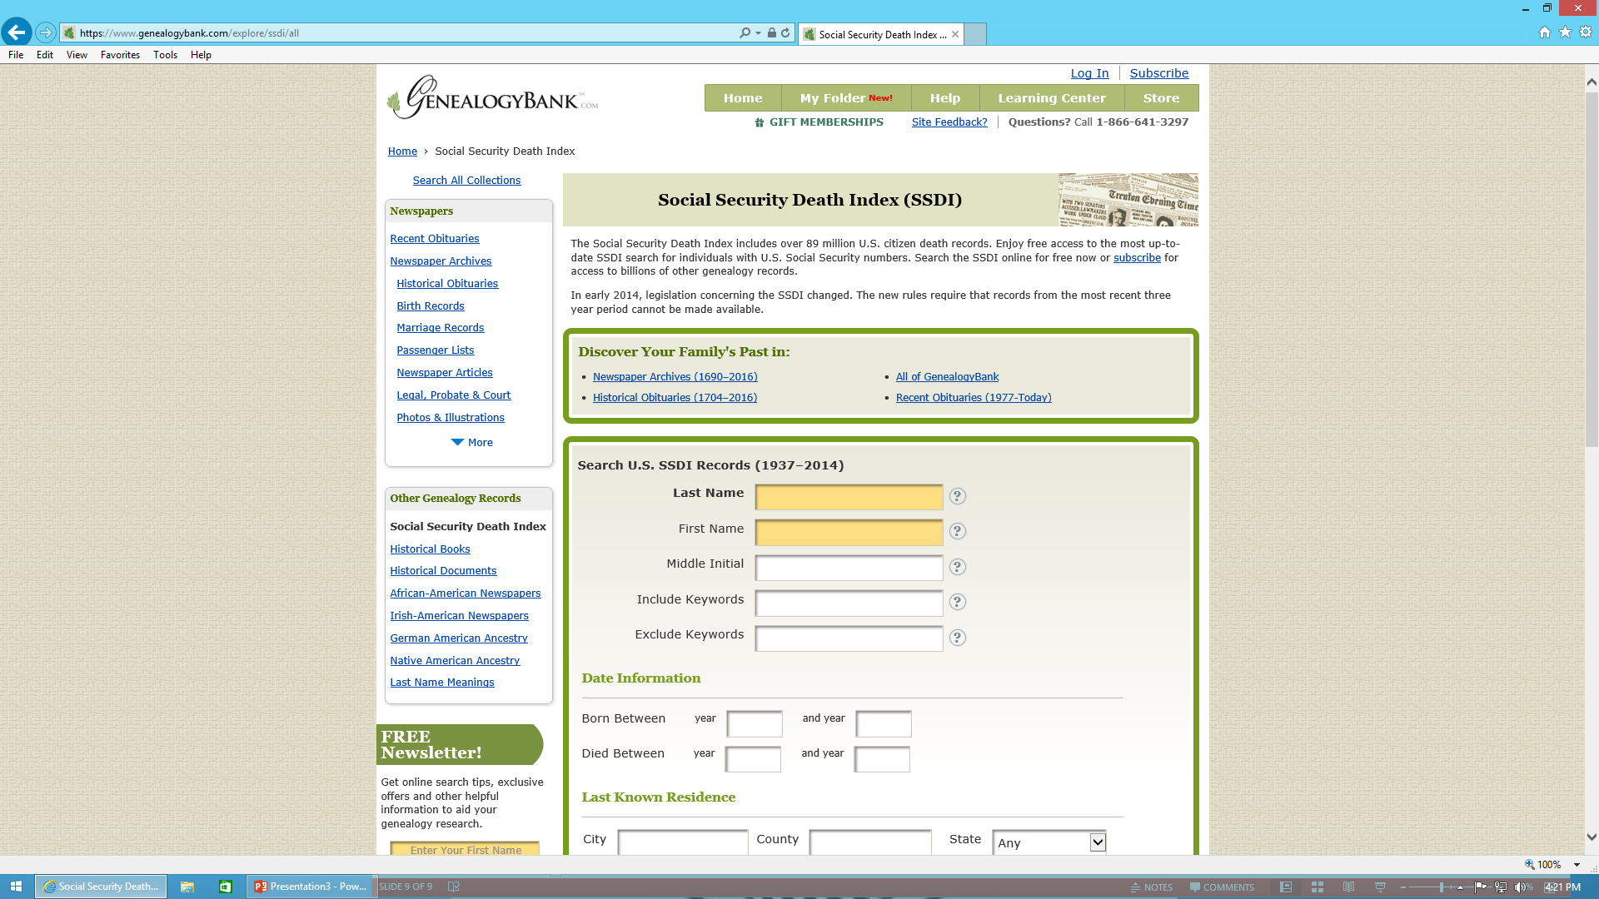

Slide 11
Identifying Active Electors who have moved
An elector who has not voted for over four years can be added to a Canvas, along with any elector who the Registrars have evidence that they no longer reside at their registered address.
Assessors Records
Returned notices from the USPS

Slide 12
Removal
There are only two ways that a voter can be removed without incident.
A voter can only be removed via a CVR Notice (ED-642)
A voter cancelation form signed by the voter
Per the Secretary of the States Office, at this time Registrars can currently include non-active voters in the Canvas, however, there is a current federal court case that could change this rule. When using this option always make sure to check with SOTS first!

Slide 13

Canvass of Electors to Determine
Change of Residence
Within Town or
Out of Town or State

Slide 14
Connecticut General Statute
Section 9-32 requires the registrars of each town to conduct a canvass of electors in person by mail or National change of Address(NCOA) system of the U.S. Postal System by Telephone or a combination of any of these.

Slide 15

Canvass by Mail
If you choose Canvass by mail the canvass must be conducted between January 1ST and May 1ST of each
The language of the Notice of Canvass by mail may not be altered as it is prescribed by regulation
If 1% of the population in your town is Hispanic the notice must be printed in English and Spanish. 9-32-3

Slide 16
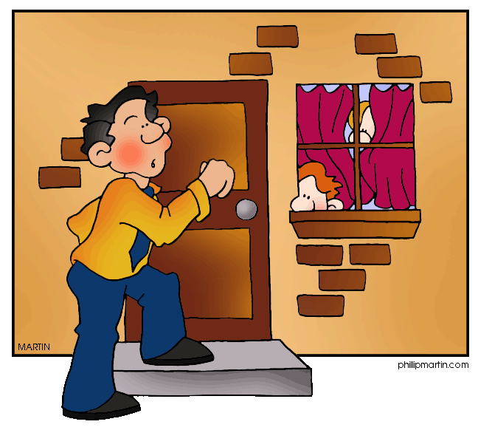

Canvass in Person or by Telephone
Regulations Conn Agencies Section 9-32-9 and Conn regulations 9-32 and 9-35 must be studied to conduct this type of Canvass
Registrar of Voters Handbook has an excellent chapter on Canvass. Best Advice is to read this before an in person or phone Canvass.

Slide 17
National Change of Address System
NCOA by the U.S. Postal System may be used if both registrars agree.
The NCOA system can only be used in towns which have a computerized registry list.
The registry list is submitted to a licensed corporation (Lorton Data ,Roast or any of the other 25 companies.

Slide 18
CVRS and Canvass
Go to Activities to start Canvass and select a Date. 01/01/201___. Best practice select the same date every year so you will remember it
The Two Confirmation of Residence letters that will be used for NCOA use are
ED-683 for those electors who have moved within your town.
ED-642 in English and Spanish for those electors who have moved out of your town or out of state.

Slide 19
Confirmation of Voting Residence
If you receive nothing back from the post office or the elector. The elector remains on the active registry list.

Slide 20
Removal from Registry list DMV
DMV removals may be made immediately except on Primary or Election . ED-684 is the prescribed form.

Slide 21
Removal from Registry without Notification
Whenever the registrar has information that an elector has died, an elector informs you in writing they have moved out of your town or whenever you receive a cancellation form you may remove that elector from the registry list without notification.
You may also send a confirmation of voting residence in the form of a friendly letter any time.

