Slide 1
Critical Infrastructure 101
Mark Listes
U.S. Election Assistance Commission

Slide 2
Topics – Questions That I’ll Answer
Cybersecurity, Elections
How did we get here?
What do we do now that we are here?
What is the EAC doing with all of this?
What is Critical Infrastructure and where did it come from?
What do I need to know about Critical Infrastructure?
Really, what is a sector?

Slide 3
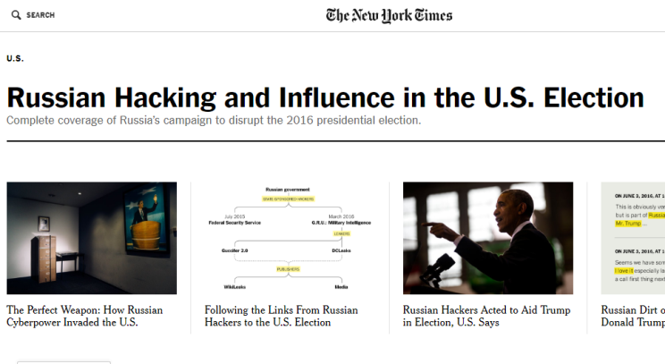
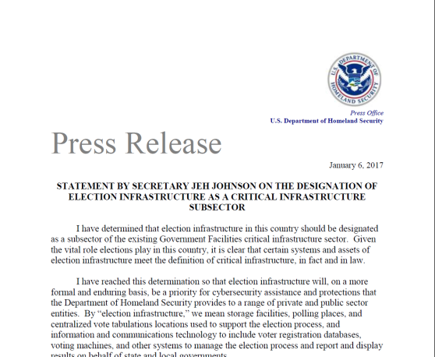
How did we get here?
Jan. 6
x193
17 GOP
CANDIDATES
Notes:
This slide is used to help set context for conversation for the audience. It displays a variety of news article headlines in chronological order, and it is intended to help the audience remember how the focus of the media has shifted from a variety of topics around the election to primarily Russia’s potential interference in the election. In researching this slide, the presenter found the New York Time’s news aggregation page for the topic of “Russia and the elections” and found that this page had 193 articles listed on it. This number is included to show how much the topic is being covered.” The Slide ends with the press release for DHS’s designation of elections as critical incfrastructure.

Slide 4
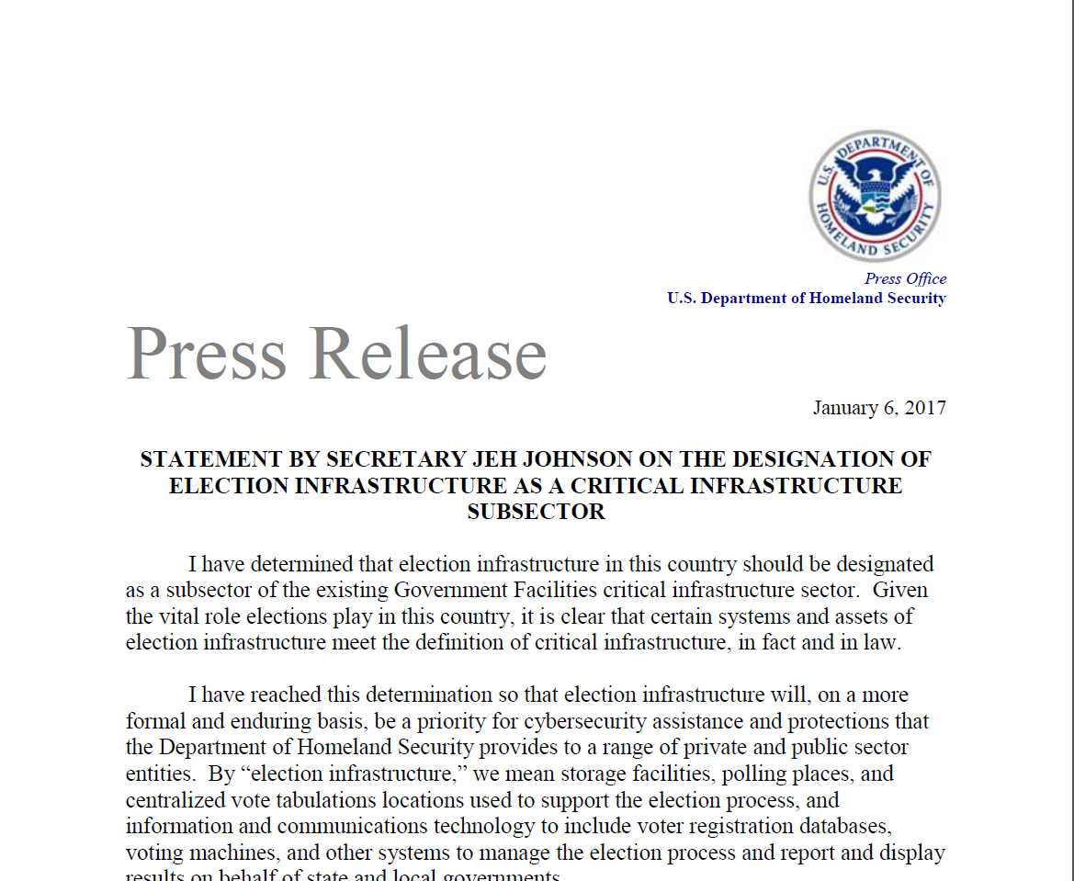
How did we get here?
DHS designates elections as critical infrastructure
DHS works to help the sector self form
DHS announces information about Russian hacking of states
The Government Coordinating Council Forms
Jan. 6
Notes:
This slide lists some important events that have happened since DHS has designated elections infrastructure as critical infrastructure on January 6.

Slide 5
So Where Are We?
~ 1 year after the election
DHS has increased the federal presence in elections
Daily Headlines About Hacking and the Elections
Things are a little bit different
We have a few more eyes watching us
We have some new terms, skills, and information that we need to know and use

Slide 6
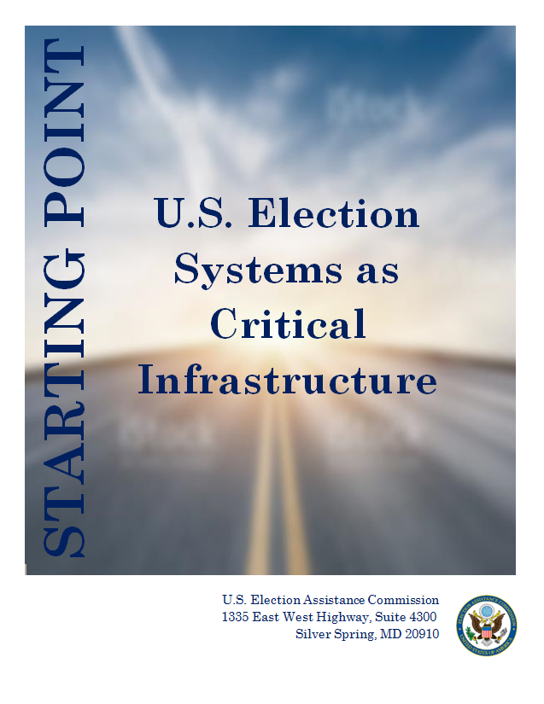
Where Do We Go From Here?
?
When the NIPP describes a SSA and its component GCC and SCCs the concept of a Co-SSA helping manage the SSP is not disallowed.
Research all that you can, and learn as much as you can so that you can engage in conversations that will affect your work in a real and meaningful way
Leverage your years of expertise and your excellent skills
Use your resources like the EAC
?
?
?
Notes:
This slide contains three recommendations for people who are learning about critical infrastructure for the first time. The graphic to the right shows a word bubble with a sentence that could be used in a critical infrastructure conversation and contains many acronyms. This sentence is used to show how complex the conversation can be. At the end of the slide, the last animation makes the EAC’s CI Starting Point Document appear over the complex sentence to indicate to the audience that the EAC’s resources help EAC stakeholders wade through the alphabet soup that is contained in CI onversations.

Slide 7
What is the EAC doing with all of this?
The EAC is dedicated to helping election officials be ready to protect their systems against modern cyber threats
We see Critical Infrastructure and the resources that come with it as one component of the larger Cybersecurity picture
We are crafting resources to address all fronts
Cybersecurity
Ongoing Cyber Best Practices and Information
Critical Infrastructure
Testing and Certification
7

Slide 8
What is CI and where did it come from?
The short answers:
What is CI?
A federal designation, made by the President (through the Secretary of DHS) stating that a type of infrastructure is critical to the function of the country
The designation primarily does two things:
Re-characterizes attacks on this infrastructure to enable the federal government to take additional steps not previously available against actors who attack this infrastructure
Prioritizes threat prevention information sharing to critical infrastructure entities and creates mechanisms that facilitate this information sharing

Slide 9
What is CI and where did it come from?
The short answers:
Where did CI come from?
Critical infrastructure is a term that has been around for a long time
The Clinton administration created the first iteration of modern CI in 1996
Created a national commission on critical infrastructure
Designated the first eight CI sectors
The current definition of comes from the Patriot act and a presidential directive (PPD-21) as:
“systems and assets, whether physical or virtual, so vital to the United States that the incapacity or destruction of such systems and assets would have a debilitating impact on security, national economic security, national public health or safety, or any combination of those matters.”

Slide 10
What is CI and where did it come from? – The timeline
HSPD-7
2017
Supersedes PPD-63
“cyber” is added to CI Definition
PPD-63
Designated federal agencies to lead sectors (SSAs)
EO 1310
Establishes national commission on CI
Establishes the original eight CI sectors
2002 Patriot Act & Homeland Security Act
Defines Critical Infrastructure
Establishes DHS
January 6: Elections Infrastructure designated as part of government facilities sector
2013
Government Facilities sector created
Builds on top of PPD-63
Increased requirements on federal departments and agencies
New definition of SSA
PPD-21 is signed initiating the process of structuring the modern CI structure through the - 2013 NIPP

Slide 11
The CI Landscape
DHS
Sectors
The Organizational Unit that represents a section of the nation’s critical infrastructure that contains entities with common traits
Department of Homeland Security: Charged with administer the National Infrastructure Protection Plan
Operational Units
Security Advisors
ISACs/ ISAOs
Sector Councils
Federal Senior Leadership
SSAs
Sector Specific Agencies: The federal agency that maintains the sector and the partnership of the councils within it & maintains the sector specific plan
Four categories of entities that make-up the CI landscape
Department of Homeland Security (DHS) – Charged with administering and managing CI as a whole
Sector Specific Agencies (SSAs) – Charged with managing a sector and its sector specific plan
Sector: The way infrastructure is categorized
Operational Units: Entities that distribute information and

Slide 12
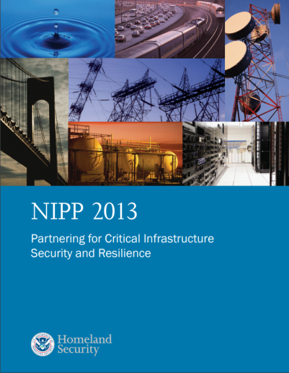
What Do I Really Need to Know About CI? – Documents to Know
Homeland Security Act
Your Sector/ Subsector’s Plan
Created DHS and empowered DHS to designate CI as well as create sectors
Sets the vision and goals for overall critical infrastructure and security and resilience efforts
This document governs how your sector is managed, maintained and shares information. There is no current elections infrastructure subsector plan

Slide 13
What Do I Really Need to Know About CI? – Key National Players
Department of Homeland Security
Charged with administering CI:
Designates infrastructure as Critical Infrastructure
Creates Sectors
Serves as many Sector’s SSA
Sector Specific Agency (SSA)
The federal agency that maintains the sector and the partnership of the councils within it
Maintains the sector specific plan
ISACs and ISAOs
Non-governmental information organizations
Protective Security Advisers & Cyber Security Advisers
DHS employee that works to help inform entities within a geographic area of threats and vulnerability mitigation information
Coordinating Council
An organizing and information sharing entity to which entities from a critical infrastructure sector belong and interact to share security information with each other and the SSA

Slide 14
Really, What is a Sector?
Questions I’ll Answer:
What is a sector?
How is a sector usually structured?
What is a Coordinating Council?
How does a sector usually operate?

Slide 15
Really, What is a Sector?
Definition: A logical collection of assets, systems, or networks that provide a common function to the economy, government or society – 2013 NIPP
What this means:
Sectors are how DHS organizes its approach to the nation’s Critical Infrastructure
If infrastructure is critical and similar to other infrastructure, then it is in the same sector
Sectors each have their own governance structure and operational protocols - each is unique

Slide 16
Really, What is a Sector? – Contents
Sectors contain relevant critical infrastructure and its owners and operators
Sectors also contain organizational mechanisms and entities that facilitate sector operation and information sharing
These are usually:
Sector Coordinating Councils
Government Coordinating Councils
ISAC
Sector/ SSA
ISAC
Councils
Sector Coordinating Council
Government Coordinating Council

Slide 17
Really, What is a Sector? How does a sector usually managed?
The Sector Specific Plan is drafted and managed by the SSA with input from the councils
This guides the sector as a whole
The councils are self-chartered and self organizing
The councils write their own rules and dictate their own membership and operations
This includes information sharing protocols
Sector Specific Plan (SSA administered)
Councils – Each self chartered and governed
Sector Coordinating Council – self chartered
Government Coordinating Council – self chartered
Contains potential working groups
Contains potential working groups

Slide 18
Sector Drilldown: What is a Coordinating Council?
General Definition: an organization to which a critical infrastructure entity, owner, or operator can belong. The coordinating councils facilitate information sharing and promote risk management efforts throughout the sector and between the sector and DHS.
Typical (but not required) Types:
Sector Coordinating Council – Represent the involved private sector entities
Government Coordinating Council – Represent the involved government entities

Slide 19
Sector Drilldown: How does a coordinating council usually operate?
Generally: The coordinating council meets regularly to discuss the state of the sector, needs of the members of the council, projected future needs, and events within the sector. The council also may usually set up working groups to explore issues.
Special Treatment: The coordinating councils may at times take advantage of CIPAC protection that allows council communications to be treated differently under FOIA
Disclaimer: The councils are self-organizing and self-governing. So, none of this is set in stone and the council charters can affect the councils’ structure and operations significantly

Slide 20
Questions?

Slide 21
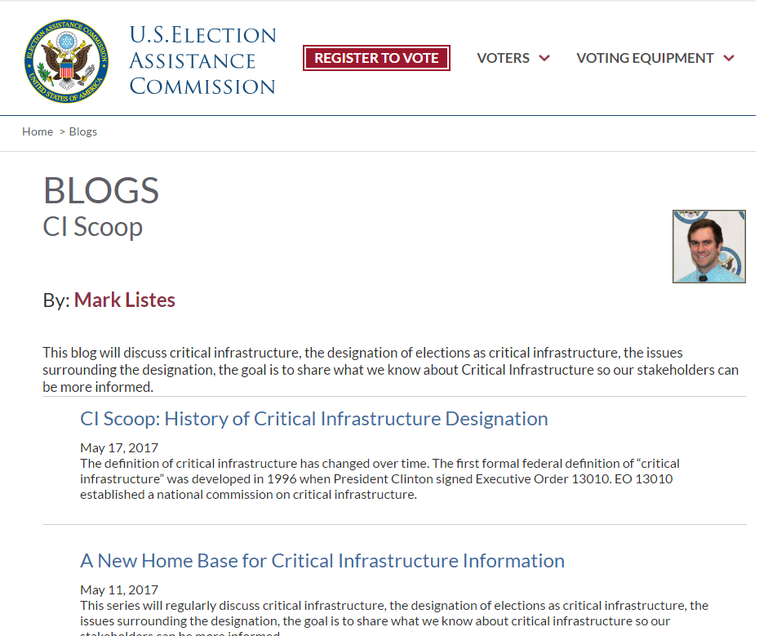
More Resources
CI Scoop – Blog
Covering all topics CI and elections as CI
Updates on the EAC and CI
Starting Point Document
6 page in-depth overview of Critical Infrastructure and Elections as Critical Infrastructure

Slide 22
Contact Us:
Mark Listes
Phone: 202-476-9051
Email: mlistes@eac.gov
U.S. Election Assistance Commission
Phone: 1-866-747-1471
Email: havainfo@eac.gov

