Slide 1

Municipal Election Calendar
November 4
2025
Veronica Rosario
Registrar of Voters
Town of East Hartford

Slide 2




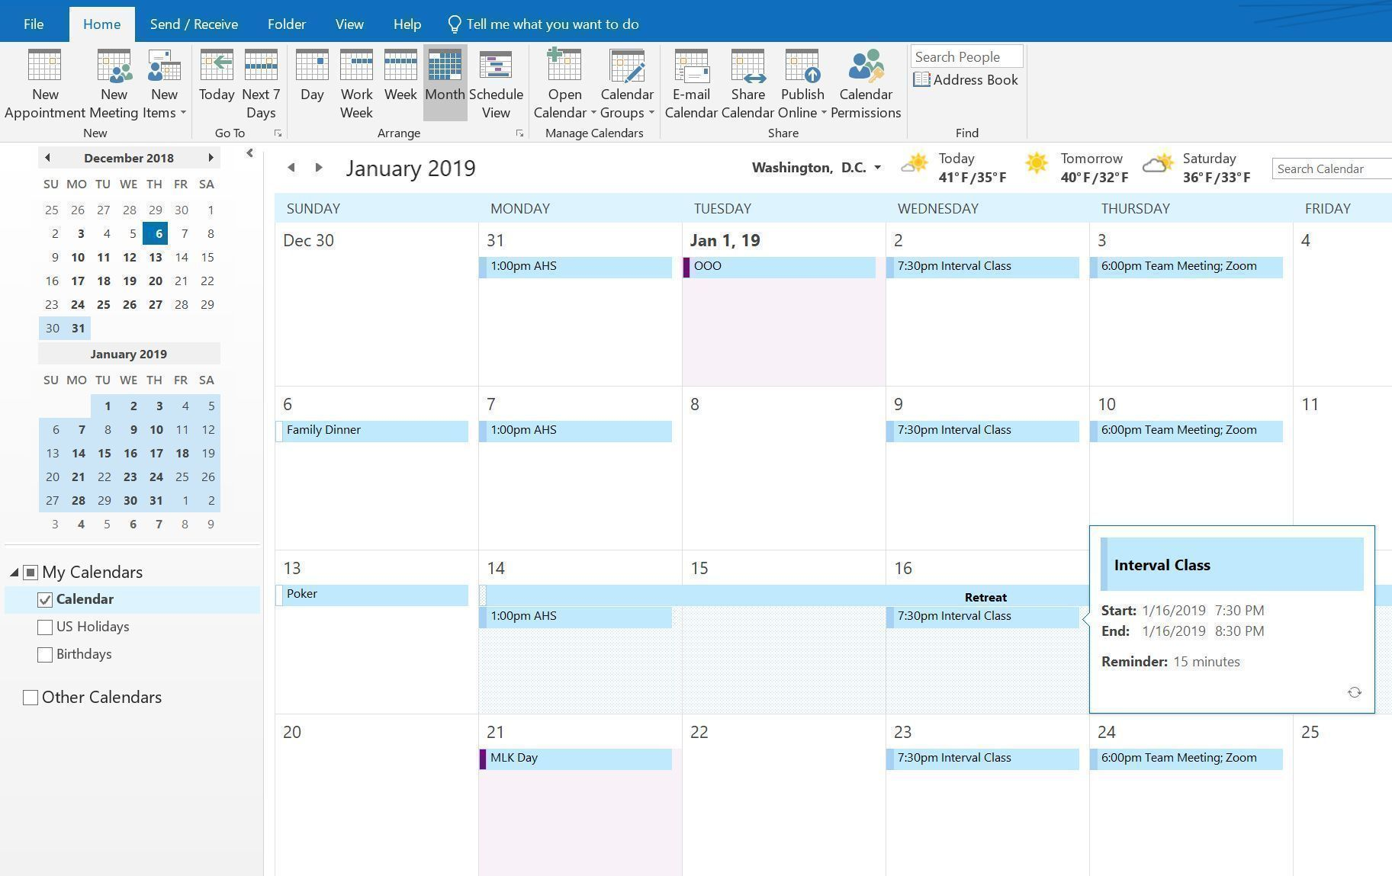




Slide 3
Event | Day | Date | Time
Canvass | Thursday through Wednesday | January 2 – April 30 | All Day
Last day to send Notice of Confirmation of Voting Residence - (SOTS Inactive) | Thursday | May 1 | End of Day
*Serialized Absentee Ballot Application Available for Primary | Wednesday | May 21
Last Day for Party Transfer | Monday | June 9 | End of Day
*Serialized Absentee Ballot Application Available for Election | Saturday | July 5
Primary Petitions Available **Party Endorsements | Tuesday through Tuesday | July 15 - July 22 | All day
*Certification of Endorsements | Wednesday | July 23 | 4:00pm
Primary Petitions | Wednesday | August 6 | 1:00pm to 4:00pm
Supervised Voting Designation | Wednesday through Tuesday | August 6 – September 2 | Choose one day
*Town Clerks / **Political Parties / ***Head Moderator: responsibility but good to know

Slide 4
Event | Day | Date | Time
Notice of 18th day before Primary Day Registration Session (August 22) | Thursday through Saturday | August 7 – August 17 | Pop. Over 25,000 Published at least once/not legal notice
Certification of Polling Places (EMS)/Deadline Early Voting Plan for Primary | Friday | August 8 | End of Day
List of Primary Officials | Monday | August 18 | Registrar must notify all candidates of their right to submit a list of designees
*Absentee Ballots Available for Primary/Central Counting AB's/Certificate of Ballot Order (EMS) | Tuesday | August 19 | Must designate in writing to Town Clerk End of Day
Registration and Enrollment Cut-Off (Mail-In) | Friday | August 22 | Postmarked by this date Can be received until 12:00pm on Sept. 8
Primary Enrollment Session | Friday | August 22 | At least 2 consecutive hours between 12:00pm to 9:00pm
Testing of Tabulators and IVS Machines/Enrollment List | Friday | August 29 | 10 days before Primary
Absentee Ballot Check-Off (Primary) | Tuesday | September 2 | 11:00am
*Town Clerks / **Political Parties / ***Head Moderator: responsibility but good to know

Slide 5
Event | Day | Date | Time
Early Voting Primary | Tuesday through Sunday | September 2 - September 7 | 10:00am to 6:00pm
Early Voting Extended Hours | Tuesday and Thursday | September 2 / September 4 | 8:00am to 8:00pm
Deadline for Submitting Certified Early Voting Plan for Election | Friday | September 5 | End of Day
Supervised Voting Deadline/In-Person Registration/Enrollment List | Monday | September 8 | End of Day
Primary | Tuesday | September 9 | 5:15am to 8:00pm+
***Head Moderator Return | Wednesday through Friday | September 10 - 13 | End of Day
Tabulator Lockdown/High School Registration Information | Tuesday | September 23 | Last day of tabulator "lockdown"
Notice of 18th day before Election Day Registration Session (October 17) | Thursday through Saturday | October 2 – October 12 | ALL TOWNS Published at least once/not legal notice
*Town Clerks / **Political Parties / ***Head Moderator: responsibility but good to know

Slide 6
Event | Day | Date | Time
Certification of Polling Places for Election/Certification of Ballots Order/ *Absentee Ballots Available/Deadline for Finalizing Early Voting Plan Election | Friday | October 3 | End of Day
Deadline to File Tabulator Report | Monday | October 6 | End
Sample Ballots | Friday | October10 | Last day for registrar of voters to file with Secretary of the State sample of completed ballot
Central Counting Absentee Ballots/Election Officials | Wednesday | October 15 | Last day for registrars of voters to notify municipal clerk in writing whether absentee ballots will be counted centrally or at polling location
Registration by Mail – Election Deadline – Application/ | Friday | October 17 | Hand-delivered mail-in registration applications, DMV or a voter registration agency and mailed mail-in registration applications must be postmarked by this date
Eighteenth day Before Election Day Registration Session. |  |  | All mail-in voter registration applications must be received or post-marked by this date. Hours: 9:00 a.m. to 8:00 p.m. Note: 11:59 p.m. on this date is also the deadline to register to vote using the On-line Voter Registration System
*Town Clerks / **Political Parties / ***Head Moderator: responsibility but good to know

Slide 7
Event | Day | Date | Time
Notice of Limited Registration Session to be Held on the Last Weekday Before Election (November 3) | Sunday-Wednesday | October 19 - October 29 | ALL TOWNS Published at least once/not legal notice
Early Voting and SDR | Tuesday through Sunday | October 20 - November 2 | 10:00am to 6:00pm
Early Voting Extended Hours | Tuesday and Thursday | October 28 / October 30 | 8:00am to 8:00pm
Voting machines | Tuesday | October 23 | Last day of tabulator "lockdown"
Absentee Ballot Check-Off | Tuesday | October 28 | 11:00am
Registry List/Supervised Balloting Deadline/Limited Registration Session | Monday | November 3
Election | Tuesday | November 4 | 5:15am to 8:00pm+
Voting Machine | Tuesday | November 18 | Last day of tabulator "lockdown"
***Head Moderator Return | Thursday - Monday | November 6 - November 10 | End of Day
*Town Clerks / **Political Parties / ***Head Moderator: responsibility but good to know

Slide 8


