Slide 1
FOI 101: A Crash Course In The FOI Act
Connecticut Freedom of Information Commission
Russell Blair – Director of Education & Communications
860-256-3968 | russell.blair@ct.gov

Slide 2
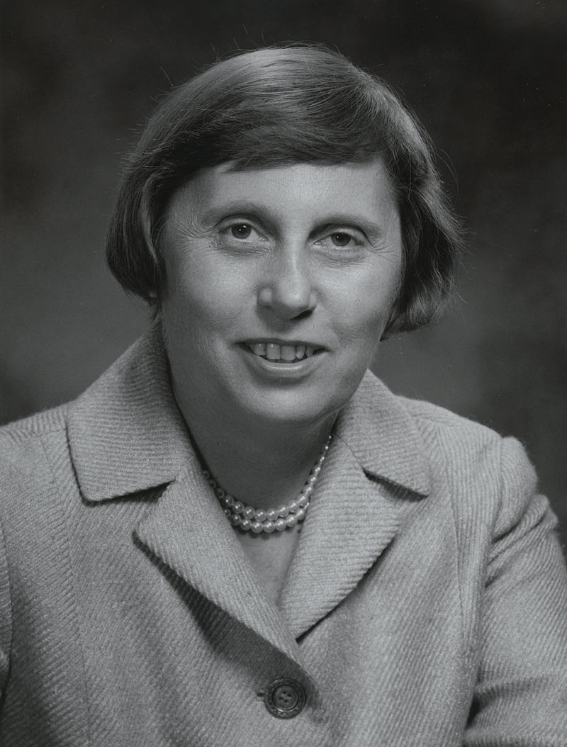
Brief History Of The FOIA
“The legislature finds and declares that secrecy in government is inherently inconsistent with a true democracy, that the people have a right to be fully informed of the action taken by public agencies in order that they may retain control over the instruments they have created; that the people do not yield their sovereignty to the agencies which serve them; that the people in delegating authority do not give their public servants the right to decide what is good for them to know.” — Freedom of Information Act Preamble, Oct. 1, 1975
Connecticut Gov. Ella Grasso

Slide 3
FOIA Basics
The Freedom of Information Act grants public access to meetings and records of public agencies
Public agencies cannot be required to answer questions, conduct research or produce documents that don’t exist
FOIA does not give the public the right to participate (speak) at a meeting, just to attend
The Freedom of Information Commission settles disputes that arise when citizens believe agencies are not following the law through complaints and contested case hearings

Slide 4
What is a Public Agency?
“Public agency” or “agency” means: (A) Any executive, administrative or legislative office of the state or any political subdivision of the state and any state or town agency, any department, institution, bureau, board, commission, authority or official of the state or of any city, town, borough, municipal corporation, school district, regional district or other district or other political subdivision of the state, including any committee of, or created by, any such office, subdivision, agency, department, institution, bureau, board, commission, authority or official
Board of Trustees of Woodstock Academy v. FOIA (1980): Created “functional equivalent” test
  Whether the entity performs a government function
  The level of government funding
  The extent of government involvement or regulation, and
  Whether the entity was created by government

Slide 5
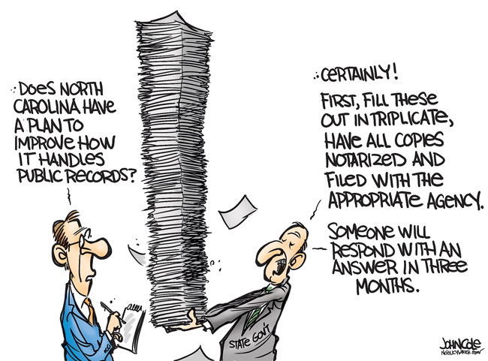
Records

Slide 6
Public Records, Definition In FOI Act
“Public records or files” means any recorded data or information relating to the conduct of the public's business prepared, owned, used, received or retained by a public agency, or to which a public agency is entitled to receive a copy by law or contract under section 1-218, whether such data or information be handwritten, typed, taperecorded, videotaped, printed, photostated, photographed or recorded by any other method.
Except as otherwise provided by any federal law or state statute, all records maintained or kept on file by any public agency, whether or not such records are required by any law or by any rule or regulation, shall be public records and every person shall have the right to (1) inspect such records promptly during regular office or business hours, (2) copy such records in accordance with subsection (g) of section 1-212, or (3) receive a copy of such records in accordance with section 1-212.

Slide 7
Public Records, Overview
Public can inspect records at no charge
You can charge for paper copies at 50 cents per page (cities & towns) or 25 cents per page (state agencies); can also charge for digital storage (USB drive, DVD); if more than $10 is owed you can collect the fee up front
$20 per session fee for portable scanner (not cellphone)
Can’t charge for copies of electronic records expect in special circumstances
No requirement that a specific form be used
Agencies do not have to answer questions, do research or create records that don’t already exist

Slide 8
How Long Do I Have to Fulfill A Request?
Must acknowledge records requests within 4 business days
Must fulfill record requests “promptly.”
Advisory Opinion No. 51: Without undue delay. FOI a primary duty.
Consider: the volume of records requested; the amount of personnel time necessary to comply with the request; the time by which the requestor needs the information contained in the records; the time constraints under which the agency must complete its other work; the importance of the records to the requester, if ascertainable; and the importance to the public of completing the other agency business without the loss of the personnel time involved in complying with the request

Slide 9
Exemptions, Exceptions
Exemptions: Permissive (optional), Sec. 1-210
Exceptions: “Except as otherwise provided by any federal law or state statute.”
  Federal laws: FERPA
  Other state statutes (examples)
    CGS § 10-151c: Public school teacher evaluations
    CGS § 1-82a: Ethics complaints (prior to probable cause finding)
    CGS § 36a-21: Department of Banking records

Slide 10
Examples Of FOI Exemptions In 1-210
  Preliminary drafts/notes
  Personnel or medical files that would be an invasion of privacy if disclosed
  Certain law enforcement records
  Records relating to pending claims/litigation
  Trade secrets
  Test questions, scoring keys and other examination material
  Real estate appraisals while acquisition of a property is pending
  Records related to collective bargaining strategy/negotiation
  Records protected by attorney-client privilege
  Information obtained by use of illegal means
  Whistleblower complaints
  Adoption records
  Plans/records that pose a security risk
  Responses to bid solicitations, RFPs (until contract is awarded)

Slide 11
Personnel Files
Only exempt if there is an invasion of personal privacy
Two-part test: Highly offensive and not a matter of public concern (Perkins v. FOIC, 1993)
If there is a privacy concern, contact the employee, they have the right to request the records be withheld

Slide 12
Preliminary Drafts/Notes
“Preliminary drafts or notes” relates to advisory opinions, recommendations and deliberations comprising part of process by which government decisions and policies are formulated; they reflect that aspect of the agency's function that precedes formal and informal decision making
Public interest in withholding documents must outweigh public interest in disclosure

Slide 13
Security Risk
Agencies do not have to release records “when there are reasonable grounds to believe disclosure may result in a safety risk.”
State agencies: Consult with the Commissioner of the Department of Administrative Services
Cities/towns: Consult with the State Police
Judicial: Chief Court Administrator makes the call
Legislative: Executive director of legislative management decides

Slide 14
Attorney-Client Privilege
Records privileged by the attorney-client relationship can be withheld
Following factors need to be met (Shew v. FOIC, 1997):
  The attorney must be acting in a professional capacity for the agency
  The communications must be made to the attorney by current employees or officials of the agency
  The communications must relate to the legal advice sought by the agency from the attorney
  The communications must be made in confidence

Slide 15
Trade Secrets
Agencies not required to release trade secrets (includes formulas, programs, devices, methods, cost data, customer lists, etc.)
Trade secrets can belong to a third-party business or a public agency
Must derive independent economic value from not being known/accessible
Entity owning trade secret must take reasonable efforts to maintain secrecy

Slide 16
Vexatious Requestors
CGS § 1-206 (b): Cities/towns/agencies can petition the FOIC for relief from “vexatious requestors”
Consider: Number of requests filed; scope of the requests; nature, content, language or subject matter of the requests; nature, content, language or subject matter of communications to the agency; pattern of conduct that amounts to an abuse of the rights granted under FOI
Executive Director determines whether a hearing is warranted; Commission decides to grant or deny petition
Requestors can be barred from making requests for up to a year; they can appeal in Superior Court

Slide 17
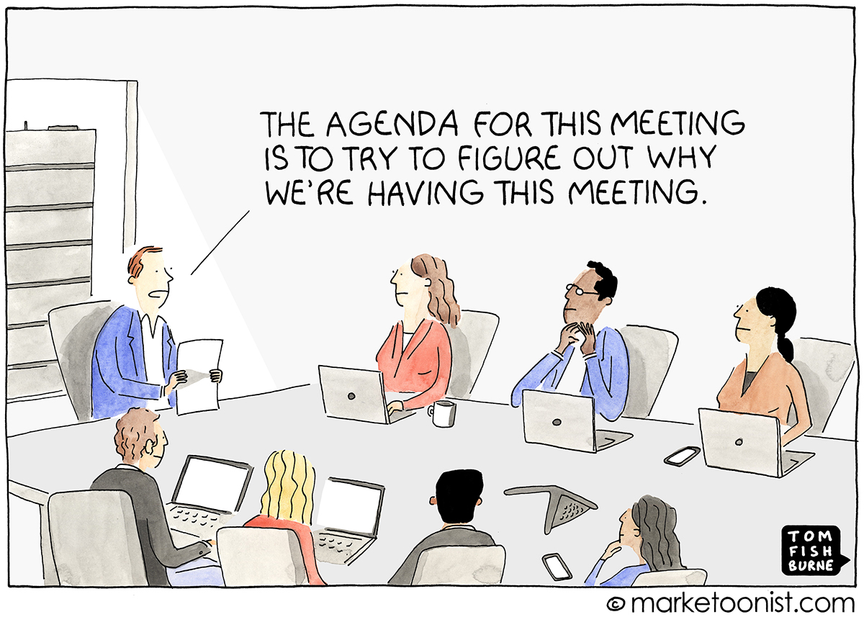
Meetings

Slide 18
Meetings, Overview
“Meeting” means any hearing or other proceeding of a public agency, any convening or assembly of a quorum of a multimember public agency, and any communication by or to a quorum of a multimember public agency, whether in person or by means of electronic equipment, to discuss or act upon a matter over which the public agency has supervision, control, jurisdiction or advisory power. – Sec. 1-200, CT General Statutes
Anybody can attend (no required sign up); boards set their own rules for public comment
Meetings may be photographed, recorded or broadcast
Agendas must fairly apprise the public on what will be discussed

Slide 19

Email & Meetings
From meeting definition: “whether in person or by means of electronic equipment”
OK to discuss items to add to agenda, or scheduling matters
Back-and-forth debate over issues should be saved for public meeting

Slide 20
Regular Meeting vs. Special Meeting
Meetings according to regular schedule filed with your municipality or the state
Notice/agenda required at least 24 hours in advance
By a 2/3 vote items can be added to the agenda during the meeting
Minutes must be filed within 7 calendar days
Meetings outside of your regular schedule
Notice/agenda required at least 24 hours in advance AND must be posted on website
Additional items CANNOT be added to the agenda during the meeting
Minutes must be filed within 7 business days

Slide 21
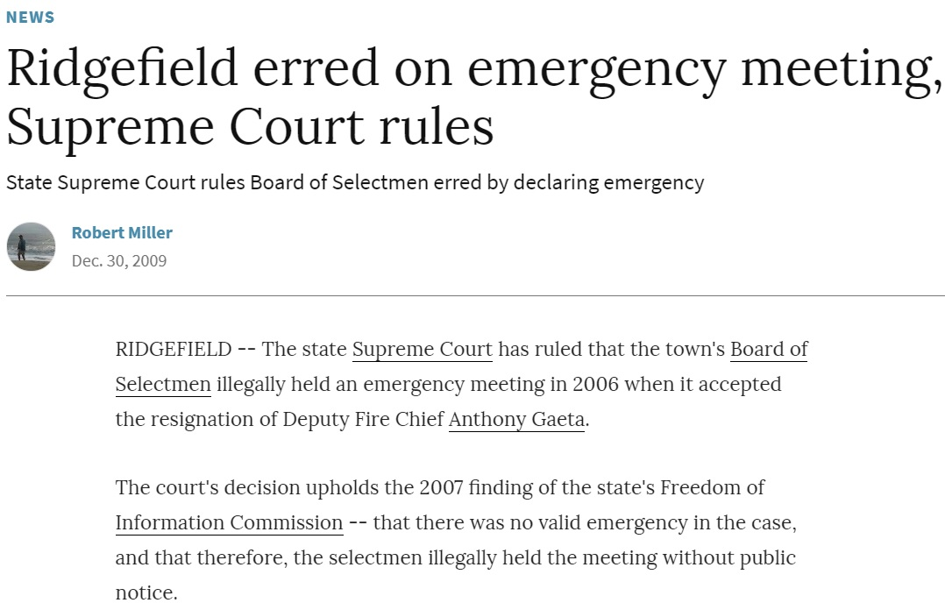
Emergency Meetings
Must only be called if there is a bona fide emergency that cannot wait 24 hours
No notice or agenda is required
Only emergency matters may be considered
Minutes must be filed within 72 hours of the meeting, posted online and state the reason for the emergency
"A situation must be unexpected and it must demand immediate action such that it is impossible for the public agency to give 24 hours notice of a meeting.“— Board of Selectmen of the Town of Ridgefield vs. Freedom of Information Commission (2010)

Slide 22
When Is A Meeting Not A Meeting?
The Freedom of Information Act carves out exemptions to its meeting requirements for the following:
Personnel search committees for executive-level employees
Strategy or negotiations related to collective bargaining
Caucuses
Staff meetings
Chance/social meetings

Slide 23

Minutes
Requirements: record of who voted for what or for whom, who was in attendance at the meeting and who attended any executive sessions
Must be available within 7 days of the meeting (draft minutes are OK)
Still required even if a recording of a virtual meeting is posted

Slide 24
Electronic/Remote Meetings
Regular meetings: Require 48-hour notice with instructions to attend; agenda can come 24 hours before
Special meetings: Require 24-hour notice with agenda
Online-only regular meetings must be recorded and posted on the agency’s website within 7 days and available for at least 45 days
You must still submit minutes, even if a recording is available
Online participants can be kicked out if they are being disruptive (same as at an in-person meeting)

Slide 25
Executive Session
It’s OK to meet behind closed doors for five specific reasons:
Personnel matters (Person being discussed can request open session)
Pending claims or litigation
Security
Sale or lease of property
Discussion of records exempt from FOIA
Must vote by 2/3 to go into Executive Session
Meetings still require notice/agenda (try to be specific)
You cannot vote during Executive Session
Staff can be invited in to assist; do not create a second audience

