Slide 1


ROV vs EXCEL

Slide 2
Agenda
PDF to Spreadsheet
Text to Columns
Spacing
Freeze Panes
Format
Find/Replace
Hide/Unhide
Merge Cells
Add/Remove/Copy/Paste
Find/Replace
Print/Protect
Views

Slide 3
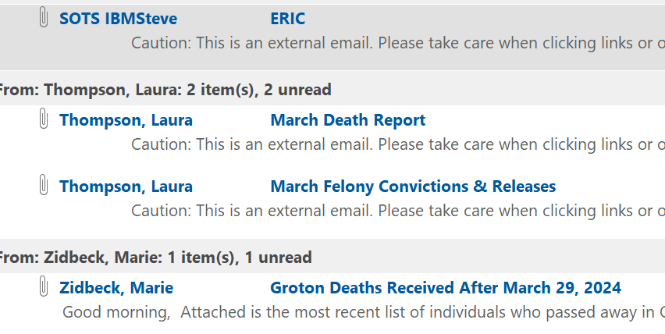
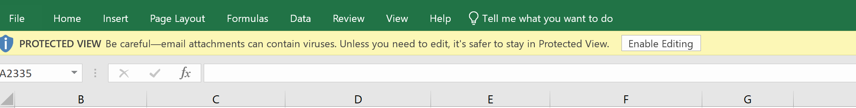
Oh no!
Now what do I do??
** HINT
Open Existing Excel Spreadsheet
Enable Editing

Slide 4
Excel
from
PDF
Data is PDF??
Click and Drag to Highlight all info on Page
Right Click / COPY
Go to new sheet Rt click / PASTE

Slide 5
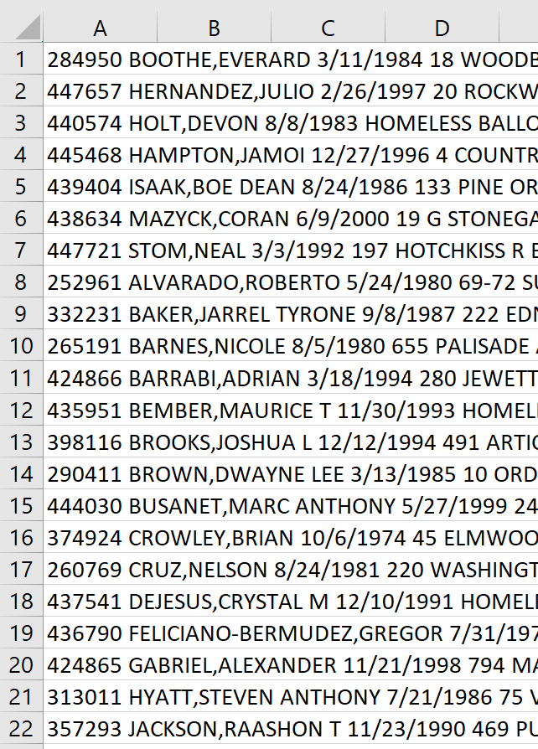
What the Heck is this??
Comes From
SOTS Incarcerations
PDF Copying
“Disk File” etc.
USE
“Text to Columns”

Slide 6
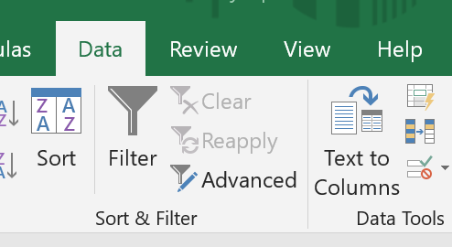
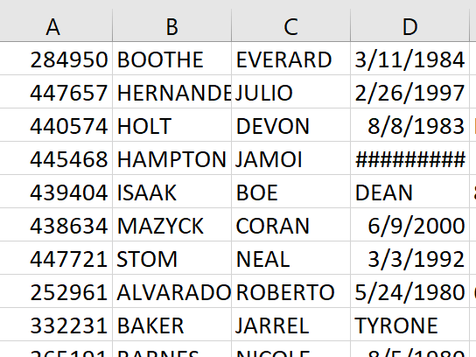
Text into Columns
From This
Highlight Column A
Click Data Tab
Click Text to Columns
To This

Slide 7
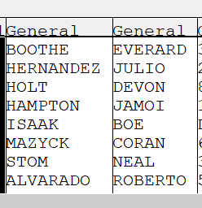
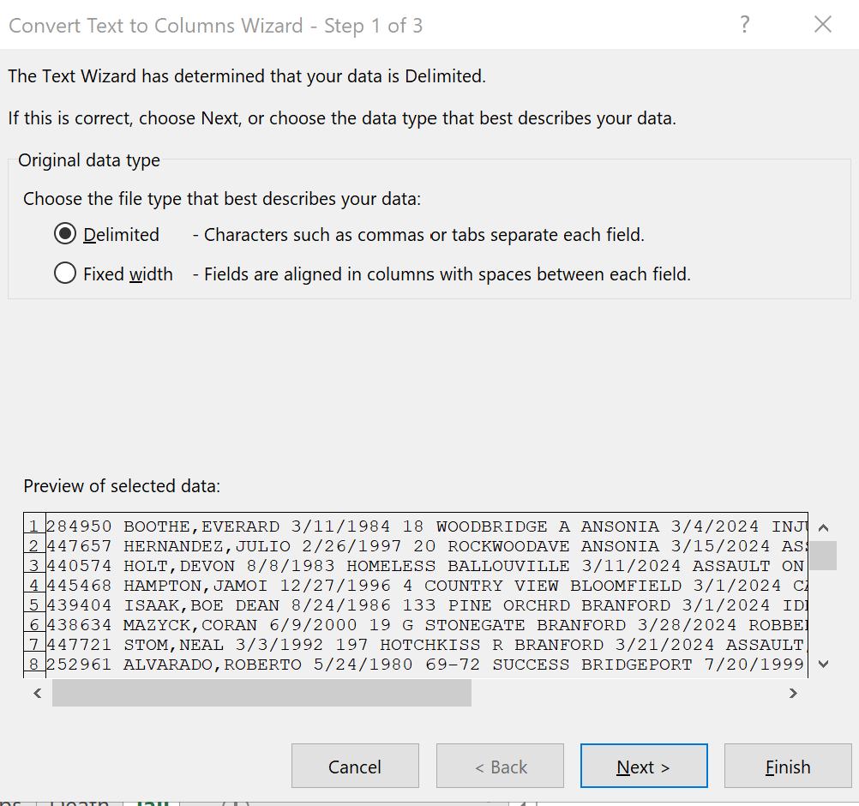
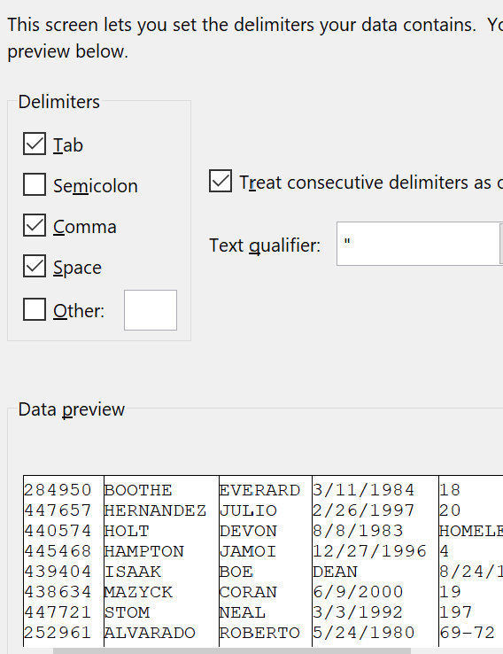
6
Information into Columns
3
1
4
7
Finish
2
5
Next

Slide 8
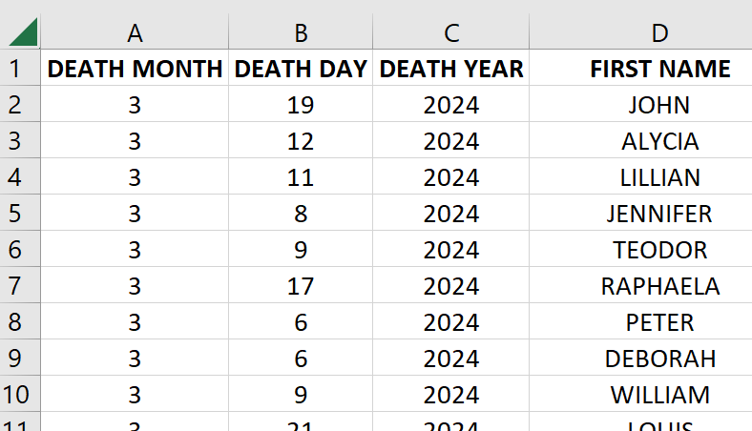
Spacing
Auto Sizing
Highlight Spreadsheet with Arrow
Double Click - Height/Width Line
All Columns Same Width?
Highlight all columns at A,B,C etc and click on the line and drag to size you want
All Columns Same Height?
Highlight all rows at 1,2,3 etc and click on the line and drag to size you want

Slide 9
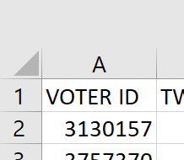
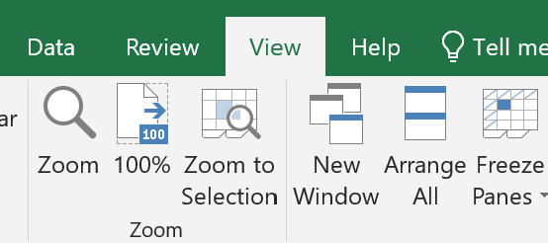
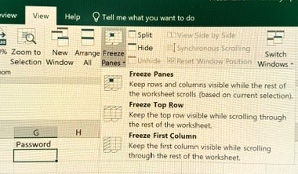
Freeze
In View Tab
Click on spreadsheet in 2A
Click arrow below freeze panes
Click on freeze top row

Slide 10
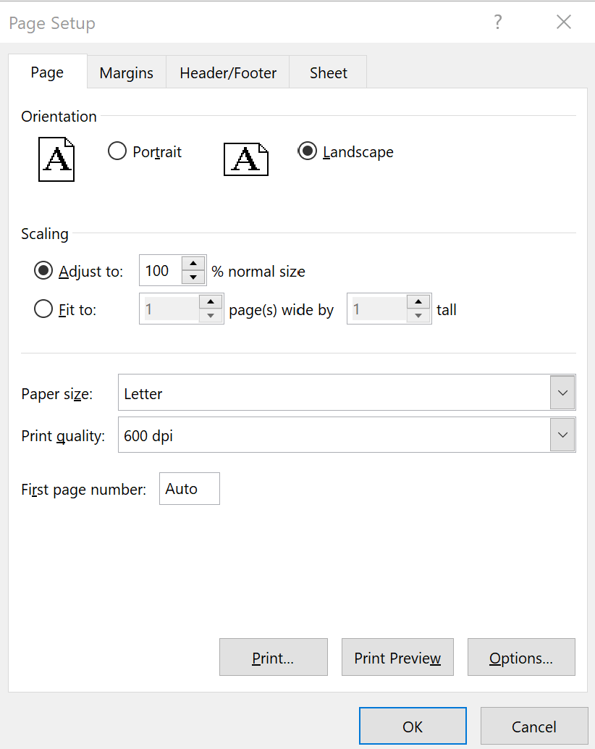
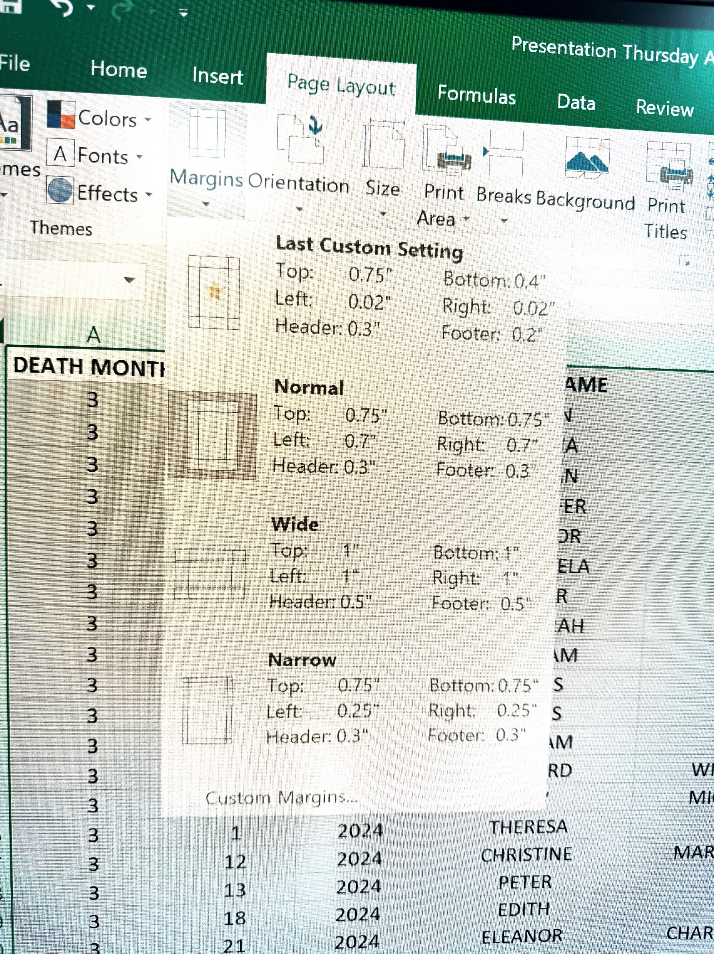
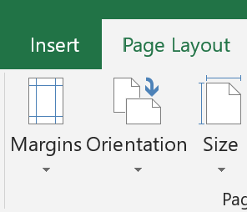
Page Set Up
Click Page Layout
Click Arrow under Margins
Custom Margins

Slide 11
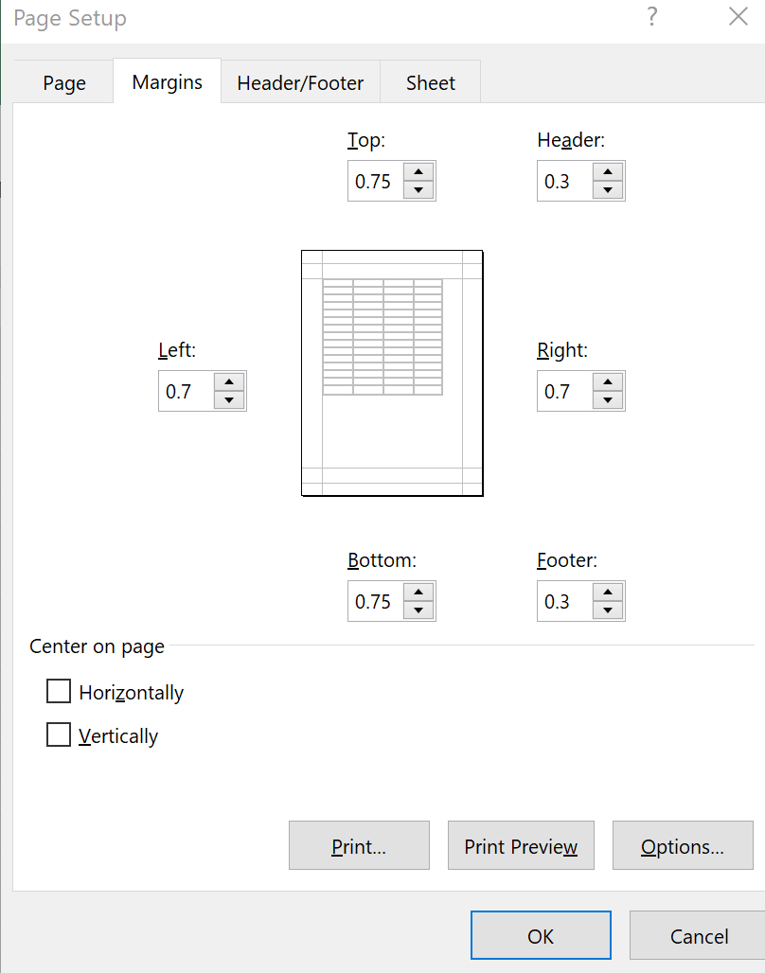
Margins
Click Margins
If you want a header/footer choose top as displayed
Click Left / Right .2 will fit on the page
Center on Page?

Slide 12
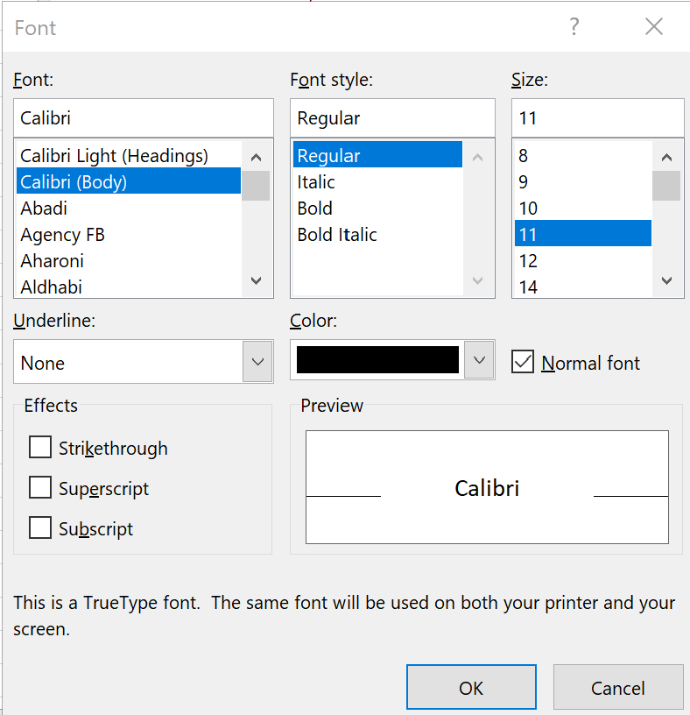
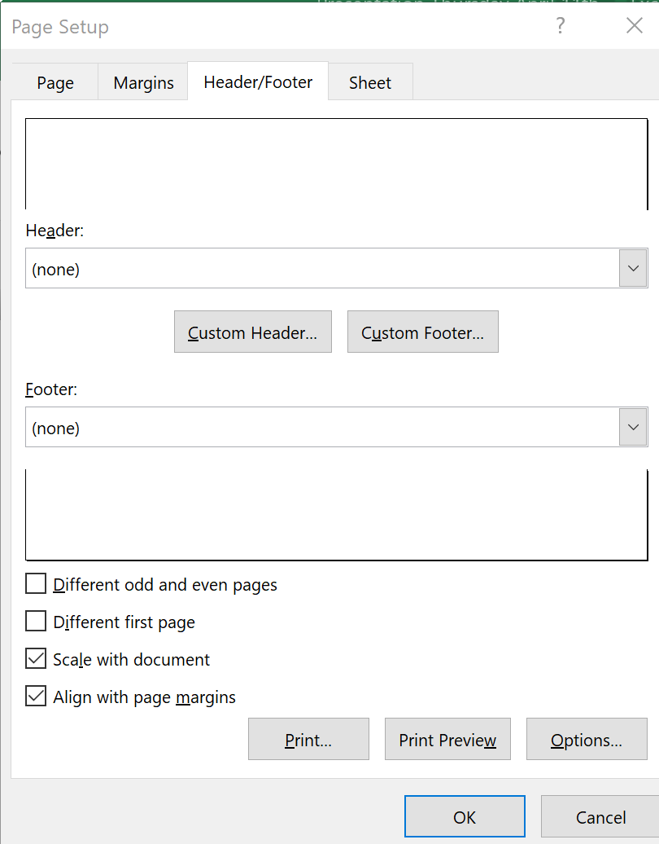
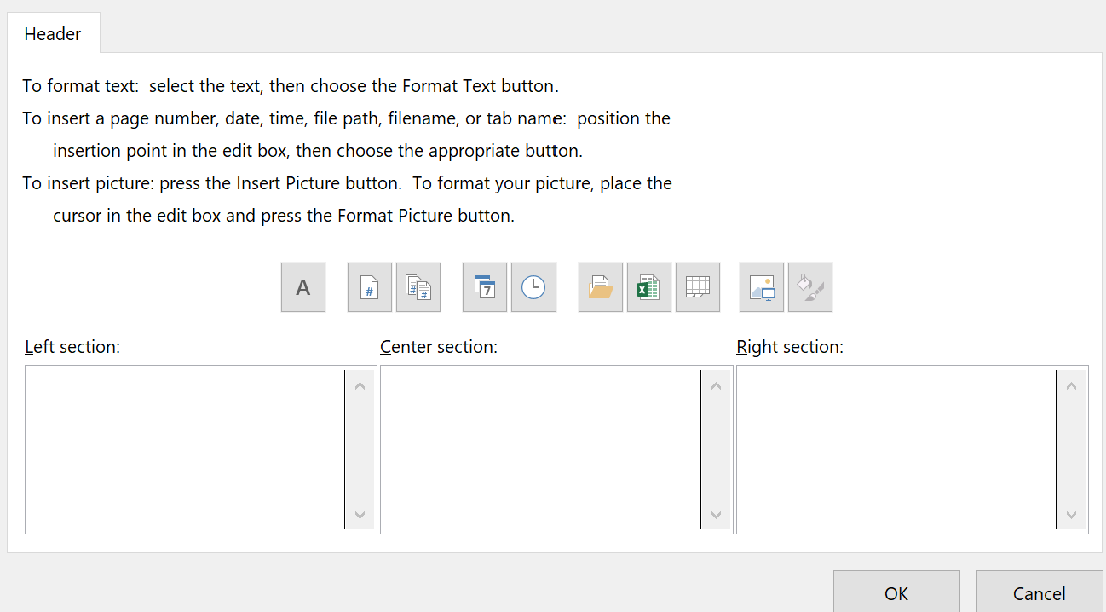
Header/Footer

Slide 13
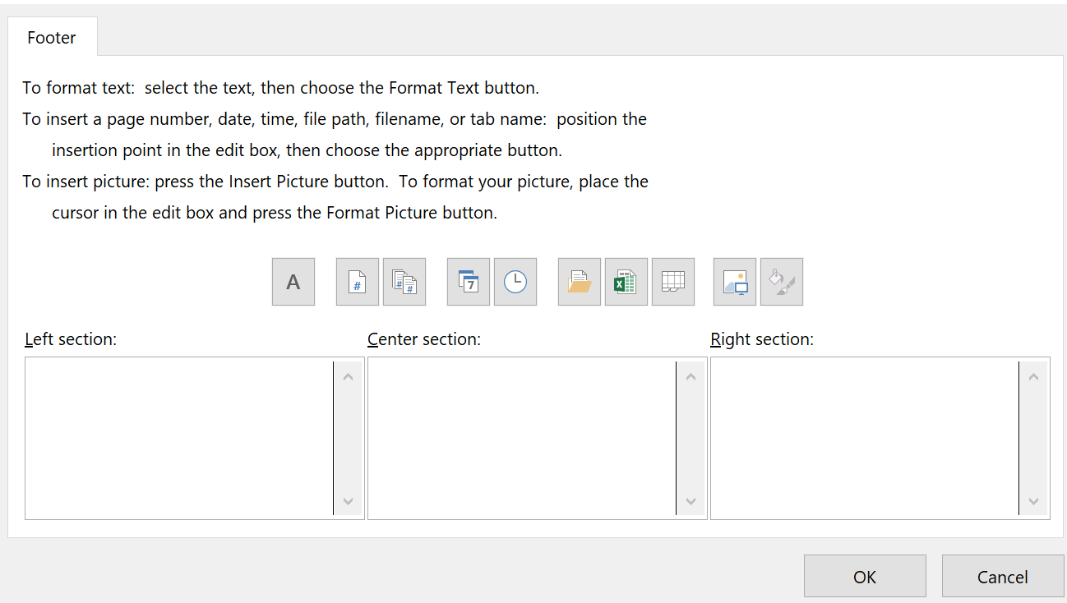
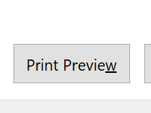
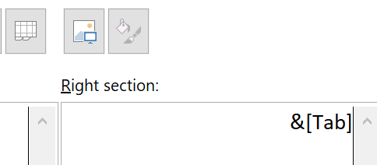
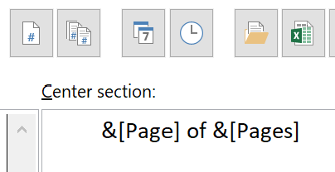
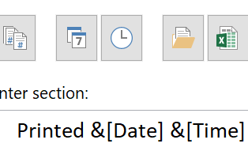
Header/Footer
Click Footer
Click in the Position you want
Click on ICON you choose
Print Page Numbers / Date & Time / File or Sheet Name / Path
Print Preview to View what you chose

Slide 14
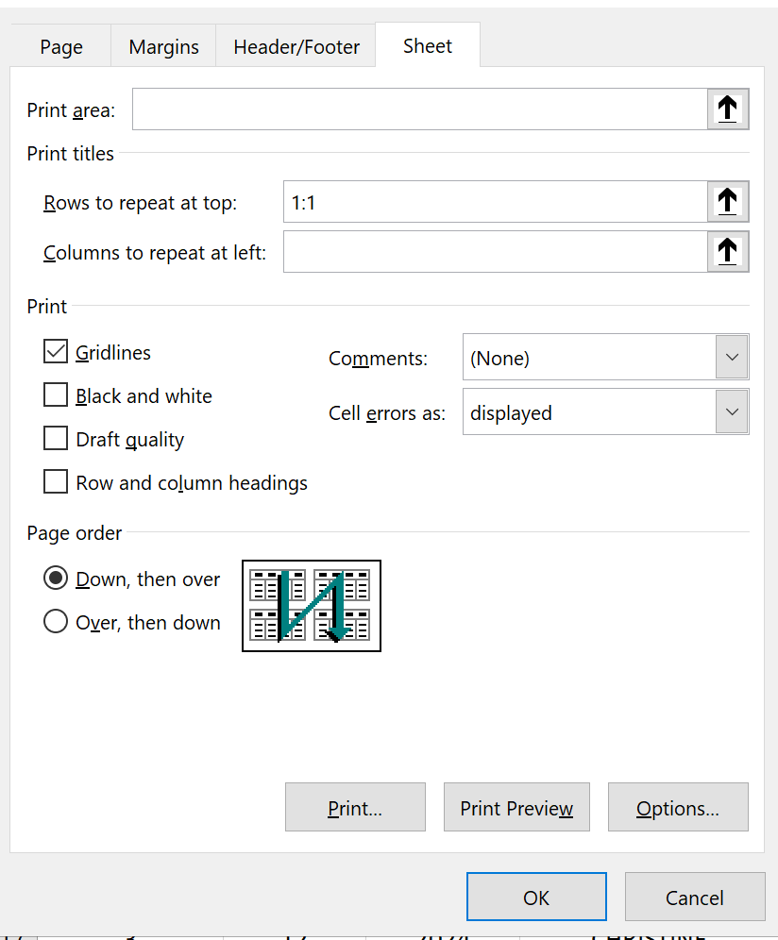
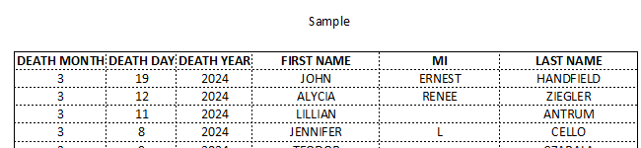
Look of Sheet
Click Sheet
Rows at Top: 1 colon 1 (1:1)
Click on Gridlines
Page Order

Slide 15

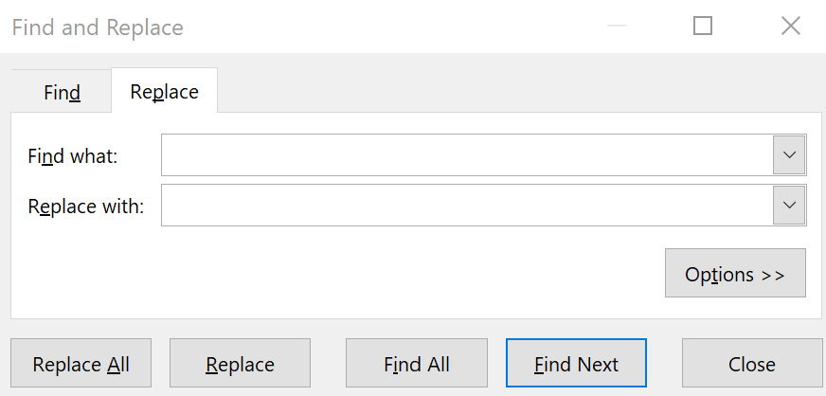
Find/Replace
Home Tab
Find
Type words to find/Replace
Find Next/Replace all

Slide 16
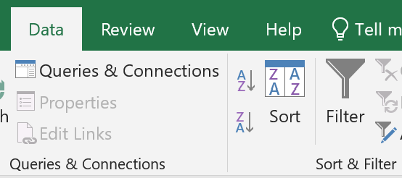

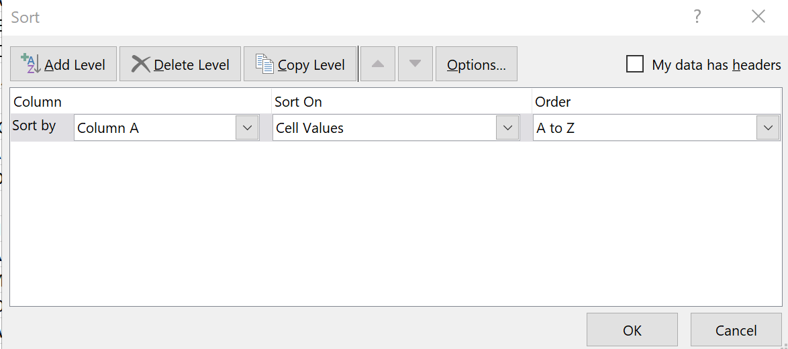
Sort/Filter
Home Tab
Highlight Sheet
Sort/Filter

Slide 17
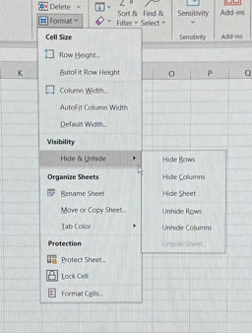
Hide or Unhide
Highlight the row(s) or column(s) that you wish to hide
On “Home” Tab Click on Format
Click arrow next to Hide & Unhide
Click on the appropriate Column or Row hide or unhide
*** If you hide the entire sheet, your screen will go blank.
Click on the Hide unhide again and click unhide sheet.

Slide 18
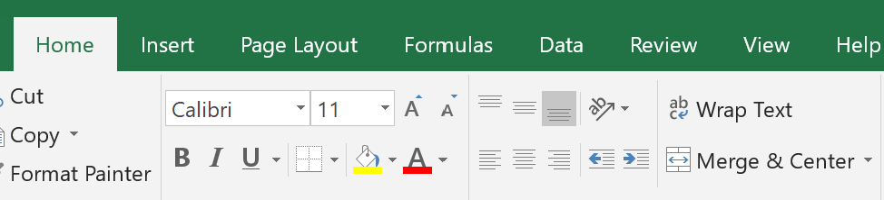
Merge & Center
Highlight the row that you wish to copy/move
To copy right click and click Copy
To move right click and click Cut
Click on the row where you wish the data to be
Click arrow under insert
Insert copied cells
** To delete, highlight row and click delete below insert

Slide 19
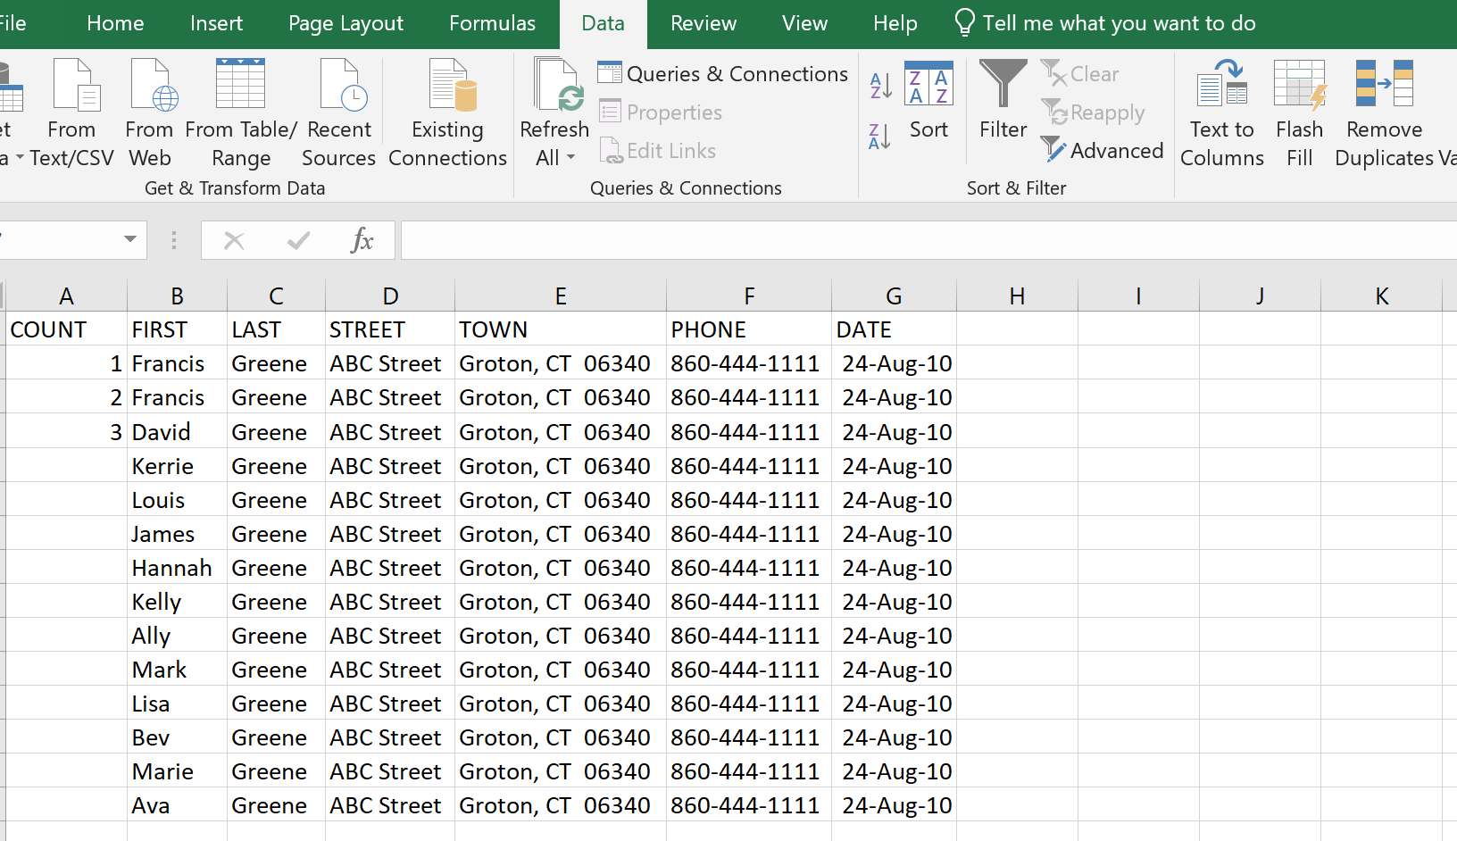
Add a Count
Highlight the cells that have the numbers
Click on the little square next to the 3 (does not show here)
Drag to all cells you wish to add the count to

Slide 20
Remove Duplicates
Highlight the cells that have the numbers
Click on the little square next to the 3 (does not show here)
Drag to all cells you wish to add the count to

Slide 21
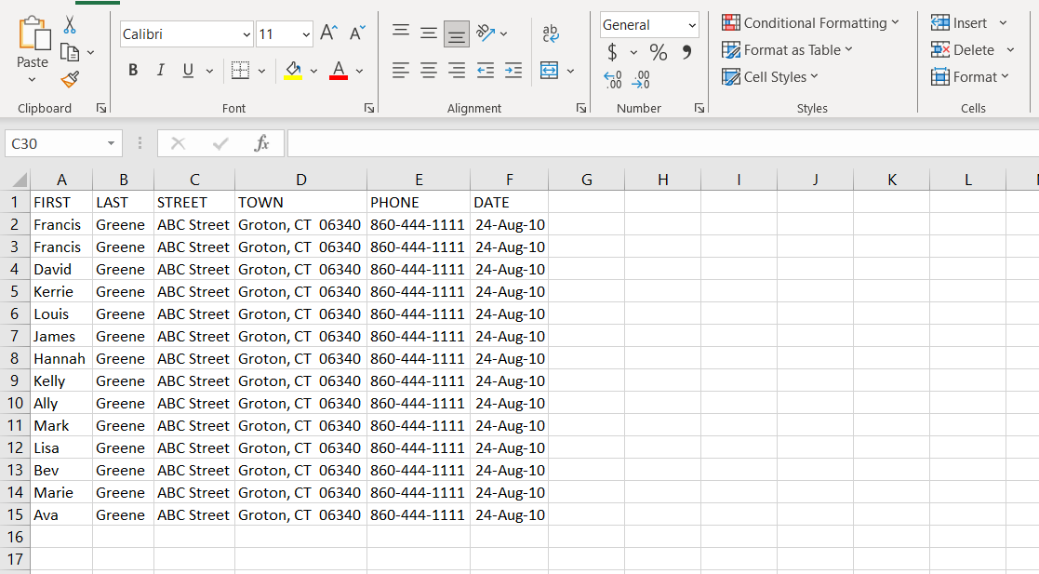
Copy/Move a Row
Highlight the row that you wish to copy/move
To copy right click and click Copy
To move right click and click Cut
Click on the row where you wish the data to be
Click arrow under insert
Insert copied cells
** To delete, highlight row and click delete below insert

Slide 22
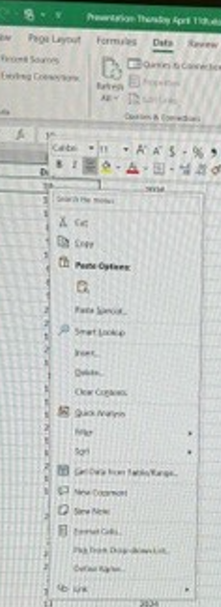
Paste Special
PASTE SPECIAL/VALUES
Copy the items you wish to copy into the spreadsheet
Right click
Hover over the paste special and see how you would like your document to look
If you do not want formatting, just want the data, click paste values
*** CLEAR CONTENTS
Click in the cell that you wish to delete the contents
Right click
Click clear contents

Slide 23
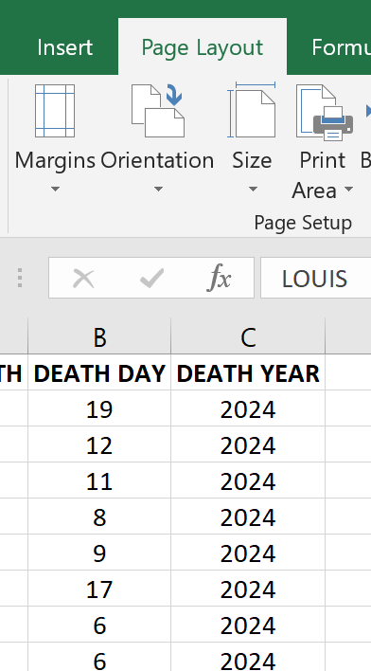
Setting Print Area
Click Page Layout
The arrow on Print Area
Click either Set or Clear

Slide 24
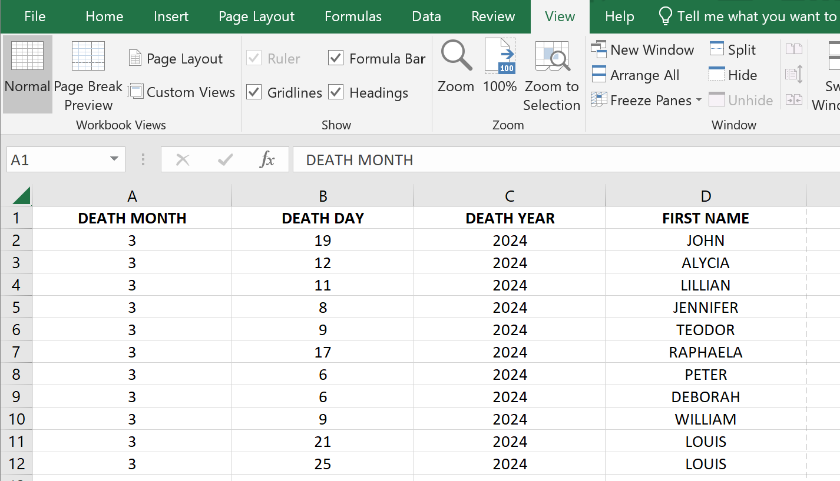
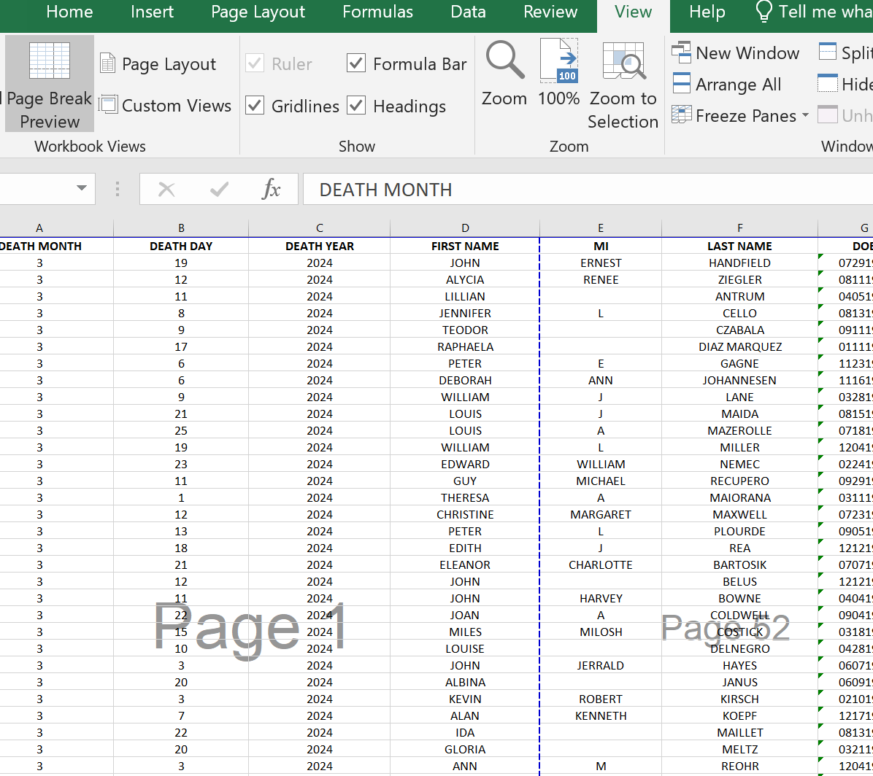
Page Break Preview

Slide 25
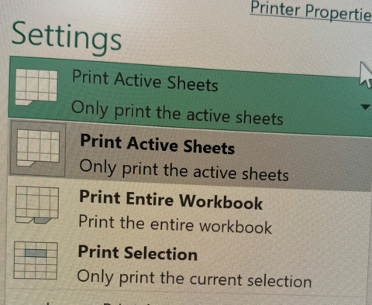
What pages will print
Active Sheet – current page/sheet
Entire Workbook – all sheets
Selection – Anything highlighted

Slide 26
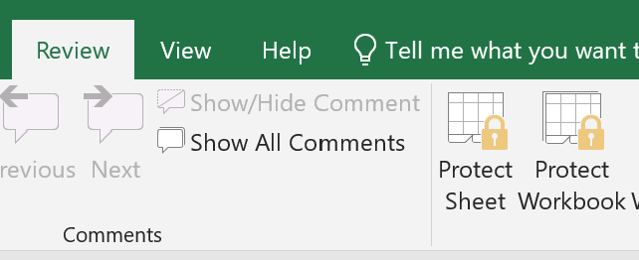
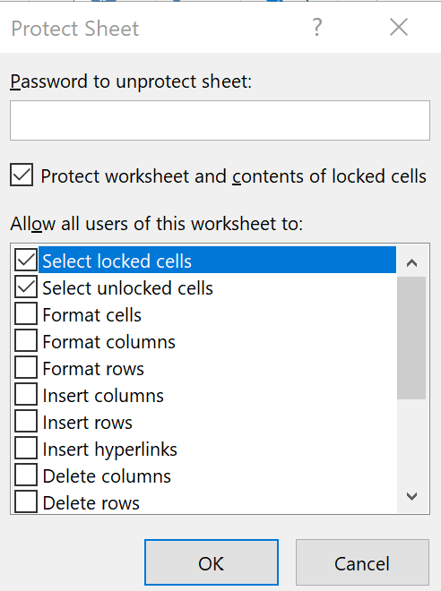
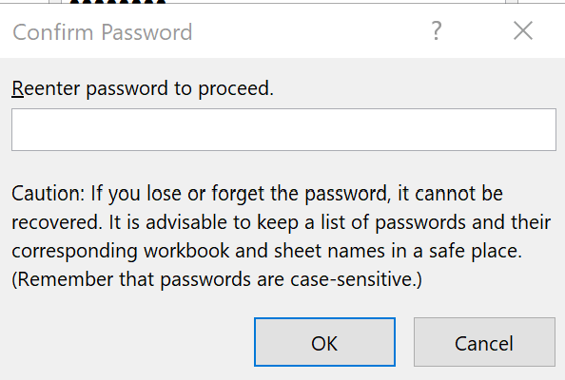
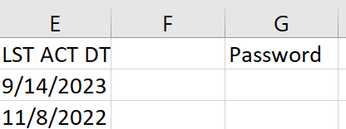
Protect
On the Review Tab
Protect Sheet
Enter password 2x and ok
** Type Password in Sheet 1st

Slide 27
Home Tab

Slide 28
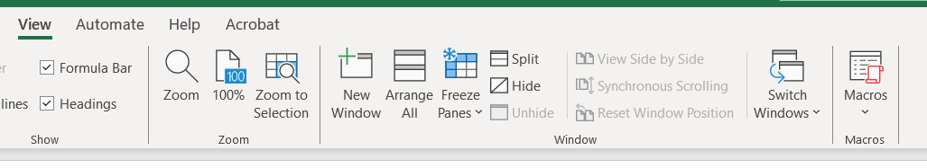
View Tab

Slide 29
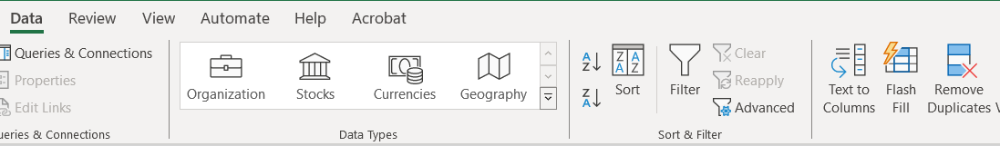
Data Tab

Slide 30
QUESTIONS??

