Slide 1

Early Voting and same day registration
Veronica Rosario
Registrar of Voters
Town of East Hartford
Notes:
Click to begin

Slide 2
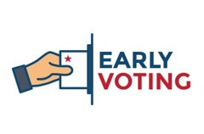
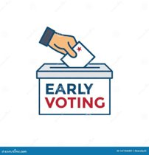
Early Voting general elections
Things to know:
Things to do:
14 days (2 weeks)
  Week 1
    Monday through Sunday
      10:00am to 6:00pm
  Week 2
    Monday, Wednesday, Friday, Saturday and Sunday
      10:00am to 6:00pm
    Tuesday and Thursday
      8:00am to 8:00pm
SDR during Early Voting and Election Day
Certify Early Voting locations
Certify Polling Places
Certify Same Day Registration for Early Voting
Certify Same Day Registration for Election Day
Certify ballot order
Supervised Voting
Election Warning in media platforms (optional)
Poll Worker Training
Notes:
Things to know click once
Things to do click for each one (8)
Election Warning - Done by Town Clerk
Recommendation:
-Post on Town's website
-Post on ROV's webpage
-Town Clerk's will be focusing on AB's

Slide 3
Important Dates for early voting sdr elections
2024
Event | Day | Date | Time
Registration Session | Tuesday | October 1 | 9:00am to 5:00pm
Registration Session | Friday | October 18 | 9:00am to 8:00pm
Early Voting | Monday through Monday | October 21-October 28 | 10:00am to 6:00pm
Early Voting Extended Hours | Tuesday | October 29 | 8:00am to 8:00pm
Early Voting | Wednesday | October 30 | 10:00am to 6:00pm
Early Voting Extended Hours | Thursday | October 31 | 8:00am to 8:00pm
Early Voting | Friday through Sunday | November 1-3 | 10:00am to 6:00pm
Registration Session | Monday | November 4 | 9:00am to 5:00pm
Election | Tuesday | November 5 | 5:00am to 8:00pm+
Notes:
No extra click

Slide 4
Early Voting Process
To cast an early voting ballot, an elector must do the following:
1. appear in person at an early voting location within the designated times,
2. comply with election day identification requirements by either
(a) showing adequate identification
(b) signing an affidavit attesting to his or her identity, and
3. declare under oath that he or she has not previously voted in the election by signing the affirmation on the back of the early voting envelope.
Notes:
No extra click

Slide 5

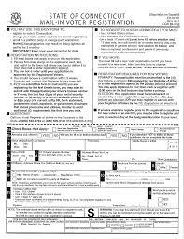
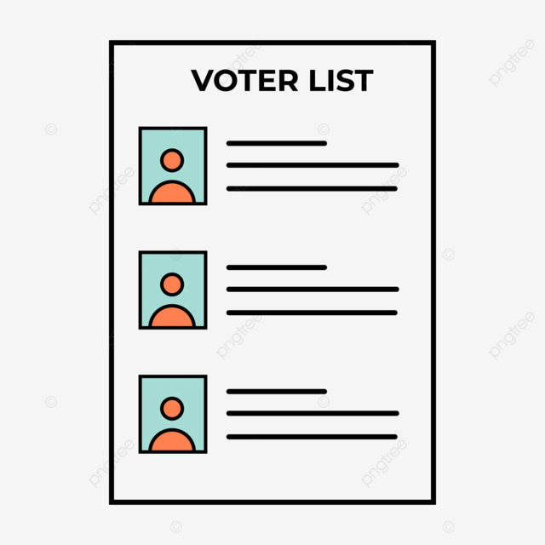
Checking Eligibility
CVRS
Registrars of voters must check the CVRS before admitting an applicant as an elector. If the person is found in the CVRS as an elector in the municipality, the appropriate ballot and corresponding envelope must be provided to the voter.
If the address in the CVRS does not match the current address of the elector, but the new address is in the same town, the official must transfer the elector to their new voting district. The officials must then provide the elector with the ballot for their new voting district.
Notes:
When finished reading:
Click for Voter Registration Application Card and explain

Slide 6
Applicant and CVRS
Applicant LISTED in CVRS
Applicant NOT LISTED in CVRS
If an applicant is registered in another municipality but wants to change their registration location, the registrars must immediately notify the registrars in the municipality where the applicant is currently registered and request that they remove the elector’s name from their official registry list.
The election officials in that municipality must cross through the elector’s name on the list and mark “OFF” next to it.
Two telephone inquiries to the previous municipality within a five- to 10-minute period.
If the registrars of voters determine that the applicant is not listed in CVRS as being registered to vote in another municipality, they must admit the applicant.
The applicant becomes an elector in the municipality immediately.
Notes:
No extra click
This is why they sign the affirmation.

Slide 7



Affirmation
AFFIRMATION: I, the undersigned, do hereby state, under penalty of false statement (perjury), that:
1. I am the elector appearing in person to vote at an election or primary prior to the day of such election or primary.
2. I am eligible to vote in the election or primary indicated for today.
3. I have identified myself to the satisfaction of the registrars of voters.
4. I have not voted in person or by absentee ballot and I will not vote otherwise than by this ballot at this election or primary.
5. I have received an early voting ballot for the purpose of so voting.
Notes:
This is why they sign the Affirmation
Click for Remember Signature

Slide 8
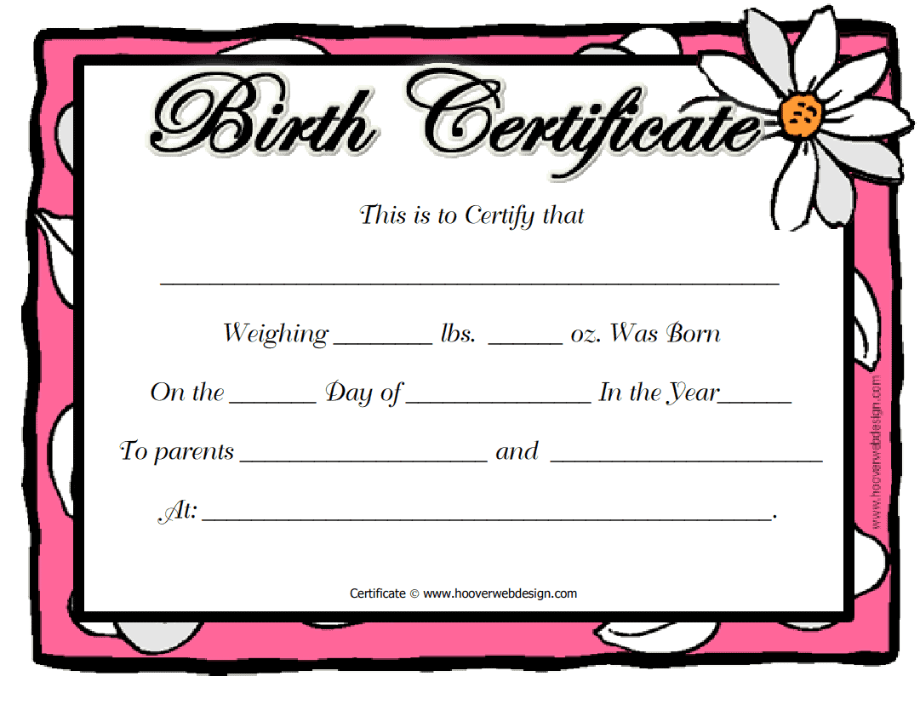

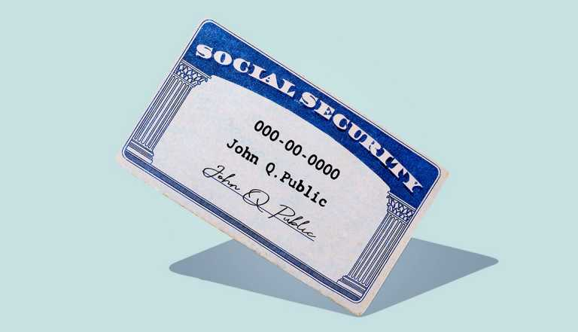
Application and Identification Requirements
This means they must provide their:
A) birth certificate
B) driver’s license
C) Social Security card
Notes:
Click for Birth Certificate
Click for DL
Click for SS

Slide 9

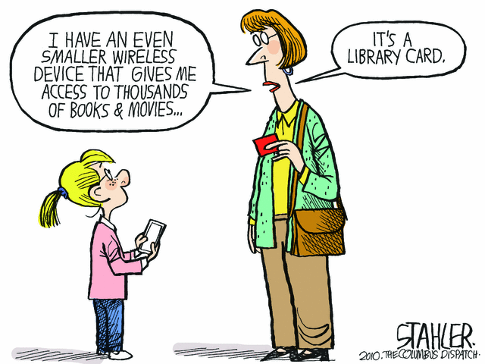

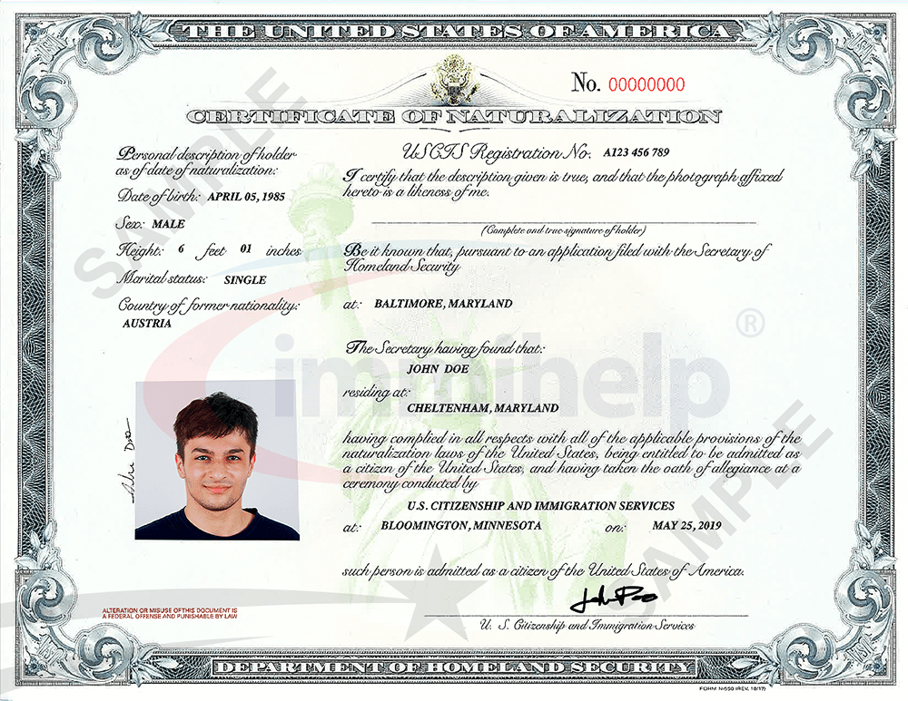
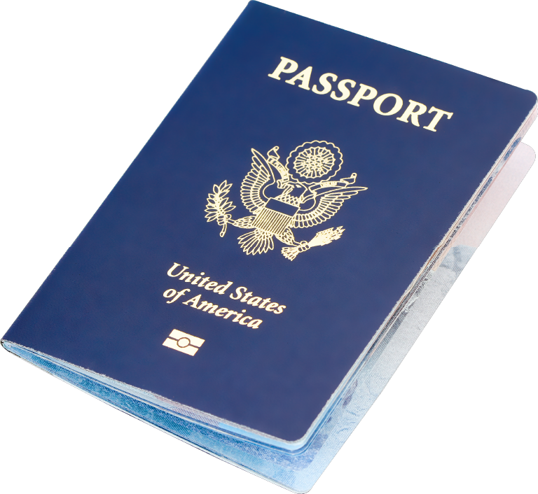
Application and Identification Requirements Continued
If an applicant does not have any of these forms of identification, they can prove their identity under the testimony of another elector or by the presentation of other satisfactory proof to the registrar of voters.
*An applicant whose identification does not include proof of their residential address must also submit another form of identification: The additional identification may include a motor vehicle learner’s permit; utility bill due no later than 30 days after the election; lease; library card; paycheck; property tax bill; naturalization documents; recent passport.
Notes:
Click after *
ITALICS Click for each clipart (5)
If the bill is on their phone they have to pull it up in front of you.

Slide 10

Application and Identification Requirements Continued
College and university students may present a current photo identification issued by their higher education institution or a current college or university registration or fee statement.
Notes:
When talking click for each clipart (2)

Slide 11

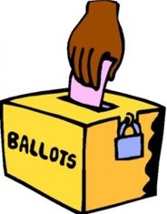

Elector is Eligible to Vote
CVRS
If the registrars of voters determine that the elector is eligible to vote, the elector must be given an early voting ballot and envelope, and the registrar must record the issuance.
An elector who receives an early voting ballot must privately mark it in the presence of the registrars or their designees.
The elector must place the ballot in the early voting envelope, sign the affirmation on the back of the envelope, and deposit the envelope in a secured early voting ballot depository receptacle. The affirmation that is printed on the early voting envelope must be signed by the elector.
EV
Early Voting
Notes:
BOLD WORD click for each clipart (4)
Ballot Box should be clearly marked as EV
Remember you will have another ballot box for SDR

Slide 12
SDR Process for General Elections
The Early Voting Act replaces EDR with SDR and makes it available for:
1. the duration of the early voting period
2. on Election Day.
NOTE: SDR applies only to regular general elections.
Notes:
No extra click

Slide 13
SDR Voting Process
Registrars of voters must give an SDR ballot and envelope to an applicant whom they admit as an elector under SDR and record its issuance. This requirement applies even when the applicant comes in during the early voting period.
In other words, SDR applicants do not receive early voting ballots and envelopes; instead, they always receive SDR ballots and envelopes.
Under SDR, the elector must:
(1) declare under oath that he or she did not previously vote in the election and
(2) sign an affirmation that is printed on the back of the SDR security envelope
Notes:
No extra click

Slide 14
AFFIRMATION:
I, the undersigned, do hereby state, under penalty of false statement, (perjury) that:
1. I am the person admitted here as an elector in the town indicated.
2. I am eligible to vote in the election indicated for today in the town indicated.
3. The information on my voter registration card is correct and complete.
4. I reside at the address that I have given to the registrars of voters.
5. If previously registered at another location, I have provided such address to the registrars of voters and hereby request cancellation of such prior registration.
6. I have not voted in person or by absentee ballot and I will not vote otherwise than by this ballot at this election.
7. I completed an application for a same-day election registration ballot and received a same day election registration ballot.
Notes:
No extra click

Slide 15
SDR Voting Process Continued
The newly admitted elector must privately mark the ballot in the presence of the registrars or their designees.
The elector must place their ballot in the SDR envelope, sign the affirmation on the back of the envelope and then deposit the envelope in a secured SDR ballot depository receptacle.
SDR
SDR
Notes:
BOLD WORD click for each clipart (4)
Ballot Box should be clearly marked as SDR
Remember you will have another ballot box for EV

Slide 16
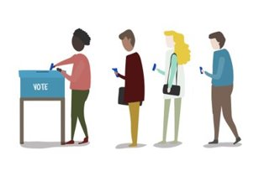


Closing the Early Voting Location
A voter must be in line by the time prescribed for closing the early voting location to cast an early voting ballot.
SDR applicant must be in line by the same time to register to vote and cast a ballot.
Registrars must place an official or police officer behind the last person standing in line at the close of early voting. The official or officer must prevent a voter or applicant from getting in line after the closing of the voting location.
Early
Voting
SDR
SDR
Notes:
Last paragraph Click for Police Officer
At what time should that be?

Slide 17
Recommendations
1. Each municipality should provide a dedicated telephone (or mobile phone) to each moderator at each early voting location to use solely to communicate information about SDR.
2. Each municipality should consider providing assistance to applicants who are in line for SDR to ensure they are not already registered to vote in the municipality.
3. Each municipality should consider dividing the SDR process among various staff and the location conducting SDR.
*Processing individuals who have never been registered to vote will be quicker because there will be no obligation to contact another municipality during the registration or voting process.
**Processing individuals who may have been registered to vote in another municipality in the state will take longer because it requires communication with another municipality and will be more time-consuming for the SDR official.
Notes:
No extra click

Slide 18
Recommendations Continued
4. Each municipality should keep the SDR Ballot Log to ensure that each SDR applicant and communication to other municipalities can be accounted for and recreated if necessary.
5. Each location conducting SDR should also have a copy of the inactive list for the municipality. Any person attempting to vote using the SDR process who is on the Inactive registry list for the town should be restored and allowed to vote under early voting.
6. The Secretary of the State will update the “online” voter look-up tool on the State of Connecticut’s website so that municipalities can use this system to pre-check voter status, if they so choose, and to act as a substitute for CVRS if the system should fail during SDR.
Notes:
Recommend printing 2 labels
1 for envelope
1 for tally sheet Remember 1 per district
Use Props
Show binder

Slide 19

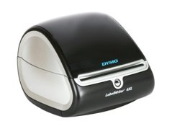
final
Recommendation
7. Registrars should consider having the official who distributes the affirmations, preferably one with GOOD PENMANSHIP, write the elector’s name on the envelope so that there will be less concern regarding illegible handwriting.
As always, the elector must sign the affirmation themselves.
Notes:
Click for Dynamo

Slide 20

Chain of Custody
At the conclusion of each day during the early voting period, registrars of voters must transport the receptacles containing the day’s early voting ballots, and SDR ballots in the case of a general election, to the municipal clerk who must secure and store them in a manner as similar as possible to the security and storage of absentee ballots. ​
The election officials who are present when the registrars transport the ballots to the town clerk must sign the Affidavit of Delivery and Receipt of Early Voting Ballots: Towns Where Town Clerks Store Ballots.
Notes:
No extra click
Use Props

Slide 21
Chain of Custody: Plan B
If this type of storage is not practical, the registrars must prepare an alternate plan and submit it to the Secretary of the State for approval. The plan should indicate the basis for the request and set out clear chain of custody and storage procedures.
At a minimum:
the registrars must store the ballots under lock and key in a tamper-proof, fire-proof receptacle. The receptacle must be locked in a secure room that is not generally accessible.
When delivering ballots for counting on the day of the primary or election, these towns will use the Affidavit of Delivery and Receipt of Early Voting Ballots: Towns Operating Under an Alternative Storage Plan.
The registrars of voters or town clerk, whichever applies, should limit access to the storage location and maintain a log of all people who have access to that storage location. For anyone who accesses the storage location, the log should show the names, dates, times, and purpose.
Notes:
No extra click
Use Props

Slide 22

Counting Procedures
The procedures relating to the custody, control, and counting of absentee ballots must apply as nearly as possible to the custody, control, and counting of early voting ballots and, in the case of a general election, SDR ballots.
This means that registrars must have two individuals of different political parties transport the ballots for counting to the same area (polling place or central location) where absentee ballots are counted.
On the day of the primary or election, the town clerk must deliver early voting ballots already in their possession, and SDR ballots in the case of a general election, to the registrars of voters between 6:00 a.m. and 10:00 a.m. The delivery must be documented using the appropriate affidavit.
If the early voting ballots are already in the possession of the registrars of voters under a Secretary of the State approved alternate plan, the town clerk should be present at the time when the ballots are transported for counting and the appropriate affidavit should be completed.
Notes:
No extra click

Slide 23
Counting Procedures Continued
Ballot counters must proceed between 6:00 a.m. and 10:00 a.m., at the time designated by the registrars, to the central counting location or their respective polling places.
When the ballots are delivered, the ballot counters must check them and count them as nearly as possible to the manner in which they count absentee ballots.
Notes:
No extra click

Slide 24
Counting Procedures Continued
In addition, counting procedures must also include the following:
1. The election officials present at the absentee ballot counting location count the ballots.
2. A section of the head moderator’s return must show the number of early voting ballots cast, and for a general election, the number of SDR ballots cast.
3. Registrars must seal a copy of the Early Voting Tally Sheet in the depository receptacle with the ballots and store the receptacle with the other election results materials.
4. For general elections, registrars must seal a copy of the SDR Tally Sheet in a separate depository receptacle with the ballots and store the receptacle with the other election results materials.
Notes:
No extra click
Use Props

Slide 25
Counting Procedures Continued
5. The registrars must preserve the early voting envelopes, and the SDR envelopes for general elections, for 180 days or 22 months depending on the election or primary—the same period the law requires that other counted ballots be preserved.
6. Registrars must account for all SDR applications received and ballots issued to ensure these totals balance. Registrars can accomplish this by using the Ballot Log and the CVRS
7. If counting at a central location, a separate tabulator may be used for the early voting ballots and, in the case of a general election, SDR ballots.
Notes:
No extra click
Confirm if it's 180 or 22 months-September 5, 2026

Slide 26
Voted Ballots
It is important to note that, once voted, a voter may not pull their early voting ballot in order to vote later in person. The vote is counted because an early voting ballot is considered “voted” when it is completed. This is different than the requirement for absentee ballots under which the ballot must be pulled and is not counted.
And at the end of the night, we can certify that...
Notes:
No extra click

Slide 27


Notes:
Click for Fireworks

