Slide 1
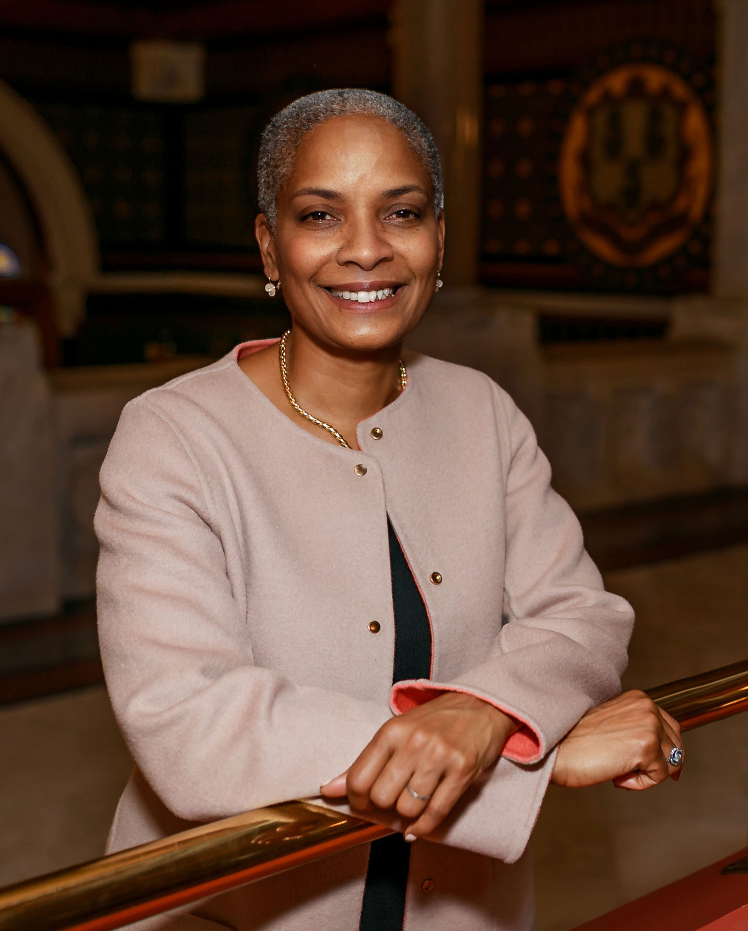
Are We There Yet?
Sorry for all the emails!
Office of the Connecticut Secretary of the State

Slide 2

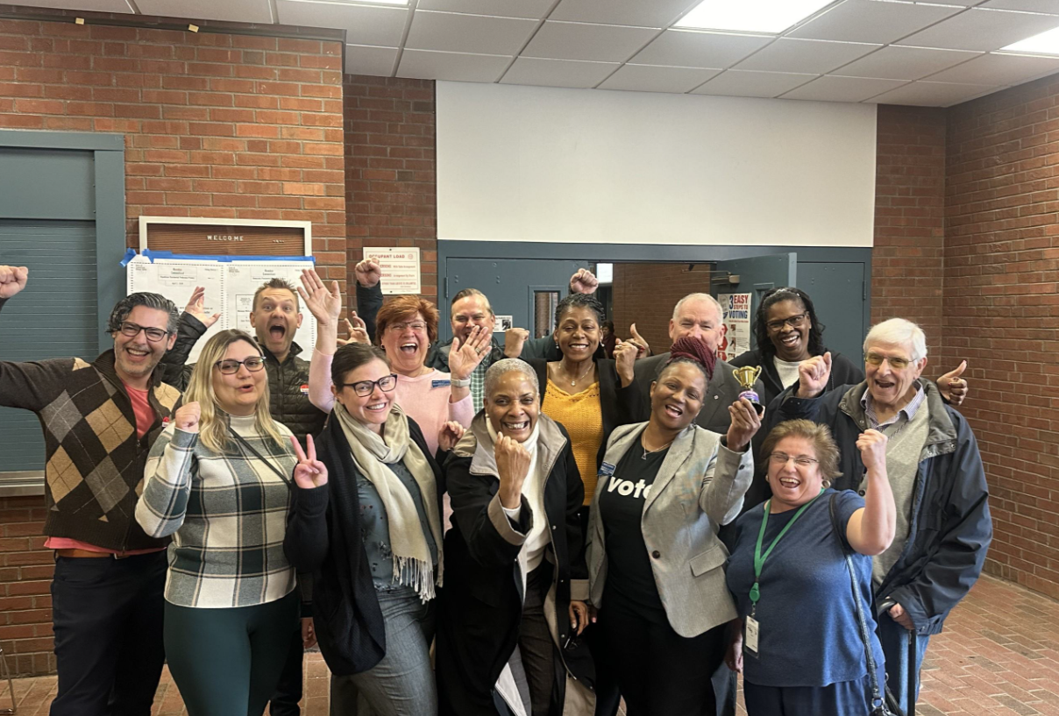

Thank You!!
Office of the Connecticut Secretary of the State

Slide 3
Freedom of Information Act
Under FOIA, the towns can only provide public records that exist at the time the request is made.
Explaining the certification process will help the requestor understand why it has not been provided if you are still in process.
Serves as a good reminder to stay up to date and track your continuing education.
Office of the Connecticut Secretary of the State

Slide 4
Early Voting Stats
Most Voters
Hamden (again!) - 1,275 voters in the Democratic Primary
Southbury – 267 voters in the Republican primary
Highest Turnout
Bridgewater – 34% in the Republican Primary
Bloomfield – 28.27% in the Democratic Primary
Office of the Connecticut Secretary of the State

Slide 5

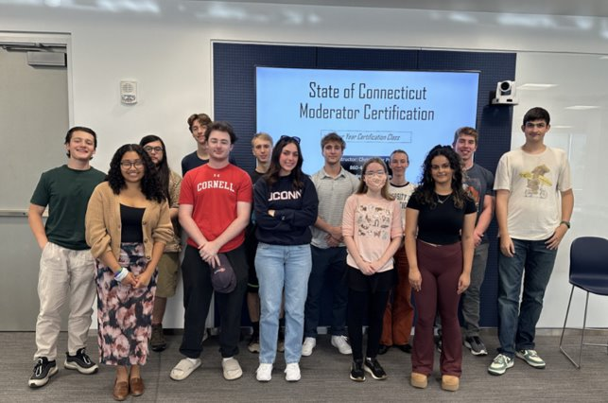
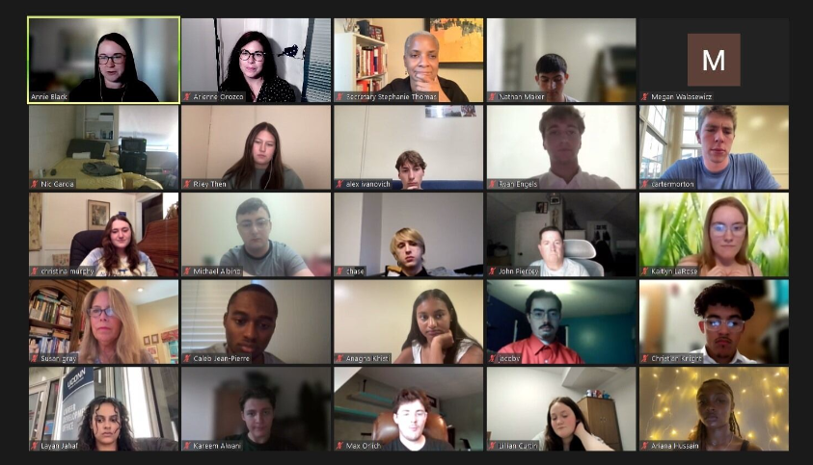
How it's Going
Signed up in 27 Towns!
Office of the Connecticut Secretary of the State

Slide 6
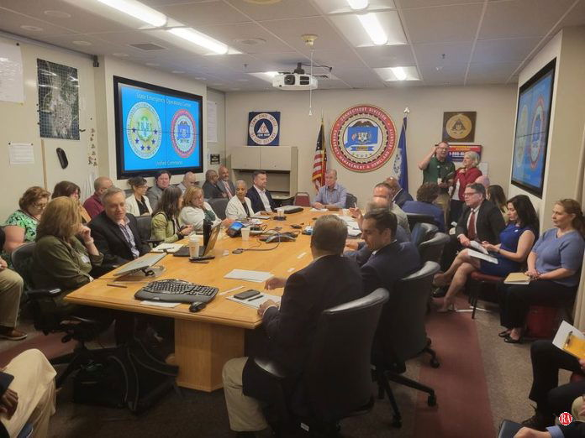
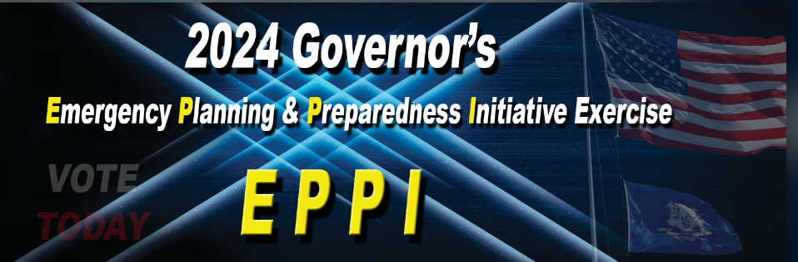
Governor's Emergency Exercise
Over 145 Towns Participated
Office of the Connecticut Secretary of the State

Slide 7


National Threat Landscape
Department of Justice
Title
Threats to Election Workers
  Follow CISA guidance, Join EI-ISAC
Artificial Intelligence
  Keep websites updated, crisis communication plan
Foreign Malign Influence
  Participate in cybersecurity training

Slide 8



National Threat Landscape CISA (ONDI)
Title

Slide 9
Common Tactics
Title
Fake personas on social media
Feeding disinformation to real people to push narratives
Using Artificial Intelligence to create fake news sites
Claims to have breeched systems

Slide 10
Russia
Amplifying divisive rhetoric to shape the outcome of the presidential election.
Office of the Connecticut Secretary of the State

Slide 11
China
Seeking to influence down ballot races around core interest areas, not party specific.
Office of the Connecticut Secretary of the State

Slide 12
Iran
Amplifying discord, undermining confidence in elections to shape the outcome of the presidential election.
Office of the Connecticut Secretary of the State

Slide 13
Preparing for the
General Election
Title
Building Resilience
  Review emergency plans with moderators
  Prepare to counter false claims
Training
  De-escalation, CISA series, cybersecurity
  You know what you're doing!
Assistance
  Fusion Center coordination
  Law Enforcement training

Slide 14
Open Letter to People of Connecticut
We are a team of elected officials who are committed to ensuring voters’ rights are protected and secure, and that no obstacles stand in the way of the voting process. Governing and politics are not one and the same. Today, we want to take an opportunity to reinforce that although we are members of different political parties, we are united in our commitment to ensure safe, secure elections for all, regardless of political affiliation.
Whether training poll workers or serving voters, our top priority is always the protection of our constituents. As proud Connecticut elections officials, we strive to uphold the tenets of voter rights: to make certain ballot access is not restricted, no eligible voter is disenfranchised, and the election process is secure.
We are proud to serve and protect this cornerstone of democracy. We are proud to call ourselves Registrars of Voters.
Office of the Connecticut Secretary of the State

Slide 15
Title
2025 Legislative Session
Allow towns to certify that their early voting plan has not changed from the prior elections rather than needing to resubmit a plan.
Should the ballot measure pass, creating a comprehensive better system of absentee and early voting.
Funding for early voting.
And much, much more.

Slide 16
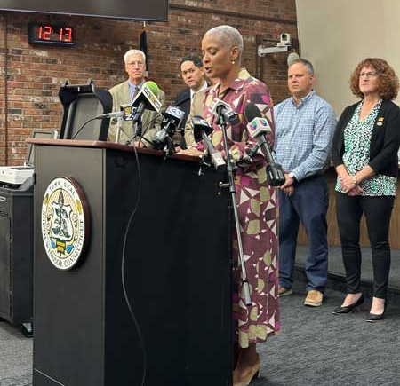
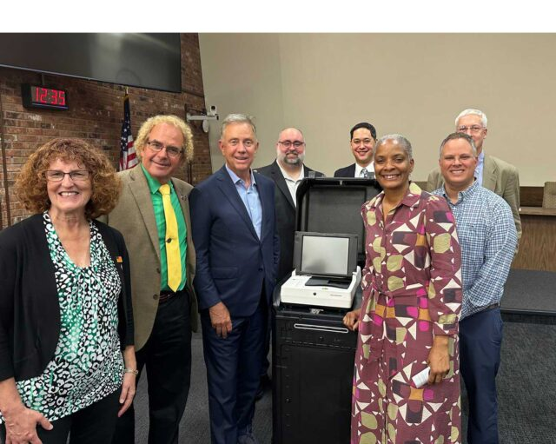
Title
New Tabulator Pilot Program
Glastonbury
Hamden
New Britain
New Haven
Rocky Hill
Southington
South Windsor
Vernon
Wethersfield
Complete Rollout in 2025!

Slide 17
Title
Election Reminders
Are you set with poll workers (+ backups)
Paper system is the law, e-pollbooks are not
Curbside signage
Availability of live language translation
  PCs, Apple & Android tablets, iPads, phones
Privacy assured at IVS
See something, say something
Breathe!

