Slide 1


New Registrar of Voters Class
Office of the Secretary of the State

Slide 2


The following will be covered during this presentation:
Important Deadlines that you need to know
Poll worker and Polling place basics
Emergency Plans
SDR
EMS
Recanvas & Audit procedures
Provisional ballots
Q&A
Office of the Connecticut Secretary of the State

Slide 3
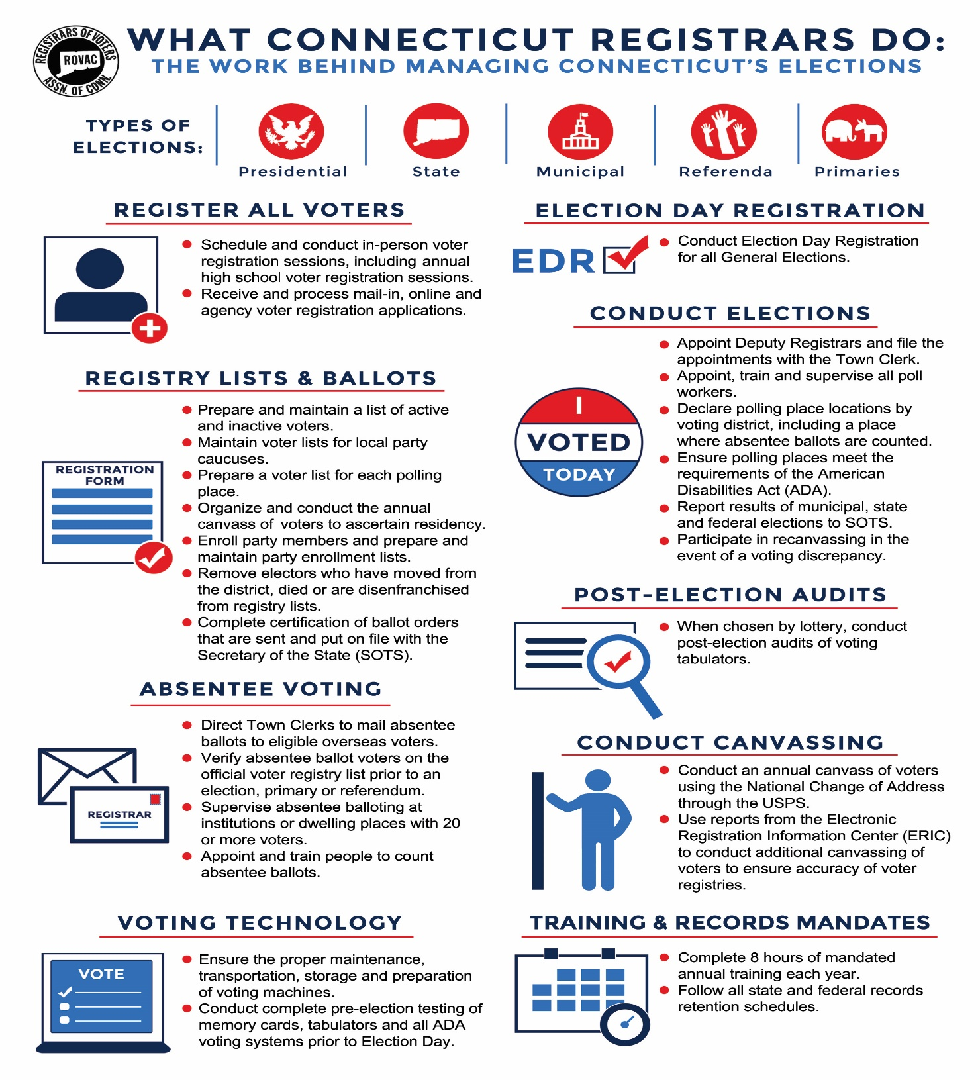

Slide 4
Secretary of the State Contact Information
Director of Elections: Kristin Sullivan - (860)509-6122 kristin.Sullivan@ct.gov
CVRS Issues: Taffy Womack – (860)509-6117 taffy.womack@ct.gov
Congressional District 1: Moriah Moriarty - (860)509-6116 moriah.moriarty@ct.gov
Congressional District 2: Mark Severance - (860)357-5369 mark.severance@ct.gov
Congressional District 3: Lori Magora - (860)438-6250 lori.magora@ct.gov
Congressional District 4: Tim De Carlo - (860)929-1061 timothy.decarlo@ct.gov
Congressional District 5: Heather Augeri - (860)356-0954 heather.augeri@ct.gov

Slide 5
Title
Deadlines
Sept 6th Deadline for Secretary of the State to respond to request for an additional Same Day Registration Location (Sec. 9-19j)
Sept 6th Last day to file for a Waiver of Accessibility of a Polling Place. 9-168d
Sept 20th Deadline to certify the Same-Day Registration Locations SOTS for the general election. (9-19j)
Sept 20th Ballot order must be certified with SOTS on or before this date.
Sept 25th Notice of the Tuesday of the 5th week before election correction session, must be posted in the newspaper. Time and location must be included.

Slide 6
Title
Deadlines
Oct 1st Session to Complete Preliminary Registration List. (5th week before election session)You must be in your office sometime between the hours of 9:00 am – 5:00 pm.
Oct 3rd -13th Notice of 18th Day before Election Day Registration Session. Must be posted in the newspaper. Session will take place on October 18th
Oct 4th Registrars must have certified the location of polling and EV locations with SOTS.
Oct 11th Last day for ROVs to put on file with SOTS a copy of the sample ballot.
Oct 14 Last day to enter in the “Who Voted” from the August 18th Primary.

Slide 7
Title
Deadlines
Oct 16th Final day to designate a Central Counting area, appoint election officials and Head Moderator.
Oct 18th 18th Day before the Election Registration Session. Your office must be open from 9:00 am – 5:00 pm
Oct 20th -30th Notice of the Nov 4th Limited Registration Session must be noticed in the newspaper.
Oct 21st Early Voting / Same Day Registration begins!
Oct 29th & 31st Extended hours of Early Voting.

Slide 8
Title
Deadlines
Oct 29 Last day to request supervised absentee balloting in a nursing home or rest home, etc., with less than 20 electors. A written designation must be made by this date by either registrar of voters or the administrator of the institution, for the state, district, or municipal primary. This deadline does not apply to a nursing home or rest home, etc., with 20 or more electors because supervised voting is mandated at such institutions.
Nov 3rd Early Voting / Same Day Registration Ends!
Nov 3rd Deadline for candidates to submit list of designees for unofficial checkers to the registrar of voters. Such list must be submitted at least 48 hours prior to the opening of the polls. The registrar must notify all candidates of their right to submit a list of designees.

Slide 9
Title
Deadlines
Nov 3rd Early Voting / Same Day Registration Ends!
Nov 3rd Deadline for candidates to submit list of designees for unofficial checkers to the registrar of voters. Such list must be submitted at least 48 hours prior to the opening of the polls. The registrar must notify all candidates of their right to submit a list of designees.
Nov 4th Limited Registration Session for all those who have become a US Citizen, returned from active duty or moved to town on or after Oct 19th .
Nov 5th Election Day

Slide 10
Title
Deadlines
Nov 6th – 19th Election Machines are in lockdown
Nov 8th Final day for Head Moderator to correct any errors identified on the Head Moderators Return and filed an amended return to SOTS
Nov 8th Final Day for Head Moderator to call a Discrepancy Recount
Nov 12th Final Day to conduct Close Vote Recanvass or Discrepancy Recount
Dec 5th Deadline to file the ED-632, Completion of the 2024 Canvass with SOTS

Slide 11
Title
Avoid a disaster before it occurs
Early Permission and Site Check
Check with those in charge of your polling place well in advance of the election to make sure that the location will be operational on the day of the election. Make sure to conduct a site visit prior to the election to make sure everything will be operational for the Primary.
Pre-Election Organization Meeting
Prior to every election you should consider calling a meeting in which everyone who would have some kind of roll be present. For example, are your polling places owned by the municipality or are they rentals? Who will be delivering your election equipment and who will be accepting delivery? Are the local authorities prepared to assist you should you loose power or have an emergency at the polls? Is everyone aware of what your Emergency Plan entails and are they ready to assist your office should a problem develop?

Slide 12
Title
Sec. 9-174a. Emergency contingency plan
for elections
Sec. 9-174a. Emergency contingency plan for elections. Model plan. (a) For each municipality, the registrars of voters, in consultation with the municipal clerk, shall create an emergency contingency plan for elections, primaries and referenda to be held within such municipality.
Such plan shall include, but not be limited to, (1) solutions for ballot shortages, and (2) strategies to implement in the event of (A) a shortage or absence of poll workers, (B) a loss of power, (C) a fire or the sounding of an alarm within a polling place, (D) voting machine malfunctions, (E) a weather or other natural disaster, (F) the need to remove a poll worker or moderator and to replace such worker or moderator, and (G) disorder in and around the polling place

Slide 13
Title
Petitions for Ballot Access
Nomination vs Primary
Nominating petitions are issued by the Town Clerk.
Primary Petitions are issued by the Registrar of Voters for Single District. (Such as State Representative, Mayor, ROV.)
Municipal Offices. SOTS for Multitown State District Offices. (Such as Congress, State Senate, Governor.)
What offices does the 15% automatic ballot access apply towards?
Only District offices. It does not apply towards any office that are considered a Municipal Office.
Where can they be filed?
Nominating with Town Clerk
Primary with ROV for Municipal
Primary with SOTS or ROV for District

Slide 14
Title
EMS Setup
Town Clerks & SOTS
Primary Created in EMS by SOTS
Offices assigned to Primary by SOTS
Candidates added to Primary by SOTS
Certification of Ballot Ordered this can be done by both Town Clerk or ROV’S for primaries.

Slide 15
Title
EMS Setup
ROVS
Assigned Polling Places to Primary
  Add or change polling locations if necessary. Make sure to notify SOTS.
Assign a Head Moderator to the Primary
  You may assign moderators, data entry, etc., and provide password
  Have a paper back up ready in case of a system failure. The form should be provided by SOTS.
  Do not assign your EV and SDR locations as polling places

Slide 16
Title
Poll Worker Training
It is the responsibility to make sure that all poll workers receive adequate training before each election.
Moderators' certification must be up to date. If their certification has lapsed make sure they attend a certification class prior to Election Day. The list of certification dates can be found on ROVAC.org
Make sure that your poll workers are aware of your Emergency Plan should an issue arise at the polls, i.e., ballot shortage, poll workers who fail to arrive, loss of power, fire, etc.

Slide 17
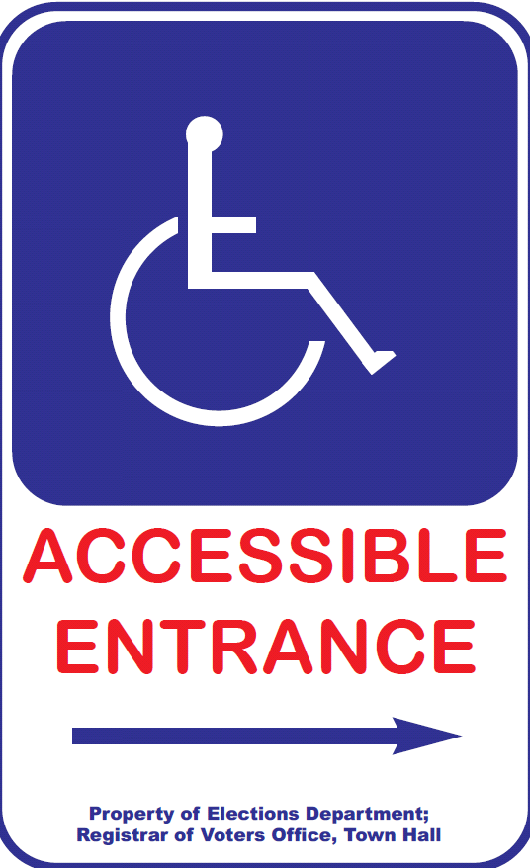
Title
Polling Place Must Be “Accessible”
Moderator should :
  Check parking lot signs.
  Post signs to accessible entry, if applicable.
  Clear all accessible pathways in polls
  Set up wheelchair-accessible privacy booth.
  Understand curbside voting process.
  Confirm presence/set-up of IVS

Slide 18
Title
Department of Justice ADA Checklist
https://www.ada.gov/votingchecklist.pdf

Slide 19
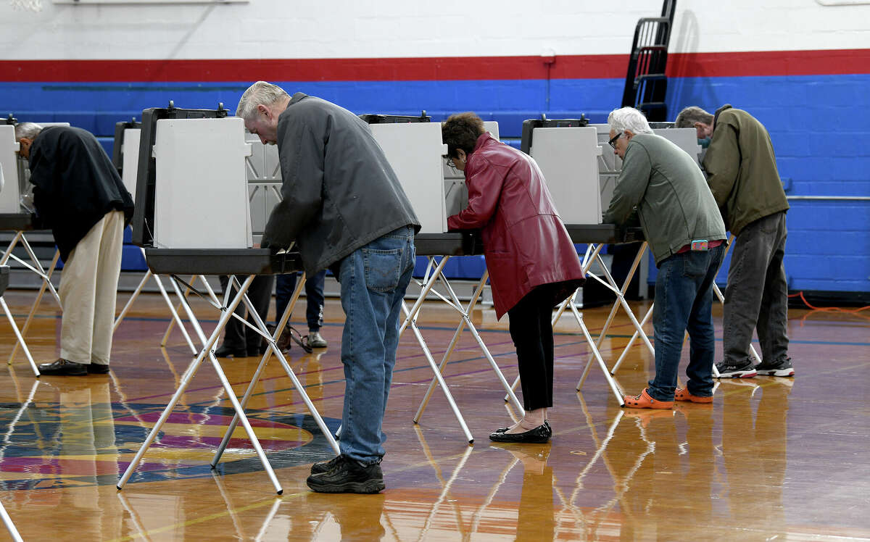
Title
Allowed Inside Polling Place
Electors (while voting)
Person assisting elector in voting or with curbside voting
  NO candidate unless member of voter’s immediate family.
  NO representative of employer or union. Record each name.
Children of the elector (must be supervised, 15 or younger)
Secretary of the State’s Designees
News media (identify themselves to moderator, no photos of any votes )
Registrar of Voters
Unofficial Checkers
PTA Bake Sales

Slide 20
Title
Unofficial Checkers
Connecticut General Statutes Sec 9-436(a)
Role— “Get Out the Vote” for their party
Confirmed with registrars 48 hours before election
Electors and party members
Seated “near” official checkers—Registrars’ discretion
Listen – do not talk to electors who are checking in
Report to party—outside of 75-foot area

Slide 21
Title
Polling Place Signage
To be posted during elections
3 Easy Steps to Voting
ID Requirements for Voters with Asterisks “*” (per HAVA)
Voters Bill of Rights
Instructions for Provisional Ballots (Federal Only)
Voter ID for checker’s table.
3 Constitution Amendment Posters (If Applicable)
Local Ballot Question Texts

Slide 22
Title
Voter ID Requirements For Checkers Table

Slide 23
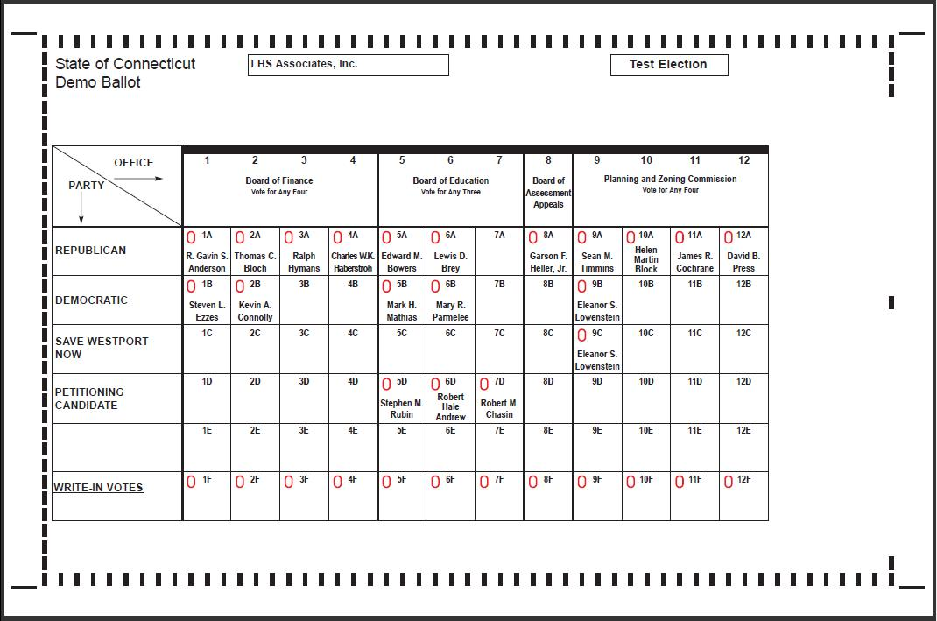
Title
Polling Place Must Display 2 Sample Ballots

Slide 24
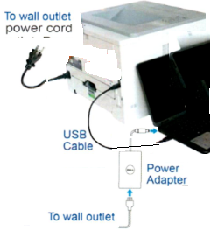
Title
Ballot Marking System Set-up
Printer & computer plugged into power outlet.
USB cable plugged in from computer to printer.
Keypad and headphone plugged into computer.
Ensure paper tray is open, extended & tray sleeve installed.
Load 1 plain piece of paper onto paper tray
Turn “On” Printer and Computer
Press “Print” on computer screen.
  A startup report will print.
Press “No” on computer screen
Access Code 9630

Slide 25
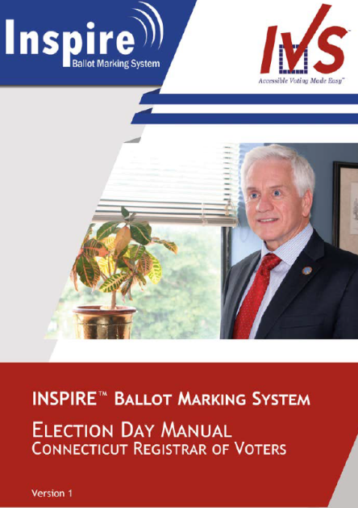
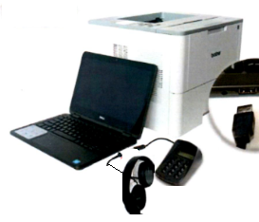

Slide 26
Title
Provisional Ballots
Provisional Ballots are for Federal Offices ONLY and are given to voters who cannot be found as registered.
You must send Provisional Ballots in the amount 1% of the total number of enrolled electors. 1000 Registered Voters = 10 Provisional Ballots
The moderator gives the voter a Provisional Ballot Envelope, Provisional Ballot, and records the voters information on the Provisional Ballot Inventory Form, (Form 9).
The voter completes application on the Provisional Ballot Envelope, seals and returns the envelope to the Moderator.
Registrars have Six Days to determine whether to count.
Voters who are unregistered should be sent to SDR.

Slide 27
Title
Early Voting
Requirement | General Election | Primary Election | Pres. Preference Primary | Special Election
Start of Early Voting Period | 15 days before | 8 days before | 5 days before | 5 days before
End of Early Voting Period | 2 days before | 2 days before | 2 days before | 2 days before
Duration | 14 days | 7 days | 4 days | 4 days
Early Voting does not apply to Town Committee Primaries or Referenda Elections.

Slide 28
Title
Early Voting Hours
Weekdays Hours | General Election | Primary Election | Pres. Preference Primary | Special Election
 | 10:00 AM – 6:00 PM except for the last Tuesday and Thursday before the election when the hours are 8:00 AM – 8:00 PM | 10:00 AM – 6:00 PM except for the last Tuesday and Thursday before the election when the hours are 8:00 AM – 8:00 PM | 10:00 AM – 6:00 PM | 10:00 AM – 6:00 PM
Saturday Hours | 10:00 – 6:00 | 10:00 – 6:00 | 10:00 – 6:00 | 10:00 – 6:00
Sunday Hours | 10:00 – 6:00 | 10:00 – 6:00 | 10:00 – 6:00 | 10:00 – 6:00

Slide 29
Title
Early Voting Locations
The act requires registrars of voters to designate a location in town—with access to the centralized voter registration system (CVRS)—in which to conduct both (1) early voting and (2) SDR during the early voting period preceding a regular general election. Municipalities with a population of 20,000 or more have the option of designating additional locations.
Separately, the law requires registrars of voters to designate a location for conducting SDR on Election Day (see below: “SDR Process for General Elections”). This location may be the same as or different than the location that is used to conduct SDR during the early voting period.

Slide 30
Title
Early Voting Process
Early Voting Process To cast an early voting ballot, an elector must do the following:
appear in person at an early voting location within the designated times,
comply with election day identification requirements by either (a) showing adequate identification or (b) signing an affidavit attesting to his or her identity, and
declare under oath that he or she has not previously voted in the election by signing the affirmation on the back of the early voting envelope

Slide 31
Title
Cast an EV Ballot
If the registrars of voters determine that the elector is eligible to vote, they must check CVRS to see if the elector has already voted. If not, the elector must be given an early voting ballot and envelope, and the registrar must record the issuance. An elector who receives an early voting ballot must privately mark it in the presence of the registrars or their designees. The elector must place the ballot in the early voting envelope, sign the affirmation on the back of the envelope, and deposit the envelope in a secured early voting ballot depository receptacle.

Slide 32
Title
Chain of Custody
At the conclusion of each day during the early voting period, registrars of voters must transport the receptacles containing the day’s early voting ballots, and SDR ballots in the case of a general election, to the municipal clerk who must secure and store them in a manner as similar as possible to the security and storage of absentee ballots. The election officials who are present when the registrars transport the ballots to the town clerk must sign the Affidavit of Delivery and Receipt of Early Voting Ballots: Towns Where Town Clerks Store Ballots.

Slide 33
Title
Chain of Custody
If this type of storage is not practical, the registrars must prepare an alternate plan and submit it to the Secretary of the State for approval. The plan should indicate the basis for the request and set out clear chain of custody and storage procedures. At a minimum, the registrars must store the ballots under lock and key in a tamper-proof, fire-proof receptacle. The receptacle must be locked in a secure room that is not generally accessible. When delivering ballots for counting on the day of the primary or election, these towns will use the Affidavit of Delivery and Receipt of Early Voting Ballots: Towns Operating Under an Alternative Storage Plan
The registrars of voters or town clerk, whichever applies, should limit access to the storage location and maintain a log of all people who have access to that storage location. For anyone who accesses the storage location, the log should show the names, dates, times, and purpose.

Slide 34
Title
Same Day Registration
The pre-election mail-in voter registration cutoff deadline is eighteen (18) days before an election or primary. For general elections, Connecticut also has Same Day Registration available during the period of Early Voting and on Election Day for voters who need it.
Same Day Registration permits anyone who meets the eligibility requirements for voting in this state and is not already registered or is registered in one town but has moved to another town, to register and vote in person. By law, a person is eligible to register and vote if he or she is (1) a US citizen, (2) age 18 or older, (3) a bona fide resident of the town in which he or she applies for admission, and (4) has completed confinement if previously convicted of a disfranchising felony.

Slide 35
Title
Same Day Registration
Same Day Registration (SDR) is not available at a polling place but is available at a designated SDR location in each town, beginning at 6 am and ending at 8 pm on Election Day. SDR is available during the hours of Early Voting as well.
Citizens will register and vote at the designated SDR location in your town. Citizens who are in line at the Same Day Registration site by the close of polls, can remain in line to complete their registration and vote.

Slide 36
Title
EV and SDR Line Management
What are ways to try and eliminate long lines that can form during the EV and SDR process?
Use a triage system for your location. Have the public check-in at a station prior to getting in line to make sure they are not currently an active or inactive elector in your town. If you have the citizen fill out the voter card, have an area where they can do that prior to getting into line
Have a worker walking the line and checking the citizen’s ID’s that they have brought with them, making sure the ID covers both IDENITY and RESIDENCY.
Add additional CVRS processing stations during the election if necessary. Make sure to check with SOTS to know how many connections that you have to the state system so that you don’t knock yourself off CVRS.

Slide 37
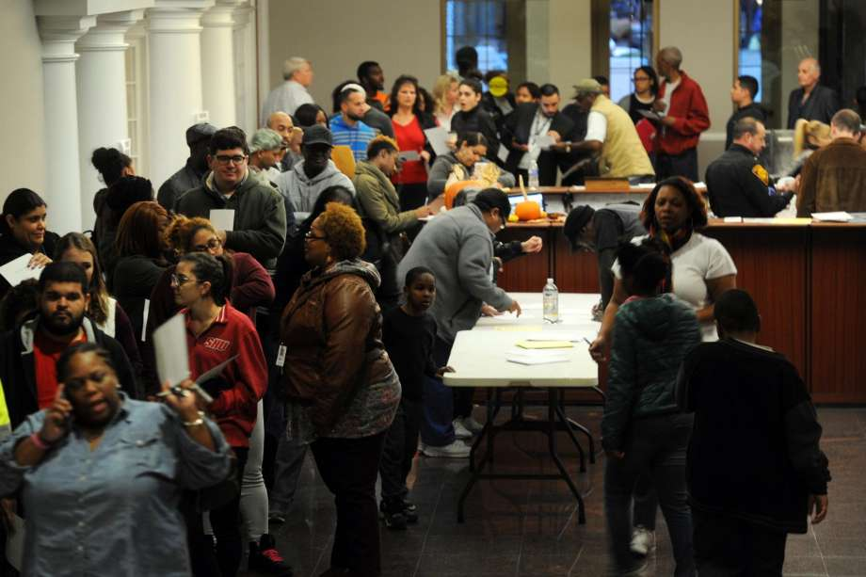
Same Day Registration Cont.
Make sure to have a dedicated phone line for outgoing calls from other towns.
Revisit your SDR plan each year as you will may not need the same number of staff for a Presidential Election vs. a Municipal Election.
The goal is to be prepared for this

Slide 38
You can create your own forms to send people out of SDR to the polls or from poll to poll. This can help cut down on confusion and more calls to your office.

Slide 39
Title
Post Election Audit
The Secretary of the States Office will conduct a lottery after the election. Those polling places selected will need to have a post election audit conducted.
The audit may be conducted either by manual or automated form. All automated audits take place in the Office of the Secretary of the State.
Regardless of the type of audit you perform it must still be noticed locally.
To conduct the audit manually make sure to reference the audit manual which is located on the SOTS website.

Slide 40
Title
Recanvas Procedures
A recanvas of an election can take place if either The moderator (or head moderator in towns divided into voting districts) may call for a recanvas of the machine counted ballots, and/or the hand counted ballots, and/or absentee ballots and/or write-in ballots if he determines there is a discrepancy in the returns of any voting district in an election or primary. (§ 9-311)
    Or
After any election or primary, when the plurality of the winning candidate for an office is 1 ½ of 1 percent or less than twenty votes are separating both the winning and defeated candidate for office.

Slide 41
Title
Recanvas Continued
In a District / Statewide recanvas, the Secretary of the State will notify the Town Clerk who will intern notify the Head Moderator.
In a municipal or Single District race the Town Clerk will inform the Head Moderator.
It is the Head Moderator who will notify the candidates, town chairmen and recanvas officials that are needed that a recanvas will be conducted. This is to be done in writing.

Slide 42
Title
Recanvas Continued
RECANVASS OFFICIALS
Recanvass officials are: the moderator, the registrars of voters (or the registrar of voters, in a primary); at least two official checkers of opposing political parties (or opposing sides, in a primary); at least two absentee ballot counters of opposing political parties who served at such election (or opposing sides in a primary); and at least two ballot clerks of opposing political parties. Although not a recanvass official, the town clerk may be involved to ensure the appropriate materials (that have been in the possession of the town clerk) have been delivered for use during the recanvass.

Slide 43
Require Town clerk and / or registrar of voters to bring (dependent on who has the material):
i. the tabulators with a memory card still sealed in them.
ii. the sealed ballot transfer cases for each voting district, which contain:
all machine counted ballots,
the sealed depository envelopes containing the hand-counted absentee ballots; notes, worksheets and other written materials used in the absentee ballot counting procedures; and the Moderator’s Record of Absentee Ballot Count for Candidates;
the sealed depository envelopes containing the counted ballots from the auxiliary bin; notes, worksheets and other written materials used in counting the ballots from the auxiliary bin (if any);
the sealed depository envelopes containing the counted ballots from the write-in bin; notes, worksheets and other written materials used in counting the ballots from the write-in bin;
iii. the sealed depository envelopes containing rejected absentee ballots and discarded inner and outer envelopes;
iv. the absentee ballot applications;
v. the list of absentee ballot applicants as provided in §9-140;
vi. the check list;
vii. the moderator's returns, including the central absentee ballot counting moderator's return, if applicable;
viii. replacement seals;
ix. challenge ballots, provisional ballots, presidential ballots and all other materials.

Slide 44
Title
Post Election Audit
The Secretary of the States Office will conduct a lottery after the election. Those polling places selected will need to have a post election audit conducted.
The audit may be conducted either by manual or automated form. All automated audits take place in the Office of the Secretary of the State.
Regardless of the type of audit you perform it must still be noticed locally.
To conduct the audit manually make sure to reference the audit manual which is located on the SOTS website.
Polling places were a recanvass occurs are excused from being audited.

Slide 45
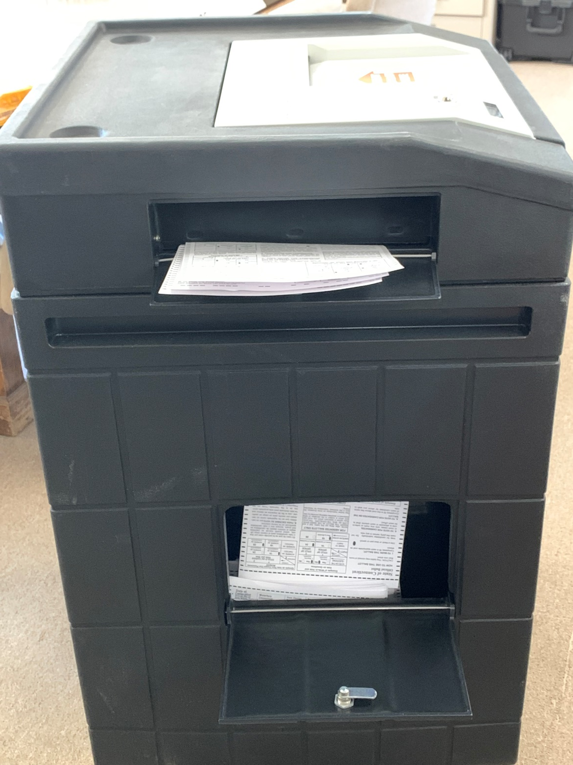
Closing out the Election
Step One
Open the bottom compartment of the auxiliary bin.
Ballots that were placed in the bin can now be inserted into the tabulator.
Make sure to check for voter intent prior to inserting a ballot.
Any ballot that you feel may not be counted in the tabulator will need to be hand counted.
Ballots that are completely blank & Over-voted can be inserted into the tabulator while holding in the “Y” button.

Slide 46
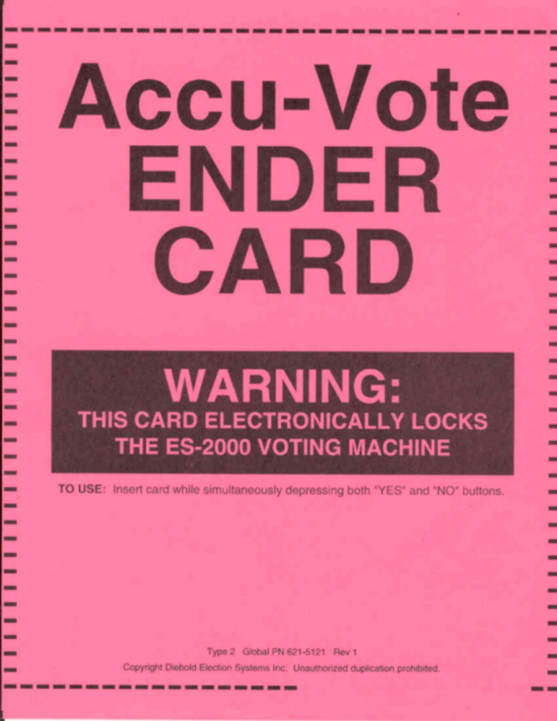
Step Two
Close out the Tabulator
  Find the ENDER CARD
  Can be white or pink
  Located in the tabulator transfer bag.
  Extra in the back-up tabulator bag.

Slide 47
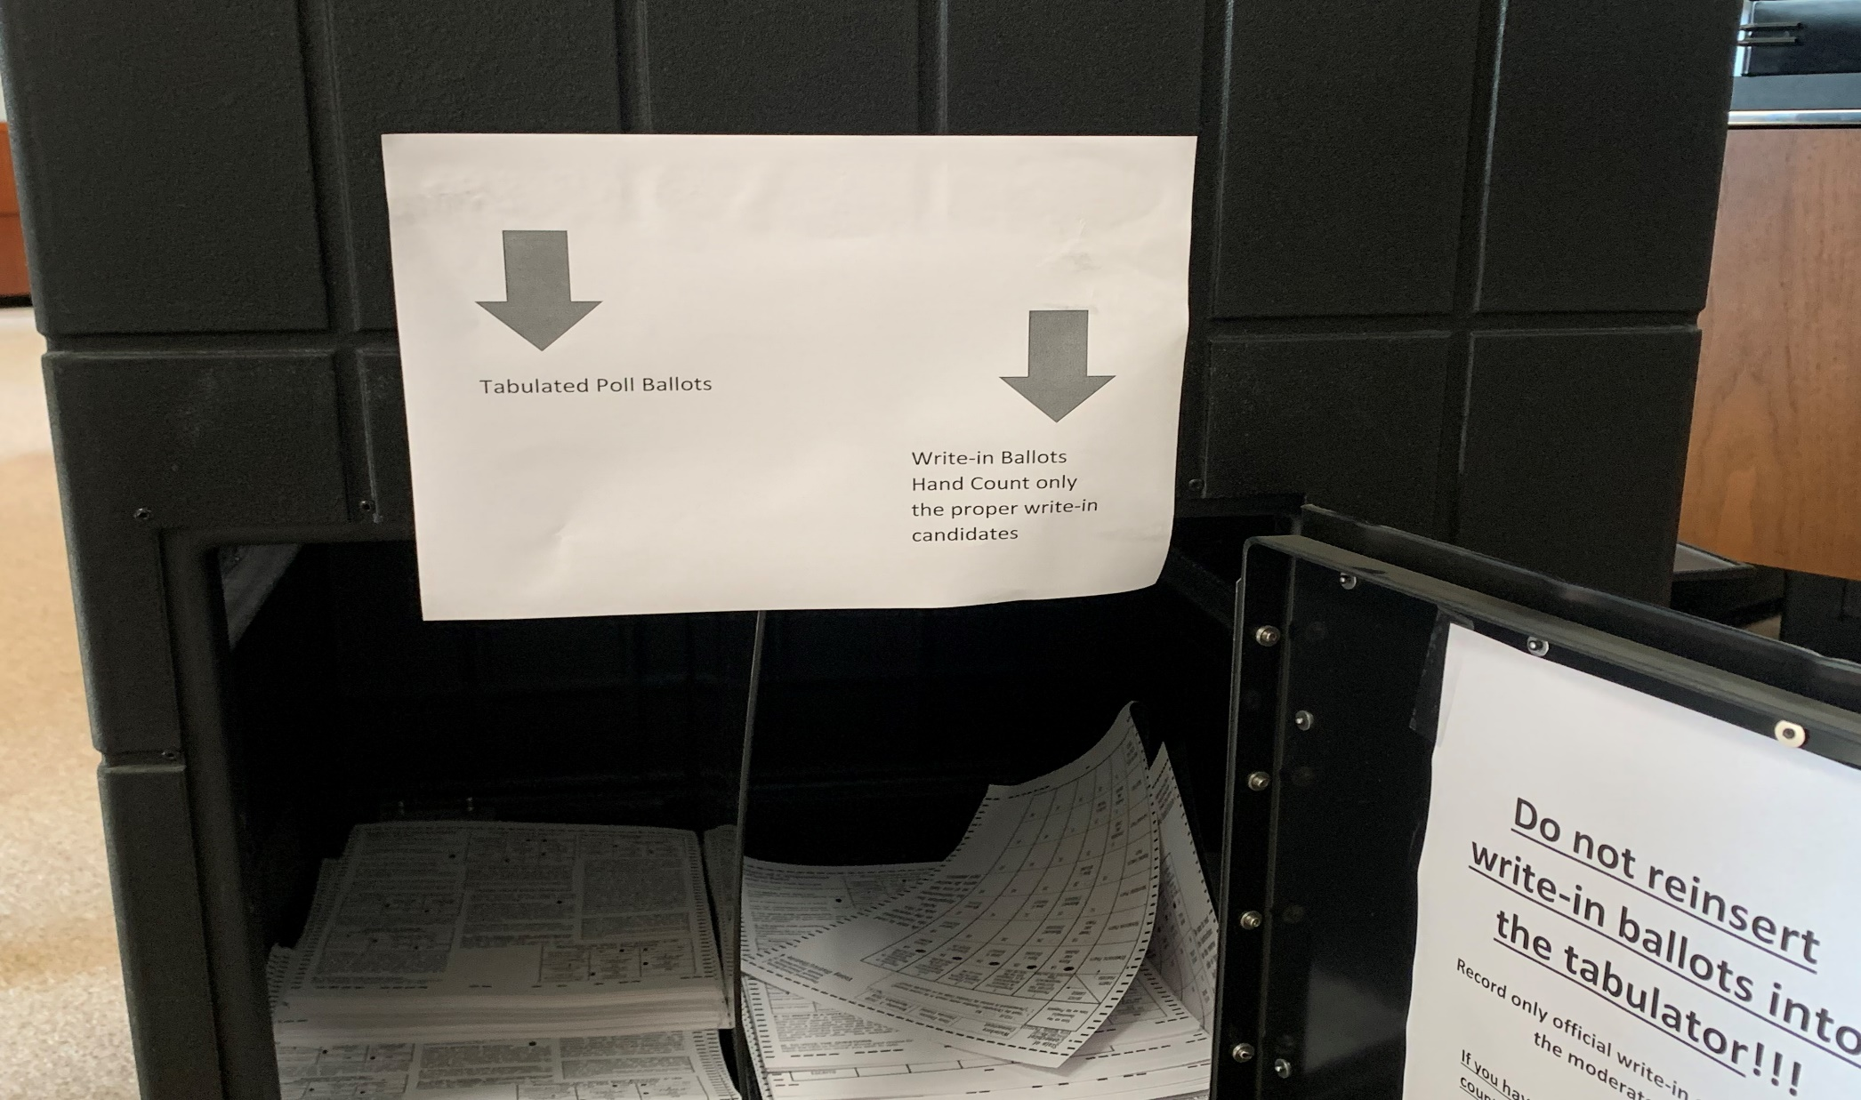
Step Three
Hand count the write-in candidates.

Slide 48
Title
Write-in Ballots
DO NOT Reinsert Write-in Ballots into the tabulator!!!
The tabulator has already recorded everything expect the write-in.
Record only official write-in candidates on the moderator form.
A candidate that appears on the ballot but is written in still counts.
Example: Chris Murphy is on the ballot for US Senate, if someone writes him in for the office of US Senate you would record it as one write-in vote for Chris Murphy for the office of US Senate.
Example: Chris Murphy is not an official candidate for State Senate. If someone was to write him in as their choice for State Senate, the vote would not count, and you would not record the vote.

Slide 49

Title
Hand Counting
Voter intent determines result.
Two election officials from different parties or factions count votes. If disagreement, moderator decides.
Ballots with write-in votes—count only votes for registered write-in candidates or for a candidate on the ballot in correct box on ballot.
Multiple votes for same candidate in same race count as just one vote.
Record on tally sheets.
DO NOT Put the ballot back through the tabulator!

