Slide 1
Field Services Program (FSP)
&
Hash Verification
Sean Pumphrey| Field Services Specialist
Field Services Program
U.S. Election Assistance Commission
September 17, 2024

Slide 2
Introduction
Sean Pumphrey, Field Services Specialist
HAVA College Program (2008)
Masters Public Administration, University of Baltimore (2014)
Election Vendor Contractor (2015)
Baltimore City Board of Elections, Data Application Specialist (2017)
NCSBE, Election Security & Support Technician (2020)
EAC Testing & Certification, Election Technology Specialist (2022)
EAC Testing & Certification, Field Services Specialist (2023)

Slide 3

2008 HAVA College Program
Source: Schaefer Center Newsletter, University of Baltimore Archives, 2009

Slide 4

2015 MD Voting System Implementation

Slide 5

2018 Baltimore City

Slide 6
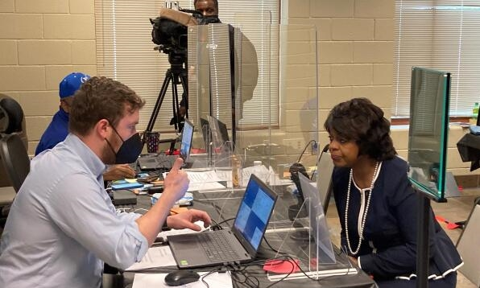
2022 North Carolina State Board of Elections
source: www.newsobserver.com

Slide 7
Agenda
EAC and Field Services Program (FSP) Background
  Testing & Certification Program Manual
  Quality Monitoring Program
Field Services Program
Hash Verification
What does this mean for you?

Slide 8
EAC & FSP Background

Slide 9

EAC Mission
The Election Assistance Commission (EAC) provides national leadership to
improve the administration of Federal elections, in accordance with the Help
America Vote Act.

Slide 10
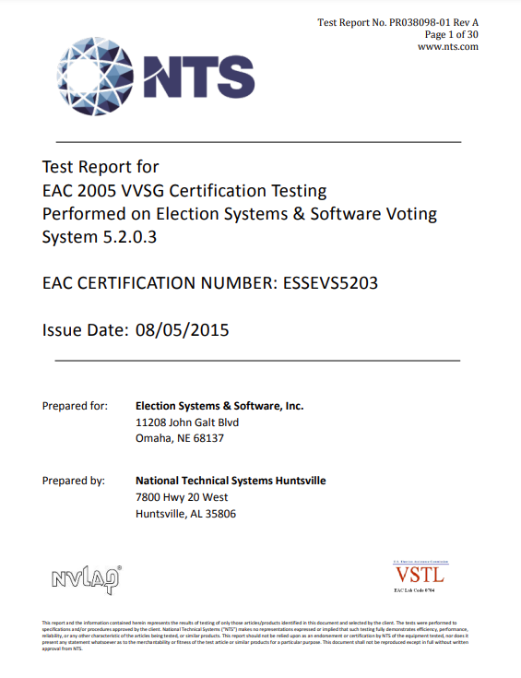
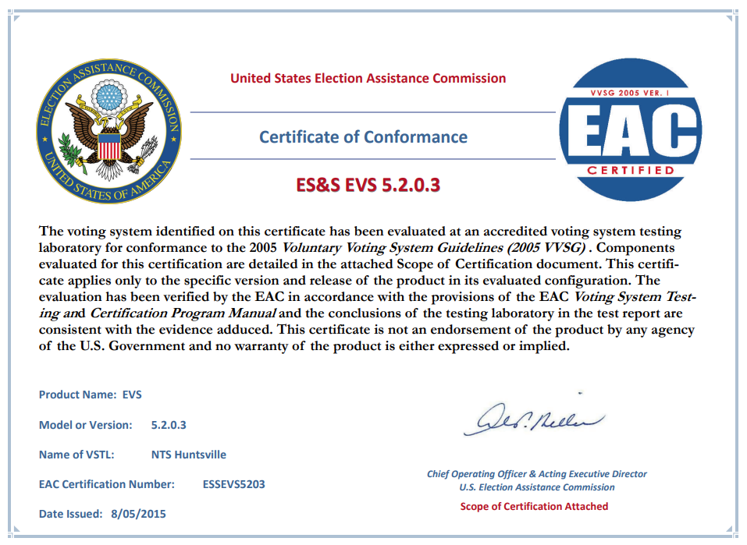
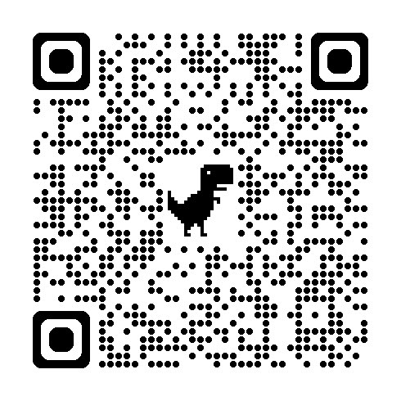
Testing & Certification
Oversee VSTL Testing Certify to VVSG
​
&
Test Report
Certificate of Conformance
Testing & Certification Program PDF

Slide 11
T&C Program Manual

Slide 12
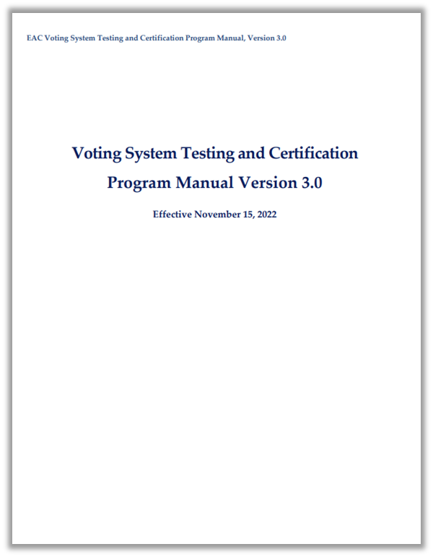
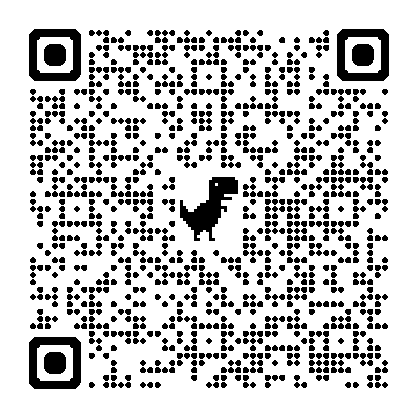
T&C Program Manual
Provides clear procedures to manufacturers for the testing and certification of voting systems.
Program Manual

Slide 13

…

Slide 14
Quality Monitoring Program

Slide 15
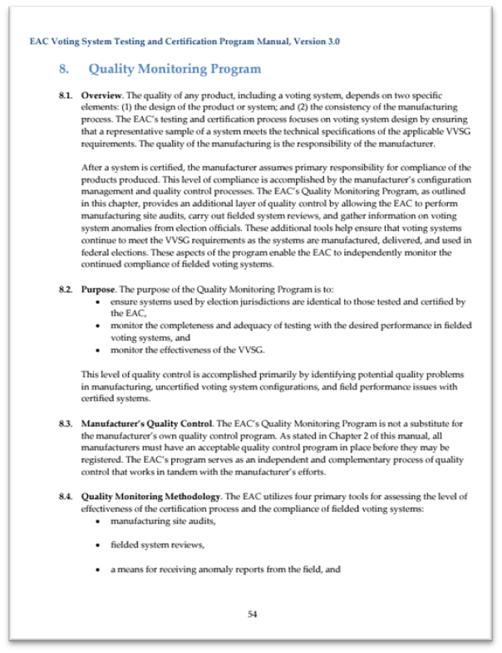
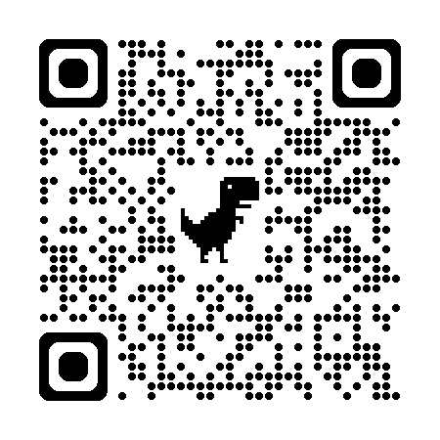
Quality Monitoring Program
Registered manufacturer site audits
Voting System Anomaly Reporting
Technical bulletins or product advisories
Fielded system reviews (optional)
Quality Monitoring Program

Slide 16
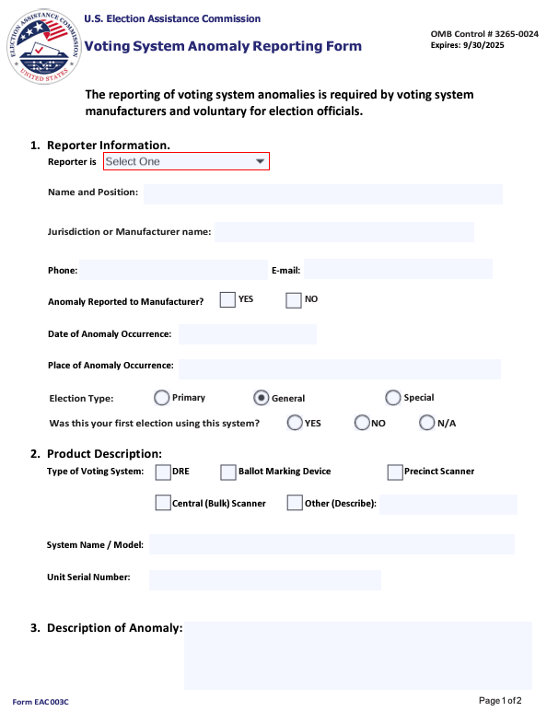
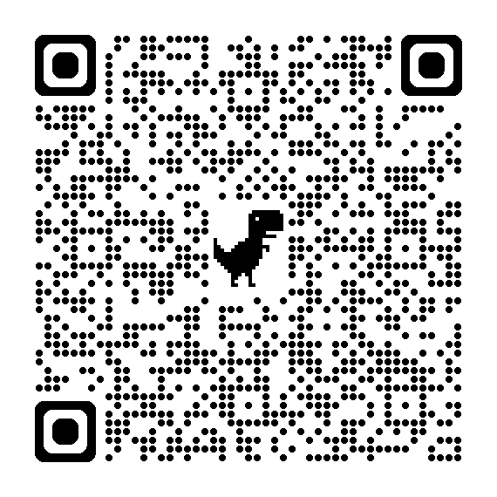
Anomaly Reporting Form
Anomaly Form Link

Slide 17
Field Services Program

Slide 18
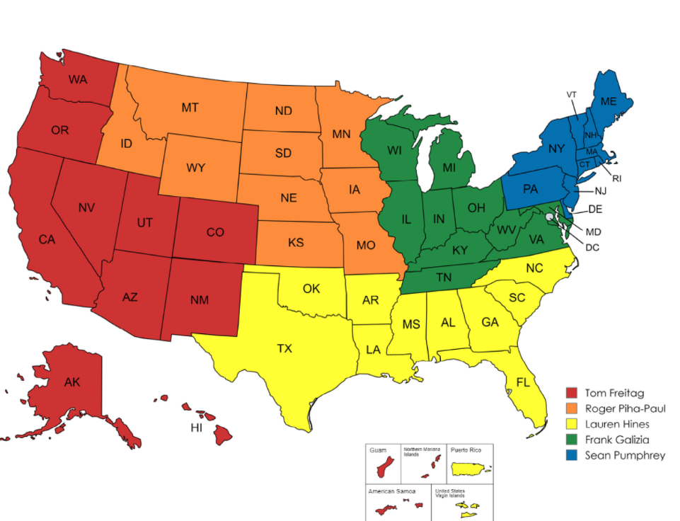
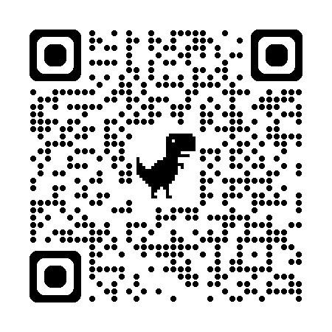
Field Service Program:
Implementing the Quality Monitoring Program
Field Services Program Webpage

Slide 19
Program Duties
Assist Fielded Systems Review and Testing
Anomaly Reports from Jurisdictions
Disseminate Product Advisories
Disseminate Technical Bulletins
Perform Manufacturer/VSTL Audits
Provide Training
Act as a Federal Liaison
Instill Confidence & Credibility

Slide 20
Hash Verification

Slide 21
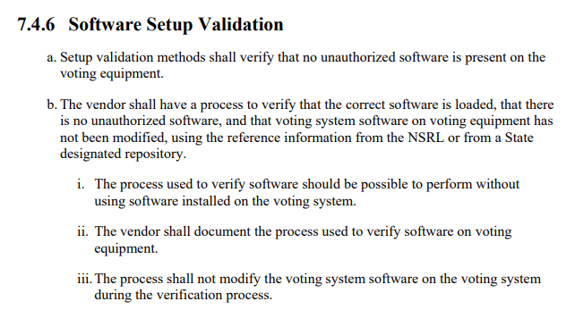
Why Hash Verification?

Slide 22
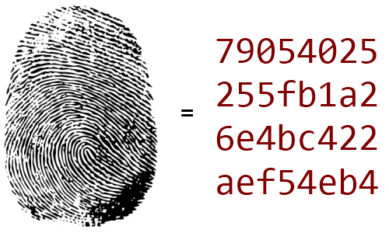
What is Hash Verification?
Hash verification is a method for checking the integrity of a digital file.

Slide 23




What is Hash Verification?
SHA-256
f9cc8b529b6fd53e40c499acc94fa471ac0299f2ec024cty5c4a33d0e31e64cf
Software
Secure Hashing Algorithm
25d914d256f114b4dc269bcc3po1c3f0b0695b3de807fd777fad33833db2039f
Encyclopedia
k1ac591fa280164967850f08035195d2d3658acf1e843ty93ac99191a84c9354
Image

Slide 24
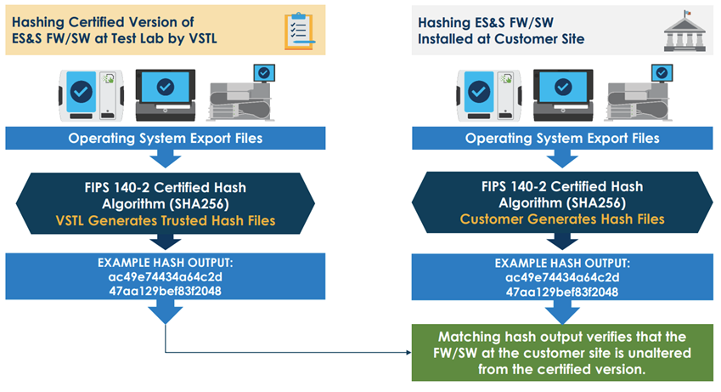



Trusted Build Hashes
Request Hashes from FSP

Slide 25
What This Means For You?

Slide 26

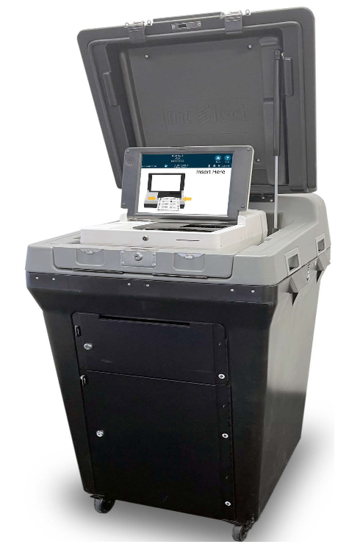

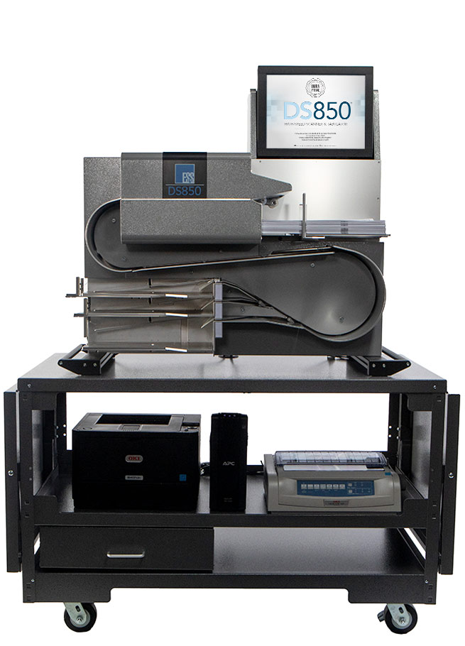

Determine what works for CT
Sample Machines Hash
Full Hash of EMS and Central Count

Slide 27
FSP Pilot Program, General Process
Determine Manufacture Process
Determine timelines and logistics and scope
Obtain Trusted Build Hashes from EAC
Generate Hashes in the Field
Perform Comparison of Hashes
Document Matching Hashes
EAC Report (If requested)

Slide 28


Seal of Approval

Slide 29

Recent Program Successes
… County
ES&S EVS 6.2.0.1
350,000+ Registered Voters
30 ExpressVotes 9-DS850 1 EMS
State of …
Hart Verity 2.7
850,000+ Registered Voters
10 Verity Central Workstations

Slide 30
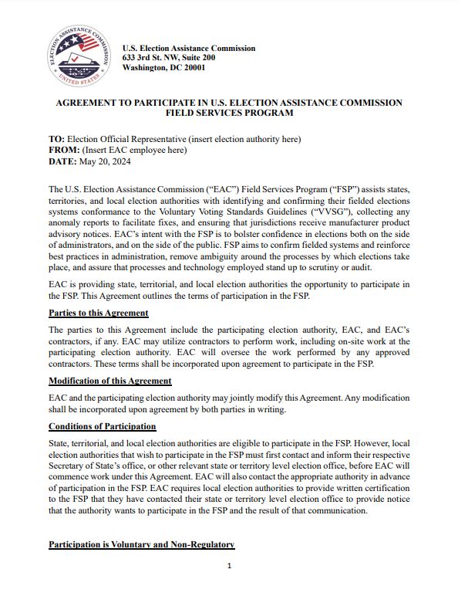
Field Services Agreement
Non-binding
Terminate at any time
Private until published
Requires state approval before local engagement

Slide 31

Let Re-HASH
EAC
Testing & Certification
T&C Program Manual
Quality Monitoring
Field Services
Hash Verification

Slide 32
Questions?

Slide 33
Contact
Field Services Program (FSP) | U.S. Election Assistance Commission (eac.gov)
Sean Pumphrey
Field Services Specialist
spumphrey@eac.gov
771-210-9632

