Slide 1


EMS Refresher:
2024 General Election
Office of the Secretary of the State

Slide 2

To-Do List
A week before the Election
Review and print your Tally Sheet Template under Reports. Polling locations need to be assigned to generate this report.
Check that polling locations are correct: Early Voting, Same Day Registration, and Central Absentee locations are not polling places in EMS. They are included in the audit drawing, that is why we require a them to be reported to us.
Verify that your Head Moderator can access EMS. You can reset their password under Maintain Moderator/Head Moderator.
Review and print a blank Head Moderator’s Return under Reports
Plan “B” for election night if there is a system failure
  Please manually fill out a paper backup of the Head Moderator’s Return (e.g., the blank return you printed for your town or the generic template SOTS emailed you).
  Email the paper backup to Moriah.Moriarty@ct.gov and LEAD@ct.gov.

Slide 3
Things to Remember
On Election Night
The Head Moderator is responsible for entering the results and generating the return.
Head Moderator may be assisted by Data Entry person.
Preliminary Results must be entered by midnight (polling place tapes).
Preliminary Stats must be entered by midnight before you can generate a return.
Remember: You must Submit to State and electronically sign and certify three times: (1)candidates results, (2) stats, and (3) question results.
The Days Following the Election
Send SOTS a final return by the Friday following the election.
Wet signature is required for the two copies (one to Town Clerk, one to SOTS) of original, and all amendments should be sent to SOTS postmarked by Friday.
No amendments will be allowed after Friday.
Multi polling place towns are required to meet with Town Clerk to reconcile Head Moderator’s Return.
Ballot ordered is for in-person voting on Election Day.
Polling place report goes to Lori Magora (email lori.magora@ct.gov).
Click Submit

Slide 4
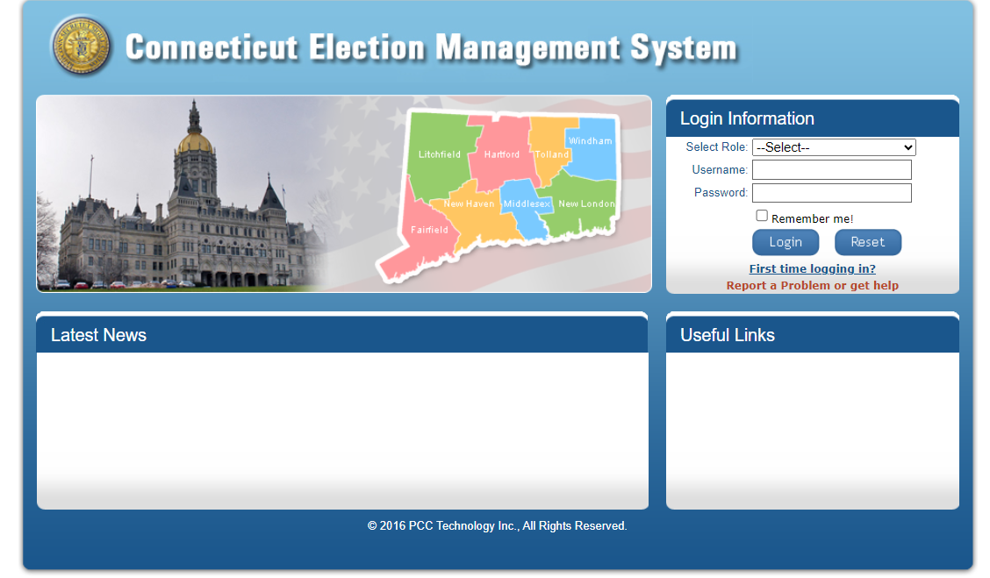
Just to remind you: SOTS Support
Do you have questions or need support? We are here to help.
EMS Help Desk before 8 p.m. on Election Day: (860) 509-6100
Forgot your login or password? Use Report a Problem or get help from the EMS home page.
Our email is also available: LEAD@ct.gov
860-509-6111
“Report a Problem”
Click Submit

Slide 5
Just to remind you: SOTS Support
LEAD Contacts
Heather Augeri: (860) 356-0954 (EMS Support)
Lori Magora: (860) 438-6250 (Accepting Returns)
Moriah Moriarty: (860) 597-6419 (Accepting Stats)
Taffy Womack: (860) 509-6117 (Accepting Returns and EMS Support)
Mark Severance: (860) 509-6108 (EMS Support)
Tim DeCarlo: (860) 213-8344 (EMS Support)
Kristin Sullivan: (860) 509-6122
860-509-6111
“Report a Problem”
Click Submit

Slide 6

75 Feet!
Your Kingdom for a Day
Office of the Secretary of the State
Notes:
Opening Joke -- Man gets a job painting a line on the road. First day he paints 300 yards of line. The boss is duly impressed and pays him. The second day the man paints 150 yards. The boss is not as impressed, but is satisfied. He pays the man. The third day the man paints 75 yards. The boss exclaims that his work is getting worse everyday. The man says that the paint can keeps getting farther away each day.
The moral of this story is that you can only make true judgments when you have all the information. So when you ask our office for an answer, we can only give you one with the facts that you have presented to us. This presentation will give you a broad overview

Slide 7


75 Feet
Who can be in it?
Where does it start?
Is it in effect during Early Voting?
Can I really Taser violators?
Where does it end?
Office of the Connecticut Secretary of the State

Slide 8


WHY?! Do we do this?
Connecticut General Statute Sec. 9-236. Activities prohibited in and near polling place; distance markers; entry restricted; exceptions.
Text

Slide 9
Why do I implement?
The purpose of the statute is to
Prevent Electioneering
Promote Efficiency
Ensure Security
Office of the Connecticut Secretary of the State
Notes:
Due to past litigation, this office has an official stance on interpretations of 9-236. This office will assess each scenario on a case by case basis. The court in McMahon v. Bysiewicz created a framework in which this office has to look at each case’s facts separately.

Slide 10


Title
What physical area does 75 feet cover?
75 Feet from any and all entrances used by voters to enter the polling place.
This is a radius with the door being the center of the circle
The area of the circle includes areas inside of the building being used as polling place.
Notes:
For those who are years off from geometry class, a semi-circle is half a circle.
Now,

Slide 11
Title
Who measures out the 75
This office has held that the moderator is responsible for measuring out the 75 feet.
Notes:
In the past we have said that
If there is any doubt that the 75 feet is accurate use a tape measure.
Moderators have paced out the 75 feet. For your own sanity give the moderator a tape measure.
When the 75 feet ends up in the middle of a road, set the sign up to the road and allow the police to deal with the traffic flow.
How many signs do we need? One for each entrance to the polling place or EV location

Slide 12
Title
What happens inside the 75 feet?
Voting
Notes:
This is suppose to be what happens in a polling place. An elector is suppose to be able to cast a ballot unfettered by undue influence.

Slide 13
Title
What happens inside the 75 feet at an EV location?
Ordinary business as long as not electioneering
Notes:
Now, you are all asking does the 75 foot rule apply to the Early Voting locations. Short answer is “yes.” Same rules as a polling place, but the twist here is that the ordinary governmental business can be done here. People coming in to pay taxes, file liens etc can come into town hall. But once done they have to leave. Otherwise, any prohibited by 9-236 for a normal polling place is prohibited in the Early Voting location.

Slide 14
Title
What Else Happens Inside 75 feet
If the registrars agree, they can let some other things happen
PTA bake sales or fund raising
Distribution of “I voted” stickers
Non-partisan activities
News crews.
Notes:
These are exceptions built into the statute. This question that has come it

Slide 15
Title
What Doesn’t Happen in 75 feet?
Electioneering
Disruption to the process of voting
Notes:
This is where things start to get muddy. This office has maintained that any paraphernalia that advocates for a candidate or cause is considered electioneering. This includes palm cards, t-shirts, hats and buttons. The McMahon case showed us that the line for advocating is not as clear as we want it. For instance, what if the firemen show up in full gear during the referendum for a new firehouse? This might not be considered electioneering, but if they come in wearing a hat that says “fire department” they could be considered electioneering. The reason that I do not give a blanket statement that it is or isn’t electioneering is because these questions are highly highly fact specific. That is when we welcome a call from you.
The disruption of voting. Unfortunately, we have to prepare for this possibility this election cycle. There may be disruptive elements to come into the polling place in November. The moderator is allowed to removed the elements. You can’t taze the person. If the person is difficult, then the moderator can ask an officer to enforce the peace.

Slide 16
Title
What Happens Outside of 75 feet?
We don’t care (almost)
Sound trucks that blast sound into the 75 foot zone is restricted. (if not by local ordinance, then by the moderator)
Blocking entry to the parking lot of the polling locations. (please call the police)

Slide 17
Title
What else?
Once the voter finishes voting and is leaving
Pollsters can be present and doing their jobs
Police at the polling location.
Curbside voting

Slide 18
Title
Curbside Voting
Voter requesting for curbside
Don’t question the condition
Two people should bring ballot
Allow the voter to complete the ballot. Abuses of CV should be reported, but not investigated by the moderator report to SEEC
Moderator is in charge of the area for voting regardless of the 75 marker.

Slide 19

Supervised Absentee Balloting
Independent Living Facilities
Office of the Connecticut Secretary of the State

Slide 20
C.G.S. § 9-159r
Mandatory supervised absentee voting at institutions
(a) Notwithstanding any provision of the general statutes to the contrary, if twenty or more of the patients in any institution in the state are electors, absentee ballots voted by such electors shall be voted under the supervision of the registrars of voters or their designees of the town in which the institution is located, in accordance with the provisions of this section. As used in this section, “institution” has the same meaning as provided in section 9-159q.
Office of the Connecticut Secretary of the State

Slide 21
C.G.S. § 9-159r
(b) Application for an absentee ballot for any such patient shall be made to the clerk of the town in which such patient is eligible to vote. The application procedure set forth in section 9-140 shall apply, except that the clerk shall deliver the absentee voting set for any such application to the clerk of the town in which the institution is located, who shall deliver all such voting sets he receives to the registrars of such town, on the date when the supervision of absentee balloting is to occur. The ballots and envelopes shall be prepared for delivery to the applicant as provided in sections 9-137 to 9-140a, inclusive. The registrars or their designees shall furnish the town clerk a written receipt for such ballots. The registrars of the town in which an institution is located and the administrator of the institution shall mutually agree on a date and time for such supervision of absentee balloting, which shall be not later than the last business day before the election or primary.
(c) The supervision of absentee balloting under this section shall be carried out in accordance with the provisions of subsections (g), (h), (i) and (k) of section 9-159q.
Office of the Connecticut Secretary of the State

Slide 22
C.G.S. § 9-159r
(d) Notwithstanding the provisions of subsections (a) to (c), inclusive, of this section, for the state election in 2020, and any election or primary held on or after June 23, 2021, but prior to November 3, 2021, the Secretary of the State may waive any requirement under said subsections, provided the Secretary (1) waives such requirement in recognition of the public health and civil preparedness emergency declared by the Governor on March 10, 2020, and has consulted with the Commissioner of Public Health or said commissioner's designee regarding such waiver, (2) has given written notice to the town clerk and registrars of voters in each municipality, and (3) has submitted a report, in accordance with section 11-4a, to the joint standing committee of the General Assembly having cognizance of matters relating to elections advising of such waiver and specifying alternative actions to be taken to provide opportunities for absentee voting by electors described in this section.
Office of the Connecticut Secretary of the State

Slide 23

What is Independent Living?
According to a private Independent Living facility in Connecticut...
Your own private retreat awaiting your personal touches.
Spacious apartment homes in your choice of studio, one and two bedrooms and standalone cottages with all the comforts of home—fully equipped kitchens, plenty of closet space and modern bathrooms.
INDEPENDENT LIVING
Independent living is the privacy of your own apartment home where the company does all the upkeep with the added benefit of community living—luxurious common areas, a variety of dining experiences, abundant amenities and plenty of opportunities to explore your personal passions and connections.

Slide 24
Independent Living
Is an independent living facility subject to 9-159r?
Depends
Many private independent living facilities in Connecticut offer three tiers of living: independent, assisted, and nursing care.
Does the independent living also house a nursing home facility on the same campus?
Are the addresses the same for the independent living and the nursing home facilities?
If so, then Yes, you must deem the address as a supervised balloting location for all residents who request an absentee ballot.
Office of the Connecticut Secretary of the State

Slide 25
Two Facilities in Connecticut
Village at East Farms in Waterbury is located at 180 Scott Road.
    The facility offers three tiers of step-down living including nursing home care
    All residents at the independent, assisted, and nursing care living areas all share the same address
    This means 180 Scott Road in Waterbury is deemed a supervised absentee facility
Elim Park Place in Cheshire is located at 150 Cook Hill Road.
    The facility offers three tiers of step-down living, including nursing home care
    The nursing care facility is located at a separate address, 140 Cook Hill Road
    This means only those located in the nursing home facility fall under 9-159r
Office of the Connecticut Secretary of the State

Slide 26
Absentee Ballots for Overseas Voters
How to Respond when an Elector's Return is Uncertain or
They Do Not Intend to Return
Office of the Connecticut Secretary of the State

Slide 27
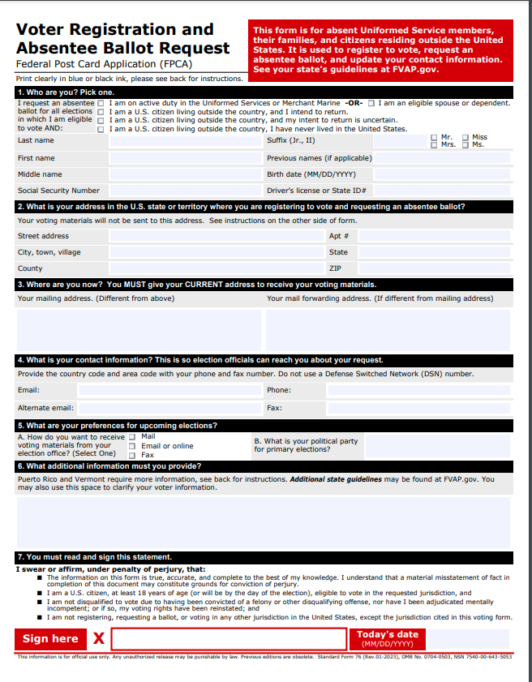

Federal Post Card Application
(Good for all elections within calendar year)
Text

Slide 28
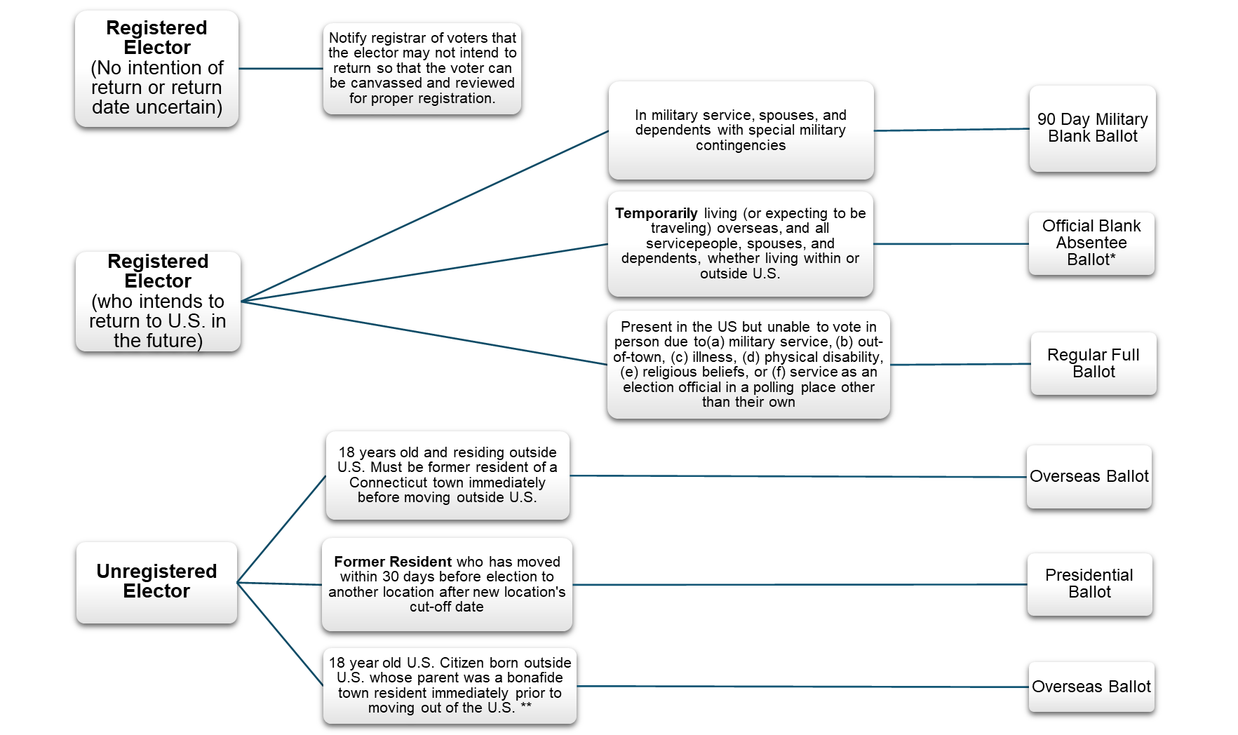
Absentee Ballot Flowchart
Office of the Connecticut Secretary of the State

Slide 29
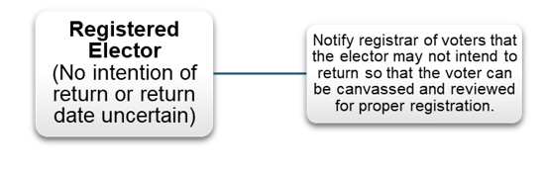
Common Point of Confusion
C
In consultation with the Department of Justice and FVAP, the Office of the Secretary of the State has clarified the proper manner to process these applications.

Slide 30
FPCA Process
Town Clerk receives an FPCA where the voter has indicated their return is uncertain or they do not intend to return. The voter is registered in CVRS and Active.
TC should give a copy of the FPCA to the Registrars of Voters
Registrars must examine FPCA in addition to facts known to them.
Registrar should process FPCA as change of address and notify voter of federal only status.
Office of the Connecticut Secretary of the State

Slide 31
Example
A registered elector who selects either no intent to return or return uncertain gets an overseas federal offices only ballot.
The ROV must be given a copy of the FPCA and must review the registration status.
Office of the Connecticut Secretary of the State

Slide 32
Example Continued...
A registered elector who selects either no intent to return or return uncertain is indicating they are no longer a resident of the town.
The elector should be removed from the registry.
Office of the Connecticut Secretary of the State

Slide 33
Best Practices
The Office of the Secretary of the State prefers the processing of the FPCA happen without delay.
The Town Clerk should send an overseas ballot to these voters.
You may wish to contact the voter to ensure no confusion
  Facts to Consider :
    Does the elector still own a home in the town?
    Could the voter be confused, and would they benefit from the canvass?
Office of the Connecticut Secretary of the State

Slide 34
Important Notes
If the voter indicates an intent to return, their status on the voter roll would not change to unregistered.
If a voter was canvassed and did not return the confirmation of voting residence card, and they are marked inactive in CVRS, the receipt of an FPCA that indicates the voter is uncertain of their return does not serve to move the voter to active status. Here, the receipt of an FPCA serves as confirmation that the voter should be unregistered and notified of being a federal-only voter.
Office of the Connecticut Secretary of the State

Slide 35
Questions?

