Slide 1
U.S. Digital Response
CT Voter Data
Registrars of Voters Association of Connecticut (ROVAC)
April 10, 2024

Slide 2

Welcome
Jide Ehimika
Product Manager - Elections Rapid Response
jide@usdigitalresponse.org
Notes:
Lead our rapid response work. Honor to talk about what we do at USDR and how we can help government do their work more efficiently.

Slide 3
We’ll cover a lot of ground over lunch!
What we do at USDR
Custom Technical Projects (Rapid Response)
  CT Data Transparency
  Other rapid response examples
Elections Program At USDR
  Simple digital solutions to complex elections problems
  Elections Software Collaborative

Slide 4
U.S. Digital Response
We’re a nonprofit, nonpartisan organization pairing the best of pro-bono technical talent with the people solving our most important public problems.
Our experienced volunteer technologists work alongside public servants to deliver digital services and build capacity, quickly.
www.usdigitalresponse.org
@USDResponse
Notes:
Non partisan, non profit, made up of mostly volunteer technologists (over 9000!) with a little over 30 FT paid staff

Slide 5
Hartford, CT ROV: Giselle Feliciano
Want to present to council before budget meeting
24 locations and 7 early voting
Part of the vote coalition group, work with data institute
  Have a lot of data that can be shared
Voter numbers have dropped significantly
  Not registered but the outreach piece
Have not used their money yet, so they may have some room for additional asks
  Want to include candidate information in that data as well

Slide 6





U.S. Digital Response
5 focus areas
Elections, federal grants, user research, procurement, language access
385 projects completed
to improve services across 43 states & territories
9,000 volunteers
1,000+ expert technologists placed on projects
www.usdigitalresponse.org
@USDResponse
Free where legally allowed
*For the Elections Software Collaborative we have a membership fee
Notes:
5 focus areas but a heavy push into AI this year. Google collaboration with their AI fellows and also additional training and resources.

Slide 7
Custom Technical Projects
Our network of expert volunteers work with you to create what you need
Free where legally allowed (Free in CT!)
Notes:
Going to share about opportunities to utilize technology to support local administration.
In part because these projects are interesting!
In part because it gives you an idea of how we work and what’s possible
In part because, selfishly, we are looking for new ideas and partners, so if you

Slide 8

Making administrators’ jobs easier
One-off very specific project for single jurisdiction
Custom to your problem/need
6-12 week avg length project
No continued support from USDR
Free where legally allowed
Notes:
USDR started in 2020 just doing rapid response projects. We wanted to get in, help and get out of the way. We still do these as needed.
Model works: we deploy experienced technologists and staff to do free custom projects for local government.
Our projects range widely in scope:
User research, RFP and procurement support (for software), hiring tech talent, language access and
Databases, gis tools, automate manual processes.
A few example of projects that I think are showcase the opportunities to use technology to support local gov. These are specifically elections projects, but we do them for non-elections departments a well.

Slide 9




U.S. Digital Response
Requests
for help
Careful Matchmaking
Project Collaboration
Skilled
volunteers
Notes:
When any level of government is looking for a technical solution, they reach out to USDR and we pair them up with vetted and highly skilled volunteers.
We do this for free where legally allowed. In CT, our projects are free.

Slide 10
CT Data Transparency Project
Bringing information to voters
Notes:
Jide

Slide 11
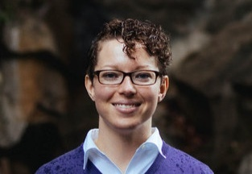

Volunteers
Sierra Brandt
Ryan Schwartz

Slide 12
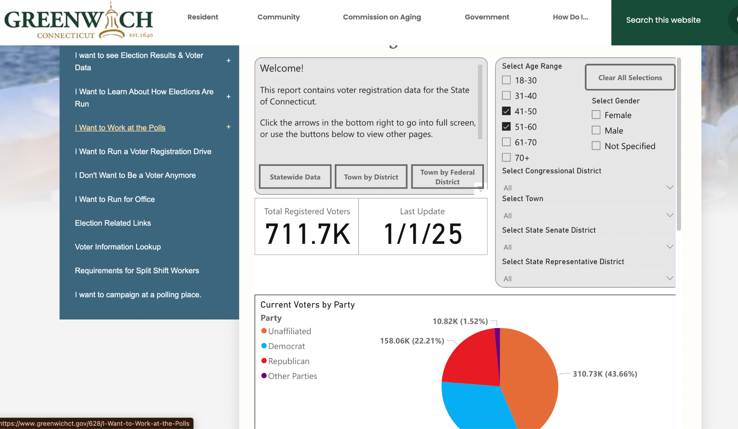
Notes:
Built on PowerBI, solution that was quickly taken by the volunteers. Worked with Fred and had the phase I of the project complete in less than a month.

Slide 13
CT Voter Data Sample
From: Fred DeCaro
Email to USDR
“Attached is the info I sent to USDR for a project which would display voter demographic data. We have already built something like this for my Town but the idea was to do something which could be iframed and used by any town.”
CT Demographic Data - State and Local Views
Notes:
How it started: After some informal discussion we received an email from Fred. We met to further discuss the requirements and timeline for this project. Then we staffed with volunteers and got started with the work.

Slide 14
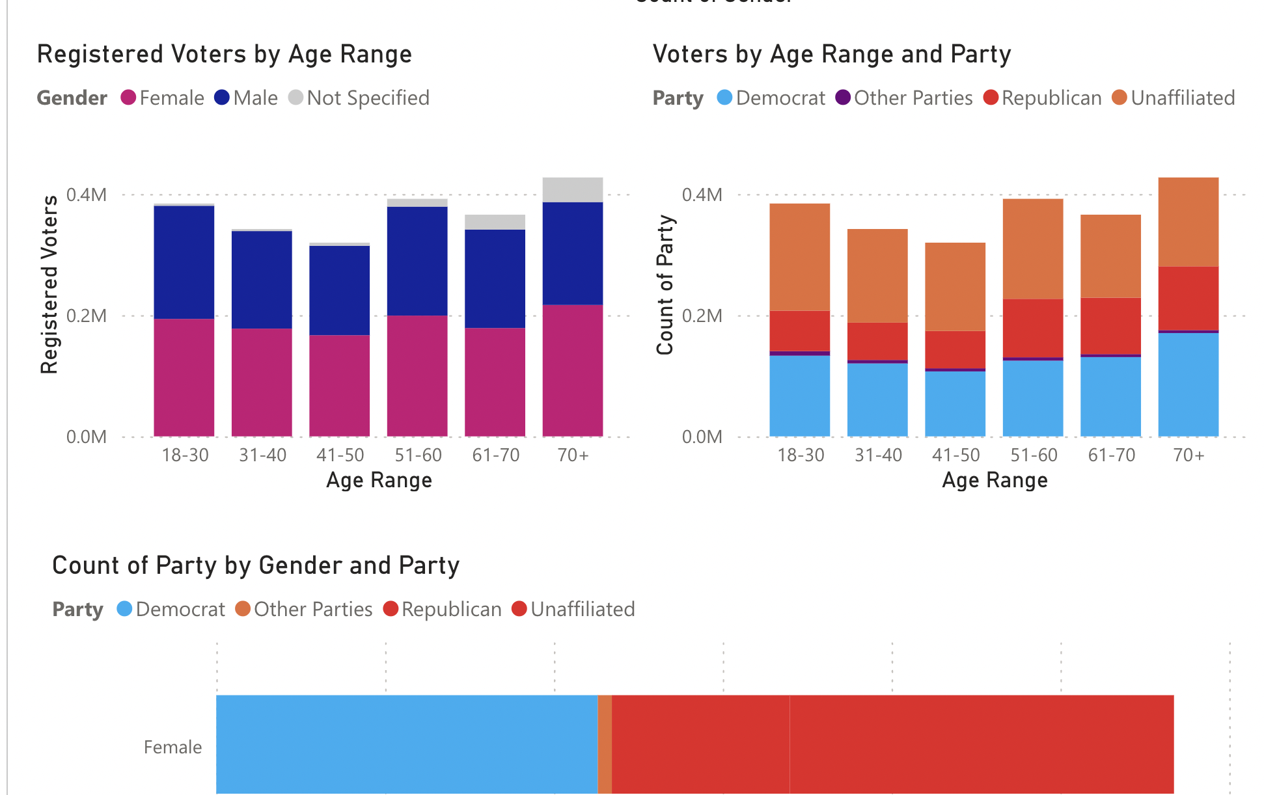
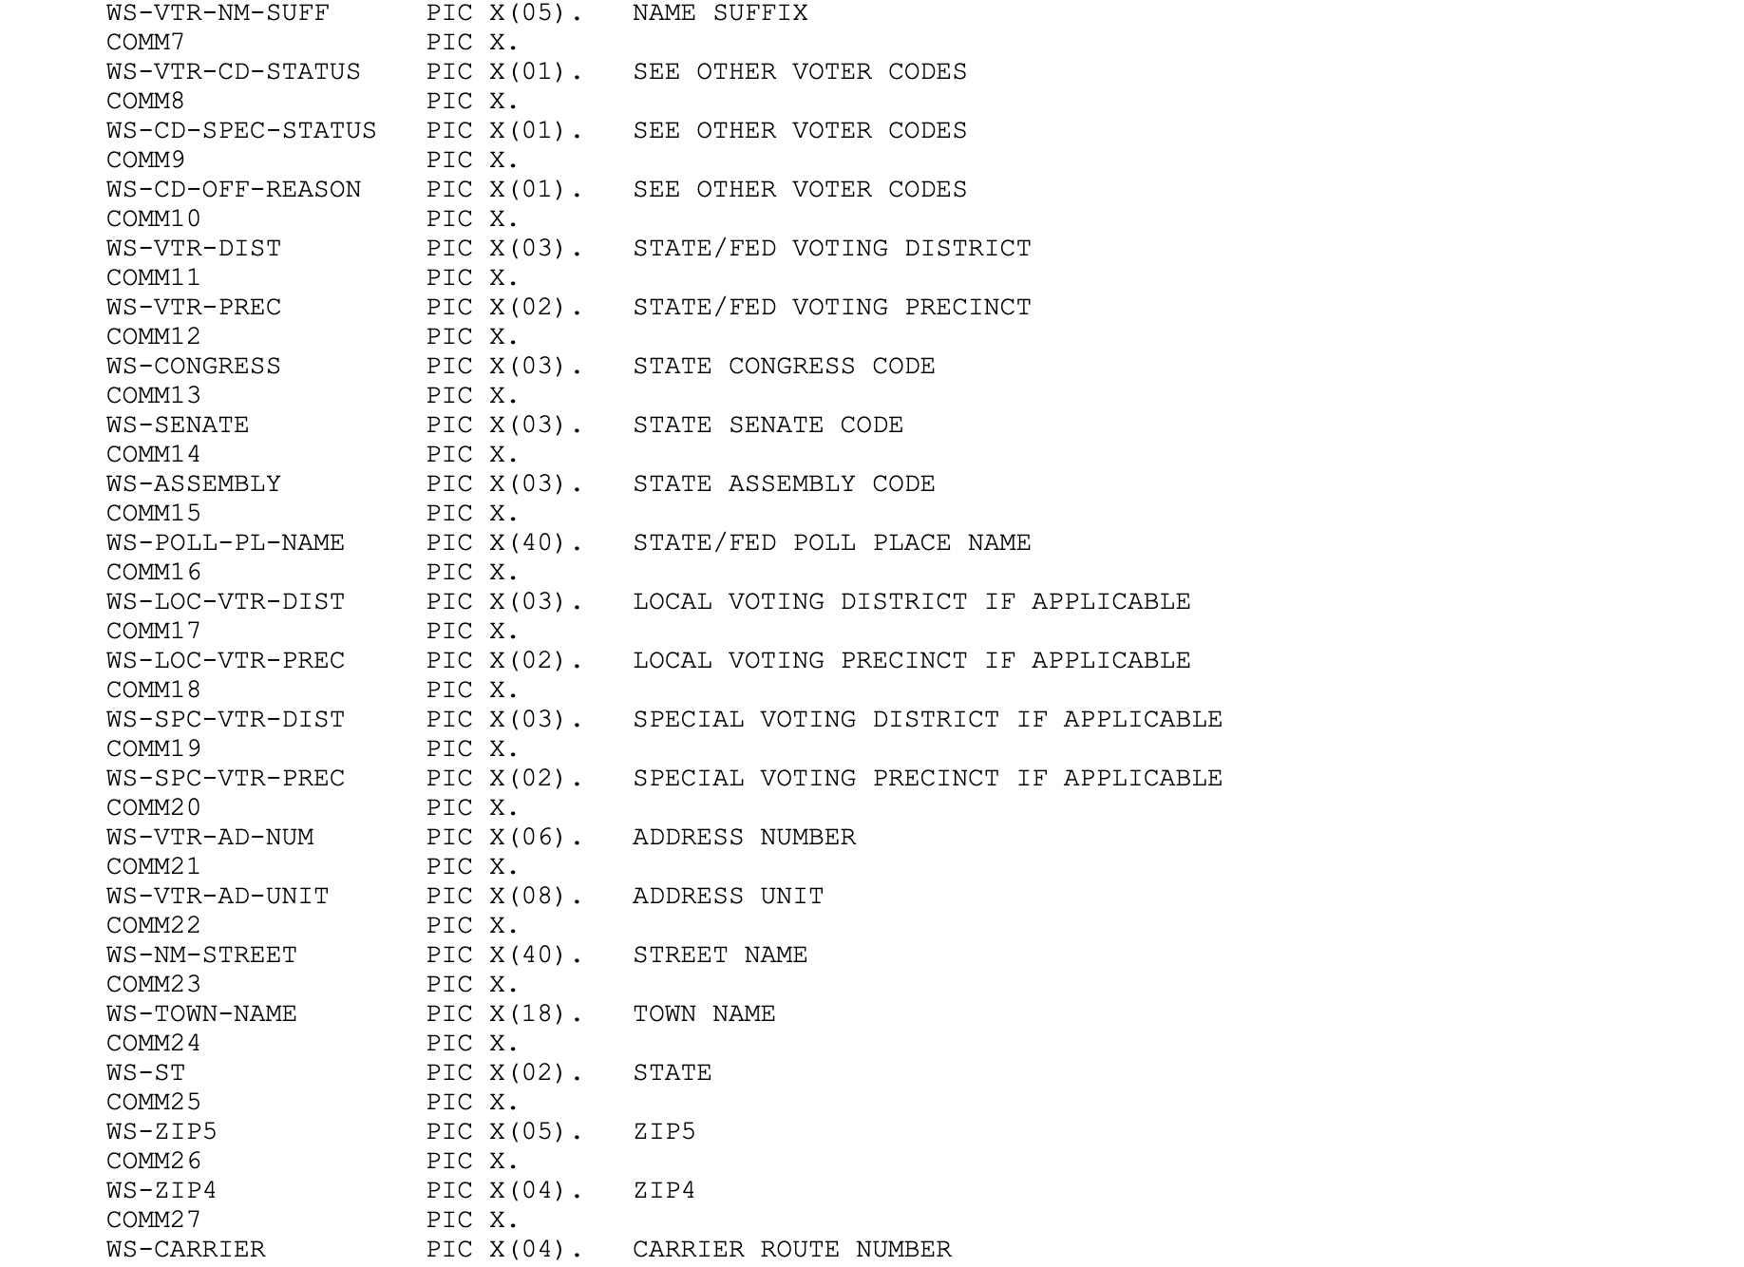
Raw Data Files
PowerBI data
Notes:
Every quarter, Fred receives file from state on voter demographic info. Our volunteer used this data to create charts in PowerBI that could embed on a website. Now when Fred receives his quarterly file from the state he can easily update the data source with new quarterly data.

Slide 15
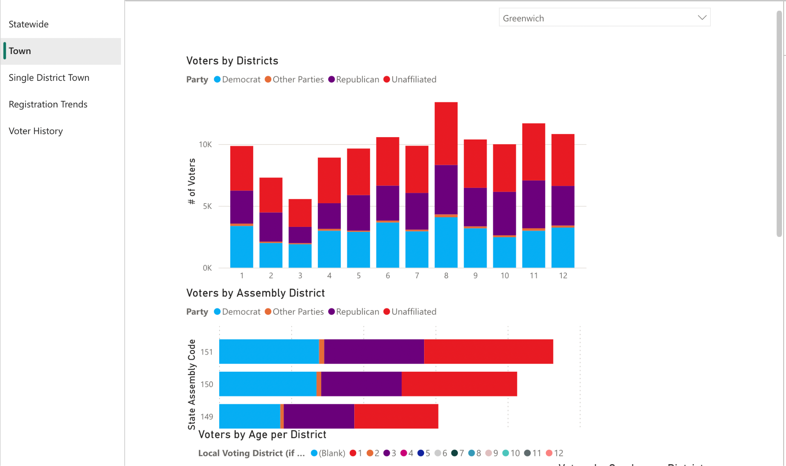
Notes:
Fred can now drill down into the data and view it in different ways that are more relevant and helpful. He can view the data statewide, by towns, and by single district towns. The solution is flexible to how CT administers their elections.

Slide 16


What is the impact?
Quality tools that are easy to use and built to solve your most pressing needs
Our network of expert volunteers work with you to create what you need
Free where legally allowed (Free in CT!)
Projects that are designed to set up and deliver quickly!
Notes:
Recap: This project delivered the best of USDR rapid response. Our team responded to a request for help. We provided qualified volunteers as a resource to build a quality easy to use tool that does not require additional ongoing support from USDR. The project was set up and delivered in 4 weeks!

Slide 17

I really enjoyed your presentation at the Election Center conference this summer.
Our office is in need of a public-facing wait time tracker for our six early voting sites. We have been working with another department that will not be able to support us through this election. We do not need anything fancy, just a table for voters to see how long the wait times are at each site during the early voting period: October 20 – November 5. Our workers will have online capabilities to report the wait times at the top of each hour. I have tried to work through building my own Airtable with no success. I am hoping you guys will be able to help our office and would love to talk through any details!
Notes:
Other examples of Rapid Response work:
Received this email on October 5th - needed to be on their website by October 20th
So, our task was build a simple wait time tracker that could be updated by each site electronically and updates would post online

Slide 18
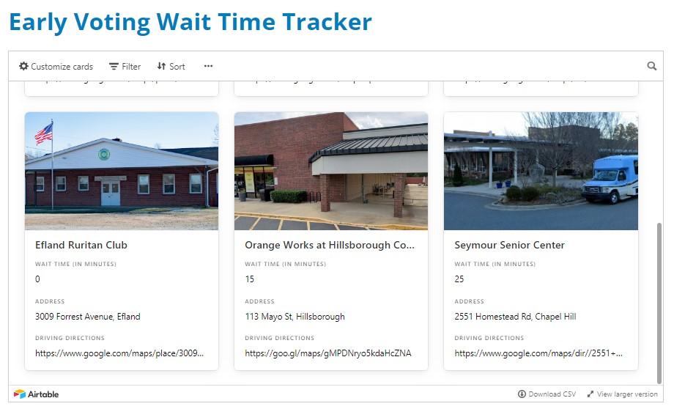
Voting Wait Time Tracker
Simple Wait Time Tool
Web Interface
From idea to completion in 2 days!
Setup for 4 add’l partners within 2 weeks

Slide 19
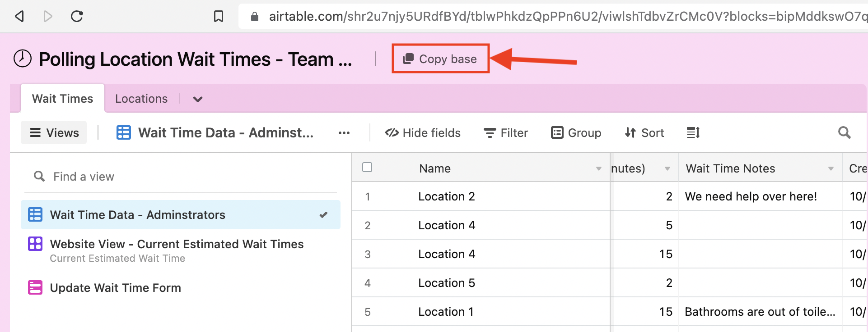
Voting Wait Time Tracker
Available FREE! For anyone
https://www.electionexcellence.org/resources
Step-by-step instructions

Slide 20
Election Administration Platform (EAP)
Software for Election Officials, co-developed by Election Officials
Notes:
Lindsey

Slide 21

The Election Administration Platform (EAP) Saves Election Officials’ Time by Streamlining Back-Office Logistics
Most popular!
Election Worker Management System
Online Help Desk
Asset Tracker
Campaign Finance
Recruit, staff, and schedule election workers to any type of voting location.
Resolve voting location problems quickly.
Use barcode scanning to keep track of chain of custody.
Track candidates, committees, and campaign finance filings.
Recent added: automated task tracker, chain of custody
Notes:
Despite their complexity and importance, the majority of elections are managed using excel.

Slide 22
Election Software Collaborative
Bringing election officials together to co-develop and co-procure affordable, high-quality and voter-centric software

Slide 23















What is a Software Collaborative?
Method for building and delivering software, featuring:
Co-Development
Cost Sharing - Joint Purchasing
Immediate deployment of product improvements through a shared platform
Mutually beneficial relationship, including member input, and support in growth
Notes:
You might be asking → what the heck is a software collaborative?
It brings together government members to co-develop and co-procure software. This fits USDR’s model of building features and products with government, while allowing us to not only scale efficiently, but also purchase better technology for cheaper prices.
Historically, each jurisdiction would purchase their own licenses of low code tools and USDR would set them up. By entering into a joint purchase agreement, costs are not only lower, we can purchase higher level tools - Enterprise edition - which has more tools, better security and is easier on the development side.
Our goal is to create an interactive community of Election Administrators that would share ideas and best practices around technology for Election Administration.

Slide 24
Joining the Software Collaborative
Membership Fee - based on population
  Compliance
  Sustainability
  Scalability
User Fees
  Based on number of users
Co-Development
  Required to attend member meetings to provide input into into new features
Notes:
Our products have been around for a while, but we just accepted our inaugural class of members into our software collaborative.
Software Collaborative - three parts
Membership fee - based on population
User fees - based on usage
Based our membership fee on 3 philosophies:
Compliance - with the various state laws governing the restriction of gifts/donations/grants/funding for election administration.
Sustainability - we want the Collaborative to be around for a long time. Right now USDR is the facilitator of the program, but out long term goal is that members of the collaborative will govern in the future.
Scalability - a goal to serve as many election jurisdictions nationwide as possible.
Co-Development - required to share with others
Are you curious how much this costs?

Slide 25
Annual Membership Fee
POPULATION TIER | Membership Fee | Up to 20% discount | Final Cost
0 - 124,999 | $2,500 | - $500 | $2,000
125,000 - 349,999 | $4,000 | - $800 | $3,200
350,000 - 749,999 | $7,500 | - $1,500 | $6,000
750,000+ | $17,000 | - $3,400 | $13,600
Notes:
We needed fees at the market rate to comply with the many state laws
Discounts! Up to 20% discount on annual membership fee
Early Adopter
Case Study
Co-presenter
Refer a Friend
Per user fees = $480/yr

Slide 26
Questions?

Slide 27
Want to get in touch?
REQUEST SUPPORT
https://www.usdigitalresponse.org/contact-us
QUESTIONS
intake@usdigitalresponse.org

