Slide 1


2024 Spring
ROVAC Conference
Office of the Secretary of the State

Slide 2

Primary Petitions Basics
Only major parties can hold primary elections in Connecticut, therefore only candidates in the Democratic and Republican parties can be issued Primary Petitions.
Primary Petition Pages are obtained by candidates looking to force a Primary Election against the endorsed candidate(s).
The person requesting a petition form must give the following information to the Registrar of Voters before it can be issued:
  their own name and address; the name, address, and office sought of each candidate for whom the petition is being obtained; and
  a statement signed by each such candidate that they consent to be a candidate for the listed office.

Slide 3
Primary Petitions Basics
The number of signatures needed is:
(1) 2% of the total party enrollment in the state for statewide office (e.g., governor); Issued by SOTS
(2) 2% of the total party enrollment in the district for U.S. Representative; Issued by SOTS
(3) 5% of the total party enrollment in the district for other district offices (e.g., State Senator)
Issued by ROV
(4) 5% of the total party enrollment in the municipality for municipal office (e.g., Mayor). Issued by ROV

Slide 4
Primary Petitions Basics
Two Ways to Access the Ballot
Primary Petitions
Vs
Nomination Petitions

Slide 5
Primary Petition Pages
Primary Petitions:
Given by Registrars / SOTS
Shorter window to obtain signatures
Signatures needed = 5% of total party enrollment in the state, district, or municipality
Success = Primary election

Slide 6
Nominating Petitions:
Nomination Petitions:
Given by Town Clerks / SOTS
Longer window to obtain signatures
Signatures needed = The lesser of 7,500 or 1% of total number of votes cast in the last election
Success = Access to the November ballot

Slide 7

Types of Primary Petition Pages
Town Committee At Large ED-610 (ROV)
Town Committee By Political Subdivision ED-610A (ROV)
Multi-Town District ED-619-DIST (SOTS)
Municipal Office(s) At-Large ED-619 (ROV)
Primary Petition for State Offices ED-619ST (SOTS)

Slide 8
2024 Primary Petition Dates
APRIL 30, 2024 (Tuesday) SEC’Y OF THE STATE PRIMARY PETITIONS - AVAILABLE. Petition forms for person desiring to oppose party endorsed candidates for state office or the district office of Representative in Congress available from the Secretary of the State beginning on this day. (9-404a)

Slide 9
2024 Primary Petition Dates
MAY 22- JUNE 12, 2024 (Wednesday-Wednesday) REGISTRARS PRIMARY PETITIONS - AVAILABLE. Primary petitions for persons desiring to oppose candidates of major party for municipal offices shall be available from the registrars of voters on the day following the making of the party’s endorsement. (9-409)

Slide 10
2024 Primary Petition Dates
MAY 28, 2024 (Tuesday) SEC’Y OF THE STATE PRIMARY PETITIONS - AVAILABLE. Petitions forms for persons desiring to oppose candidates for the district offices of state senator or state representative shall be available from the Secretary of the State on the seventy-seventh day preceding the primary for such office. (9-404a)

Slide 11
2024 Primary Petition Dates
JUNE 11, 2024 (Tuesday) REGISTRARS PRIMARY PETITIONS – FILING. Primary petitions for opposing candidates of major party for state office or district office including Representative in Congress must be submitted to the respective registrars of voters by 4:00 p.m. of the sixty-third day preceding the primary.

Slide 12
2024 Primary Petition Dates
Primary petitions for opposition candidates of a major party for municipal offices must be submitted to respective registrars by 4:00 p.m. of the sixty-third day preceding the primary.
Registrars of voters, deputy registrar or assistant registrar must be in their office or office facilities between 1:00 p.m. and 4:00 p.m. to accept petitions. (9-405 and 9-406

Slide 13
Who Can Circulate
Each circulator must be an enrolled member of the party holding the primary, in any town in this state*.
No candidate, whether an endorsed or petitioning candidate, may circulate a petition for another candidate (or another group of candidates contained in one petition)for the nomination of the party for the same office.
No person may circulate petitions for more than the maximum number of candidates to be nominated by a party for the same office. A candidate may circulate a primary petition in which they are proposed as a candidate. Registrars must reject any petition page circulated in violation of these provisions of the law

Slide 14
Who Can Circulate
The circulator must be certain to have signers sign in their presence, and that their own signed statements are true, or they shall be guilty of a class A misdemeanor, and the whole page may be rejected. A class A misdemeanor is punishable by up to 364 days in prison, a fine of a up to $2,000 or both.
You must give each circulator a significant number of blank copies of the petitions to be used and/or copied.

Slide 15
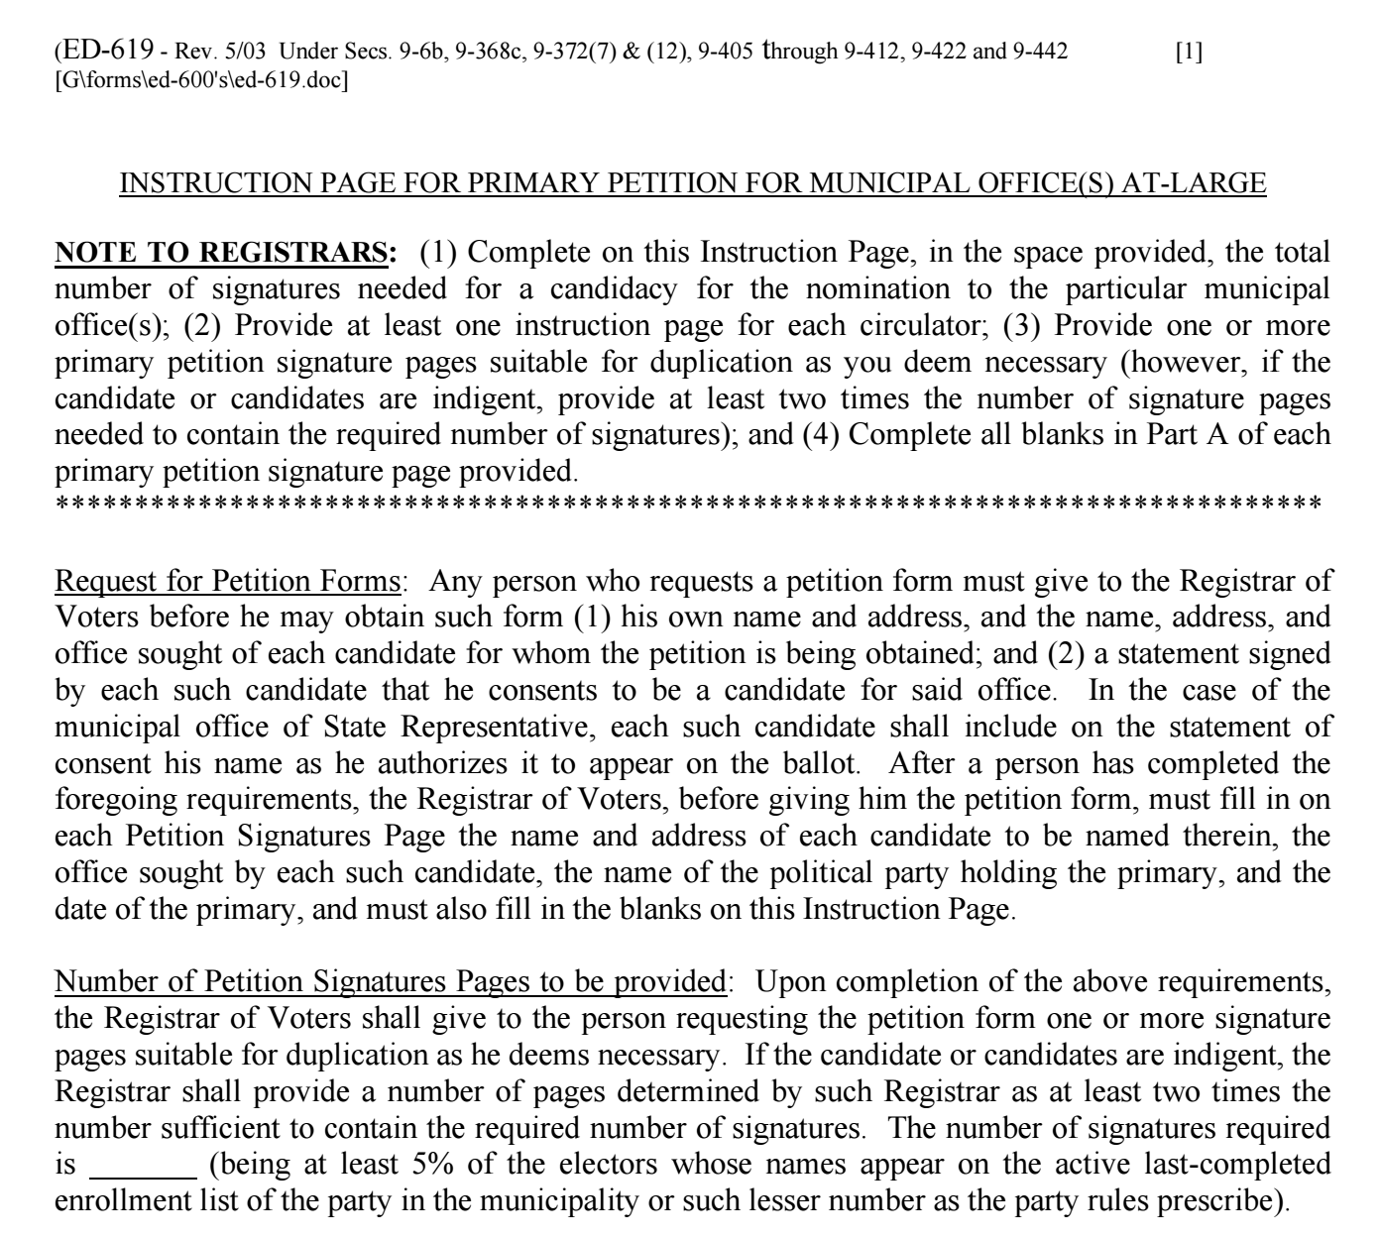
Back Side of Instruction Form
The registrar must insert the number of signatures needed before giving the forms to the candidate.

Slide 16
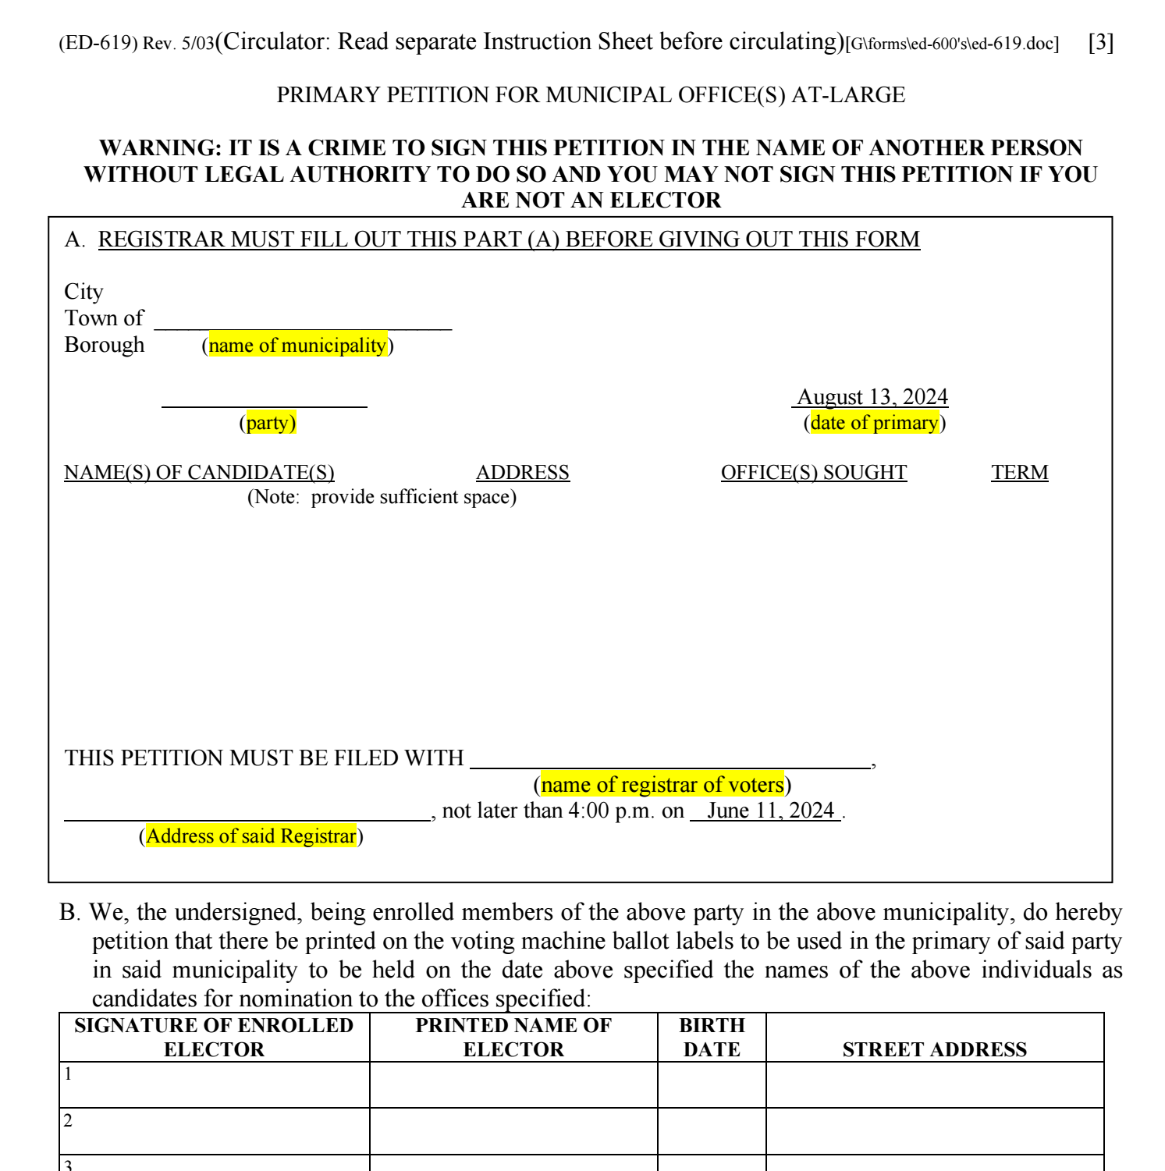
Front Side of Petition Form
These sections are completed by the Registrar

Slide 17
Processing
Registrars are to accept the signature of an elector who:
Appears at said address and has active status
Appears at said address and has inactive status (restore voter in CVRS)
Make sure to select “Petition” for the reason for restoring the voter to active in CVRS.

Slide 18
Processing
Registrars are to reject the signature of an elector who:
Is not enrolled in the political party attempting to have a primary
Is not a registered voter in their town
Has “Off status” in CVRS

Slide 19
Processing
Registrars are to reject the entire form if:
Sections C or D of the petition are not completed

Slide 20
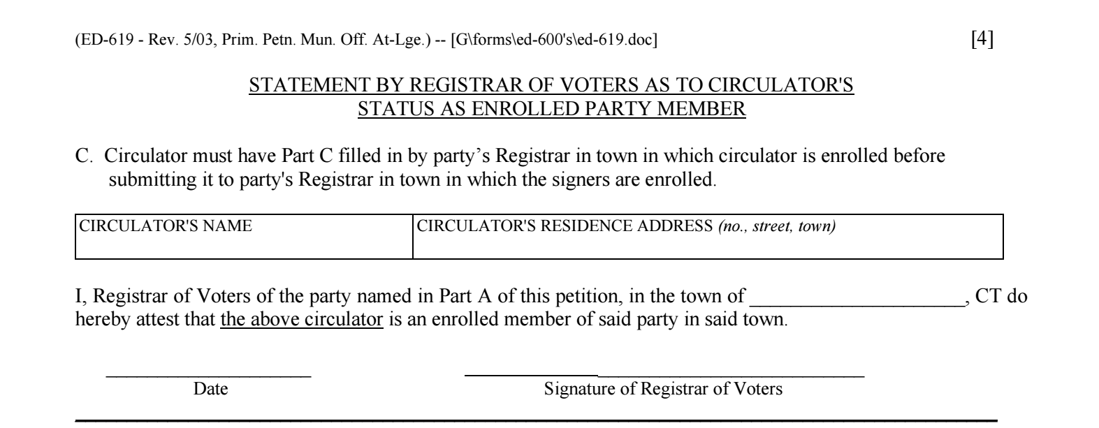
This section must be completed by the Registrar of the town in which the circulator is registered to vote.
If this is not completed upon submission to the Registrar of Voters Office, the registrar must reject.
Back Side of Petition Page

Slide 21
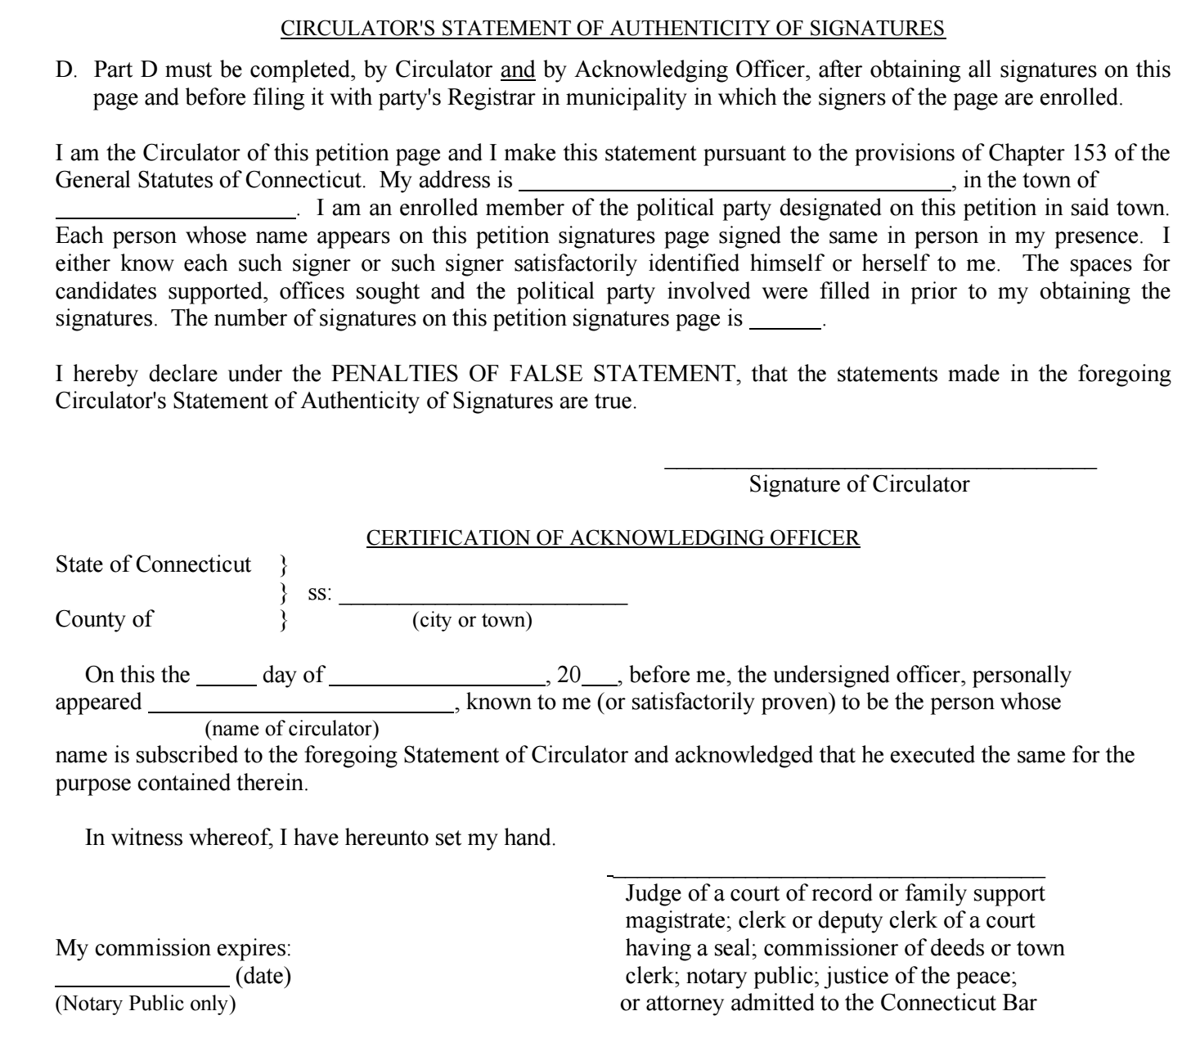
Back Side of Petition Page
These sections must be completed by the Registrar in which the circulator is registered to vote.
If this is not completed upon submitted to the Registrar of Voters Office, you must reject.

Slide 22
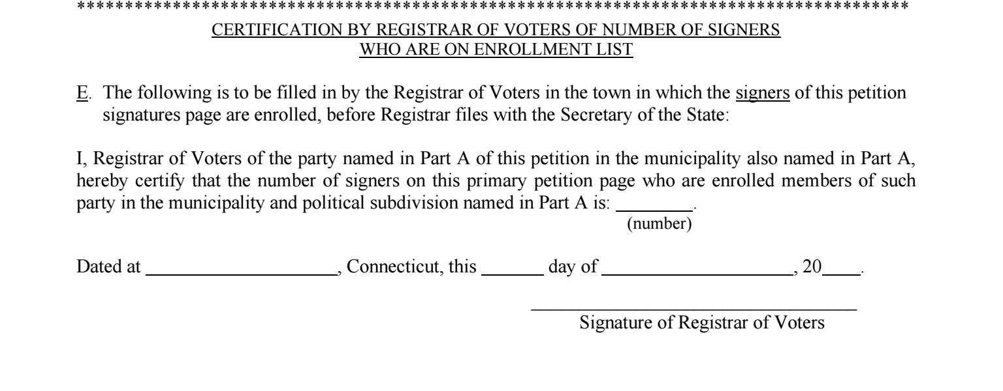
Back Side of Petition Page
This section must be completed by the Registrar after processing the petition.
Failure to complete this section will cause the form to be rejected by SOTS.

Slide 23
Primary Petition Deadline Day
Primary Petition Pages are due to the Registrars of Voters Office no later than 4:00 PM on June 11, 2024.
All 169 Registrars of Votes offices MUST be open between 1:00 PM and 4:00 PM on June 11, 2024, to accept petitions.
A receipt must be given to the circulator or person submitting the petitions stating the number of pages filed and the date and time of the filing.

Slide 24
Primary Petition Deadline Day
Registrars have seven days to process the petition pages, including any petition pages that are forwarded by SOTS to the ROVs.
If the office is a statewide (e.g., U.S. Senator) or district office (e.g., State Senator) the primary petition pages must be sent by the registrar to SOTS.
If the office is a municipal office (e.g. State Representative wholly within one town or registrar of voters)

Slide 25
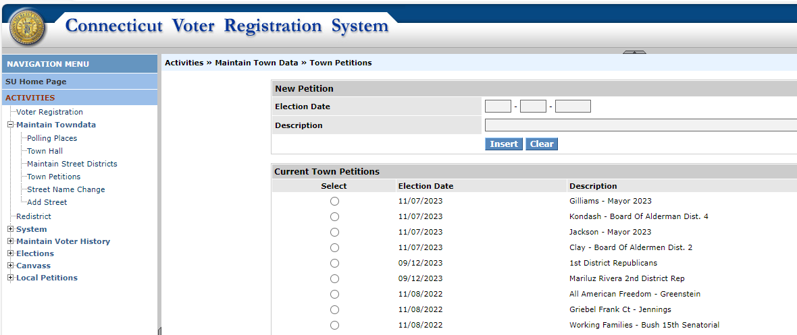
To input a new petition into CVRS you will need to go to "Activities," "Maintain Town Data," and select "Town Petitions."

Slide 26
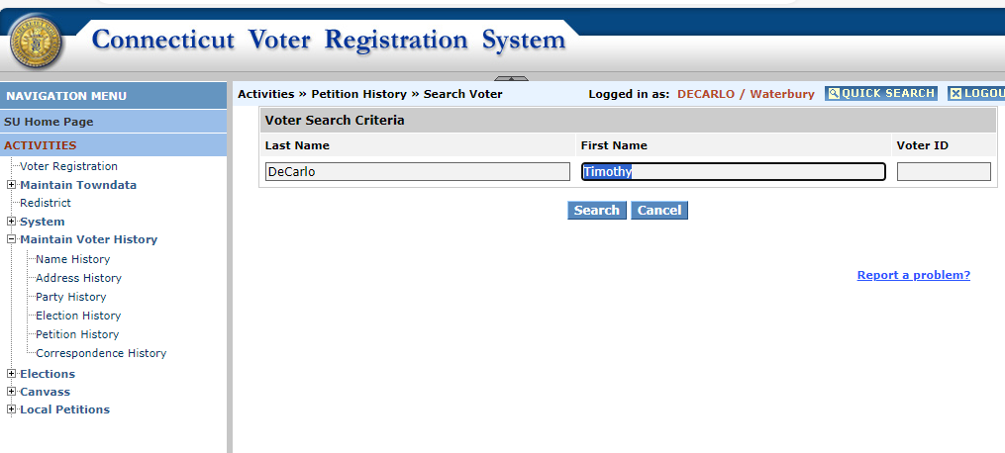
To assign a petition to a voter in CVRS you will need to go to “Activities,” “Maintain Voter History,” “Petition History,” and select your voter.

Slide 27
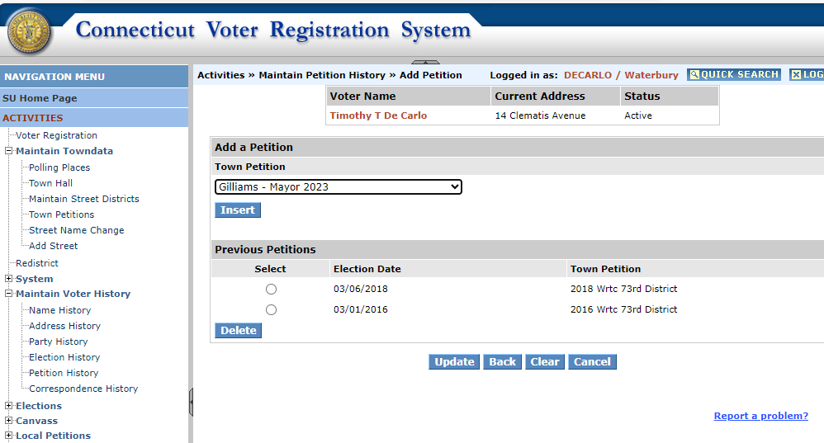
Next add the petition from the dropdown menu, hit “Insert” and then “Update” to assign the petition to the voter.

Slide 28
Now Begins Q&A
Tim De Carlo
Election Officer
Timothy.Decarlo@ct.gov
(860) 929-1061

