Slide 1
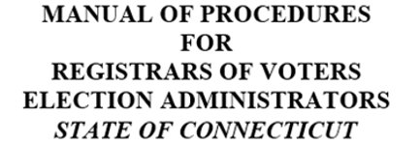
PROCEDURES MANUAL COMMITTEE
Chair: Darlene Burrell - Suffield (Burrdar@cox.net)
Lisbeth Becker – Glastonbury, Karen Birck – Wilton, Kathy Doyle – Woodbury, Anne Greineder – Mansfield, Pennell Hamilton – Woodbridge, Monita Hebert - Bolton, Jennifer Marshall-Nealy – Blmfd, Donna Rusgrove – Burlington, James Simon – Stratford, Claudia Sweeney – Ledyard, Paul Willis - Granby

Slide 2
COMPANION GUIDE to:
CT General Statutes
Public Acts
Regulations
SOTS Guidelines
Best Practices
Handbook Puts Them Together Per Task

Slide 3
ON-LINE USE RECOMMENDED
Easy Navigation Through Manual Online
Live Links to:
To & From Chapters and Table of Contents
References
Statutes (§9-6)
Regulations (Reg. 9-5a)
Public Acts (PA 393)
SOTS Manuals & Guides
HAVA

Slide 4
REGISTRAR’S POSITION
Governed by CT General Statutes
Paid by Municipality
Works Closely with Office of SOTS
Endorsed by Political Party
Politics Does Not Belong in ROV’s Office.
Ensure Fair & Equitable Implementation of all Laws.
Ch1, Pg 3

Slide 5
LIST OF REGISTRAR’S RESPONSIBILITIES
List of Duties CT Registrars are required to do
Tool Often Used In:
Budget Preparation
Helping Others Know What a Registrar Does
Quick Review for ROV
Ch1, Pg 4 - 8

Slide 6
Written Rulings, Instructions & Opinions Regarding Administration of Elections & Primaries
Presumed Correct
Implemented, Executed, and Carried Out
List of SOTS’s Duties Relating to ROV
LEAD
Legislation & Elections Admin. Division
Ch 2, Pg 9 - 10

Slide 7
SEEC
Duties Relating to ROV
Investigate Complaints of Election Law Violations
Power to charge civil penalties
Ch3, Pg 11 - 12

Slide 8
VOTER REGISTRATION & ENROLLMENT
Admission of Electors
Procedures
Registration Sessions
Enrollment of Electors/Party Affiliation
Felons
Registry List
Ch4, Pg 13 - 28

Slide 9
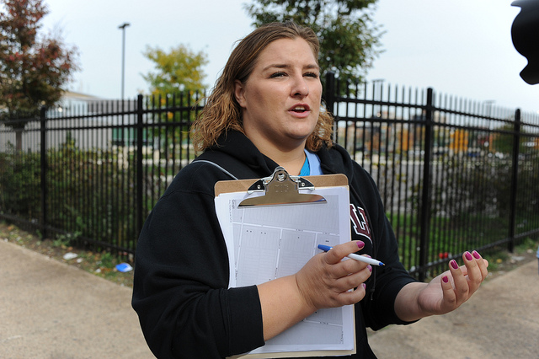
CANVASS & ERIC
Requirements
Types of Canvass
In Person
Telephone
Mail
NCOA
Combination
Step by Step Instructions on NCOA
Ch 5, Pg 29 - 38

Slide 10
VOTERS
Goal
Only One Record Per Voter
Procedure
Step By Step Instructions
Try to Preserve ORIGINAL Record
Ch 6 Pg 39 - 42

Slide 11
FOIA
FREEDOM OF INFORMATION ACT OF CT
Questions and Answers from FOI
Relating to ROV
Records to be Released
Timing
Fees
FOI Pertains to Existing Records Only
Ch 7, Pg 43 - 44

Slide 12
RETENTION & DISPOSITION
Records & Documents
Requirements Apply Only to Official Record Copies.
http://www.ctstatelibrary.org
Series # M6
Ch 8, Pg 46 - 53

Slide 13
PETITIONS *
Primary Petition Procedures
Forms
Signature Requirements
Checking
Filing
ROV Not Responsible for Nomination Petitions
Ch 9, Pg 45

Slide 14
BALLOT TYPES & USES *
Official Regular
EV - Early Voting
Absentee
Supervised
Emergency
Presidential (blank absentee)
Overseas
Provisional (overseas)
Blank Absentee
SDR – Same Day Registration
Fed. Write-In Absentee (FWAB)
Challenged
Ch 10, Pg 54

Slide 15
PRIMARIES *
Procedures
Possible # of Primaries in a Year
Dates & Times
Absentee Ballots
Forms, Notices, Press Releases
Ch 12, Pg 64 - 73

Slide 16
SAME DAY REGISTRATION
SDR *
Location & Staffing
Eligibility and Identification Requirements
Admitting Procedures
Voting Procedures
Closing the SDR Location
Suggestions and Best Practices
Ch 13, Pg 74 - 76

Slide 17
*
Types of Elections
Municipal, State, Federal, Special
Hours of Voting
Voting Districts
Place of Holding Elections
Supervised Absentee Balloting
Write-In
AB Check-Off
Tabulators
Accessible Voting System
Sessions Ch 14, Pg 88

Slide 18
(continued)
Voter Registry List
Notices
Election Day Workers
Unofficial Checkers
Certifications
Voter ID Requirements
Emergency Contingency Plan
Presence of Registrars
“To Do” Check List

Slide 19
An Election That Is Not a Regular Election
General Instructions in Handbook
SOTS Provides Specific Instructions
Filling Vacancies
No Special Election Held If Only One Candidate
Create a New Office
Ch 15 Pg 89 - 91

Slide 20
REFERENDA
Held Not In Conjunction with a Regular or Special Election
Held in Conjunction with a Regular Election
Petition to Initiate Local Referendum
Recanvass on Close Question Vote
Charter Enactment or Revision
Regional School District Referendum
Ch 16, Pg 92 - 97

Slide 21
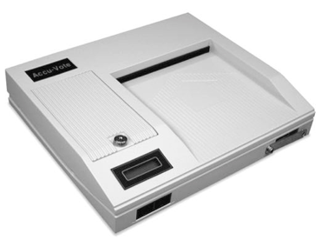
TABULATOR – MEMORY CARD TESTING – SET UP
Preparations
Test Deck
Changing Date & Time
Testing Ballot Box Deflector
Step By Step Instructions
Ch 17, Pg 98 - 100

Slide 22
RECANVASS
Reasons to Recount/Recanvass Ballots
Following Election or Primary
Chain of Custody
Ballot Counting Rules
Closing Recount
Link to SOTS “Recanvass Procedure Manual”
Ch 18, Pg 101 - 106

Slide 23
AUDIT POST-ELECTION *
Steps to Take:
Preparing for an Audit
Conducting an Audit
Counting the Total for Candidates
Two Methods of Counting
Manual
UConn’s electronic equipment
Link to the SOTS Audit Procedures Manual
Ch 19, Pg 107 - 109

Slide 24
HELPFUL HINTS & ON-LINE LINKS
Instructional Information
How to Create:
Lists
Reports
Labels
Letters
Election Related Miscellaneous
Links to:
Manuals
Instructions
Forms
Election Related Organizations
Ch 21, Pg 111 - 114

Slide 25
GLOSSARY
Commonly used in election law:
Words
Phrases
Titles
Etc.
Ch 22, Pg 124 - 129

Slide 26
MANUAL / HANDBOOK
A work in progress.
Comments and suggestions welcome.
Send to handbook committee
burrdar@cox.net

Slide 27
DO YOU KNOW THE ANSWERS TO THESE QUESTIONS?

Slide 28
Envelopes With Instructions Requesting Return if Not Deliverable at Address Shown Must Be Used When Mailing What Notices?
A. Notice of Acceptance/Approval
B. Notice of Tabulator Testing
C. Notice of Lottery
Notice of Rejection/Disapproval

Slide 29
Envelopes With Instructions Requesting Return if Not Deliverable at Address Shown Must Be Used When Mailing What Notices?
Notices of approval and disapproval of voter registration applications are to be sent by first-class mail with instructions on the envelope that it be returned if not deliverable at the address shown on the envelope. (§9-19b(c), §9-19j(i) & §9-23g(c))
A. Notice of Acceptance/Approval
B. Notice of Tabulator Testing
C. Notice of Lottery
Notice of Rejection/Disapproval

Slide 30
What is used as a Provisional Ballot?
A. Polling Place Ballot
B. Official Overseas Ballot
C. Official Blank Absentee Ballot
D. Same Day Registration Ballot

Slide 31
What is used as a Provisional Ballot?
A. Polling Place Ballot (only as fall back if overseas ballot not provided)
B. Official Overseas Ballots are used as provisional ballots at federal elections because they contain only federal offices.
C. Official Blank Absentee Ballot
D. Same Day Registration Ballot

Slide 32
What Must Be Redacted From Reports Requested?
Voter’s Social Security Number
Driver’s License Numbers
Identity Card Numbers
Day of Birth
All the Above

Slide 33
What Must Be Redacted From Reports Requested?
Redacting Requirements: Redact EEEs (exemption, exclusion, exception) from copies of reports requested:
Voter’s Social Security Number
Driver’s License Numbers
Identity Card Numbers
Day of Birth (day of birth may be given for governmental purposes only).
E. All the Above
Remember the EEEs don't eliminate those records, merely redact them if someone requests records that have them. The month and year of birth are subject to FOI requests and are not to be redacted. Redact all records that are an invasion of privacy, highly offensive and not of public concern.

Slide 34
What is Not the Purpose of an Audit?
To Determine Tabulator’s Performance
To Determine Voters’ Intent & Vote Total
To Assess How Well Tabulator Performed
To Confirm that Votes Cast were counted properly by the tabulator

Slide 35
The Purpose of an Audit is NOT?
To Determine Tabulator’s Performance
To Determine Voters’ Intent & Vote Total is the purpose of a Recanvass/Recount, not an Audit
To Assess How Well Tabulator Performed
To Confirm that Votes Cast were counted properly by the tabulator

