Slide 1
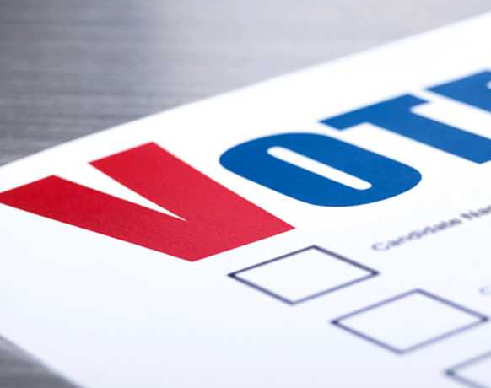
Voter Outreach

Slide 2
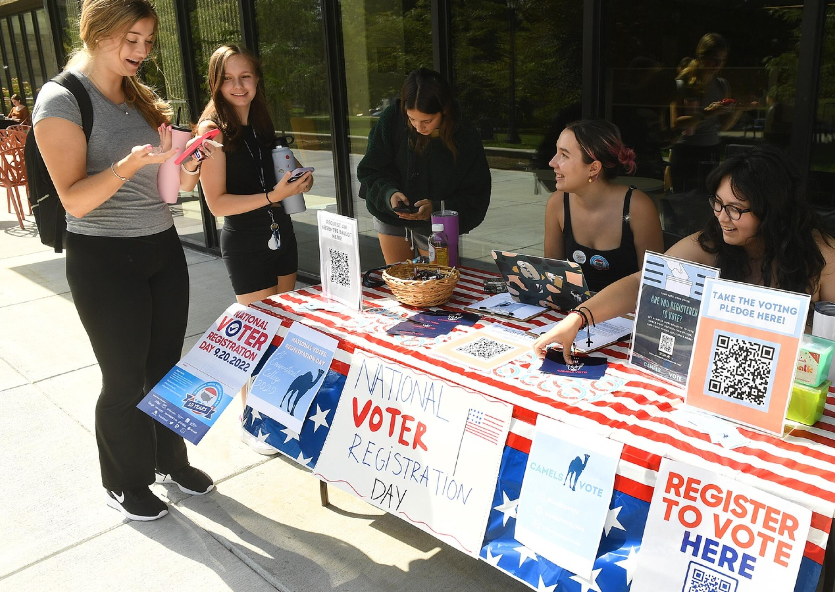
Best Practices and Requirements
Elections Resources available to our communities
Your Office & Webpage
Voter Registration Drives
Working with Town Committees, and Civic Organizations
Title 9 - Elections

Slide 3
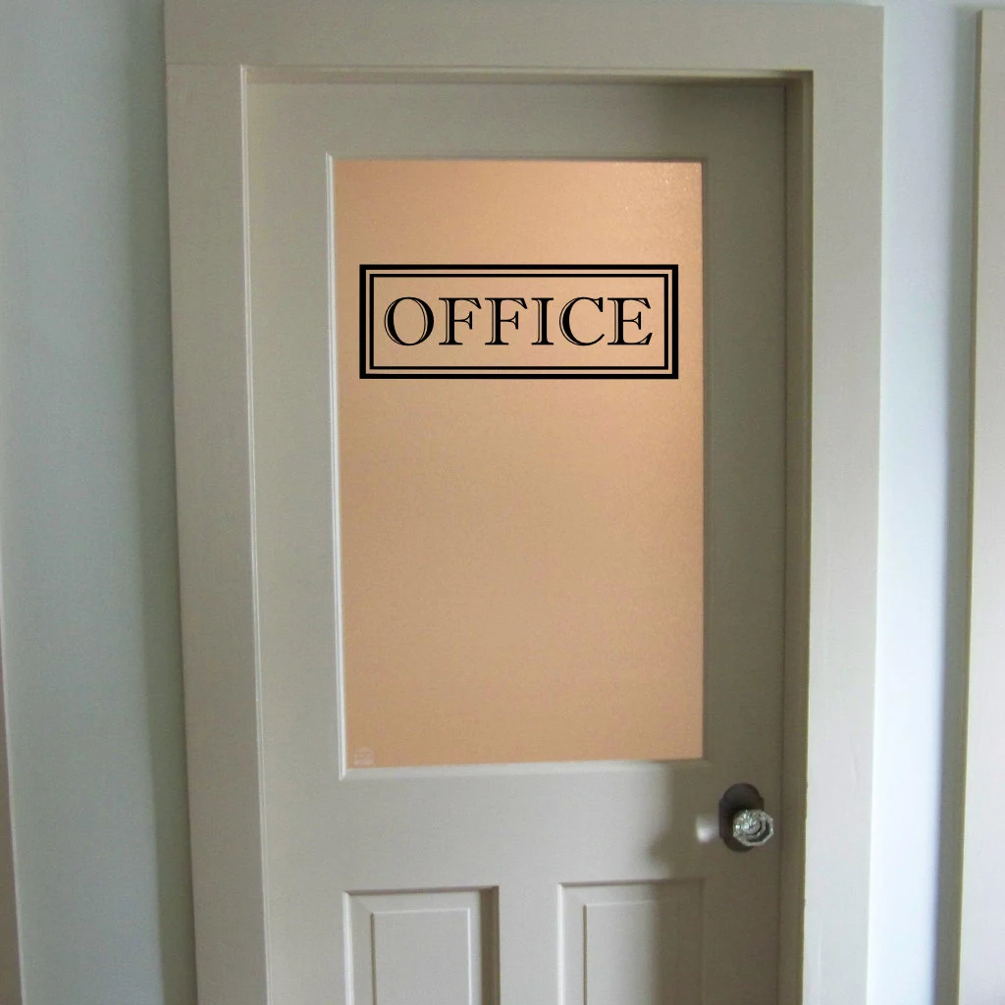
Your Office
Post your hours (required) Sec. 9-23
Add a shelf by the door that has Voter Registration Cards Sec. 9-23g
Add a QR Code for the SOTS webpage
Descriptive voicemail – consider inviting caller to visit a webpage
Email Signature – Consider a link
Out of Office Auto Reply

Slide 4

Email Signature Example
Brenda Falusi
Deputy Registrar of Voters
(860) 871-3634
Town of Tolland
21 Tolland Green, Tolland CT 06084
Hours Mon-Wed 9am-11am, Thurs Noon-2pm
Voter Registration questions: www.tollandelections.org

Slide 5
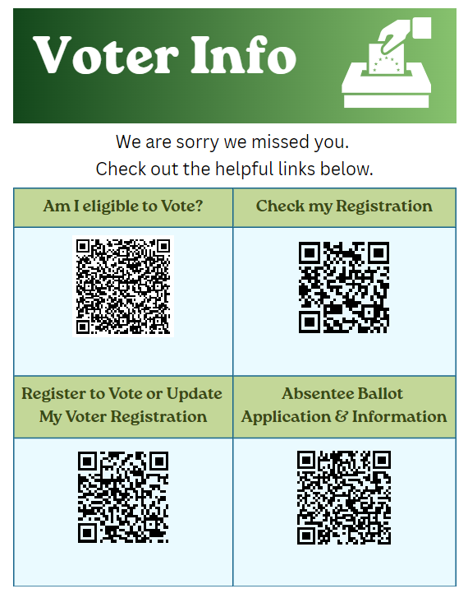
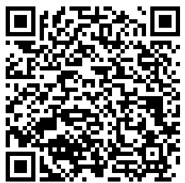
Use this QR Code for the page
Sec. 9-19k

Slide 6
Your Election Webpage – Best Practice
Contact info – Name, Address, Phone, Email
Hours of Operation
Links to:
  Eligibility to Vote
  Register to Vote
  Check Registration
  Check your polling location.
  SOTS
  Election Results
Important Election Dates and Deadlines

Slide 7
Community
Voter Registration/Education Program – Once or Twice a year election staff present a voter education program to area high schools. Students will be registered (or preregistered) to vote. (Sec. 9-17)
Voter Registration Drives – Help community organizations encourage people to register to vote. Sec. 9-19c & Sec. 9-19d.
Public Library – The Public Library has Voter Registration Cards on Hand. Sec. 9-19h

Slide 8
Community
Request a Speaker – Consider offering a representative from the elections office to speak to clubs or organizations about the election process.
Application for Admission at place of employment, residence or study. Sec. 9-19, Sec. 9-23pc.
DMV - If you are visiting DMV for a driver’s license, learner’s permit or non-driver identification card service (new, renewal or duplicate) or changing your address with DMV. Sec. 9-19h, Sec. 9-19i.

Slide 9
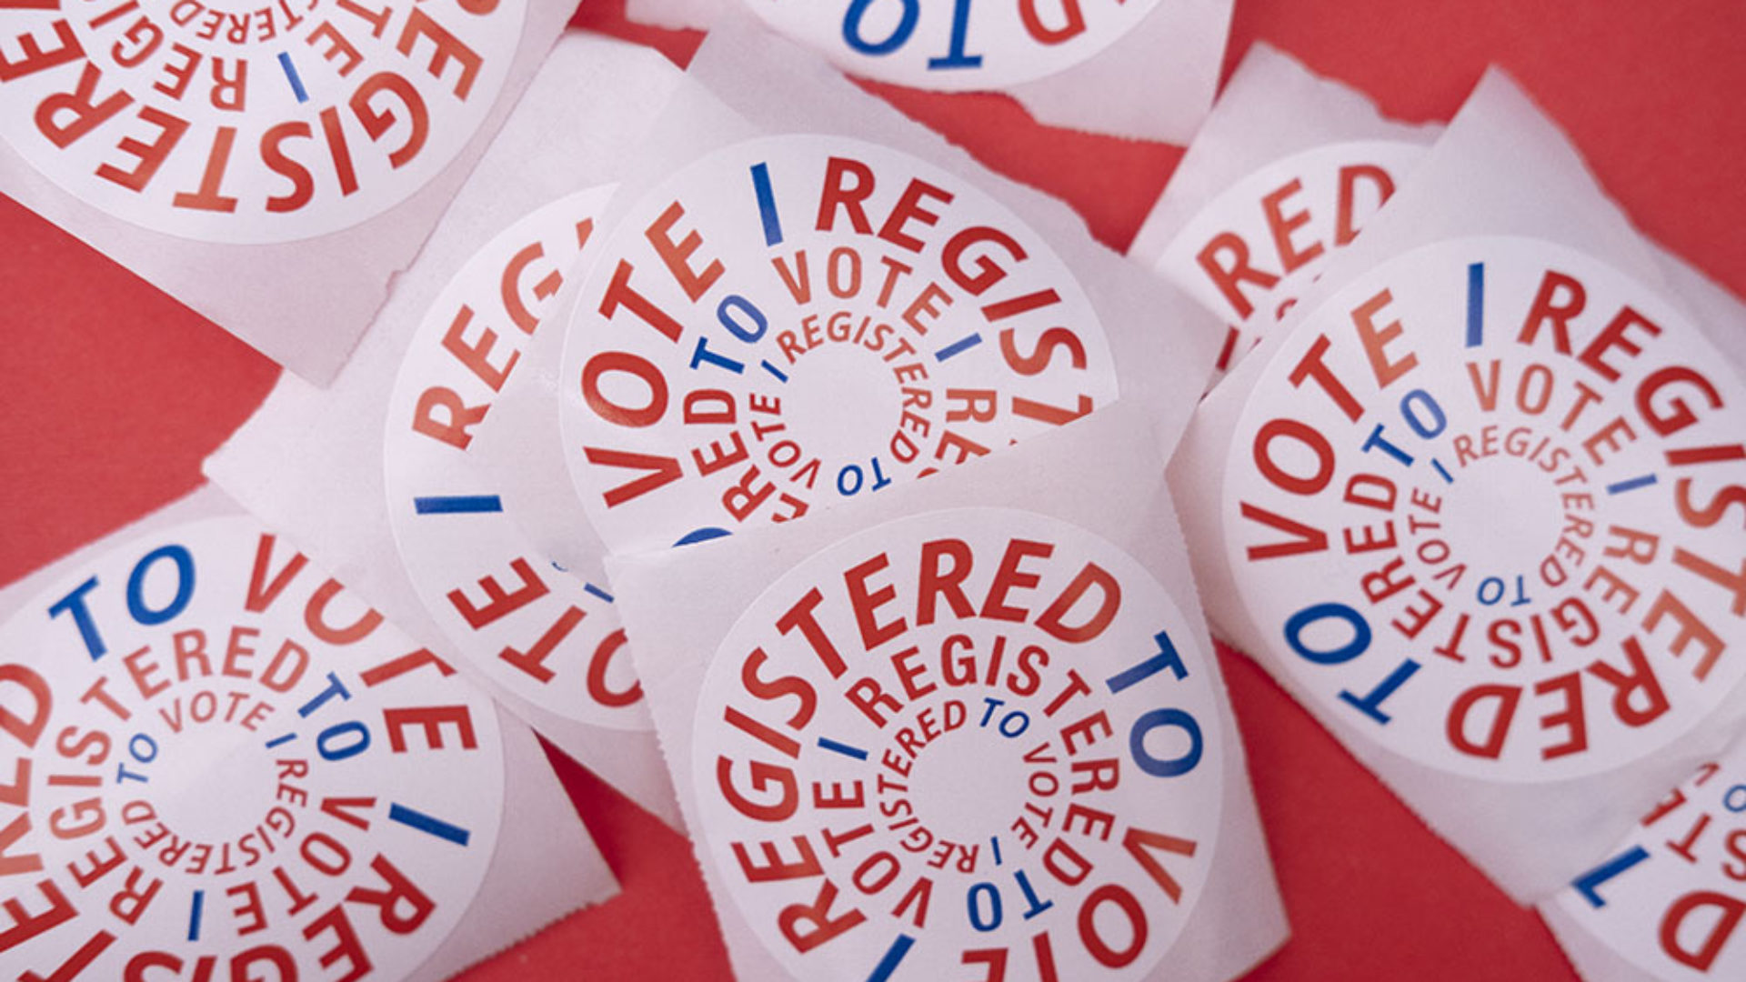
Voter Registration & Information Drives
  Military Base
  Farmer’s Market
  Town Celebration
  Parades
  Kindergarten Registration
  Library
  Meet and Greet or Town Halls for Candidates
  Naturalization Ceremonies Sec. 9-20b
  College & University
  Civic Organizations
  Town Committee Meetings
  Open House
  Corporations, Unions and other special interest organizations or individuals may hold a GOTV drive.
  11 CFR 100.24(a)(3).

Slide 10
Thank you
Brenda Falusi
Deputy Registrar in Tolland
860-874-1278
bfalusi@tollandct.gov

