Slide 1

  2023 Election Mail Planning
Registrars of Voters Association - Connecticut Spring Conference
Postal Service Update
April 4, 2023
Adrienne Marshall
Executive Director – Election and Government Mail Services
Lisa Del Rio
Election Mail Atlantic Area Field Specialist – Election and Government Mail Services

Slide 2
  2023 Election Mail Planning
  Agenda
  2022 Election Cycle Recap/Highlights
    Post-Election Analysis Report
    Introduction of Election and Government Mail Services Team
Upcoming USPS Outreach and Communications
Policies and Mailing Recommendations
  Postmarking
  Mailpiece Visibility
  Larger Sized Postcard
  Mailpiece Design
  Printing & Mailing Schedule
  Prepaid Reply Mail Options
  Informed Visibility
  Resources

Slide 3
  2023 Election Mail Planning
  The Postal Service’s Role in the Election Process
  The Postal Service is committed to fulfilling our role in the electoral process and we provide a secure, efficient and effective way for citizens to participate when policymakers decide to use mail as part of their elections. The Postal Service has a robust and tested process for proper handling and timely delivery of Election Mail.
  Every federal election cycle, we make efforts across the nation to inform local and state election officials about mailing procedures, our operational standards, and our recommended best practices for utilizing the mail.

Slide 4
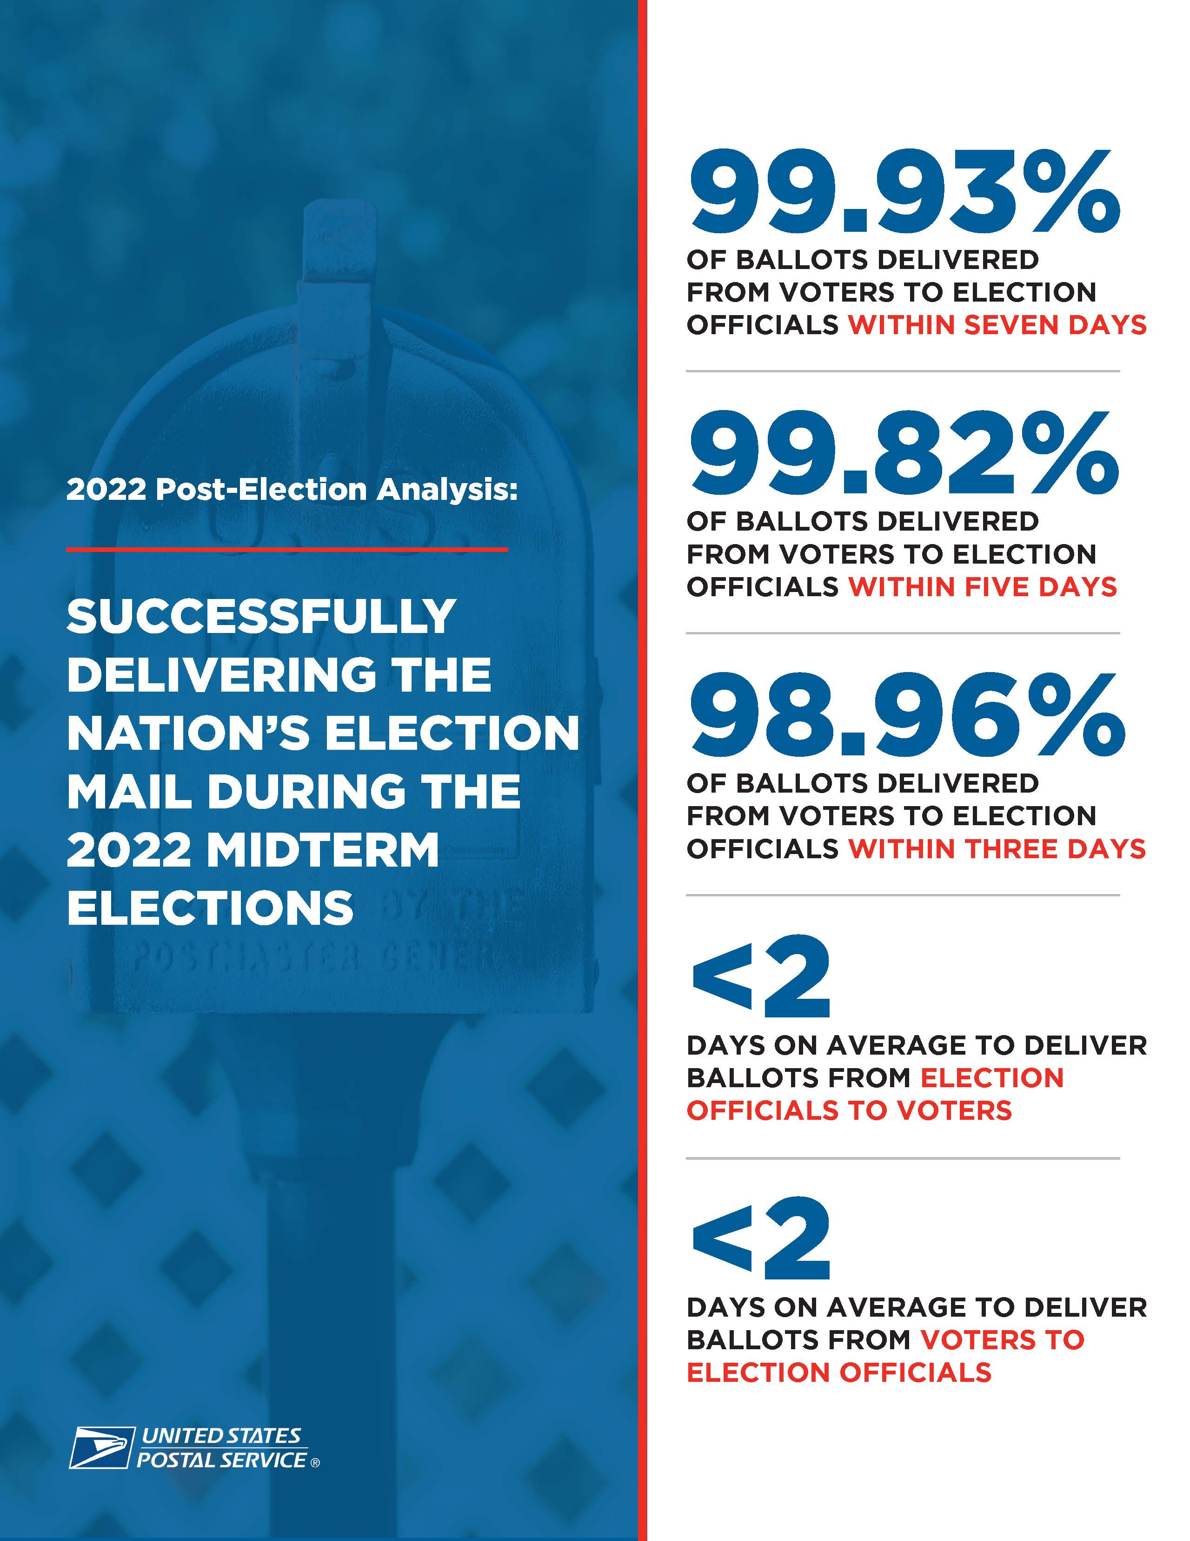
  2022 Election Cycle Recap/Highlights
Thank you for your partnership in the 2022 midterm elections as the United States Postal Service’s executed its role in the vote-by-mail process.
Monday, January 9, 2023, we released our 2022 Post-Election Analysis Report. The final performance numbers for the 2022 election cycle show that the Postal Service once again performed strongly in delivering the nation’s election mail.

Slide 5
Election & Government Mail Services
Director of Election & Government Mail Services
Adrienne Marshall
Election & Govt. Mail Specialist
Jerod Siddle
Election & Govt. Mail Specialist
Daniel A. Garcia
Election & Govt. Mail Specialist
Steven J. Carter
Election & Govt. Mail Specialist
Tiffany Todd
Election and Govt. Mail Specialist
Emily Matyas
Election and Govt. Mail Specialist
Will Hensley
Manager, Policy & Strategy
Dan Bentley
Election & Govt. Mail Specialist
Lisa Del Rio
ATLANTIC AREA & PROCESSING DIVISIONS
CENTRAL AREA & PROCESSING DIVISIONS
SOUTHERN AREA & PROCESSING DIVISIONS
WESTPAC AREA & PROCESSING DIVISIONS

Slide 6
Election Mail Outreach Teams
4 Area Election Mail Field Specialists
  Area leadership to promote HQ Election Mail policies with field operations
4 Area Directors of Customers Relations
  Area leadership and senior point of contact to election officials
50 Managers of Customer Relations at the District level
  Primary point of contact for the District with Election Officials
District Election Mail Strike Teams
  Cross-functional support to ensure the timely processing and delivery of Election Mail, and address and resolve mailing issues
Director, Election & Government Mail Services
(w 4 Area Specialists)
HQ Cross
Functional
Election Team
4 Area VPs
Retail
& Delivery
2 Processing &
Maintenance
Regions
4 Area
Directors,
Customer
Relations
50 District
Managers
Customer
Relations
District
Strike Teams
(Cross
Functional)
Chief State
Election Executives
State
Elections
Directors
7,500+ Local Jurisdiction Administrators
Tribal Election Leaders

Slide 7
  ELECTION & GOVERNMENT MAIL SERVICES
Upcoming USPS Outreach and Communications
  USPS Election Mail Visibility Survey
  Survey of state and local election jurisdiction’s use of Election Mail visibility tools
  USPS Request for Information on Ballot Mail Return Address List
  Ballot Mail Return Address Lists help USPS improve mail processing procedures and more effectively implement Election Mail “extraordinary measures.”
  National Postal Forum: Election Mail Day – May 24, 2023 - Charlotte, NC
  Proposed Topics: Election Mail Visibility, Mail Security and the Postal Inspection Service, Address Management Services, Mailpiece Design, Analytics

Slide 8
USPS Election Mail Policies and Mailing Recommendations for Election Officials

Slide 9
  2023 Election Mail Planning
  Mailpiece Visibility:
  The Postal Service has a number of tools available to elections officials to improve the visibility of all Election Mail, including ballot mail, throughout the postal network.
  These visibility tools are strongly recommended to help improve processing and enhance customers’ experience.

Slide 10

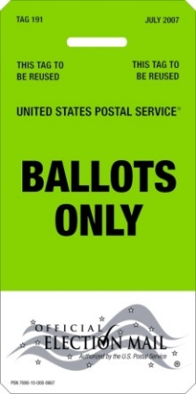
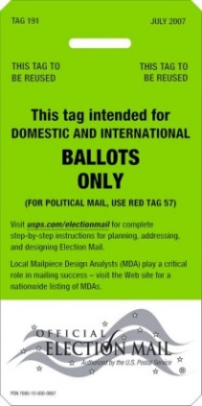
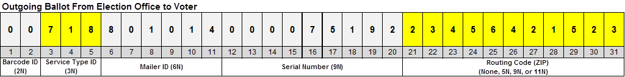
  2023 Election Mail Planning
  Election Mail Visibility Tools
  Official Election Mail logo
  Tag 191, Domestic and International Ballots
  Serialized Intelligent Mail barcode (IMb®)
  Ballot Mail Service Type Identifiers (STIDs)
  Election Mail Postage Statement Check Box
Official
Election Mail
Logo
Tag 191
IMb
&
STID
Defined STID
Assigned MID
Matching Serial Number
Recipient / Voter Address

Slide 11
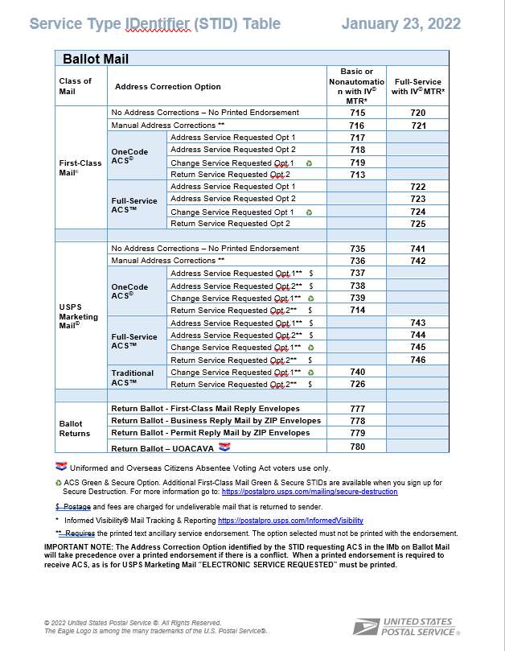




  Official Ballot Mail Tracking
  Service Type Identifiers (STIDs):
      Leveraging specified Ballot STIDs in IV-MTR data provides visibility into ballot mail
      Outbound Ballot Mail
    Use appropriate Ballot Mail STID for First-Class Mail® Ballots or Marketing Mail® Ballots and services desired
      Return Ballots
    Use appropriate Ballot Returns STID for payment method
NOTE: Use the “Election Mail” attribute in eDoc for ALL election mail.
Ballot Mail STIDs are reserved for ballots ONLY.
STID Table:
https://postalpro.usps.com/mailing/service-type-identifiers

Slide 12
Election Officials that want to receive discounted First-Class® and USPS Marketing Mail® postage rates are required to use an approved Move Update option
NCOA^{Link®}
Pre-mailing, secure automated process that allows mailers to submit a listing of names and addresses or a mail piece for matching to a Change-Of-Address record to find and update to the new address.
ACS™
Post-mailing service that acts on the mail piece to determine the correct disposition of undeliverable mail and generates an electronic address correction notice which includes Change-of-Address information.
Ancillary Service Endorsements
Post-mailing service that provides manual address corrections or return of the mail depending on endorsement used (Address, Return, and Change Service Requested).
Alternative Methods
Pre-approved exceptions available for First-Class® Mail
Mailer is tested to demonstrate their mailing list is 99% accurate
Documented Legal Restraint that prohibits updating of list without customer approval

Slide 13
  2023 Election Mail Planning
  Mailpiece Design:
  The Postal Service has developed detailed guidance and recommendations on design considerations that elections officials and your commercial mailing partners should consider when designing your Election Mail. Adherence to this guidance helps ensure that the Postal Service advanced mailing automation tools can efficiently process your Election Mail.

Slide 14
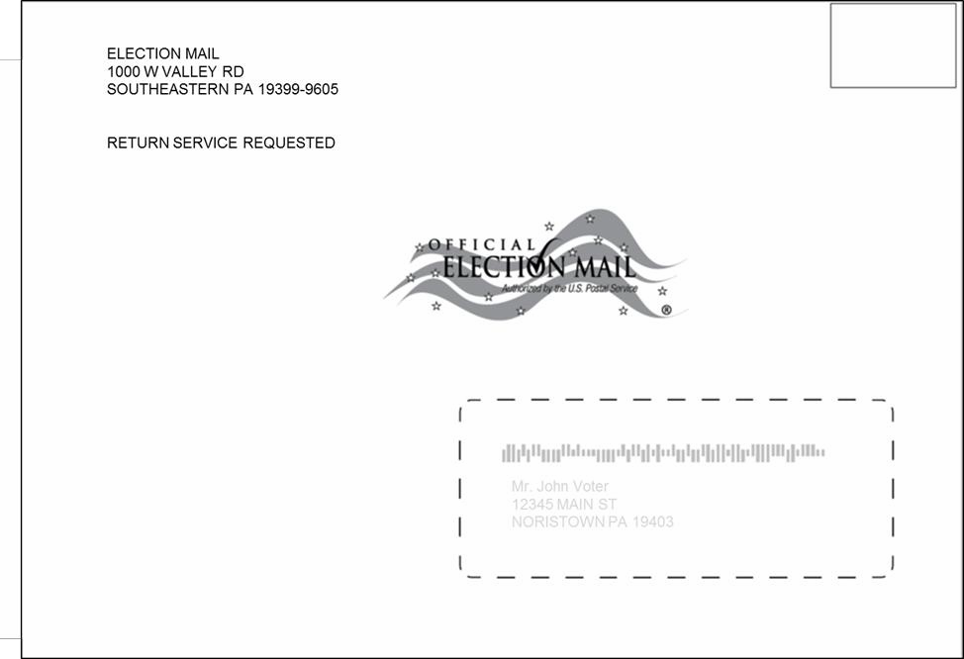
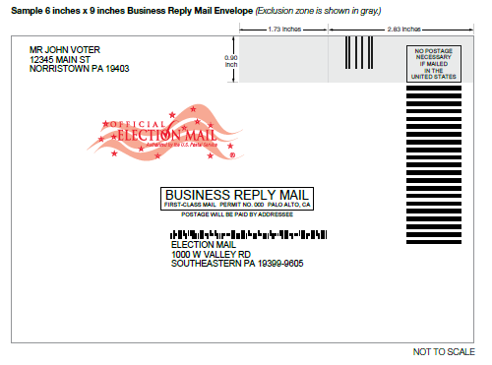
  2023 Election Mail Planning
Sample Outgoing Ballot
  Mailpiece Design
  Design Considerations
    Letter-size Reply Envelopes
    Colors
    Weight limitations
    Proper wording
    Placement of postal markings
  Mailpiece Design Analyst Review
    Consultation for mailing standards
    Guidance regarding automation rate qualification
    Technical assistance for printers, graphic designers, and envelope manufacturers
    We recommend that every Election Mail envelope design be reviewed by an MDA before it is used
Sample BRM/QBRM Design Standard
Mailing & Shipping Solution Center (MSSC)
MSSCadmin@usps.gov
or 1-877-672-0007

Slide 15
  2023 Election Mail Planning
  Printing & Mailing Schedule:
  The Postal Service continues to recommend the use of First-Class Mail for time sensitive election mail, particularly outbound ballots.
  The process for designing, printing, and mailing Election Mail materials takes time. Be sure to consult with a Mailpiece Design Analyst early in the process to ensure your Election Mail is designed properly and includes all of the recommended visibility tools.
  Managers of Customer Relations, Mailpiece Design Analysts, and other Postal Service experts are available to assist you with your Election Mail program. Sharing information regarding your mailpiece design, estimated volume, mailing date, mail entry location, and other information about your mailing plans supports the timely processing and delivery of Election Mail.

Slide 16
  2023 Election Mail Planning
  Prepay Reply Mail Options:
The Postal Service offers a variety of ways for elections officials to prepay for mail returned to them, such as voter registration forms, ballots, or other materials. Depending on your expected volume of reply mail, tracking requirements, and other factors, the Postal Service has a solution that will meet your needs.
State and local officials may choose to offer their voters a prepaid reply mail option such as:
Business Reply Mail
Qualified Business Reply Mail
Metered Reply Mail
Permit Reply Mail
Stamps

Slide 17
  2023 Election Mail Planning
  Resources:
  The Postal Service maintains a comprehensive collection of published materials to help you understand how to best use the mailing process to meet your goals for your Election Mail. Resources like KIT 600, the Postal Bulletin and USPS.com, in addition to your Manager of Customer Relations, are available to support your needs.

Slide 18
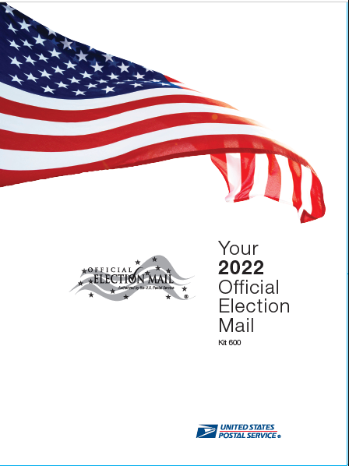
  2023 Election Mail Planning
Resources:
Kit 600 - The 2022 Official Election Mail Program Kit
Official Election Mail Recommendations and Resources
Steps to Creating Your Intelligent Mail® Barcode (IMb®)
Service Type Identifier for Ballot Mail
Tag 191, Domestic and International Ballots and Sample Tag
Informed Visibility® Mail Tracking and Reporting (IV®-MTR)
Business Reply Mail® (BRM) and Qualified Business Reply Mail™ (QBRM™)
Special Procedures: APO/FPO/DPO and Overseas Citizens Absentee Ballots
Mailing Standards of USPS, Domestic Mail Manual (DMM®)
Election Mail Checkbox
Postmarking Guidelines
Publication 631: Official Election Mail—Graphic Guidelines and Logos
Publication 632, State and Local Election Mail—User’s Guide
Much More

Slide 19
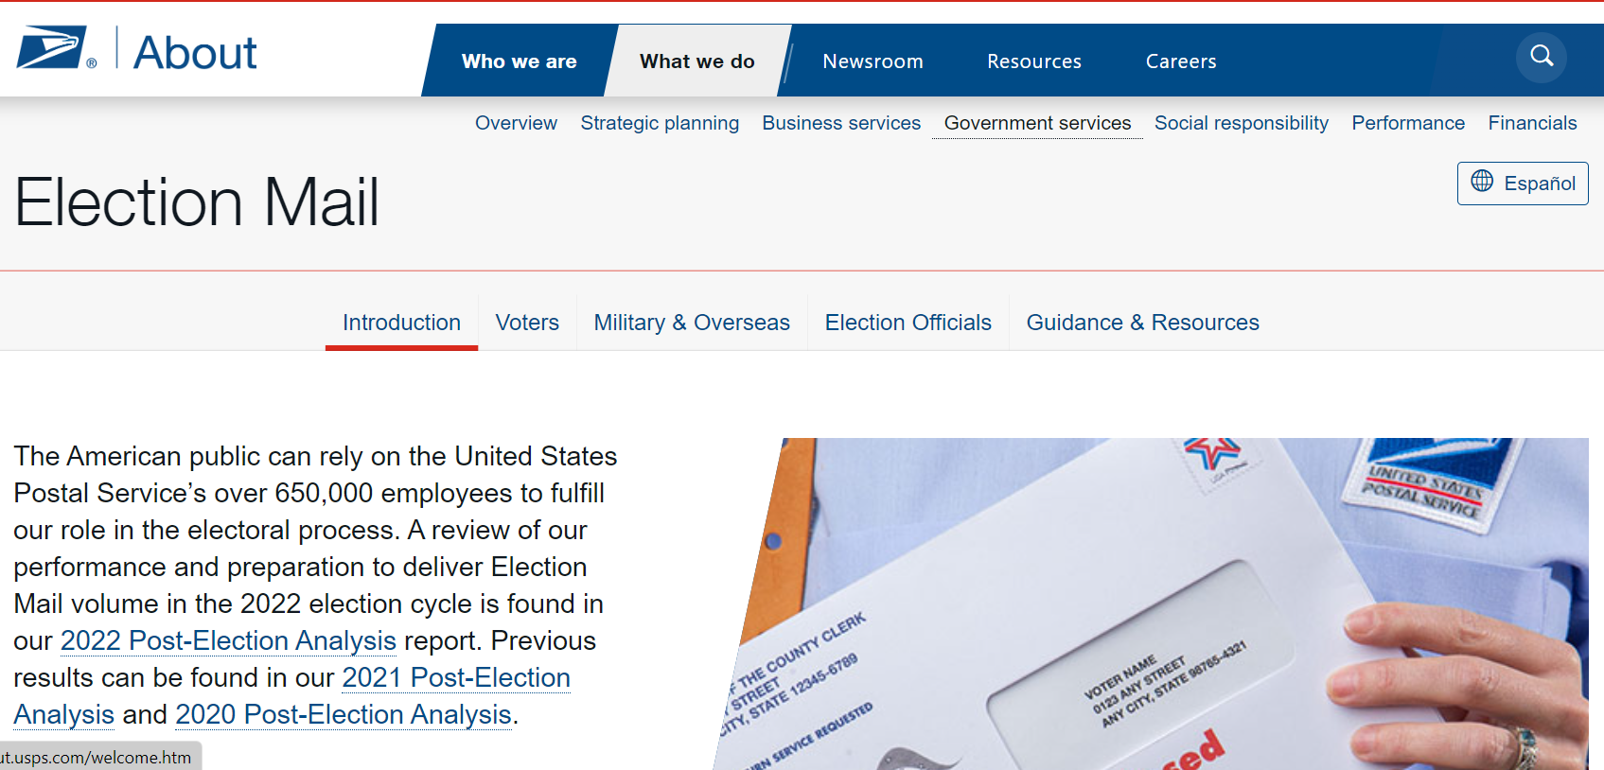
USPS.com/electionmail

Slide 20
  2023 Election Mail Planning
  USPS Point of Contact:
  The Postal Service has designated your District Manager of Customer Relations as a single point of contact for your election mail planning. Your Manager of Customer Relations is supported by local and national Election Mail experts to assist you with questions, issue resolution, mailpiece design, and other issues. These dedicated postal employees are deeply knowledgeable about and fully committed to the timely delivery of Election Mail.
Connecticut District Manager of Customer Relations:
Rhonda Cunningham: (929) 312-0306
Connecticut District Business Mail Entry Manager:
Bindhumol Cheriyan: (860) 524-6311
EGMS Atlantic Field Specialist:
Lisa Del Rio: (860) 508-6233

Slide 21

  Thank You for Your Time and Attention!

