Slide 1
READ ME - IMPORTANT INFO
Thank you for considering on using this PowerPoint for your poll worker training. I created this PPT with the hope that many Registrars can use it across the state for their training. Here are a few points to help you customize this presentation for your town.
Feel free to change the pictures of areas in your town. We have some nice pictures of Naugatuck as part of the deck which you can also keep using if you wish.
This PPT was created using a template from OpenOffice software (not Microsoft Word). If using MS Word, 99.9% of changes/updates will not have issues, but if you do, just try again or using a different option.
This document was created for Naugatuck,CT. However, 90% of the slides will be the same no matter which town you live in. Make any updates you require so it works for you town.
Early voting is NOT covered in this presentation, it will be added when the early voting law is passed.
Absentee voting procedure is NOT covered in detail here. We train them separately. I may add a section for AB if there is enough interest.
Do you have suggestions on what can be added? See a mistake? Drop me an email at mkatra@naugatuck-ct.gov with recommendations.
DELETE THIS SLIDE BEFORE PRESENTING.
Poll Worker Training - Naugatuck, CT 8 Nov 2022 Slide

Slide 2
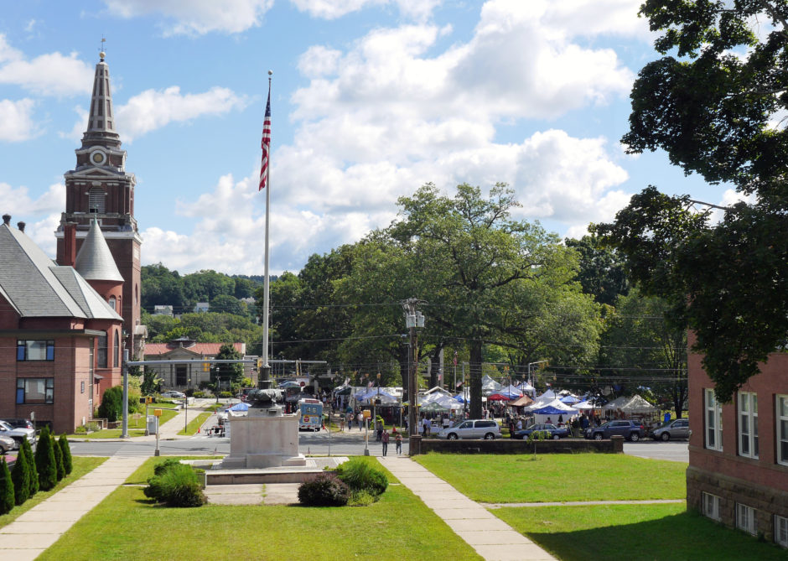

Naugatuck Poll Worker Training
November 8, 2022
Matthew Katra
Louise Sheedy

Slide 3
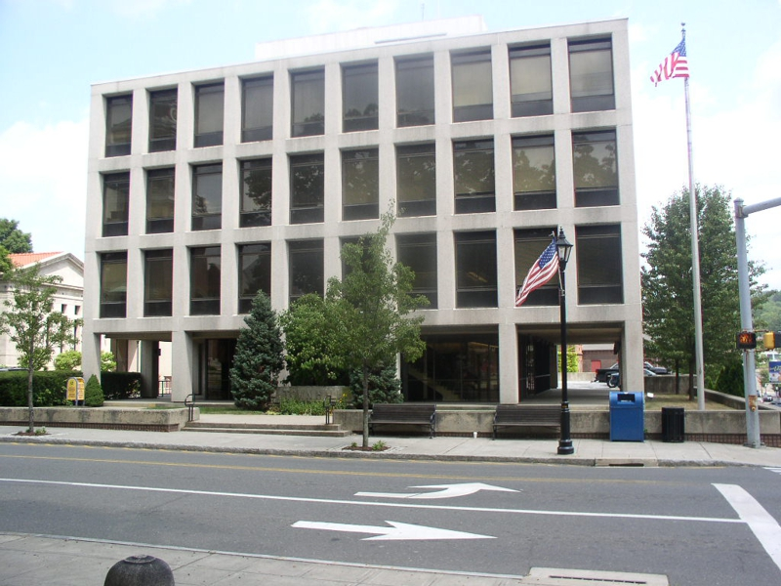
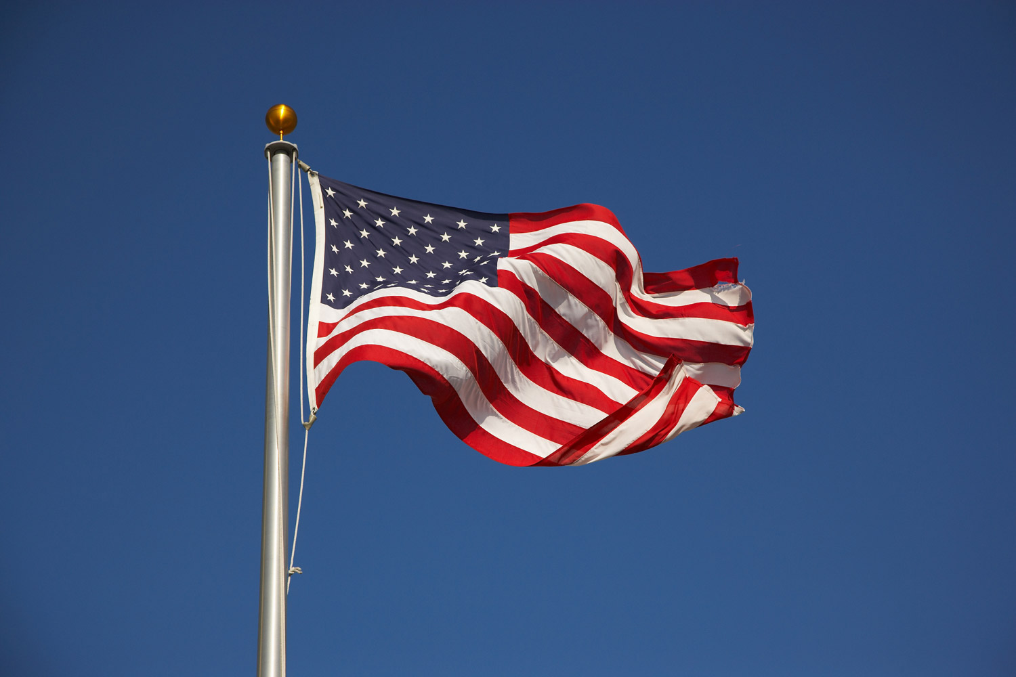
Pledge and Thank You
Thank you for signing up to be an election worker for our upcoming election in Naugatuck. We welcome both our returning poll workers as well any first time workers. It is critical that every poll worker know his or her job and understand how they fit into the big picture. Just as important is that every poll worker understands the roles of their fellow workers. This will ensure a smooth and organized election.
Louise Sheedy & Matthew R Katra
Poll Worker Training - Naugatuck, CT 8 November 2022 Slide

Slide 4
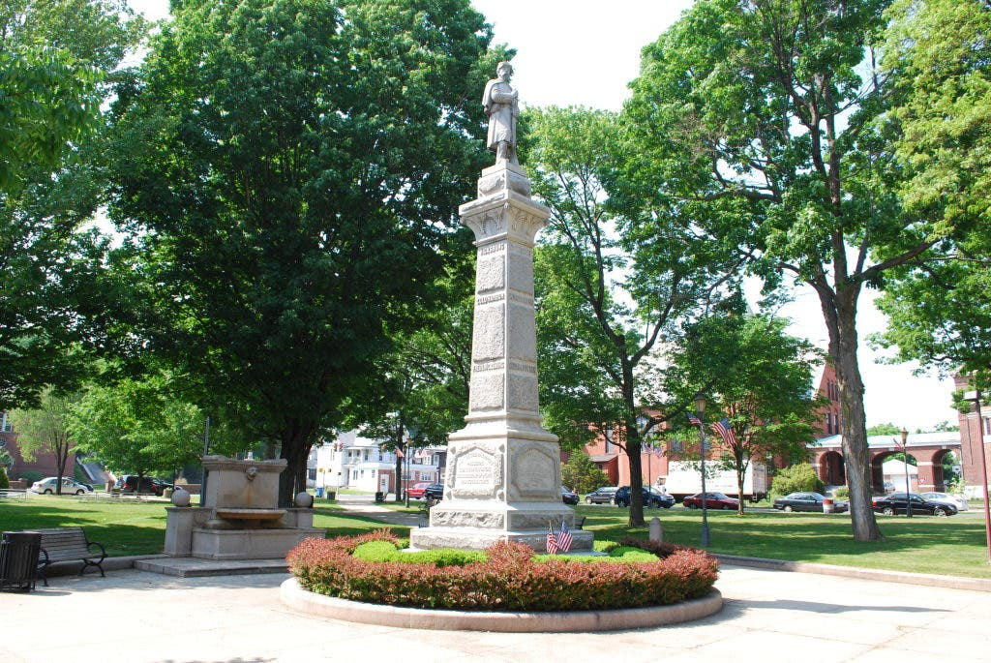
Oath
Stand up, raise your right hand
You solemnly swear that you will faithfully discharge, according to the law, your duties as an election worker to the best of your ability, and that you will serve in this election (primary) as an official, completely impartial with respect to any any candidate, any political party, or question on the ballot; so help you God.
Poll Worker Training - Naugatuck, CT Slide

Slide 5
Table of Contents
Welcome
Oath
Introductions (Registrars and Moderators)
General Info
Payroll Requirements
Naugatuck Polling Districts and Locations
Ballot Overview
General Instructions
  Voter Rights
  Arrival and Setup
  Dress and Breaks
  Who is (not) allowed in polling place
  Assisting Voters with Disabilities
  Closing of the Polls
  Absentee Voting
  Emergency Plan
  Tips and Tricks
Duties of the:
  Greeter
  Checker
  Ballot Clerk
  Tabulator Tender
  Assistant Registrar of Voters
  Moderator
Special Topics
  Reports
  Write In Candidates
  Curbside Voting
  Tabulator Overview
  Submitting Results @ Town Hall
  IVS Overview
  Voter CheckList Overview
  Election Day Registration
  Voter CheckList Demo (Optional)
Poll Worker Training - Naugatuck, CT 8 Nov 2022 Slide

Slide 6
Introductions
Registrar of Voters
Registrar of Voters (D)
Registrar of Voters (R)
ROV NAME
ROV NAME
Moderators
Head Moderator
HC NAME
Absentee (Town Hall)
AB NAME
Election Day Reg. (Event Center)
EDR NAME
Cross St (1-1)
Andrew Ave (1-2)
Andrew Ave (1-3)
MODERATOR NAME
MODERATOR NAME
MODERATOR NAME
Central (2-1)
Cross St (2-2)
Maple Hill (2-3)
MODERATOR NAME
MODERATOR NAME
MODERATOR NAME
Parks and Rec (3-1)
City Hill (3-2)
Parks and Rec (3-3)
MODERATOR NAME
MODERATOR NAME
MODERATOR NAME
Poll Worker Training - Naugatuck, CT 8 Nov 2022 Slide

Slide 7
Payroll Information
This must be filled EVERYONE who did not work in August. You CANNOT be paid with out filling out the necessary payroll forms. You will be paid the week (on Thursday) following the election.
Who/When?
Taxes
Election pay is considered tax exempt.
Forms
(A) Federal W-4; (B) CT State W-4; (C) Employee Information form; (D) Direct Deposit Form
Contact
Direct all payroll questions and completed forms to <ENTER PAYROLL CONTACT/EMAIL>
Poll Worker Training - Naugatuck, CT 8 Nov 2022 Slide

Slide 8
General Information
NON-PARTISAN
CELL PHONES
WORKER MANUAL
You must always work in a NON-PARTISAN manner. Do not engage in any conversations of a political nature or any candidate on the ballot.
Do not use cell phones in the polling location except for official communications.
Each worker should have picked up their manual for the position assigned. They are available up front.
PARKING
SCHOOLS
THE BOSS
Please use the parking spots AWAY from the main entrance. Leave the parking spots close to the doors for voters.
NO SMOKING on school grounds.
No exceptions!
The moderators are in charge at each location. Come to them if you have any questions.
Poll Worker Training - Naugatuck, CT 8 Nov 2022 Slide

Slide 9
VOTING DISTRICTS
WARD 1
WARD 2
WARD 3
CROSS ST (1-1)
Voters: 559
Sen: 17 House: 131
CENTRAL AVE (2-1)
Voters: 3489
Sen: 17 House: 70
PARKS AND REC (3-1)
Voters: 2257
Sen: 15 House: 70
Formerly @ Oak Terrace
ANDREW AVE (1-2)
Voters: 3378
Sen: 17 House: 131
CROSS ST (2-2)
Voters: 573
Sen: 17 House: 70
CITY HILL (3-2)
Voters: 4119
Sen: 15 House: 70
ANDREW AVE (1-3)
Voters: 1739
Sen: 17 House: 70
MAPLE HILL (2-3)
Voters: 2836
Sen: 17 House: 70
PARKS AND REC (3-3)
Voters: 883
Sen: 15 House: 131
Formerly @ Western School

Slide 10
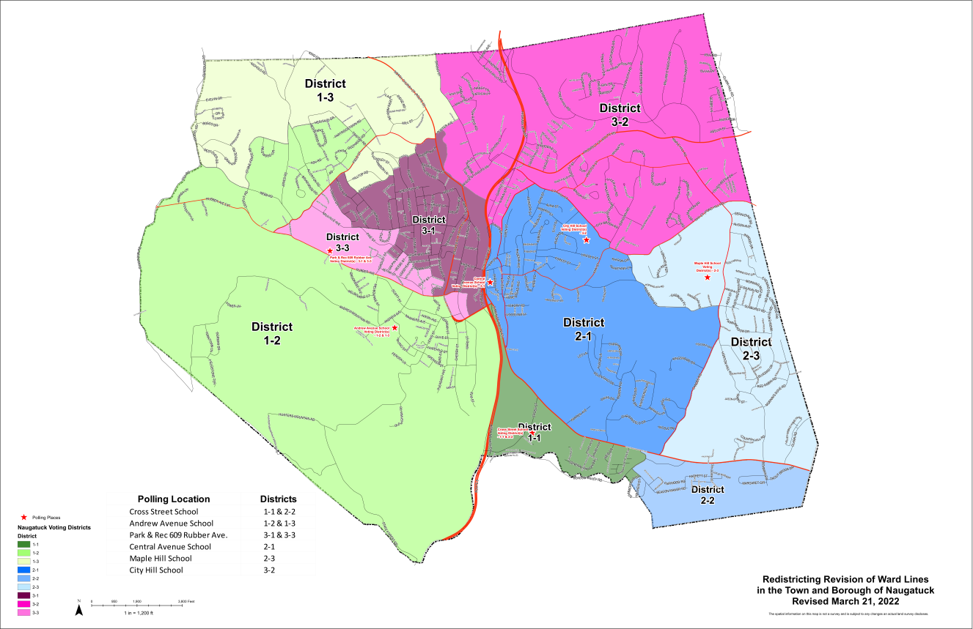
Locations
Poll Worker Training - Naugatuck, CT 8 Nov 2022 Slide

Slide 11
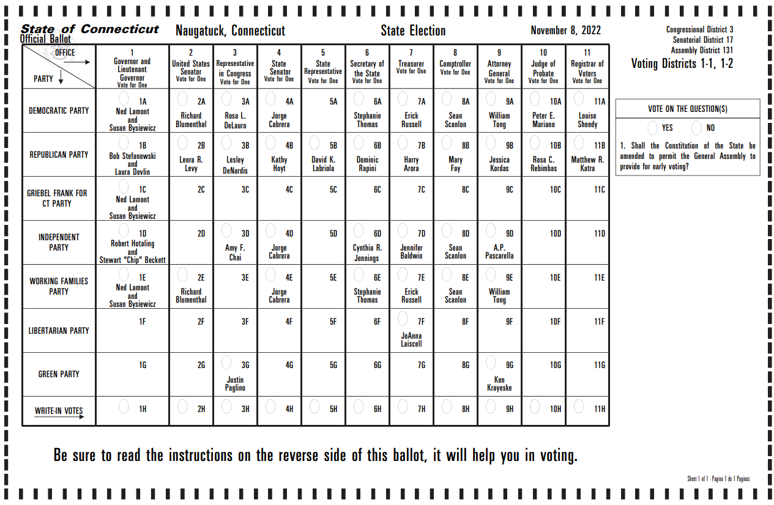
Ballot Sample (1-1 and 1-2)
Poll Worker Training - Naugatuck, CT 8 Nov 2022 Slide

Slide 12
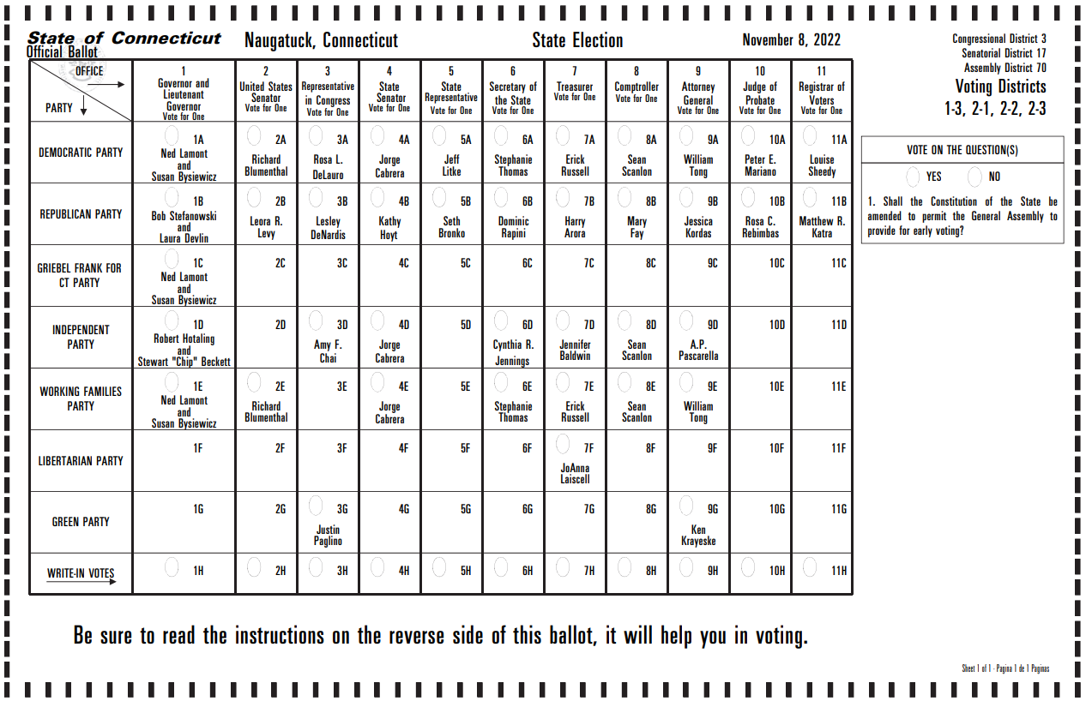
Ballot Sample (1-3, 2-1, 2-2, 2-3)
Poll Worker Training - Naugatuck, CT 8 Nov 2022 Slide

Slide 13
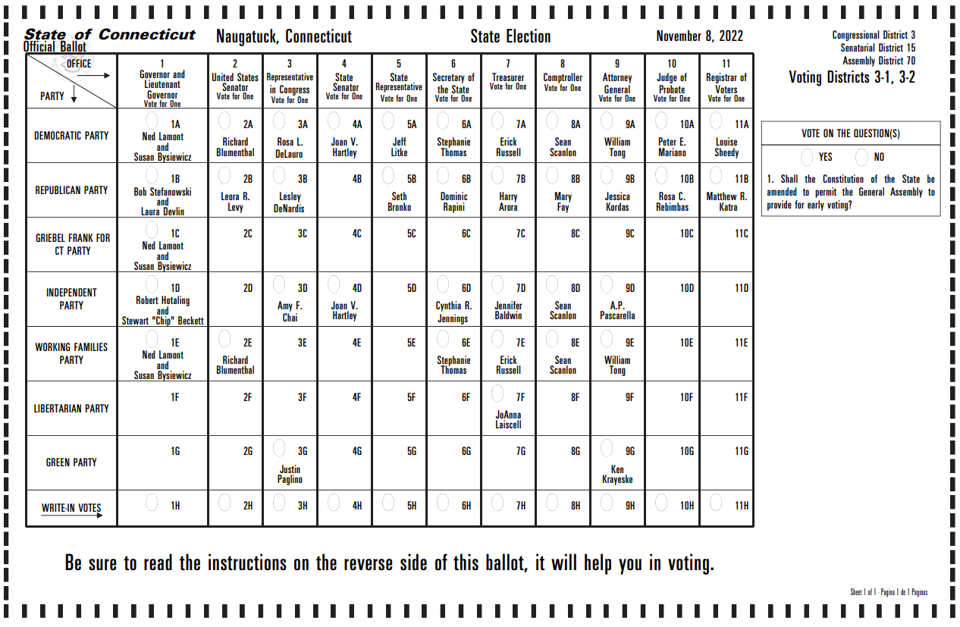
Ballot Sample (3-1, 3-2)
Poll Worker Training - Naugatuck, CT 8 Nov 2022 Slide

Slide 14

Ballot Sample (3-3)
Poll Worker Training - Naugatuck, CT 8 Nov 2022 Slide

Slide 15
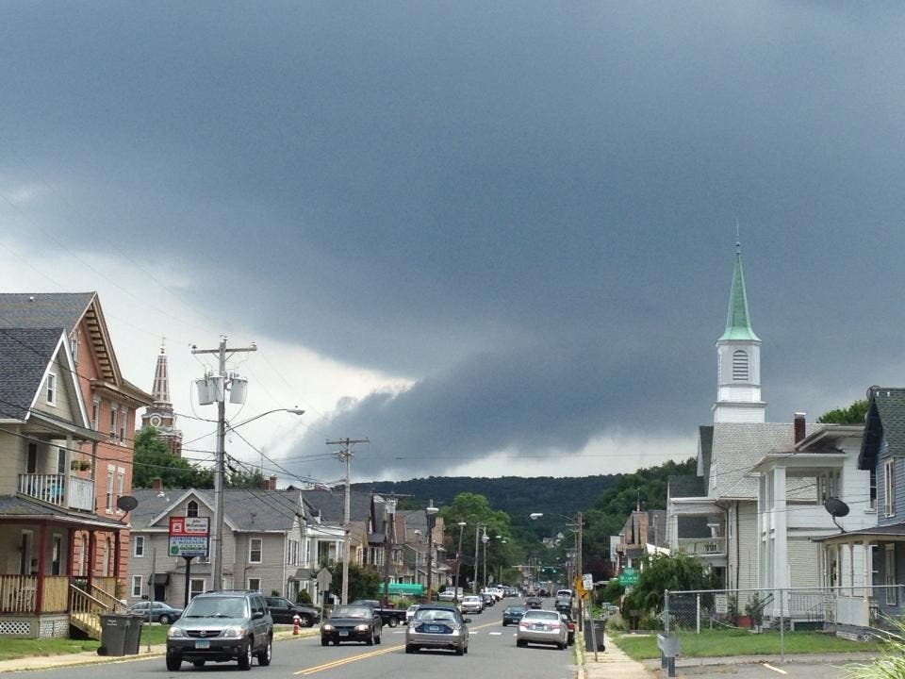
GENERAL INSTRUCTIONS
Voter Rights
Opening the Polls
Dress and Breaks
Who is (not) Allowed Inside
Assisting Voters with Disabilities
Closing the Polls
Emergency Plan
Tips and Tricks

Slide 16
CT Voter Bill of Rights
Every registered voter in this state has the right to:
Inspect a sample ballot before voting;
Receive instructions concerning how to operate voting equipment, on sample voting equipment before voting;
Cast a ballot if the voter is in line when the polls are closing;
Ask for and receive assistance in voting, including assistance in languages other than English where required by federal or state law;
Vote free from coercion or intimidation by election officials or any other person;
Cast a ballot using voting equipment that accurately counts all votes;
Vote by provisional ballot if the individual had registered to vote and the individual’s name is not on the voter list;
Be informed of the process for restoring the individual’s right to vote if the individual was incarcerated for a felony conviction; and
Vote independently and in privacy at a polling place, regardless of physical disability.
Poll Worker Training - Naugatuck, CT 8 Nov 2022 Slide

Slide 17
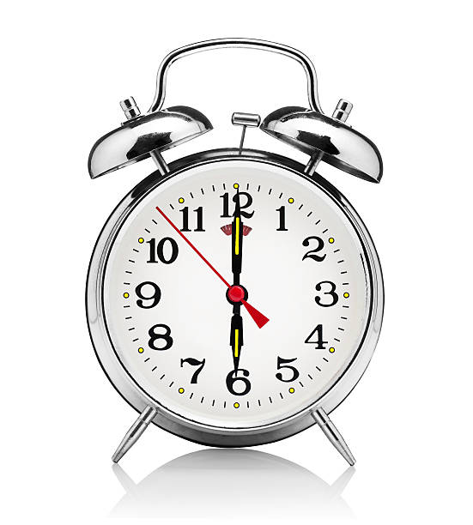
Opening and Setup
Arrive at your polling place by 5:15AM.
  Or 15 minutes before your start time if not working full day.
Park away from the main entrances. Leave parking near the entrance for the voters.
Tables and chairs should already be set up at each location when you arrive.
Report to the moderator when you arrive to sign in and receive instruction.
Set up your assigned work area. Ensure you have all the proper supplies.
IVS System must be setup before 6AM.
Voting MUST start at 6:00AM (no sooner, no later). Use auxiliary bin if tabulator not ready.
  Items required to allow voting: (a) Checkers laptop/book, (b) ballot clerk w/ ballots, (c) pens in voting booths, (d) Auxiliary bin in black box
Poll Worker Training - Naugatuck, CT 8 Nov 2022 Slide

Slide 18
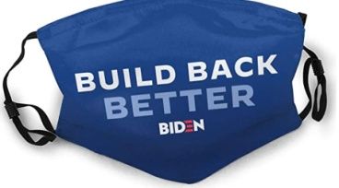

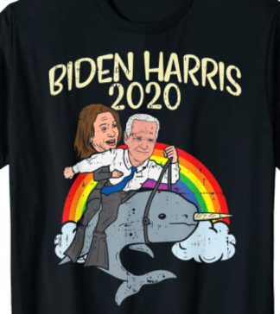
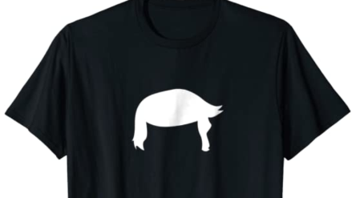
Dress and Breaks
Dress comfortably and professionally.
Political symbols/slogans/candidate names are not allowed in the polling place.
Do not discuss the candidates or politics within the polling place.
Breaks will be allowed by the moderator at their discretion.
Lunch and Dinner breaks will be allowed at appropriate times.
Bring your own meals/snacks/drinks with you or arrange meal delivery.
No alcohol is allowed.
Do not leave the polling place without the moderators knowledge.
Poll Worker Training - Naugatuck, CT 8 Nov 2022 Slide

Slide 19

Who is allowed in the polling place...who is NOT allowed
WHO MAY BE PRESENT Election Officials / Poll Workers Electors (Voters) (only to cast their ballot) Persons Assisting Electors Children Accompanying an elector (15 years of age or younger) Designee of the Secretary of State Record name in diary May NOT interfere with voters’ privacy Unofficial Checkers if approved by ROV May not interfere with the voting process Runners (relay info. from Unofficial Checkers) News Media Record name in moderator diary May NOT interfere with voters’ privacy May NOT ask elector how they voted within 75’ Student Observers - with teacher or guardian supervision (limit 4) PTO Bake Sales in Schools (Registrar’s approval required) Non-Partisan Activities (Registrar’s approval required) Police, Fire, EMS, Facilities/Equipment Maintenance May enter polls to Perform their duties Make note in Moderator diary | WHO MAY NOT BE PRESENT Candidates Except to cast their own ballot or assist an immediate family member Elector Who Has Already Voted Person with Political Clothing, Jewelry, Stickers, etc... Electors in the Wrong Polling Place Anyone Disrupting, Delaying, or Interfering with The Orderly Process of Voting Other people who need to access other parts of the building containing the polling place may pass through the 75-foot restricted area and the corridors leading to the polling place but cannot enter the room designated as the polling place. They may not display any candidate info.
Poll Worker Training - Naugatuck, CT 8 Nov 2022 Slide
Notes:
Some location will have Girl Scout Cookie sales, they setup out side the polling location(Andrew/CHMS), but within the 75 ft. This is approved by RoV.

Slide 20
Assisting Voters with Disabilities
Offer (but do not require) assistance to people with disabilities.
    Offer individuals with disabilities the same opportunity to vote privately and independently as other voters.
Use People First language.
    People First language emphasizes the person rather than disability. •
Avoid petting or otherwise distracting service animals.
    Distractions could potentially endanger the safety of the individual with a disability, the service animal or both.
Treat all voters as adults and with respect.
    Poll workers may not question a person’s right to vote based on their perception of an individual’s competence or ability to vote.
Address people with disabilities directly rather than deferring to their friends or companions.
    If you need to get the attention of a person with a visual or hearing disability, a gentle tap on his or her shoulder will enable the interaction.
Allow a person of the voter’s choice to assist them (within the limits of the law).
Finally, remember that this is about voter choice.
    All voters including voters with disabilities, have the right to choose whether they will vote by ballot marking device or an alternate method.
Poll Worker Training - Naugatuck, CT 8 Nov 2022 Slide

Slide 21
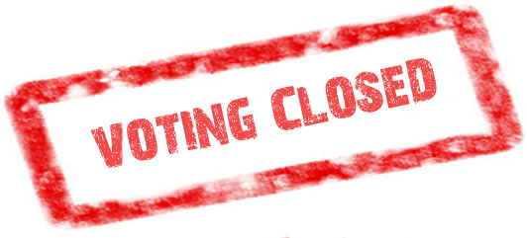
Closing of the Polls
The moderator shall publicly and loudly announce “the polls are closed” at exactly 8:00:00PM.
Any voter, as long as they are in line by 8:00PM, can complete the process to vote.
  No one can vote if they arrive after the moderator announces the closing of the polls. The moderator shall place a worker at the end of the line to ensure no one else enters the line. Politely turn away late arrivals.
Complete and sign any needed paperwork. The moderator has all required paperwork.
Return supplies to the moderator.
The moderator will assign two workers (one from each party) to stay with sealed tabulator and ballot bags until the hired runners pick them up from each location. Do not leave until they have been picked up.
Place the sealed IVS black box, signs, and sneeze shields next to the the tabulator black boxes for pickup the next day.
Do not leave the polling place until Moderator has excused you.
Poll Worker Training - Naugatuck, CT 8 Nov 2022 Slide
Notes:
- We will go over all the paperwork later on in the training.

Slide 22
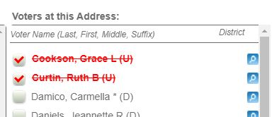
Absentee Voting
Absentee Ballots in Naugatuck are counted centrally.
Absentee ballots CANNOT be dropped off at the polling location.
Ways to submit absentee ballots:
  In Person @ Town Clerks Office (before the election)
  Via USPS mail
  AB Drop Box @ Town Hall
All ballots MUST arrive to town hall before 8PM on election day to be counted. Any ballot arriving after 8PM is rejected by Town Clerk
Any person that voted by absentee ballot will show with
a red strike though in VoterCheckList. The CANNOT vote
in person on election day.
Poll Worker Training - Naugatuck, CT 8 Nov 2022 Slide

Slide 23

Emergency Plan
SAFETY FIRST
Getting yourself and all voters in the polling place to safety is highest priority!
The Borough Election Emergency Plan is located in the Moderator Book.
Call 911 first, then call Registrar Office.
If possible, take the following with you as you get to safety:
  Black-box with active tabulator - push outside on wheels.
  Blank Ballots
  Checker Laptops / Checkers backup paper list
  Spare Tabulator (if on site)
  Any other election supplies you are able to carry.
Set up voting outside if possible and safe to do so.
Moderator should take head count of workers once to safety. Listen to emergency personnel before re-entering the building.
Poll Worker Training - Naugatuck, CT 8 Nov 2022 Slide

Slide 24
Tips and Tricks
Do not call the Registrars cell phone, use the office line first. The office lines rings all phones in the office.
Tabulator displays “POWER FAILURE”
  - Ensure UPS is powered on.
  - Check power cables (tabulator, UPS, outlet)
VoterCheckList page shows “HTTP ERROR 500”.
- Click ‘Refresh’ button in
Chrome.
- or Close Browser, reopen VCL
- or Reboot laptop
Ballots can stick together. Fan out ballots and triple check only giving each voter a single ballot.
Ensure extension cord is taped down or out of the way of traffic. Use the blue painters tape to ensure no one trips on the extension cord. Ask custodian for a small rug if needed.
Tabulator tape too light. - Try pushing down on the ink ribbon as it is printing.
- Replace the ink ribbon, request during day from registrar office.
Poll Worker Training - Naugatuck, CT 8 Nov 2022 Slide

Slide 25
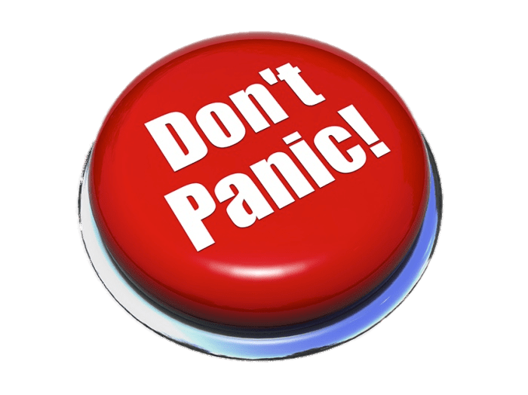
Tips and Tricks
Our office is just a phone call away!
Poll Worker Training - Naugatuck, CT 8 Nov 2022 Slide

Slide 26
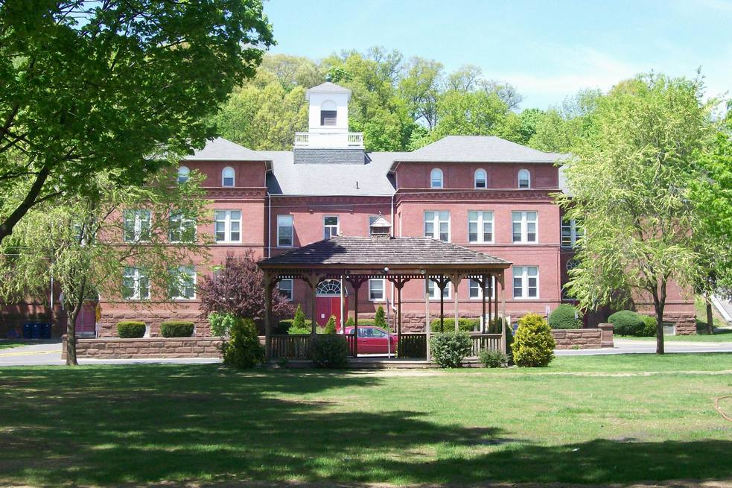
Election Worker
Duties
Greeter
Checker
Ballot Clerk
Tabulator Tender
Asst. Registrar of Voters
Moderator

Slide 27
Greeter (Some locations)
Greeter Supplies
  Street Listing
  A smile
Greeter Duties
Some large locations or locations with multiple districts will have greeters.
  Andrew Ave, Cross St, Parks and Rec
The greeter will stand at/near the main entrance to direct people to their correct voting district.
Warmly welcome each voter!
Stop anyone from entering with visible candidate literature, clothing, pins, etc.
  Call over the moderator if needed.
Can fill in at other rolls though out the day as breaks are taken.
Poll Worker Training - Naugatuck, CT 8 Nov 2022 Slide

Slide 28
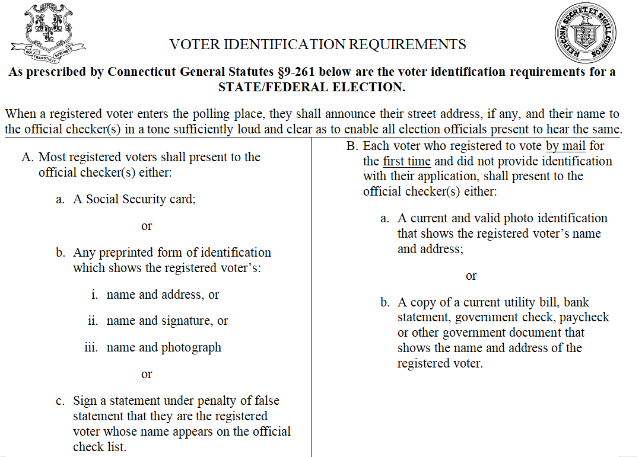
Checkers (Voter Identification - State/Federal)
Poll Worker Training - Naugatuck, CT 8 Nov 2022 Slide

Slide 29
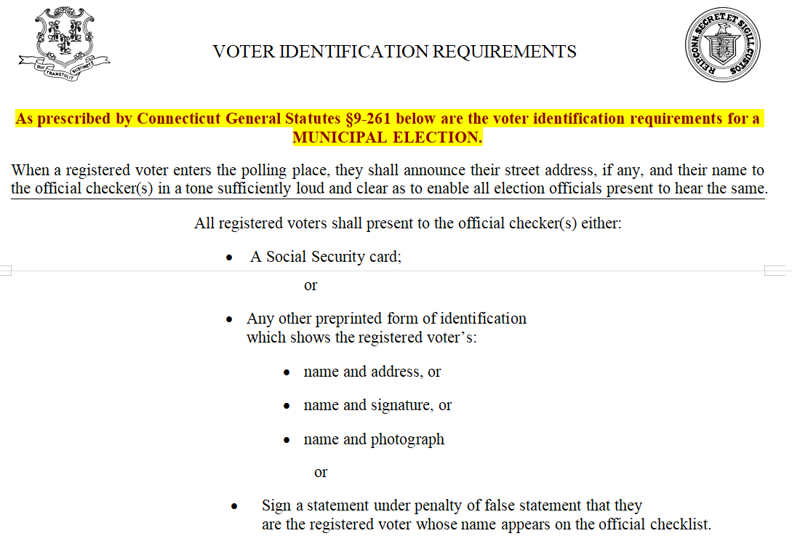
Checkers (Voter Identification - Local)
Poll Worker Training - Naugatuck, CT 8 Nov 2022 Slide

Slide 30

Checkers
Checkers Supplies
Voter Identification Signs
VoterCheckList Laptop (2)
  Laptop, power supply, USB Drive, USB Mouse, extension cord, power strip.
CHECKED VOTER slips
Official Voter Poll List Binder (kept with moderator unless needed due to laptop failure)
Checker Duties
Ensure Elector’s Name is on Official Voter Check List or supplemental list, suppressed address list.
  NOTE: VoterCheckList will be covered in more detail later in the presentation
Ask and verify the voters ID.
Check off the voter as ‘Voting’ in the Voter Checklist software.
Provide voter with a ‘CHECKED VOTER’ slip and direct them to the Ballot Clerk.
Poll Worker Training - Naugatuck, CT 8 Nov 2022 Slide

Slide 31
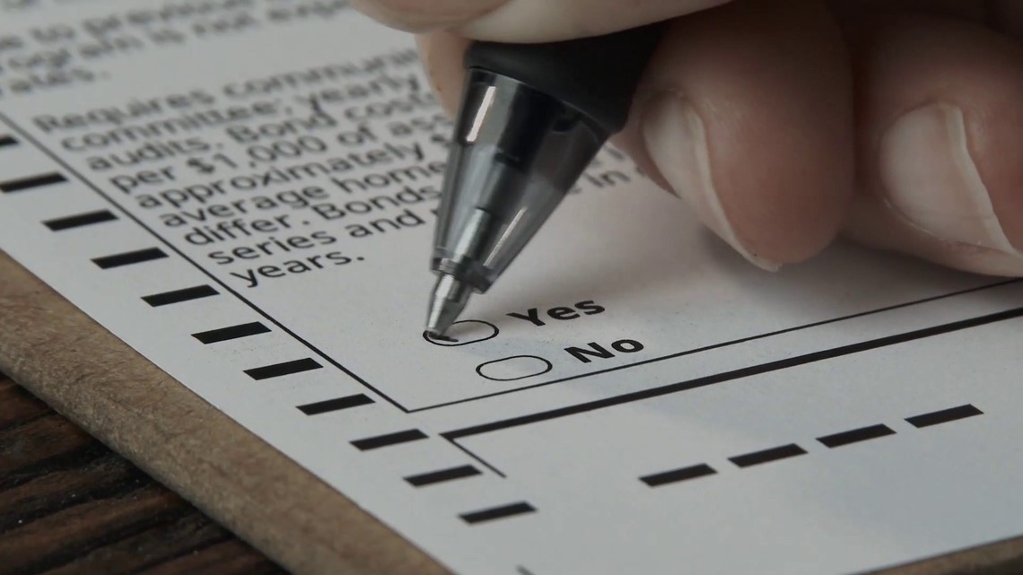
Ballot Clerk
Ballot Clerk Supplies
Packages of Ballots
Spoiled & Abandoned Ballot envelopes
Privacy Folders
Marker and/or spoiled ballot stamp
Ballot Clerk Duties
Verify you have the correct ballots for your voting district. The district #/location will be printed on the top of the ballot. Open only one package of ballots at a time. Keep extra packages with the moderator.
Take ‘CHECKED VOTER’ slip from voter. Hand ONE ballot to the voter.
Direct voter to the voting booths.
If a voter needs a replacement ballot, (1) take the original ballot, (2) mark as spoiled and place a cross
through the bar-code on the edge (place in spoiled envelope), and (3) then give the voter another ballot.
Monitor number of ballots remaining. Contact Moderator if you feel you will run out before 8PM.
Poll Worker Training - Naugatuck, CT 8 Nov 2022 Slide
Notes:
Each location is provided enough ballots based on historical turn out. If you feel you will run out of ballots before end of the night, contact your moderator. We also track this in the office using VoterCheckList

Slide 32
Checkers \ Ballot Clerk (Combined for Primary)
Checkers Supplies
Voter Identification Signs
VoterCheckList Laptop
  Laptop, power supply, USB Drive, USB Mouse, extension cord, power strip.
Official Voter Poll List Binder
  Kept with moderator unless needed due to laptop failure
Ballot Clerk Supplies
Packages of Ballots
Spoiled & Abandoned Ballot envelopes
Privacy Folders
Marker and/or spoiled ballot stamp
Checker\Ballot Clerk Duties
Verify you have the correct ballots for your voting district. The district #/location will be printed on the top of the ballot. Open only one package of ballots at a time. Keep extra packages with the moderator.
Ensure Elector’s Name is on Official VoterCheckList
  If using backup paper checkers list: Also check supplemental list, and suppressed address list.
  NOTE: VoterCheckList will be covered in more detail later in the presentation
Ask and verify the voters ID. Check off the voter as ‘Voting’ in the VoterCheckList software.
Hand ONE ballot to the voter and direct them to the voting booths.
If a voter needs a replacement ballot, (1) take the original ballot, (2) mark as spoiled and place a cross
through the bar-code on the edge (place in spoiled envelope), and (3) then give the voter another ballot.
Monitor number of ballots remaining. Contact Moderator if you feel you will run out before 8PM.
Poll Worker Training - Naugatuck, CT 8 Nov 2022 Slide

Slide 33
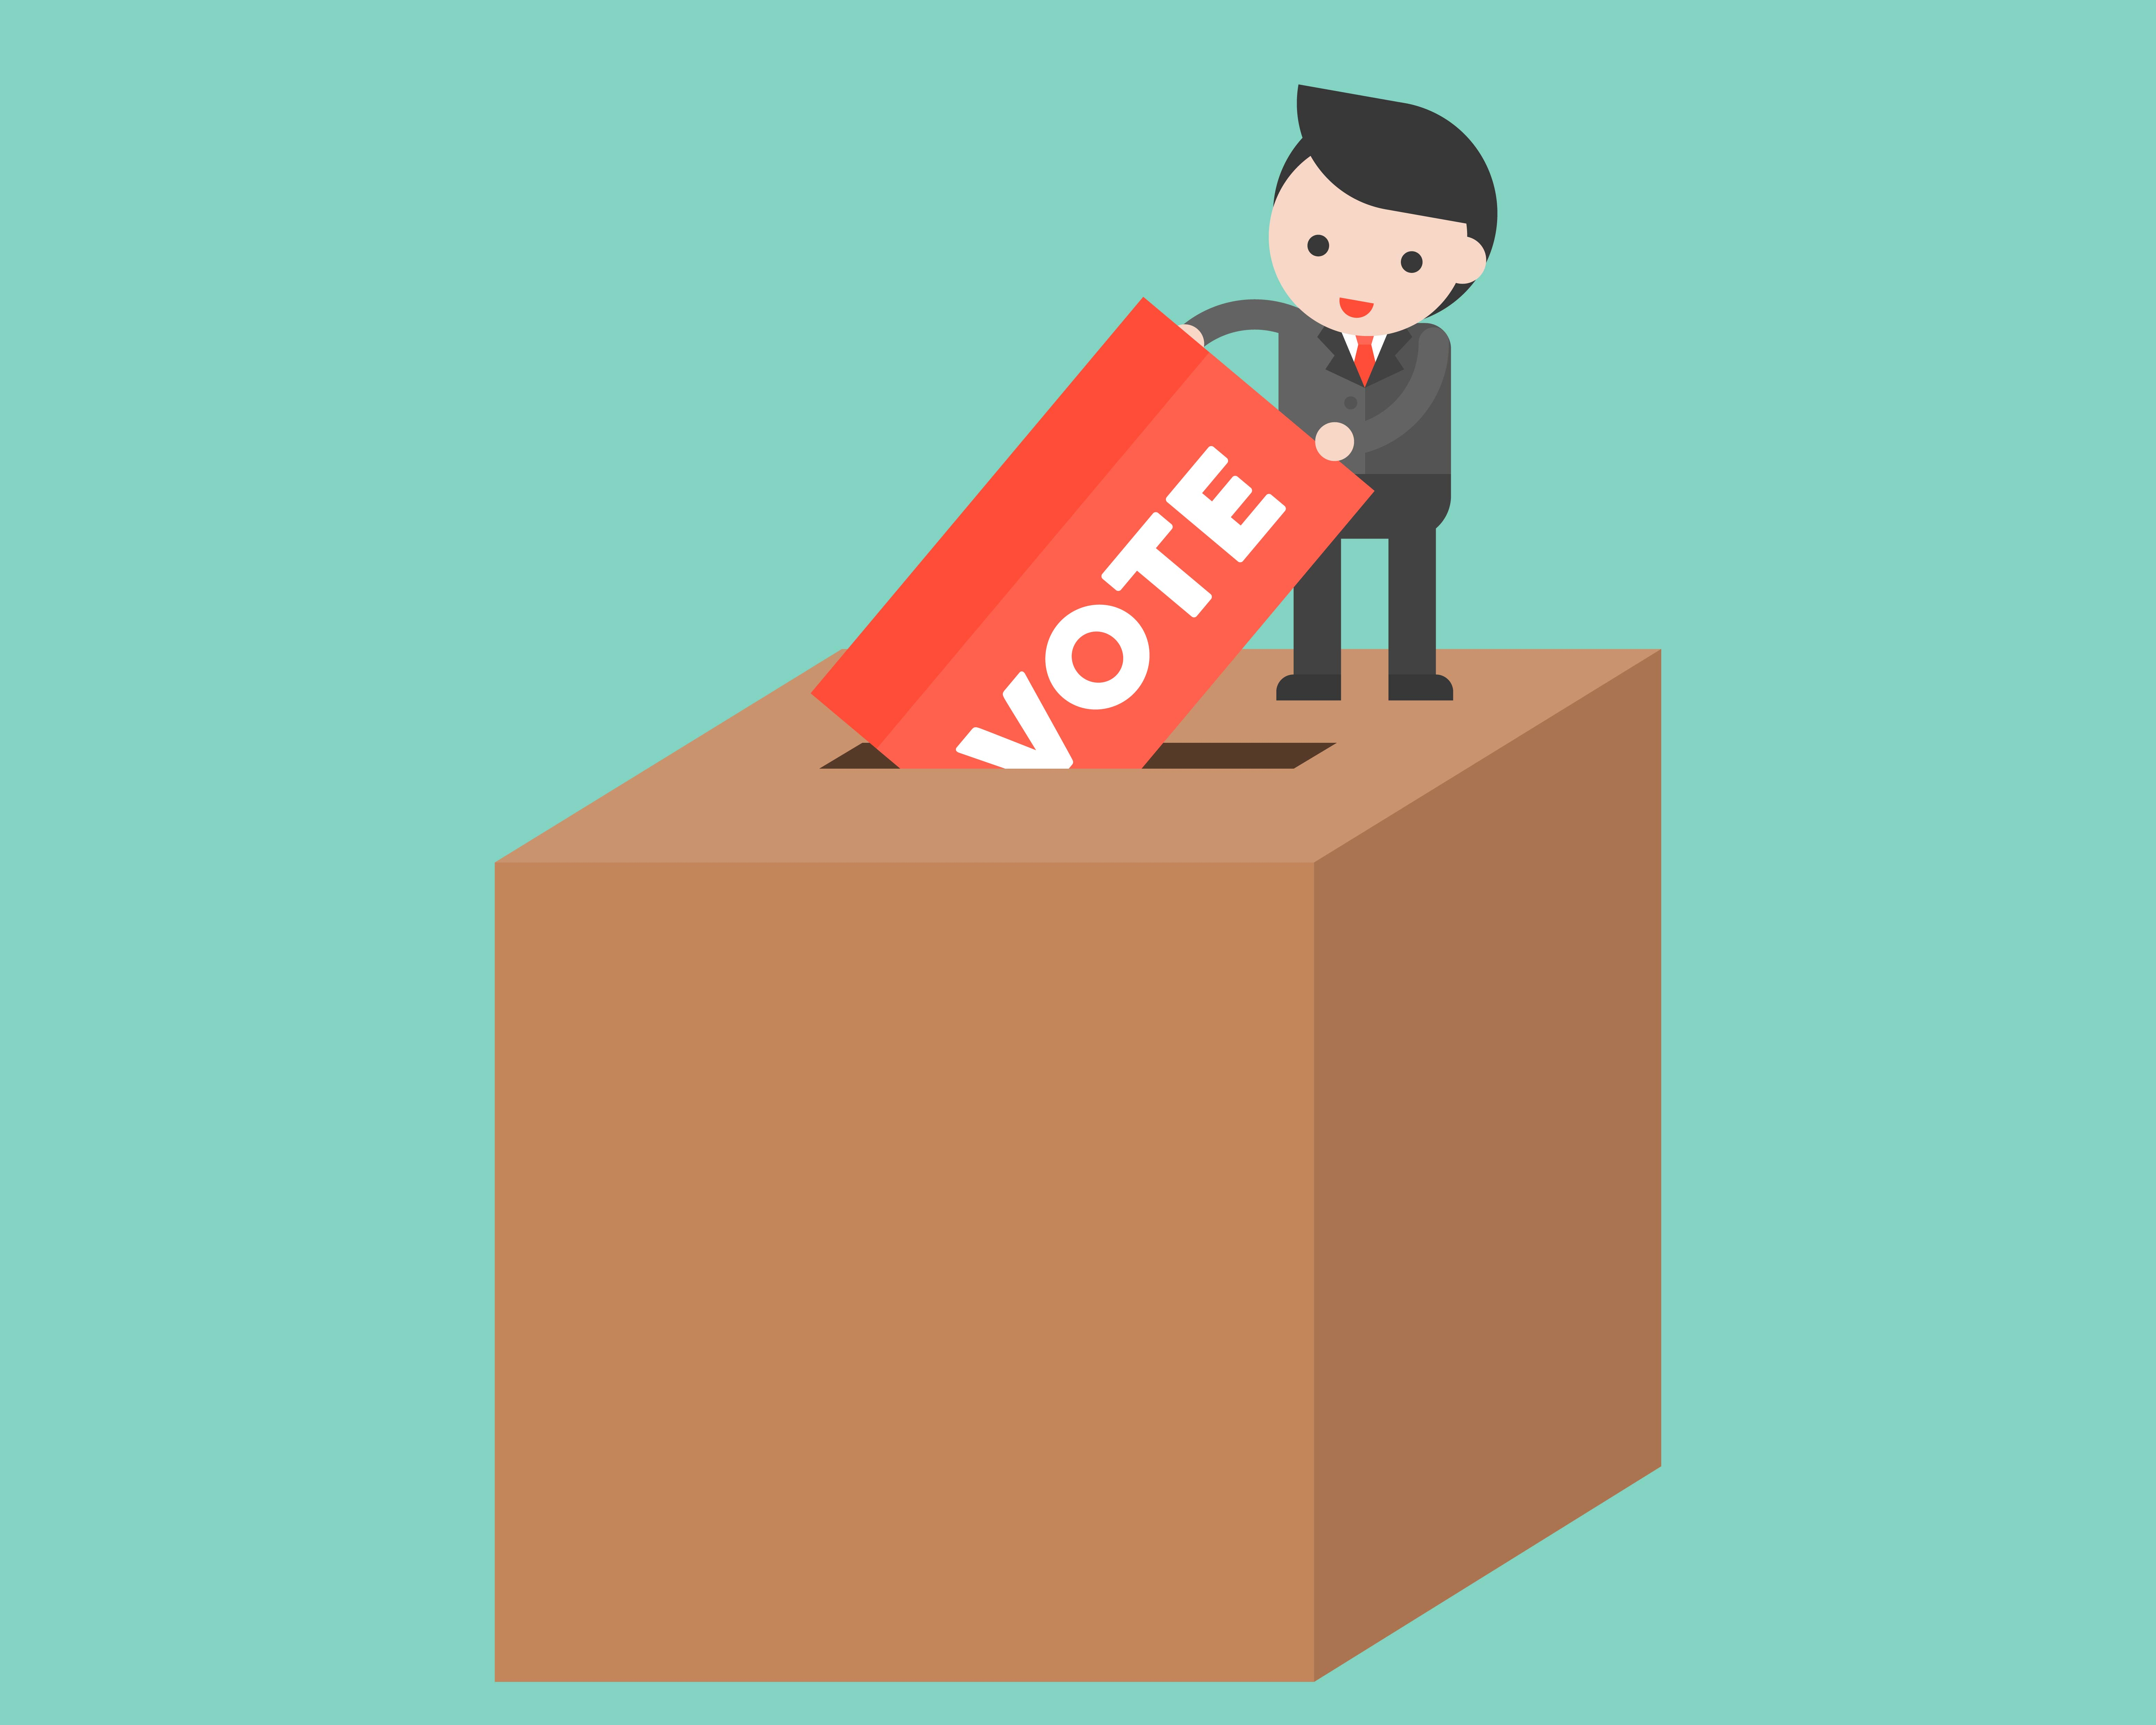

Tabulator Tender
Tabulator Tender Supplies
I Voted Stickers
Tabulator Tender Duties
Serve as the guardian of the tabulator and witness ballots being cast.
  Do NOT stand close enough to observe how people voted.
  Review/diagnose Tabulator Error messages as needed
Stand/Sit no closer then 3 to 4 feet away from the tabulator.
Assist the voter if needed to inset their ballot.
  Use a privacy folder to cover ballot when assisting a voter cast their ballot.
Offer the voter a ‘I Voted Today’ sticker. Do NOT put the sticker on the voter!
THE FLEEING VOTER: Voter walks away from tabulator without re-inserting their rejected ballot
If Election Official witnesses the voter insert their ballot into the tabulator and walk away. Ballot is to be counted. Insert ballot into auxiliary compartment. | If Election Official DOES NOT witness the voter insert their ballot into the tabulator and walk away. Ballot is not counted. Call over the Moderator. Moderator will handle as an Abandoned ballot
Poll Worker Training - Naugatuck, CT 8 Nov 2022 Slide
Notes:
Tabulator Error messages - to be reviewed later on in the session. Moderator is trained and will help with these issues.

Slide 34
Assistant Registrar of Voters
ARV Supplies
Pens, Markers, Notebook
Forms:
  Voter Registration Form, No Voter ID Form, Erroneously Checked off Voter Form, Challenged Ballot Form, Provisional Ballot Envelope/Form.
Clipboard (for curbside voting)
ARV Duties
Carry out the duties of the RoV at the polling place. Always work as a ‘pair’, that is why we have an ARV from each party.
Assist the moderator in completion of his/her duties. Assist Moderator with the opening/closing of the tabulator.
Perform curbside voting.
Assist voters as request within the polling location.
Fill in at other positions as needed for worker breaks.
Poll Worker Training - Naugatuck, CT 8 Nov 2022 Slide
Notes:
All RoV Forms are in the ARV handbook or the Moderator book. Most common used form is the Voter Reg Form.

Slide 35

Moderator
Moderator Supplies
On next slide
Moderator Duties
YOU ARE THE BOSS! Know your job and all other jobs at the polling location.
Pick up supplies the day before (1pm - 3pm) from the RoV Office in town hall.
Direct poll workers to make sure their stations are set up and ready before 6:00AM. Open the tabulator with assistance from the AVRs for 6:00AM opening.
Complete all the forms (opening and closing) in the Moderator handbook, ensure forms are signed as needed by each worker.
Ensure voting location is set up correctly. (Posters, tables, IVS, tabulator, forms, booths, etc).
Ensure each worker is doing their tasks properly. Teach/correct workers if they need guidance.
Direct workers for breaks, ensure constant coverage for each position.
Poll Worker Training - Naugatuck, CT 8 Nov 2022 Slide
Notes:
Reach out to Louise if you need alternate arrangements to pick up the bag on Monday!

Slide 36
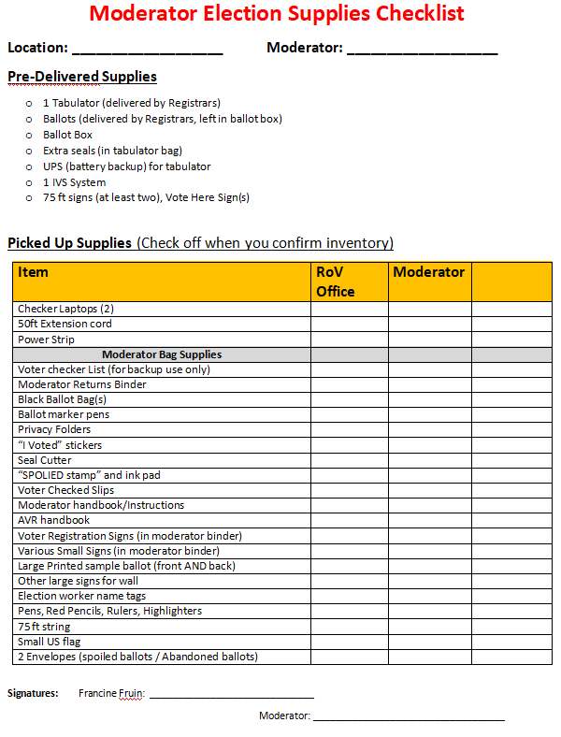
Moderator (Supplies Pickup)
Moderator Supplies
Check your supplies when you pick them up the day before the election.
Check off each items on the provided checklist as you review your supplies. Sign the form and give to Francine.
You are responsible bringing back all items at the end of the night. (Tabulator and ballots will be picked up).
Poll Worker Training - Naugatuck, CT 8 Nov 2022 Slide

Slide 37
Moderator (Supplies Return)
Moderators Responsible to Return:
VoterCheckList Laptops
  w/ power supplies, mouse, USB stick, extension cord, power strip
Moderator Binder
  w/ completed reports, forms
Unused ballots
Moderator Bag w/ all supplies
  Backup Checkers list
  Ballot Pens
  Privacy Folders
  “I Voted” stickers
  Seal Cutter
  “Spoiled Stamps”w/ Ink Pad
  Voter Checked Slips
  Moderator Handbook/Instructions
  AVR Handbook
  ‘Inside’ Signs
  Election worker name tags
  Pens, Pencils, Rulers, Highlighters
  75ft String
  Small US flag
  All other supplies
Picked up by Runners (election night)
Sealed Tabulators
Sealed Ballot Bags
Picked up next day by hired staff
Black Ballot Box (empty)
Sneeze shields
Voting booths
UPS Battery
Stanchions
Outdoor signs (75 ft, Voter Here, etc.)
Please bring all signs inside and place near the black box.
NOTE: Tables and chairs are usually owned by the location where voting occurred at. The custodian at each location will take them down.
Poll Worker Training - Naugatuck, CT 8 Nov 2022 Slide

Slide 38
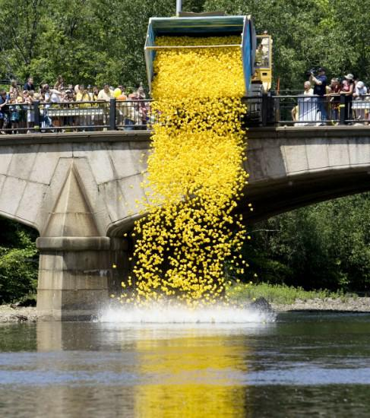
SPECIAL TOPICS
Reports
Write-In Candidates
Curbside Voting
Voter Transfers
Tabulator Overview
Submitting results @ Town Hall
IVS Voting
VoterCheckList

Slide 39
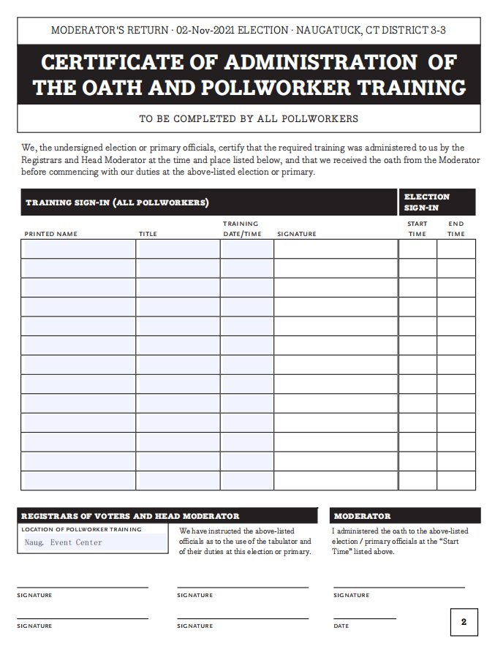
Reports - Training and Oath Report
Moderator to ensure each poll worker sign the training and oath form when workers arrive.
Moderator to sign the form at end of the night. (Lower right area of form)
Used for payroll processing.
NO WRITE-IN’S ALLOWED IN A PRIMARY
Poll Worker Training - Naugatuck, CT 8 Nov 2022 Slide

Slide 40
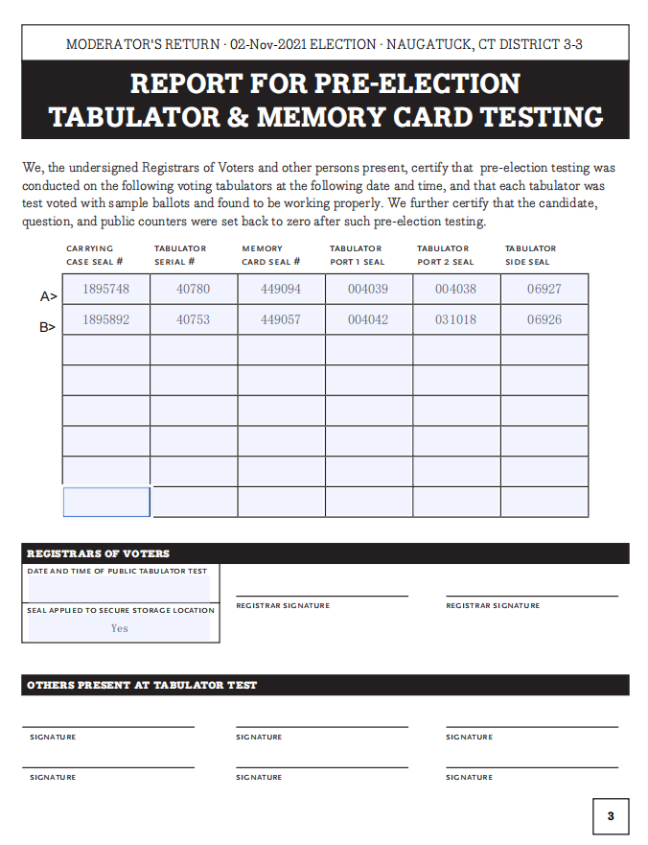
Reports - Tabulator Testing and Memory Cards
Report completed by the Registrar of Voters before each election.
Report confirms all tabulators have been tested and configured correctly for each polling place.
Moderators to use as reference for tabulator seal numbers and serial numbers. Confirm all numbers match when filling in other reports.
NO WRITE-IN’S ALLOWED IN A PRIMARY
Poll Worker Training - Naugatuck, CT 8 Nov 2022 Slide

Slide 41
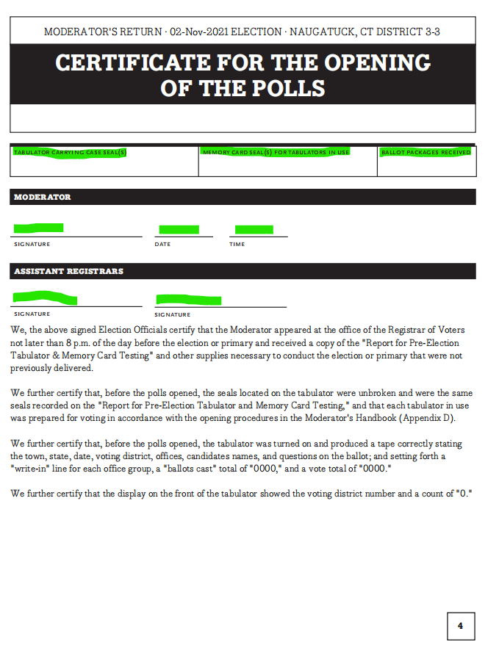
Reports - Opening the polls
Moderators and ARV’s to complete this report when opening the tabulator before 6:00AM.
Compare seal numbers against the Tabulator Testing Report.
Moderator and both Assistant Registrars must sign.
NO WRITE-IN’S ALLOWED IN A PRIMARY
Poll Worker Training - Naugatuck, CT 8 Nov 2022 Slide

Slide 42
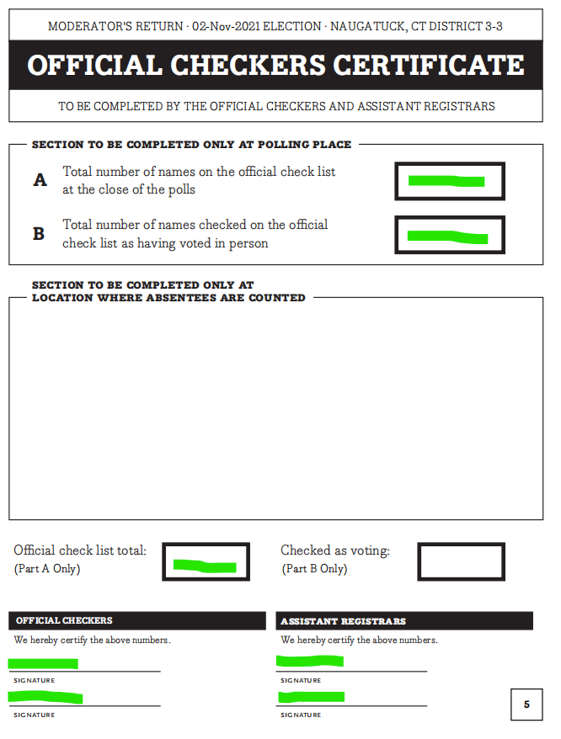
Reports - Checkers Certificate
Checkers and ARV’s to complete this report and the end of the night after the polls are closed.
Get information from the VoterCheckList report area.
Both Checkers and Assistant Registrars must sign.
Provide report to the Moderator.
NO WRITE-IN’S ALLOWED IN A PRIMARY
Poll Worker Training - Naugatuck, CT 8 Nov 2022 Slide

Slide 43
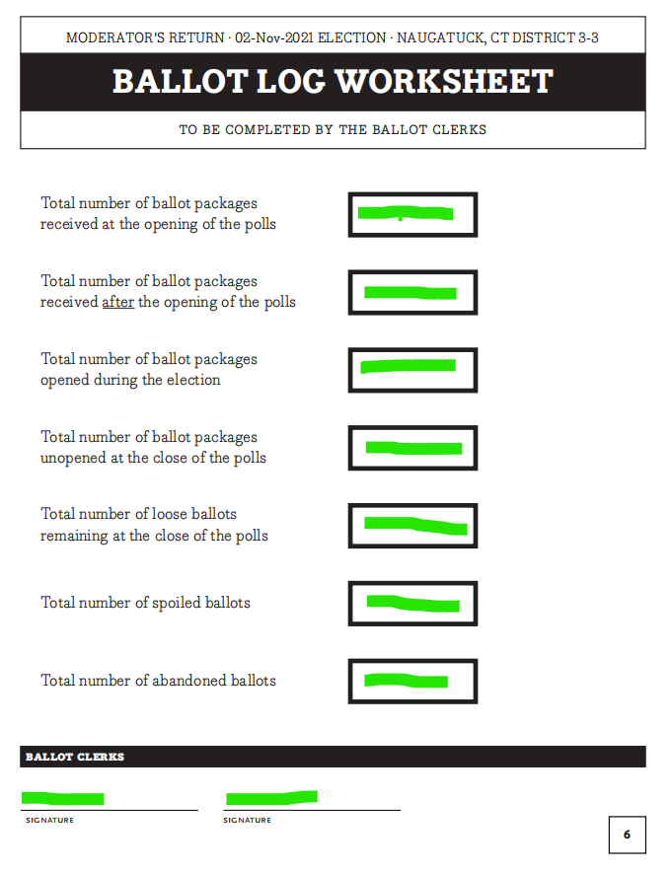
Reports - Ballot Log
To be completed by the Ballot Clerk.
Complete the first question at the start of the day.
Update the second question during the day if more ballots are delivered.
Complete remaining question after the polls are closed.
Ballot Clerk(s) must sign. Provide report to the Moderator.
NO WRITE-IN’S ALLOWED IN A PRIMARY
Poll Worker Training - Naugatuck, CT 8 Nov 2022 Slide

Slide 44
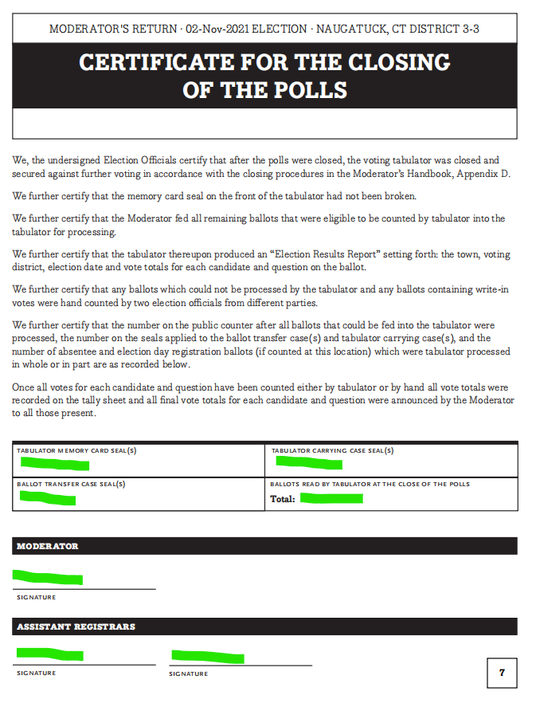
Reports - Closing the Polls
Moderator and ARV’s to complete this report and the end of the night after the polls are closed.
Compare Seals numbers from the Opening of the Polls report and the Tabulator Testing report.
The Moderator and Assistant Registrars must sign.
NO WRITE-IN’S ALLOWED IN A PRIMARY
Poll Worker Training - Naugatuck, CT 8 Nov 2022 Slide

Slide 45
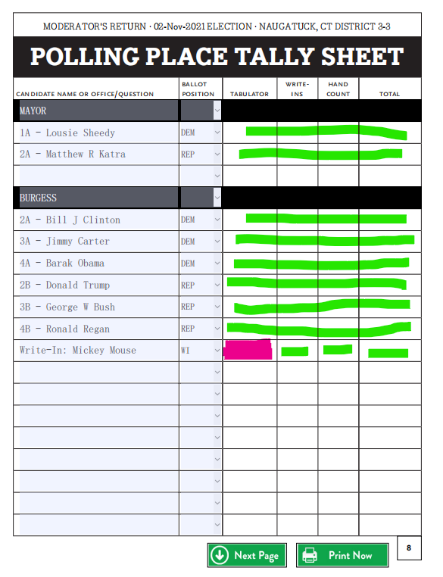
Reports - Voting Results/Tally Sheet
Moderator and ARV’s to complete this report and the end of the night after the polls are closed.
Fill in results from tabulator tape, write-in votes, and any ballots that had to be hand counted.
Add up totals for final column for each candidate.
Don't forget Write-In candidates. (No Write-In for primaries)
NO WRITE-IN’S ALLOWED IN A PRIMARY
Poll Worker Training - Naugatuck, CT 8 Nov 2022 Slide

Slide 46
What is a Primary?
A primary election is an election used either to narrow the field of candidates for a given elective office or to determine the nominees for political parties in advance of a general election.
Connecticut has a “closed primary” which means that only voters registered in the political party holding a vote can cast a ballot.
This year, there is both a Democrat primary vote and a Republican primary vote on August 9th.
Only Democrats can vote in the Democrat Primary.
Only Republicans can vote in the Republican Primary.
Unaffiliated voters or those in a minor party CANNOT vote in the primary.
Poll Worker Training - Naugatuck, CT 8 Nov 2022 Slide

Slide 47
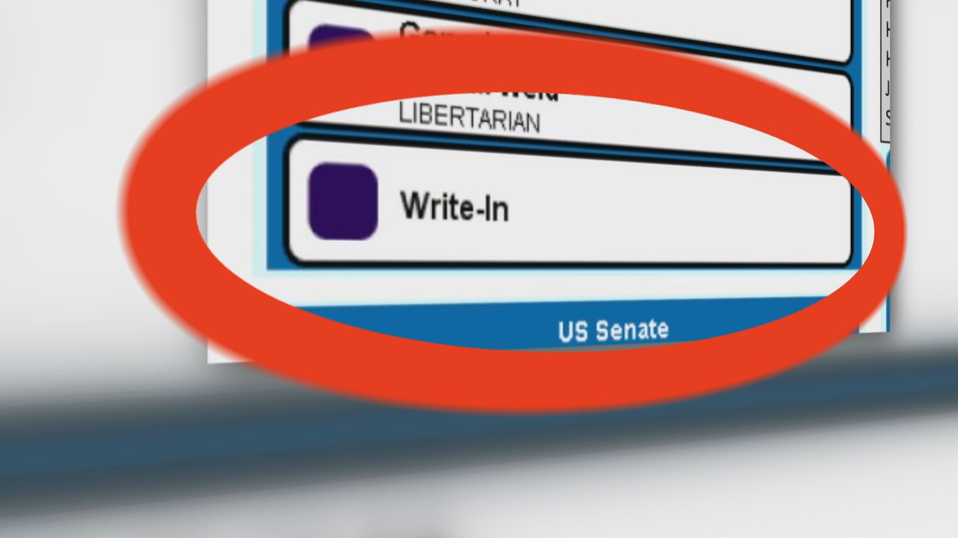
Write-In Candidates
DO NOT PUT WRITE IN BALLOTS THROUGH THE TABULATOR AT THE END OF THE DAY. ALL RACES (other then the write-in vote) ARE ALREADY COUNTED.
Valid Write-In Candidates for this election:
Governor/Lt. Governor
  Michelle Louise Bicking / Cassandra A Martineau
US Senate
  John Anderson
  Shabadjot Bharara
There is a page in each moderator binder with the listed write-in candidates.
Poll Worker Training - Naugatuck, CT 8 Nov 2022 Slide
Notes:
NOTE: Also, there is NO Election Day Registration for a Primary

Slide 48
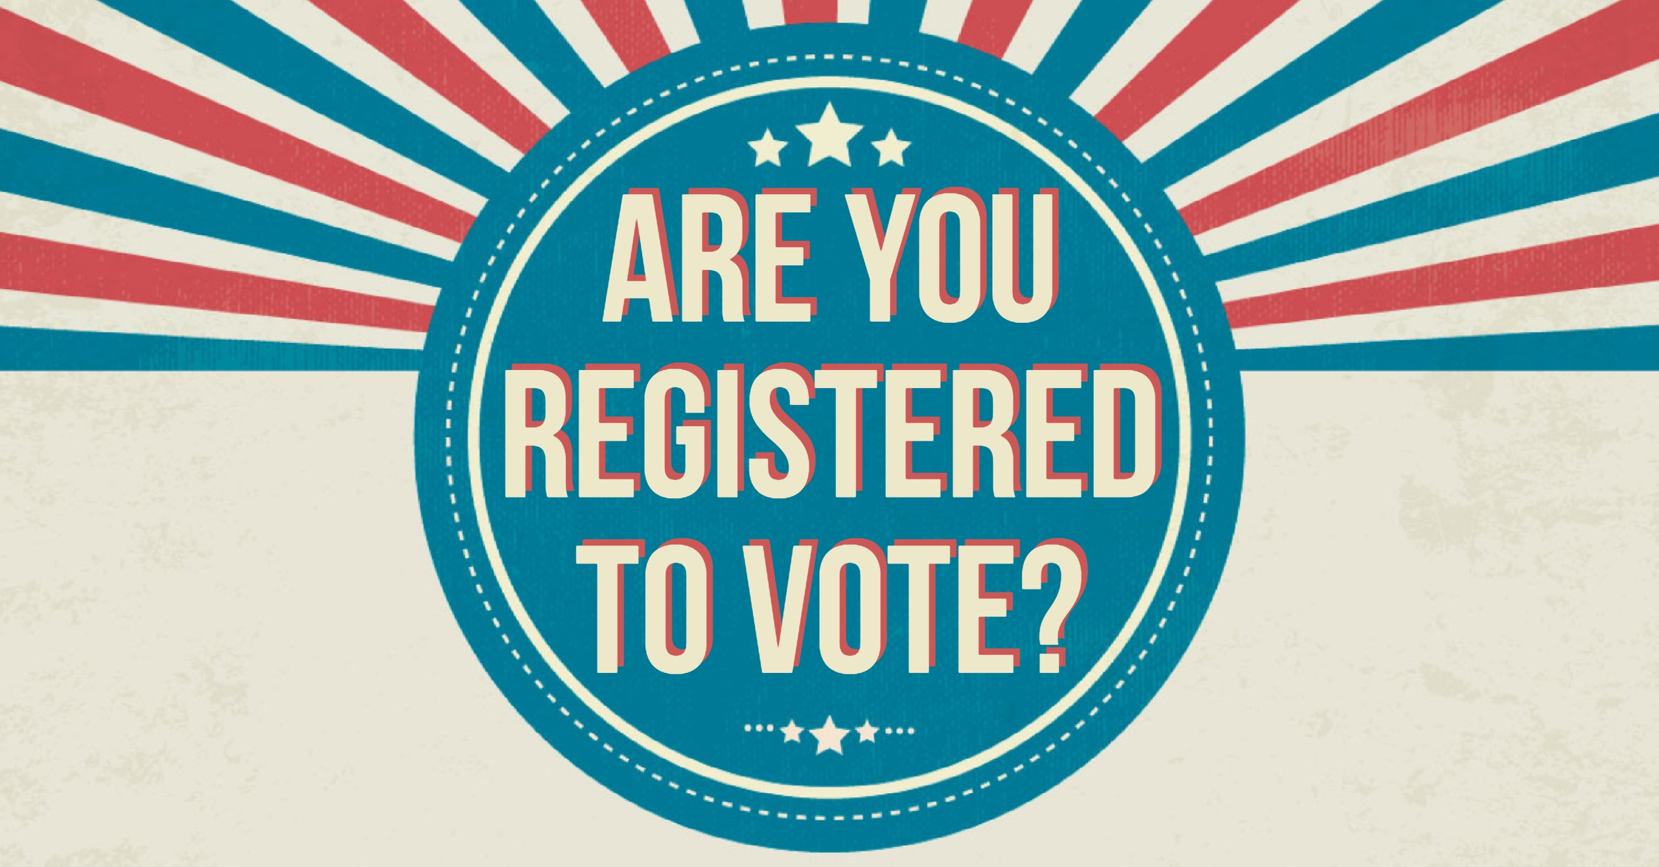
Write-In Candidates / Election Day Registration
ELECTION DAY REGISTRATION IS NOT AVAILABLE FOR A PRIMARY
NO WRITE-IN’S ALLOWED IN A PRIMARY
Poll Worker Training - Naugatuck, CT 8 Nov 2022 Slide
Notes:
NOTE: Also, there is NO Election Day Registration for a Primary

Slide 49
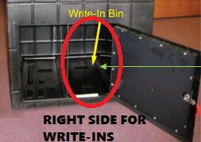
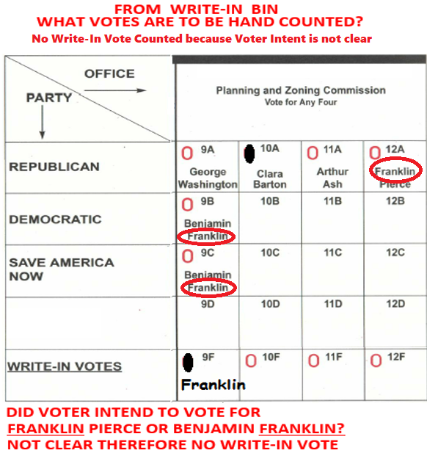
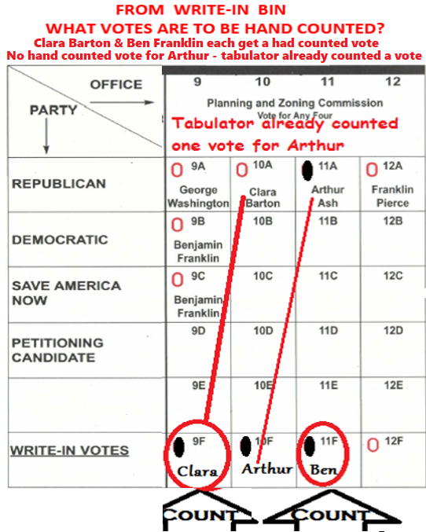
Write-In Candidates
DO NOT PUT WRITE IN BALLOTS THROUGH THE TABULATOR AT THE END OF THE DAY. ALL RACES (other then the write-in vote) ARE ALREADY COUNTED.
Hand count any valid write in votes.
Voter intent takes priority.
Poll Worker Training - Naugatuck, CT 8 Nov 2022 Slide

Slide 50
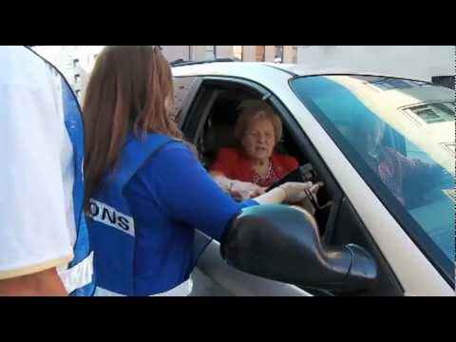
Curbside Voting
Used by any elector if they are outside the polling place and unable to gain access due to physical incapacity. No proof of incapacity needs be shown. Requests that a ballot be brought them in their car.
BOTH Assistant Registrars (or two poll workers of opposing parties) will go out to the car to perform the curbside voting process:
INSPECT voter’s ID – if no ID have voter sign Form ED 681 (Form 3)
CONFIRM voter is on the official list.
  Assist elector with restoration or transfer if applicable
ASK the official checker to mark voter off as voting
DELIVER a ballot, marking pen and privacy folder to the elector.
  Allow voter to fill out ballot privately in their car
  Completed ballot to be put into privacy folder
CAST BALLOT, without looking at it, by inserting it into the tabulator or auxiliary bin.
  Moderator records assistance in Moderator’s diary.
Poll Worker Training - Naugatuck, CT 8 Nov 2022 Slide

Slide 51
Voter Transfers/Reactivate
A voter may arrive and say, “I moved two months back but I know I am on the voting list here. I would like to vote.” Stop and call over the Assistant RoVs (or Moderator). If the person admits to no longer living at the residence on the voter roles, they may need to transfer before being allowed to vote.
Types
  Moved WITHIN town, never updated voting address (Can transfer between locations)
  Moved OUT of town, moved back. (Will need to go to Election Day Reg.)
Mainly a role for the Assistant RoV’s and Checkers.
Do NOT send the voters to other locations without checking with Registrars office.
No transfers are to made without approval from the Registrar of Voters Office.
When sending a person to EDR or another location, give them a Voter Registration Form as they will need to complete for next location.
CALL THE RoV OFFICE LINE, NOT OUR CELL PHONES.
Poll Worker Training - Naugatuck, CT 8 Nov 2022 Slide
Notes:
Do not call our cell phones.
-When calling the RoV office, it rings at all 3 desks and any of us can pick up in help.
- We may not be in the office.
- We may on the cell with someone else already.

Slide 52

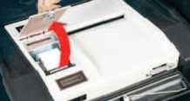
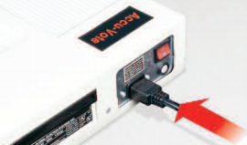
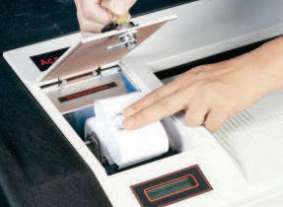
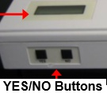
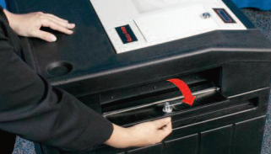
Tabulator Overview (Opening)
Tabulator Video: http://www.youtube.com/watch?v=qs--WTH0ZKM
NOTE: REFER TO TABULATOR SETUP IN MODERATOR BOOK FOR FULL SET OF INSTRUCTIONS.
Plug Uninterruptible power supply (UPS) in to wall (heavy black unit). Make sure UPS is powered on!
Check all compartments in the black ballot box, ensure it is empty.
Open the auxiliary ballot bin on side of black box, leave open for duration of voting.
Confirm seals on tabulator match those listed in tabulator hand book, open case.
Plug tabulator in to the UPS.
Place tabulator in black ballot box, open register compartment, power on.
Print 3 ‘zero’ reports’, all reports must be signed by moderator and both ARVs. Place one in black box ballot bin, and post one on the wall near tabulator, keep the third rolled up in the tabulator all Election Day. This third report will then be attached to the first results ribbon, do not separate them!
Poll Worker Training - Naugatuck, CT 8 Nov 2022 Slide
Notes:
Ensure the # of votes show as ‘0’ (zero) on the display.

Slide 53
Tabulator Overview (Video)
Using the AccuVote Tabulator in CT Elections
by Fred DeCaro
http://www.youtube.com/watch?v=qs--WTH0ZKM
Poll Worker Training - Naugatuck, CT 8 Nov 2022 Slide
Notes:
Ensure the # of votes show as ‘0’ (zero) on the display.

Slide 54
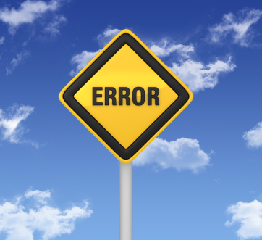
Tabulator Overview (Error Codes)
MESSAGE | ISSUE - PROBLEM | INSTRUCT - OPTIONS
BALLOT NOT READ PLEASE REINSERT | Tabulator could not read ballot | Ask voter to flip ballot & reinsert.
OVERVOTE | Tabulator reads too many ovals filled in on at least one contest | Spoil ballot & get a new one (OR) Put ballot into auxiliary bin. NOTE: Call Moderator over to override system and inset ballot.
BLANK VOTED BALLOT | Tabulator reads NO ovals filled in on ballot. | Review ballot in privacy booth & mark ballot per instructions (OR) Spoil ballot & get a new one (OR) Put ballot into auxiliary bin.
INVALID BALLOT SEE OFFICIAL RACE | Wrong ballots for this district | Call Moderator over immediately
COUNTED BALLOT JAMMED IN READER | Tabulator has counted ballot. It is jammed & needs a little help to drop into ballot box | Call Moderator over Moderator will pull tabulator forward & pull ballot through back & let it drop into ballot box.
RETURNED BALLOT JAMMED IN READER | Tabulator has NOT counted ballot. It is jammed & needs to be pulled out from rear or front of tabulator & reinserted into tabulator | Call Moderator over Moderator will pull tabulator forward, pull ballot out from rear & give ballot to elector to reinsert into tabulator
POWER FAIL | Tabulator is running off its battery power and no power is coming in through the cord. | Call Moderator over Make sure power cord is properly plugged in. Make sure UPS is powered on.
NOTE: The ballot is the large style ballot (legal paper size). Empty the black tabulator boxes around every 750-800 votes cast.
Poll Worker Training - Naugatuck, CT 8 Nov 2022 Slide
Notes:
This is also in the Moderator Binder

Slide 55
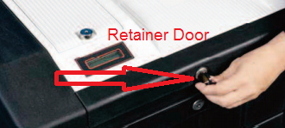
Tabulator Overview (Closing)
NOTE: REFER TO TABULATOR CLOSING IN MODERATOR BOOK FOR FULL SET OF INSTRUCTIONS.
Open the tabulator printer door and black box retainer door.
Open the auxiliary ballot bin on side of black box, insert any ballots that can be read.
Record all seal #’s in the ‘closing of the polls’ report.
  Confirm seals on tabulator match those listed in moderator hand book.
While pressing both ‘YES’ and ‘NO’ buttons, insert the ENDER CARD.
Print and sign 3 reports.
  1 - This report is attached to the ‘zero’ report from start of the day. Place this report in the moderator book. Transcribe result to the moderator results forms. Read aloud the results.
  2 - Post report on wall for public review.
  3 - Place in ballot transfer case.
Shut off tabulator and place in carry case. Seal the carry case and record the seal.
Poll Worker Training - Naugatuck, CT 8 Nov 2022 Slide

Slide 56
Submitting Results @ Town Hall (Moderators)
NOTE: The moderator at each site is responsible for submitting all reports and returning all supplies at town hall. They may not leave until dismissed by both Registrars.
BEFORE LEAVING: Assign one person from each party to stay with sealed tabulator(s) and sealed ballot bag(s) until they are picked up by the hired runners.
Bring back following to town hall:
  (a) Both VoterCheckList laptops (and all accessories, cables); (b) moderator bag with all supplies; (c) completed reports; (d) unused ballots
There are two ‘stations’ that must be completed before dismissed
  w/ Matt: Submit election results and voter numbers in to CT Election Mgmt System
  w/ Louise: Drop off all supplies, review all reports. Investigate voter count discrepancies.
Poll Worker Training - Naugatuck, CT 8 Nov 2022 Slide
Notes:
Ensure the # of votes show as ‘0’ (zero) on the display.

Slide 57
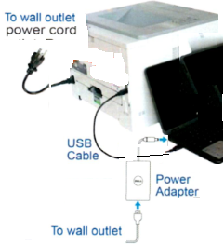
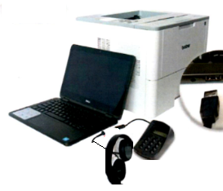
IVS System (Setup)
BEFORE POLLS OPEN ELECTION MORNING
1)Ensure printer and computer are plugged in to power outlet.
2)Ensure USB cable is plugged in from computer to printer.
3)Ensure keypad and headphone are plugged into computer.
4)Ensure paper tray is open, extended & tray sleeve installed.
5)Load plain paper onto the paper tray
6)Turn “On” Printer and Computer
7)Press “Print” on computer screen. A startup report will print. Give the startup report to moderator to place in moderator book.
8)Press “No” on computer screen.
Poll Worker Training - Naugatuck, CT 8 Nov 2022 Slide

Slide 58
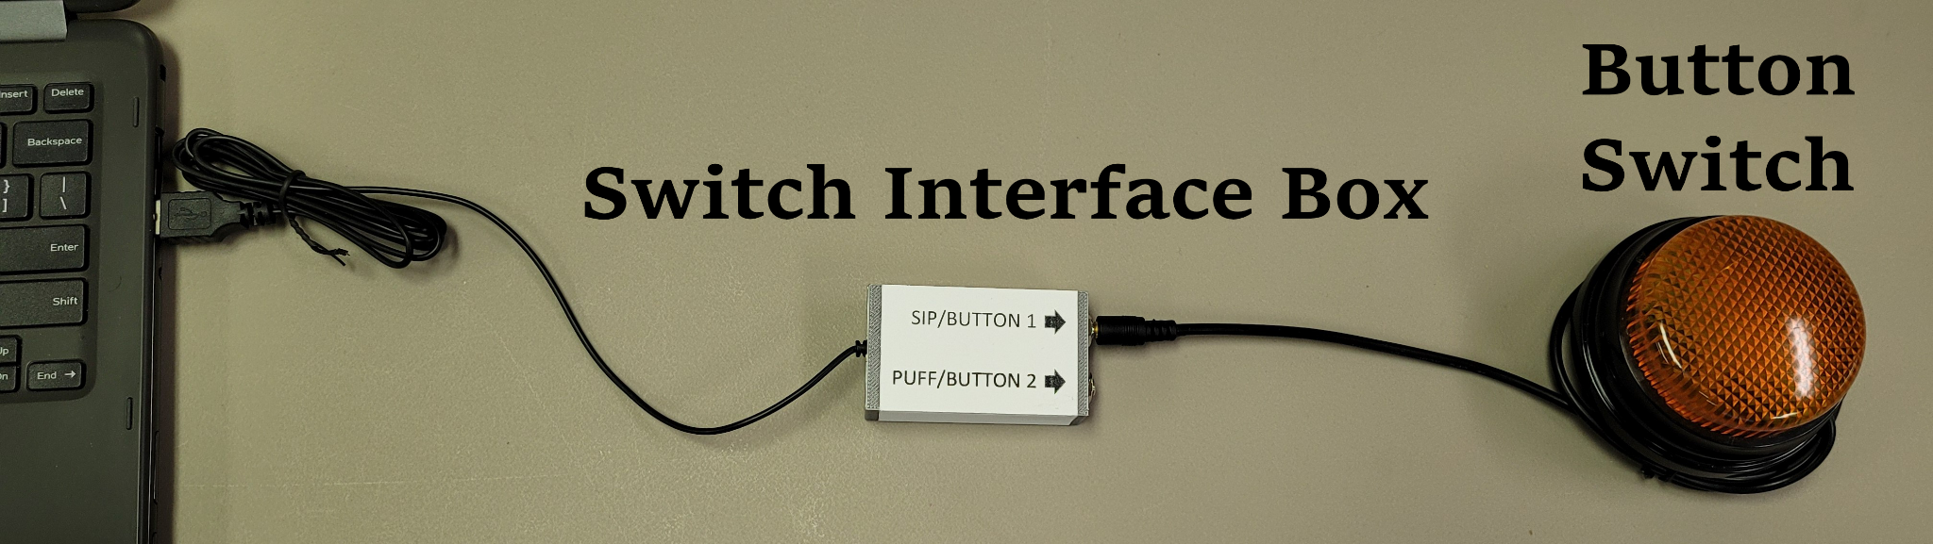
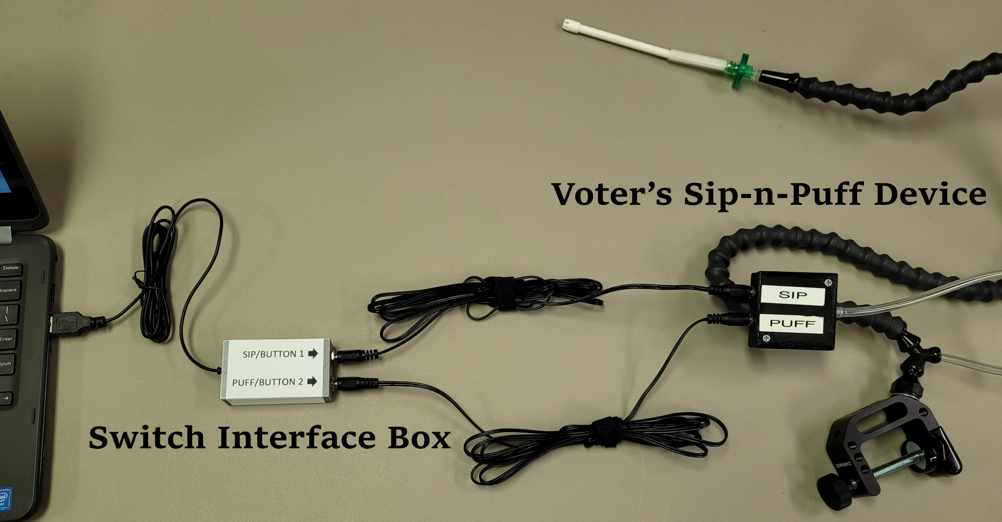
IVS System (Setup)
NEW FOR 2022
Sip and Puffer Devices - Only need to set up if requested by the voter.
Button Switch
1) Connect the wire of the button switch to one of the sockets on the switch interface box. You can use either sockets on the box.
2) Connect the interface box to an open USB port on the computer.
Sip and Puff
1) Connect the SIP wire of the voter’s device to the SIP socket of the interface box.
2) Connect the PUFF wire of the voter’s device to the PUFF socket of the interface box.
3) Connect the interface box to an open USB port on the computer.
These instructions are also included in the moderator handbook.
Poll Worker Training - Naugatuck, CT 8 Nov 2022 Slide

Slide 59
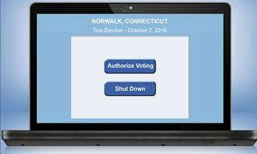
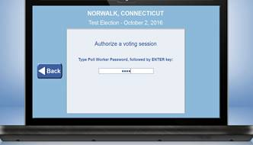
IVS System (Usage)
USING THE IVS SYSTEM
1) Press “Authorize Voting”
2) Type in 4-digit password (“9630”), Click “Enter”
3) For the primary do the following:
a.Select ”Republican” or “Democrat”
4) Load ballot into paper tray, FRONT page UP & LEFT (or TOP) edge first
5) Select one of two options – Touch Screen or Audio Ballot
6) Stand where you cannot see voter’s markings on the ballot
7) Elector is to put ballot into tabulator (You may help them with this if help is needed)
The complete IVS Manual is located in the IVS Black Box as well as in the moderator handbook.
Poll Worker Training - Naugatuck, CT 8 Nov 2022 Slide

Slide 60
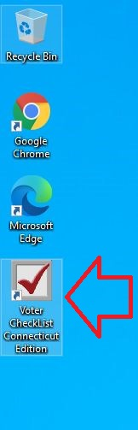



VoterCheckList - Startup
1) Set up the laptop according to the picture to the right.
2) Log in to Windows. Start the VoterCheckList program.
3) Your laptop is configured for your polling location only.
4) You will then see the program open to a vote selection screen with the most current vote information.
5) Click Start Election
6) Select the drive letter of your
thumb disk (D:\), Click Continue.
7) The program will automatically
open to the In-Person Voting tab for
the district.
Your moderator has access to a traditional paper voter checkers book as a backup in case of both laptops failing. The paper backup check list can only be used if the Registrars of Voters advised you to do so. Do NOT use the paper backup without approval from your moderator who will REQUIRE approval from the Registrars.
Poll Worker Training - Naugatuck, CT 8 Nov 2022 Slide

Slide 61


VoterCheckList Overview
Poll Worker Training - Naugatuck, CT 8 Nov 2022 Slide

Slide 62



VoterCheckList - Voters
Voter shows in GREY – Voter, if showing proper ID, can proceed to vote. Once you check the voter in, they will show checked off and in black/bold.
Voter checked and name struck through in BLACK – This voter has already voter in-person and cannot proceed. Request help from your moderator or Asst. Registrars.
Voter checked and name struck through in RED – This voter has cast their ballot by Absentee and cannot proceed. Request help from your moderator or Asst. Registrars who will call the Registrars office.
Voter checked and name struck through in GREEN – This voter was inactive and made active and was checked in remotely by the registrars. You will only see this after calling the registrars office.
Voter with CHECK MARK rather then a check box – This voter is not of the political party for this checkers line. You will see this only in a primary. Direct voter to the other party checker or inform (if U or minor party) that they cannot vote in a primary.
Poll Worker Training - Naugatuck, CT 8 Nov 2022 Slide

Slide 63

Election Day
Registration

Slide 64
Election Day Registration (Who)
Election Day Registration permits anyone to register and vote in person on Election Day who meets the eligibility requirements for voting in this state and is not already registered, OR is registered in one town but has moved to another town.
By law, a person is eligible to register and vote if he or she is
  (1) a US citizen,
  (2) age 18 or older,
  (3) a bona fide resident of the town in which he or she applies for admission, and
  (4) has completed confinement if previously convicted of a disfranchising felony.
Election Day Registration is not available at your polling place, but is available at a designated EDR location in each town, beginning at 6 am and ending at 8 pm. You will register and vote at the designated EDR location in your town. Please plan to arrive early in the day as there may be long lines. You must be registered by 8 pm in order to vote. You will need to provide proof of identity and residency.
Source: https://portal.ct.gov/SOTS/Election-Services/Election-Day-Registration/Election-Day-Registration
Poll Worker Training - Naugatuck, CT 8 Nov 2022 Slide

Slide 65
Election Day Registration (Where)
November 8th, 2022
Naugatuck Election Day Registration
is held at the:
Naugatuck Event Center
6 Rubber Ave
Naugatuck, CT 06770
Poll Worker Training - Naugatuck, CT 8 Nov 2022 Slide

Slide 66
Election Day Registration (ID Reqs)
Under the act, applicants must appear in person at the designated EDR location and declare under oath (by signing a certification provided with the EDR envelope) that they have not previously voted in the election. They must complete the application for voter registration and provide the same information CGS §9-20 currently requires from anyone seeking to become an elector in person in the state. This means they must provide their birth certificate, driver's license, or Social Security card. If the person does not have any of these forms of identification the applicant can prove their identity under the testimony of another elector or by the presentation of other satisfactory proof to the registrar of voters. The act also allows college and university students to present a current photo identification (ID) issued by their higher education institution in lieu of a birth certificate, driver’s license, or Social Security card.
Under the act, if an applicant's identification does not also include proof of their residential address, he or she must also submit another form of identification showing their residential address in the municipality. The additional identification may include, but is not limited to a motor vehicle learner's permit, utility bill due no later than 30 days after the election, for a college or university student, a current college or university registration or fee statement, a lease, library card with residential address, paycheck, property tax bill, naturalization documents, passport (assuming it is recent and includes residential address).
Poll Worker Training - Naugatuck, CT 8 Nov 2022 Slide

Slide 67
Election Day Registration (EDR Voters)
1) Current (Active) Naugatuck Registered Voter (and still residing at the same address)
- Direct the person to their correct voting location.
2) Inactive Naugatuck Registered Voter
- Direct the voter to the phone table where a poll worker will call Registrar of Voters office.
  - The RoV’s will need to ask the voters a series of questions to check the proper place for that person to vote.
3) Not registered (or Active) anywhere in CT
- Voter arrives and is NOT FOUND ANYWHERE in CVRS.
- The person will need to complete a voter registration card as well as the registration form.
- Register the person in CVRS and proceed to allow to vote.
4) Inactive in any town other then Naugatuck
- Same process as #3
5) Registered (Active) in another CT town
- See next slide
Poll Worker Training - Naugatuck, CT 8 Nov 2022 Slide

Slide 68
Election Day Registration (EDR Voters - con’t)
5) Registered (Active) in another CT town
  Voter complete voter registration card and provide proof of Naugatuck residency.
  CVRS searched and finds person is already registered and active in another CT municipality.
  Call the municipality where the person is already registered.
    Provide full name, birth date, previous address, previous voting district.
    Provide your name and call back number
  The town will confirm that the person did not already vote. If provided that conformation, allow the voter to person registration and vote.
    If other municipality says they already vote, STOP and call Registrars Office.
    If no answer at other municipality, try again 2 more times in 10-15 minutes, allow the person to continue to register and vote (using EDR Envelope)
All persons (accepted or rejected), and phone calls MUST be logged on the EDR tracking forms.
Poll Worker Training - Naugatuck, CT 8 Nov 2022 Slide

Slide 69



Election Day Registration (Voter Forms)
Poll Worker Training - Naugatuck, CT 8 Nov 2022 Slide

Slide 70
Election Day Registration (Process)
High level voting process for Election Day Registration (for a person not already registered anywhere in CT)
  1) The perspective voter arrives, complete voter registration card and EDR Form
  2) The perspective voter hands forms and Identification to checkers (Asst. Registrars). ARV confirms provided authentication for validity and confirm person is who they say they are.
  3) ARV searches CVRS for person by name and birth day. (person not found anywhere in CT)
  4) ARV then registers the person as a new voter in Naugatuck.
  5) ARV prints out TWO copies of the new voter conformation letter.
  a) Attach one copy to the completed Voter Reg card and EDR form
  b) Give the second copy to the voter and direct them to the ballot clerk
  6) Ballot clerk asks for the New Voter Conformation letter. They give the voter a ballot corresponding to their assigned district. Ballot Clerk KEEPS the letter.
  NOTE: This letter will be mailed back to the voter after the election
  7) Direct the voter to the voting booths. Voter completes ballot.
  8) Voter places ballot in to tabulator, takes ‘I Voted’ sticker and promptly leaves the building.
Poll Worker Training - Naugatuck, CT 8 Nov 2022 Slide

Slide 71

QUESTIONS?

Slide 72

THANK YOU

