Slide 1


YOU SURVIVED THE 2023 MUNICIPAL ELECTION
Presented By:
Barbara Crouch

Slide 2
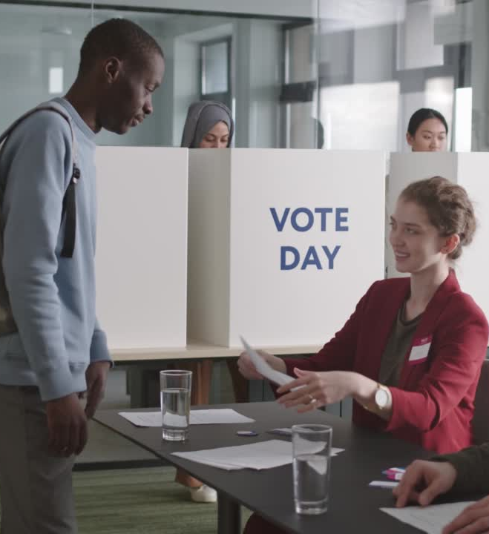

Important Dates

Slide 3
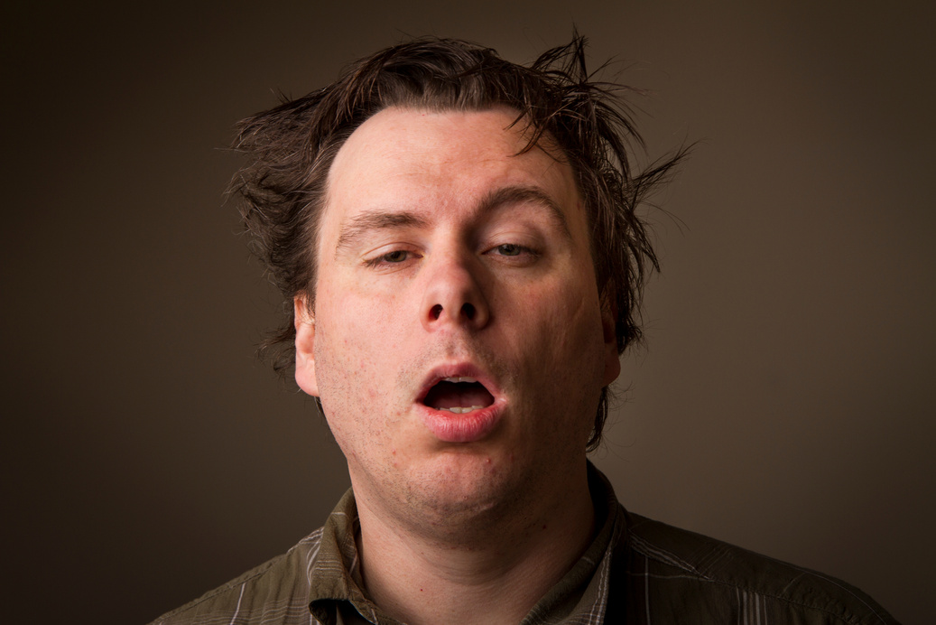


November 8th
Head Moderators Return due to the Secretary of State with 48 hours
Town Clerk receives copy/duplicate of Certificate of Votes Cast

Slide 4
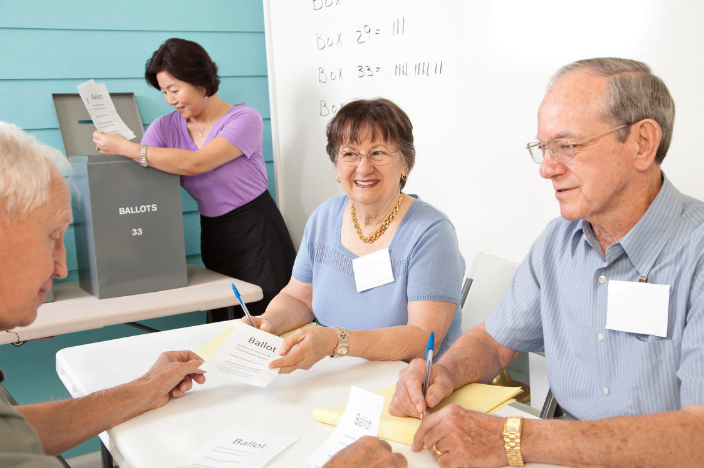
November 8th
Technically November 9 -13th
No later than November 10th 9am - Moderator, Registrars and town Clerk meet to discuss discrepancy or the need for a recanvass (recount).

Slide 5
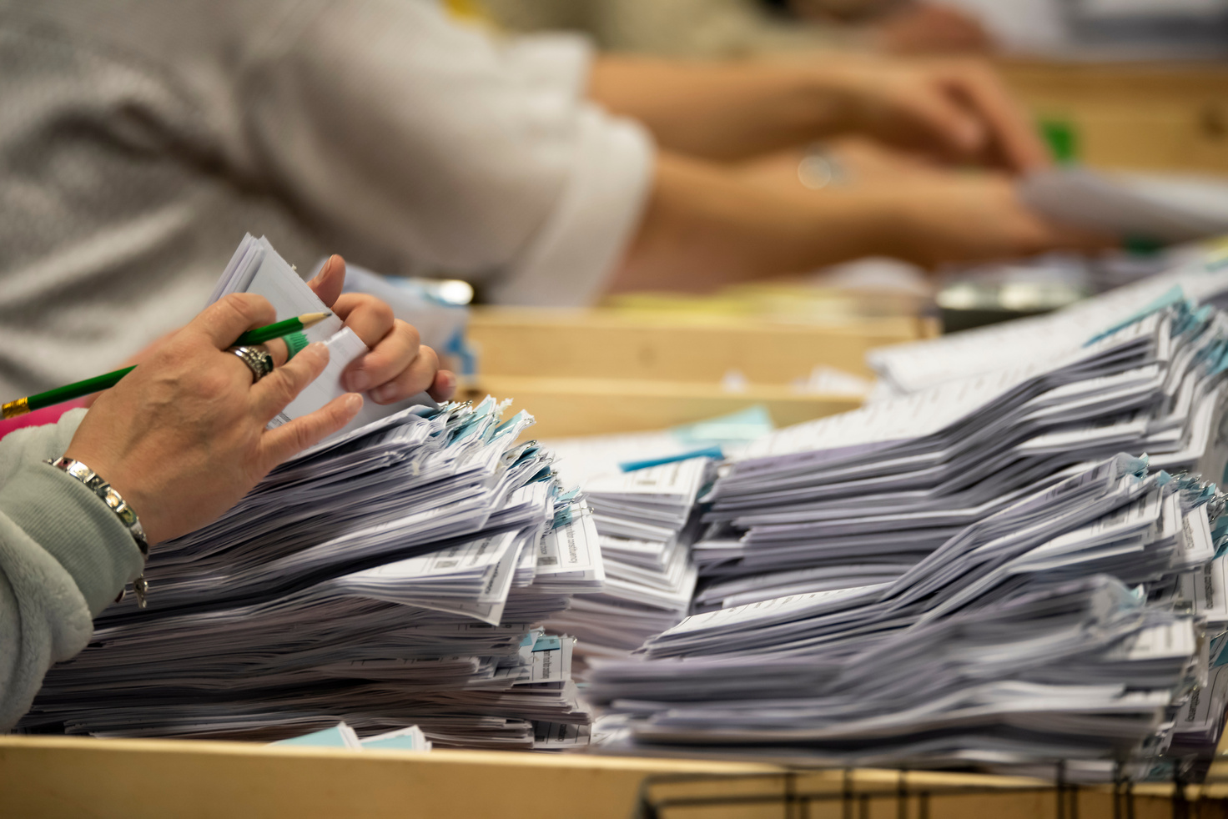
November 10th
Last Day to Schedule a Recount
No later than November 10th 9am - Moderator, Registrars and town Clerk meet to discuss discrepancy or the need for a recanvass (recount).

Slide 6
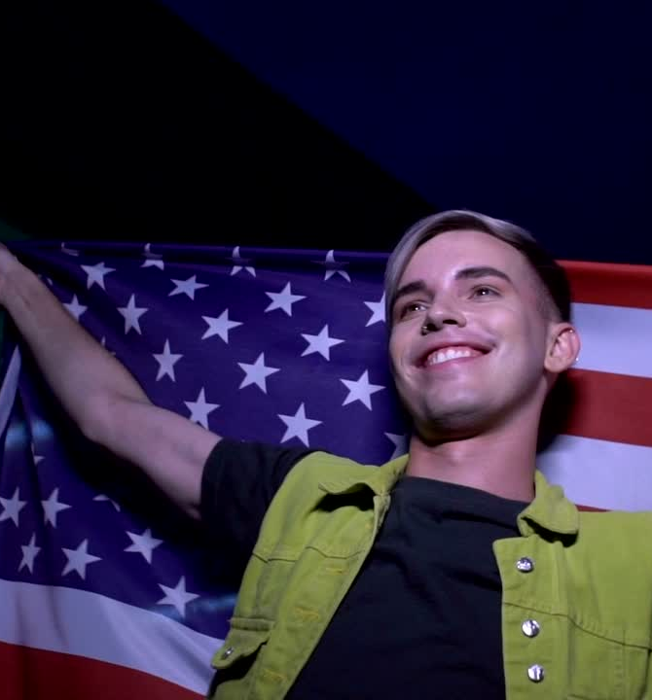
November 15th
Last Day to Conduct this Recount
No later than November 10th 9am - Moderator, Registrars and town Clerk meet to discuss discrepancy or the need for a recanvass (recount).

Slide 7


November 22nd
Tabulators can be opened !

Slide 8
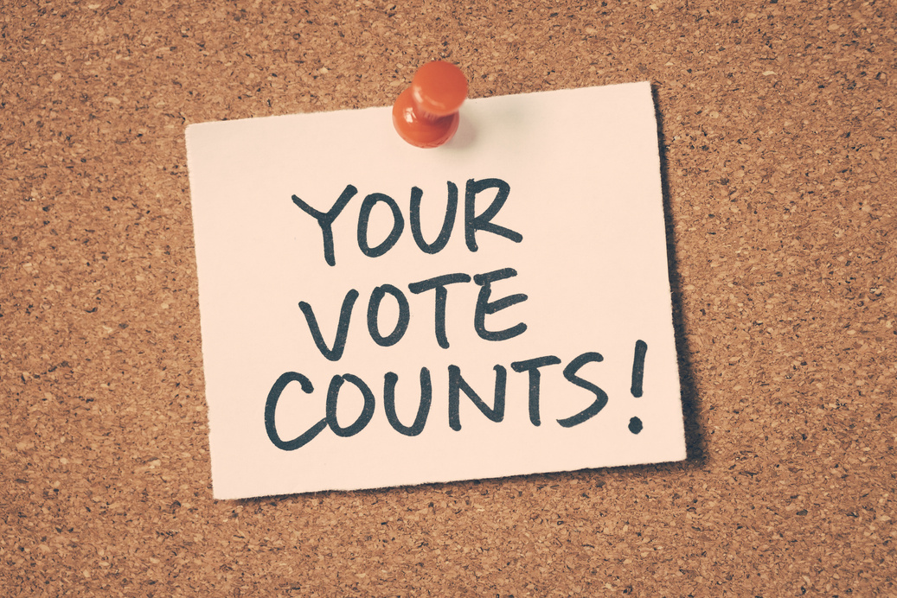
JANUARY 8TH
Final Day for Registrars to update “WHO VOTED” in the system.

Slide 9
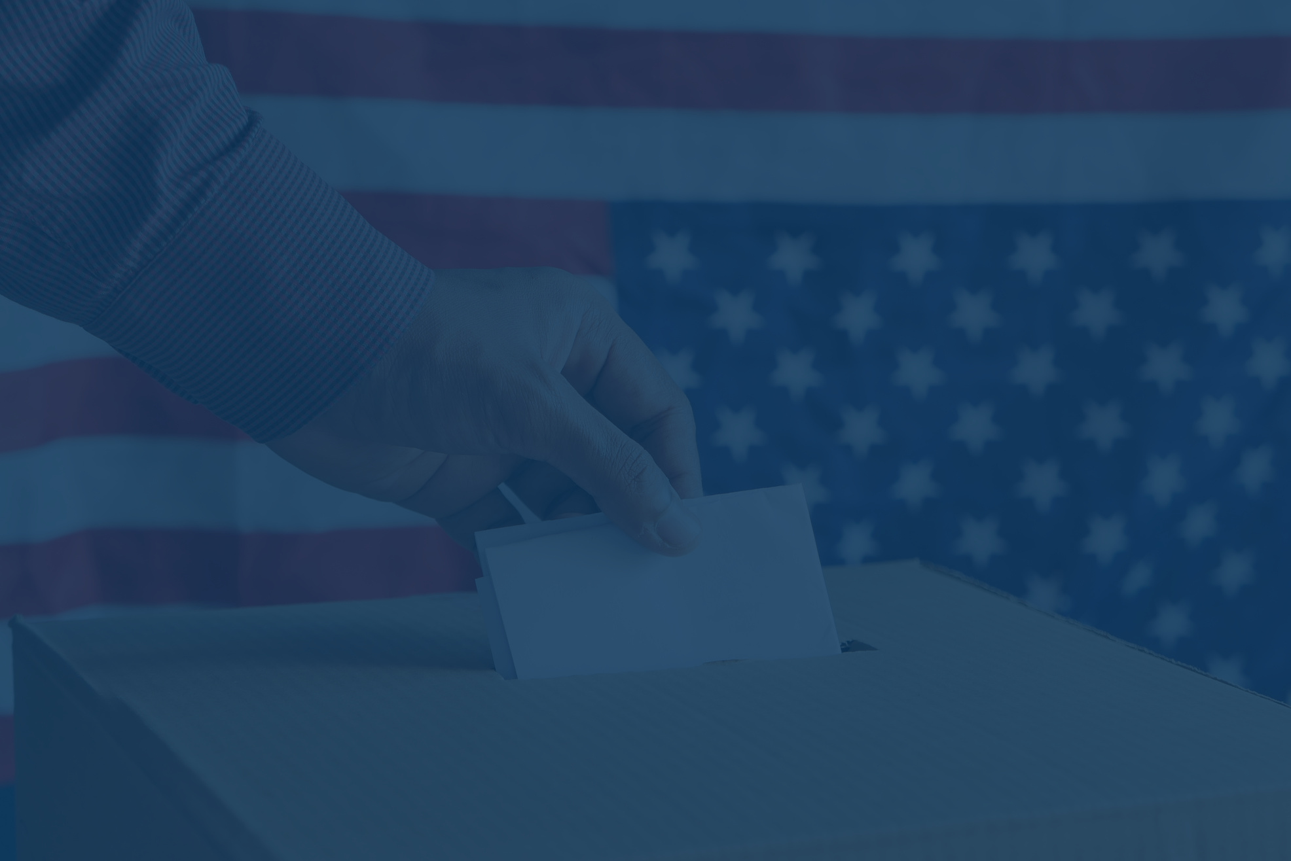

QUESTIONS

Slide 10
THANK YOU
Barbara Crouch
registrar@ctsprague.org

