Slide 1
2023 ROV and Head Moderator Primary Training for EMS
Office of the Secretary of the State

Slide 2
Connecticut’s Election Management System: This Training Will Cover
Registrar of Voter responsibilities preparing for the primary and setting up EMS
Preparing for the primary
Assigning polling locations and Head Moderator
Ordering ballots
Primary day duties
Head Moderator responsibilities
How to create your return
Entering stats and certifying results
Things to remember
Plan B

Slide 3
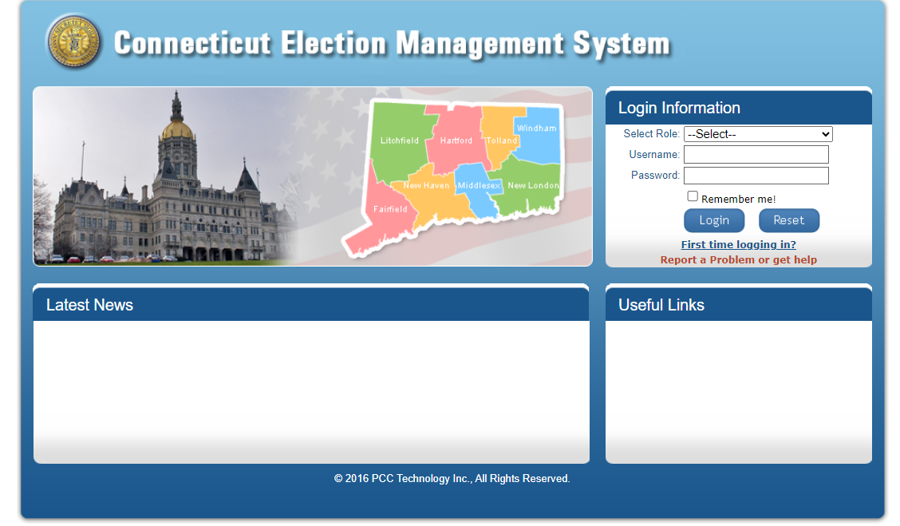
SOTS Support
Do you have questions or need support? We are here to help:
EMS Help Desk before 8 p.m. on Primary Day: (860) 509-6100
EMS Help Desk after 8 p.m. on Primary Day: (860) 509-6111
Forgot your login or password? Use Report a Problem or get help from the EMS home page.
Our email is also available: LEAD@ct.gov
860-509-6111
“Report a Problem”
Click Submit

Slide 4
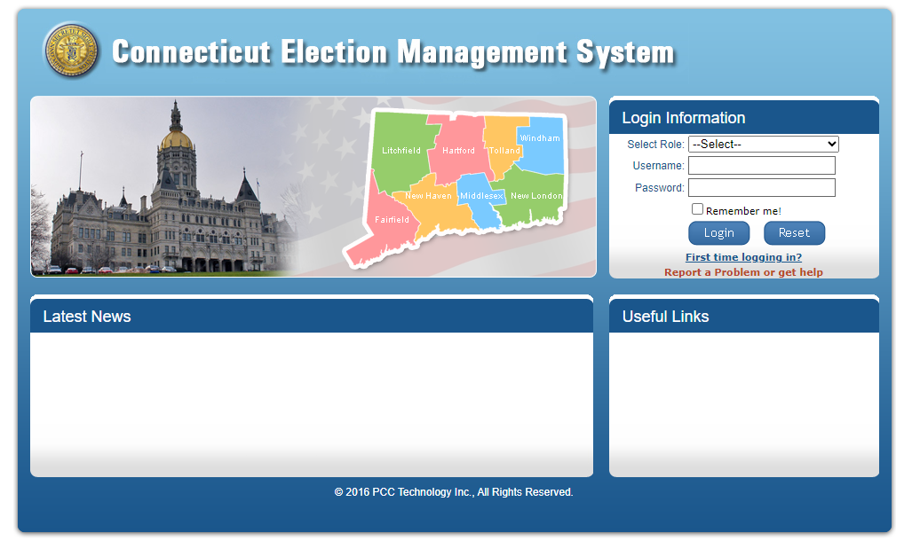
Election Management System
ROV Role and Responsibilities

Slide 5
Preparing for the Primary
Assign Polling Places for Each Primary
Add or change polling locations if necessary. Make sure to notify SOTS.
Assign polling locations for Democratic and Republican Primaries
Enter amount of Ballot Ordered
Assign Moderators to the Municipal Primary
Enter Amount of Ballots Ordered
Email your List of Moderators, List of Polling Locations, and Ballot Order to your assigned election officer
ROV provides username and password to Head Moderators, data entry, etc.

Slide 6
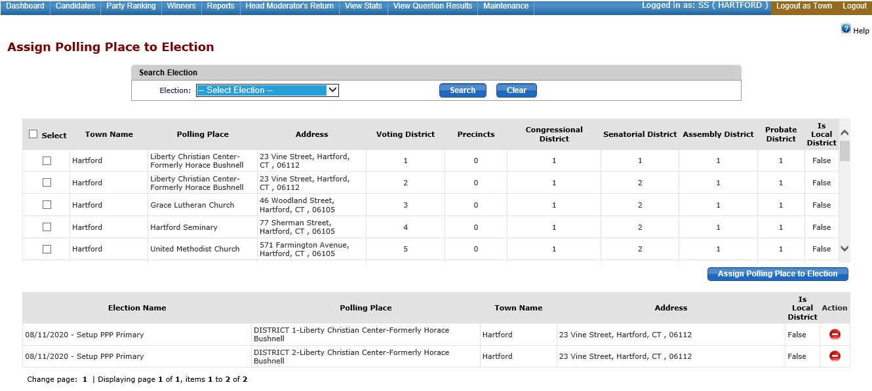
Assigning Polling Locations
Select the election.
Select the polling place by checking the box beside the polling place name.
Click on Assign Polling Place to Election.
The assigned polling place will be at the bottom.

Slide 7
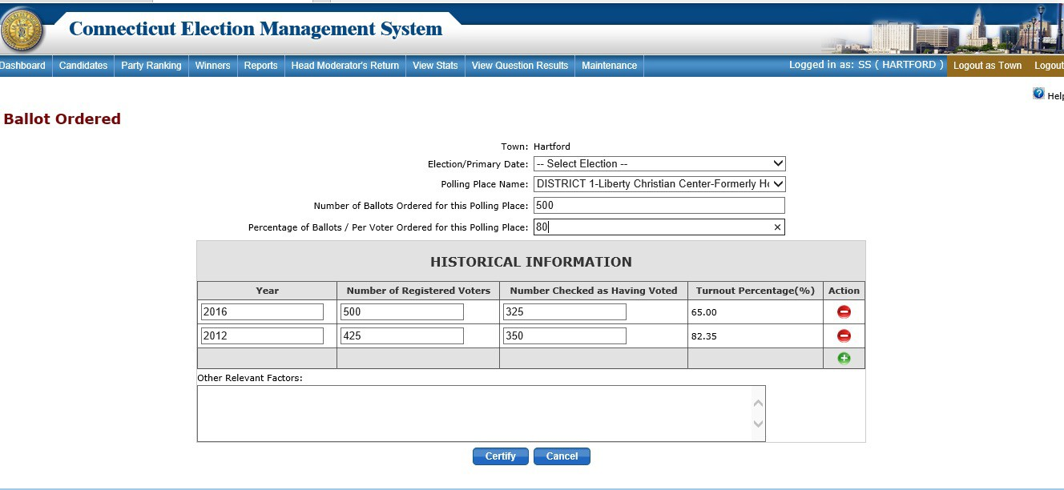
Order Ballots
Enter the number of ballots ordered for each polling location for the past two like election cycles
Click Certify
Select Election
Click on Enter Ballot Order

Slide 8
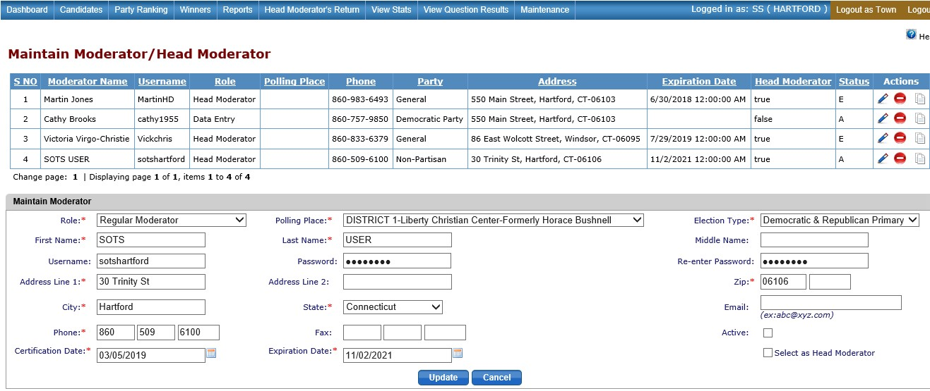
Maintain Moderator/Head Moderator
Enter Moderator information and/or Data Entry Clerk
Assign Moderator to polls Status-Active
Moderator status codes
A - Active
I - Inactive
E - Expired
Select Election Type
Sharing moderator- select Democratic & Republican Primary
Moderator working as Poll Moderator and Head Moderator at end of night
Role – Regular Moderator
Check “Select as Head Moderator”

Slide 9
To-Do List
A week before the Primary
Review and Print your Tally Sheet Template under reports.
Check that polling places are correct
Check that offices are correctly assigned
Check that candidates are in correct order & have a * for the endorsed candidate
Review & Print a blank Head Moderator’s Return under Reports
Plan “B” for primary night if there is a system failure
Please manually fill out a paper backup of the Moderator’s Return (e.g., the blank return you printed for your town or the generic template SOTS emailed you).
Email the paper backup to Moriah.Moriarty@ct.gov and LEAD@ct.gov.

Slide 10
Primary Day
Have Head Moderator & Data Entry Clerks sign into EMS on primary day to make sure their usernames & passwords are valid.
ROVs are responsible for assigning Head Moderator or Data Entry Clerk username and password.
Rules When Using EMS
One person - one session open on the browser
Use Internet Explorer or Edge
One person in each district at a time
Everyone should log out of the system, not close the browser
Remind Data Entry staff that they must SAVE,
click on End Process back to GREEN when finished entering results for a district.

Slide 11
Head Moderator Role and Responsibilities

Slide 12
Primary Day – During the Day
Make sure ROV has printed out an emergency Head Moderator’s Return template from EMS
( blank Head Moderator’s Return).
Sign into EMS live site with the username & password the ROV has given you (ONLY ON PRIMARY DAY - NOT BEFORE)
Before 8 p.m. on Primary Day – Make sure all polling places and candidates' name are on the Head Moderator data input page.
The ROV is responsible for providing your username and resetting the password.
Make sure you are using Explorer or Edge and that pop-up blockers are off on the computer you will be using on primary night.
Any issues, use Report a Problem on the EMS site.

Slide 13
Polls are Closed - Time to Enter Results
You have the tapes from polling places, Absentee Voting (central counting). Towns that count ABs at polls will have results for ABs on the polling place tapes.
You have the total number of electors on the official list, the number checked as voting in-person, the number of ABs received from the Town Clerk, the number rejected, the number of overseas, and the number of military.

Slide 14
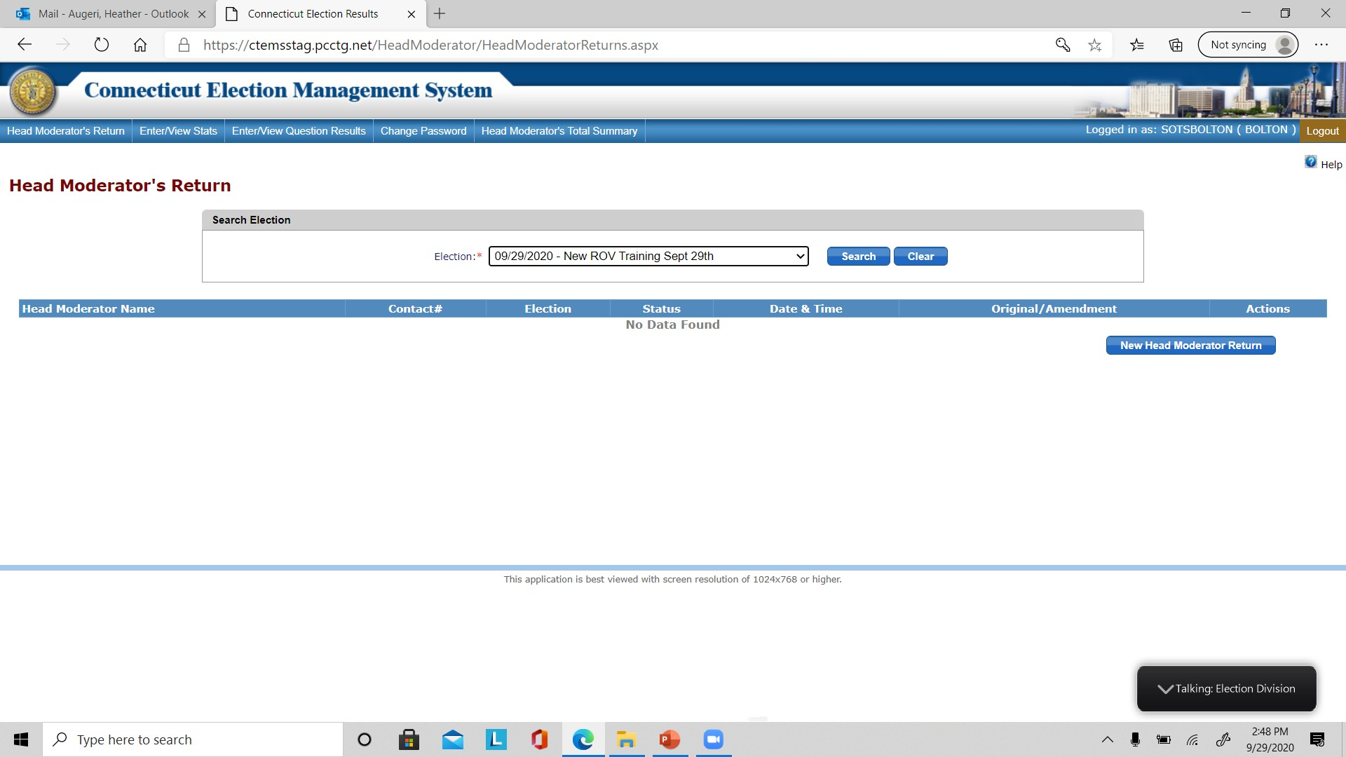
Al
Creating Your Return
Click the new Head Moderator’s Return blue action button on the right side of the screen.

Slide 15
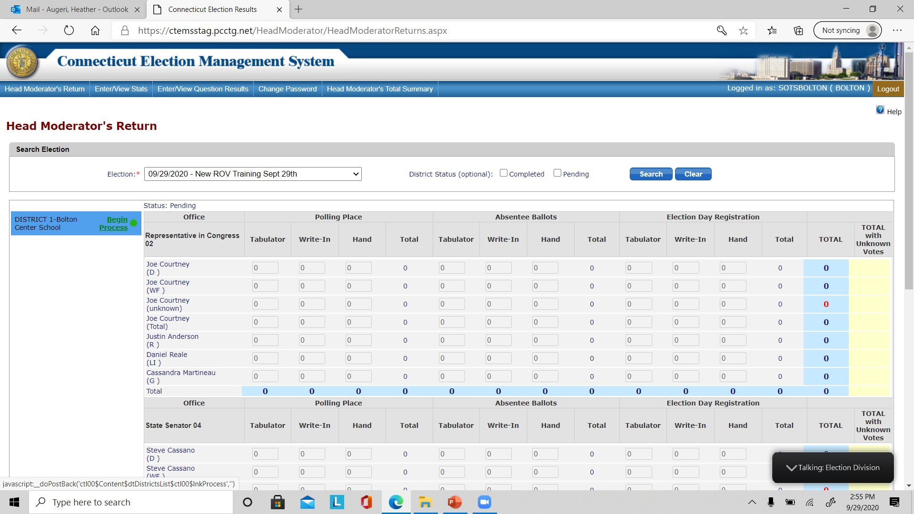
Entering Results
Entering Results from the Tapes
Polling location – Absentee Ballots
If your data entry screen is blank, please call the help desk.
Single Polling Location Town – will see only one district on the left.
Multi-Location Towns – you will see all of your districts.

Slide 16
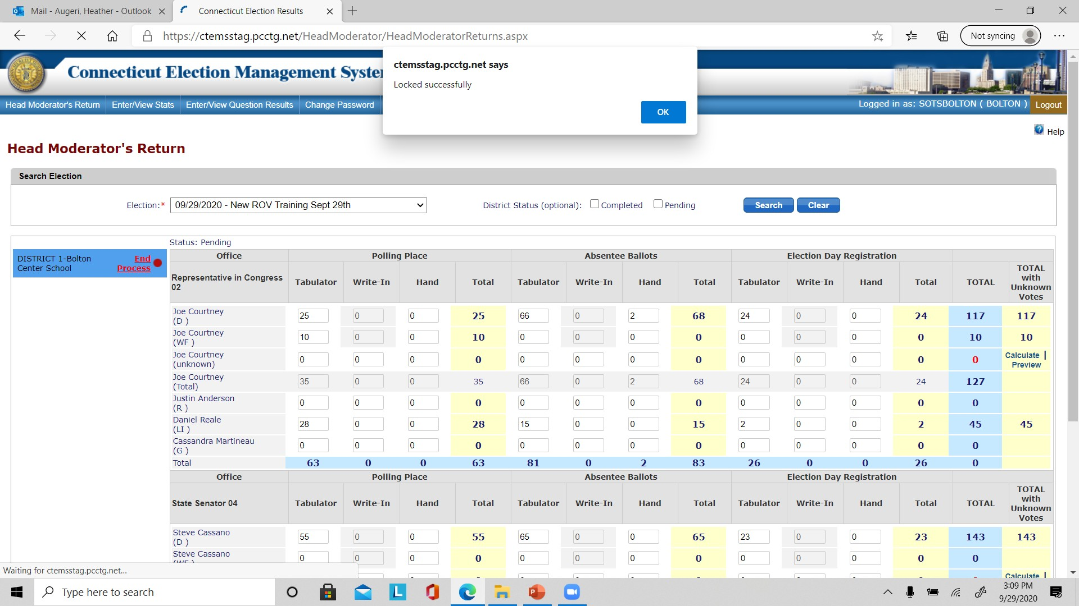
GREEN
Entering Candidate Results
RED
To start entering results
Click on the green BEGIN PROCESS button, which then changes to red END PROCESS
This locks the district and keeps anyone from entering results in the same district.
You can now enter results
Click on END PROCESS when you are finished, and it goes back to green BEGIN PROCESS
Click Save

Slide 17
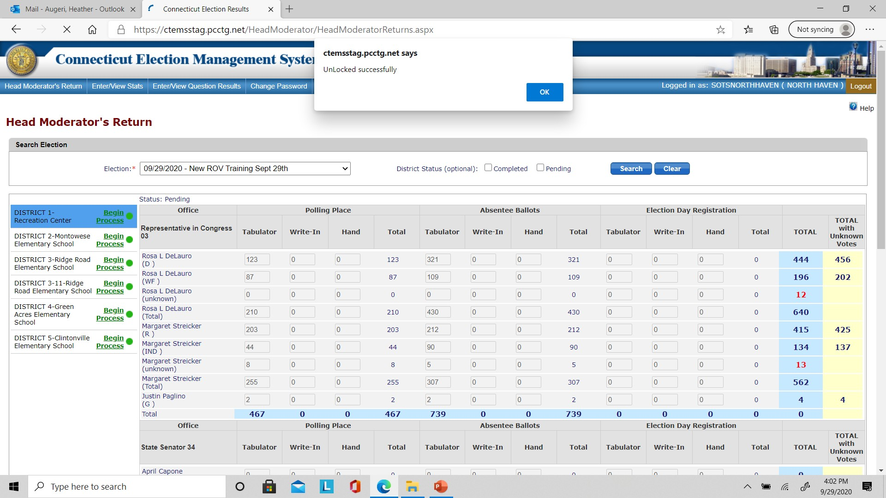
Entering Candidate Results
AFTER SAVING
Click on Red – END PROCESS turns back to Green.
Popup Unlocked Successfully.
Results entered are shown.
Pop up window: Saved Successfully click OK.
REMEMBER – Partial results can be entered and saved.

Slide 18
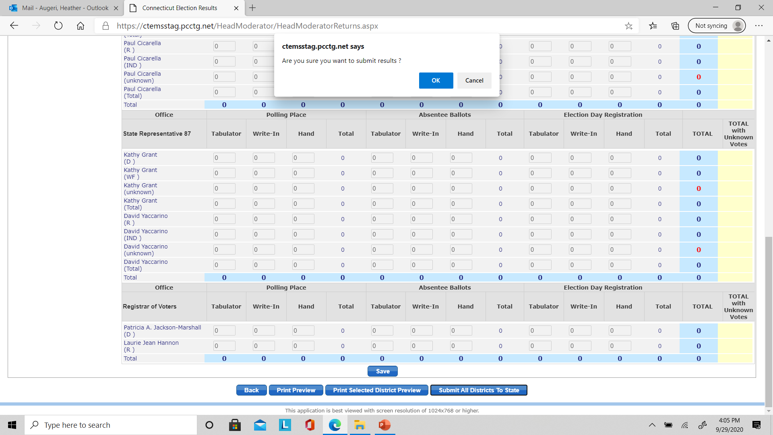
Entering Candidate Results
Click Submit All Districts to State.
Pop up – Are you sure you want submit results?
Click - OK

Slide 19
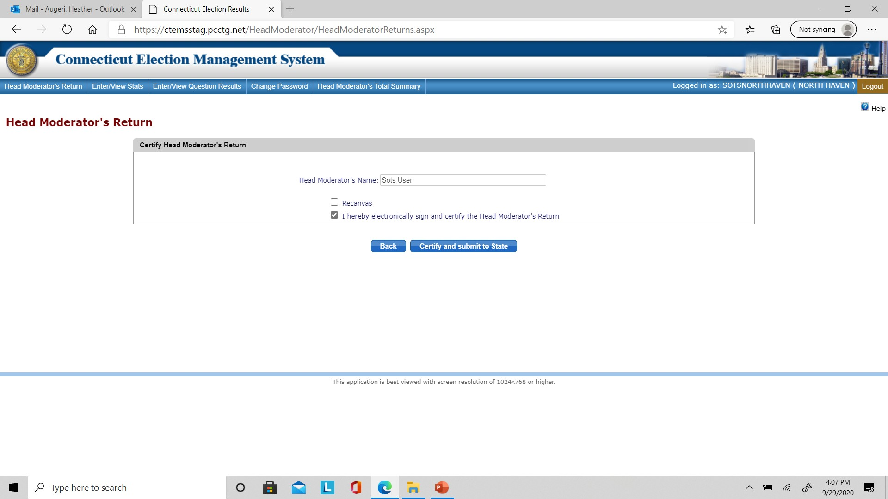
Certifying Results
Check the box “ I hereby electronically sign and certify.”
Click Certify and Submit to State.

Slide 20
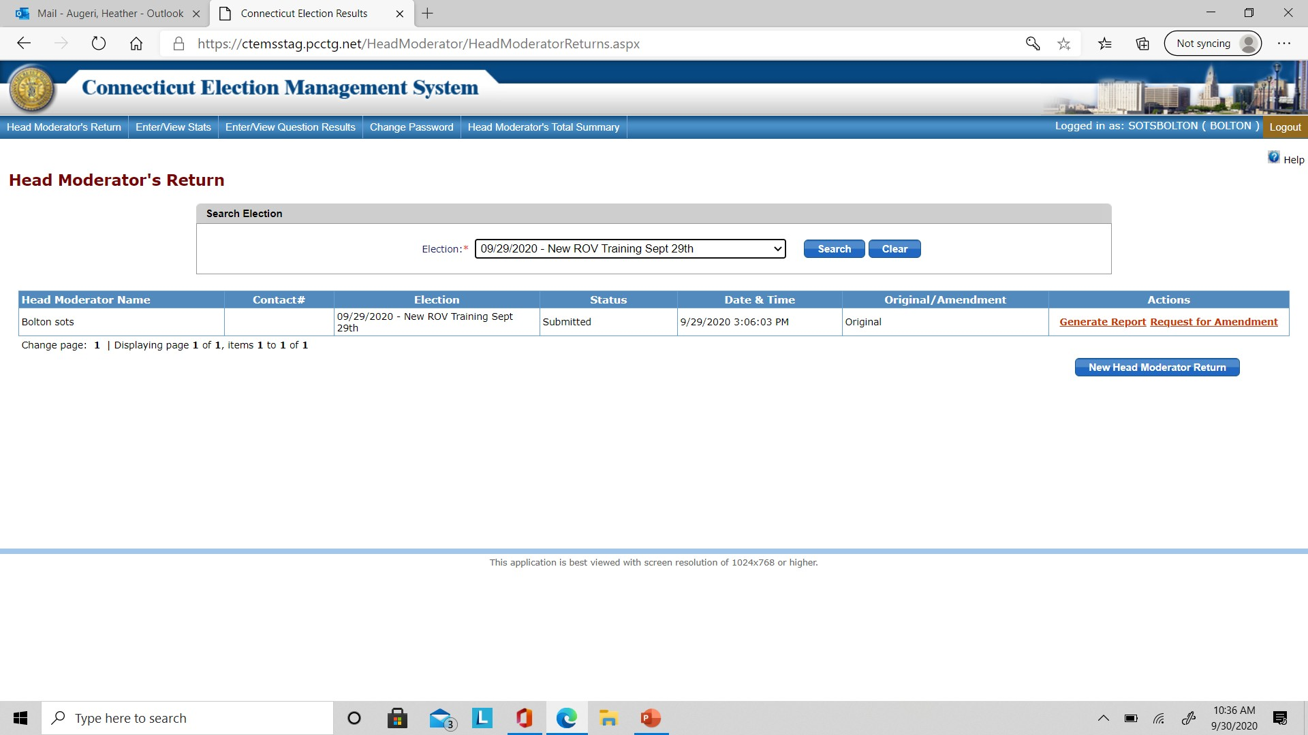
Primary Night Candidate Results
You can amend the results for up to 48 hours.
Check the box “ I hereby electronically sign and certify”.
You must submit preliminary numbers to SOTS by midnight on Primary Day.
You should be able to submit tabulator polling place totals (in-person numbers; in smaller towns, in person & AB numbers) by midnight.
Click and submit to State
You must also enter some stats.
ss

Slide 21
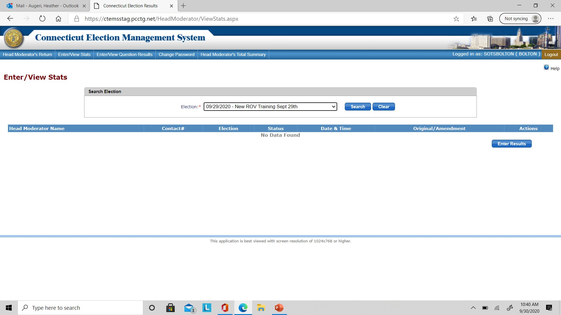
Click on View/Enter Stats from the dashboard.
Primary Night - Enter/View Stats
Click Enter Results.

Slide 22
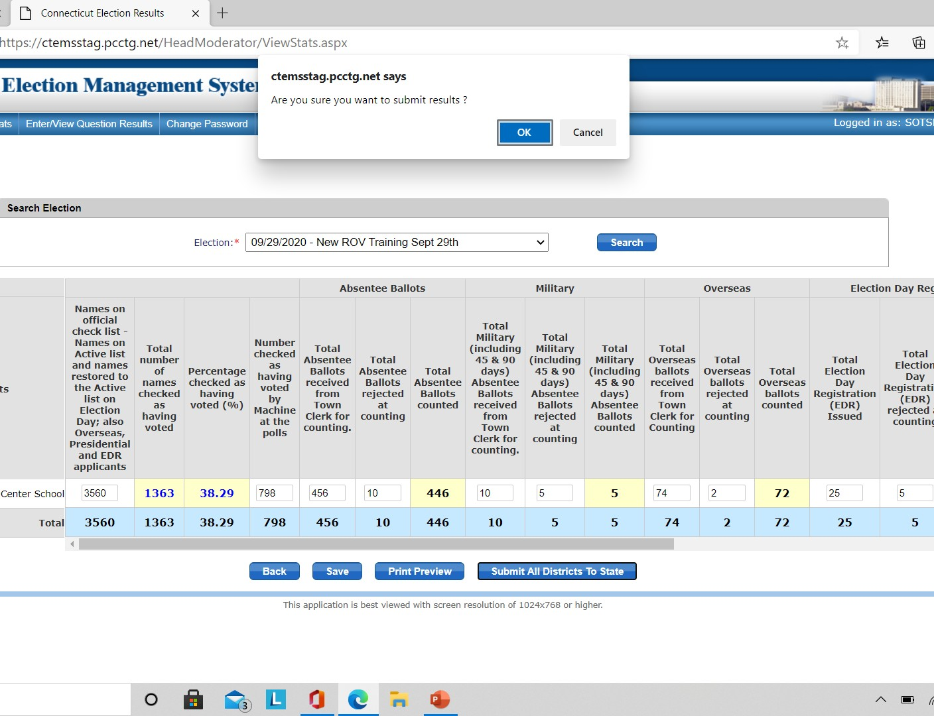
Click on View/Enter Stats from the dashboard.
Primary Night - Enter/View Stats
You must enter some data into the View/Enter Stats screen to generate a moderators return. (ROV can provide preliminary numbers of voters from Official Voters List.)
Talk with your ROV & TC – You will need numbers by category.
Click SAVE.
Click Submit to SOTS.
Click Enter Results

Slide 23
STATS Data Entry Fields
Names on the Official Check List (Active List, Names Restored to active list on Election Day, EDR applicant and Overseas, Presidential)
Number Checked as Having Voted at the polls
Absentee Ballots - Total received from Town Clerk for counting and Total Rejected at counting
Military Ballots (includes 45 & 90 days) – Total received from the Town Clerk for counting and Total Rejected at counting
Overseas Ballots total – Total received from Town Clerk for counting and Total Rejected at counting
Click and submit to State

Slide 24
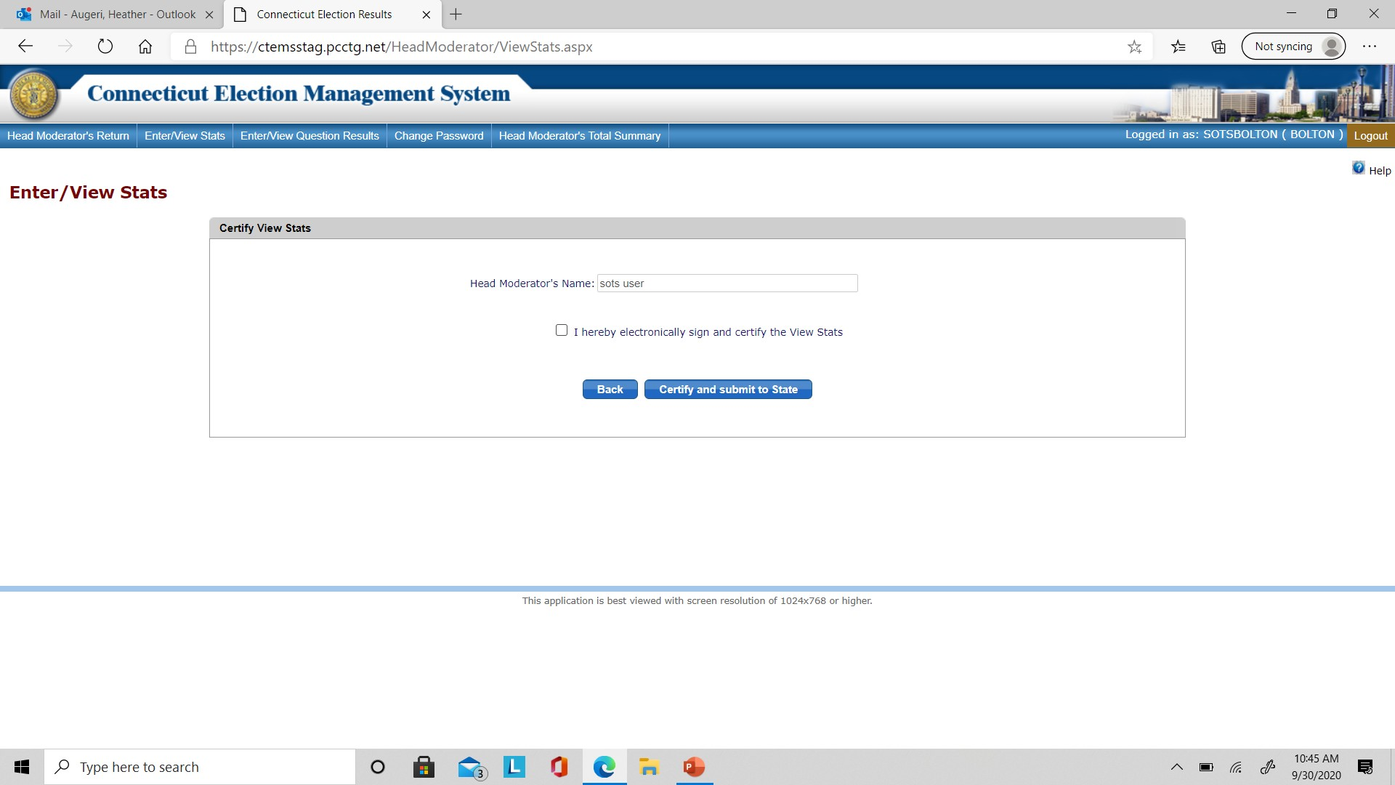
Primary Night Enter/View Stats Certification
Click the box to electronically sign and certify.
Click and submit to State
Click Submit.

Slide 25
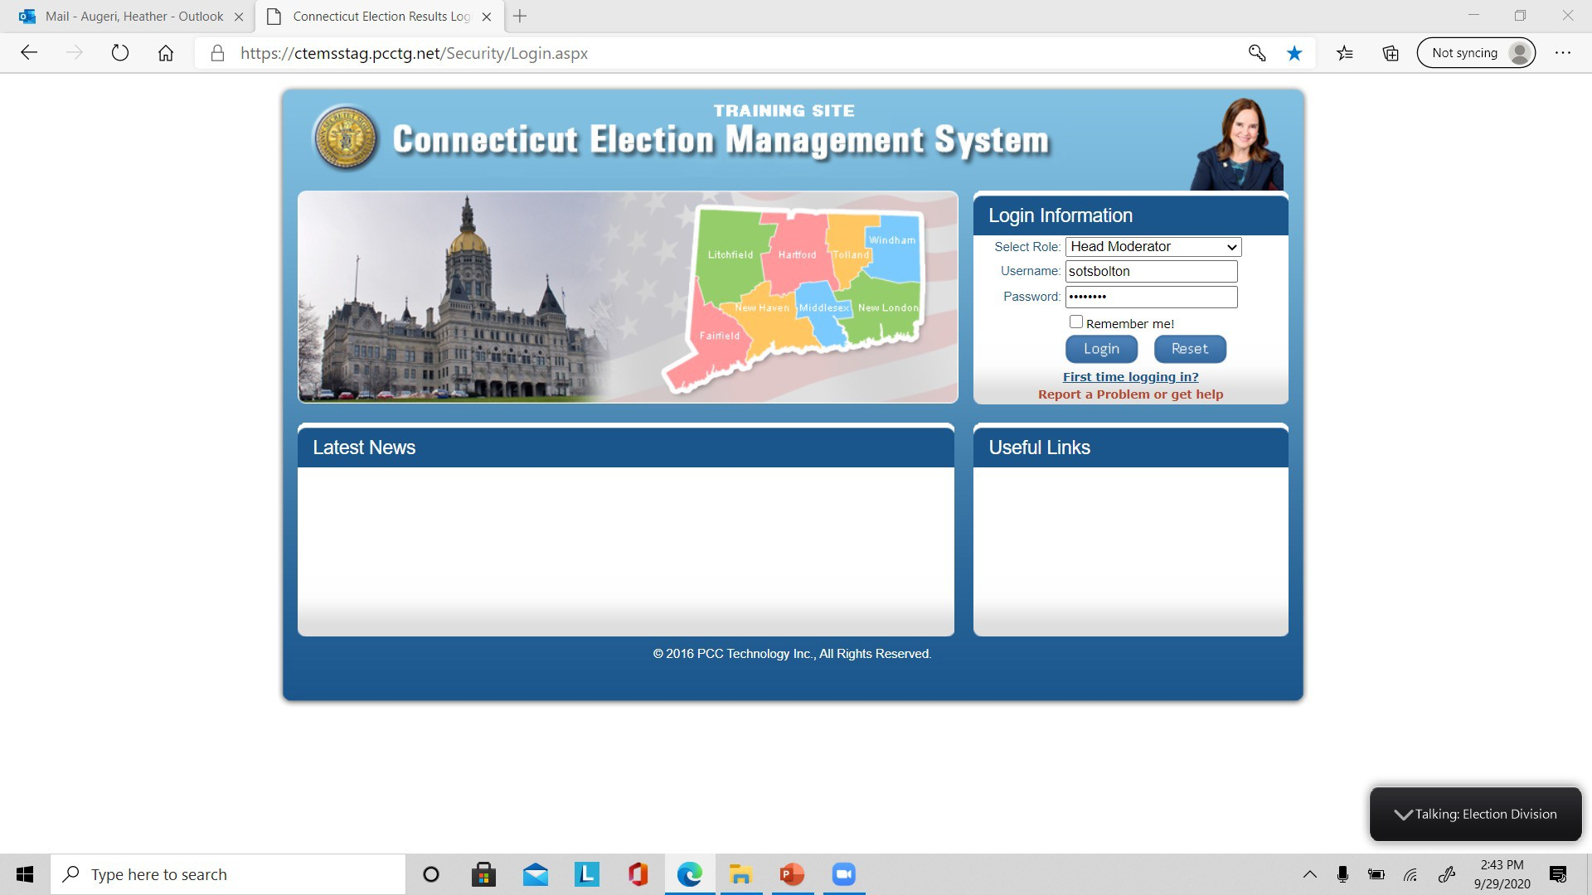
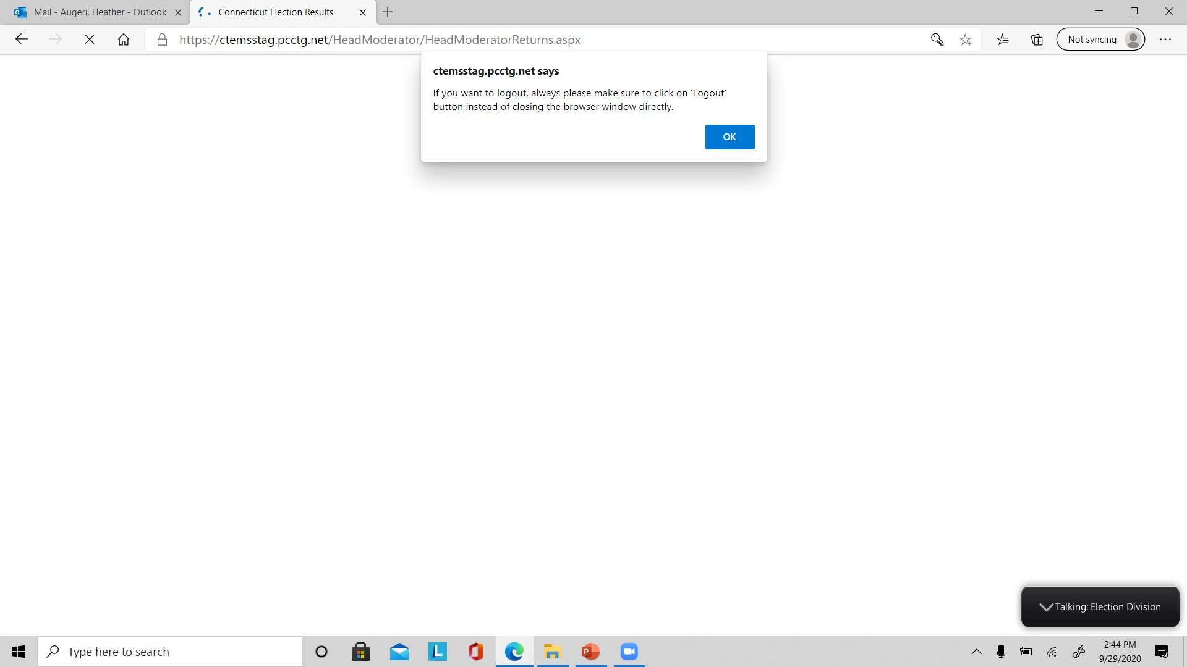
System Warning
Always Log Out –
Do Not Use the Browser’s X to Leave the System
Click the box to electronically sign and certify
Click Submit

Slide 26
Things to Remember
REMEMBER – you must submit to state TWO times: (1)candidates results and (2) stats.
Send SOTS a final return by the Friday following the election.
Wet signature is required for the two copies (Clerk & SOTS) of original, and all amendments should be sent to SOTS by Monday.
The Head Moderator is responsible for entering the results and generating the return.
May be assisted by Data Entry person.
Preliminary Results to be entered by midnight (polling place tapes).
Preliminary Stats must be entered by midnight before you can generate a return.
Click Submit

Slide 27
What to do if there is a system failure? Plan B
Plan “B” for primary night if there is a system failure
Please manually fill out a paper backup of the Moderator’s Return (e.g., the blank return you printed for your town or the generic template SOTS emailed you).
Email the paper backup to Moriah.Moriarty@ct.gov and LEAD@ct.gov.

Slide 28
Just to remind you: SOTS Support
Do you have questions or need support? We are here to help:
EMS Help Desk before 8 p.m. on Primary Day: (860) 509-6100
EMS Help Desk after 8 p.m. on Primary Day: (860) 509-6111
Forgot your login or password? Use Report a Problem or get help from the EMS home page.
Our email is also available: LEAD@ct.gov
860-509-6111
“Report a Problem”
Click Submit

