Slide 1


ROAD TRIP
Two Decades in the Making

Slide 2

JOURNEY
our

Slide 3
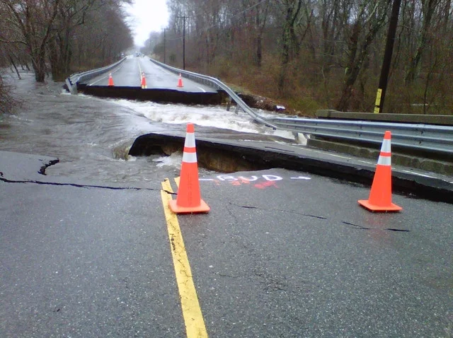
2010 March Floods

Slide 4
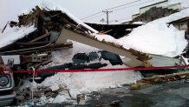
January 2011 Snow Blitz

Slide 5
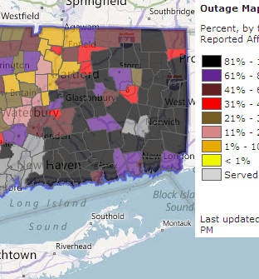
Hurricane Irene
August 28, 2011

Slide 6
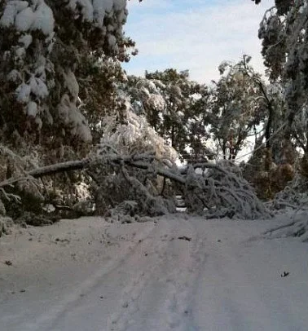
October Snowstorm
October 2011

Slide 7

Super Storm Sandy
October 2012

Slide 8
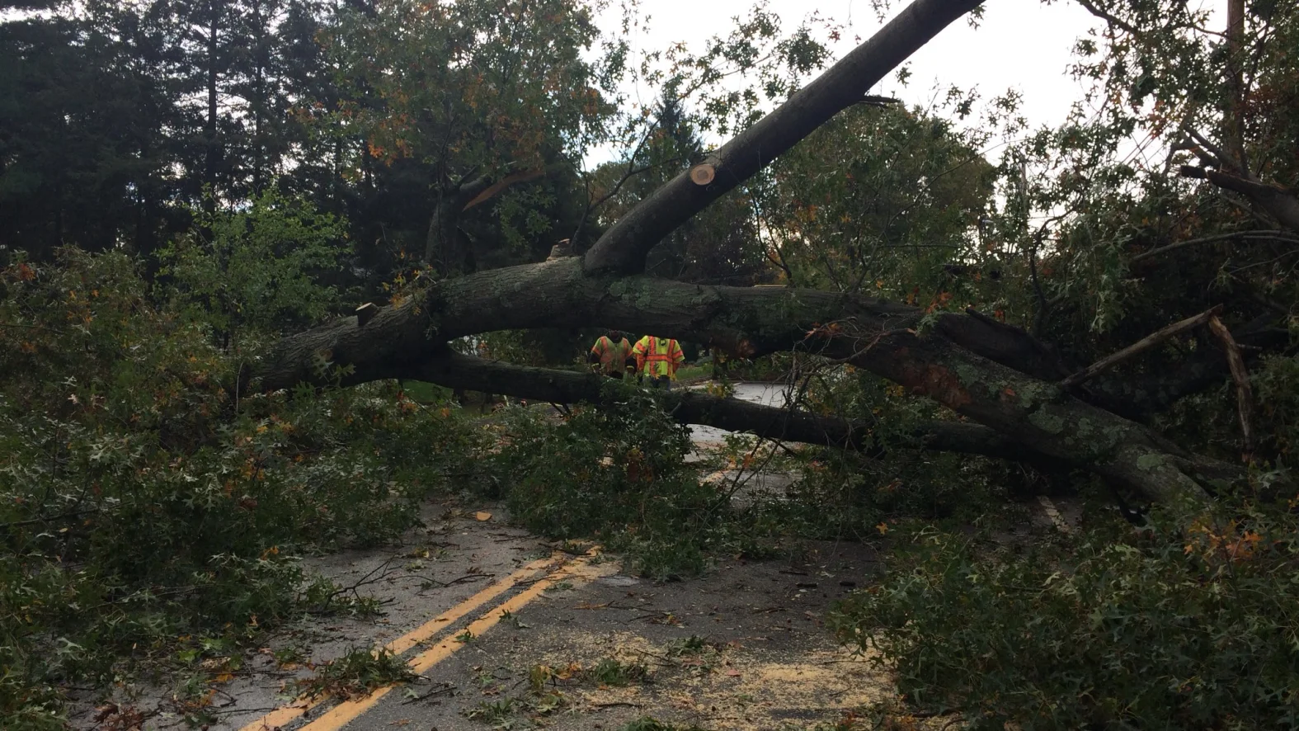
October 2017 Wind Storm

Slide 9

2019 – Present COVID

Slide 10
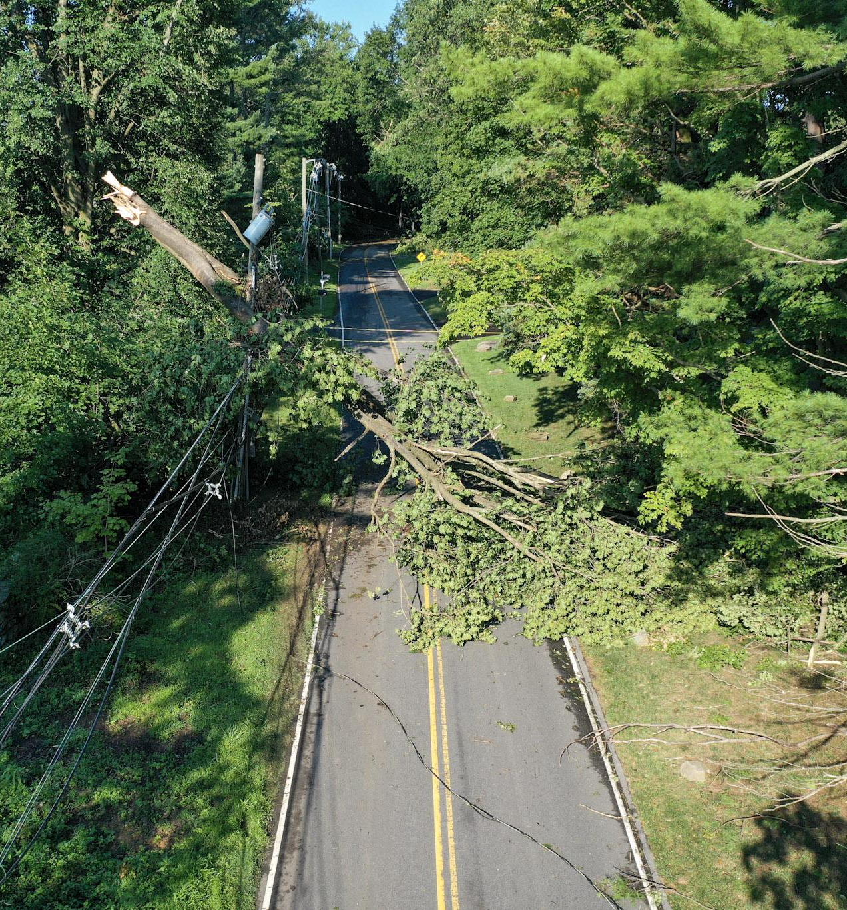
Tropical Storm Isaias
August 4, 2020

Slide 11
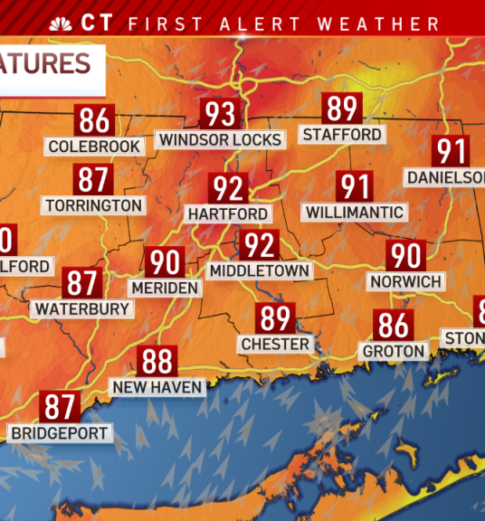
August 2022 Record Heat

Slide 12


Slide 13
Why does this matter?

Slide 14
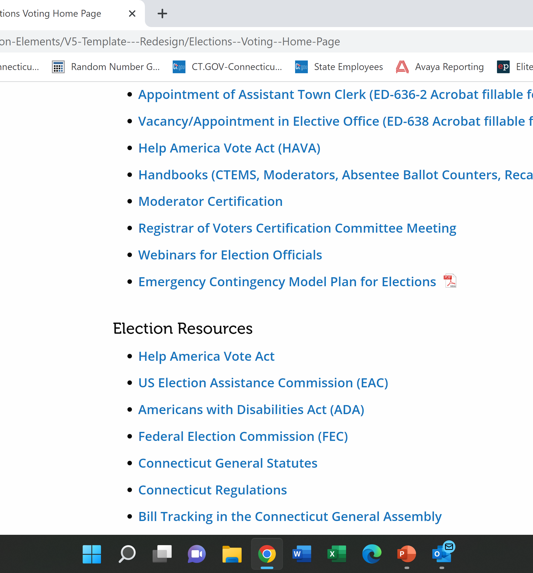
Sec. 9-174a. Emergency contingency plan for elections. Model plan. (a) For each municipality, the registrars of voters, in consultation with the municipal clerk, shall create an emergency contingency plan for elections, primaries and referenda to be held within such municipality. Such plan shall include, but not be limited to, (1) solutions for ballot shortages, and (2) strategies to implement in the event of (A) a shortage or absence of poll workers, (B) a loss of power, (C) a fire or the sounding of an alarm within a polling place, (D) voting machine malfunctions, (E) a weather or other natural disaster, (F) the need to remove a poll worker or moderator and to replace such worker or moderator, and (G) disorder in and around the polling place.

Slide 15
Scapegoated for election outcomes election officials have been under unprecedented attack.
Many states lack election emergency laws that empower officials to adequately respond to these crises. As a result, courts are frequently called upon to adjudicate the consequences of election emergencies.
Poll of Local Election Officials Finds Safety Fears for Colleagues — and Themselves
Our electoral system is vulnerable to terrorist attacks, natural disasters, and other calamities that can render polling places inaccessible, trigger mass evacuations, or disrupt governmental operations to the point that conducting an election becomes impracticable

