Slide 1
Registrar of Voters
New Registrar Class
Fall 2022
Tim De Carlo - Waterbury

Slide 2
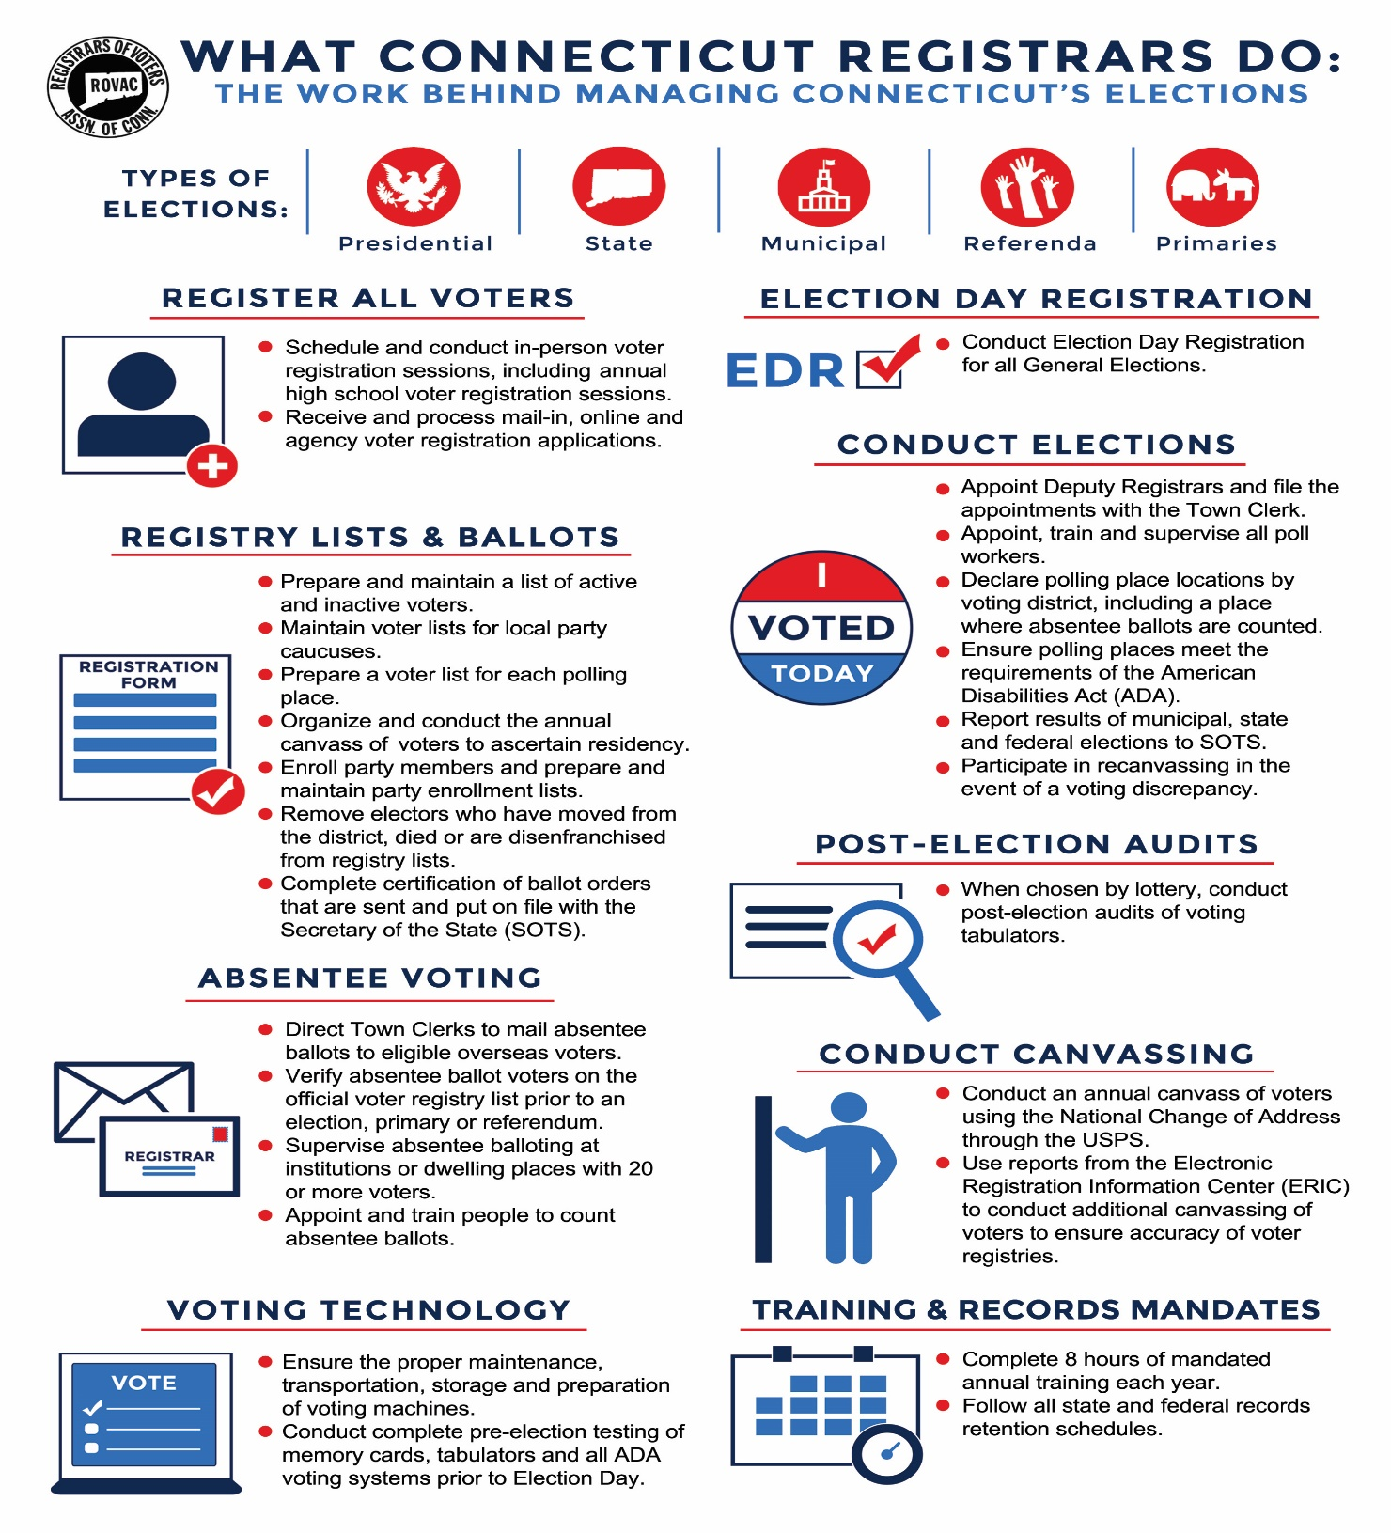

Slide 3
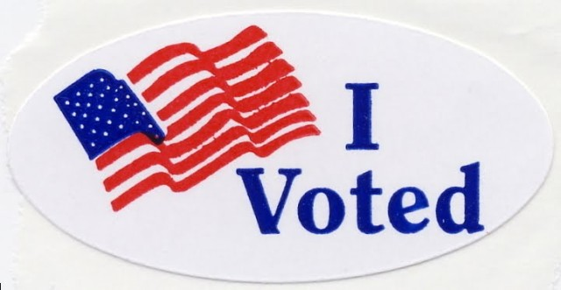
Subjects that will be covered
Important Deadlines that you need to know
Poll worker and Polling place basics
Emergency Plans
Provisional ballots
EDR
EMS
Recanvas & Audit procedures
Q&A

Slide 4
Deadlines
Sept 8 Last day to file for a Waiver of Accessibility of a Polling Place. 9-168d
Sept 27 Voter Registration information needs to be sent to the area High Schools
Oct 4 You must be in your office sometime between the hours of 9:00 am – 5:00 pm.
Oct 7 Registrars and Town Clerk must certify with SOTS the ballot order.
Oct 7 Registrars must have certified the location of polling places with SOTS.
Oct 17-26 Notice of the Nov 1st Registration Session must be noticed in the newspaper at least once during this time.
Oct 18 Last day to notify the Town Clerk in writing as to whether or not you will centrally count Abs.
Supervised Balloting TBD by SOTS.

Slide 5
Oct 24 to Nov 2 Notice of Limited Registration Session to be held on the last Weekday before the Election. Must be noticed in the newspaper.
Nov 1 7 days prior to the Election, Mail-in Registration deadline This includes online, DMV and hand delivered for anyone other than the elector.
Nov 1 Seventh Day before the Election Day Registration Session. You must be in your office from 9:00 am to 8:00 pm. This is the last day to register in person*.
Nov 1 Absentee Ballot check-off can begin.
Nov 6 Deadline (6:00 AM) for Town Chairmen or candidates to submit a list of unofficial checkers to the Registrar.
Nov 7 Limited Registration Session 9:00 am – 5:00 pm. This is for anyone who has turned 18, become a US Citizen or moved to the town after Nov 1st
Nov 7 Last day to conduct Supervised Balloting of nursing homes. TBD
Notes:
Military allowed to register by 5:00 PM all others have till 12:00 Noon.

Slide 6
Nov 14 Final day for the Head Moderator to correct any errors identified on the Head Moderators Return and file an amended return to SOTS.
Nov 9-22 Tabulators are in lockdown during this period. If you are in a recanvas you will need to use your backup tabulators and memory cards.
Dec 8 Last day to submit Certificate of Canvass Completion to SOTS.

Slide 7
Poll Worker Training
It is the responsibility to make sure that all poll workers receive adequate training before each election.
Moderators certification must be up to date. If their certification has lapsed make sure they attend a certification class prior to Election Day.
Make sure that your poll workers are aware of your Emergency Plan should an issue arise at the polls, i.e. ballot shortage, poll workers who fail to arrive, loss of power, fire, etc.

Slide 8
Sec. 9-174a. Emergency contingency plan for elections
Sec. 9-174a. Emergency contingency plan for elections. Model plan. (a) For each municipality, the registrars of voters, in consultation with the municipal clerk, shall create an emergency contingency plan for elections, primaries and referenda to be held within such municipality.
Such plan shall include, but not be limited to, (1) solutions for ballot shortages, and (2) strategies to implement in the event of (A) a shortage or absence of poll workers, (B) a loss of power, (C) a fire or the sounding of an alarm within a polling place, (D) voting machine malfunctions, (E) a weather or other natural disaster, (F) the need to remove a poll worker or moderator and to replace such worker or moderator, and (G) disorder in and around the polling place

Slide 9
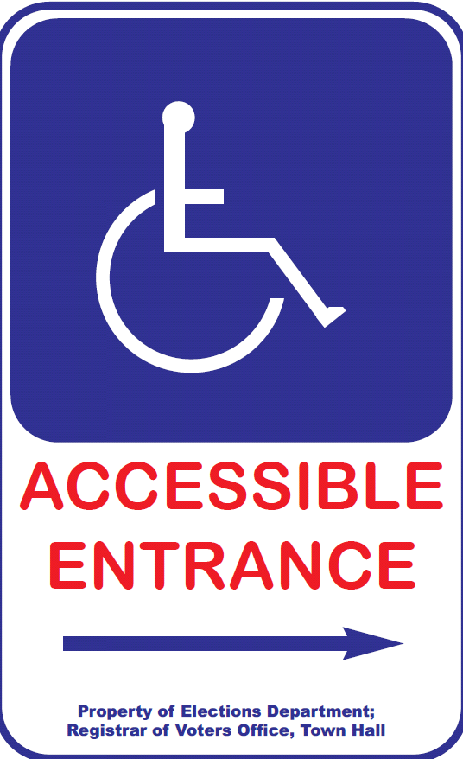
Polling Place Must Be “Accessible”
Moderator (or designee) should :
  Check parking lot signs.
  Post signs to accessible entry, if applicable.
  Clear all accessible pathways in polls
  Set up wheelchair-accessible privacy booth.
  Set up seating for tired voters.
  Review curbside voting process.
  Make sure to have DOJ ADA Checklist on file
Confirm presence/set-up of IVS accessible voting equipment –ready to go at 6 am!

Slide 10
Department of Justice ADA Checklist
https://www.ada.gov/votingchecklist.pdf

Slide 11
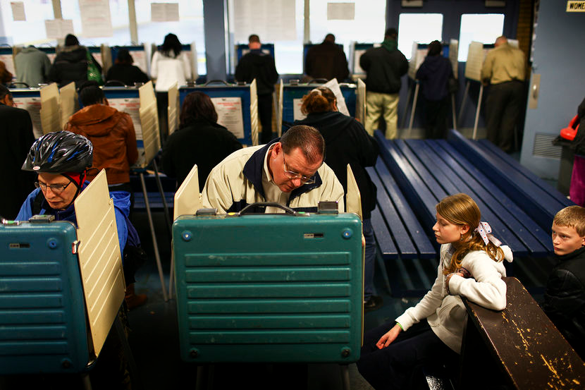
Allowed Inside Polling Place
Electors (while voting)
Person assisting elector in voting or with curbside voting
  NO candidate unless member of voter’s immediate family.
  NO representative of employer or union. Record each name.
Children of the elector (must be supervised, 15 or younger)
Secretary of the State’s Designees
News media (identify themselves to moderator, no photos of any votes )
Registrar of Voters
Unofficial Checkers
Bake Sales

Slide 12
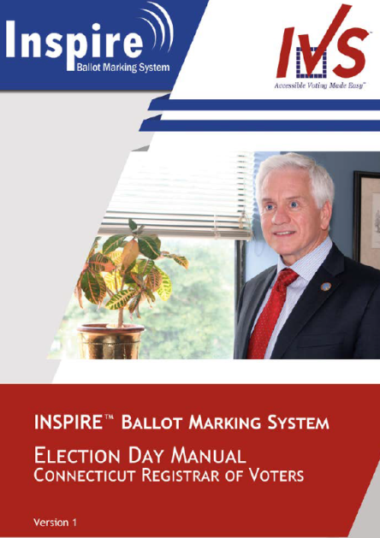
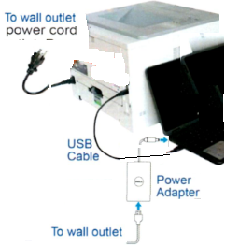
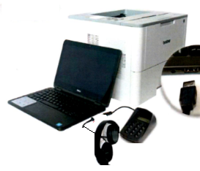
BALLOT MARKING SYSTEM - SET-UP
BEFORE POLLS OPEN ELECTION MORNING
Follow Instructions on pages 5-6 of the Election Day Manual
Printer & computer plugged into power outlet.
USB cable plugged in from computer to printer.
Key pad and headphone plugged into computer.
Button and Sip & Puff Connection
Ensure paper tray is open, extended & tray sleeve installed.
Load 1 plain piece of paper onto paper tray
Turn “On” Printer and Computer
Press “Print” on computer screen.
  A startup report will print.
Press “No” on computer screen
Access Code 9630

Slide 13
Polling Place Signage
At Federal Elections
3 Easy Steps to Voting
ID Requirements for Voters with Asterisks “*” (per HAVA)
Voters Bill of Rights
Instructions for Provisional Ballots (Federal Only)
Voter ID for checker’s table.
3 Constitution Amendment Posters (If Applicable)
Notes:
Municipal version of acceptable ID for this November. Asterisks only count at State Elections Governor and Presidential

Slide 14

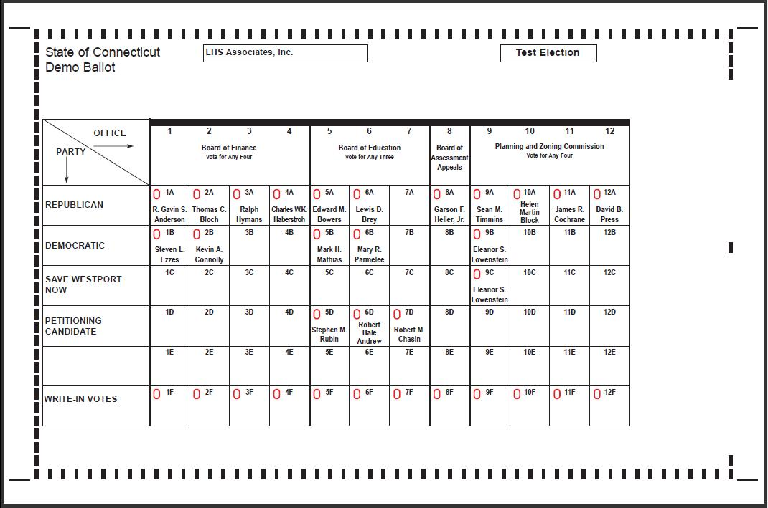
POLLING PLACE MUST DISPLAY
2 SAMPLE BALLOTS

Slide 15
VOTER ID REQUIREMENTS for Checker’s Table

Slide 16
PROVISIONAL BALLOTS
Provisional Ballots are for Federal Offices only and are given to voters who cannot be found as registered.
You must send Provisional Ballots in the amount 1% of the total number of enrolled electors. 1000 Registered Voters = 10 Provisional Ballots
The moderator gives the voter an Provisional Ballot Envelope, Provisional Ballot, and records the voters information on the Provisional Ballot Inventory Form, (Form 9).
The voter completes application on the Provisional Ballot Envelope, seals and returns the envelope to the Moderator.
Registrars have ????? Days to determine whether or not to count.
Voter should be going to EDR
Notes:
Reminder not used in Municipal Elections.

Slide 17

HAND COUNTING
Voter intent determines result.
Two election officials from different parties or factions count votes. If disagreement, moderator decides.
Ballots with write-in votes—count only votes for registered write-in candidates or for a candidate on the ballot in correct box on ballot.
Multiple votes for same candidate in same race count as just one vote.
Record on tally sheets.
DO NOT Put the ballot back through the tabulator!

Slide 18
Election Day Registration
Election Day Registration takes place only during General Elections.
Citizens will need to prove both identity as well as residency on the day of the election.
Only voters who are unregistered, registered in a different town or in off status in your town may register that day. You may want to use a greeter to redirect registered or inactive voters to the proper polling place.
The EDR location is not a polling place, however the 75ft rule still applies.
An IVS machine must be set-up and ready to use that day.
Make sure your EDR location can handle a large turnout on Election Day. Also, make sure your location has access to CVRS.
Contact SOTS to find out how many how many connections to CVRS you are allowed.
You will need to have an educated guess on what your turnout will be that day. Do you have a college in town, or an active organization what will try to turn out the vote?
Make sure that you have given SOTS the correct phone number so that towns can cross check during the day.
Completed ballots are to be brought to your counting location by members of opposing parties.

Slide 19
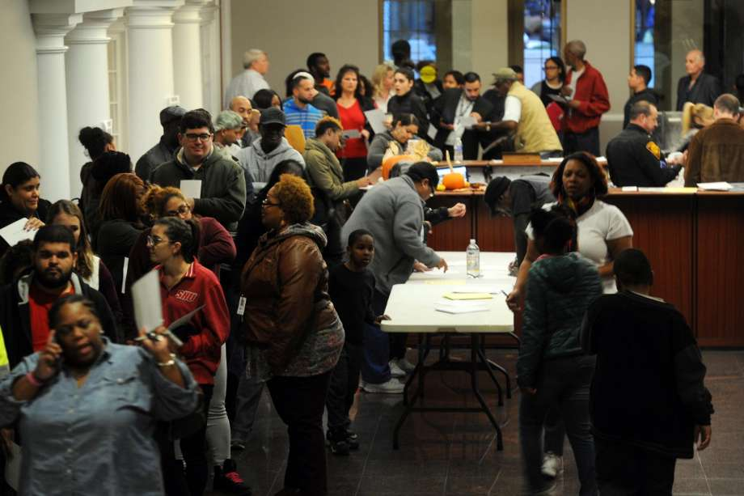
Election Day Registration Cont.
Make sure to have a dedicated phone line for outgoing calls from other towns.
Revisit your EDR plan each year as you will may not need the same amount of staff for a Presidential Election vs. a Municipal Election.
The goal is to be prepared for this

Slide 20
EDR Line
What are ways to try and eliminate long lines that can form during the EDR process?
Use a triage system for your EDR location. Have the public check-in at a station prior to getting in line to make sure they are not currently an active or inactive elector in your town. If you have the citizen fill out the voter card, have an area where they can do that prior to getting into line
Have a worker walking the line and checking the citizen’s ID’s that they have brought with them, making sure the ID covers both IDENITY and RESIDENCY.
Add additional CVRS processing stations during the election if necessary. Make sure to check with SOTS to know how many connections that you have to the state system so that you don’t knock yourself off of CVRS.

Slide 21
You can create your own forms to send people out of EDR to the polls or from poll to poll. This can help cut down on confusion and more calls to your office.

Slide 22
EMS Setup
Town Clerks & SOTS
Primary Created in EMS by SOTS
Offices assigned to Primary by SOTS
Candidates added to Primary by SOTS
Certification of Ballot Ordered this can to be done by both Town Clerk or ROV’S for primaries. Email to: jessica.gelin@ct.gov
ROVS
Assigned Polling Places to Primary
  Add or change polling locations if necessary. Make sure to notify SOTS.
Assign a Head Moderator to the Primary
  You may assign moderators, data entry, etc., and provide password

Slide 23
Recanvas Procedures
A recanvas of an election can take place if either The moderator (or head moderator in towns divided into voting districts) may call for a recanvas of the machine counted ballots, and/or the hand counted ballots, and/or absentee ballots and/or write-in ballots if he determines there is a discrepancy in the returns of any voting district in an election or primary. (§ 9-311)
Or
Or after any election or primary, when the plurality of the winning candidate for an office is 1 ½ of 1 percent or less than twenty votes are separating both the winning and defeated candidate for office.

Slide 24
Recanvas Cont.
In a District / Statewide recanvas, the Secretary of the State will notify the Town Clerk who will intern notify the Head Moderator.
In a municipal or Single District race the Town Clerk will inform the Head Moderator.
It is the Head Moderator who will notify the candidates, town chairmen and recanvas officials that are needed that a recanvas will be conducted. This is to be done in writing.
RECANVASS OFFICIALS
Recanvass officials are: the moderator, the registrars of voters (or the registrar of voters, in a primary); at least two official checkers of opposing political parties (or opposing sides, in a primary); at least two absentee ballot counters of opposing political parties who served at such election (or opposing sides in a primary); and at least two ballot clerks of opposing political parties. Although not a recanvass official, the town clerk may be involved to ensure the appropriate materials (that have been in the possession of the town clerk) have been delivered for use during the recanvass.

Slide 25
Recanvas Cont.
Require Town clerk and / or registrar of voters to bring (dependent on who has the material):
i. the tabulators with a memory card still sealed in them.
ii. the sealed ballot transfer cases for each voting district, which contain:
all machine counted ballots,
the sealed depository envelopes containing the hand-counted absentee ballots; notes, worksheets and other written materials used in the absentee ballot counting procedures; and the Moderator’s Record of Absentee Ballot Count for Candidates;
the sealed depository envelopes containing the counted ballots from the auxiliary bin; notes, worksheets and other written materials used in counting the ballots from the auxiliary bin (if any);
the sealed depository envelopes containing the counted ballots from the write-in bin; notes, worksheets and other written materials used in counting the ballots from the write-in bin;
iii. the sealed depository envelopes containing rejected absentee ballots and discarded inner and outer envelopes;
iv. the absentee ballot applications;
v. the list of absentee ballot applicants as provided in §9-140;
vi. the check list;
vii. the moderator's returns, including the central absentee ballot counting moderator's return, if applicable;
viii. replacement seals;
ix. challenge ballots, provisional ballots, presidential ballots and all other materials.

Slide 26
Post Election Audit
The Secretary of the States Office will conduct a lottery after the election. Those polling places selected will need to have a post election audit conducted.
The audit may be conducted either by manual or automated form. All automated audits take place in the Office of the Secretary of the State.
Regardless of the type of audit you perform it must still be noticed locally.
To conduct the audit manually make sure to reference the audit manual which is located on the SOTS website.

Slide 27
Links to Manuals & websites
Absentee Counting
Audit
Recanvas
Moderator
http://portal.ct.gov/SOTS/Election-Services/Handbooks/Handbooks-Moderators-Absentee-Ballot-Counters-Recanvass-and-Audit
ROVAC handbook
http://rovac.org/index.php?page=Handbook

Slide 28
ROVAC website: http://rovac.org/
SOTS: http://portal.ct.gov/SOTS/Common-Elements/V5-Template---Redesign/Elections--Voting--Home-Page
SOTS LEAD Communications: http://portal.ct.gov/SOTS/Election-Services/LEAD-Communications/LEAD-Communication
SOTS Election Calendar: http://portal.ct.gov/SOTS/Election-Services/Calendars/Election-Calendars
LHS Associates: http://www.lhsassociates.com/ 1(888) 547-8683
IVS: https://ivsllc.com/indexWelcome.html 1(855) 730-6161
Adkins Printing http://www.adkinsinc.net/ 1(800) 228-9745 x 125
UConn CITI https://citi.uconn.edu/registrarofvoters

Slide 29
