Slide 1
New Legislation and the 2021 Redistricting
By: Tim De Carlo
Registrar of Voters, Waterbury, CT
2021 ROVAC Fall Conference, Southbury, CT

Slide 2
2021 Changes to Title 9 of the Connecticut General Statutes
In Special Session in June of 2021, the Connecticut General Assembly passed into law what would become Public Act No. 21-2
This Public Act introduces changes to Election Laws in Title 9

Slide 3
§ 93 — DISTRIBUTING VOTER REGISTRATION INFORMATION AT HIGH SCHOOLS
Requires registrars of voters to annually distribute voter registration information at public high schools.
Registrars are required to annually distribute information, on the fourth Tuesday in September, at each public high school about the qualifications and procedures for registering to vote. Under the law, registrars and the principal of any public high school must determine the best distribution method to distribute the information to students.
This does not require the Registrars to have to be onsite on the fourth Tuesday of September.
This is in addition to the annual high school registration sessions that Registrars must hold between January 1st and the last day of the school year. However per SOTS these sessions can be combined.

Slide 4
§§ 96-98 — VOTING RIGHTS FOR INDIVIDUALS CONVICTED OF A FELONY
Only those who are convicted of a felony and in either an in-state or out-of-state prison will have their voting rights suspended.
Those who are serving Parole will not no longer lose their voting rights.
Parolees can register or re-register to vote.
Probation and Parole will now mirror each other in regards to registration status.

Slide 5
§ 102 — DROP BOXES FOR RETURNING ABSENTEE BALLOTS
Makes permanent the use of drop boxes for returning absentee ballots.
Beginning 29 days before a primary, election, or referendum, and each weekday thereafter until the polls close, the bill requires town clerks to retrieve absentee ballots from the secure drop boxes. The bill eliminates a requirement that applied during the 2020 state election under which a police officer had to escort the town clerk in retrieving absentee ballots from any drop box located outside of a building other than the clerk’s office building.

Slide 6
§ 104 — VOTER REGISTRATION INFORMATION
Generally limits disclosure of certain voter registration information
The law limits disclosure of a voter’s date of birth under state election law to year and month of birth unless the information is requested and used for a governmental purpose, as determined by the Secretary of the State. In that case, the complete birth date must be provided. The bill specifies that “a governmental purpose” must at least include jury administration.
Campaigns are not considered “a governmental purpose”.
Also expands those who can have their address suppressed from voter lists. These requests should be sent to SOTS.

Slide 7
§ 110 — ASSISTANCE IN VOTING BOOTHS AT EDR LOCATIONS
Specifies that electors may receive voting assistance in voting booths at designated EDR locations.
By law, electors may receive voting assistance from anyone other than their employer, employer’s agent, union representative, or with one exception, candidates whose names appear on the ballot. (A candidate may provide assistance if the elector making the request is an immediate family member.)
Currently, a person assisting an elector may accompany that person into the voting booth. The bill specifies that this authorization applies at both polling places and designated EDR locations.

Slide 8
§§ 111-114 — POLLING PLACE CHALLENGERS
Conforms the law with current practice by eliminating provisions authorizing registrars of voters to appoint challengers as polling place officials.
The bill conforms the law with current practice by eliminating registrar-appointed challengers as authorized poll workers during a primary or election. Existing law, unchanged by the bill, authorizes any elector to act as a challenger.

Slide 9
§ 126 — TOWN COMMITTEE PRIMARIES
Impacts those cities and town that do not Caucus and instead hold a Direct Primary.
Allows for the direct endorsement of Town Committee Members at a Convention. Once endorsed, there will be no need for them to circulate Primary Petition pages.
If a Town Committee leaves a vacancy any member of the party in good standing can submit to the Registrar a letter of intent to primary. Because there is a vacancy that induvial will instantly take the open seat.
Challengers of the endorsed slate will still need to petition onto the ballot.
To primary an Town Committee Slate the Challengers will need to have a slate consisting of at least 25% of the total number of positions available.

Slide 10
ROVAC Legislative Committee
Two members per county.
Meets monthly while Legislators are in Session.
Compose testimony in favor of or in opposition of pending legislation.
Work with members of the Government Administration and Election Committee in drafting legislation as well as amendments.
Organize annual ROVAC Day at the Capitol.
Conduct meetings with members of the General Assembly and other State Agencies .
Compile a weekly bill tracking list.

Slide 11
Committee Members
Fairfield County
Annalisa Stravato (Wilton)
Mary Hegarty (Greenwich)
Harford County
Mindy Lewis (South Windsor)
Theresa Avey (Newington)
Litchfield County
Melissa Russell
Middlesex County
David Bauer (Middletown)
Bonnie Anderson ( Cromwell)
New Haven County
Lisa Kops (Guilford)
Tim De Carlo (Waterbury)
New London County
Barbara Richardson Crouch (Sprague) Bill Giesing (New London)
Tolland County
Mike Wyman (Tolland)
Bill Wilson (Tolland)
Windham County
Lauren Olson (Ashford)
(

Slide 12
ROVAC President
Chris Prue (Vernon)
ROVAC Immediate Past President
Sue Larsen (South Windsor)
Sullivan & LeShane, Inc.
Paddi LeShane, CEO
Ryan Bingham, Senior Director of Government Affairs
Joe Canio, Legislative Associate
Chris Zaccaro, Public Relations Associate
Lobbying and Public Relations Firm

Slide 13
ROVAC Legislative Survey
This year the survey will be emailed to every Registrar. Please make sure that your email address in the ROVAC Portal is up to date.
This survey will help our lobbying team with informing Legislative Members on where ROVAC stands on certain issues in the Connecticut General Assembly.

Slide 14
Redistricting
Connecticut Reapportionment Committee
Reapportionment Committee Members:
Senator Kevin C. Kelly, 21st Senatorial District, Co-Chairman
Representative Gregg Haddad, 54th Assembly District, Co-Chairman
Senator Douglas McCrory, 2nd Senatorial District Senator
Mary Daugherty Abrams, 13th Senatorial District Senator Paul Formica, 20th
Senatorial District Representative Tammy Exum, 19th Assembly District
Representative Vincent J. Candelora, 86th Assembly District Representative
Jason Perillo, 113th Assembly District
Every ten years Congressional, State Senate, General Assembly and local districts are looked at for possible redrawing. Data from the U.S. Census is used to determine whether or not a district has grown or shrunk and will need to be redrawn.

Slide 15
What to expect
Once the committee has completed it’s work, your office will receive a “shapefile”—(a data storage format of geometric data) that you will need to use in order to demine what changes will need to be placed into CVRS.
Those municipalities that have multiple districts will need to consult your Public Works or Engineering Department to ask for assistance with utilizing the municipal Geographic Information System – (GIS)
ROVAC is currently advocating that more data be given to ROVs instead of simply a shapefile.
The state will provide you with the changes for Federal and State Offices only, Local Districts are drawn using the same data at the local level. If you have Local Districts, consult your Town Charter to find out who is in charge of updating local district lines.

Slide 17
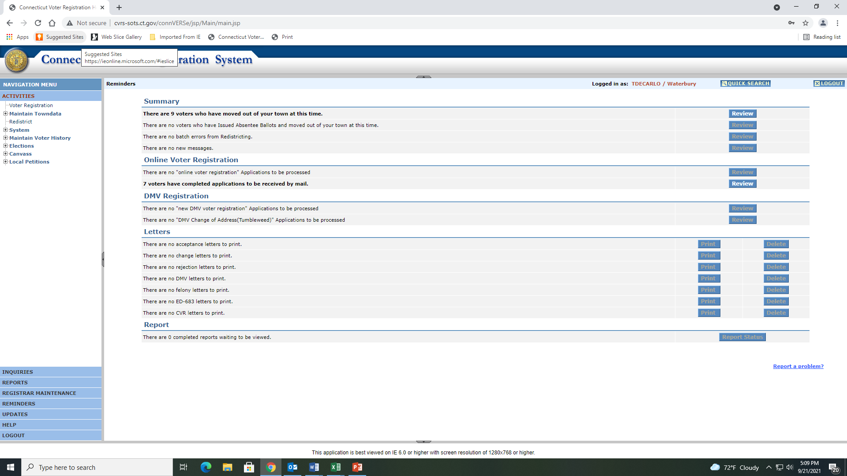
Select Redistrict
Which is under
Maintain Towndata

Slide 18
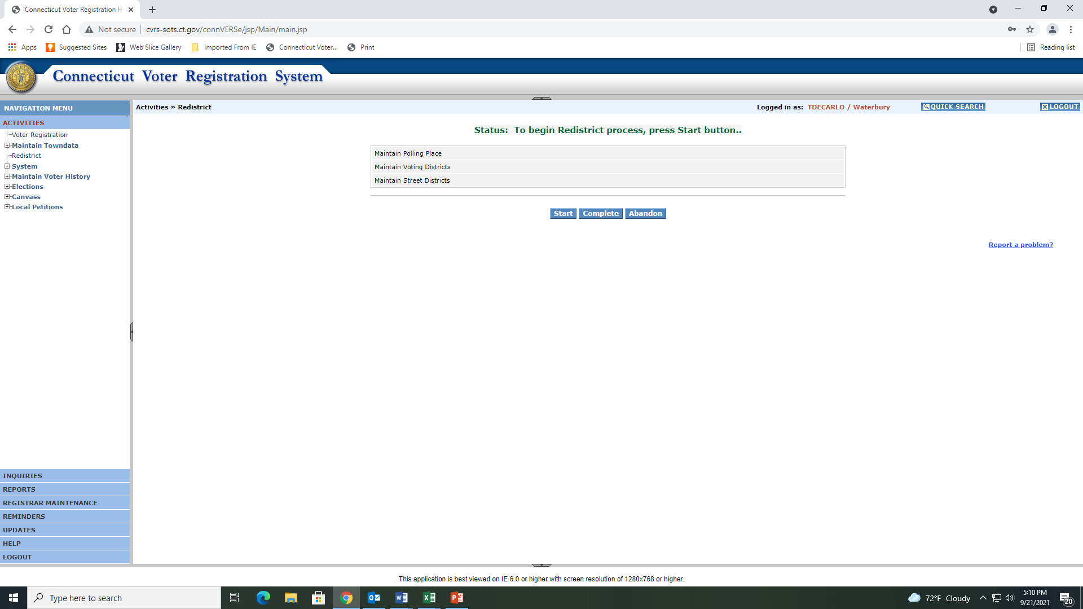
You will need to hit Start in order to
begin the Redistricting process

Slide 19
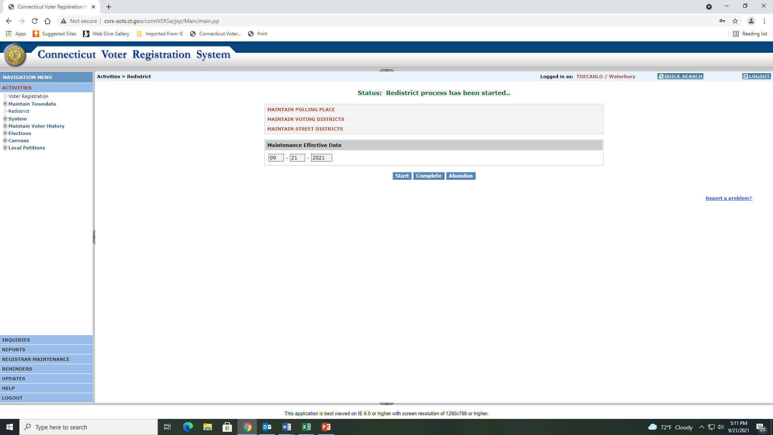
Once you hit Start it will bring you to this page, you will see a Maintenance Effective Date, as well as three areas where you will be working in.

Slide 20
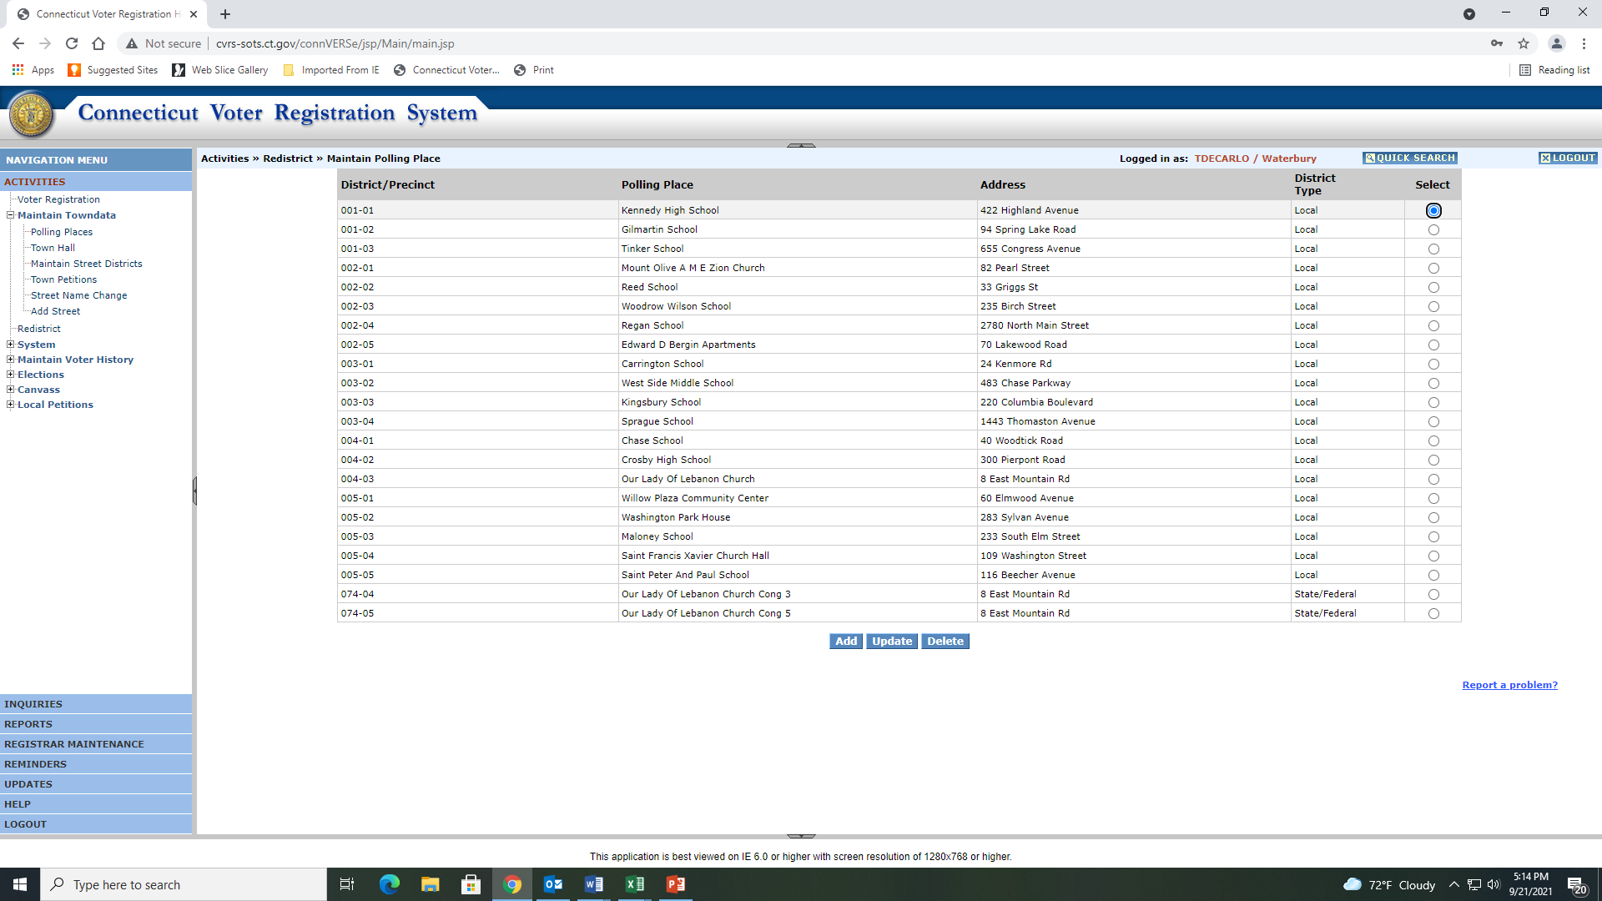
Maintain Polling Place is were you will add or remove polling places.

Slide 21
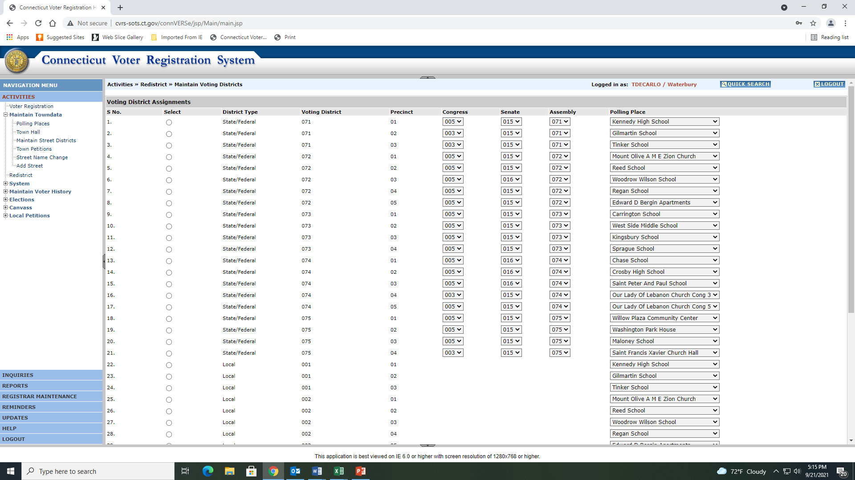
Maintain Voting Districts is were you will add the corresponding districts to each polling place.

Slide 22
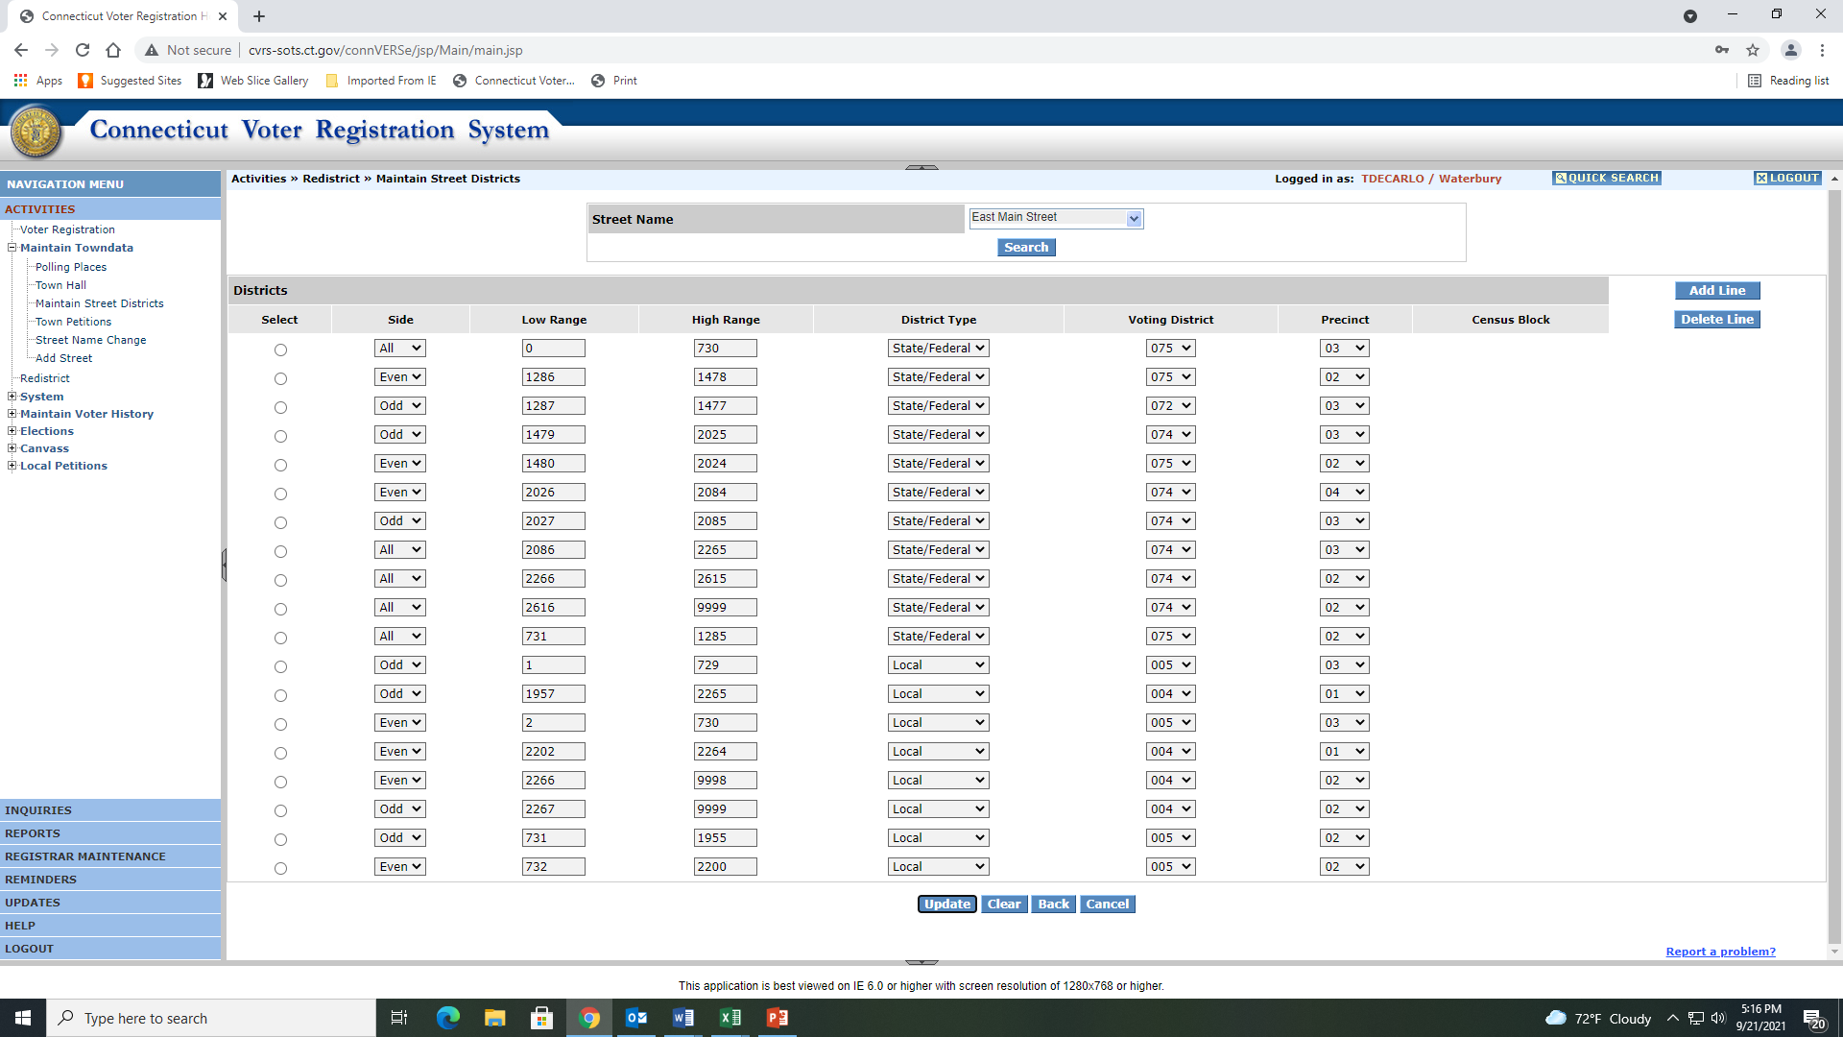
You will need to enter into CVRS how each road is cut. If the road is cut between odd and even you will need to enter each side of the road. You will also have to do the same if you have Local Districts.

Slide 23
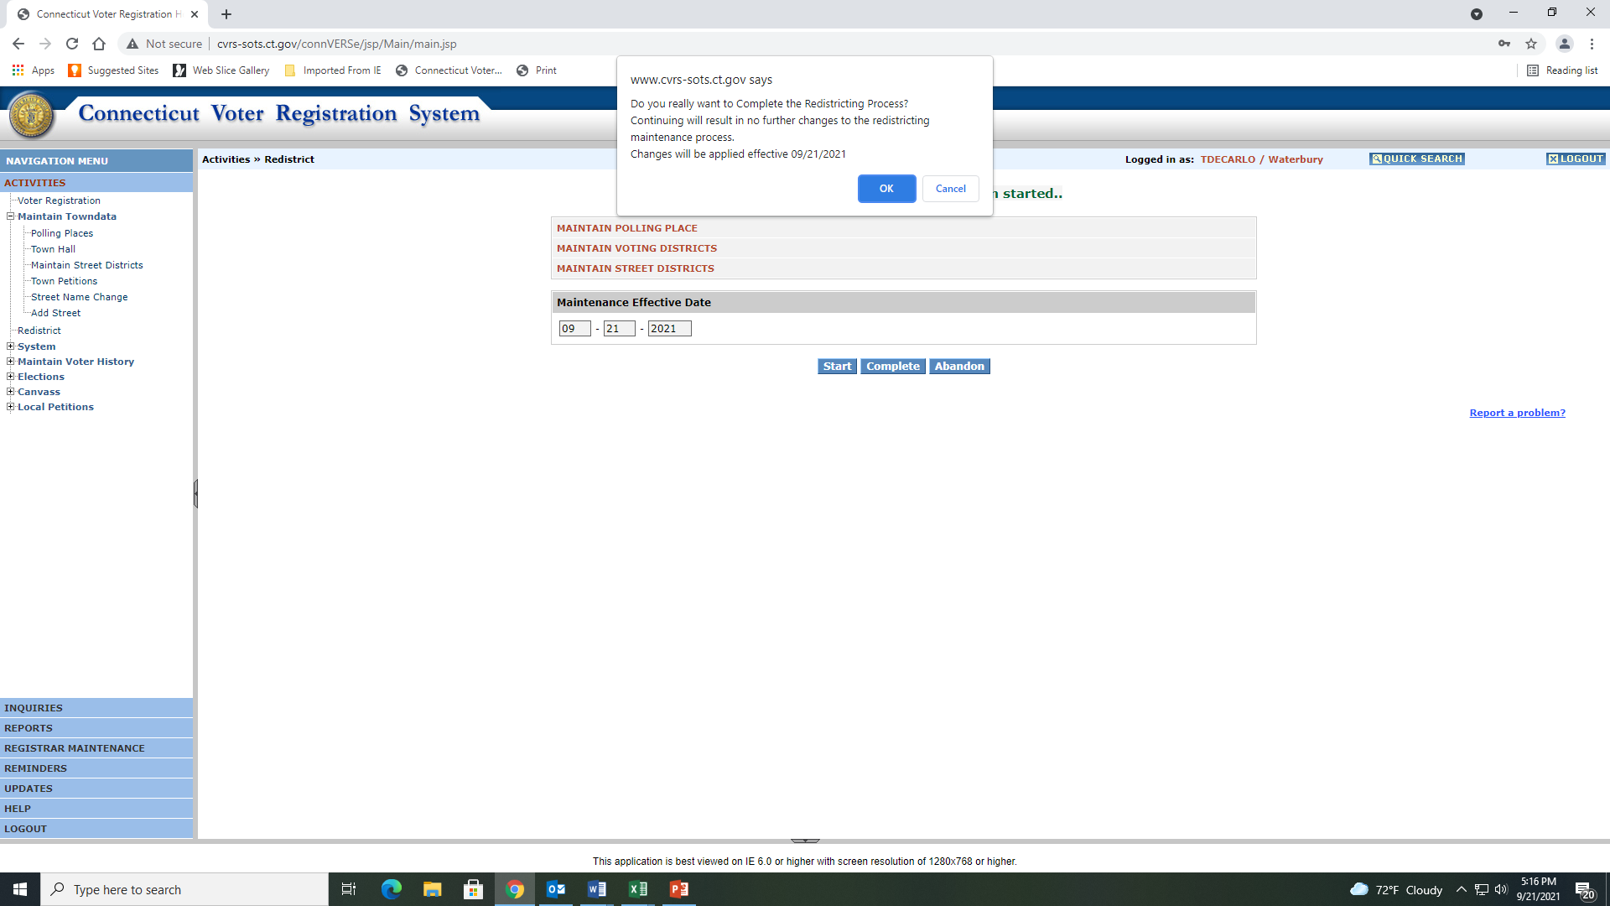
Once you hit Complete you will be unable to work in CVRS until the following morning.
Once you hit complete the system will ask you if you really want to Complete the Redistricting Process.

Slide 24
The system has now waiting to update your changes

