Slide 1

NEW REGISTRAR DAY
FEBRUARY 6, 2021
ELECTION MANAGEMENT SYSTEM
[ EMS ]
Presented by
Peter Gostin
Registrar of Voters – New Britain
Deputy Treasurer - ROVAC
Email: peter.gostin@newbritainct.gov
Cell: 860-977-5856

Slide 2
IMPORTANT!!
* Must Use Internet Explorer browser
* Head Moderator should NOT login until just before election ends at 8:00 pm! The election reporting begins once Head Moderator logs in and all Maintenance information outlined in this presentation must be populated beforehand!
* EMS report MUST be submitted to the
Secretary of the State’s office by midnight!

Slide 3
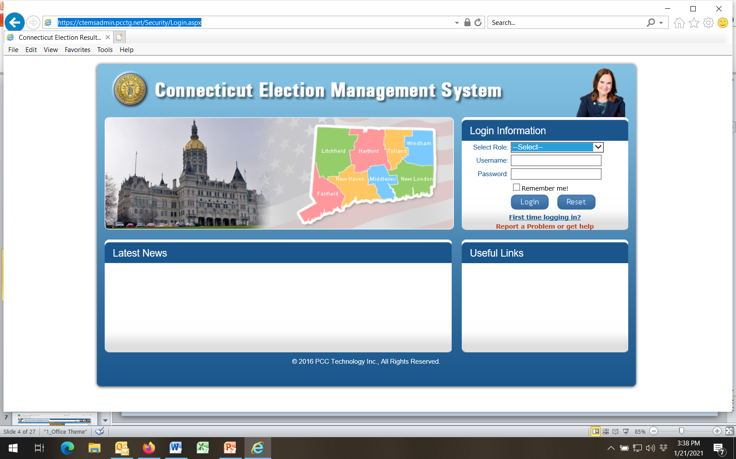
Type in URL, then Bookmark as Favorite for easy retrieval

Slide 4
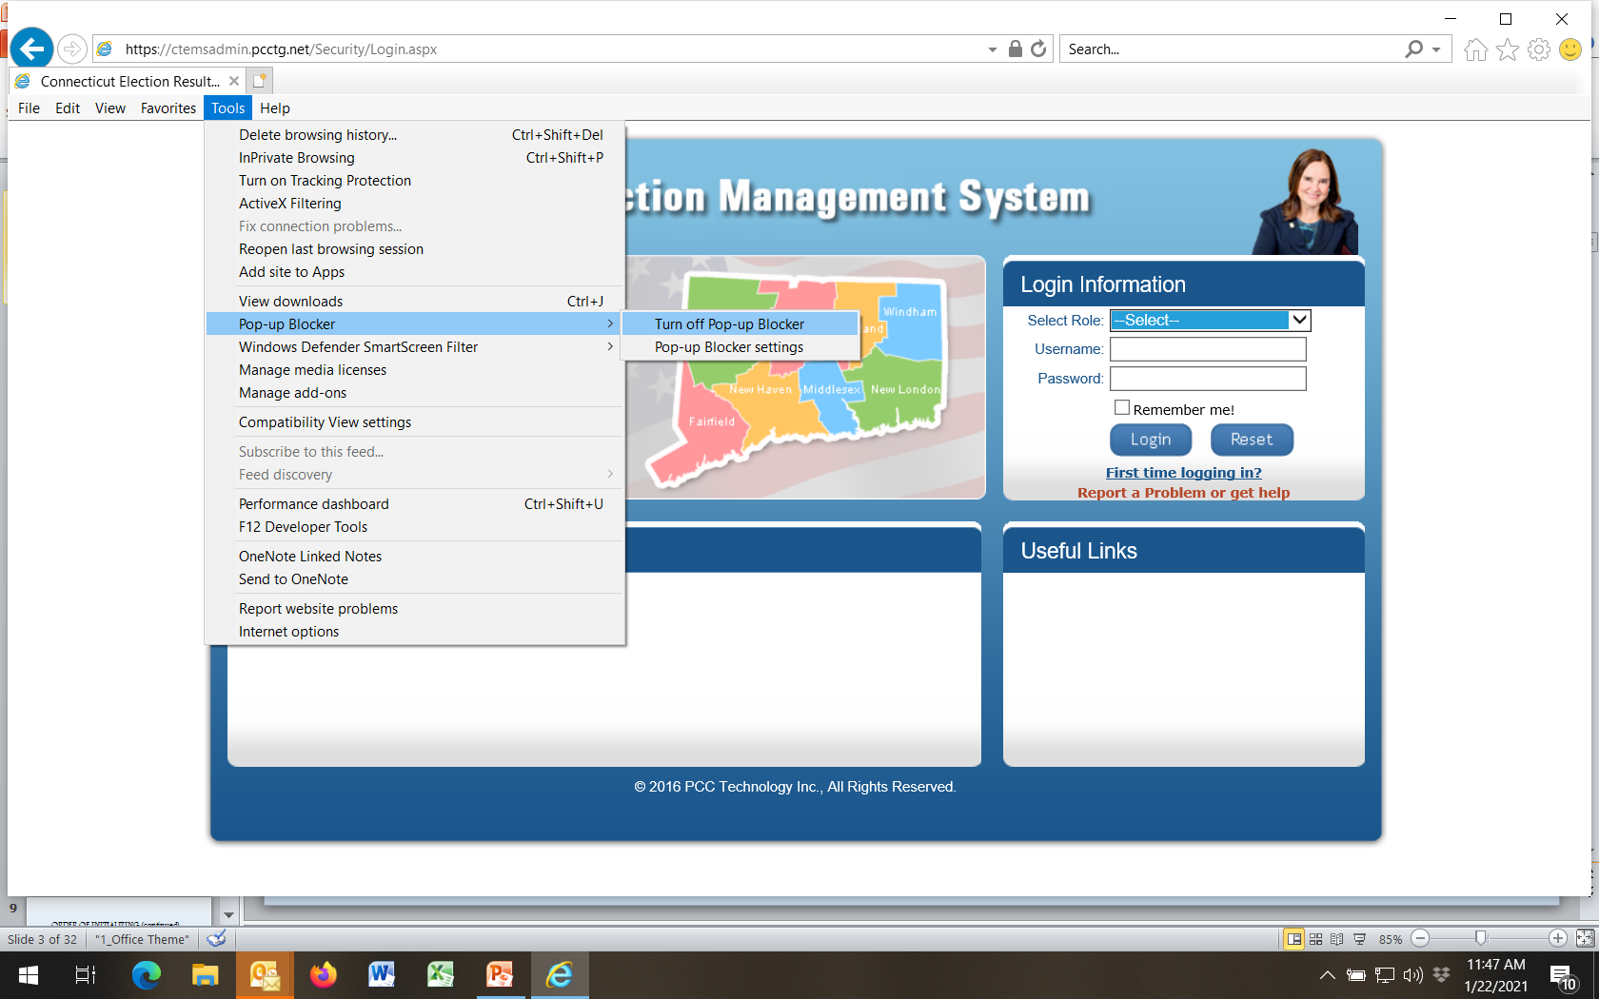
If first time user
Turn off pop-up blocker!

Slide 5
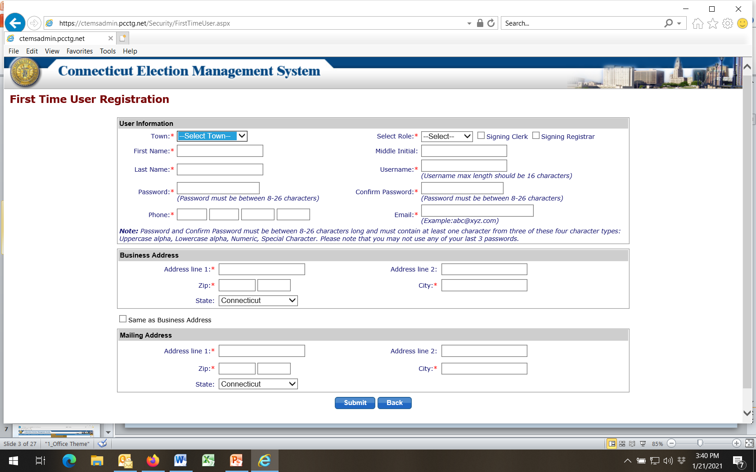
Fill in all info
then

Slide 6
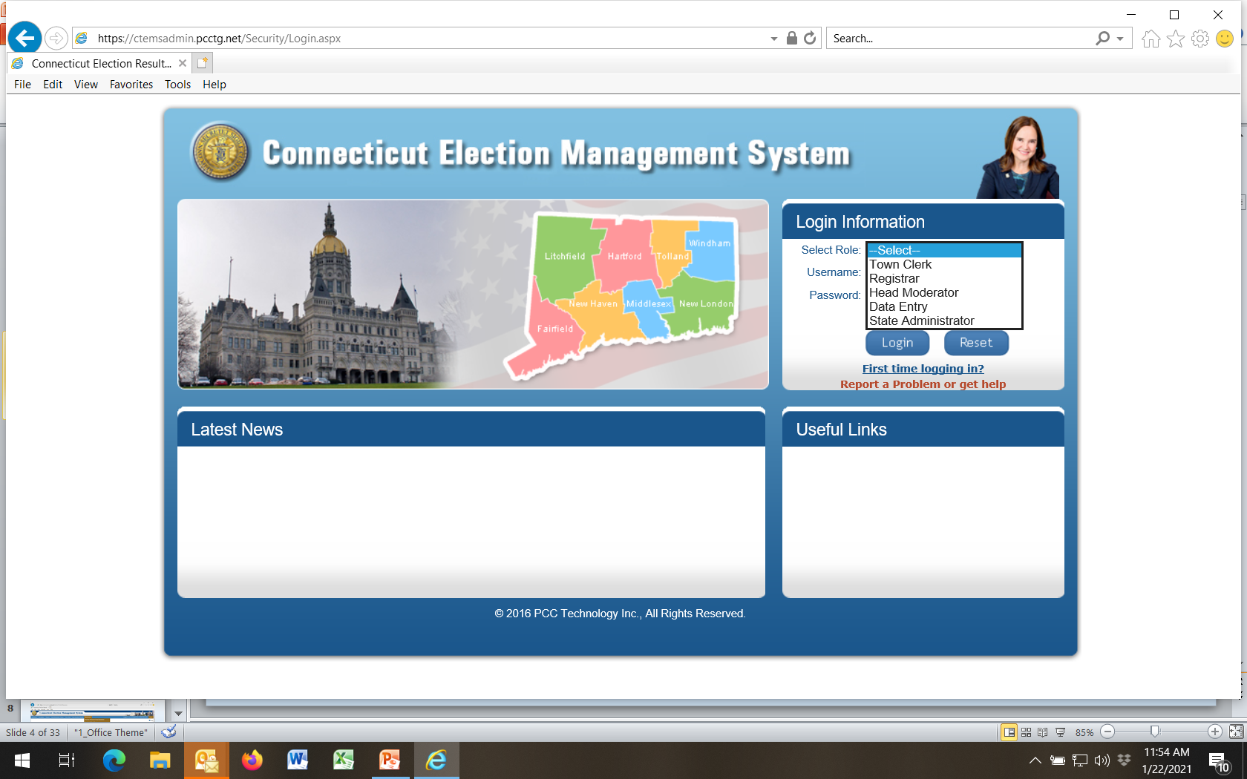
Select User Role
IMPORTANT!
Head Moderator should NOT login until ready to enter election results as Election begins immediately!

Slide 7
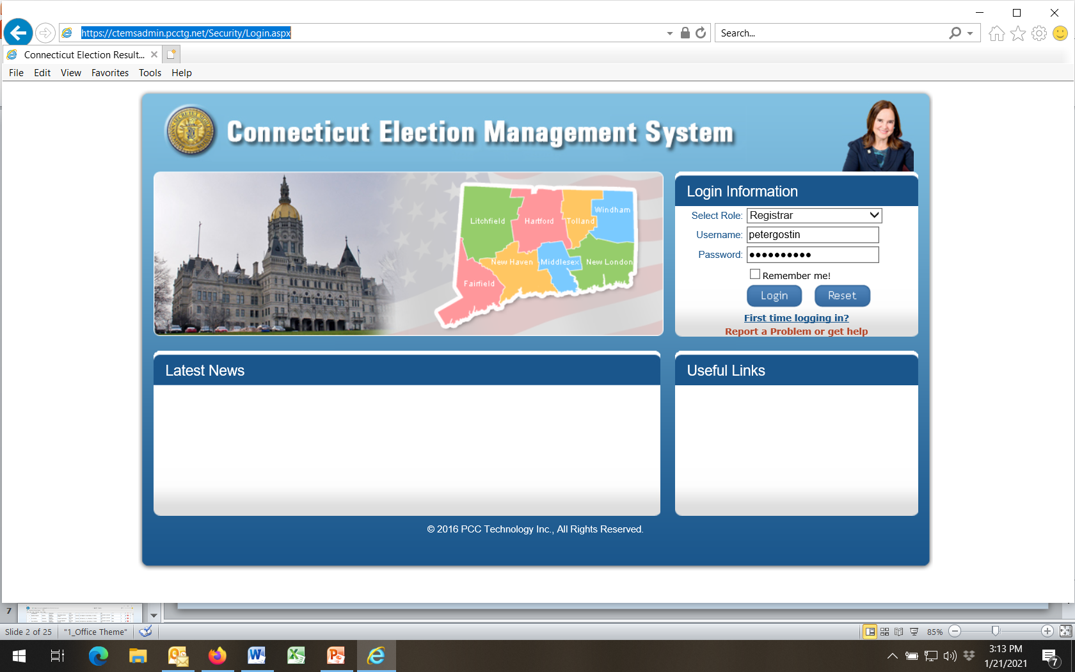
For Registrar logins
Passwords for all Selected Roles expire after 90 days

Slide 8
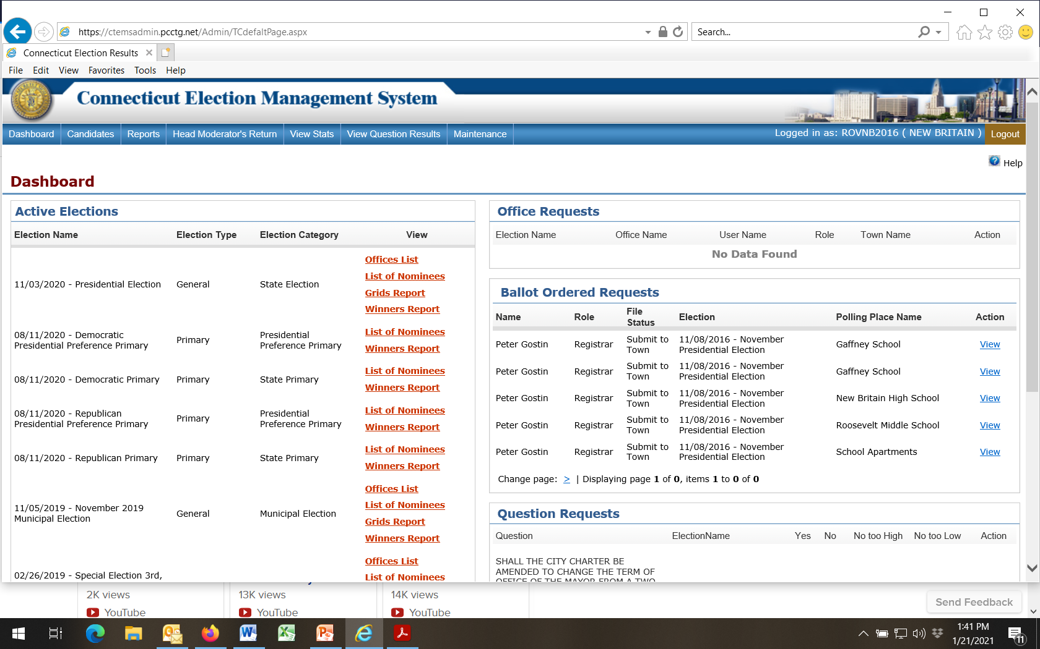
Registrar login

Slide 9
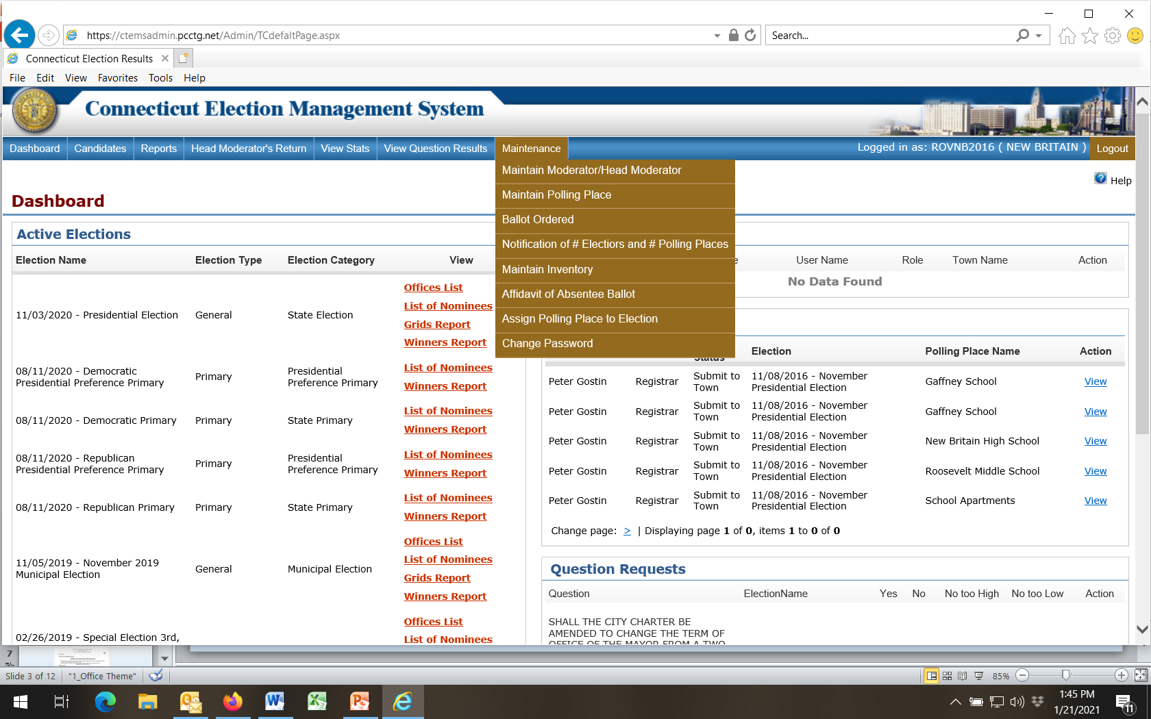
Click on Maintenance and select task from drop-down box

Slide 10
ORDER OF INITIALIZING
Under Maintenance Tab:
* Add / Maintain Polling Places (6 – 8 weeks prior to primary or election)
* Assign Polling Places (6 weeks prior to primary or election)
* Certification of Ballot Order (6 weeks prior to primary or election) a. One ROV enters data and certifies b. Other ROV goes to Dashboard Maintain Ballot Order View Certify c. Town Clerk certifies ballot order (final step) d. Review Affidavit of Absentee Ballot
* Add Head Moderator and other EMS users (4 weeks prior to primary or election)
[note: Head Moderator will use separate EMS login to enter all election results!]

Slide 11
ORDER OF INITIALIZING (continued)
* Maintain Inventory (4 weeks prior to primary or election)
* Add / View Candidates (under Candidates Tab; 3 weeks prior to primary or election)
* Tally Sheets (under Reports Tab; 4 – 7 days prior to primary or election)
* Reports (under Reports Tab – select / review when all data entry is complete)
- - - - - - - - - - - - - - - - - - - - - - - - - - - - - - - - - - - - - - - - - - - - - - - - - - - - - - - - - - - - - - - - - - - - - - - - - - - - - - - - - - - - - - - - - - - - - - - - - - - - - - - - - - - - - - - - - - - - -
Other Procedures
+ Head Moderator (login only when ready to begin entering results!)
+ Notification of Number of Electors and Number of Polling Places
(Registrars need to fill this out in January. Town Clerks need this information to file ED626 report to SOTS in February)

Slide 12
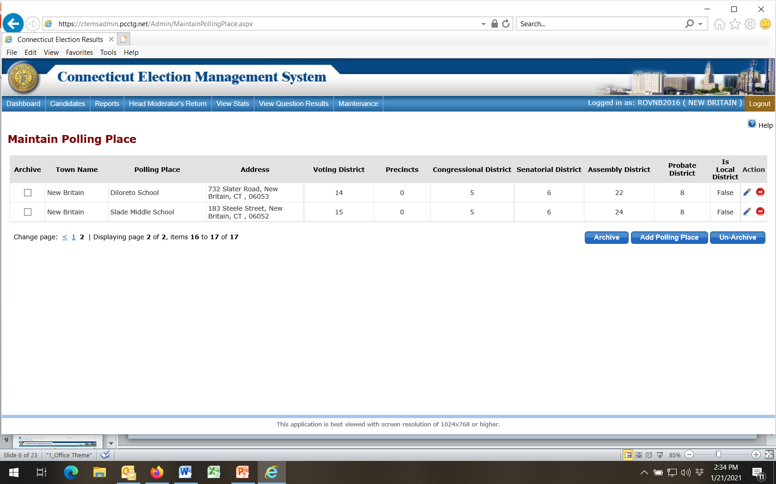
To Add Polling Place

Slide 13
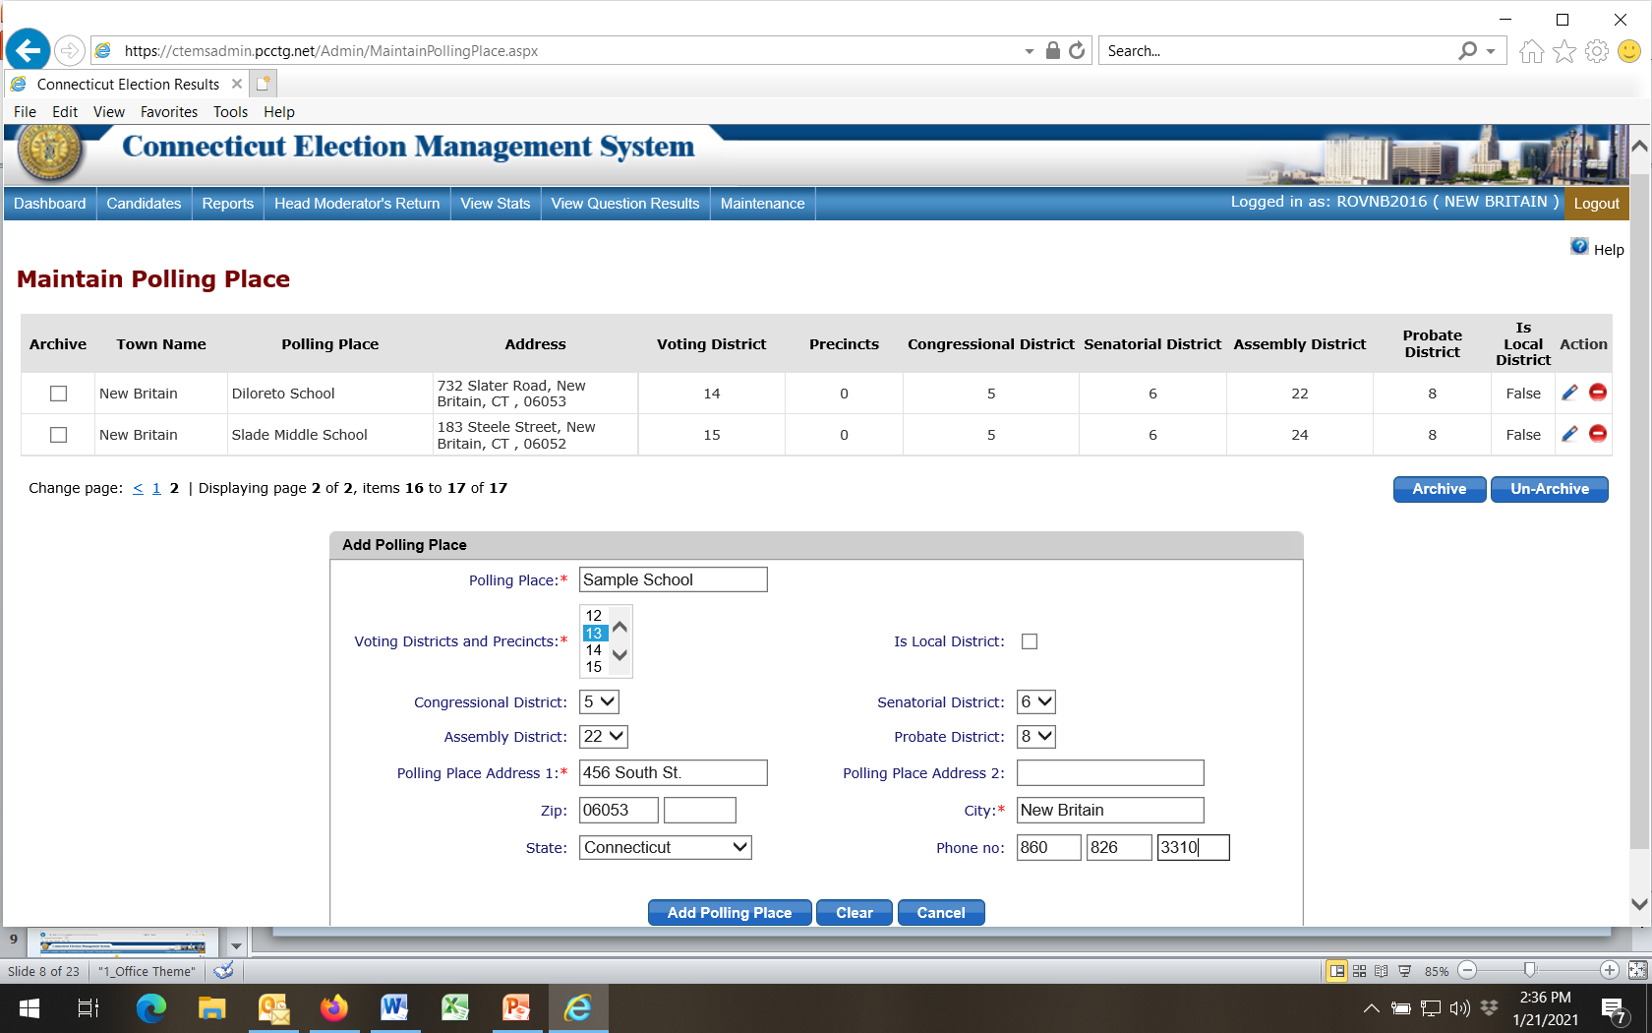
Fill in all info
Finalize

Slide 14
To Edit Polling Place

Slide 15
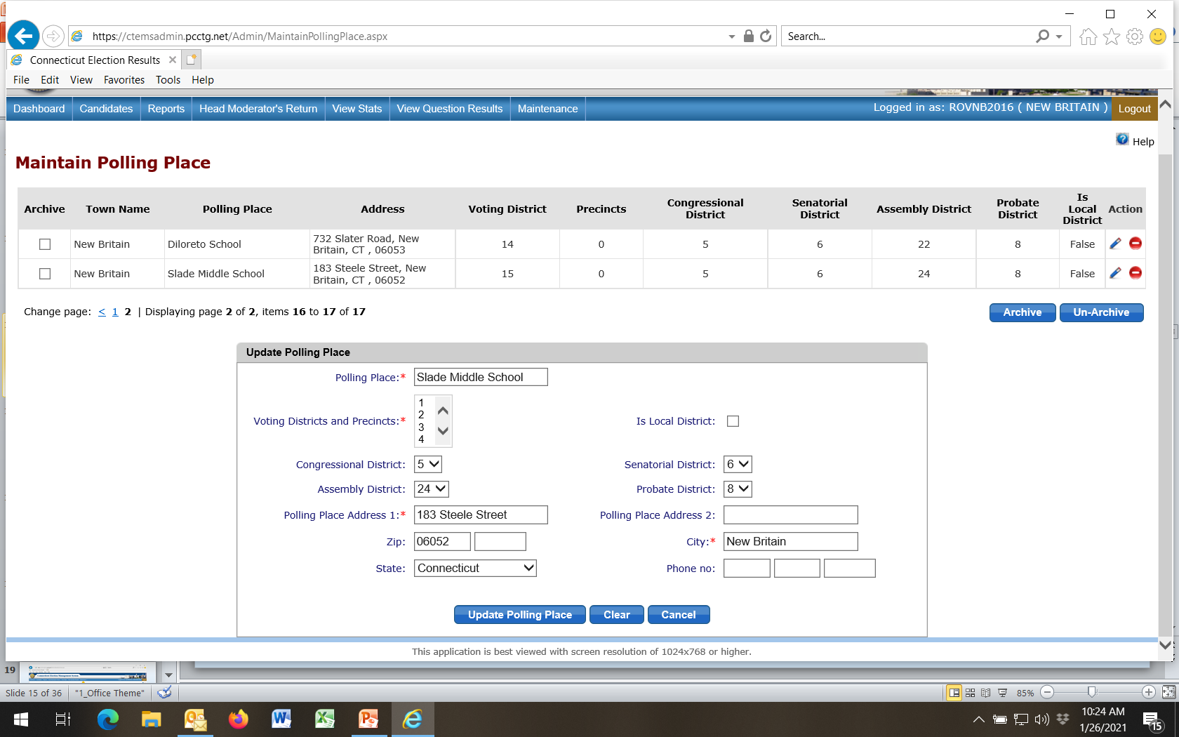

Review “Is Local District”: True = Local elections
False = State elections
Note: Duplicate this listing; use one set for state elections and one set for local elections
Finalize

Slide 16
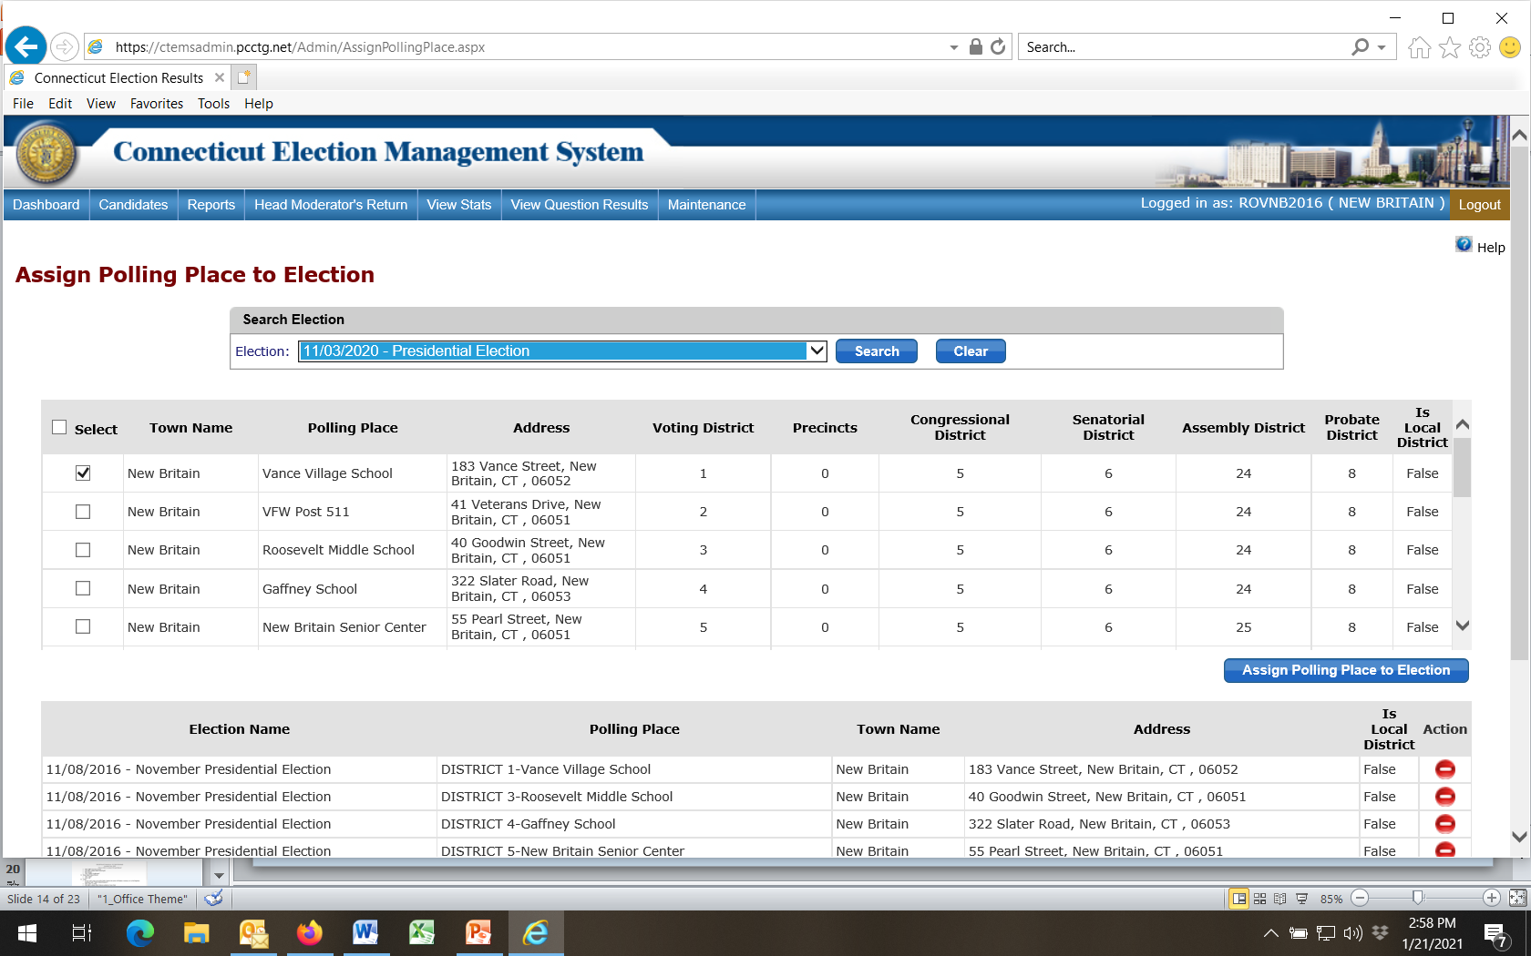
Example shown here is to assign a polling place to a state election. For local elections select a district that shows TRUE in the “Is Local District” column.
1
2
3

Slide 17
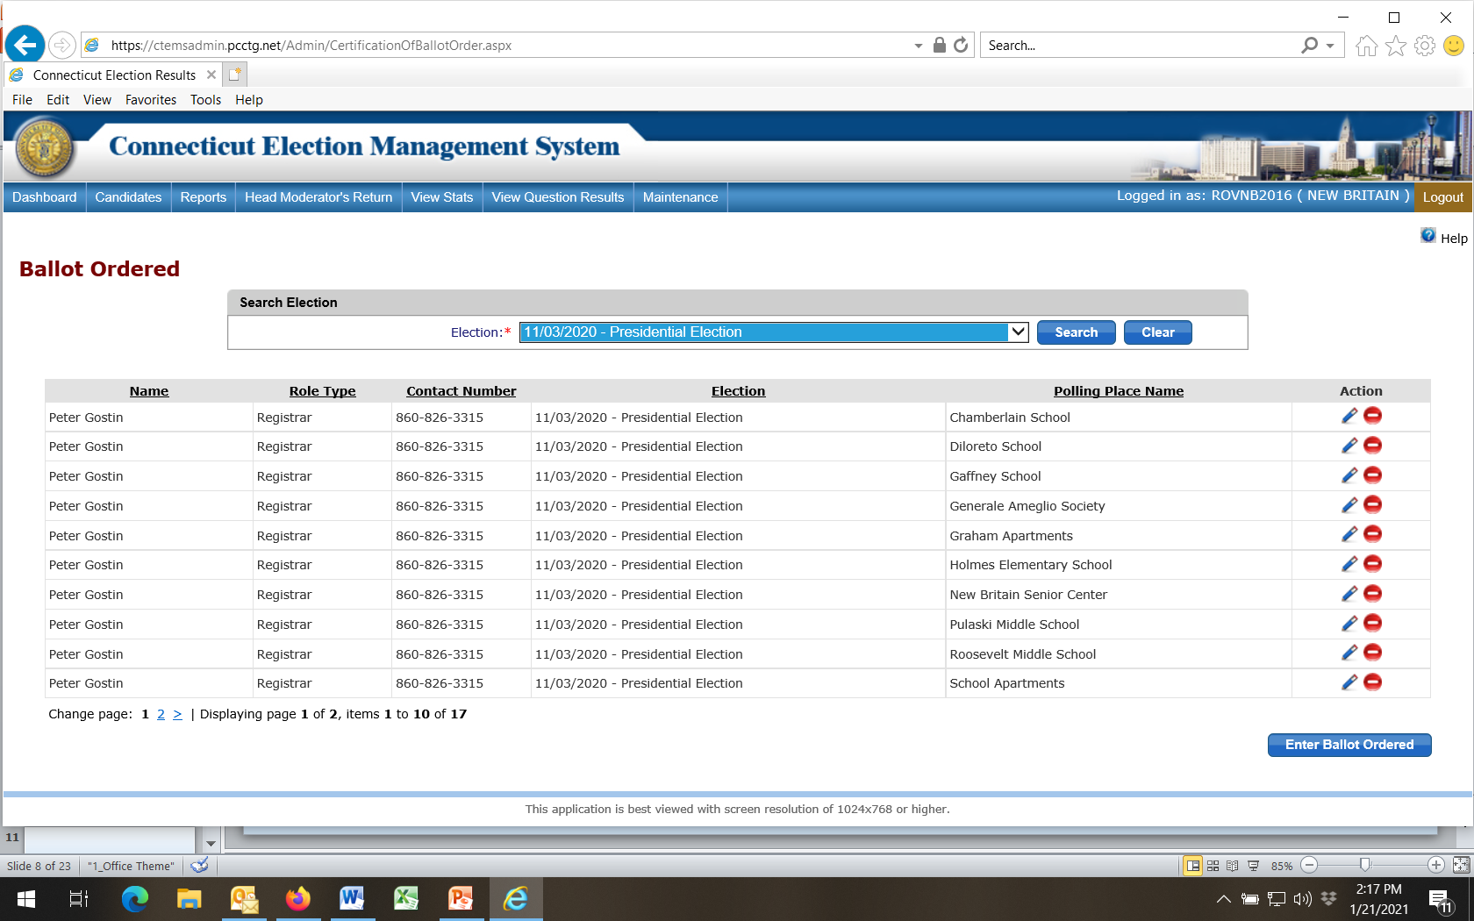
Select Election (added by SOTS)
Then

Slide 18
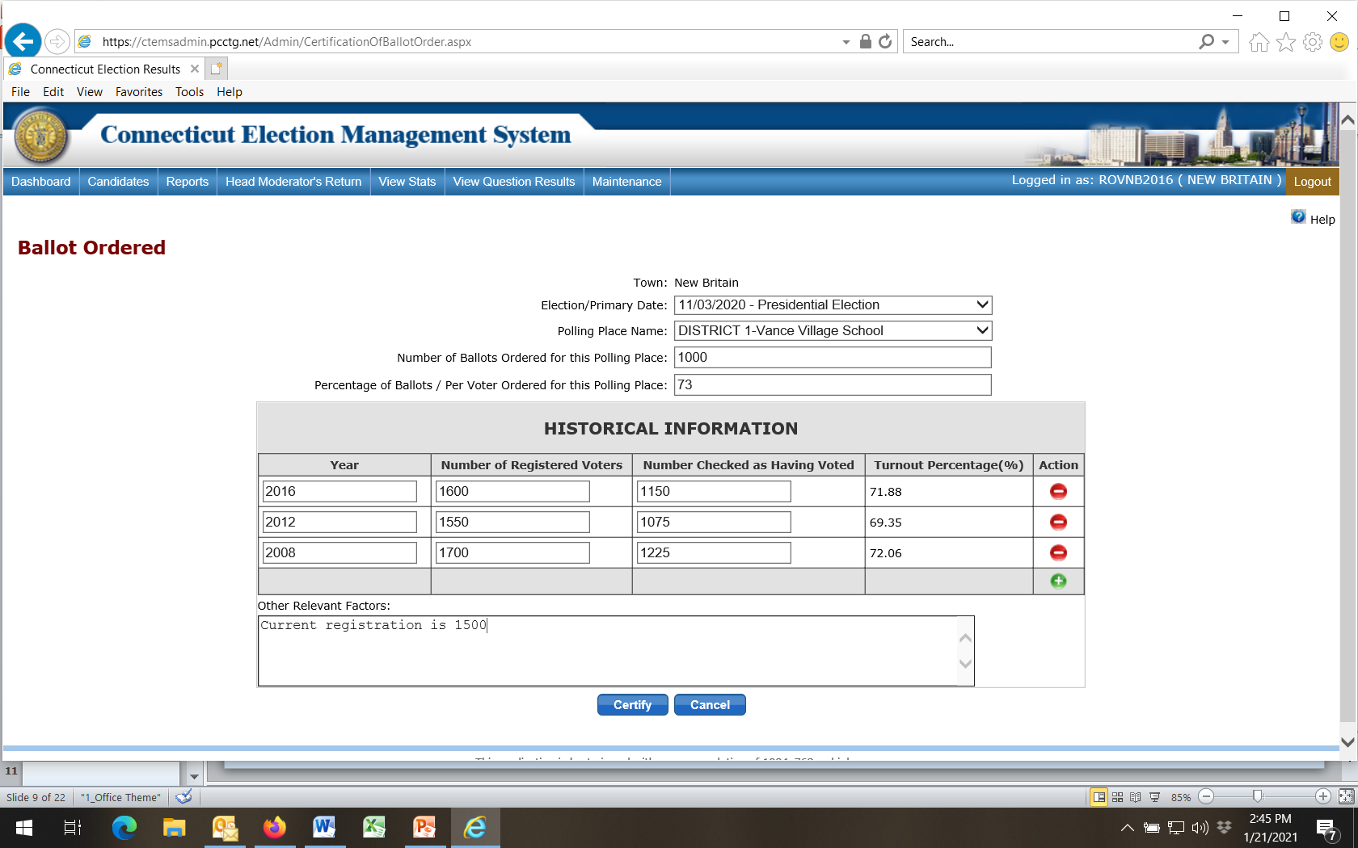
1
Fill in all info; add more years of same-type election history
2
3
Finalize
Repeat steps for all your voting districts
4

Slide 19
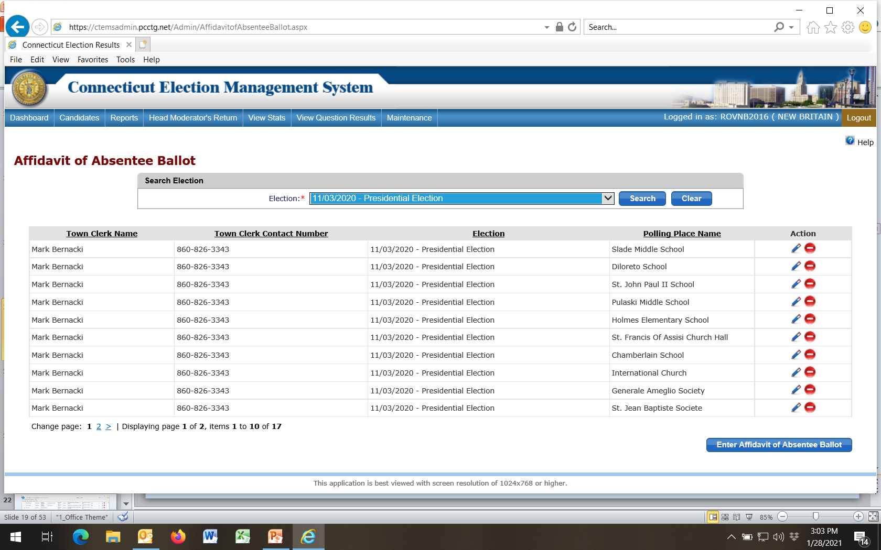
Select Election
If desired, review data entered by Town Clerk through Edit function (do not edit!)

Slide 20
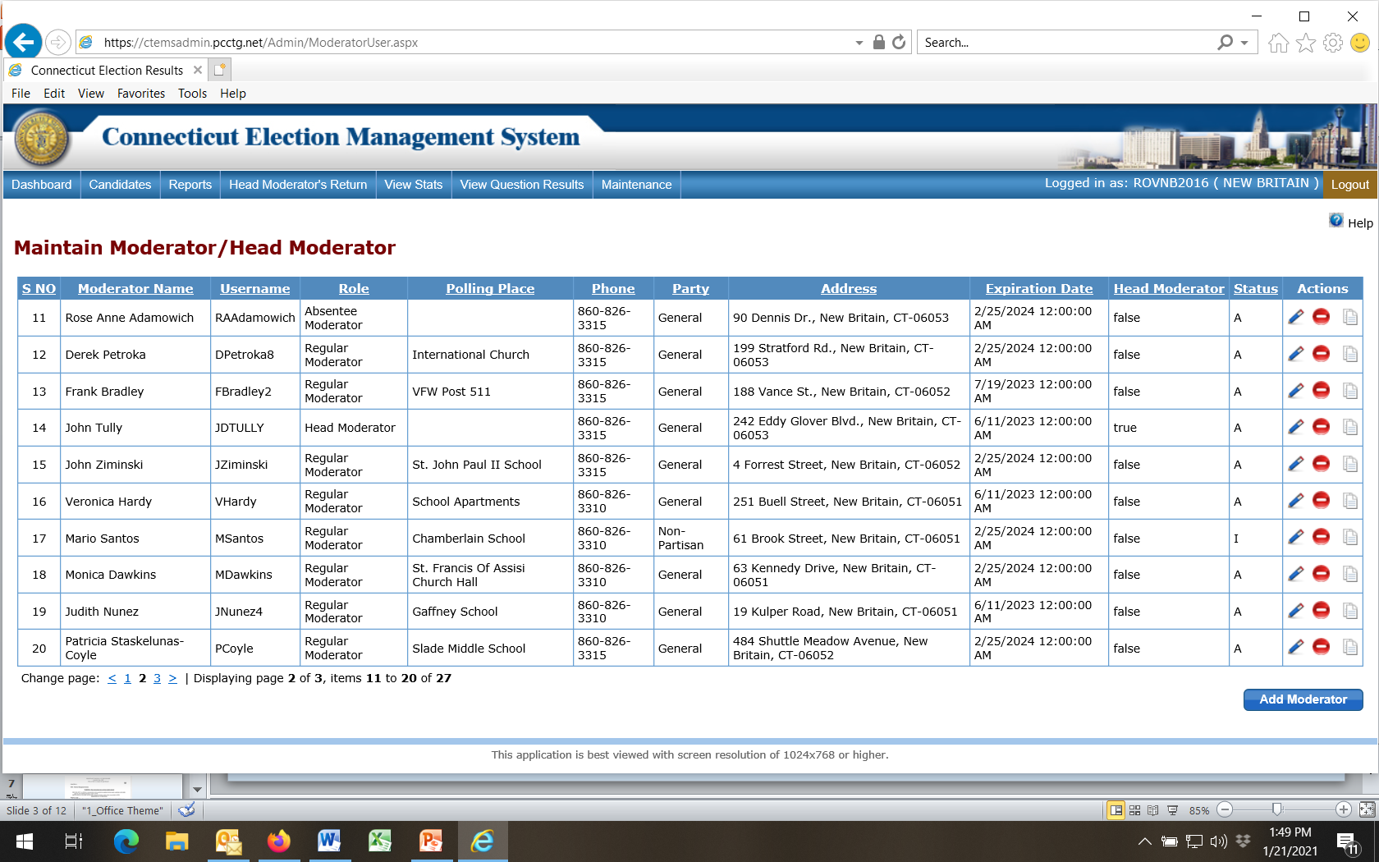

Slide 21
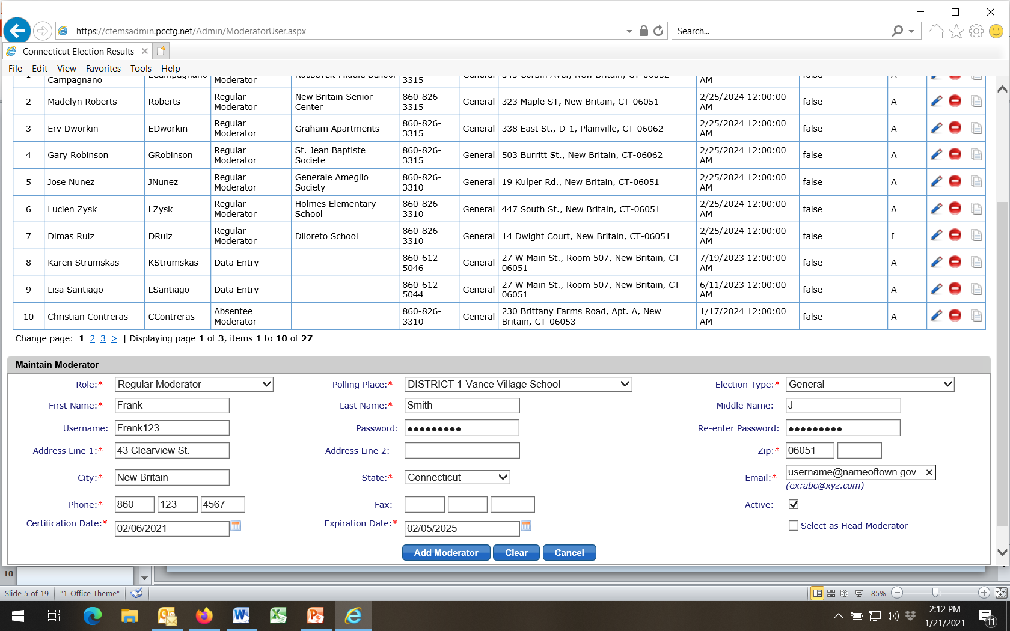
To Add Moderator
Fill in all info
Then

Slide 22
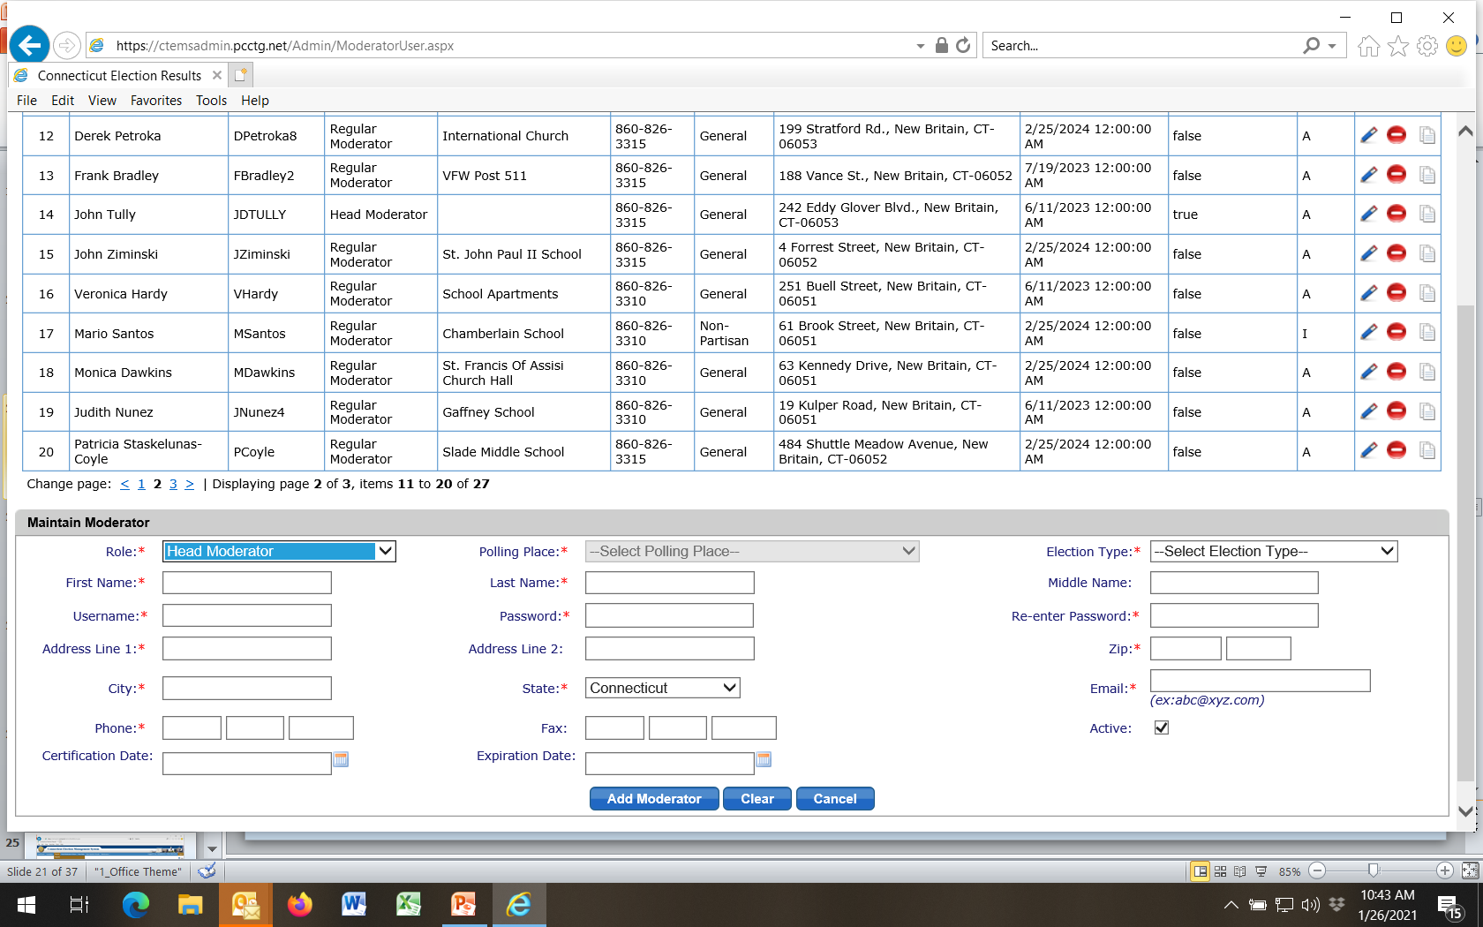
To Add Head Moderator
Fill in all info (note: polling place goes gray)
This fills automatically
Finalize

Slide 23
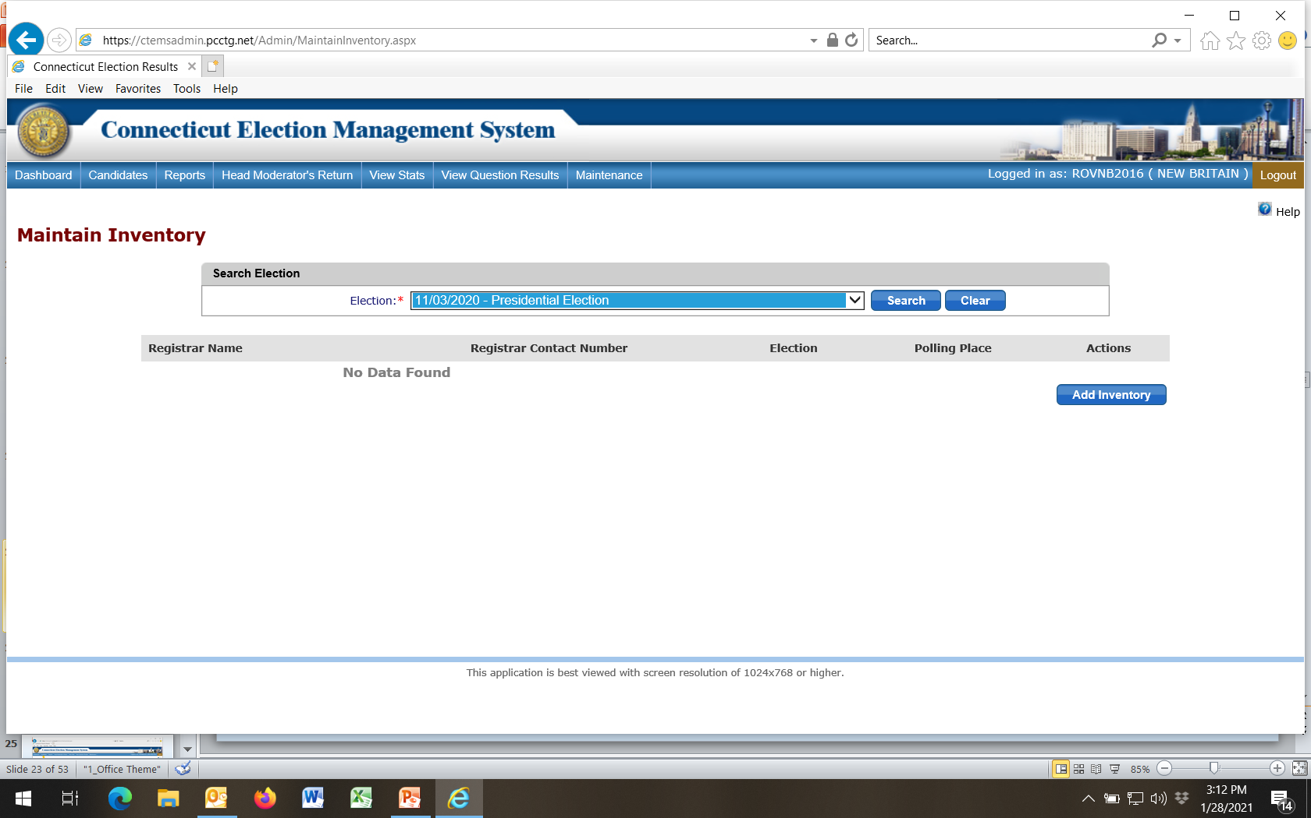
Select Election
Then

Slide 24
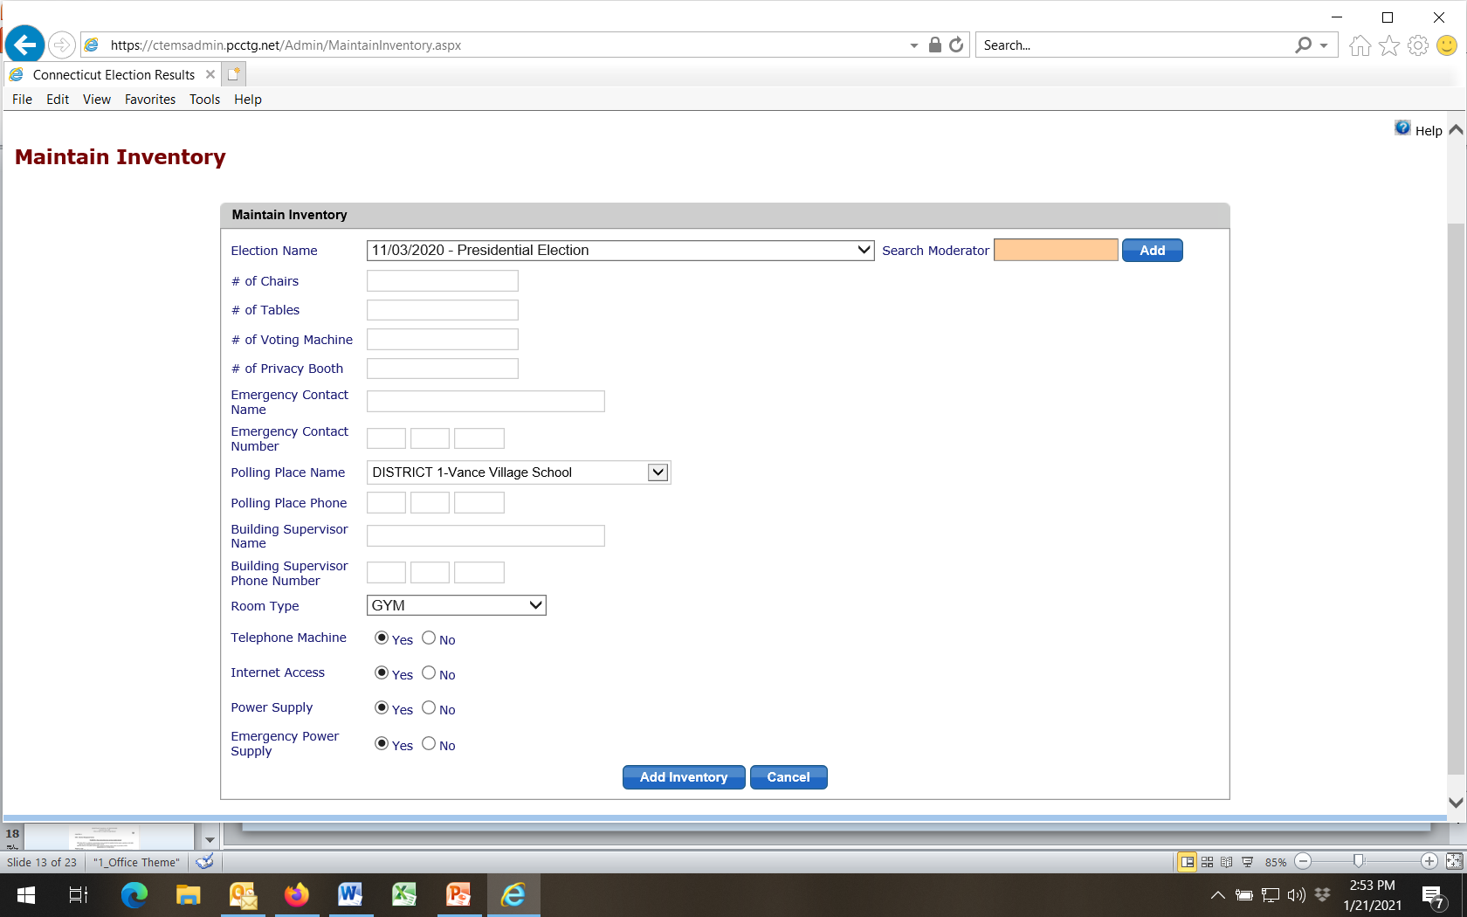
Fill in pertinent info:
Election Name
Polling Place Name
Room Type
Other (if desired)
Then

Slide 25
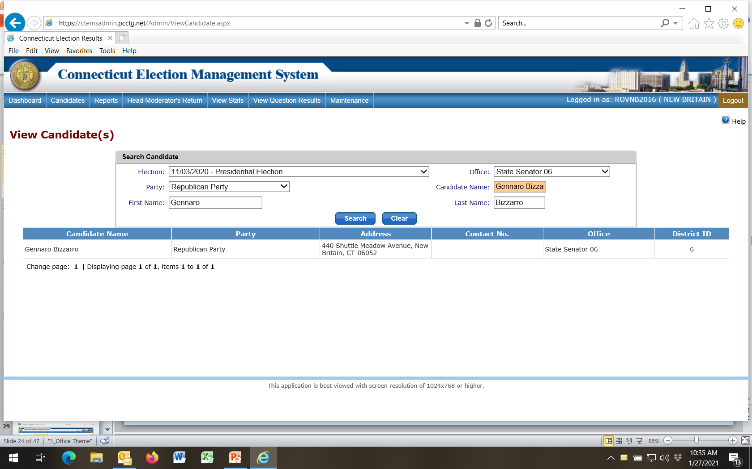
Select Election Type
SOTS populates candidates for state elections
Town Clerk populates candidates for local elections
Select Party
Select Office and type in candidate’s names
Search

Slide 26
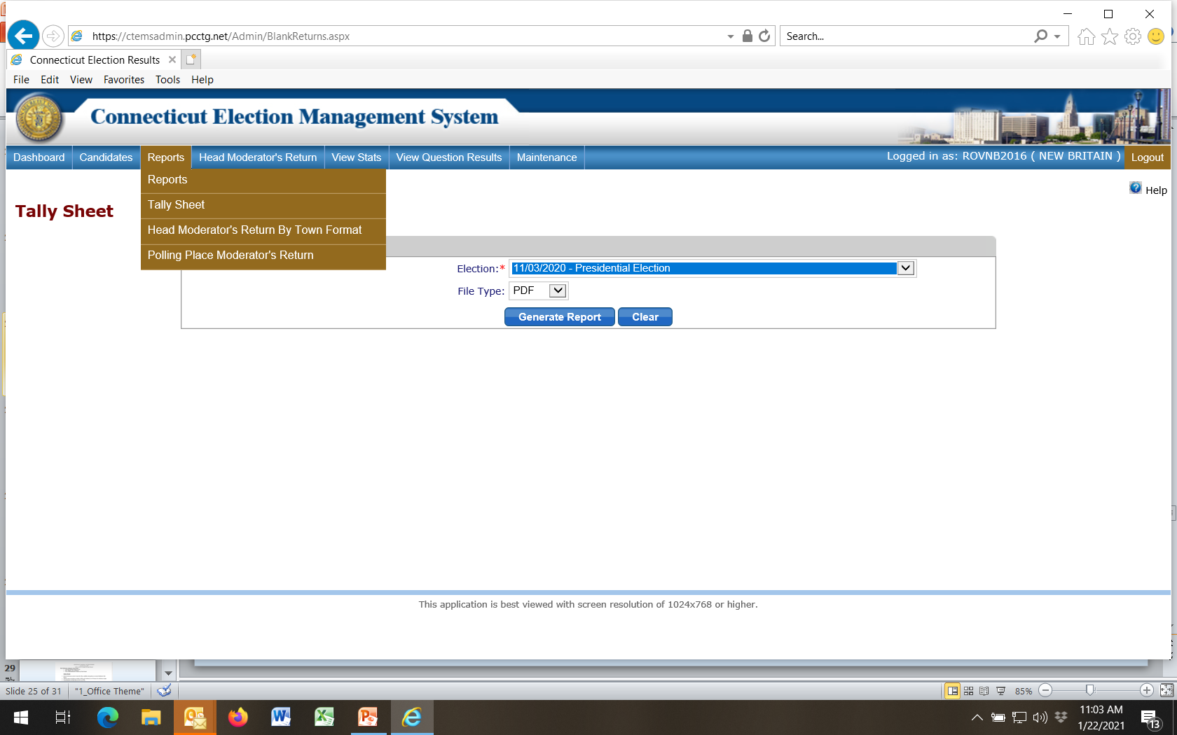
IMPORTANT!
Check Tally Sheet for all offices and candidate listings before election. Head Moderator must have information listed to enter results.

Slide 27
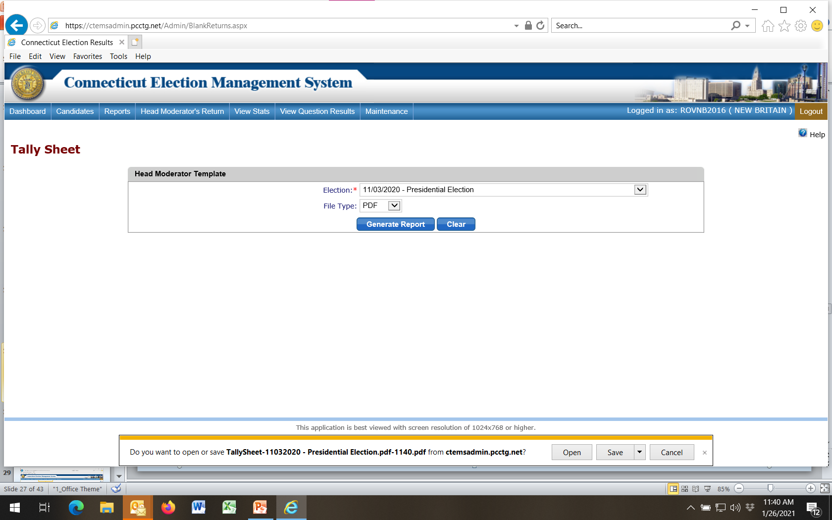
Select election
1
2
Generate Report
Open PDF File
3

Slide 28
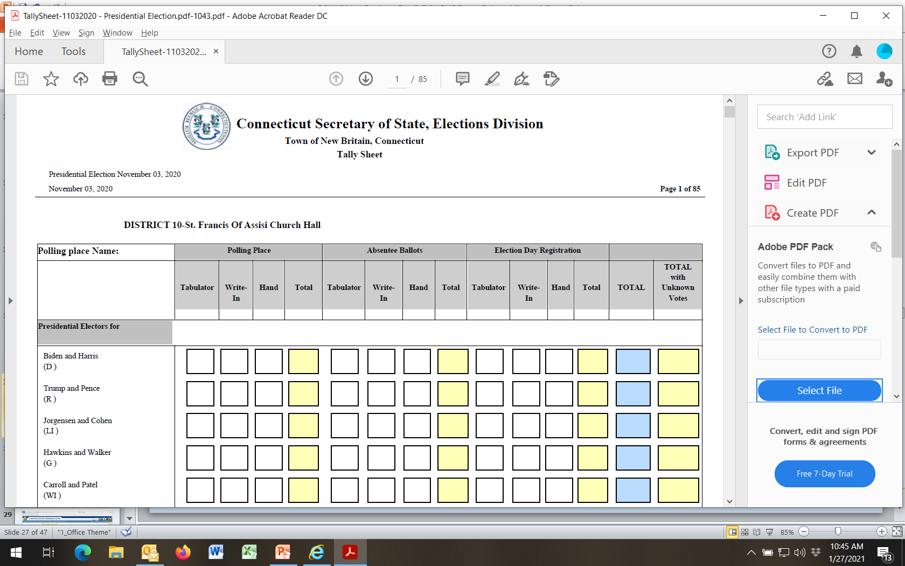
Should have many pages displaying all offices & candidates
You may want to print out a “blank” Tally Sheet for backup in case EMS goes down before / during election

Slide 29
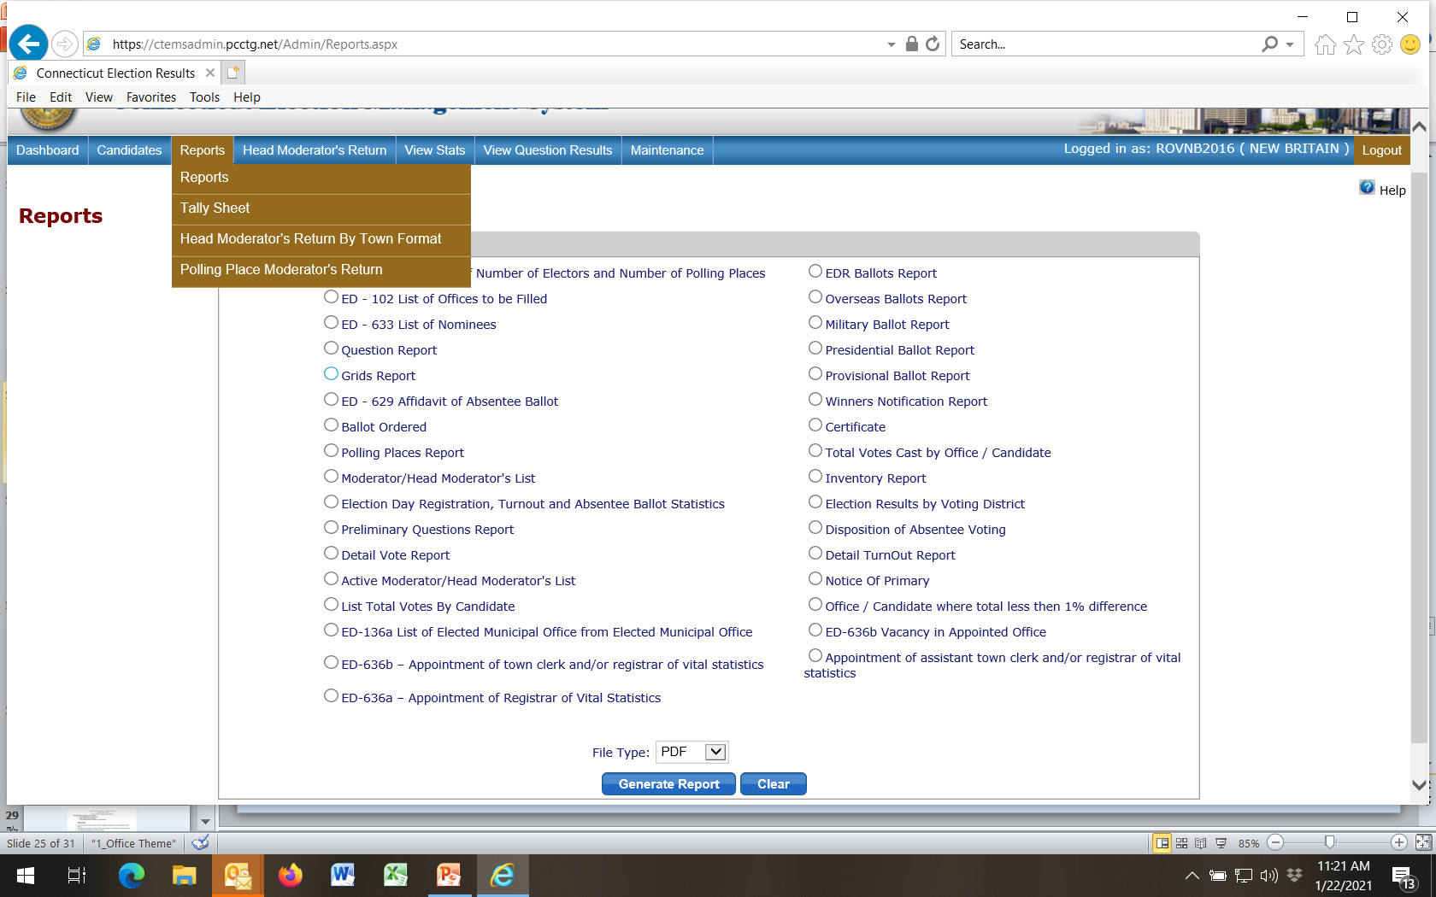
Select a report type
Then

Slide 30
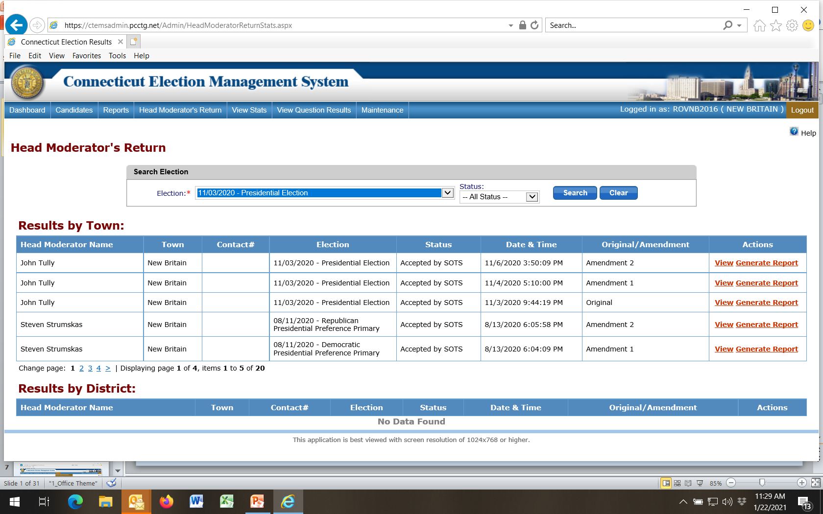
Note: Tabs for
* Head Moderator Return
* View Stats
* View Question Results
These are Post-Election Reports
Can be run by Registrars once all election data has been entered and finalized by Head Moderator

Slide 31
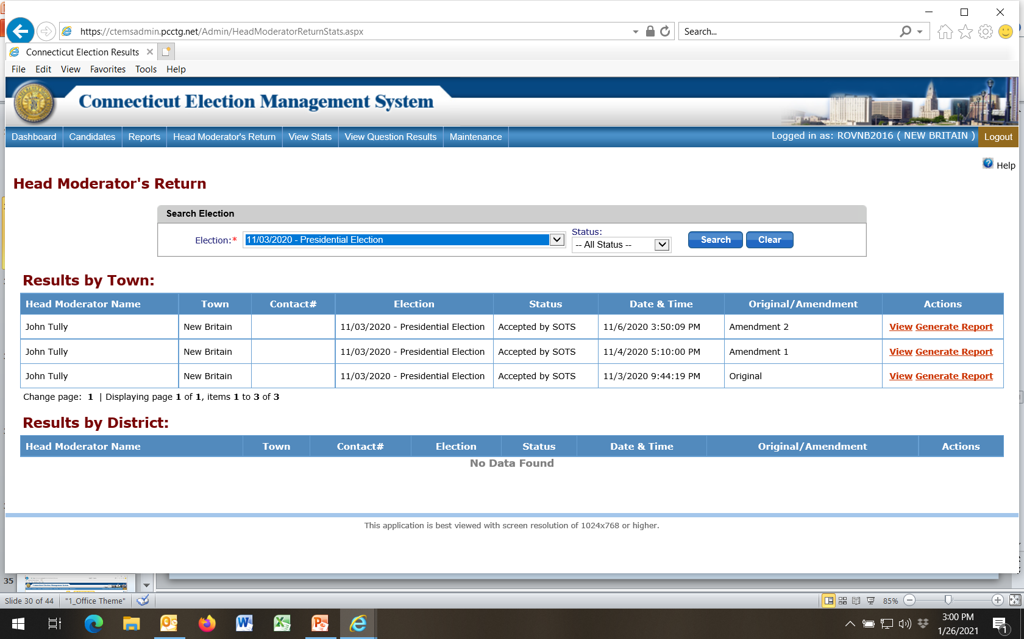
1
Select election
2
Select View
3

Slide 32
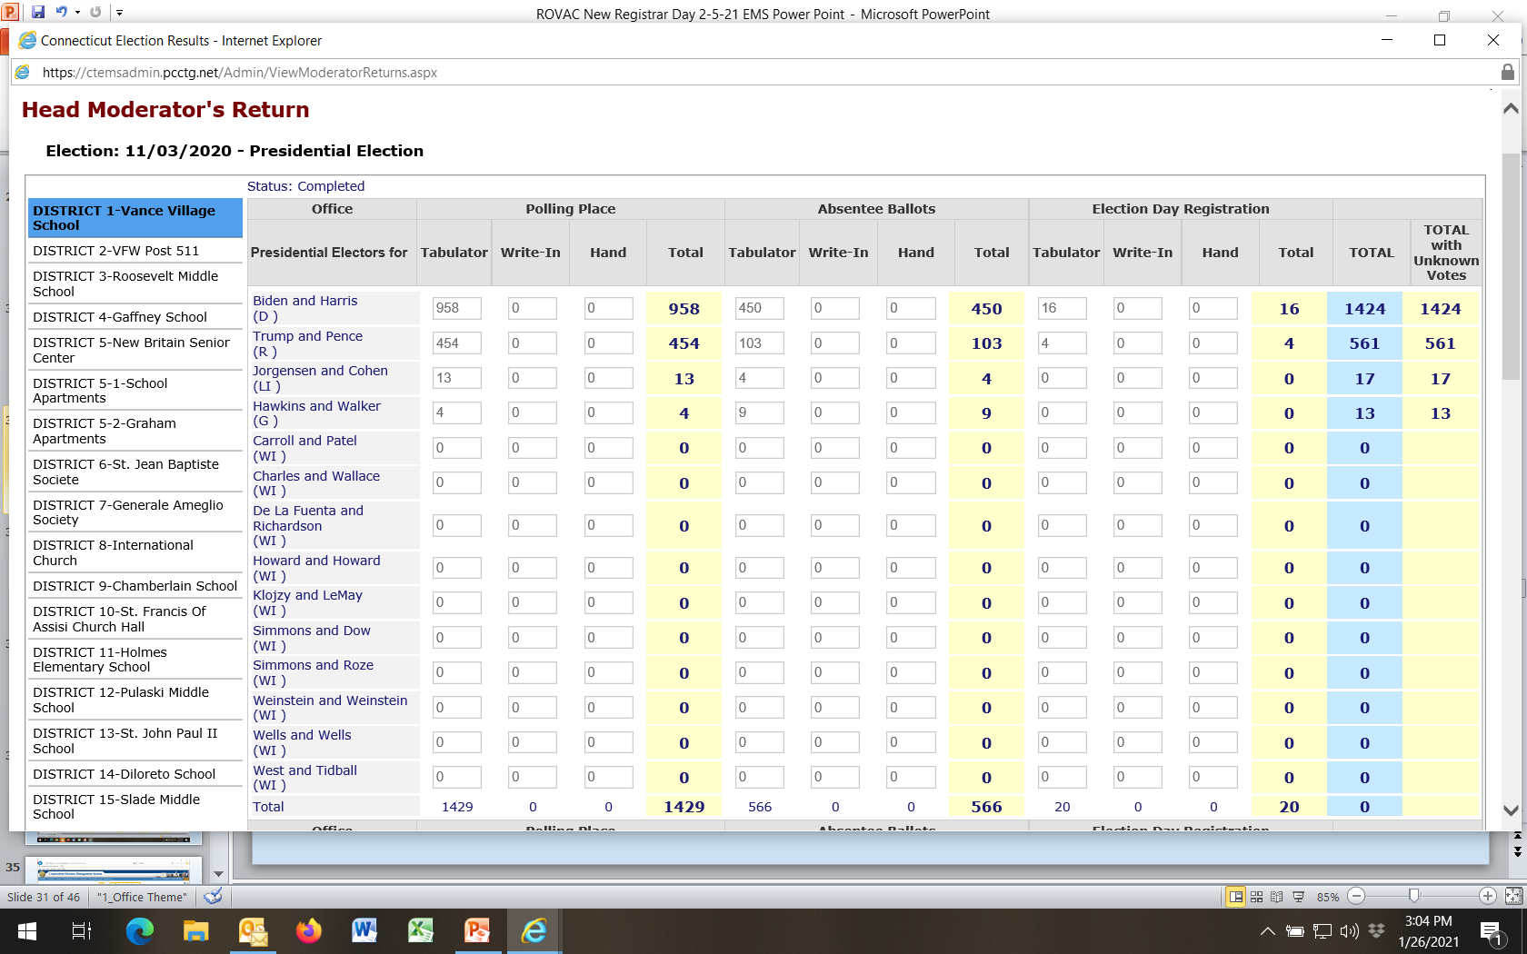
Summary of Tape Tallies from Voting Districts, Absentee Ballots and EDR Entered By Head Moderator

Slide 33
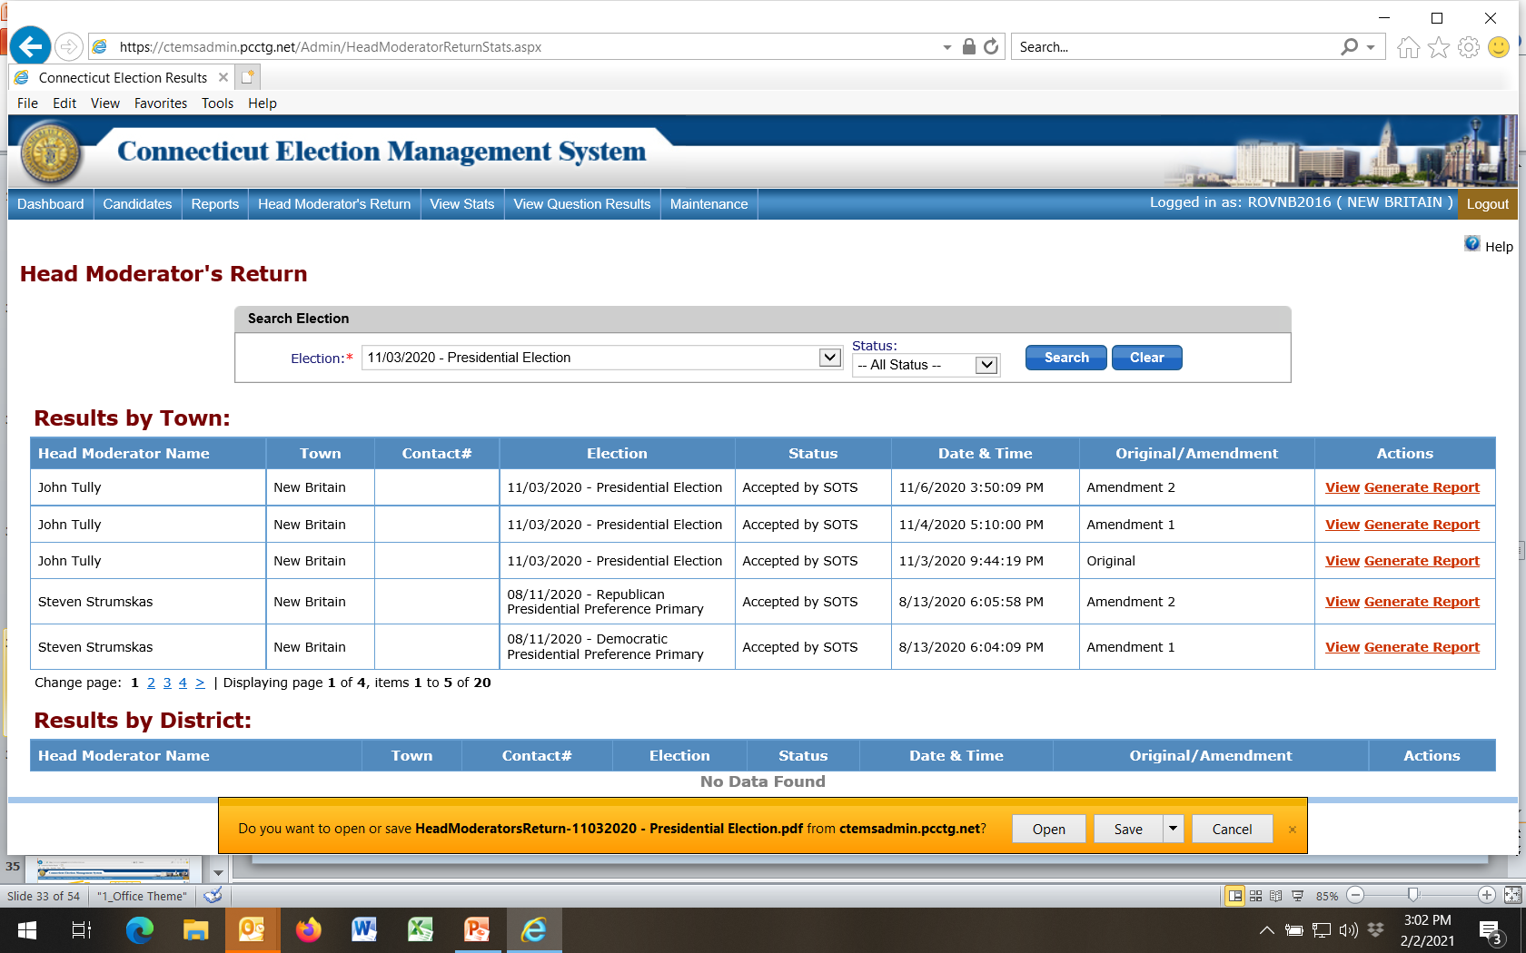
1
Select election
Generate Report
2
3
Open PDF File

Slide 34
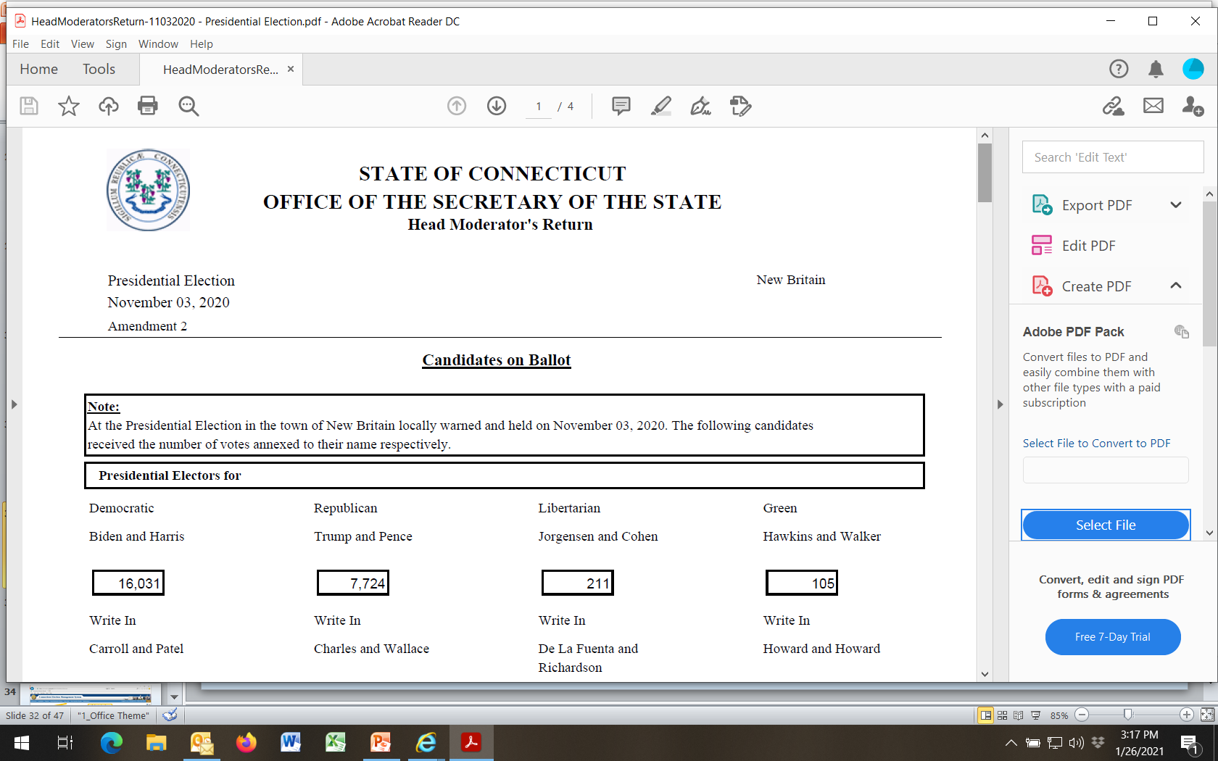

Slide 35
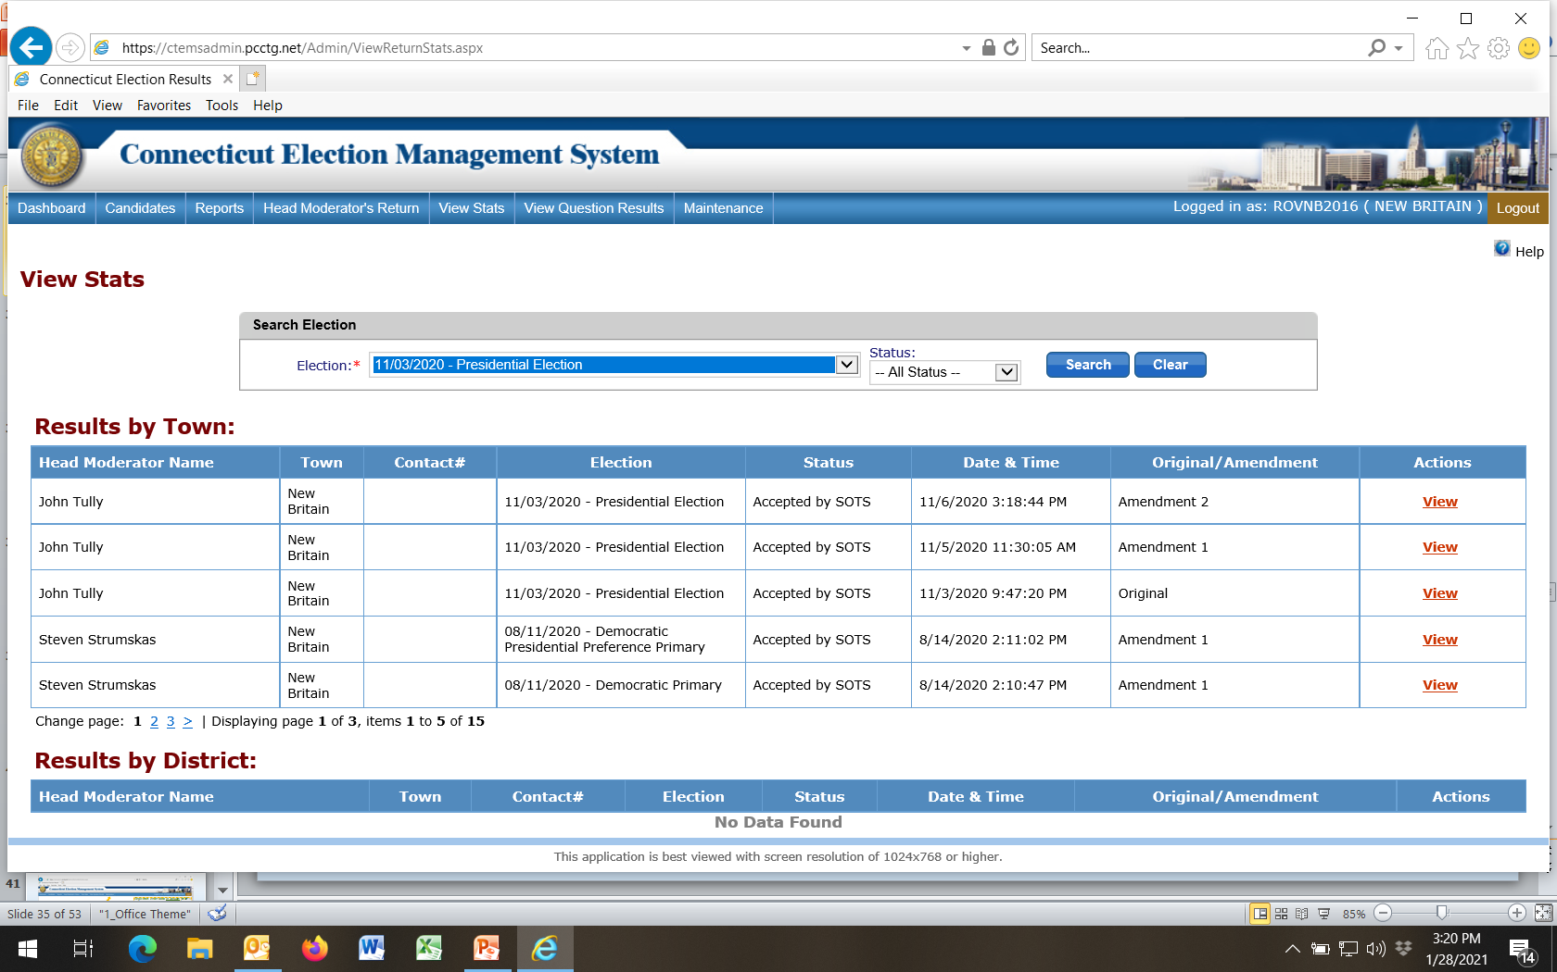
1
2
Select election
Select View
3

Slide 36
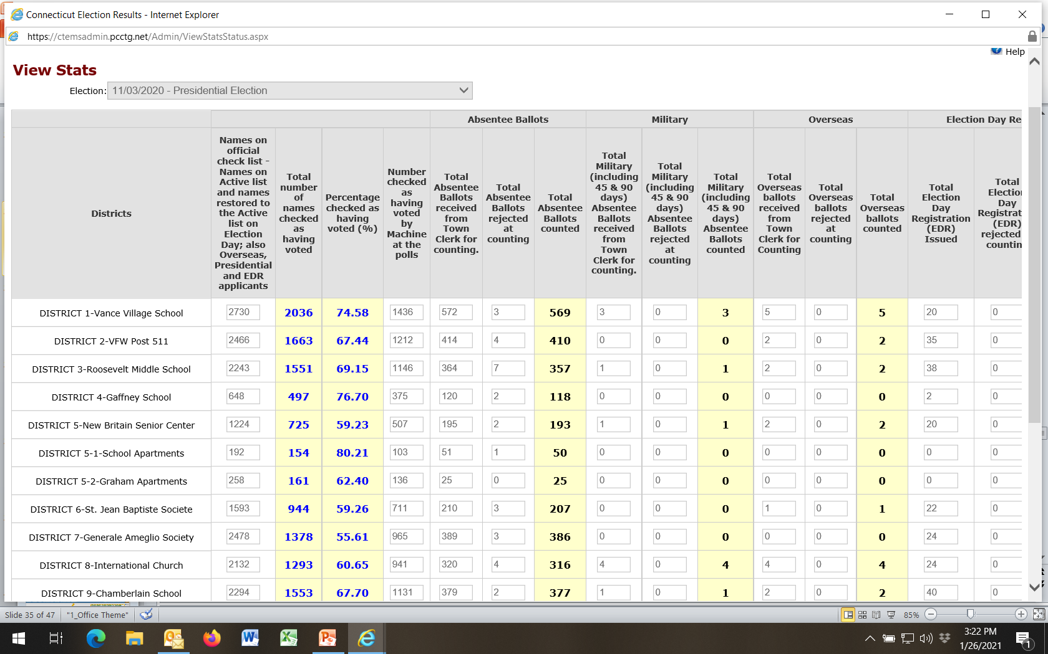
Summary of All Tabulator Tapes Plus Electors Voting & Eligible To Vote in Official Checker & Absentee Ballot Books Entered By Head Moderator

Slide 37
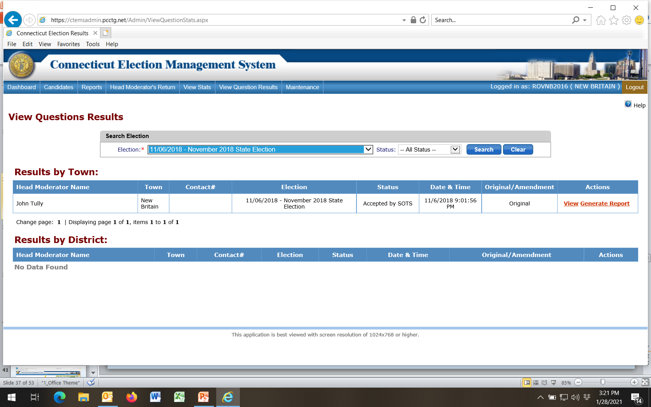
1
Select election
View Results
2

Slide 38
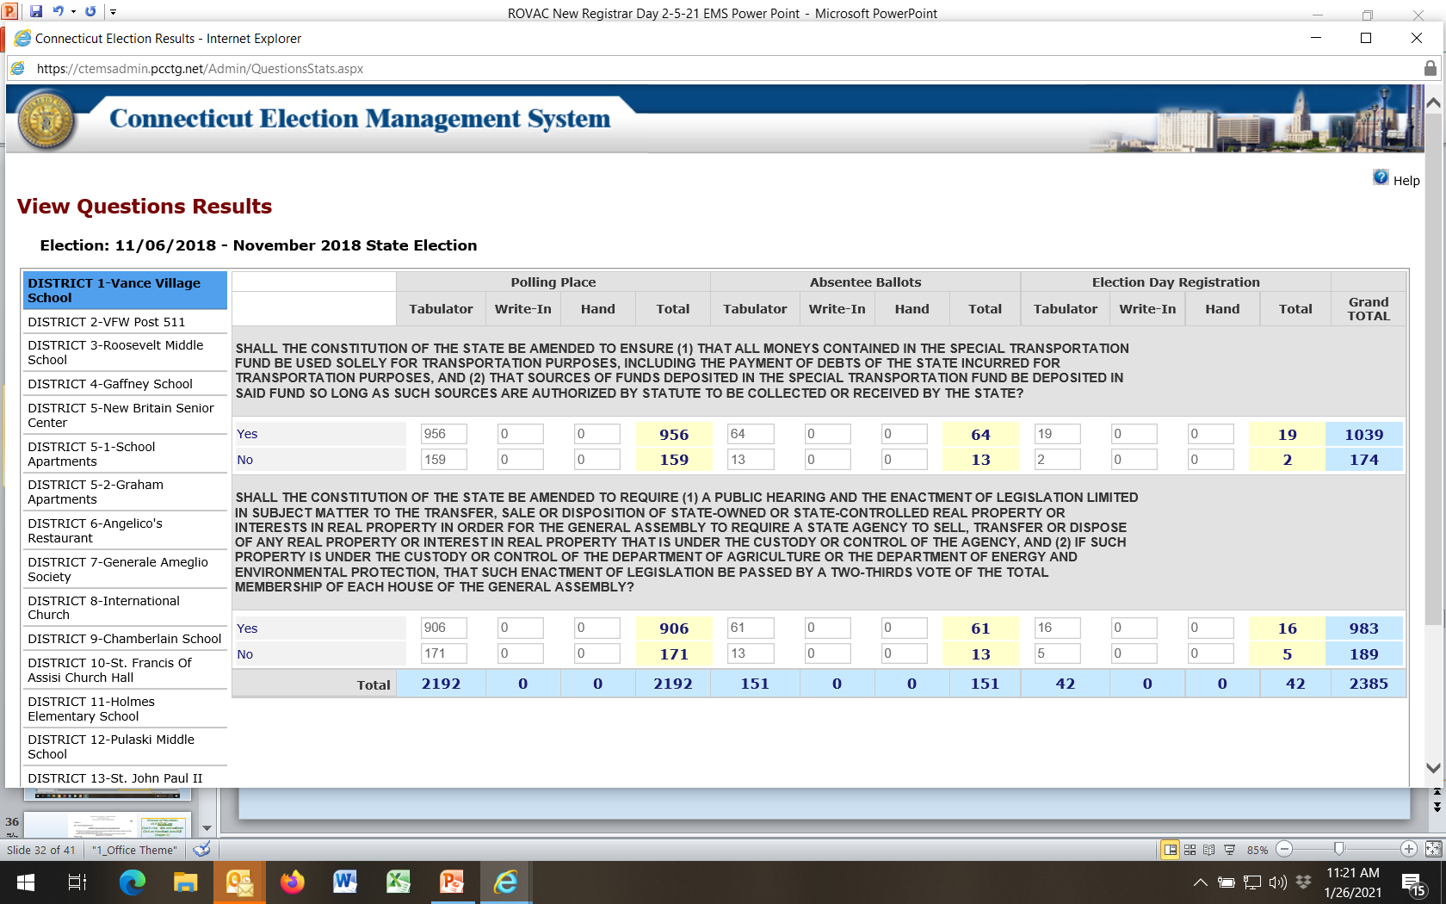
Summary of Tape Tallies from Voting Districts, Absentee Ballots and EDR Entered By Head Moderator

Slide 39
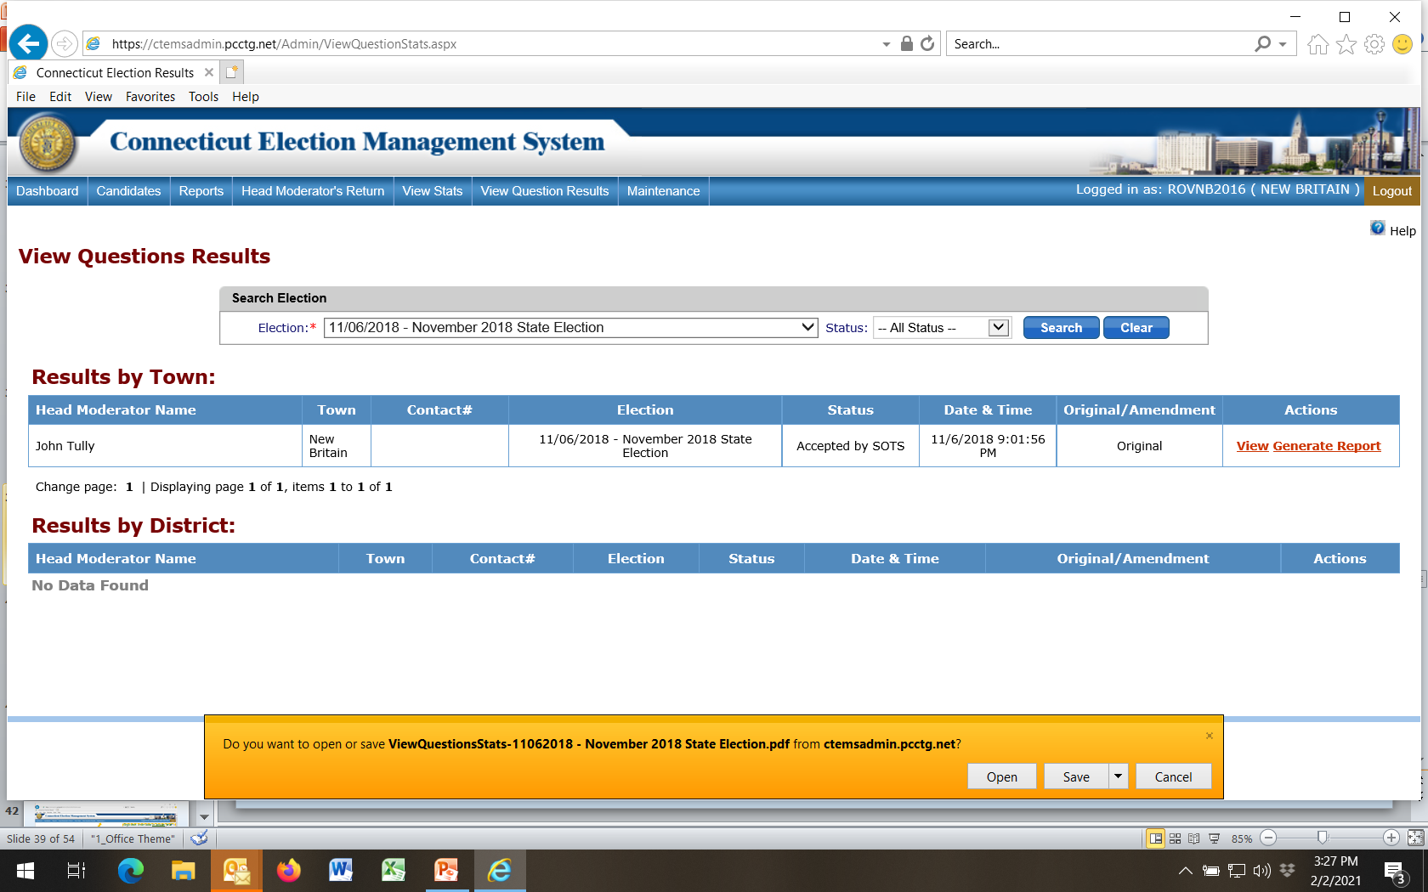
1
Select election
Generate Report
2
Open PDF File
3

Slide 40
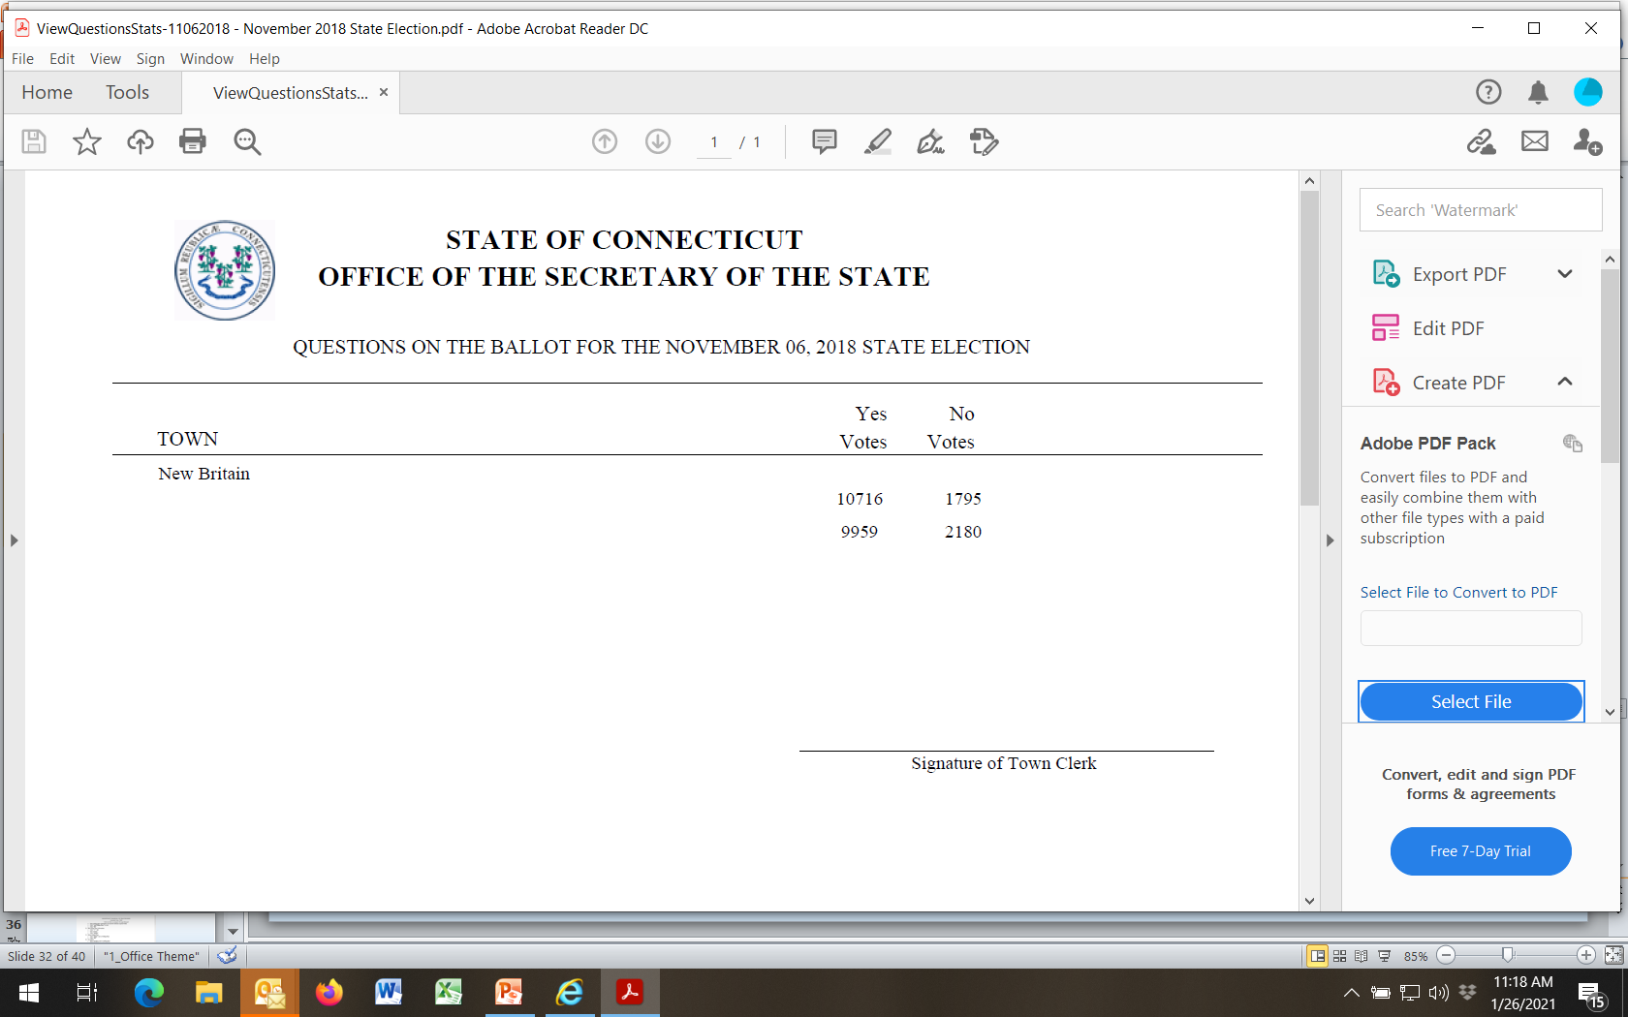

Slide 41
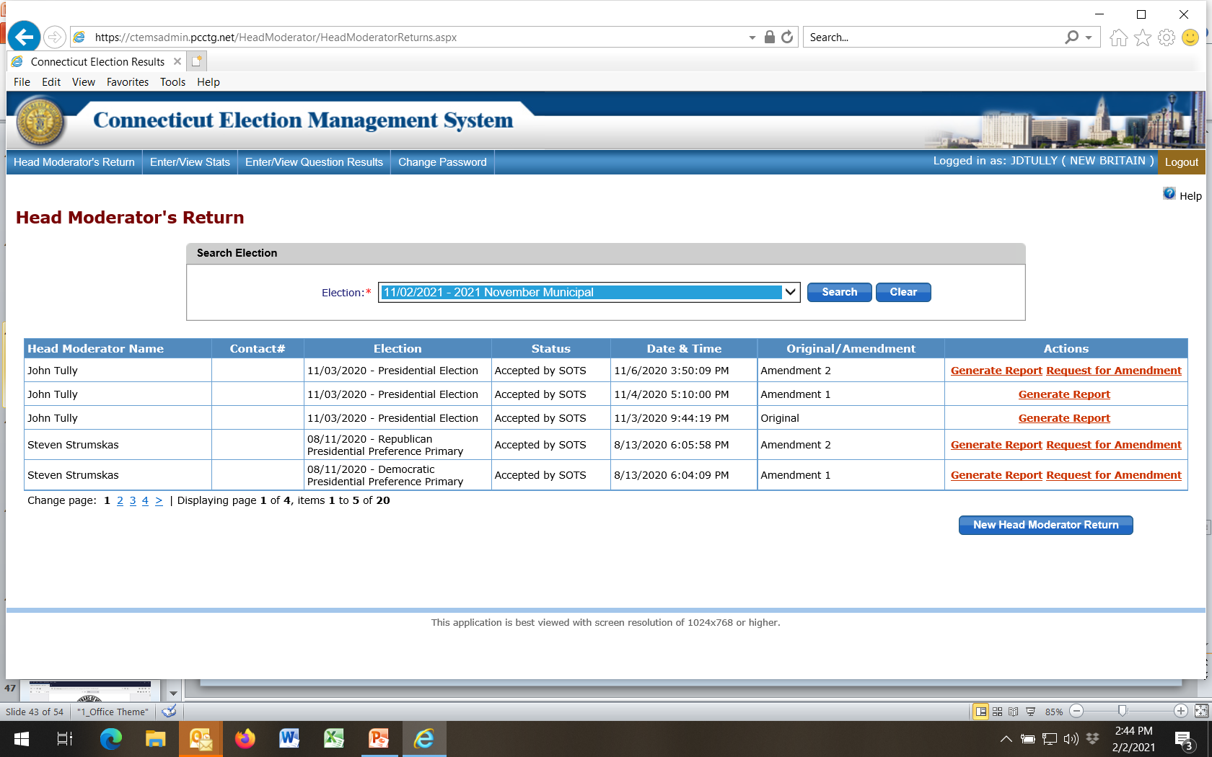
REMINDER!
Head Moderator should NOT login until ready to enter results as Election begins immediately!
DO NOT CLICK HERE UNTIL POLLS CLOSE AND RESULTS COME IN FROM VOTING DISTRICTS, ABSENTEE BALLOT COUNTING AND EDR

Slide 42
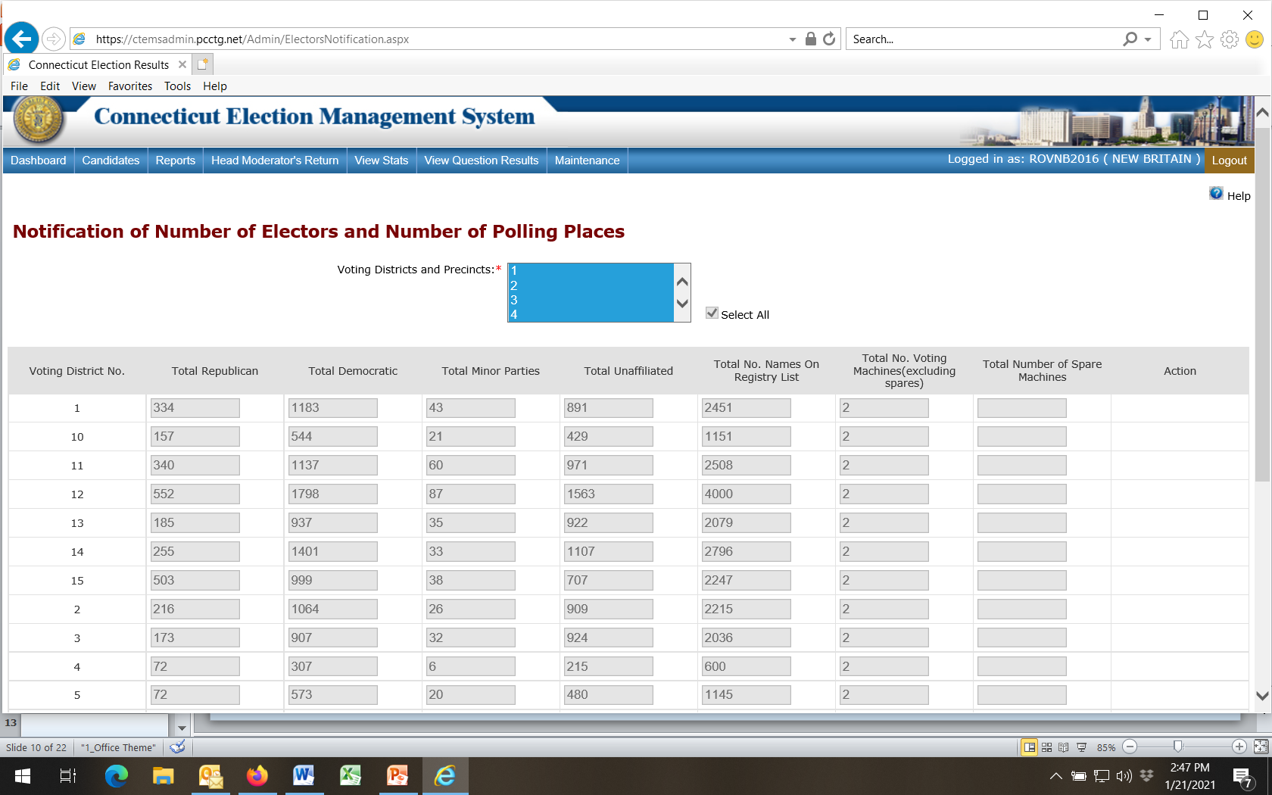
Registrars enter data in January for all voting districts and number of tabulators. Town Clerk uses this information for the ED626 report they file with SOTS in February of each year.

Slide 43
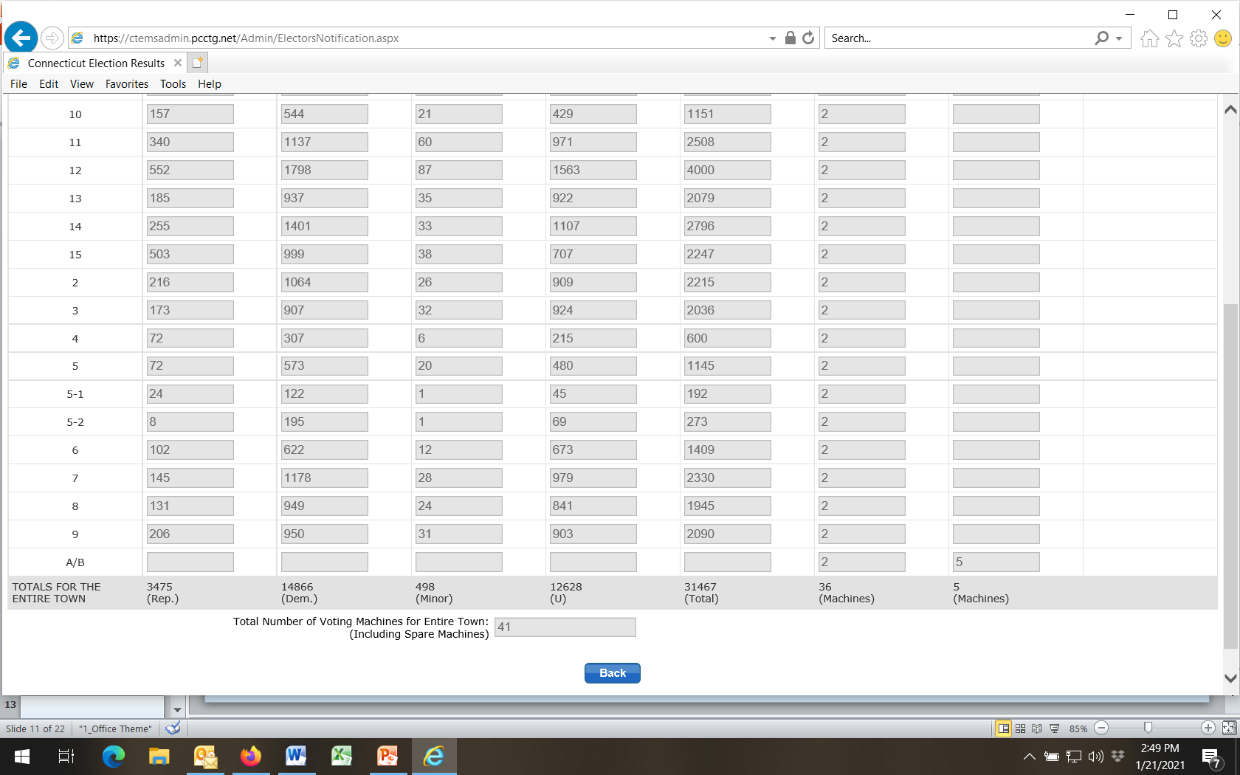
Registrars enter data in January for all voting districts and number of tabulators. Town Clerk uses this information for the ED626 report they file with SOTS in February of each year.
Be sure to enter total
number of tabulators

Slide 44
Manual of Procedures
visit ROVAC.org
** Step-By-Step Instructions **
1) Quick Link On Left - Click on Handbook
2) Click on Handbook January 2021
3) Chapter 11 – EMS Election Management System
- - - - - - - - - - - - - - -- - - - - - - - - - - - - - - - - - - - - - - - -
Outlines data entry steps in greater detail!
(note: be sure to follow Order of Initialization steps as shown earlier in this presentation, not the order shown in Handbook)

Slide 45
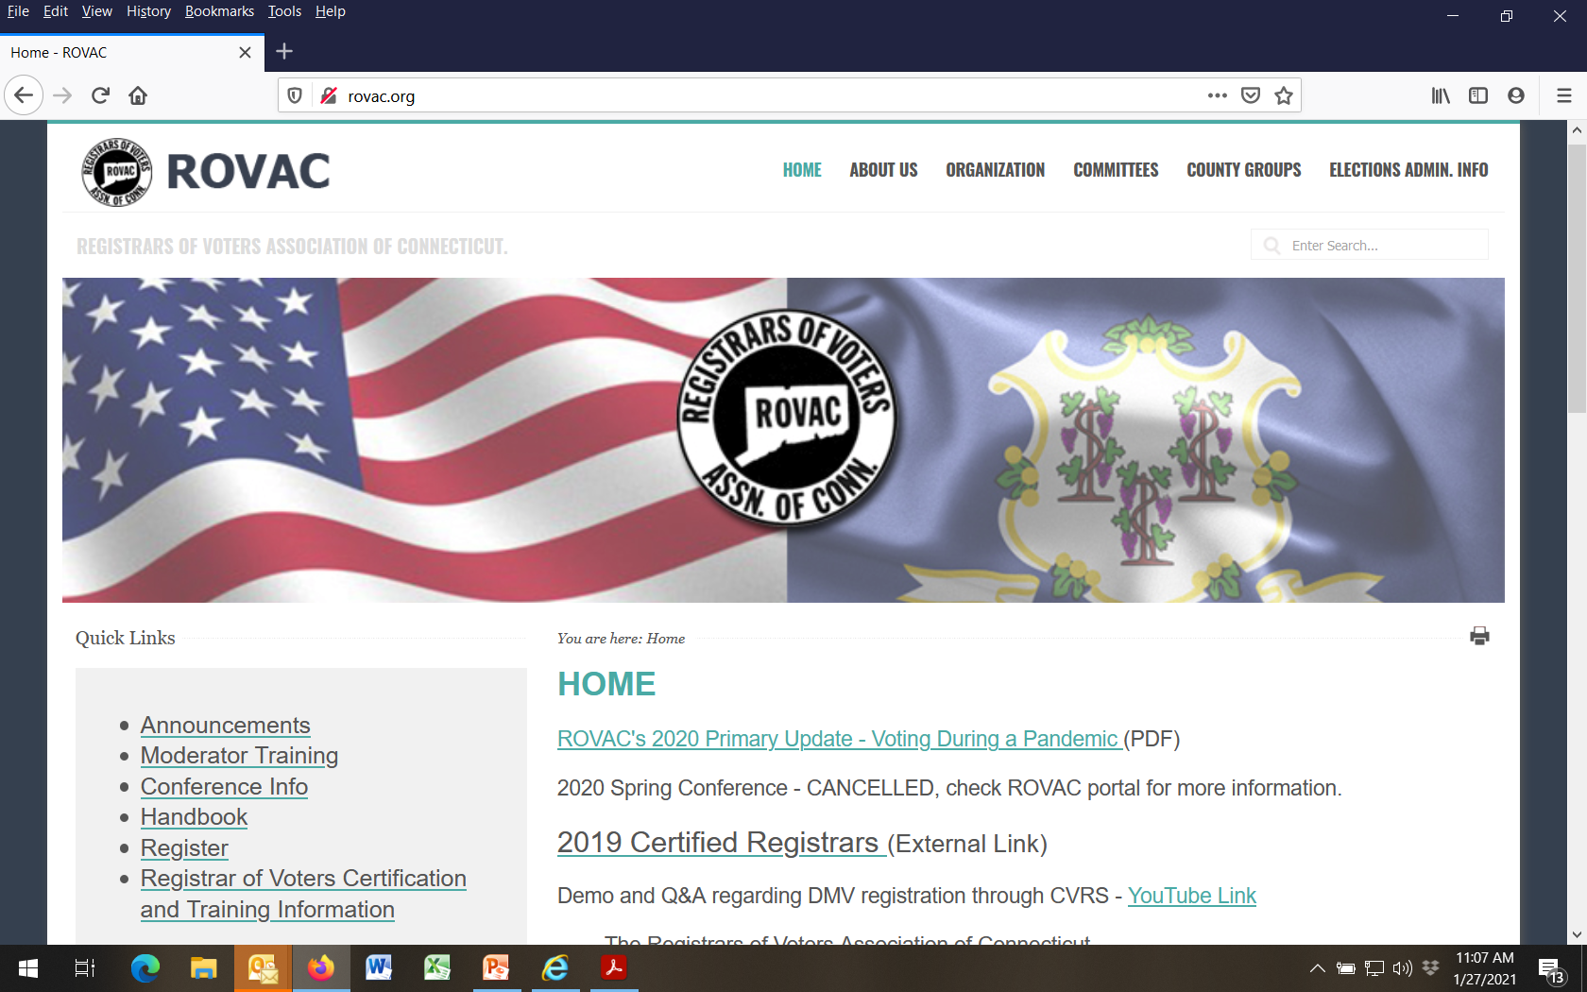
Type rovac.org into your web browser and hit Enter
1

Slide 46
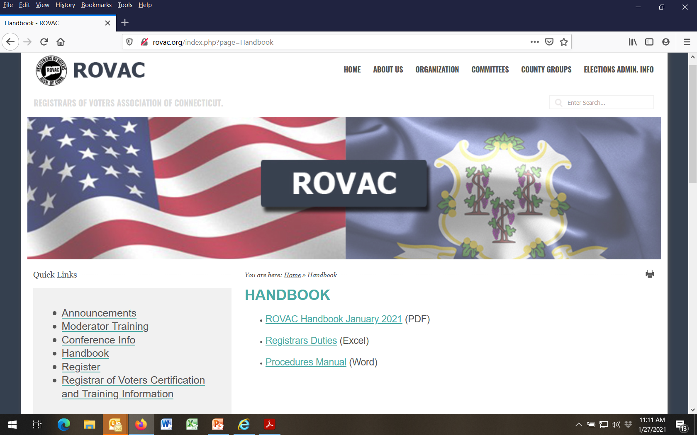
2

Slide 47
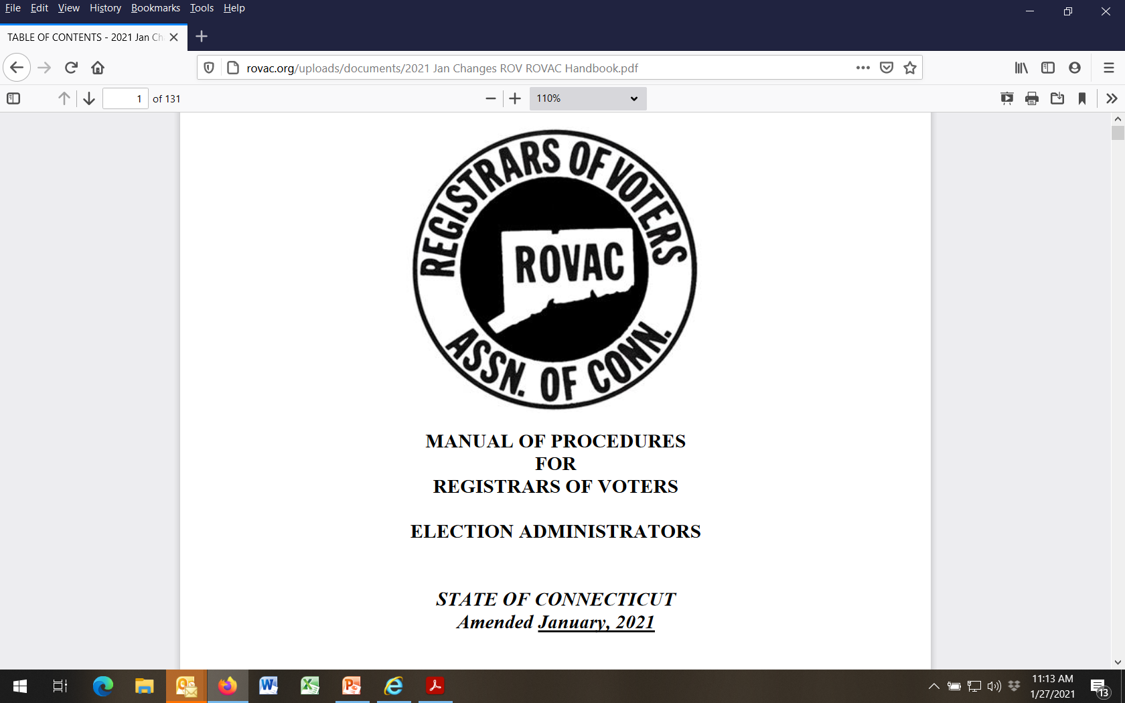

Slide 48
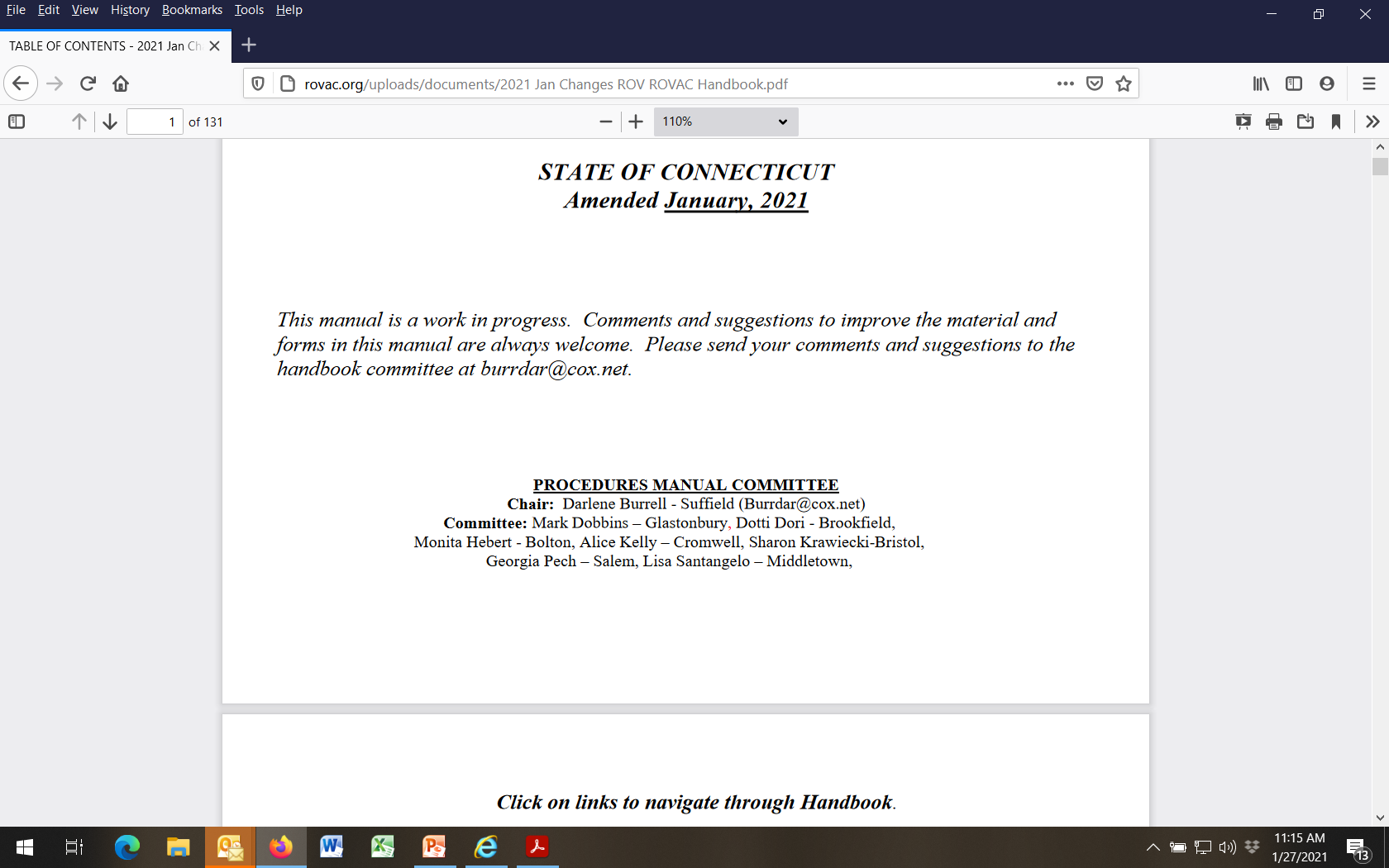
Many thanks to these current Registrars (and others past not listed) who, over the better part of two decades, have persistently devoted their time and talent to develop this “how-to” roadmap for the benefit of our members and profession.
Well Done!

Slide 49
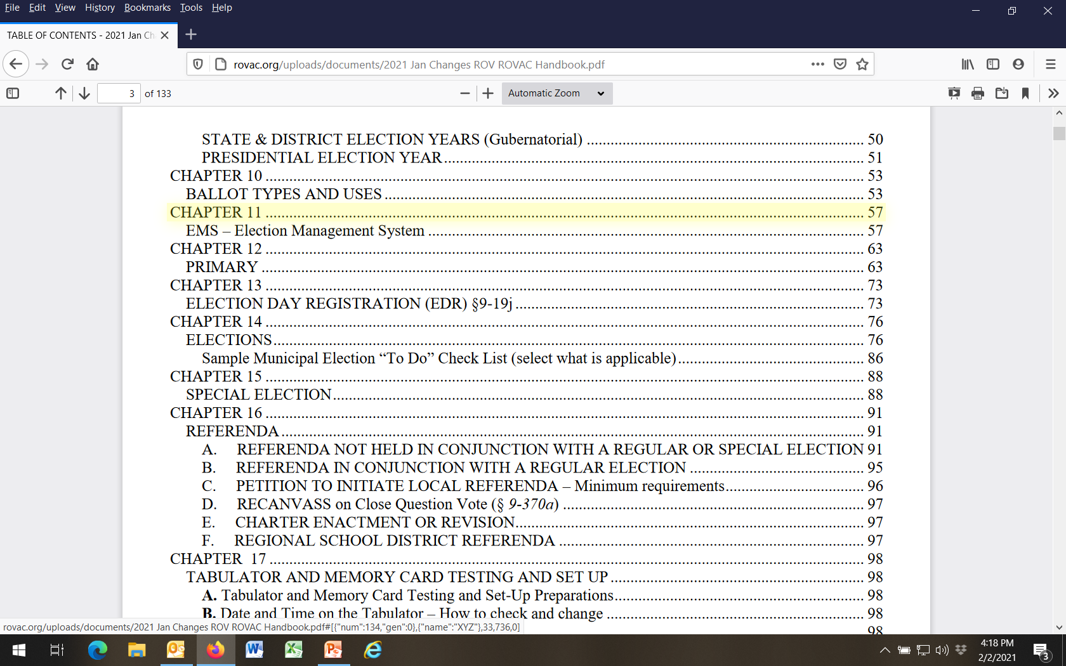

Slide 50
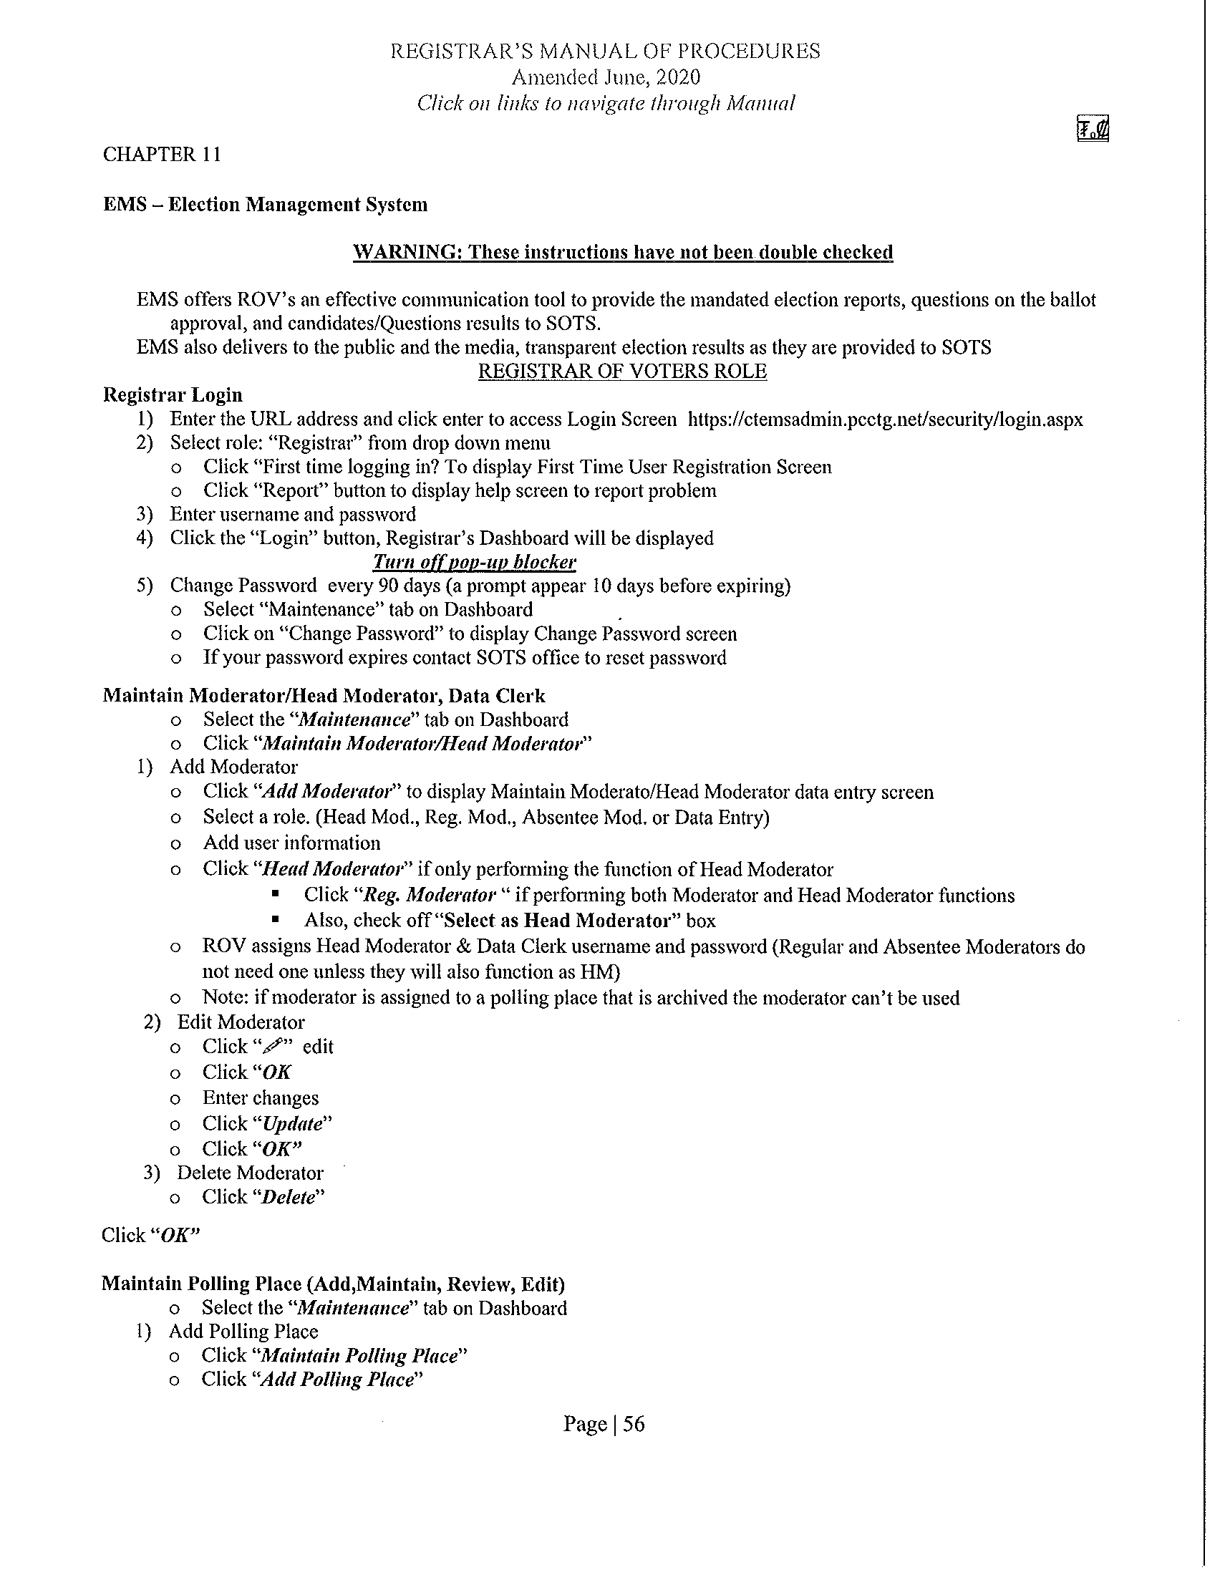

Slide 51
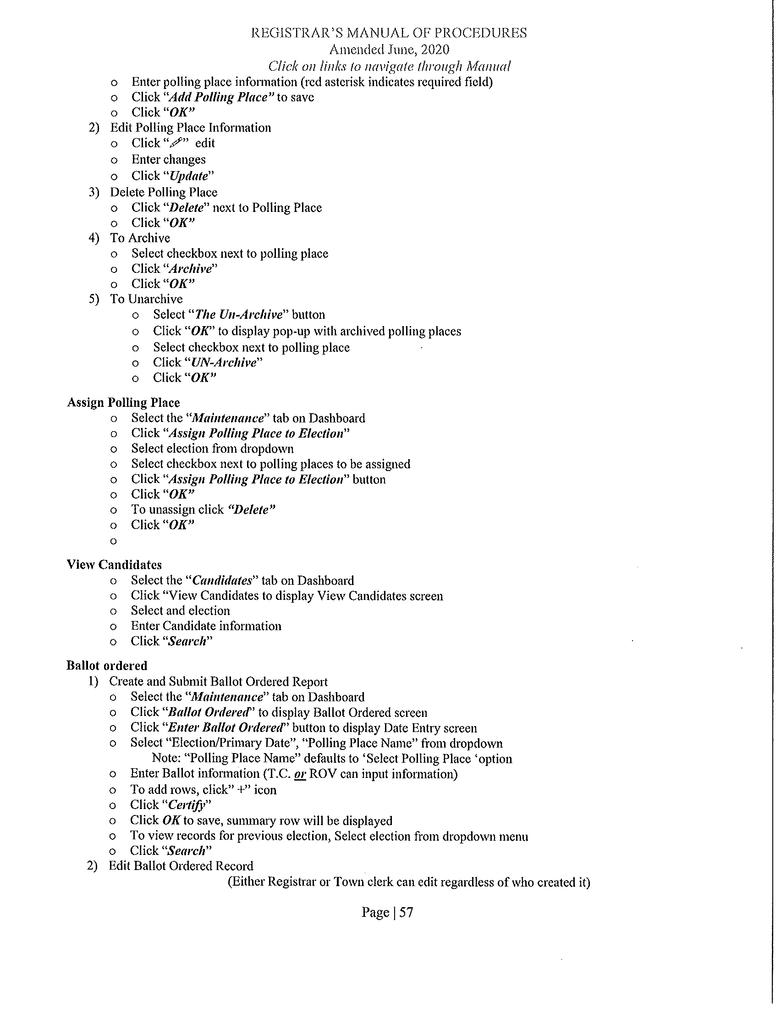

Slide 52
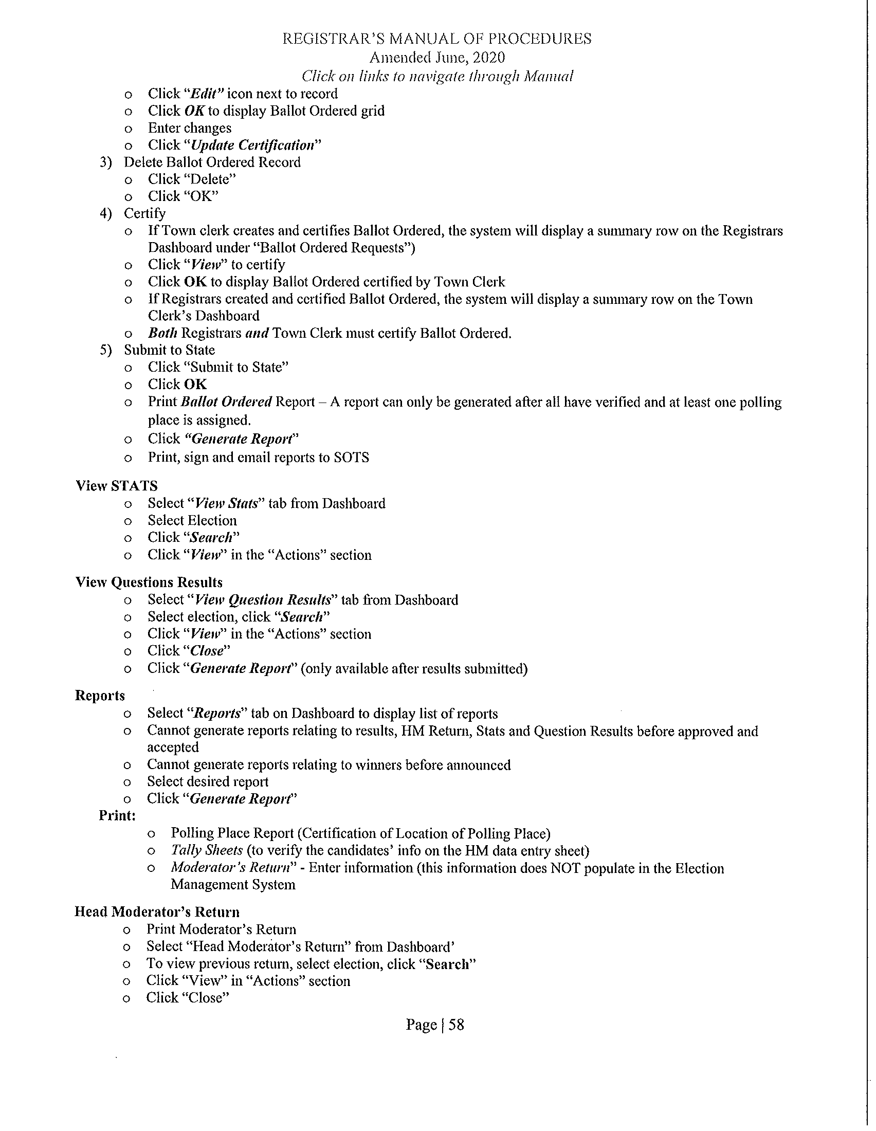

Slide 53
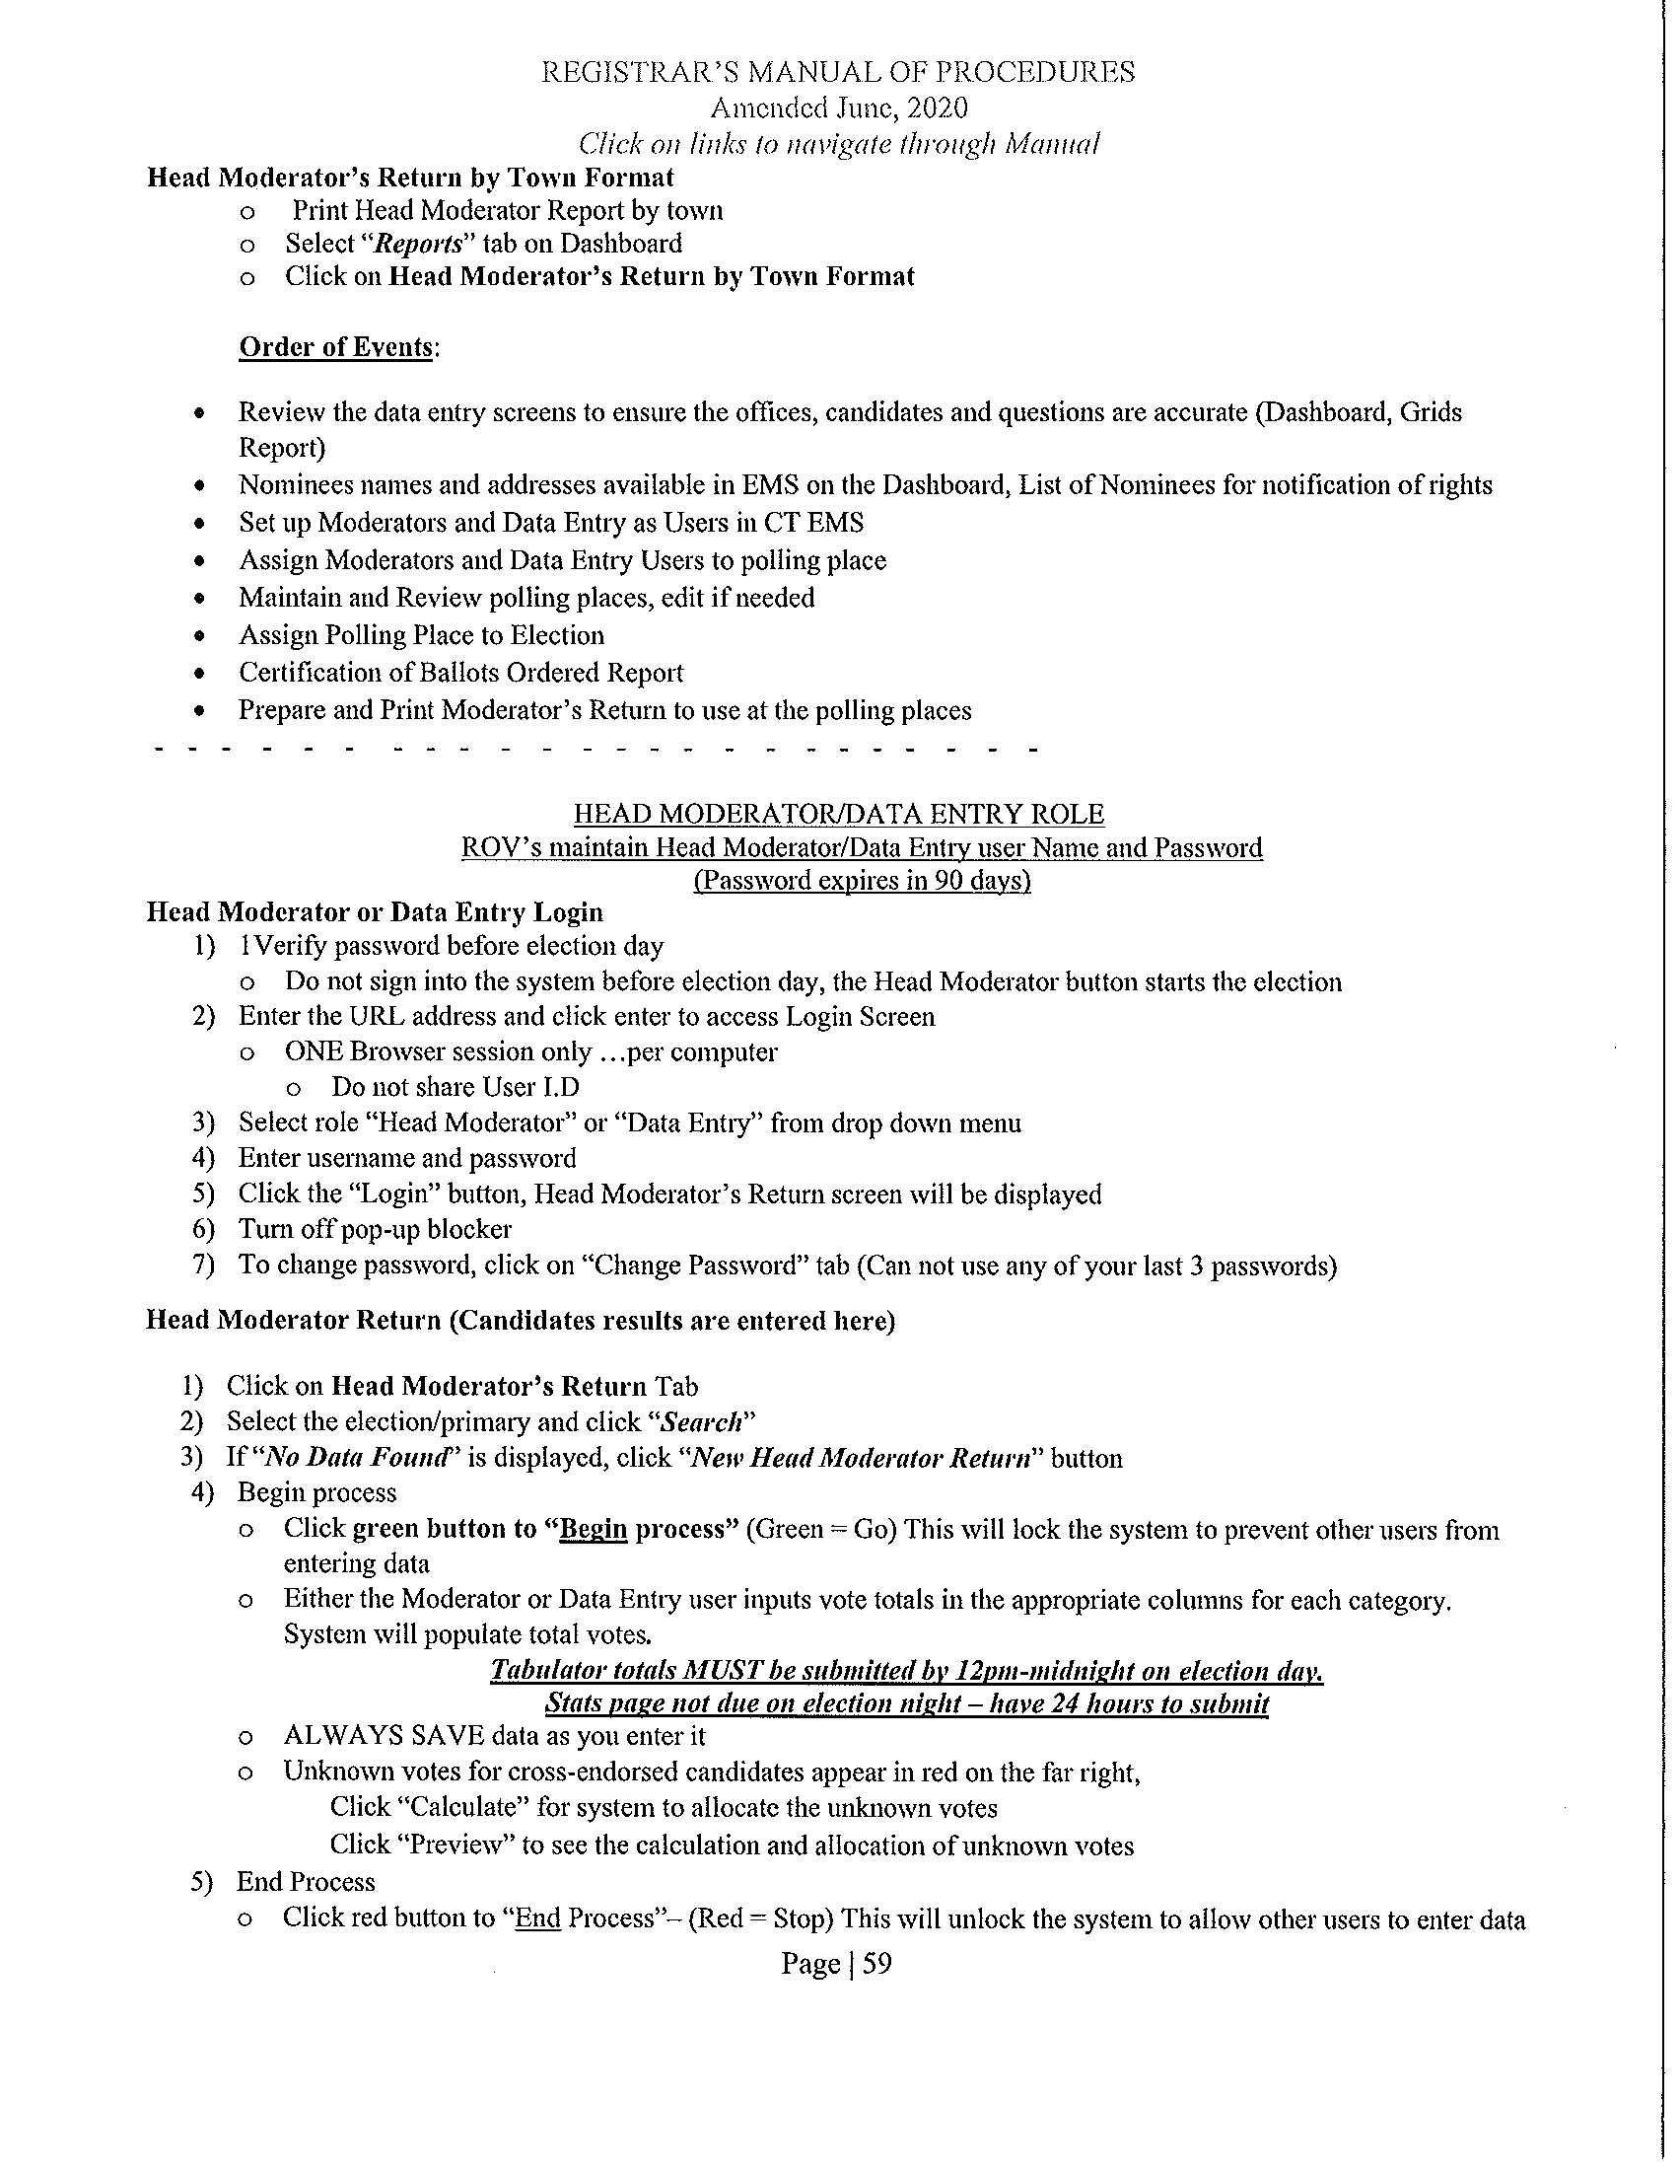

Slide 54
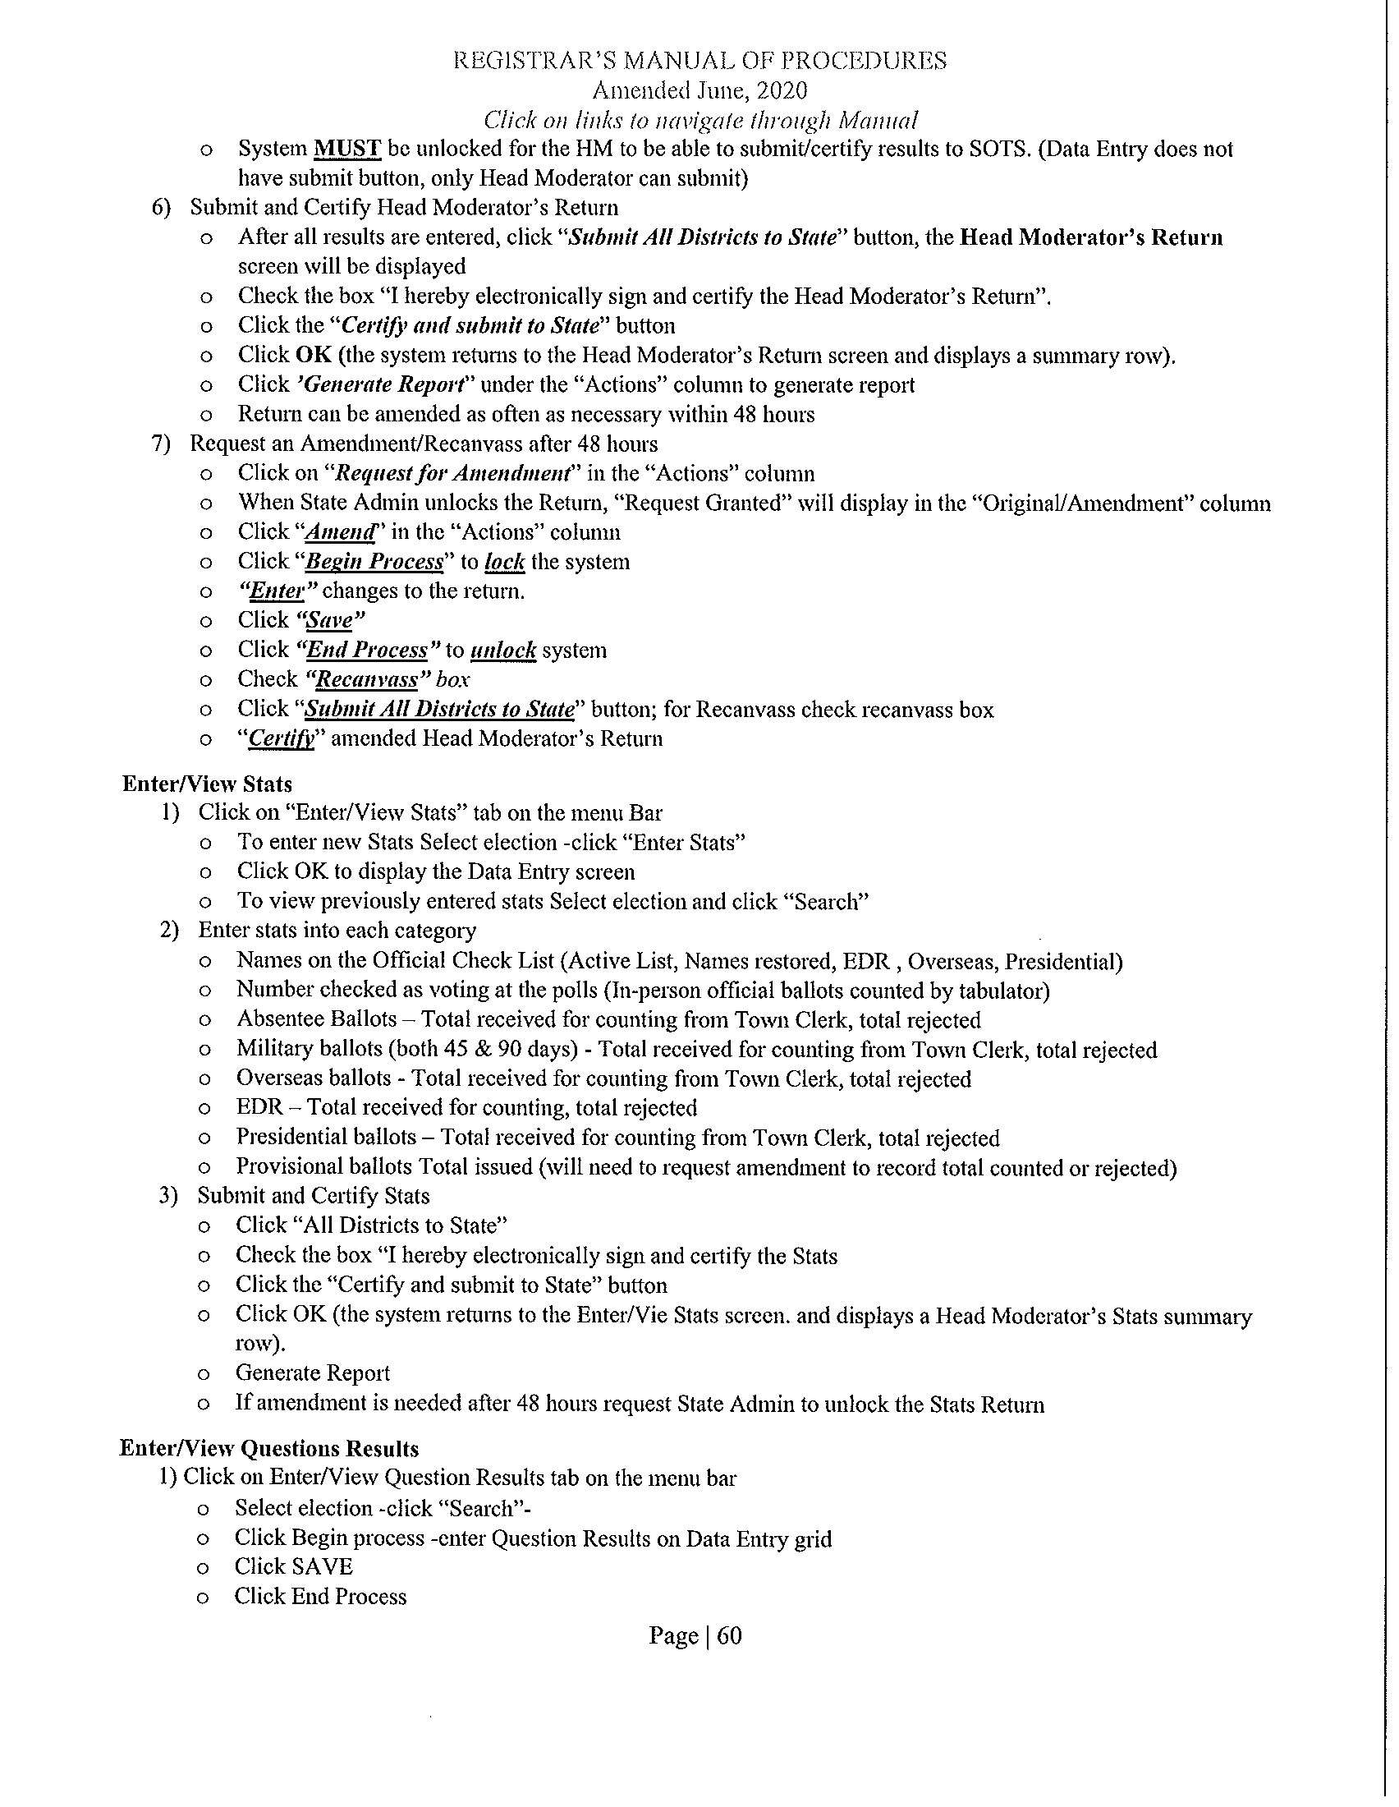

Slide 55
