Slide 1
Committee: Darlene Burrell, Mark Dobbins, Dotti Dori, Monita Hebert, Alice Kelly, Sharon Krawiecki, Georgia Pech & Lisa Santangelo

Slide 2
COMPANION GUIDE to:
CT General Statutes
Public Acts
Regulations
SOTS Guidelines
Best Practices
Handbook Puts Them Together Per Task
Pg 2 - 3

Slide 3
ON-LINE USE RECOMMENDED
Easy Navigation Through Manual
Links to:
To & From Chapters and Table of Contents
References
Statutes (§9-6)
Regulations (Reg. 9-5a)
Public Acts (PA393)
SOTS Manuals & Guides
HAVA

Slide 4
PRINCIPLES & PLEDGE
Principles of Election / Registration Officials
Standards of Conduct for Elections / Registration Officials
My Personal Pledge to Freedom, Democracy & My Profession:
Pg 4

Slide 5
REGISTRAR’S RESPONSIBILITIES
Governed by CT General Statutes
Paid by Municipality
Work Closely with Office of SOTS
Endorsed by Political Party
Politics Does Not Belong in ROV’s Office.
Ensure Fair & Equitable Implementation of all Laws.
Ch1, Pg 5

Slide 6
LIST OF REGISTRAR’S RESPONSIBILITIES
List of Duties CT Registrars are required to do
Tool Often Used In:
Budget Preparation
List available on ROVAC.org as an Excel document allowing hours per task to be entered.
Helping Other Know What a Registrar Does
Quick Review for ROV
Ch1, Pg 6 - 10

Slide 7
SOTS
Opinion & Interpretation Concerning Rulings Regarding Administration of Elections & Primaries Presumed Correct
In Writing
List of SOTS’s Duties Relating to ROV
LEAD
Legislation & Elections Admin. Division
Ch 2, Pg 11 - 12

Slide 8
SEEC
State Election Enforcement Commission
Duties Relating to ROV
Investigate Complaints of Election Law Violations
Power to charge civil penalties
Ch3, Pg 13 - 14

Slide 9
VOTER REGISTRATION & ENROLLMENT
Admission of Electors
Procedures
Registration Sessions
Enrollment of Electors/Party Affiliation
Felon
Registry List
Ch4, Pg 15 - 28

Slide 10
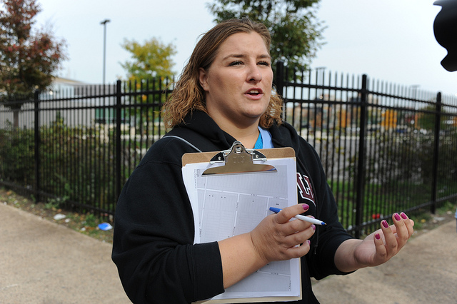
CANVASS
Requirements
Types of Canvass
In Person
Telephone
Mail
NCOA
Combination
Step by Step Instructions on NCOA
Ch 5, Pg 29 - 37

Slide 11
DUPLICATE VOTERS
Goal
Only One Record Per Voter
Procedure
Step By Step Instructions
Try to Preserve ORIGINAL Record
Ch 6, Pg 38 - 41

Slide 12
FOI
FREEDOM OF INFORMATION ACT OF CT
Questions and Answers from FOI
Relating to ROV
Records to be Released
Timing
Fees
FOI Pertains to Existing Records Only
Ch 7, Pg 42 - 43

Slide 13
RETENTION & DISPOSITION
Records & Documents
Requirements Apply Only to Official Record Copies.
http://www.ctstatelibrary.org
Ch 8, Pg 44

Slide 14
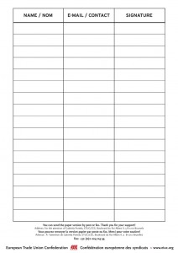
PETITIONS
Primary Petition Procedures
Forms
Signature Requirements
Checking
Filing
ROV Not Responsible for Nomination Petitions
Ch 9, Pg 45 - 52

Slide 15
BALLOT TYPES
Official Regular
Absentee
Supervised
Provisional (overseas)
Overseas
Emergency
Presidential
Blank
EDR
Ch 10, Pg 53 - 56

Slide 16
EMS
Election Management System
Communication Tool to Provide to SOTS
Mandated
Election Reports
Election Results
Etc.
To Public and Media
Election Results
Ch 11, Pg 57 - 62

Slide 17
PRIMARIES
Procedures
Possible # of Primaries in a Year
Dates & Times
Absentee Ballots
Forms, Notices, Press Releases
Ch 12, Pg 63 - 72

Slide 18
EDR
Election Day Registration
Location & Staffing
Eligibility and Identification Requirements
Admitting Procedures
Voting Procedures
Closing the EDR Location
Suggestions and Best Practices
Ch 13, Pg 73 - 75

Slide 19
ELECTION
Types of Elections
Hours of Voting
Voting Districts
Place of Holding Elections
Supervised Absentee Balloting
Write-In
AB Check-Off
Tabulators
Accessible Voting System
Sessions
Ch 14, Pg 76 - 79

Slide 20
ELECTION (continued)
Voter Registry List
Notices
Election Day Workers
Unofficial Checkers
Certifications
Voter ID Requirements
Emergency Contingency Plan
Presence of Registrars
“To Do” Check List
Ch 14, Pg 79 - 87

Slide 21
SPECIAL ELECTION
Election Not a Regular Election
Filling Vacancies or
Create a New Office
Instruction Summary
SOTS to Provide Specific Instructions
Ch 15, Pg 88 - 90

Slide 22
REFERENDA
Ref. Not Held In Conjunction with a Regular or Special Election
Ref. in Conjunction with a Regular Election
Petition to Initiate Local Ref.
Recanvass on Close Question Vote
Charter Enactment or Revision
Regional School District Ref.
Ch 16, Pg 91 - 97

Slide 23
TABULATOR – MEMORY CARD TESTING – SET UP
Preparations
Test Deck
Changing Date & Time
Testing Ballot Box Deflector
Step By Step Instructions
Including Supervisory Instructions
Ch 17, Pg 98 - 100

Slide 24
RECANVASS
Reasons to Recount Ballots
Instruction Summary
Link to SOTS “Recanvass Procedure Manual”
Ch 18, Pg 101 - 106

Slide 25
AUDIT POST-ELECTION
Steps to Take:
Preparing for an Audit
Conducting an Audit
Counting the Total for Candidates
Two Methods of Counting
Link to the SOTS Audit Procedures Manual
Ch 19, Pg 107 - 109

Slide 26
TAXES, POLLWORKERS
From IRS:
Form I-9 not required
The immigration Reform & Control Act of 11/6 1986 (IRCA) Public Law 99-603; U.S. Immigration & Customs Enforcements (ICE) Homeland Security Investigations 11/19/2013
Form W-4 not required (Per IRS)
their filing status and # of exemptions don’t matter
they are not required to withhold federal income tax.
? CT W-4 may be required?
Ch 20, Pg 110 - 111

Slide 27
HELPFUL HINTS & ON-LINE LINKS
Hints / Instructional Information
CVRS (ConnVerse)
How To …
On-Line Links to:
Manuals & Instructions
Election Related Miscellaneous
Ch 21, Pg 112 - 115

Slide 28
CVRS ALPHA INDEX
Connecticut Voter Registration System
ConnVerse
User Manuals
Found on CVRS Login Page
Index Provides:
Page # in Manual
Navigation Menu Tabs to Click on in CVRS
Ch 22, Pg 116 - 125

Slide 29
GLOSSARY
Commonly used in election law:
Words
Phrases
Titles
Etc.
Ch 23, Pg 126 - 131

Slide 30
MANUAL / HANDBOOK
A work in progress.
Comments and suggestions welcome.
Send to handbook committee
burrdar@cox.net

