Slide 1
2020 Presidential Election
September 10, 2020
Registrars of Voters Conference
ELECTION MANAGEMENT SYSTEM

Slide 2
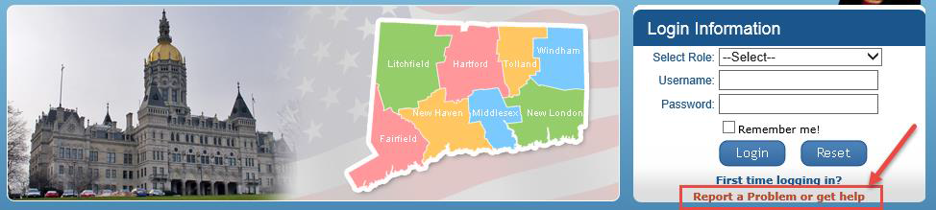
2020 Presidential Election
Help Desk EMS after 8:00pm 860-509-6111
To reset password – “Report a Problem”
Email for EMS
heather.augeri@ct.gov; taffy.Womack@ct.gov; shirley.surgeon@ct.gov; moriah.moriarty@ct.gov

Slide 3
EMS Election Setup ROV’s
Assigned Polling Places for the election
  Add or change polling locations if necessary. Notify SOTS.
Certification of Ballot Ordered – Can be entered by Town Clerk, print and ROV’S signs
  Enter amount of Ballot Ordered only for polling places
Head moderators, data entry, etc., ROV- provides Username and password
Email your List of Moderators, List of Polling Places & Ballot Ordered to Jessica.gelin@ct.gov

Slide 4
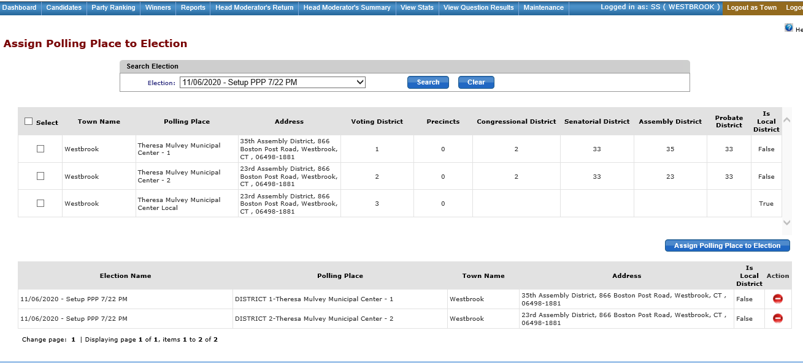
Assign Polling Place
This is a state election year- Only Assign polling places that are false.

Slide 5
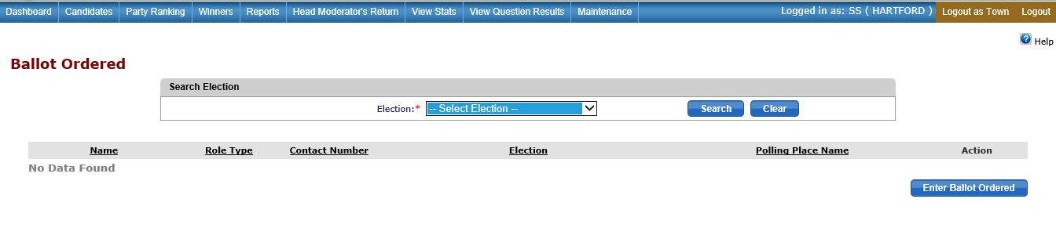
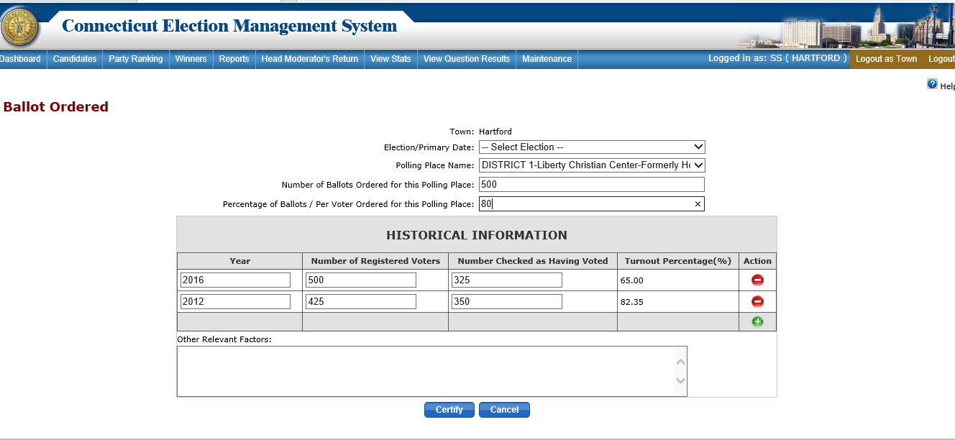
Ballot Ordered
Enter the amount of ballot ordered for polling place
Click on certify,
NEW- From Reports, print - ROV’s & TC signs

Slide 6
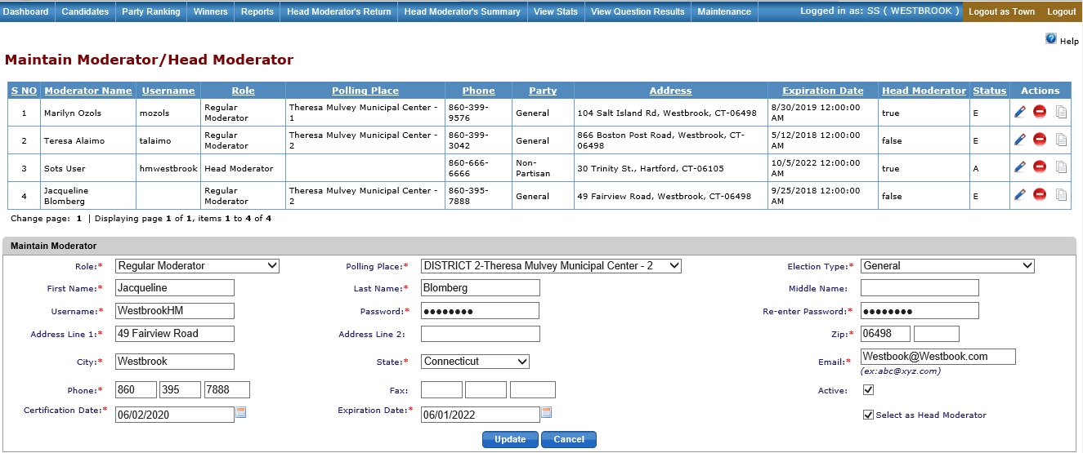
Maintain Moderator/Head Moderator
Status-Active
Select Election Type
Moderator working as polling place moderator and Head moderator at end of night
  Role – Regular Moderator
  Check “select as Head Moderator”

Slide 7
To Do List
At Least a Week before the Primary
Review & Print your Tally Sheet Template from Reports.
  Check that polling places are correct
  Offices are correctly assigned
  Candidates are in correct order
Review & Print a blank Head Moderator’s Return under Reports
  Plan “B” backup for primary night – manual fill out Moderator’s Return and Email if you can: lead@ct.gov or if you can’t email then
  Fax:1-866-392=4023

Slide 8
Election Day/Night
Have Head Moderator & or Data Entry Clerks sign into EMS Election day to make sure their usernames & passwords are valid.
  ROV’s are responsible to assign Head Moderator or Data Entry Clerk username and Password
NEW- Head Moderator must enter Stats to generate Head Moderators Return
Rules when using the EMS
  One person - one session open on the browser
  One person in each district at a time
  Everyone should log out of the system not close the browser
  Reminder Data Entry clerks that they must SAVE, click on End Process back to GREEN when finished entering results for a district .

Slide 9


