Slide 1
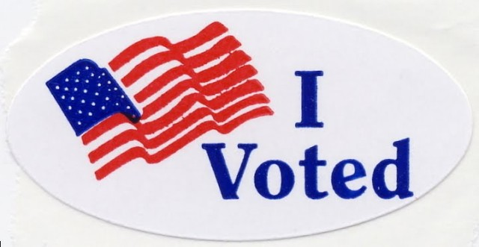
Registrar of Voters
New Registrar Class
Summer 2020
Tim De Carlo - Waterbury
&
Anne-Marie Mastroianni - Bethlehem

Slide 2
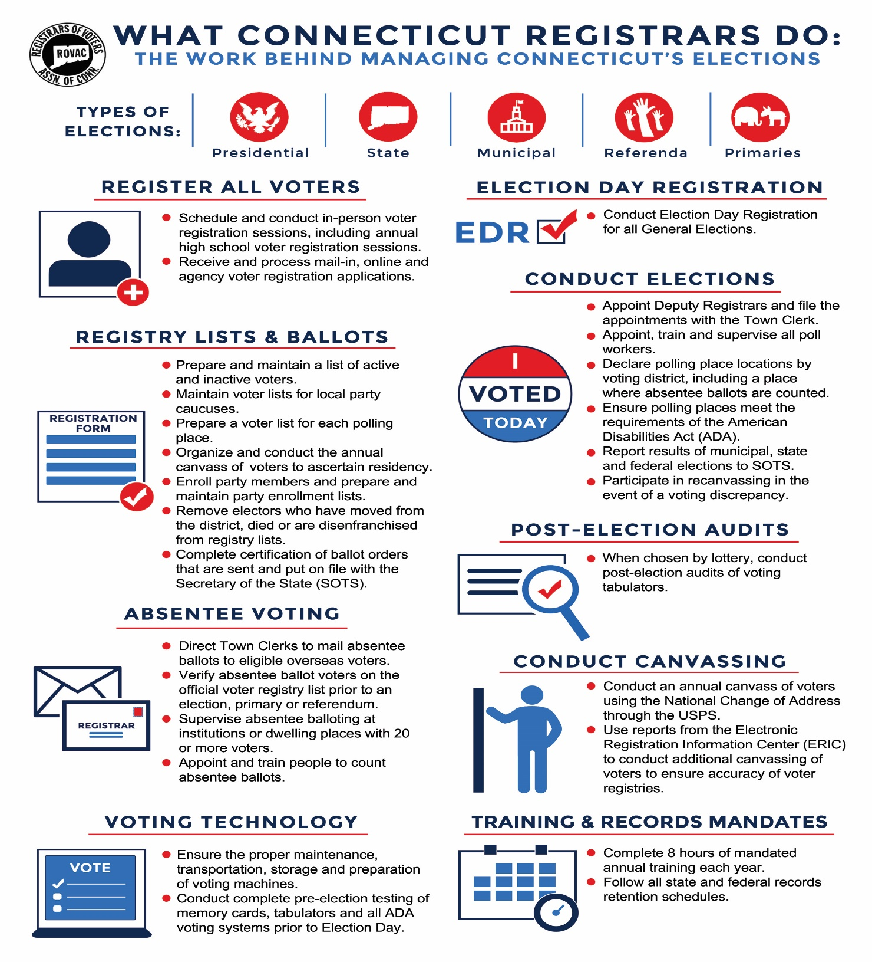

Slide 3
Resources available to Registrars
ROVAC
ROVAC is the statewide association of Registrars of Voters in Connecticut. We work as a group to
help educate fellow Registrars in executing clean, organized and impartial democratic elections.
This is done through semi-annual educational conferences as well as on the county level.
Secretary of the State
The Secretary of the States office oversees the CVRS System, online registration system,
supplies Registrars with election supplies (voter registration cards, posters, envelopes, etc.)
and provides training to Registrars.

Slide 4

ROVAC Board of Directors
Executive Board:
Sue W Larsen (South Windsor) – President
Chris Prue (Vernon) – Executive Vice-President
Annalisa Stravato (Wilton) – Vice-President
Loren Olson (Ashford) – Secretary
Lisbeth Becker (Glastonbury) – Treasurer
Full Board (includes Executive Board plus):
Anne Marie Mastroianni (Bethlehem) – Litchfield County Chair
Marla Cowden (Westport) – Fairfield County Chair
Darlene Burrell (Suffield) – Hartford County Chair
Bonnie Andersen (Cromwell) – Middlesex County Chair
Timothy De Carlo (Waterbury) – New Haven County Chair
Dianne Slopak (Norwich) – New London County Chair
Michael Wyman (Tolland) – Tolland County Chair
Loreen Hegan (Canterbury) – Windham County Chair

Slide 5

ROVAC Committees and Chairmen
Conference – Chris Prue Legislation – Tim De Carlo
Education – Melissa Russell Ways & Means – Sue Burnham
Technology – Lisbeth Becker Handbook – Darlene Burrell
Audit – Ann Kilby Budget – Chris Prue
Certification – Ann Marie Mastroianni

Slide 6


Connecticut Secretary of the State
State of Connecticut
165 Capital Ave
Hartford CT, 06106
Phone Number: (860) 509-6200
State Election Enforcement Commission, (SEEC)
20 Trinity ST
Hartford, CT 06106
(860) 256-2940

Slide 7
Certification UConn
Complete a required certification program no later than two years from their first day in office. Once certified, each registrar is required to complete at least 8 hours of training per year.
Effective 7/1/2020: The ROV Certification Program is now available online. We now have Sections 1, 3 & 8 available. To register, please click on a Section listed below. We expect the other sections to be available online over the next 8 weeks. CITI anticipates the release of the ROV Cybersecurity Training Course later this summer.
NOTE: The ROV Certification Exam is also available online. Please click the link below to sign up.
https://citi.uconn.edu/registrarofvoters
Section 1: Election Administration, Laws, and Regulations
Section 2: Voter Registration, Maintaining Voter List & Service to Voters
Section 3: Registrar’s Office Management
Section 4: Preparing for Elections, Primaries, Referenda and EDR
Section 5: Conducting Elections, Primaries, Referenda, and EDR
Section 6: Absentee Voting & Supervised Absentee Voting
Section 7: Post-Election Audits & Recanvasses
Section 8: Petitions

Slide 8
Methods of Registering Voters & Letters Sent to Voters
Online Voter Registration
DMV / Tumbleweed
In person / mail in registrations
High Schools
Permanent Absentee Letter
Acceptance / Change Letter
Disenfranchisement Letter
DMV Letter
ED 683 / CVR Letters
Rejection Letter

Slide 9
CVRS System / Reports
The Centralized Voter Registration System, CVRS is the system that you will use to process and make changes to a voter’s profile.
CVRS is where you will find your daily online voter registrations as well as changes through the DMV / Tumble Weed systems.
Make sure when you process a new voter to write down the voter ID# on the card. While not mandatory, this will help you locate the voter should they be taken in error.
The CVRS System also generates several reports that you will need. These reports are also allowed to be given to the public upon request.
Change in Detail Report
Disk file (entire voter file in text format)
Alpha List
Street Guide

Slide 10
DMV / Tumbleweed
TUMBLEWEED – is the DMV ‘s secure server which registrars of voters and tax collectors have access to records showing address changes made by residents of your town by the residents. (§9-19i).

Slide 12
Removal of a Voter from the rolls
There are only two ways that a voter can be removed without incident.
A voter can be removed via a CVR Notice (ED-642)
A voter cancelation form signed by the voter
Per the Secretary of the States Office, at this time Registrars can currently include non-active voters in the Canvas, however, there is a current federal court case that could change this rule. When using this option always make sure to check with SOTS first!

Slide 13
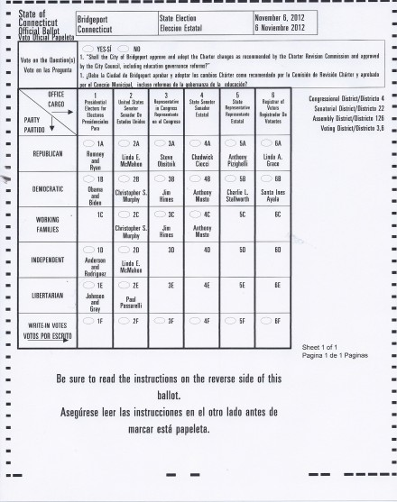
Ballot Access
A candidate has several ways that they can gain access to a ballot.
Nomination from a major party, or minor party with ballot access.
Successfully petitioning onto the ballot via a Nominating Petition.
Obtaining at least 1% of the total vote for an office in a
General Election.

Slide 14
Deadlines For the Presidential
Preference Primary
July 21, 2020 Tuesday Absentee ballots become available.
July 28, 2020 Tuesday Deadline for state party chairmen to certify to Secretary of the State: the number of national convention delegates from Connecticut; the formula, if any, prescribed by national party rules for apportioning delegates among candidates based on the primary vote; or, if applicable, the fact that such party rules provide "winner takes all".
July 28, 2020 Tuesday Mandatory enrollment session for primary - all towns.
August 6, 2020 Thursday Deadline for new voters, and for unaffiliated voters, to enroll in a party for voting in its primary. For new voters, mail-in applications must be postmarked, or received by Registrar of Voters or voter registration agency, by this date. For unaffiliated voters, the mail-in application must be received (not merely postmarked) by the Registrar of Voters by this deadline. (See exception below for in-person enrollment.)
August 10, 2020 Monday 12:00 noon In-person enrollment deadline, for new voters and unaffiliated voters enrolling in a party in person at Town Hall, for voting in primary.
August 11, 2020 Tuesday Presidential Preference Primary. Polls open from 6 a.m. to 8 p.m.

Slide 15
Things to Remember
      Make sure when you run your Official List for the polls to select only the party holding the primary, as well as entering the date of the primary. If the primary date is not put in, voters without Party Privilege will appear on your list.
      Remember that 17 year old voters who will be 18 on or before Election Day are allowed to vote, however they will appear at the back of your list stating that they are not yet 18. Make sure your Moderator and Checker are aware of this issue.
      There is no Election Day Registration for Primary Elections
      You will only need one set of poll workers unless both Major Parties are holding primaries that day.
      You may use less privacy booths than in a General Election. One privacy booth per every 500 registered voters. ( 9-436 (a) )
      Make sure to use the State/Federal ID Poster for the Checker’s table.
      Provisional Ballots must be made available.
      You will need to use IVS for this election.

Slide 16
Poll Worker Training
It is your responsibility to make sure that all poll workers receive adequate training before each election.
Moderators certification must be up to date. If their certification has lapsed make sure they attend a certification class prior to Election Day.
Make sure that your poll workers are aware of your Emergency Plan should an issue arise at the polls, i.e. ballot shortage, poll workers who fail to arrive, loss of power, fire, etc.

Slide 17
Election Equipment
ALL POLLING LOCATIONS HAVE TWO TABULATORS (One is a back-up)
IT IS UP TO THE REGISTRARS TO TEST VOTE THIS EQUIPMENT AND SEND THE CORRECT MEMORY CARD TO EACH POLLING LOCATIONS ALONG WITH THE APPROPIATE BALLOTS FOR THAT ELECTION.
THE IVS/AVS BALLOT MARKING EQUIPMENT MUST BE AVAILABLE AT ALL POLLING LOCATIONS FOR ANYONE WHO WISHES TO USE THEM REGARDLESS OF DISABILITIES.

Slide 18
Maintenance of Election Equipment
LHS is contracted to maintain the voting tabulators and ballot boxes.
There are three different service contract tiers available make sure to know which tier your town has purchased.
It is your responsibility to make appointments to have equipment serviced by LHS yearly.
Make sure that all ballot boxes are checked to make sure write-in baffle is in working order.
IVS is contracted to maintain the AVS equipment.
IVS/AVS system will be a download from IVS
Your town is responsible for the cost for programing the AVS equipment for elections and referenda.

Slide 19
Polling Place Pre-Election Check
Early Permission and Site Check
Check with those in charge of your polling place well in advance of the election to make sure that the location will be operational on the day of the election. Make sure to conduct a site visit prior to the election to make sure everything will be operational for the Primary.
Pre-Election Organization Meeting
Prior to every election you should consider calling a meeting in which everyone who would have some kind of roll be present. For example, are your polling places owned by the municipality or are they rentals? Who will be delivering your election equipment and who will be accepting delivery? Are the local authorities prepared to assist you should you lose power or have an emergency at the polls? Is everyone aware of what your Emergency Plan entails and are they ready to assist your office should a problem develop?

Slide 20
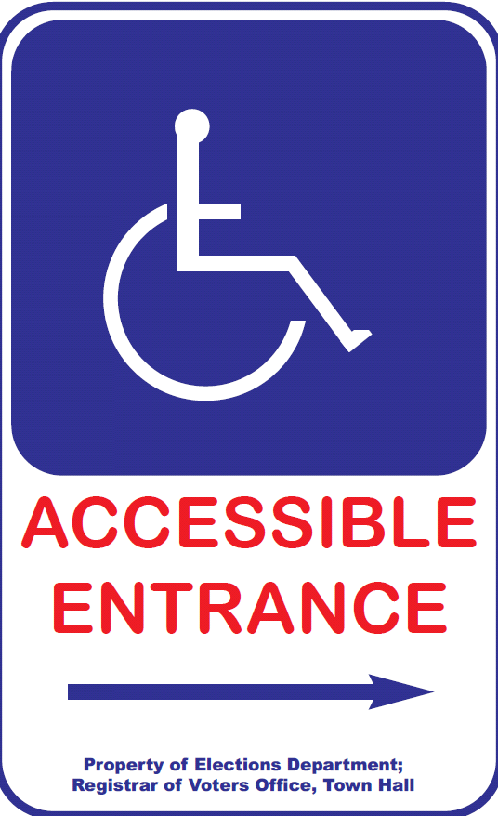
Polling Place Must Be“Accessible”
Moderator (or designee) should :
  Check parking lot signs.
  Post signs to accessible entry, if applicable.
  Clear all accessible pathways in polls
  Set up wheelchair-accessible privacy booth.
  Set up seating for tired voters.
  Review curbside voting process.
Confirm presence/set-up of IVS accessible voting equipment –ready to go at 6 am!

Slide 21
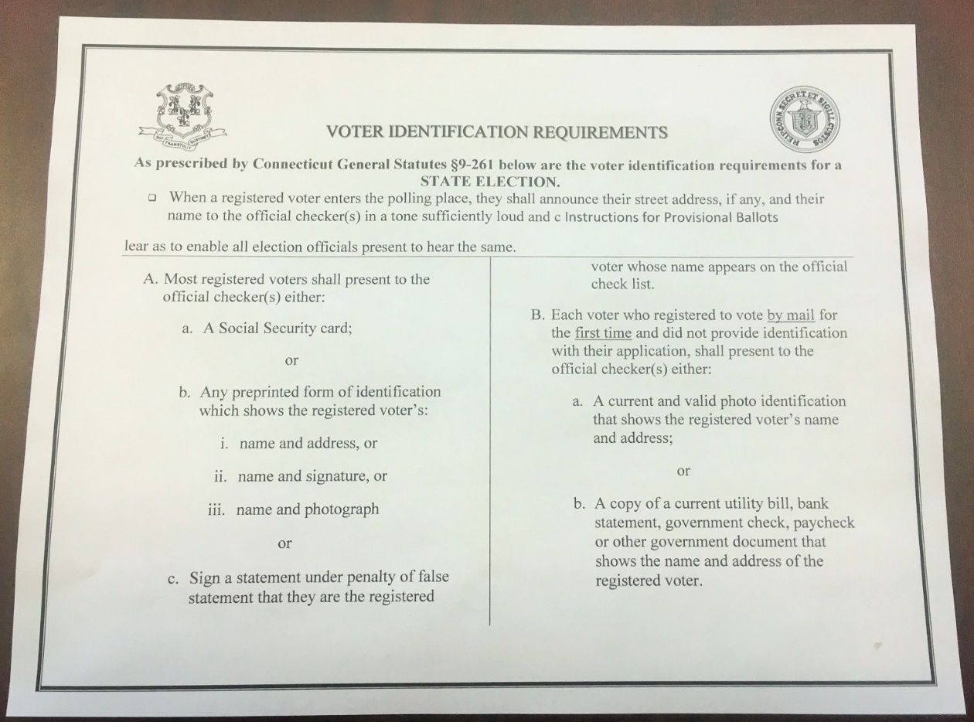
VOTER ID REQUIREMENTS for Checker’s Table

Slide 22

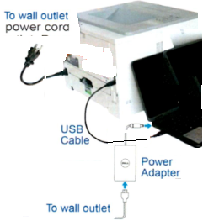
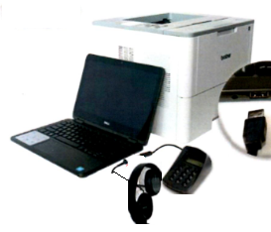
BALLOT MARKING SYSTEM - SET-UP
BEFORE POLLS OPEN ELECTION MORNING
Follow Instructions on pages 5-6 of the Election Day Manual
Printer & computer plugged into power outlet.
USB cable plugged in from computer to printer.
Key pad and headphone plugged into computer.
Ensure paper tray is open, extended & tray sleeve installed.
Load 1 plain piece of paper onto paper tray
Turn “On” Printer and Computer
Press “Print” on computer screen.
  A startup report will print.
Press “No” on computer screen
Access Code 9630

Slide 23
PROVISIONAL BALLOTS
Provisional Ballots are for Federal Offices only and are given to voters who cannot be found as registered.
You must send Provisional Ballots in the amount 1% of the total number of enrolled electors. 1000 Registered Voters = 10 Provisional Ballots
The moderator gives the voter a Provisional Ballot Envelope, Provisional Ballot, and records the voters information on the Provisional Ballot Inventory Form, (Form 9).
The voter completes application on the Provisional Ballot Envelope, seals and returns the envelope to the Moderator.
Registrars have ????? Days to determine whether or not to count.
Voter should be going to EDR

Slide 24
Polling Place Signage
At Federal Elections
3 Easy Steps to Voting
ID Requirements for Voters with Asterisks “*” (per HAVA)
Sample Ballots
Voters Bill of Rights
Instructions for Provisional Ballots (Federal Only)
Voter ID for checker’s table.
3 Constitution Amendment Posters (If Applicable)

Slide 25
Elections Management System (EMS)
This system is used to report end of night election results to SOTS.
Town Clerks, Registrars and Head Moderators all have a roll in this system.
Training on this system comes from the Secretary’s office.
This is an online system to report all election results.

Slide 26
EMS Setup
Town Clerks & SOTS
Primary Created in EMS by SOTS
Offices assigned to Primary by SOTS
Candidates added to Primary by SOTS
Certification of Ballot Ordered this can to be done by both Town Clerk or ROV’S for primaries. Email to: jessica.gelin@ct.gov
ROVS
Assigned Polling Places to Primary
  Add or change polling locations if necessary. Make sure to notify SOTS.
Assign a Head Moderator to the Primary
  You may assign moderators, data entry, etc., and provide password
Email your List of Moderators & List of Polling Places to Jessica.gelin@ct.gov

Slide 27
Head Moderator & Head Moderator’s Return
  Head Moderator must “Submit All Districts to the State” the results to SOTS
    A certification screen with a box to check for electronic signature will appear
  Tabulator results are to be submitted by midnight
  Next day Wednesday the return must be completed !!!
    Head Moderator to confirm results and enter any hand counts
    Head Moderator to enter statistics (number on the list, number checked as having voted, etc.)
      Submit to SOTS and a certification screen will appear with a box to check for electronic signature.
  Print the 2 copies of the return, one for Town Clerk, one for SOTS.
    Sign both copies and forward one to SOTS – should be received by close of business Friday
  Amendments – any changes that you enter into EMS, require that you generate an amended return.
  Print 2 copies for Town Clerk & SOTS
  Recounts – if you have a recount, the Head Moderator should amend the return and at the Certification Screen check both boxes (signature & recount)

Slide 28
To Do List
At Least a Week before the Primary
Review & Print your Tally Sheet Template under reports.
  Check that polling places are correct
  Offices are correctly assigned
  Candidates are correct order & have * for endorsed (this for local primaries only)
Review & Print a blank Head Moderator’s Return under reports
  This is a just in case, if something goes wrong on primary night

Slide 29
Recanvas Procedures
A recanvas of an election can take place if either The moderator (or head moderator in towns divided into voting districts) may call for a recanvas of the machine counted ballots, and/or the hand counted ballots, and/or absentee ballots and/or write-in ballots if he determines there is a discrepancy in the returns of any voting district in an election or primary. (§ 9-311)
Or
After any election or primary, when the plurality of the winning candidate for an office is one half of 1 percent or less than twenty votes are separating both the winning and defeated candidate for office.

Slide 30
Recanvas Cont.
In a District / Statewide recanvas, the Secretary of the State will notify the Town Clerk who will in turn notify the Head Moderator.
In a municipal or Single District race the Town Clerk will inform the Head Moderator.
It is the Head Moderator who will notify the candidates, town chairmen and recanvas officials that are needed that a recanvas will be conducted. This is to be done in writing.
RECANVAS OFFICIALS
Recanvas officials are: the moderator, the registrars of voters (or the registrar of voters, in a primary); at least two official checkers of opposing political parties (or opposing sides, in a primary); at least two absentee ballot counters of opposing political parties who served at such election (or opposing sides in a primary); and at least two ballot clerks of opposing political parties. Although not a recanvas official, the town clerk may be involved to ensure the appropriate materials (that have been in the possession of the town clerk) have been delivered for use during the recanvas.

Slide 31
Recanvas Cont.
Require Town clerk and / or registrar of voters to bring (dependent on who has the material):
i. the tabulators with a memory card still sealed in them.
ii. the sealed ballot transfer cases for each voting district, which contain:
all machine counted ballots,
the sealed depository envelopes containing the hand-counted absentee ballots; notes, worksheets and other written materials used in the absentee ballot counting procedures; and the Moderator’s Record of Absentee Ballot Count for Candidates;
the sealed depository envelopes containing the counted ballots from the auxiliary bin; notes, worksheets and other written materials used in counting the ballots from the auxiliary bin (if any);
the sealed depository envelopes containing the counted ballots from the write-in bin; notes, worksheets and other written materials used in counting the ballots from the write-in bin;
iii. the sealed depository envelopes containing rejected absentee ballots and discarded inner and outer envelopes;
iv. the absentee ballot applications;
v. the list of absentee ballot applicants as provided in §9-140;
vi. the check list;
vii. the moderator's returns, including the central absentee ballot counting moderator's return, if applicable;
viii. replacement seals;
ix. challenge ballots, provisional ballots, presidential ballots and all other materials.

Slide 32
Post Election Audit
The Secretary of the States Office will conduct a lottery after the election. Those polling places selected will need to have a post election audit conducted.
The audit may be conducted either by manual or automated form. All automated audits take place in the Office of the Secretary of the State.
Regardless of the type of audit you perform it must still be noticed locally.
To conduct the audit manually make sure to reference the audit manual which is located on the SOTS website.

Slide 33
Links to Manuals & websites
Absentee Counting
Audit
Recanvas
Moderator
http://portal.ct.gov/SOTS/Election-Services/Handbooks/Handbooks-Moderators-Absentee-Ballot-Counters-Recanvass-and-Audit
ROVAC handbook
http://rovac.org/index.php?page=Handbook

Slide 34
ROVAC website: http://rovac.org/
SOTS: http://portal.ct.gov/SOTS/Common-Elements/V5-Template---Redesign/Elections--Voting--Home-Page
SOTS LEAD Communications: http://portal.ct.gov/SOTS/Election-Services/LEAD-Communications/LEAD-Communication
SOTS Election Calendar: http://portal.ct.gov/SOTS/Election-Services/Calendars/Election-Calendars
LHS Associates: http://www.lhsassociates.com/ 1(888) 547-8683
IVS: https://ivsllc.com/indexWelcome.html 1(855) 730-6161
Adkins Printing http://www.adkinsinc.net/ 1(800) 228-9745 x 125
UConn CITI https://citi.uconn.edu/registrarofvoters

Slide 35


