Slide 1

FRIENDLY LETTERS
Considerate Communications and outreach
ROVAC Spring Conference
April 15-17, 2019

Slide 2

Contents
Party Chairperson
  Public notice(s)
  Lottery Notice
Town Clerks Notifications
  Public notice (s)
  Appointments - Permanent Absentee Verification
        Follow-up
        AB Information #1 &#2
Letters to Sellers & buyers ~ Friendly canvass
Welcome letters & pamphlet
Other Considerate Communications
  Missed deadlines
  Petition signers
  Inventory for Poll set-up/Breakdown
  Potential Poll Workers
  Rejections and recruitment
  Incomplete online follow-ups
  Duplicates:
  ROV Requests for removals
  Voters Requests for removals
Supervised Balloting Notices
Special AR appointment

Slide 3





Party Chairperson
Notifications of
Tabulator testing
Unofficial checkers( rights & responsibilities)
Ballot position lottery (municipal elections)
Notes:
These are actually must dos

Slide 4
Public Notice
Let it be known that on _______________20__
Testing of the all machines used to count ballots for the _____________ election will take place in the _____________ room located at _____________________ at __o`clock.
Members of public are welcome to attend.
Notes:
Posted in Town clerks’ office, outside ROVs’ office and on towns’ website sent by email to party chairperson

Slide 5
Party Chairperson
  Registrars of Voters LETTERHEAD
  Date
  NAME
  Dear ______________,
  This letter is to inform you that, as _________ Town Committee Chairperson, you and any candidate for an office appearing on the ______________ballot may attend or designate others to be present when the tabulators are being prepared, tested and sealed by the Registrars of Voters on _____________. The preparation of the tabulators will take place at ____, in the ________________ room located at ________________________________.
  All persons present for the testing and sealing of the tabulators must sign a pre-election statement that indicates that the tabulators were test-voted and found to be working properly. This statement will be filed with the Town Clerk.
  Your party is also entitled to have unofficial checkers serving in the polling room on Election Day, in two or more shifts, between 6 am and 8 pm. These unofficial checkers must be enrolled members of the party and shall be designees of the town chairperson, who shall submit their names in writing to us at least 48 hours prior to the opening of the polls. Each group of unofficial checkers will be provided with a copy of the active voter list. The unofficial checkers will be seated near the official checkers but may not ask the voters or official checkers to repeat information. In addition, no election official may perform the function of an unofficial checker and a candidate may not serve as an unofficial checker or as a runner.
  Thank you for your cooperation. If you have any questions, please call ______________________________________.
  Sincerely
  Democratic Registrar
  Republican Registrar
Notes:
Dependent on your relationship with your party chair people email and or phone call may be enough. This is more formal.

Slide 6
Posting Notice of Lottery
A lottery will be held on _____________20____ at ______ in the ___________Town Hall in the
__________________room to determine the placement of candidates on the November___ 20___ ballot.
Note: Send to Party Chairperson, and Candidates. Post in a visible area
Notes:
Note: Usually emailed to party chairman and posted in Town Clerks’ Office and outside ROV’s door

Slide 7
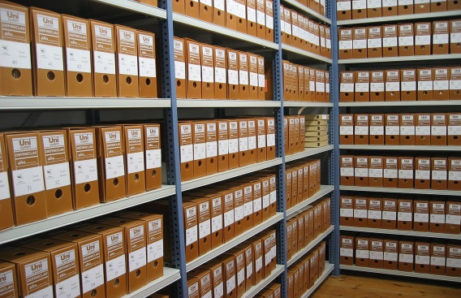
Town Clerk
Notifications
  Pre-election testing & lottery for public posting (must do)
  Permanent Absentee renewal letter (must do)
  List of confirmed renewals (must do)
  Poll workers info sent to polls (must do)
  Appointments of Temporary AR’s for Supervised balloting and schedule of dates
  A list by day or event of Special registration hours that may take place

Slide 8

Permanent Absentee Verification (must do)
REGISTRARS OF VOTERS
_______________________contact information________________________
January – 20__
Name
Address
Town, CT. zip
Important! This Concerns Your Permanent Absentee Ballot Status
We, the Registrars of Voters, are conducting an annual review as required by §9-140e to determine if you continue to reside at the residence address indicated above for purposes of your permanent absentee ballot status. The address listed above is the address you provided on your permanent absentee ballot application.
Please check the statement that applies to you, sign in the space provided below and return this form in the envelope provided.
( ) Remove me from the permanent absentee ballot list.
( ) My residence is at the address shown above.
( ) I have moved. My NEW address is: ______________________________________________
Note: If this new address is in another town, you must register to vote in that other town in order to be entitled to vote in the next election and to renew your permanent absentee ballot status, you must supply a note from your doctor to your new town with your new application.
If this new residence address is still within town, we will change your address on the official voter list pursuant to section 9-35.
Signature of: ___________________________________________
NAME______________________________________________DOB____________________________office use only Voter ID #_________________________________
Important: We must receive this form from you within thirty (30) days, completed and signed so you may remain on the list of permanent absentee ballot voters. Pursuant with §9-140e failure to return this will result in your removal from the list of permanent absentee ballot voters. Please cooperate by returning this form within thirty (30) days.
Thank you for your help. If you have any further questions please feel free to contact our office at XXX-XXX-XXX .
Very truly yours,
ROV’s
Notes:
This must go out to all in January. HIPPA forbids TC forwarding Drs. notes to another town. Voter can ask for their note from the TC.

Slide 9
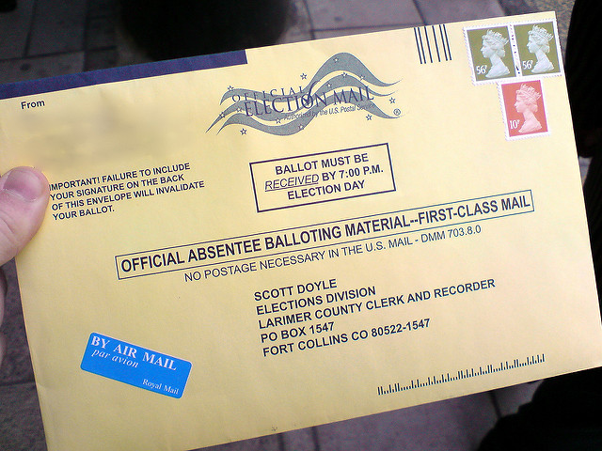
Follow-up to Town Clerk usually interoffice email
REGISTRARS OF VOTERS
February X, 20XX
Name
XXXXXXX Town Clerk
Pursuant with §9-140e the following people have returned their paperwork confirming their Permanent Absentee Ballot Status.
Name Address DOB
1
2
3
4
5
Etc
The following person(s) did not return their confirmation letter and have lost their Permanent Absentee Status
Name Address DOB
ROV’s
Notes:
Note that those who DO NOT return their letters must have their status changed.

Slide 10
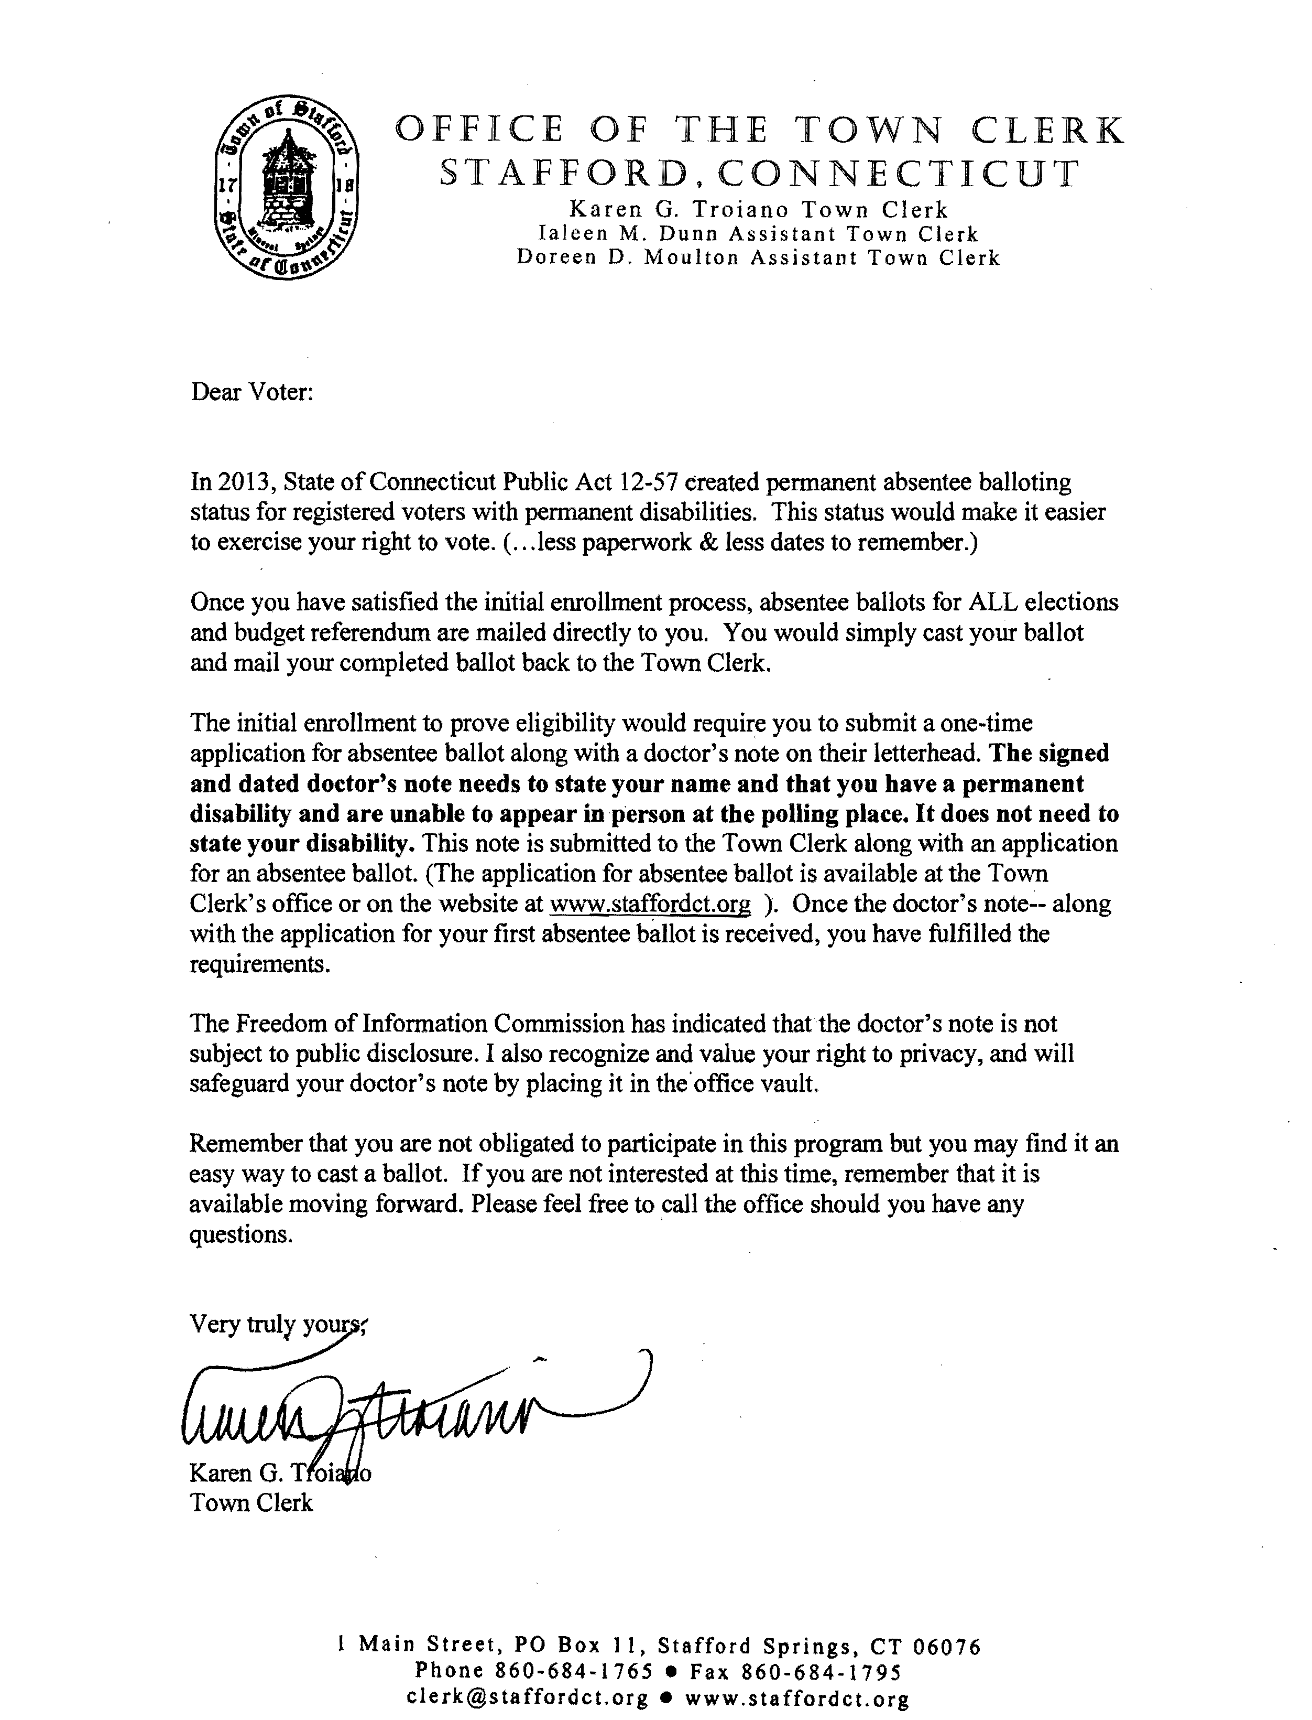
Additional AB info goes out from the Town Clerk
Notes:
This is ust here as a reference for you are curious about how permanent AB status is obtained.

Slide 11
Sample #2 AB T/C letter
TOWN OF WINDHAM
TOWN CLERK
Barbara McKinney Patricia P. Spruance Correna Bibeau
Deputy Town Clerk Town Clerk/Treasurer Assistant Town Clerk Phone: (860) 465-3014 Phone: (860) 465-3013 Phone: (860) 465-3015
September 13, 2018
Jane Doe
Absentee Ballot Road
Willimantic, CT 06226
Dear Jane,
In 2013, Public Act 12-57 “An Act Concerning Permanent Absentee Ballot Status for the Permanently Disabled” passed legislation and became law. Per our recent conversation, I have enclosed an “Application for Absentee Ballot” (ED-3) and a copy of Public Act 12-57. If you are interested in being placed on the Permanent Absentee Ballot list, please bring in or send a doctor’s note explaining your permanent disability with the completed application to my attention.
The Absentee Ballots for the upcoming November 7, 2018 Election will be sent during the first week of October.
Feel free to contact me if you have any questions.
Sincerely,
__________________________________
Patricia P. Spruance CMC
Windham Town Clerk

Slide 12
Additional Absentee Ballot Information
If a registered voter is unable to vote in person on Election Day, s/he may apply to the Town Clerk for an absentee ballot for any of the following reasons:
• Absence from the Town during all hours of voting.
• Illness
• Physical Disability
• Active service in the Armed Forces
• Duties as an election official at a different polling location
• Religious tenets
To apply for an Absentee Ballot, return a completed Absentee Ballot Application to the Town Clerk’s office. The Town Clerk’s Office will then send you a ballot. The voted ballot must be received back in the office by Election Day in order for your vote to count.
Notes:
Included here as a reminder that AB’s are generated from the TC office & are ALL accounted for IMPORTMANT to Remind POLLWORKERS

Slide 13
“Special” Asst. Registrar appointment
  LETTER HEAD
  Letter head specific or town symbol
  Date_______________
  _____________________
  Town Clerk, your town
  Re: Temporary Assistant Registrar of Voters
  This letter is to notify you that I hereby appoint the following people: ___________, as Assistant Registrar of Voters, for the purpose
  of supervising absentee ballot procedures. They will at all times be paired with opposite party counterparts during this process.
  This appointment will remain in effect until such time as all applications and ballots have been collected for the election to be held on ____day the of _______________ 20___.
  See attached schedule of when and where absentee balloting procedure will take place.
  Respectfully submitted,
  Registrar of Voters
  Your name, your party Your name, your party,
Notes:
Important for Supervised Balloting if ROV’s are not doing it but can be modified for any AR appoint

Slide 14
Letters to sellers and buyers
Friendly canvass letters

Slide 15

Letter to Sellers
WHY?
UPDATES!!!!! Accuracy of CVRS information
These letters are sent to anyone who has moved.
If the move is within town, a new card is sent requesting updated address info along with name and or party changes.
If the seller has moved out of town or state they are asked to sign, date and return* the letter approving they be removal from our registry.
*May include a self addressed stamped envelope
These are sent using information from Property transfer lists provided monthly by the T/C’s office
Notes:
Cuts down on those you HAVE TO canvass annually Having

Slide 16
Sellers Letter
  LETTERHEAD ROV’s Names and Contact info
  Name Date
  Street Address
  Town/State, Zip
  Dear ____________Resident:
  Our records indicate that you are a registered voter in the town of ____________CT and we have been notified that you have sold a house in town.
  If you have moved:
  Within Town Please complete the enclosed Voter Registration Card and return it to our office so we may update our records.
  Within Connecticut Please use the Voter Registration Card and register in your new town.*
  Out of State Please indicate that you no longer reside in CT by signing this letter and returning it in the enclosed envelope. If there are other members of your household that are registered voters and have moved out of state, please have them print their names, enter their dates of birth and also sign this letter. Please use the back if necessary.
  * You can find information about registering online by going to https://voterregistration.ct.gov/OLVR/welcome.do
  Thank you for helping to keep our records accurate
  Printed name(s)____________________________________ Printed name__________________________________
  Signature(s): _______________________________________ Signature ____________________________________
  Date of Birth: ______________________________________ Date of Birth _________________________________
  Date Signed : ______________________________________ Date Signed __________________________________
office use only Voter ID#____________________________________ office use only Voter ID#_________________________

Slide 17


If information is received on someone who has Moved out
LETTERHEAD ROV’s Contact Information
Date
Name
Street Address
Town/State/Zip
Dear
The Registrars of Voters in __________, CT, are working to update and maintain an accurate voter registry file. We believe you may no longer live in town. At this time, we cannot remove your name from our list without your signature confirming that you are no longer a resident.
Please complete the form below, sign it and return it in the enclosed postage paid envelope. If there are others within your household that were also registered voters please have them sign as well. Use the back if needed. If you have any questions feel free to contact us.
Thank you in advance for helping us to maintain an accurate voter registry list.
Sincerely,
ROV’s
[ ] I no longer live in _______. Please remove my name from the Voter List.
I currently live at: ________________________________ST _ Zip_______
{ } I do still live in __________. Please leave my name on the Voter List.
I currently live at:___________________________________________
{ } I am temporarily absent from____________but intend to return. My temporary address is _______________________ and I can be reached if needed at: (optional) phone ___________________email ___________________
PRINTED NAME ___________________________
Signature: _________________________________________ D.O.B._____________ Date:__________
office use only VOTER ID ___________________________

Slide 18
Requests for removals
LETTERHEAD
Dear
You are receiving this letter from our office because we believe the voter listed below has moved or has passed away. We would appreciate any assistance you can provide. By doing so, you will be helping us in keeping our voter lists accurate and up-to-date. Please fill out the form below and mail it back to our office at the above address. We appreciate and thank you in advance for your cooperation.
Sincerely,
ROV’s
_________________________________________________________________________________________________________
Voter name_______________________________________________________________Date of Birth_____________________
Address in our system_______________________________________________________________________________________
______Yes, the voter has moved. Their current address is___________________________________________________________
______Yes, the voter has passed away. Date of Death____________________
Relationship to the above voter ____________________________________________________________________
Printed name _________________________________________________
Your Signature_____________________________________________________ Date____________________________
We would very much appreciate a phone number should any questions arise________________________
For Internal Use: Voter ID#______________________ _Date rec’d _________________________ ROV initials___________
Notes:
In cases where information is given to us by the poll workers or otherwise heard through the grapevine

Slide 19

Letters to Buyers
These are sent to anyone who hasn’t yet changed using DMV(those not appearing on Tumbleweed)
Just a general welcome to town, to register or change existing CVRS info
Enclose a new voter registration card with a request for return
Includes info regarding registering online with links to town website and/or state online registration
If a Welcome pamphlet is available in your town include it for new residents
These are sent using information from Property transfer lists provided monthly by the Town Clerk’s office

Slide 20
New Buyers &/or In Town Moves
  LETTERHEAD
  ROV’s names & Contact info
  Name
  Address
  Town Zip
  Welcome to _________,
  We have been notified by the Town Clerk, that a warranty deed has been recorded into the Towns records.
  This may mean that you are new to _________ or have changed your address within the Town. In either event we want to give you an opportunity to either register to vote or to update your voter registration information.
We are enclosing a mail-in voter registration card for your use. If you are eligible to register to vote, please fill out the enclosed card
completely and return it to our office at the above address.
You may also register to vote online by visiting https://voterregistration.ct.gov/OLVR/welcome.do and following the prompts.
1. input your valid CT driver’s license number and completely fill out the form OR
2. without a driver’s license -Completely fill in the information online, print it out, sign the application and mail or deliver it to
our office .
  If we can be of any assistance please contact us.
  Sincerely,
  Registrars of Voters

Slide 21
New Buyers sample#2
Letterhead
ROV’s Contact info
Name
Address
WELCOME TO _your town inserted here__
The Town of ______________ Assessor's Office has informed us that you are the new owners of the property at ________________________________.
In order to help you with some of the things you do when you move into town, we are enclosing __ self addressed Voter registration cards. Please fill them out as a new voter to town, sign, date and return them to the Registrars of Voters. If you have been a voter in another town or state, please provide that information in box 10 on the card so that we can notify them.
You may also register to vote online by visiting https://voterregistration.ct.gov/OLVR/welcome.do and following the prompts.
1. input your valid CT driver’s license number and completely fill out the form OR
2. without a driver’s license ~completely fill out the on line form, sign the application and mail or deliver it to our office
Other Information you may find helpful:
1. The towns website is________________________
2. ____________has a cable channel, _____, where you can see Town Council Meetings and which lists events and other information.
3. ___________has a monthly e-blast entitled “______________” that you can subscribe to through our website.
4. If after you’re settled in, you would like to become active on a Board or Commission, registered voters can access a list on the Town’s website under “Government” and apply on line or at the Town Clerk’s Office.
5. Each spring, fall and winter, a newsletter is sent to all households and is full of information on many subjects and has news from all town departments.
6. The Town Clerk’s office has a map of _____________ that is available to you at no charge.
Again, Welcome to ________________
ROV’s
Notes:
This includes a lot of WELCOME info as opposed to sending out a pamphlet

Slide 22

Pamphlet
This can be as inclusive as you feel necessary and hand out as you see fit (town wide celebrations etc.)but at the very least should contain;
Contact info: name(s) of ROVs, phone, email, physical address
Office Hours ~ who to contact when office is closed
Polling place location(s) especially if you use a different location for referenda votes
http://voterregistrion.ct.gov
Voterlookup http://portaldir.ct.gov
Optional ~ other town services with contact information i.e. Human services, Library, etc
Town of Willington provided the following example

Slide 23
Notes:
If you want more information on this template Contact Willington

Slide 25
Other considerate communications
Missed deadlines
Petition signers
Poll set-up inventory lists
Potential & ACTUAL poll workers
Incompletes
Duplicates
Removals
Supervised Balloting Communique

Slide 26

Missed deadline for party change
Highlight PRIVILEGE date on change letter and include the following Notice ~
Because there is a 3 month waiting period to attain new party privileges. You will be unable to vote in the up coming primary on ________ in either your past or now present party. The next election in which you are eligible to vote is highlighted on the enclosed letter.
Notes:
Works best in smaller towns NOTE CARDS IN YOUR Possession must be processed.

Slide 27
Petition Signers sample #1
LETTERHEAD
Date
Name
Address
TOWN, CT xxxxxx
Dear
It came to our attention that you signed a petition for _________________________________________ so that his/her _______________name could appear on the November ballot for the position of _________________________________________________________________________________________________.
We noticed that the information you provided on the petition does not match all the information we have on file for you. Would you please fill out the enclosed registration card and return it to our office at your earliest convenience. It will save you a lot of time, confusion and/or frustration at the polls on Election Day.
You may also make changes to your registration online by visiting voterregistration.ct.gov and following the prompts.
1. input your valid CT driver’s license number and completely fill out the form OR
2 Completely fill out the online form. Print it out, sign the application and mail or deliver it to our office
If you have any questions please feel free to contact us __________________.
We thank you for your time and consideration in helping us to maintain an accurate registry .
Registrars of Voters
Notes:
This could be first you become aware that someone moved OR there was a typo in CVRS

Slide 28
Petition Signers sample #2
Letterhead
Dear
You recently signed a petition in ________________CT, with an address of___________________. Your name does not appear on our voter registry list.
Enclosed is a registration card which when completed can be returned by mail or delivered to our office. You may also register to vote online by visiting voterregistration.ct.gov and following the prompts.
1. input your valid CT driver’s license number and completely fill out the form OR
2 without a driver’s license ~ Completely fill out the online form, print it out, sign the application and mail or deliver it to our office.
We hope to receive your registration in time for the __________________ Election. The deadline for that election is_____________________.
If you have questions please feel free contact us.
Sincerely,
ROV’s

Slide 29
Department of Public Works or other Election set-up personal (forms on/in EMS)
Pre-Election Equipment needs for the following Locations, for Primaries and General Elections (August & November and every 4 years in April) Which must be in place the night prior to the Date of the Election
Each Polling Location - 2 ballot boxes and 2 battery back ups , 2 VOTE HERE signs, 2 75 Foot Markers and 1 IVS machine ( *IVS machines are located at the REGISTRARS office)
Additionally
West Stafford Fire House
________Privacy booths set up ~ Plus 1 handicap assessable booth
________ Tables* and ______Chairs* (*permanently kept here)
Stafford Public Library
________Privacy booths set up ~ Plus 1 handicap assessable booth
________ Tables* and ______Chairs *(*permanently kept here)
Senior Center
________Privacy booths set up ~ Plus 1 handicap assessable booth
________ Tables* and ______Chairs *(*permanently kept here)
For Referendum: only 1 location (usually in May or June at the Library)
___ Privacy booths set up
___ Ballot Box
POST ELECTION ~ Anything brought to the polls must be picked-up and returned to the Old Town Hall *Black IVS machines are returned to ROV office
Notes:
Great way to play with EMS

Slide 30
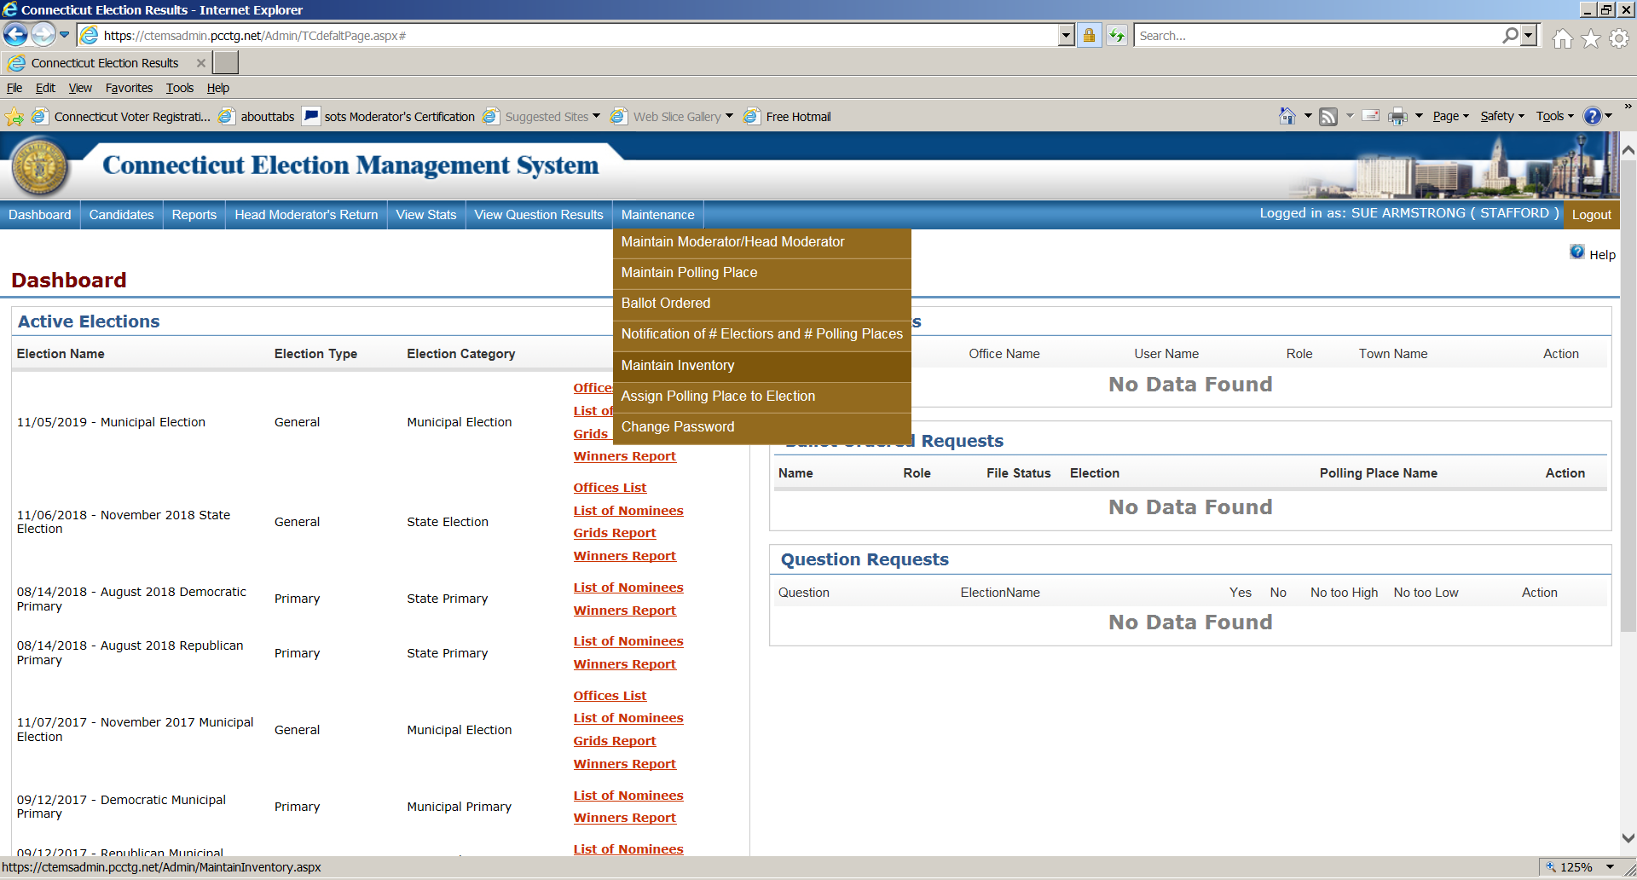
SCENESHOT OF EMS DASHBOARD

Slide 31


Potential Poll Workers
Dear____________
Thank you for your interest in working at the polls. Here is some information which you need to be aware of;
The next vote/election will be held on___________ at ___________________ from ________ to ___________.
State statues require that all poll workers attend poll worker training so that they understand the importance of their role and their responsibilities on election day. There will be two training sessions available and will take place on _______________ and on ______________ at ______________ from the hours of _________________. You must attend one of these training sessions to be considered and to receive your assignment instructions, and fill out payroll documents.
Please confirm your continued interest by contacting us here at the Registrar of Voters office.
Thank you again for your interest in helping to maintain the highest standards of voters rights.
Sincerely yours,
ROV________________
Contact email
Phone
PS Please provide the best way to contact you. Email? Cell phone? Home phone? Other?
Notes:
When someone has checked off the magic box that indicates their interest.

Slide 32
LETTER TO POLLWORKERS
Letterhead
Date
Name & Address
Dear______________
We will be holding the pre-election poll workers meeting on _____________________ beginning at__________ at _______________________.
Your attendance at this meeting is required and mandated by state law. If you do not attend this meeting or call the registrars, your position at the polls will be filled with another worker. If you absolutely cannot attend you must contact______________ at ____________ or ______________ at _________.
Your assignment for the election to be held on _______________, 20____ is to be a/an _____________________________ at ________________________
You should be at your assigned polling place by 5:15 AM and are to remain until the Moderator has dismissed you. No poll worker should leave until the polling place is totally cleaned. You will be provided with fill in whatever you provide, meals, drinks etc.
If you are working out of your district please go to the Town Clerk’s office at the Town Hall to obtain an absentee ballot and cast your vote. Do not lose your right to vote.
We thank you for your time and appreciate your help for this election/referendum/primary and look forward to seeing you at the pre-election meeting on_____________________.
Sincerely,
ROV’s

Slide 33
Rejection and recruitment
LETTERHEAD Contact name and other info
Date
Name
Address
Name,
Thank you for taking the time to submit your voter registration application. We are returning your application siting CGS Sec 9-12 (b), you must be 18 years old on or before the next election.
We look forward to processing your new registration card, when you apply again closer to your 18th birthday.
Even though you may not vote at this time perhaps you would be interested in working at the polls on election day. If you have any questions feel free to contact us with your name and your preferred contact information e.g. phone, email etc.
Thank you for your interest in voting.
ROV’s
Notes:
Targeted to 17yr olds whose application is rec’d by mail

Slide 34
REJECTION (Different mailing addresses)
LETTERHEAD
Date
Name Address
Dear_________________
Even though you have a _________________mailing address your residence is located in the Town of ______________________.
For that reason we have forwarded your registration card to that town.
Please call either Registrars’ Office if you have any questions.
Thank you for registering to vote.
Sincerely,
Registrars names
(rejection) town information (forward) Town information
Phone:_______________ Phone:___________________
Address:________________________ Address:___________________
Email:__________________________ Email:_______________________

Slide 35

Online Incomplete
LETTERHEAD~ ROV’s~ Name and Contact info
Date
Name
Address
Dear
RE: New or Changes to your Online Voter Registration
It appears that you started the process of either trying to register to vote or make changes to your voter registration using the state’s Online Registration System.
In order for you to complete the online registration process, it is necessary for you to do one of the following ;
1. go back to the online system(voterregistration.ct.gov), input your valid CT driver’s license number and completely fill out the form
2. go back to the online system(voterregistration.ct.gov follow the directions for registering without a driver’s license , print out the form, sign the application and mail or deliver it to our office OR
3. You may fill out the enclosed registration card and mail or deliver it to our office.
If you have any questions please stop in or contact our office.
ROV’s

Slide 36

Incomplete
LETTERHEAD
Date:
Name
Address
Your Town, CT zip
Dear________________,
We recently received your enclosed voter registration application. Your application cannot be processed due to missing information. We have highlighted those areas which are needed to complete the process.
Please take a moment to provide that information and return your registration application in the self-addressed stamped envelope.
We have also included a blank card in case you wish to start over.
Thank you for your interest in voting. We look forward to receiving your completed application soon.
ROV’s
Notes:
Refers mostly those without a birthdate

Slide 37

DVM Incomplete
LETTERHEAD
Date
Name & Address
Dear__________________
We received your enclosed application from the Dept. Of Motor Vehicles as an unfinished voter registration. Enclosed is a new voter registration card, if you choose to, fill it out or you can sign the form from the DVM and return either or both to the Registrars’ Office to become a voter in ______________________
If you need assistance or have questions, please call us at __________. We are a part-time office but will return your call as soon as possible.
Sincerely,
ROV’s
Notes:
Specific to DMV incomplete ~ Use it or not

Slide 38

Duplicates Sample #1
Date
Registrars of Votes~ Town of______________
Re: Name, DOB, Voter ID of Duplicate Voter
Enclosed is a printout of the above voters’ election history from Dates of history or your town’s name.
We would appreciate you re-registering this voter so that our list will be more accurate. When you go into activities, the name will appear in both towns, please select the voter listed in our town with the above referenced older Voter ID number. Doing so will automatically import the voter’s history to your town.
Please contact us if you have any questions or if you believe we have contacted you in error. We are in the office_______________________ and can also be reached by email or by phone at_______________________.
Sincerely yours,
ROV’s

Slide 39

Duplicates Sample #2
Letterhead
Date
Registrars of Voters
Town of__________
Street, Town, State, Zip
RE: Duplicate Voter
Name_______________~ Voter ID # XXXXXXXXXX DOB XX/XX/XXX
Dear Registrars,
PLEASE NOTE: The voter listed above has an off status in our town. Currently, they are listed as active in your town.
PLEASE re-register them and pull them from our town using the older Voter ID # referenced above.
If you have any questions, you may contact us at__________________________.
ROV’s

Slide 40
Pre-registered/Duplicates
LETTERHEAD
Date:
Name
Address
Town, CT Zip
Dear,
We received your online voter registration application. We wanted to let you know that you are already an active voter in __________________ having registered on________. Enclosed is a copy of your original ‘notice of acceptance’ from us. There is no need to re-register unless you are making changes such as: your name, address or party affiliation or are making corrections such as including a suffix such as Sr., Jr., etc.
We look forward to seeing you at the polls on _______________, or if you will not be in town on that date, don’t forget to apply for an absentee ballot. You can start that process by contacting the Town Clerk’s office at ________________, online at _____________________or at sots.ct.gov and clicking “voter information”.
If you have any questions feel free to contact us ___________________________
Warm regards,
ROV’s
Notes:
Usually those who registered as students or others haven’t yet voted.

Slide 41
Voters REQUESTS FOR REMOVAL copies available in Town Clerk’s office
To the REGISTRARS of VOTERS of ______________CT
I ____________________________ wish to have my name removed from your voter registry list
because;
1_______I no longer reside in town.
2.______ I will be moving. Effective date________________
3.______ I no longer wish to be a registered voter.
My Date of Birth is_____________________.
My TOWN NAME address was/is______________________________.
My forwarding address is (optional)_______________________________________________________
PRINTED NAME__________________________________________________
SIGNATURE__________________________________Date_____________20____
office use: Voter ID#________________ Date rec’d ____________ ROV initials__________
Notes:
Copies of this are available in the town clerks’ office where many voters will go first

Slide 42
Sample removal request sample #1
LETTERHEAD AND CONTACT INFORMATION
Name
Address
State
Dear Voter,
We have been notified by your current state of residence that you have registered to vote in that state and may have recently voted in a state other than CT in 2018.
IF YOU HAVE MOVED BACK TO TOWN, please go online at http://Govote.ct.gov and register at your new address within _______________. We will adjust your voting residential record and advise you of your new polling location.
IF YOU HAVE MOVED OUT OF STATE, please sign and return this letter so we may remove your name from ________________’s voting list.
Thank you for your cooperation. If you have any further questions, please call this Office at the above telephone numbers.
Cordially yours,
Registrar of Voters Registrar of Voters
I/We have moved out of ______________________Please remove my name(s) from your voting list.
____________________ _____
Printed Name Signature Birth date
____________________ _______________________________ _______________
Printed Name Signature Birth date
ADD AS MANY SIGNATURES AS YOU NEED

Slide 43
Optional removal sample #2 (university specific)
Letterhead
Date
Name
Address etc
Dear______________
We are updating our files for _________________________ University and would appreciate your help. Your voter registration was put into the system on ____________ after the November election because it was received after the ______________ deadline for that election and you did not appear at the polls nor at the EDR location.
Enclosed is: 1) your letter of acceptance, indicating your polling location for the next election, and 2) a blank removal form to indicate if you wish to remain a voter in the town of ___________________.
If you do nothing we will leave everything as is.
We’re looking forward to receiving your response. Thank you in advance for your cooperation.
ROV’s
Notes:
University specific

Slide 44
University HANDOUT
VOTING:
Register in your HOME TOWN using your home address and vote in your hometown.
OR
Request an absentee ballot from your HOME TOWN: APPLICATIONS will be available in any Town Clerk’s Office or online at sots.ct.gov. You may send an application to the Town Clerk’s Office in your HOME TOWN before the ballots are available to insure a ballot will be sent to you within your timeline.
The Town Clerk in YOUR HOME TOWN will send you a ballot to the address you requested on your application. Fill out the ballot and send it back to the Town Clerk in your HOME TOWN.
Please note you will need to plan to allow for mail time
____________ Registrar’s Office Phone:________________________ Email:_______________________________________
Register in _________ using ____________Street, ___________ CT and put your dorm in the mailing address if on campus. Use your street address if you live off campus.
If registered in Windham/Willimantic using a campus address-- VOTE AT THE V.F.W. -- across from Burger King and Walgreen’s (park and enter from Valley Street—across from 165 Valley Street apartments)
Registering in any CT town - send or bring a registration card to a Registrar’s Office or Town Clerk’s Office in Connecticut.
Registration cards are available at the public library, University library, Registrar’s Office, Town Clerk’s Office, registration drives on campus, or call a Registrar’s Office and have a card sent to you. OR go online to sots.ct.gov and follow the directions.
ONLINE, MAIL-IN, AND IN-PERSON registration must be received or postmarked by ________________________ . Online registrations will be received until 11:59 pm. Cards HAND-DELIVERED by a person other than the voter must also be in by this date by the close of business.

Slide 45
Absentee Ballot Procedures
ABSENTEE BALLOT PROCEDURES
1. Applications for absentee ballots, a list of registered voters and blank voter registration cards will be delivered.
2. Have an employee as a contact person and also allow an employee to accompany the registrars when residents vote if deemed necessary
3. Three dates must be set with the registrars and liaison: drop off applications, pick up completed applications and registration cards, and to vote. Ask for permission to display posters with voting date.
4. Extra blank applications (which must be accounted for) will be left for new people (from our town or out-of-town) to complete should they wish to vote. New clients must also fill out a registration card.
Out-of-town applications (and registration cards, if necessary) will be sent to the respective town and their ballot will be sent back to our Town Clerk to be included in supervised voting
5. The person assisting the voter must sign the application and include their home address.
REGISTRARS CONTACT INFORMATION
Office phone
Email:

Slide 46
Special AR appointment
  LETTER HEAD
  Letter head specific or town symbol
  Date_______________
  _____________________
  Town Clerk, your town
  Re: Temporary Assistant Registrar of Voters
  This letter is to notify you that I hereby appoint the following people: ___________, as Assistant Registrar of Voters, for the purpose
  of supervising absentee ballot procedures. They will at all times be paired with opposite party counterparts during this process.
  This appointment will remain in effect until such time as all applications and ballots have been collected and returned to the Town Clerk for the election to be held on ____day the of _______________ 20___.
  See attached schedule of when and where absentee balloting procedure will take place.
  Respectfully submitted,
  Your name, your party, Registrar of Voters
Notes:
Specific to supervised balloting procedures. Important if a relative is on the ballot and you can’t be involved.

Slide 47



Slide 48

Sue Armstrong & Bunny Lescoe
Thank all those towns & people who contributed samples.

