Slide 1
Process in CVRS to correct and/or change Voter party.
This function is typically used to correct party change information. Any existing previous party records will be displayed in the Previous Party section of the screen. There is a limit of 16 previous party records for this system.

Slide 2
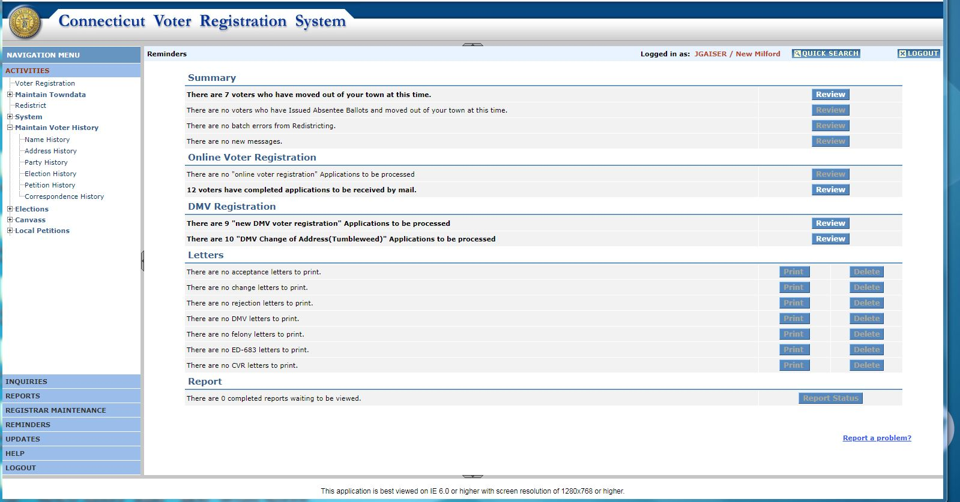
Go to Activities.

Slide 3
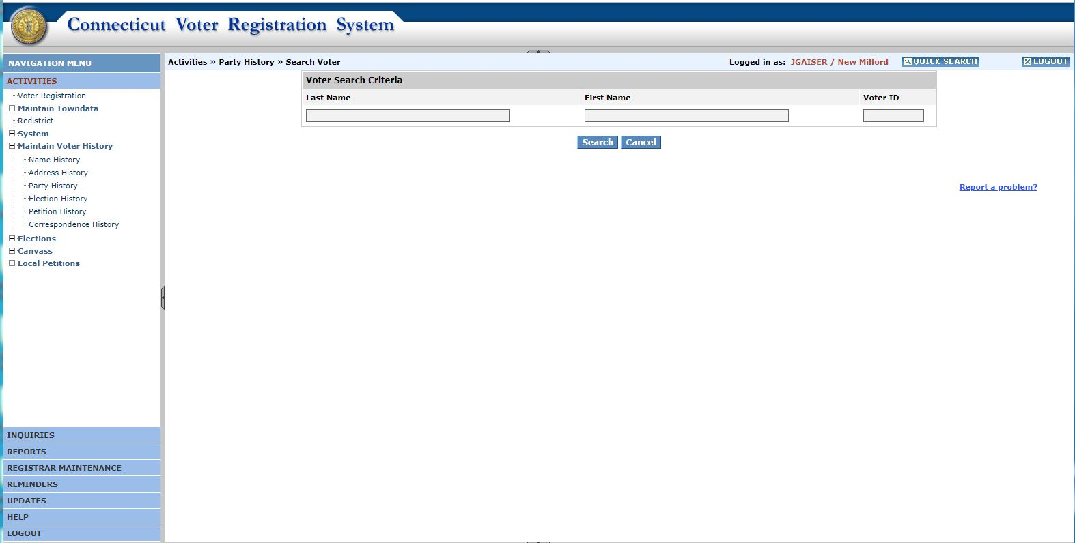
Select “Maintain Voter History”
and then select “Party History”

Slide 4
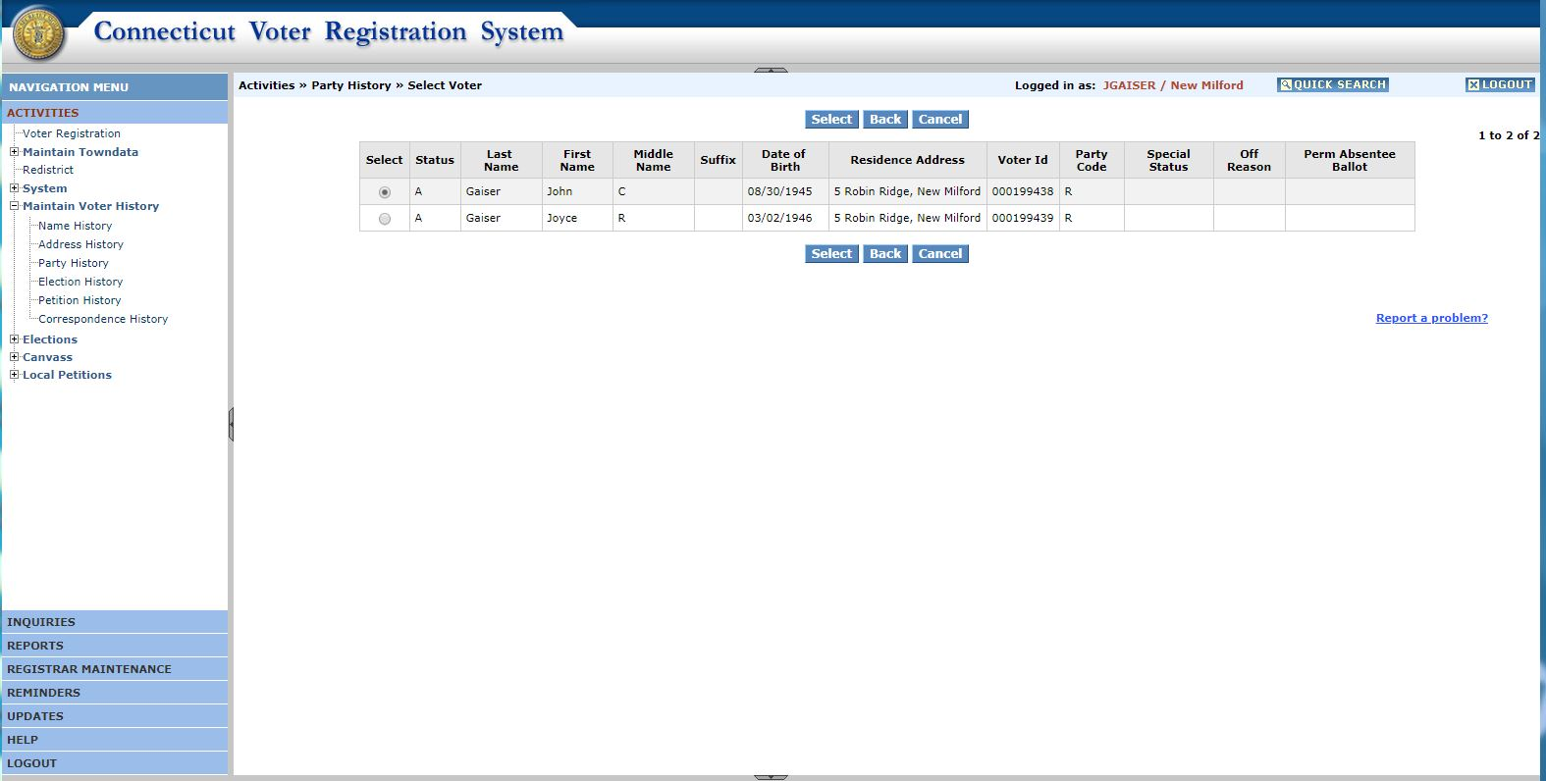
Select Voter, in this case John Gaiser
00/00/00
67 Main St, Anytown
00000000

Slide 5
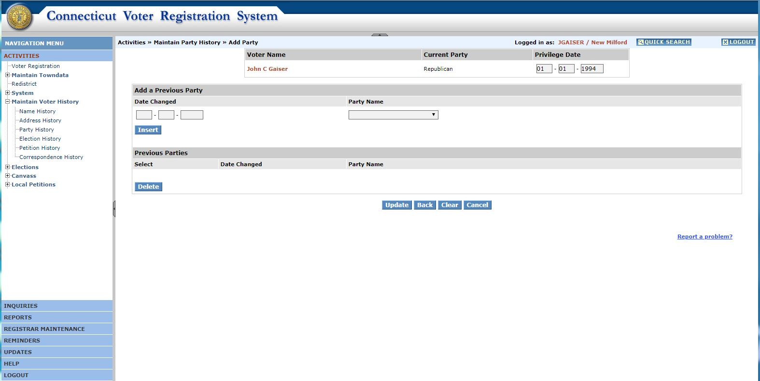
Once selected, this screen displays

Slide 6
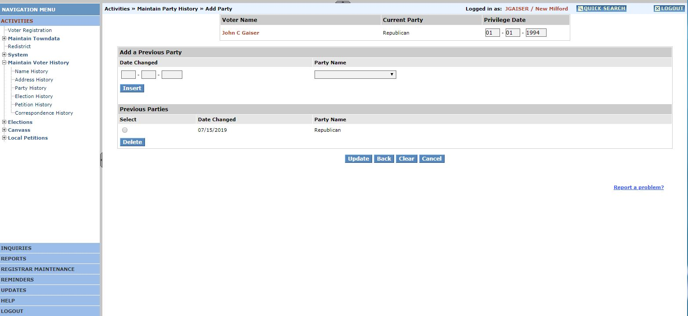
Be sure to “Insert”, then click “Update”.
The screen displays the voter name, current party enrollment and the privilege date. To add party history, enter the date the party changed in Date Changed (MM-DD-YYYY). Choose a Party Name from the drop-down box, click on INSERT button. The data just entered will be displayed in the Previous Parties section of the screen.

Slide 7
Once selected, this screen displays
To delete a previous party, using the mouse, click on the Select button in front-of the line that should be deleted, and click on the Delete button. The line will be deleted from the screen, but remember no permanent updates will be made until the user clicks on the Update Button. Multiple insert and/or delete requests are allowed; and must be done prior to using the Update button.

Slide 8
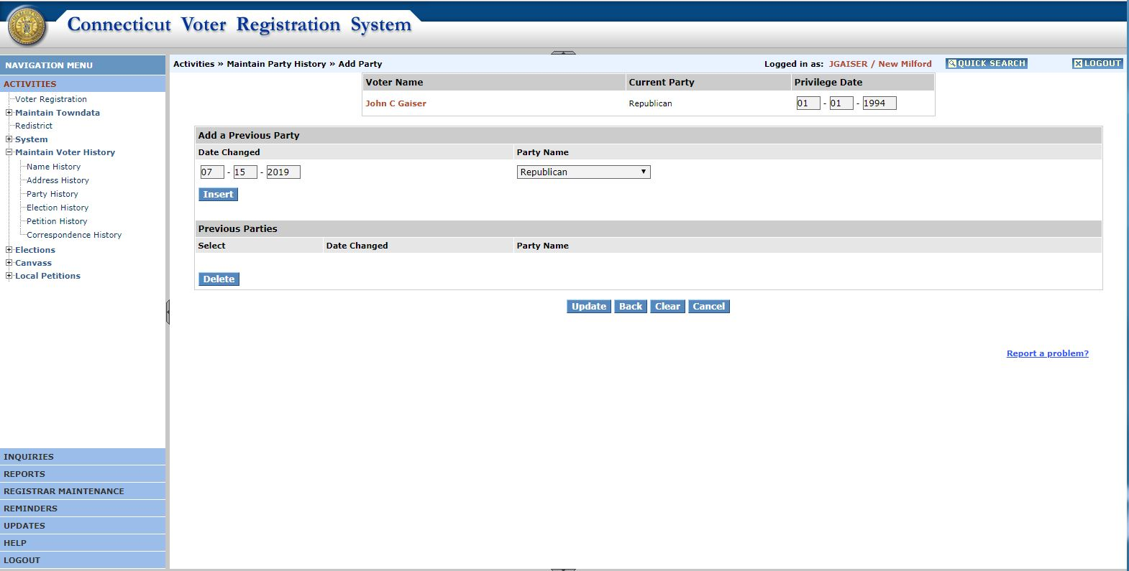
Fill in the effective date of change, and party.
Privilege Date can not be prior to Date Changed date
The user may also change Privilege Date on this screen. Check against the inserted “date changed” field, thus checking previous party history records and verify this entered value with this information:
- Not allowed to be spaces; must be a valid date
- Can NOT be prior to any date changed
- Can be a future date

Slide 9
Fill in the effective date of change, and party.
Privilege Date can not be prior to Date Changed date
To update, click on the UPDATE button. The update request will only update those records that are displayed within the Previous Parties section. Once the update is done the transaction will be processed and the Conﬁrmation Screen will be displayed. Click on Maintain Voter Party History to return to the Search-Maintain Party
History screen.

Slide 10
Be sure to “Insert”, then click “Update”.

Slide 11
Maintain Party History Summary from CVRS manual
This function is typically used to correct party change information. Any existing previous party records will be displayed in the Previous Party section of the screen. There is a limit of 16 previous party records for this system.
The user should use this function for the following types of changes:
1. When the voter’s party was changed incorrectly during the change voter registration process. In this case, the speciﬁed previous party history records
are deleted, and the privilege date is corrected.
2. To correct the calculated privilege date to an earlier date when the change voter transaction should have been processed in a timely manner. Changes to
privilege date affect the Ofﬁcial Voter List report.

Slide 12
The screen displays the voter name, current party enrollment and the privilege date. To add party history, enter the date the party changed in Date Changed (MM-DD-YYYY). Choose a Party Name from the drop-down box, click on INSERT button. The data just entered will be displayed in the Previous Parties section of the screen.
There is a limit of 16 previous party history records that will be retained by the system, and thus displayed on this page. If the user tries to enter more than 16
previous parties, or there are already 16 previous parties, the user will receive an error message. The user needs to delete at least one party, before being allowed to add an additional party history.
To delete a previous party, using the mouse, click on the Select button in front-of the line that should be deleted, and click on the Delete button. The line will be deleted from the screen, but remember no permanent updates will be made until the user clicks on the Update Button. Multiple insert and/or delete requests are allowed; and must be done prior to using the Update button.

Slide 13
The user may also change Privilege Date on this screen. Check against the inserted “date changed” field, thus checking previous party history records and verify this entered value with this information:
Not allowed to be spaces; must be a valid date
Can NOT be prior to any date changed
Can be a future date
Important Note: Changes to “privilege date” on this screen may impact the voter’s eligibility date for the next afﬁliated party’s primary. All voters not eligible to vote in the party’s primary are included in the exception section of the Ofﬁcial Voter List report.
To update, click on the UPDATE button. The update request will only update those records that are displayed within the Previous Parties section. Once the update is done the transaction will be processed and the Conﬁrmation Screen will be displayed. Click on Maintain Voter Party History to return to the Search-Maintain Party
History screen.

Slide 14
Page Display Information:
Reguired Fields: Privilege Date (pre-loaded)
Conditionally Required Fields: Date Changed, Previous Party
Optional Fields: None
Action Buttons:
INSERT The data just entered will be displayed in the Previous Parties section of the screen
DELETE Selected line(s) will be deleted from the screen display, awaiting Update.
UPDATE The update request will update those records that are displayed within the Previous Parties section only.
RESET will restore the screen to its initial state.
CANCEL Will bring the user back to the Search Maintain Party History Screen,
without making any permanent changes to the voter.

