Slide 1
OFFICE MANAGEMENT
New Registrars Day
Kevin McCauley – kmccauley@bristolct.gov
860-584-6165
Notes:
Bristol is a full time office, open M – F (8:30 am – 5:00 pm). A full time Office Coordinator/Manager & 2 Registrars. Deputies work on an ‘as-needed” basis helping with canvass stuffing of envelopes, inventory & election preparedness, such as supervised balloting. Deputies also work in ROV office on election day from 4:30 am to post return of poll station moderators.

Slide 3
Teamwork begins with checking egos and party affiliations at the ROV door. By statute, you must be non-partisan in your duties to fulfill statutory requirements. Follow our Code of Ethics.
No talking politics
No conducting town committee business
Don’t steer voters toward one party or the other
Remind visitors to talk politics outside
Answer the phone generically
By following this protocol, managing the office becomes less stressful.
Notes:
Get to know each others strengths and weaknesses, then go from there to sort out duties & tasks to optimize results. Continually re-assess and discuss your progress, issues, frustrations, and struggles to limit duplicated efforts or unfinished /forgotten items from going unnoticed (slipping through the cracks).

Slide 4
Notes:
SOTS November 5, 2019 Election Calendar. Cover page has Key Dates that you should take notice of each election year.

Slide 5
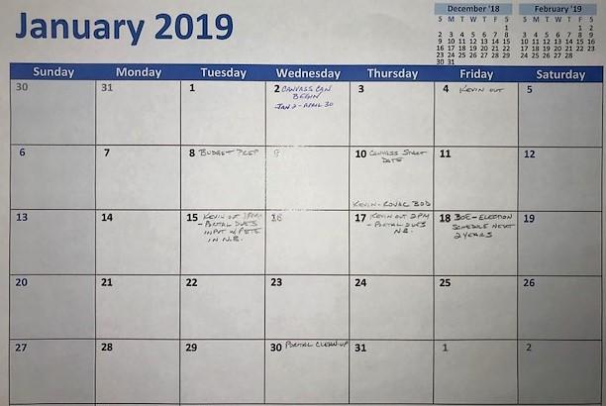
Notes:
From the SOTS Election Calendar provided to us via email from SOTS each year, transfer all pertinent reminders & actions to an office calendar or white board that everyone in ROV office has access to. Use this for quick/easy review of actions needed to be accomplished for the day, month or upcoming months. It will also help in planning upcoming events (such as Registration Drives) or when you’ll need support from Deputies or ARs.

Slide 6
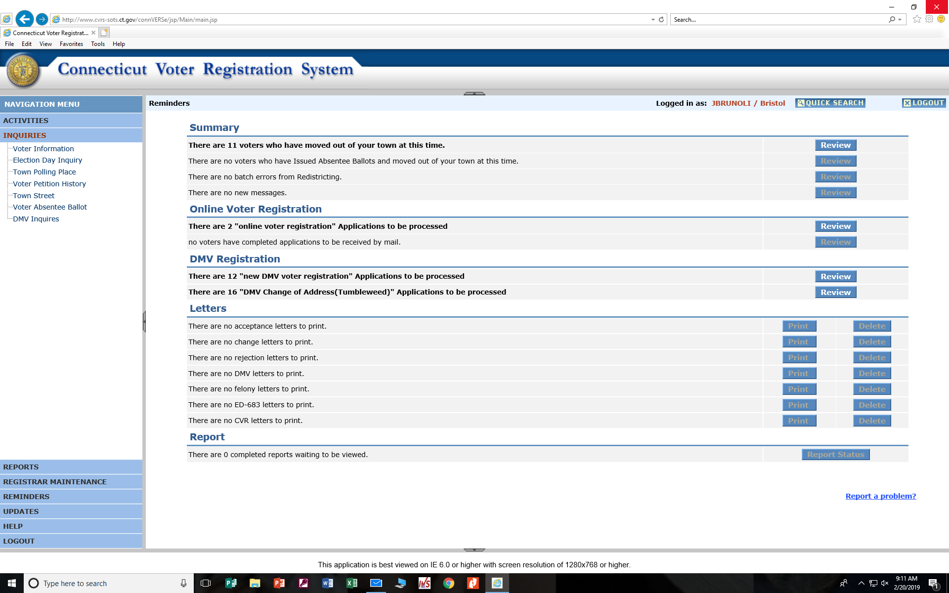
Notes:
One of the 1st things you want to look at when your day begins is the Reminders Page of CVRS – which is the default page that opens when you sign in. Be sure to “Review” each list and process accordingly.

Slide 7
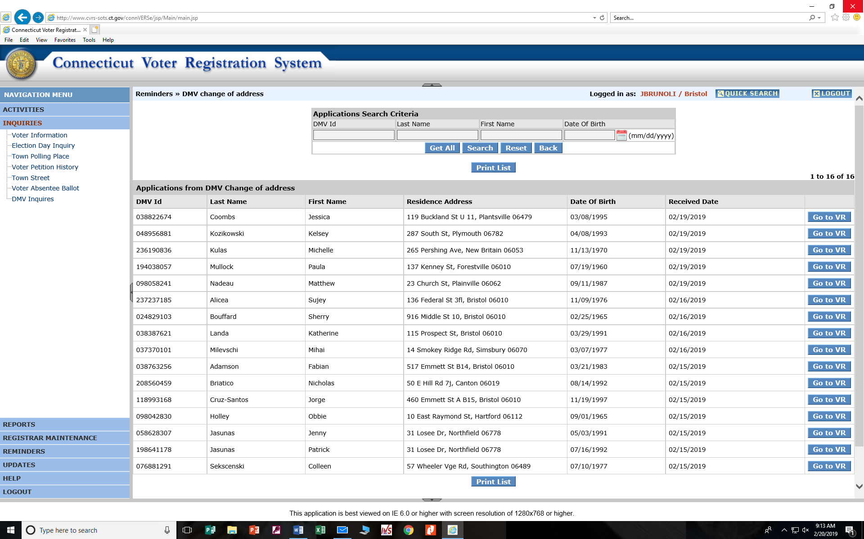
Notes:
The previous Reminders Page showed 16 DMV VR- Change of Address (Tumbleweed) applications to be processed. Here we see the “Review” page of this list.

Slide 8
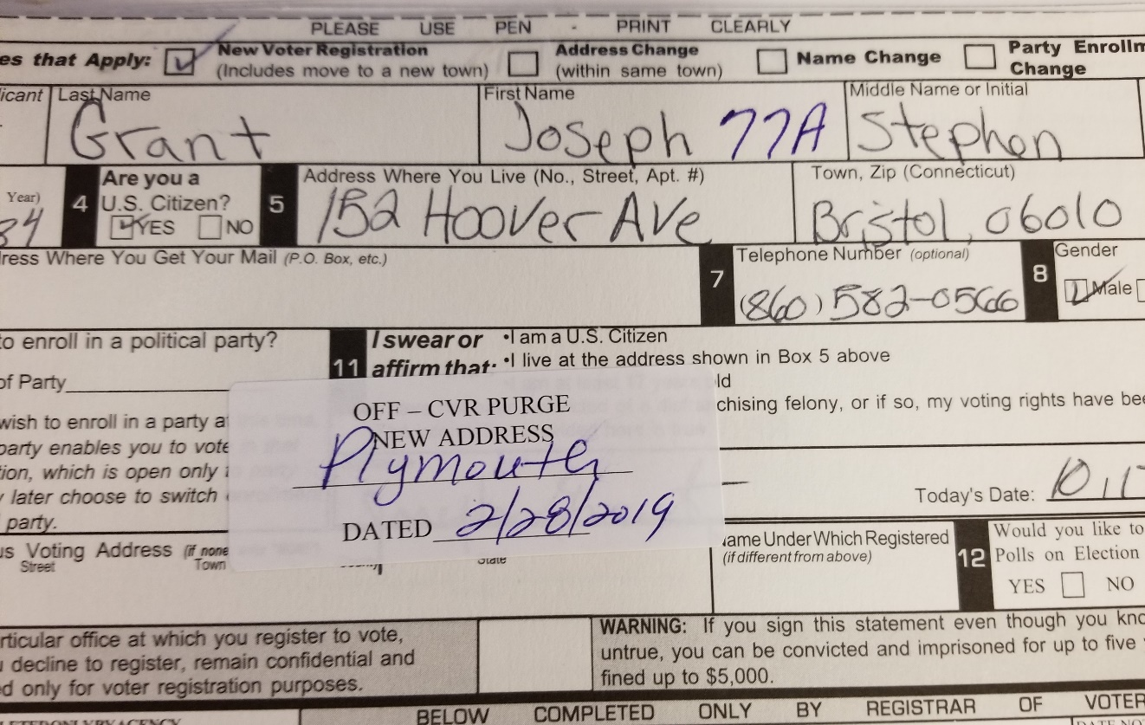
Notes:
The Previous Reminders Page also showed 11 voters who have moved out of your town at this time. Above shows that list from clicking the “Review” button. Process accordingly. Also shown is a VR card that was pulled from our Active or Inactive file. We placed an “OFF – CVR PURGE NEW ADDRESS” label on the back of card and placed in the OFF file. Bristol also uses other labels on back of cards for Canvass and Obituaries, as seen on next slide. The example card above remains in the “Off” file until the elector shows up on a future In State Cancellations List (like above) in 4 years – or 1 year if because of a death.
NOTE – The **PURGED** names are already in the “Off” file, so these get moved to the “Purged” file and upon approval from Records Disposition Authorization (RC-075), they can be destroyed.

Slide 9
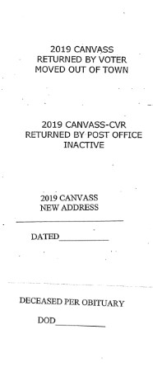
Notes:
Example Labels to use on back of VR Cards with Canvass and Obituaries. You can print these out on 30 per page mailing label sheets.

Slide 10
Notes:
Reminders Page showing all names processed and cleared and all pertinent letters printed and cleared.

Slide 11
Notes:
One of many “Unofficial” or “Friendly” letters that our office uses. We created a shared file for the ROV office, where we can access different letter templates and modify as needed. In this example, we include a paper copy of the Registration Card, along with a postage paid return envelope. Sarah registered online using the last four of her SSN rather than her D.L. number, so there is no signature which makes this application incomplete.

Slide 12
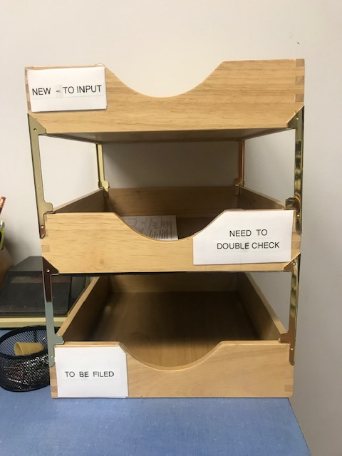
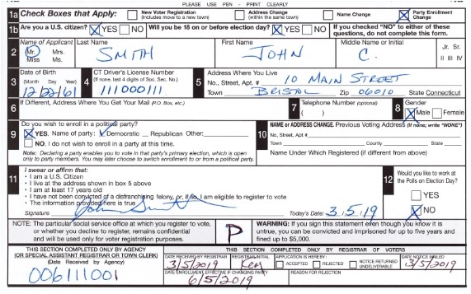
Notes:
A common task is processing walk-in electors or new voter applicants. This shows a request for a Party Enrollment Change from an existing elector in town. Once this was processed through CVRS, his old card was removed from the Active card file (with a marker left in place) and taped to the back of the new card. Blue arrow shows that a “P” was written for “In-Person” designation. Green arrows show the important items to remember – what party changing to & restriction date (if applicable). Then place in our “NEED TO DOUBLE CHECK” tray for review by second set of eyes. Once confirmed, check off ACCEPTED Box and place in “TO BE FILED” tray or place back in Active file.

Slide 13
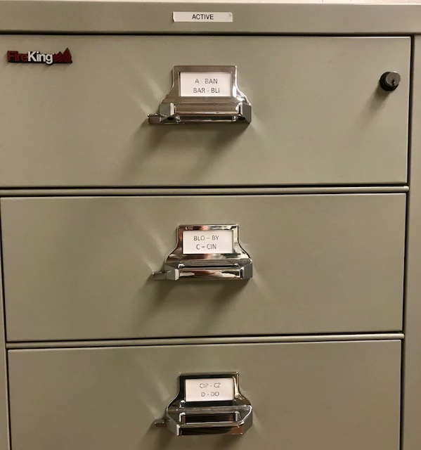
The registrars shall also enter such voter information in the state-wide Centralized Voter Registration System (CVRS) and shall maintain such voter information for “Active" electors in a fire-proof cabinet in the registrars' office. Reg.9-23b
Notes:
Bristol uses FireKing fire-proof cabinets with two-row card drawers. The next slide shows our invoice for the purchase of 3 in December, 2015. We got approval for these through our budget proposal under ‘Capital Investments” for a “One-Time” purchase, where we included the statute.

Slide 14
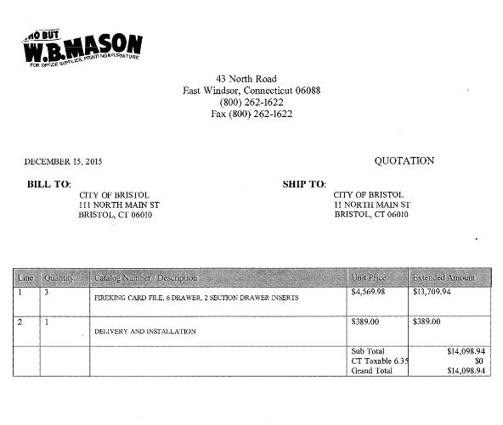

Slide 15
Notes:
There is a recurring theme stressing the importance of cooperation. You decide who which role you play based on each others strengths (and weaknesses). We are all a work in progress – no matter how long we’ve been election administrators. Our roles are always evolving as we learn new and more things.

Slide 16
Notes:
Example of an online newspaper Obituary page. We want to check the obituaries as often as possible in order to keep current with your active list. If applicable, change to “Off” in CVRS, pull VR card from the ‘Active” file and move to the “Current Deceased” file.

Slide 17
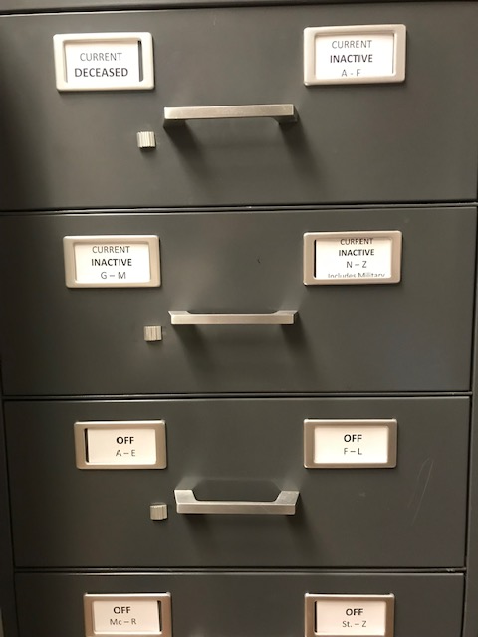
Daily/Weekly/Monthly Check of Deceased Voters
Local Paper’s Obituaries
Funeral Home Tributes
www.Legacy.com
ERIC Report
Town Clerk’s Report
Notes:
Other reference areas to check obituaries.

Slide 18
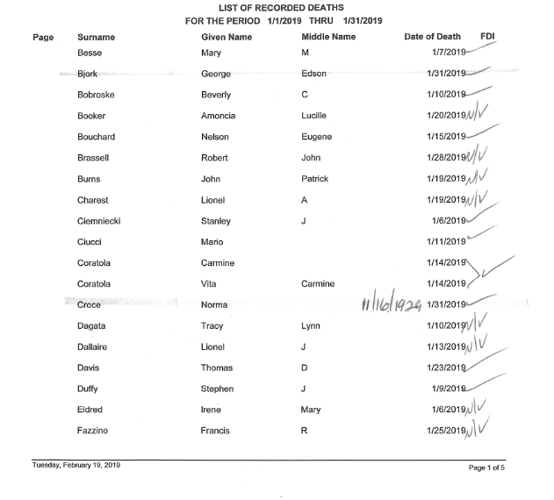
Town Clerk’s Report
Notes:
Example of a Town Clerk’s Report. This is a monthly report given to the ROV office.

Slide 19
Notes:
Conviction Release Report sent monthly via email from SOTS. Pull up on CVRS - if name is listed, state their release date in “Memo Field”, so if they make contact to be restored, you’ll have the information to process.

Slide 20
Notes:
Conviction Report sent monthly via email from SOTS. Pull up on CVRS – if registered, change status to “Off” and click on “Felon” from change reason drop down menu. NOTE: This will generate a “Notice of Forfeited Electoral Rights” letter to be mailed certified mail to the felon explaining they have (10) ten days to provide proof of why they should not be removed from the Voter Registry List. If returned undeliverable, [place letter on file until Records Retention allows for proper disposal.
Pull VR card from file and place in “Off” file.

Slide 21
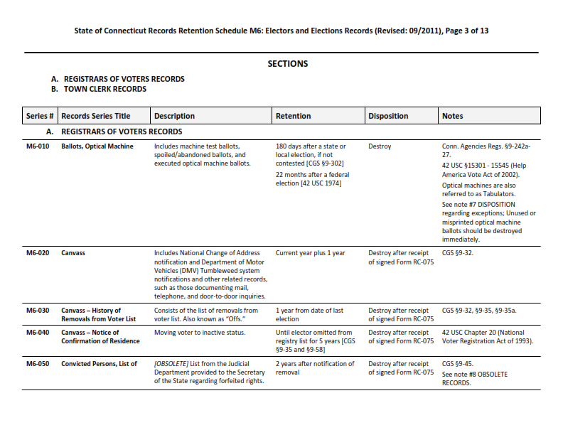
Notes:
Page 3 of 3 of the Records Retention Schedule.

Slide 22
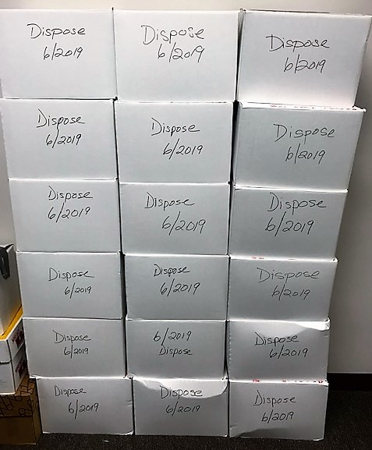
Notes:
Ballots and other election materials boxed and marked for records retention/disposal dates.

Slide 23
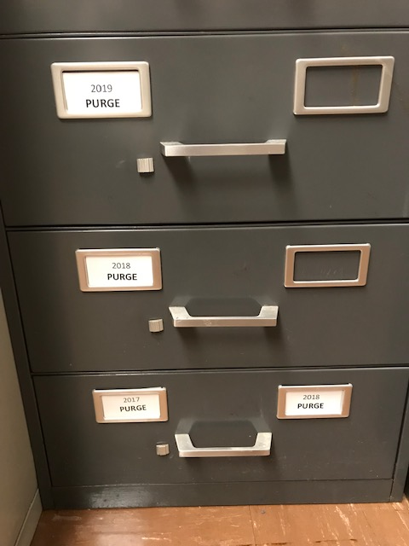
Notes:
Usually done once a year, you can complete a Records Disposition Authorization Form (RC-075). This form (and the schedule) can be found at: www.cslib.org/publicrecords

Slide 24
Notes:
One of a few additional annual forms you should be aware of, the Town Clerk may take care of this for you or ask you to complete.

Slide 25
Notes:
ERIC Voting Project – Received from SOTS via email, complete and return to SOTS via U.S. mail.

Slide 26
Notes:
Canvass of Electors Report – Completed and sent to SOTS via U.S. mail upon completion of Canvass.

Slide 27
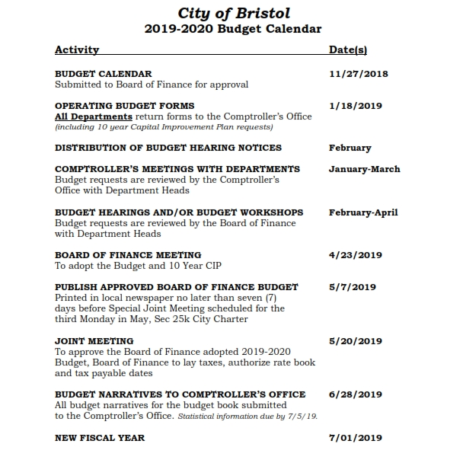
Notes:
Ask for a budget calendar/schedule from your town for the upcoming fiscal year. Plan to begin working on your budget as early as possible, usually December for a July 1 FY. This will give time to refining prior to submitting proposal the first of the year. Examples of narratives and line item budgeting on next couple slides.

Slide 30
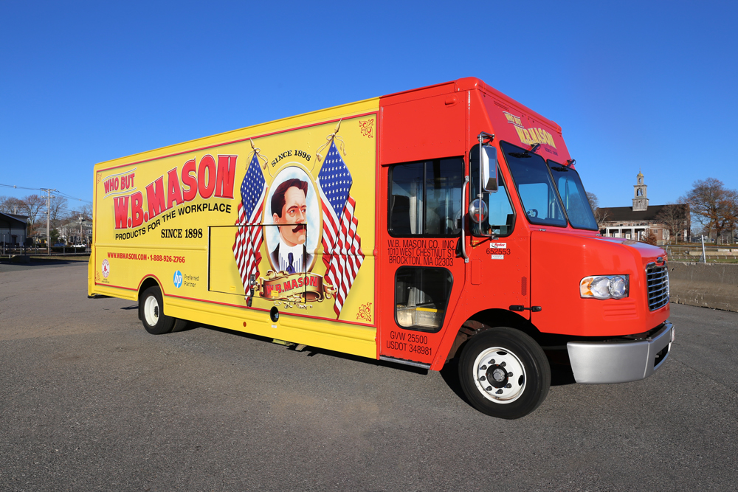
SUPPLIES!
Notes:
Bristol has a contract with W.B. Mason, so we use them for most of our office supplies. We use Adkins for our ballots, LHS for memory cards & seals and a local print shop for our envelopes (business reply, general correspondence & canvass).

Slide 31
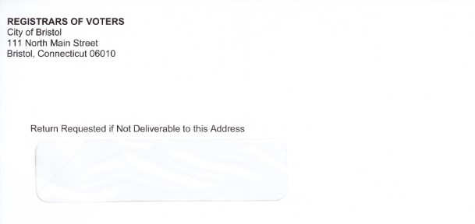
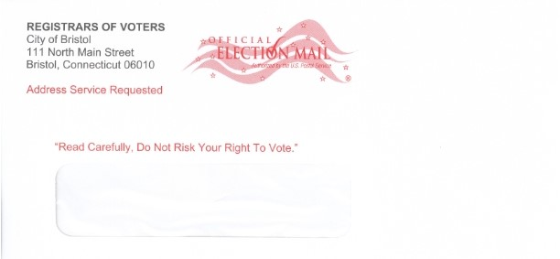
Reg. 9-35-1b
Notes:
By statute (Reg. 9-35-1b), specific wording and placement is required for canvass envelopes. Top example shows a confirmation letter envelope and the bottom example shows the canvass envelope.

Slide 32
Election Checklist
Notes:
As we approach election time, we use a modified checklist of that found in the ROVAC Handbook, adding dates and actions specific to our office and town.

Slide 33
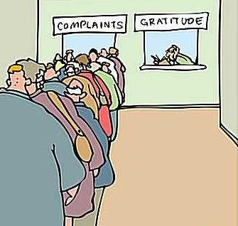
If you want to be incrementally better, be competitive.
If you want to be exponentially better, be cooperative.

Slide 34
In closing, strive to get as many of the complainers over to the Gratitude line!
Agree to disagree and compromise is especially important for any election decisions, such as ballot ordering. This goes a long way in avoiding pitfalls or problems which can quickly manifest to a SEEC complaint, which hurts your entire office and ROVAC on the whole. With each complaint, you can count on negative headlines that will undermine the electors’ confidence in your office. Public perception is also a reality, whether getting along famously with your co-registrars or not.
Party allegiance is definitely put on hold at election time.
Embrace the awkwardness of new office dynamics and rise above to ask the questions that will make you more comfortable with your role. You should follow the same principles as opportunities present themselves, such as at seminars or conferences. Ask fellow registrars and deputies how they or their office perform certain tasks. If you don’t have to re-invent the wheel, then don’t. Modify and adjust to what works best for your ROV office.
Contact your fellow registrars for support. Attend your County meetings. Engage in conversations with other members, wherever you encounter them.
Listen intently to what is discussed, shared or answered!

