Slide 1
Election Day Preparation
A quick review

Slide 2
Resources
Calendar
ROVAC Handbook
SOTS
Moderator’s Handbook

Slide 3
Calendar
Step by step guide for compliance

Slide 4

Voter Registration
9-17 to 10-15: mail acceptances w/in 4 days:
10-16 to 10-22: mail acceptances day of receipt

Slide 5
Notices
September 25th: publish October 1st, Preliminary list session
Registrar chooses hours as necessary.

Slide 6
Notices
Publish between Oct 14 and Oct 23 to a public notice for Oct. 29th: 7th day prior to election
Publish between Oct 20 and Oct 29 to a public notice for Nov. 4th: last weekday prior to election.
None need be legal notices.
ROVAC will publish
Email Sue Larsen with your media contacts
  sue.larsen@southwindsor.org

Slide 7
Polling Places
Oct 4th is last day to certify polling places for election.
Certification to SOTS on EMS

Slide 8
Certificate of Ballot Order
Due Oct. 4th
How Many to order
EMS: Town Clerk must complete before registrars.
Allow for spoilage

Slide 9
Absentee Ballots
Oct. 4th :
ABs become available from TC.
Registrars may direct TC to send to electors:
(1)electors outside U.S.; (2) Service members, spouse, or dependent

Slide 10
Absentee Ballots cont.
Oct. 25^{h} :
Last day to notify TC of Central Counting for AB.
Oct. 29th: can begin to check off Abs ( sec. 9-140(b)

Slide 11
Testing The Tabulators
Tested by 10th day before election: Oct 26th.

Slide 12
Testing The Tabulators
The IVS machine will create test ballots
Can vary number of ballots
Minimum of 27 including blank and fully voted ballots
Saves time.

Slide 13
Testing The Tabulators
Covers most balloting contingents
You may manually fill in ballots if IVS is not sufficient.

Slide 14
Testing The Tabulators
Check ink
Check tape
Change date and time if necessary

Slide 15
Who to notify
Observers must understand their roles are strictly observational
must not involve themselves in the process. Will be asked to leave if they interfere.
Must sign moderator return
Party Chair persons
Public (Posted)
Candidates

Slide 16
Emergency Plan
Every Municipality should have its own plan. State has template
Update regularly
Educate Moderators

Slide 17
Moderator’s Packet
Moderators’ forms: see moderator’s handbook
Tally sheets (2 copies)
EMS has Tally Sheets
  Include hand counted tally sheets

Slide 18
Pre-Day/night setup
Setup the polling station
Tables/chairs
Signs
Flag

Slide 19
Poll Workers
Oct . 15^{th:} last day to appoint poll workers
EMS: moderator and head moderator

Slide 20
Poll Workers: Who can work the polls
  No Candidates
  Relation to Candidates?
  Municipal elections are tricky

Slide 21
Who can Work cont.
Use out of town workers if necessary
Asst. Reg. and Tab Tenders must be residents of town
Must have Asst Reg from both parties

Slide 22
Training
Meeting with Moderators and AR’s
Meeting with line poll workers (Checkers, Ballot Clerks, Machine Tenders) Must sign into training
Meeting with Abs Moderator and counters

Slide 23
Resources:
SOTS HAndbooks
Moderator’s Handbook
https://portal.ct.gov/-/media/SOTS/ElectionServices/Handbooks/2013ModeratorHandbookpdf.pdf?la=en
Moderator’s Return
https://portal.ct.gov/-/media/sots/ElectionServices/LEAD_Communications/2014/Aug82014BlankModeratorsReturnSaveablepdf.pdf?la=en

Slide 24
Poll Training Moderators
Opening procedures/forms
Setting up booths
Changes in laws and Regs
Paperwork
End of night procedures/forms

Slide 25
Training: Asst. Registrars
Paperwork for Registrar
IVS Setup
ID requirements

Slide 26
Poll Training: Checkers
ID Requirements
Different drivers’ licenses as ID
Different forms of ID
Those pesky * don’t count!

Slide 27
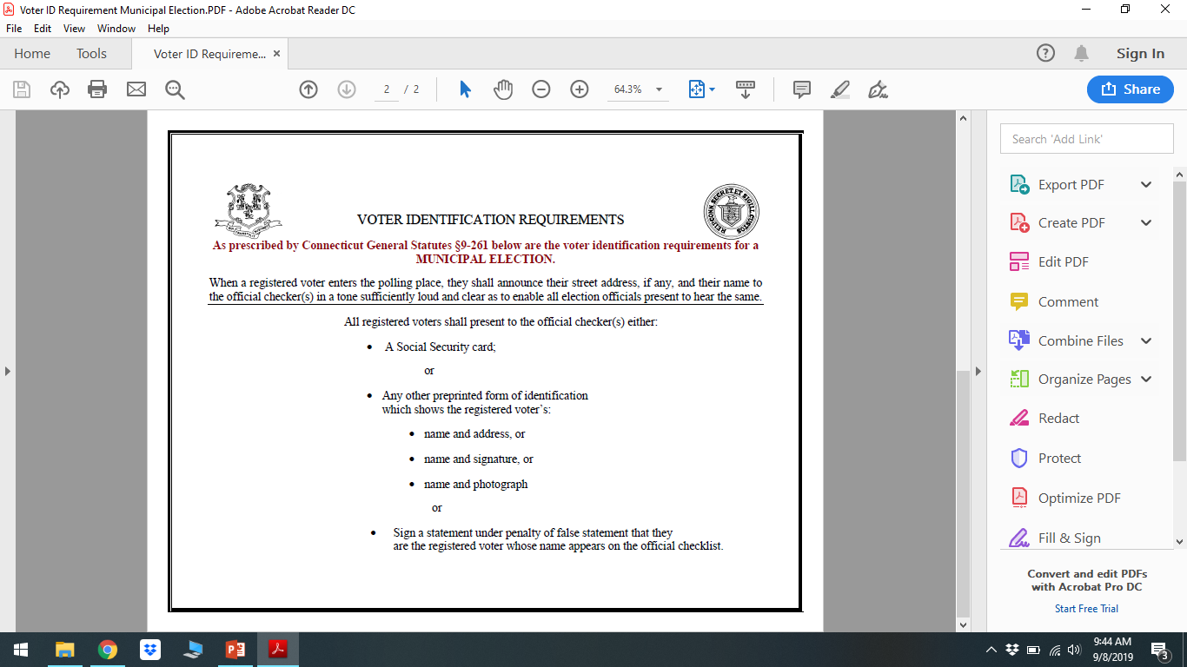

Slide 28
Poll Training Subjects
Ballot Clerks
        Duties
        Abandoned Ballots

Slide 29
Poll Training Subjects
Tabulator/Machine Tender
        Duties

Slide 30
Poll Training Subjects
      Demonstrators
        Role in polling place

Slide 31
LHS Maintenance
Machines should have been serviced
Call Ryan if this has not been done
Check write-in deflector
Battery back-up (batteries)

Slide 32
EDR Refresher
Where can it be held
Look at prior municipal elections.
Usually not as heavy as even years.
Not a polling place…yet!
75 ’ sign is needed
IVS is set-up!

Slide 33
Questions?????

