Slide 1
Duplicates
Duplicates
ROVAC Spring Conference
April 15 – 17, 2019

Slide 2
Duplicates
Duplicates
Problem:
Same voter appears to be registered in multiple towns.
Notes:
Duplicates are the voter registration process gone wrong!
Generally, it is existing voters incorrectly entered as new!
Occurs frequently as a result of EDR activity, ROV workers misunderstanding or a miscommunication of the voter registration process... frequently resulting from new, inexperienced workers and many times it’s a result of name change because of marriage or even change of gender.
It is the responsibility of the town with the most recent Privilege/Registration date to research and initiate action on potential duplicates. Because of Canvass, you may wish to wait until after initial CVR letters are sent to begin work on the duplicate list. (§9-21a(b)).

Slide 3
Duplicates
Duplicates
Same voter registered in multiple towns.
Causes:
Existing voter incorrectly entered as new.
EDR activity or, ROV workers
Misunderstanding or a miscommunication of the voter registration process
Mistakes by new, inexperienced workers.
Notes:
Duplicates are the voter registration process gone wrong!
Generally, it is existing voters incorrectly entered as new!
Occurs frequently as a result of EDR activity, ROV workers misunderstanding or a miscommunication of the voter registration process... frequently resulting from new, inexperienced workers and many times it’s a result of name change because of marriage or even change of gender.
It is the responsibility of the town with the most recent Privilege/Registration date to research and initiate action on potential duplicates. Because of Canvass, you may wish to wait until after initial CVR letters are sent to begin work on the duplicate list. (§9-21a(b)).

Slide 4
Duplicates
Duplicates
Solution: Short version
§9-21a(b)
LEAD memo 2/18/2017
ROVAC Handbook Ch 6, p. 36
READ THEM KNOW THEM USE THEM!

Slide 5
Duplicates
Duplicates
Solution: Short version
§9-21a(b)
READ THEM KNOW THEM USE THEM!
Notes:
Sec. 9-21a. Search of computerized voter registration records. Duplicate registrations.
(a) The Secretary of the State, at such times as the Secretary determines, may cause a search to be made of computerized voter registration records to identify electors who may be registered in more than one town. The Secretary may compile, from such search, a list of possible duplicate registrations in any town or towns and transmit such list to the registrars of voters of the appropriate town or towns.
(b) Upon receipt of such list from the Secretary, the registrars may make such additional investigation as they deem necessary to determine if any elector in their town whose name appears on such list was previously registered in another town. The registrars of voters shall send to each elector on the registry list in their town, who the registrars of voters determine to be the same person who was previously registered in another town, a notice of duplicate registration in a form prescribed by the Secretary of the State stating that (1) based on a computer search of voter registration records it appears that the elector may have been registered to vote in another town before registering in the registrars' town, (2) as the result of such previous registration, the elector is no longer entitled to remain on the registry list in the previous town, and (3) unless the elector contacts the registrars of voters within thirty days to confirm that the elector is still entitled to be on the registry list in the previous town, the elector's name shall be removed from the list. The notice of duplicate registration shall include a form on which the elector may confirm that the elector is entitled to be on an active registry list because the elector is a bona fide resident of the registrars' town and either is not the person whose name appears on the registry list of another town, or has registered in the registrars' town after registering in any other town.
(c) When an elector whose name appears on the inactive list files the confirmation provided for in this section, the elector's name shall be restored to the active list. No elector shall be removed from the registry list pursuant to this section unless both registrars of voters agree that such elector has subsequently registered to vote in another town.

Slide 6
Duplicates
Duplicates
Solution: Short version
LEAD memo 1/18/2017
READ THEM KNOW THEM USE THEM!

Slide 7
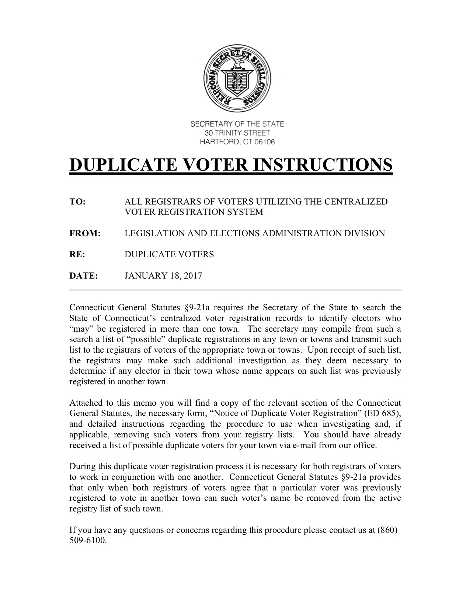

Slide 8
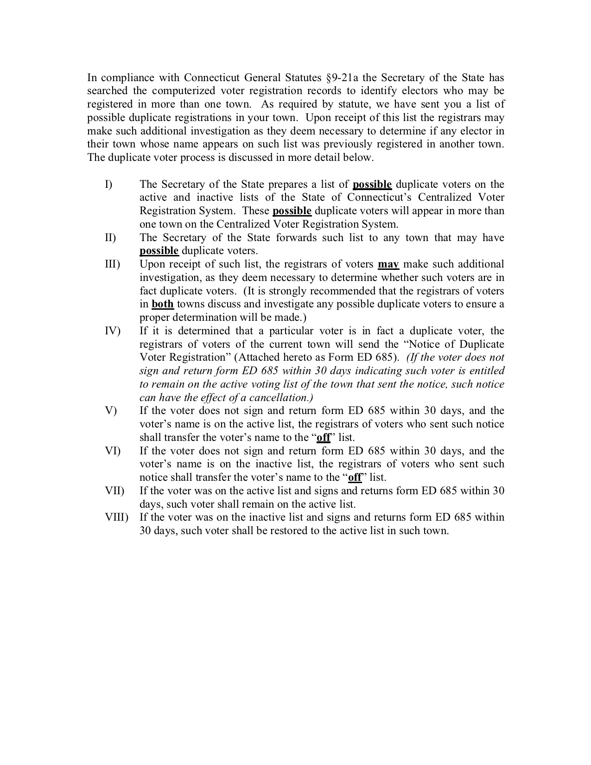

Slide 10
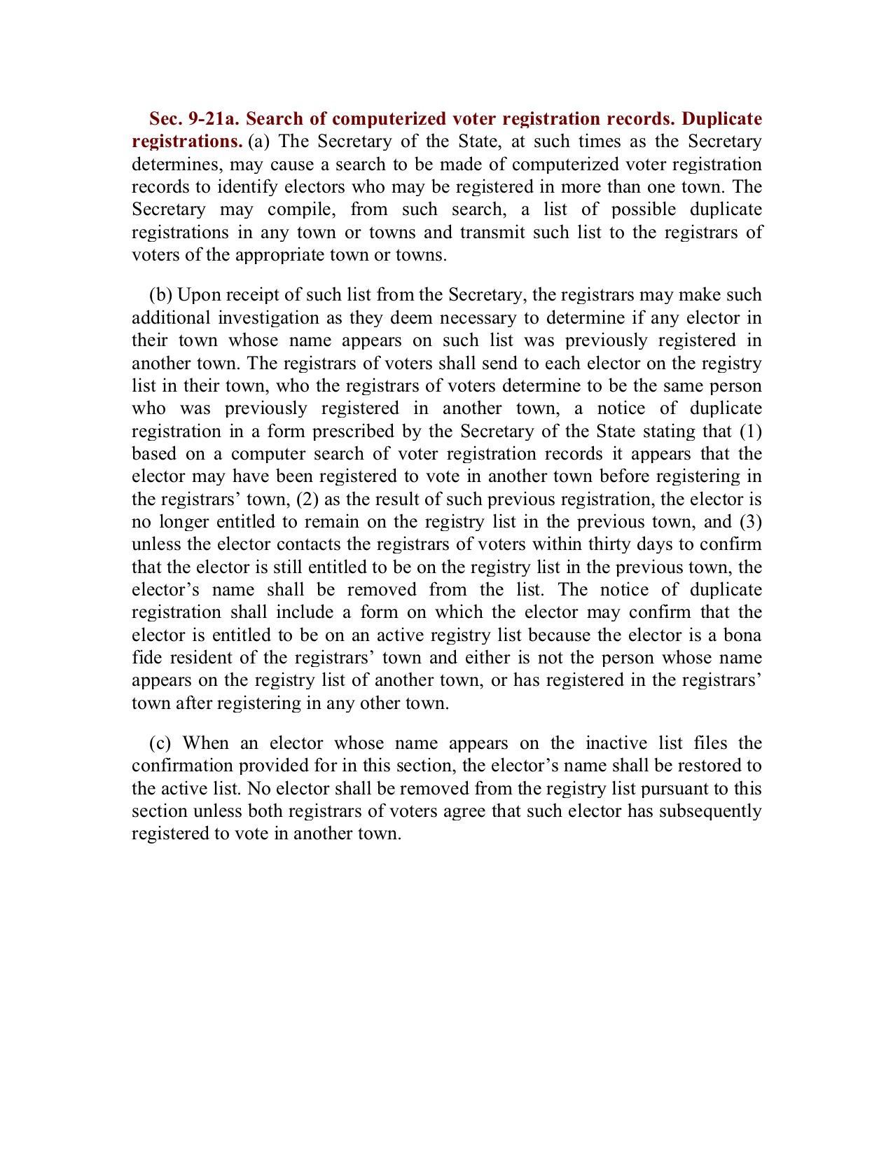

Slide 11
Duplicates
Duplicates
Solution: Short version
ROVAC Handbook Ch 6, p. 36
READ THEM KNOW THEM USE THEM!
Notes:
Finally the ROVAC Handbook. We are going to review the process outlined by the handbook and hopefully put everyone on the same road to duplicate free (or at least minimum) voter registrations.

Slide 12
Duplicates
Duplicates
Solution: Short version
LIST
RESEARCH
ACTION
Notes:
12

Slide 13
Duplicates
Duplicates
LIST

Slide 14
Duplicates
Duplicates
SOTS sends a file showing possible duplicate records in the CVRS system based on:
First Name
Last Name
Birth Date
Active, Inactive and Off status
Notes:
Each year, SOTS sends a file showing possible duplicate records in the CVRS system. These are based on First Name, Last Name and Birth Date (in Active, Inactive and Off status) (§9-21a). SOTS at work!! Please note that SOTS does NOT look middle initials.

Slide 15
Duplicates
Duplicates
RESEARCH
Notes:
When the most recent town has inserted and updated all information into the original record (including the registration date), print copy of online voter reg. card (if applicable) and delete the newer record.

Slide 16
Duplicates
Duplicates
Correction Process
If :
Voter appears twice in CVRS (in different towns) as a true duplicate
the objective is to preserve the ORIGINAL record with its ORIGINAL data.
Town with the most recent Privilege/Registration date to research and initiate action on potential duplicates.
Notes:
If a voter appears twice in CVRS (in different towns) as a true duplicate, the objective is to preserve the ORIGINAL record with its ORIGINAL data.
If you have duplicate records for the same voter in your own town, make note of both Voter ID numbers. Eventually you will insert all the information from the newest file into the older file, update, and delete the newer file. You should finish with only one complete record for that voter.
In most cases, it is easier to pull the older record and update with newer information. Preserving only the new record will jeopardize loss of voter history.
The primary objective is to preserve the original voter and oldest data
It is the responsibility of the town with the most recent Privilege/Registration date to research and initiate action on potential duplicates. Because of Canvass, you may wish to wait until after initial CVR letters are sent to begin work on the duplicate list. (§9-21a(b)).

Slide 17
Duplicates
Duplicates
Correction Process
“It is strongly recommended that the registrars of voters in both towns discuss and investigate any possible duplicate voters to ensure a proper determination will be made.” (LEAD memo)
Notes:
Both towns need to communicate. “It is strongly recommended that the registrars of voters in both towns discuss and investigate any possible duplicate voters to ensure a proper determination will be made.” (LEAD memo)

Slide 18
Duplicates
Duplicates
Correction Process
Only when both registrars of voters from both towns agree that a particular voter was previously registered to vote in another town can such voter’s name be removed from the active registry list of the “old” town. (CGS §9-21a)
Communication is important
Notes:
If both towns agree with the discoveries, then then the voters record who no longer votes in the “old” town can be removed. We want to take action on the old voter record.
We use the concept of “old town” and “new town” to differentiate between municipalities and to assist in defining a “time line”.

Slide 19
Duplicates
Duplicates
Correction Process
Duplicates with an “on-line” record
the “on-line” record must be preserved if it is the correct/latest voter registration application.
Includes name change, address, and voter history
Notes:
If any of the duplicates have an “on-line” record, the “on-line” record must be preserved if it is the correct/latest voter registration application.
This activity maintains history of voter.

Slide 20
Duplicates
Duplicates
Correction Process
Duplicate records in your own town
make note of both Voter ID numbers
insert all the information from the newest file into the older file
Update
delete the newer file
You should finish with only one complete record for that voter
Notes:
>make note of both Voter ID numbers. Can’t emphasize enough. Best way to differentiate between voters.
>insert all the information from the newest file into the older file, specifically election history.
>Update
>delete the newer file
>You should finish with only one complete record for that voter
Thus, we have the short version of the Process.
And now the details

Slide 21
Duplicates
Duplicates
Correction Process
INACTIVE OR ACTIVE STATUS—IN YOUR TOWN
Most recent town initiates research of duplicate registrations.
Use the same research procedures used with a new voter to determine whether you should pull a record from another town.
Notes:
Start by redoing the voter registration process;
>Activities >Last Name >First Name >DOB
High probability you will find an existing voter somewhere in CT (your town, other town).

Slide 22
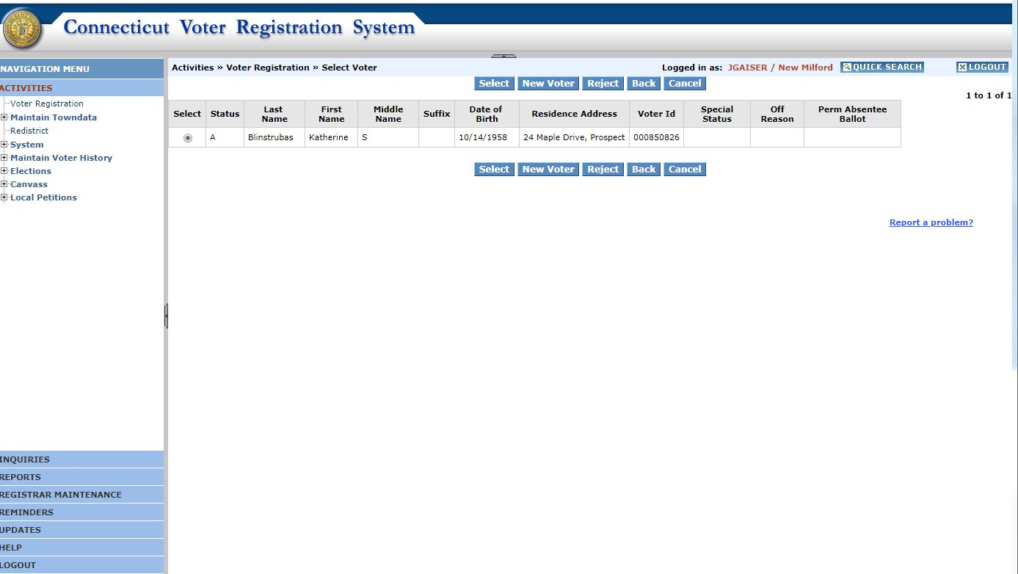
Notes:
E

Slide 23
Notes:
E

Slide 24
Duplicates
Duplicates
Correction Process
INACTIVE OR ACTIVE STATUS—IN YOUR TOWN
COMPARE middle initials, name changes, and other changes.
Request copies of voter registration cards, if needed, to compare signatures, DMV numbers or SSNs.
Notes:
In many cases, it will be simple and data will jump out that “we missed this one”.
If not simple then,
> COMPARE middle initials, name changes, and other changes.
> Request copies of voter registration cards, if needed, to compare signatures, DMV numbers or SSNs.

Slide 25
Duplicates
Duplicates
Correction Process
INACTIVE OR ACTIVE STATUS—IN YOUR TOWN
Use “Inquiries” search – statewide – to view voter’s previous addresses or name changes in previous town’s records.
Use any available phone numbers to request information from voter.
Notes:
Not easy, then:
Use “Inquiries” search – statewide – to view voter’s previous addresses or name changes in previous town’s records.
Use any available phone numbers to request information from voter.

Slide 26
Duplicates
Duplicates
ACTION

Slide 27
Duplicates
Duplicates
Correction Process
OFF STATUS—IN YOUR TOWN
NO ACTION IS NECESSARY.
Let them age out or wait until another town takes them.
Notes:
OFF STATUS—IN YOUR TOWN
This is my favorite:
If the duplicate voter is OFF in your town. May be active in “new” town.
NO ACTION IS NECESSARY.
Let them age out or wait until another town takes them. And another town taking them using this process is very possible.

Slide 28
Duplicates
Duplicates
Correction Process
INACTIVE OR ACTIVE STATUS—IN YOUR TOWN
If it is determined that it is a TRUE duplicate voter situation:
The most recent town sends a Form ED 685 to the voter using the most recent address.
Notice of Duplicate Voter Registration” (If the voter does not sign and return form ED 685 within 30 days indicating such voter is entitled to remain on the active voting list of the town that sent the notice, such notice can have the effect of a cancellation.)
Notes:
Most recent town initiates research of duplicate registrations.
After some research, recent town sends ED 685 or reasonable facsimile. In fact, the ED 685 must be sent to every duplicate voter and :
Note well: ED 685 sent….not returned by voter requires status change TO OFF!!!

Slide 29
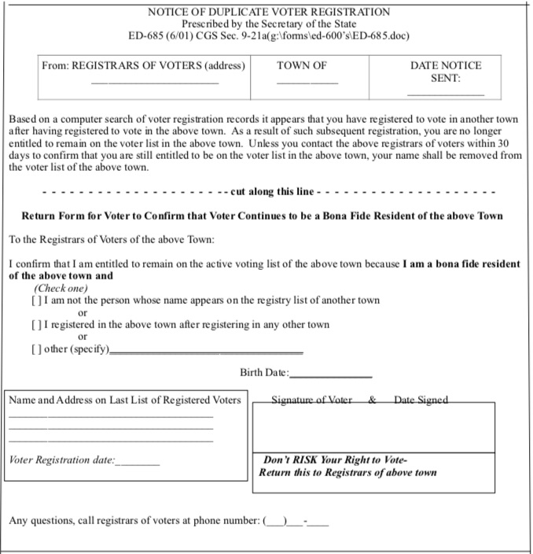
Notes:
Sample ED 685. Use as a guideline.

Slide 30
Notes:
Highlight statement that indicates failure to respond to this letter will result in removal from the voting records.

Slide 31
Duplicates
Duplicates
Correction Process
INACTIVE OR ACTIVE STATUS—IN YOUR TOWN
Notify the registrar in the former town that you’re sending the form to that voter.
A response is required within 30 days from the voter.
If NO RESPONSE - Transfer the voter’s name to the “off” list.
Notes:
It is strongly recommended that the registrars of both towns discuss and investigate any possible duplicate voters to ensure a proper determination will be made. Communicate!

Slide 32
Duplicates
Duplicates
Correction Process
INACTIVE OR ACTIVE STATUS—IN YOUR TOWN
If A RESPONSE is received and voter indicates that he/she:
Is NOT the same person whose name appears on the other town’s registry list
Make no changes to the voter’s records.
If Inactive: restore to Active
Notes:
A response from the voter should provide clarity to the situation.

Slide 33
Duplicates
Duplicates
Correction Process
INACTIVE OR ACTIVE STATUS—IN YOUR TOWN
If A RESPONSE: Voter IS the same person listed in the other town
Voter’s current town pulls the voter record from the former town
prepares to preserve it as the ORIGINAL record
inputs information from the newest voter registration card.
Notes:
If the voter responds that they are the same person listed in the other town, then activate “The pull process” which is identical to processing a voter registration application. Go to “Activities” and input Name and DOB data.
The voter information should appear with address in the old town. Then select to update in the new town and process as if a new registration.

Slide 34
Duplicates
Duplicates
Correction Process
INACTIVE OR ACTIVE STATUS—IN YOUR TOWN
Most recent town:
“Activities”/ “Select” the voter’s record from the former town
Confirm you are pulling the correct record by checking the duplicate list
Check any notes you made when researching the duplicates
Notes:
Again, we are in essence the new town ROV is reenrolling a voter who has moved to their town. We return to “Activities > Voter Registration” and input as if a new voter.
Make sure you have the correct voter by checking the duplicate list.
Have any notes available that were part of any research you did.

Slide 35
Notes:
Here is the screen after a search.

Slide 36
Notes:
Zoomed in on the data displayed and highlighted some essential action words. You do not want to select “New Voter”.

Slide 37
Duplicates
Duplicates
Correction Process
INACTIVE OR ACTIVE STATUS—IN YOUR TOWN
Most recent town:
IF “ON-LINE” VOTER REGISTRATION APPLICATION:
Print a copy of the on-line voter registration application.
Notes:
Print copy of registration card (if not done already).
Write down the Voters ID#s for both the old and new. Best way to keep track of the voters.

Slide 38
Duplicates
Duplicates
Correction Process
INACTIVE OR ACTIVE STATUS—IN YOUR TOWN
Most recent town:
Use the information from the newest voter registration card:
new street address,
party,
name changes, etc.
just as if you were processing a new voter registration.

Slide 39
Duplicates
Duplicates
Correction Process
INACTIVE OR ACTIVE STATUS—IN YOUR TOWN
Most recent town:
IF “ON-LINE” VOTER REGISTRATION APPLICATION:
Make note of the voter ID number
“Accept” the registration.
Notes:
Write down the Voters ID#s for both the old and new. Best way to keep track of the voters.
Accept the registration. When we do a search we should have two in the “new” town

Slide 40
Duplicates
Duplicates
Correction Process
INACTIVE OR ACTIVE STATUS—IN YOUR TOWN
Most recent town:
Go to “Inquiries”
verify that the record pulled over correctly
you now have 2 records for that voter.

Slide 41
Duplicates
Duplicates
Correction Process
INACTIVE OR ACTIVE STATUS—IN YOUR TOWN
This process will:
have created a duplicate record in your town.
alert the former town that you’ve pulled the voter’s record from their town through CVRS.
The previous town will get a CVRS “Reminder” of the pulled record, providing the paper trail to move the voter’s card to its “Off “files.

Slide 42
Duplicates
Duplicates
Correction Process
INACTIVE OR ACTIVE STATUS—IN YOUR TOWN
Go to
“Activities”
“Maintain Voter History”
Add history that have been made by your office to that voter
name history
address history
party history
election history
Remember to think of the dates as “up until this date, this was the correct information.”

Slide 43
Duplicates
Duplicates
Correction Process
INACTIVE OR ACTIVE STATUS—IN YOUR TOWN
Most recent town:
inserts and updates all information into the original record (including the registration date)
prints copy of online voter registration card (if applicable)
Notes:
We want to insert as much data as possible from the new voter data to add to the voter’s history.
Should have already printed a copy of the voters registration card.

Slide 44
Duplicates
Duplicates
Correction Process
INACTIVE OR ACTIVE STATUS—IN YOUR TOWN
Most recent town:
Change the Registration Date to reflect the date on which the voter registered in YOUR town.
If necessary, use “Change” in “Inquiries” to make this change.

Slide 45
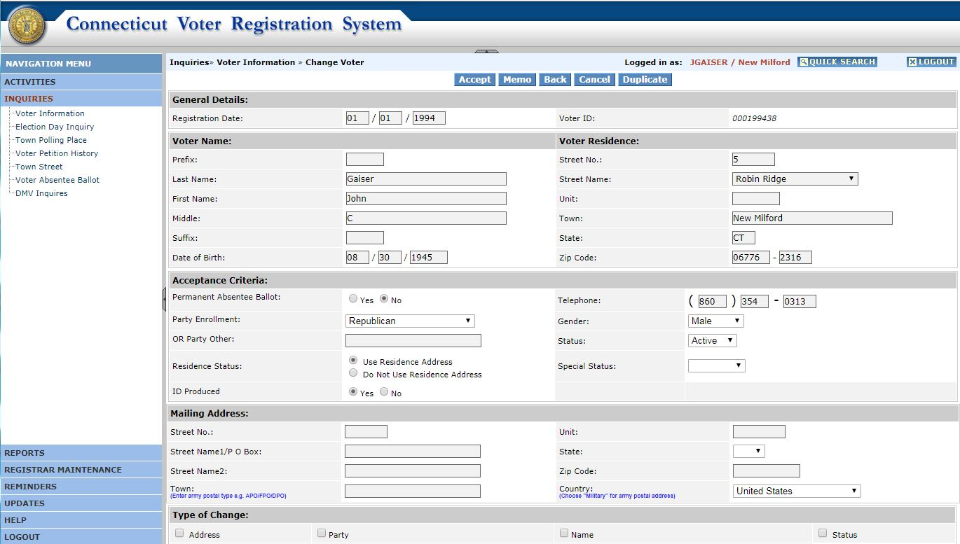

Slide 46
Notes:
We are getting close to completing the process.

Slide 47
Duplicates
Duplicates
Correction Process
INACTIVE OR ACTIVE STATUS—IN YOUR TOWN
Most recent town:
“Inquiries”
“Search”
Select the duplicate record that is going to be deleted
Either write notes or print a copy of the record
“View” “File” “Print”
Notes:
Best and most accurate way to call up and /or search for voters is to use voter ID #, and hopefully you’ve kept a careful record of the voter ID #’s. The voter ID of the record to be kept should be a SMALLER number than the one you will delete ( which would determine age).

Slide 48
Duplicates
Duplicates
Correction Process
INACTIVE OR ACTIVE STATUS—IN YOUR TOWN
Note different Voter ID numbers and be careful not to delete the ORIGINAL record that you just pulled from the previous town and updated!
Hint: The older file would have a lower number than the newer one.
Notes:
Measure twice, cut once!!

Slide 49
Duplicates
Duplicates
Correction Process
INACTIVE OR ACTIVE STATUS—IN YOUR TOWN
Delete your town’s newer record for this voter because you have added all of its information to the file pulled from the former town which has all the ORIGINAL information on it.
Notes:
Done.
Until the next round of duplicates

Slide 50
Duplicates
Duplicates
Observations
Comments
Additions
Questions

