Slide 1
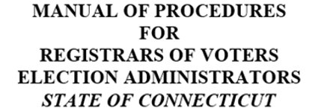
PROCEDURES MANUAL COMMITTEE
Chair: Darlene Burrell - Suffield (Burrdar@cox.net)
Dotti Dori - Brookfield, Shannel Evans – New Haven, Monita Hebert - Bolton, Rose Horan – Windsor Locks, Sharon Krawiecki-Bristol, Beth Kyle – West Hartford,
Bunny Lescoe-Windham, Georgia Pech – Salem

Slide 2
COMPANION GUIDE to:
CT General Statutes
Public Acts
Regulations
SOTS Guidelines
Best Practices
Handbook Puts Them Together Per Task

Slide 3
ON-LINE USE RECOMMENDED
Easy Navigation Through Manual
Links to:
To & From Chapters and Table of Contents
References
Statutes (§9-6)
Regulations (Reg. 9-5a)
Public Acts (PA393)
SOTS Manuals & Guides
HAVA

Slide 4
REGISTRAR’S POSITION
Governed by CT General Statutes
Paid by Municipality
Work Closely with Office of SOTS
Endorsed by Political Party
Politics Does Not Belong in ROV’s Office.
Ensure Fair & Equitable Implementation of all Laws.
Ch1, Pg 7

Slide 5
LIST OF REGISTRAR’S RESPONSIBILITIES
List of Duties CT Registrars are required to do
Tool Often Used In:
Budget Preparation
Helping Others Know What a Registrar Does
Quick Review for ROV
Ch1, Pg 8

Slide 6
Written Rulings, Instructions & Opinions Regarding Administration of Elections & Primaries
Presumed Correct
Implemented, Executed, and Carried Out
List of SOTS’s Duties Relating to ROV
LEAD
Legislation & Elections Admin. Division
Ch 2, Pg 13

Slide 7
SEEC
Duties Relating to ROV
Investigate Complaints of Election Law Violations
Power to charge civil penalties
Ch3, Pg 15

Slide 8
VOTER REGISTRATION & ENROLLMENT
Admission of Electors
Procedures
Registration Sessions
Enrollment of Electors/Party Affiliation
Felon
Registry List
Ch4, Pg 17

Slide 9
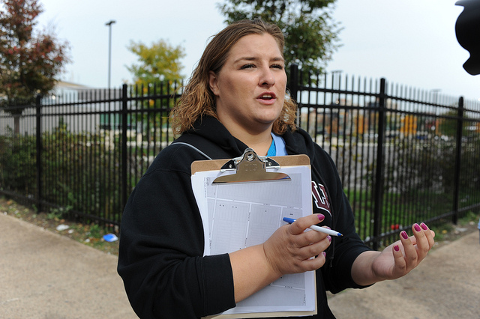
CANVASS
Requirements
Types of Canvass
In Person
Telephone
Mail
NCOA
Combination
Step by Step Instructions on NCOA
Ch 5, Pg 30

Slide 10
VOTERS
Goal
Only One Record Per Voter
Procedure
Step By Step Instructions
Try to Preserve ORIGINAL Record
Ch 6 Pg 38

Slide 11
FOI
FREEDOM OF INFORMATION ACT OF CT
Questions and Answers from FOI
Relating to ROV
Records to be Released
Timing
Fees
FOI Pertains to Existing Records Only
Ch 7, Pg 42

Slide 12
RETENTION & DISPOSITION
Records & Documents
Requirements Apply Only to Official Record Copies.
http://www.ctstatelibrary.org
Ch 8, Pg 44

Slide 13
PETITIONS
Primary Petition Procedures
Forms
Signature Requirements
Checking
Filing
ROV Not Responsible for Nomination Petitions
Ch 9, Pg 46

Slide 14
BALLOT TYPES
Official Regular
Absentee
Supervised
Emergency
Presidential
Overseas
Provisional (overseas)
Blank Absentee
EDR – Election Day Registration
Fed.Write-In Absentee (FWAB)
Challenged
Ch 10, Pg 54

Slide 15
PRIMARIES
Procedures
Possible # of Primaries in a Year
Dates & Times
Absentee Ballots
Forms, Notices, Press Releases
Ch 11, Pg 58

Slide 16
EDR
ELECTION DAY REGISTRATION
Location & Staffing
Eligibility and Identification Requirements
Admitting Procedures
Voting Procedures
Closing the EDR Location
Suggestions and Best Practices
Ch 12, Pg 68

Slide 17
Types of Elections
Municipal, State, Federal, Special
Hours of Voting
Voting Districts
Place of Holding Elections
Supervised Absentee Balloting
Write-In
AB Check-Off
Tabulators
Accessible Voting System
Sessions Ch 13, Pg 71

Slide 18
(continued)
Voter Registry List
Notices
Election Day Workers
Unofficial Checkers
Certifications
Voter ID Requirements
Emergency Contingency Plan
Presence of Registrars
“To Do” Check List

Slide 19
An Election That Is Not a Regular Election
General Instructions in Handbook
SOTS Provides Specific Instructions
Filling Vacancies
No Special Election Held If Only One Candidate
Create a New Office
Ch 14 Pg 83

Slide 20
REFERENDA
Held Not In Conjunction with a Regular or Special Election
Held in Conjunction with a Regular Election
Petition to Initiate Local Referendum
Recanvass on Close Question Vote
Charter Enactment or Revision
Regional School District Referendum
Ch 15, Pg 86

Slide 21
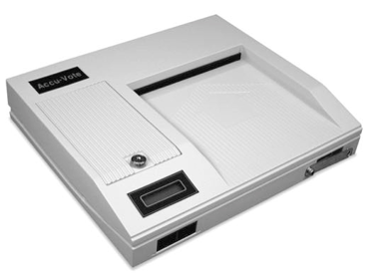
TABULATOR – MEMORY CARD TESTING – SET UP
Preparations
Test Deck
Changing Date & Time
Testing Ballot Box Deflector
Step By Step Instructions
Ch 16, Pg 93

Slide 22
RECANVASS
Reasons to Recount/Recanvass Ballots
Following Election or Primary
Chain of Custody
Ballot Counting Rules
Closing Recount
Link to SOTS “Recanvass Procedure Manual”
Ch 17, Pg 96

Slide 23
AUDIT POST-ELECTION
Steps to Take:
Preparing for an Audit
Conducting an Audit
Counting the Total for Candidates
Two Methods of Counting
Link to the SOTS Audit Procedures Manual
Ch 18, Pg 100

Slide 24
TAXES, POLLWORKERS
From IRS:
Form I-9 not required
The immigration Reform & Control Act of 11/6 1986 (IRCA) Public Law 99-603; U.S. Immigration & Customs Enforcements (ICE) Homeland Security Investigations 11/19/2013
Form W-4 not required (Per IRS)
their filing status and # of exemptions don’t matter
they are not required to withhold federal income tax.
? CT W-4 may be required?
Ch 19, Pg 104

Slide 25
HELPFUL HINTS & ON-LINE LINKS
Instructional Information
How to Create:
Lists
Reports
Labels
Letters
Election Related Miscellaneous
Links to:
Manuals
Instructions
Forms
Election Related Organizations
Ch 20, Pg 106

Slide 26
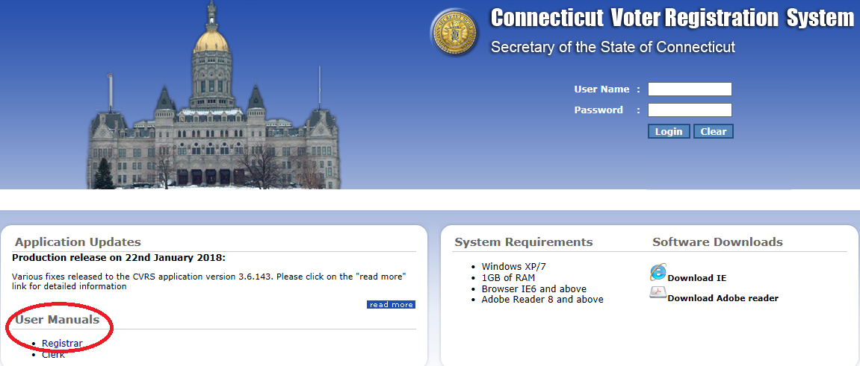
CVRS USERS MANUAL FOR REGISTRARS
CT Voter Registration System
Alpha Index For The 2013 Users Manual
Manual Found On Login Screen For CVRS
Ch 21, Pg 110

Slide 27
GLOSSARY
Commonly used in election law:
Words
Phrases
Titles
Etc.
Ch 22, Pg 120

Slide 28
MANUAL / HANDBOOK
A work in progress.
Comments and suggestions welcome.
Send to handbook committee
burrdar@cox.net

