Slide 1
Post Election
It’s 8 p.m. The polls are closed. Now What?
By Sue Armstrong & Darlene Burrell
Sept. 12, 2019

Slide 2
Well almost closed…..
Let’s assume that this isn’t happening in your town and that all your moderators have done everything perfectly!

Slide 3
SECURITY

Slide 4
What needs to be sealed?
What needs to be stored in a secure location?
What needs to be impounded and when?
Chain of Custody
Return of Votes
Meetings ~ who and when?
When to Up-date who voted?
Payroll
Audit vs Recanvass

Slide 5
IMMEDIATELY AFTER THE CLOSE OF POLLS
Moderator is to:
Ensure that Moderator’s Return is completed and signed by all the appropriate poll workers
Deliver Moderator’s Return & Check List
Ensure that tabulator and ballots (locked & sealed) are delivered to Registrars or secured in designated location by 2 election officials from different parties

Slide 6
What is a seal? A seal leaves evidence when tampered with.

Slide 7
What needs to be stored in a secure location? (Controlled Access)
Secure Storage & Sealed
During temporary interruption of canvass (§9-309)
Tabulators, depository envelopes, write-in ballots, absentee ballots, moderators’ returns, and other notes, worksheets or written materials used at the election
Up to 14 days after election, primary or referendum
Tabulators (§9-266 & 9-310), depository envelopes (reg 9-242a-27), write-in ballots, absentee ballots
Secure Storage
Up to 14 days - Keys to Tabulator by Registrars (§9-266)
If Recanvass is called Clerk secures and controls access to :
Moderators’ returns & official check lists.
Must be available for public inspection
Clerk maintains a log of all public inspections

Slide 8
What needs to be stored?
All Ballots.
22 months for ballots with a federal office on it.
180 days (6 months) for state or local ballots, if not contested (§9-310)
check retention schedule https://ctstatelibrary.org/publicrecords/general-schedules-municipal/
Unused Ballots 60 days
As a default, Connecticut General Statutes sec. 9-150b(h) will apply.
You may dispose of all unused ballots including those for federal, state and municipal elections after 60 (sixty) days. (Per Bernard Liu, SOTS Staff Attorney 5/16/17.)
Signatures of Electors~ Failure to Present ID ~ 18 or 22 months
Memory cards until reprogramming is required
IVS machines
Tabulators
Registry lists- Final and Supplementary ~ 2 years
Lists: Polling place officials and unofficial checkers lists (generally 14 days)

Slide 9
What needs to be impounded and when? (Give no access. Seize and take legal custody of.)
“Impounding means secure storage that remains the same as it was on Election Night until recount is conducted.” (per Ted Bromley 9/4/19)
If recanvass is required (or) if ordered by the SEEC (§9-7b(1))
Registrar impounds:
Tabulators, write-in ballots, and all other notes, worksheets or written materials used at the election. (§9-310)
Clerk impounds:
Absentee ballots and notes, worksheets or written materials used during counting.

Slide 10
RETURN OF VOTES
Electronically transmit results to SOTS: (Pres.Pref.Primary is different)
Preliminary list of vote totals by midnight (tabulator counts)
Full list of vote totals & turnout statistics to SOTS within 48 hrs
Hard Copy of Head Moderator’s Return to be delivered:
To Clerk within 48 hrs.
To SOTS within 3 Days
Submit Official Voter list to Clerk within 48 hrs
(§§ 9-314 and 9-440)

Slide 11
Give to Municipal Clerk as soon as practicable:
The sealed depository envelopes of :
Absentee ballot inner & outer envelopes, rejected ballots and counted ballots (9-150b(e))

Slide 12
Meetings ~ who and when?
Meeting to review Head Moderator’s Return to identify any error in the returns filed with the SOTS. (§9-322a)
Head Moderator, Town Clerk & Registrars
By 9 a.m. 3rd day after election
NOVEMBER 7, 2019 thru NOVEMBER 8, 2019 (Thursday - Friday)
If an error is identified, it must be corrected
An amended head moderator’s return to be filed with the SOTS, Clerk & Registrars
By 1 p.m. 3rd day after election
NOVEMBER 8, 2019 (Friday)

Slide 13
When to up-date who voted into CVRS
Enter “Who Voted” information into CVRS within 60 days after election
Technically we have until Jan 6, 2020 to upload who voted and how (AB or in Person) , into CVRS….Double CHECK THE current ELECTION CALENDAR for the deadline.
Don’t forget those in-person voters from EDR

Slide 14
Payroll
Don’t Forget to Submit Your Poll Worker Payroll

Slide 15
MANUAL OF PROCEDURES FOR REGISTRARS OF VOTERS
https://www.rovac.org/index.php?page=Handbook
Registrars’ responsibilities
Voter Registration & Enrollment
Canvass
Duplicate Voters
Petitions
Primary
Elections
EDR
Elections
Referenda
Re-Canvass/Recount
Audit Post-Election
Taxes, Pollworkers
Etc.

Slide 16
What is the difference between an Audit and a Recanvass/Recount
Audit
Verifies Accuracy of tabulator
Recanvass
Verifies that Voter intent has been counted properly

Slide 17
CHAIN-OF-CUSTODY
Chain-of-custody is required to maintain integrity of an election, primary, etc. when:
Removing ballots, memory cards & tabulators from secure storage for both audits and rencanvass and
Under the supervision of two election officials of opposing parties or police officer
until locked into storage again

Slide 18
AUDIT POST-ELECTION Verify Accuracy of Tabulator
Audit determined by lottery held by SOTS
Pre-determining at the time of poll worker training when and which poll workers can be available in the event of an audit will save time.
Audits are to be performed by:
hand counting or
electronically when authorized to do so by the SOTS.
Follow established procedures, including requirements for providing notice, chain of custody, and counting procedures.
Audit Procedures Manual on SOTS website
https://www.rovac.org/index.php?page=Handbook
Handbook provides 3 methods of hand counting
Election officials conducting the audit are to be compensated at the same rate of pay established by the municipality for elections and primaries. §9-320 (f)

Slide 19
Audit of Tabulators in a Municipal Election Year
The SOTS shall conduct a random drawing to select the districts subject to Audit
The MUNICIPAL CLERK shall conduct a random drawing to select the offices in question.
§9-320f (b) (3)

Slide 20
Recanvass Verify Voter Intent is counted properly
3 days to determine if recanvass is required
5 business days to complete recanvass (by 11/13)
3 ways a Recanvass May Occur: (Reg 9-242a-28)
Discrepancy (§9-311) Called by HM
Moderator determines there is a discrepancy in the return of any district.
Moderator summons recanvass officials & notifies town chairmen.
May be limited by moderator to area of discrepancy
Close Vote(§9-311a, 9-445) Called by TC in Municipal Election by SOTS during State and Federal Elections
Difference between winning candidate & defeated candidate is less than ½ of 1% of total votes cast for a single opening office (OR)
½ of 1% of the number of electors as having voted in a multi opening office (OR)
less than 20 votes separate the winner from the defeated candidate
Question - Difference between “Yes” & “No” vote is less than ½% of total votes cast for the question but not more than 2,000 votes. (§9-370a)
Tie vote for any office
When there is a tie vote in any office

Slide 21
Who Calls for RECANVASS ~during Municipal Election Year
Discrepancy ~ The Head Moderator calls for recanvass
Close Vote ~ the Town Clerk calls for recanvass ~ Notifies HM
IMPORTANT TO BE AWARE OF
Multiple-Opening Offices /Contests (ie BOE, BOF, Town Council etc….)
The returns for all candidates in contest will be recanvassed
A loser of a close vote may decline having a recount if done in writing.(§§ 9-311, 9-311a, 9-445)

Slide 22
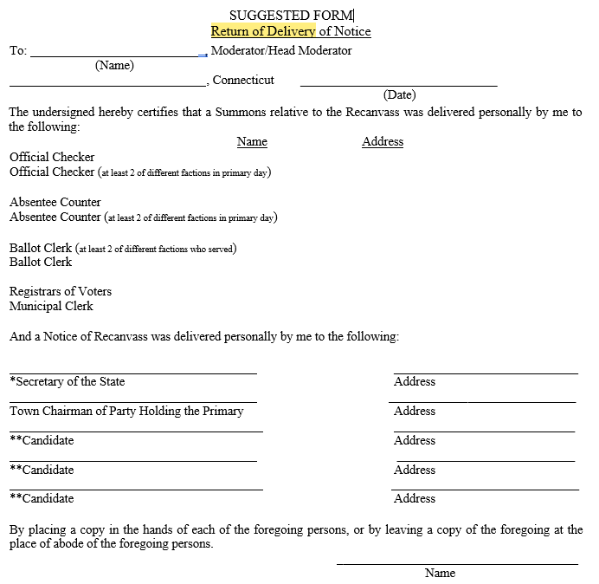
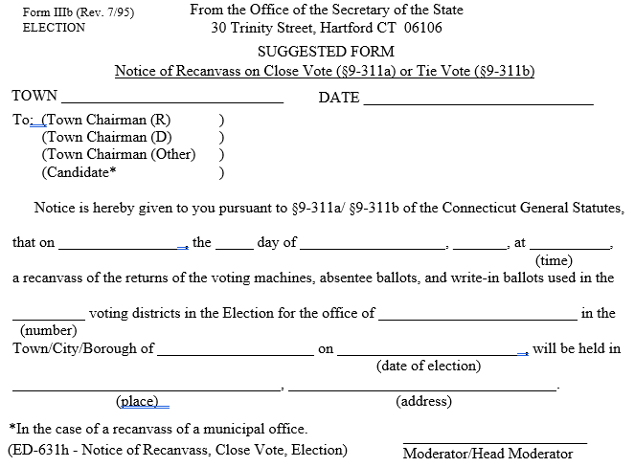
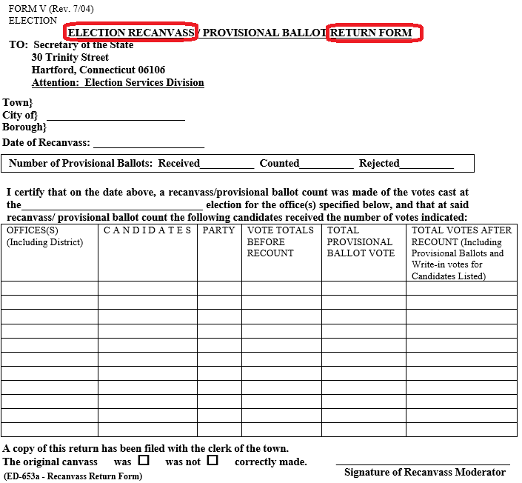
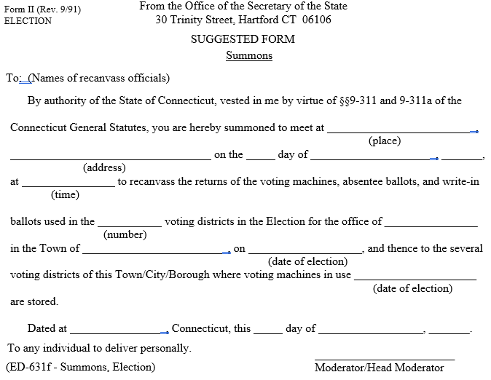
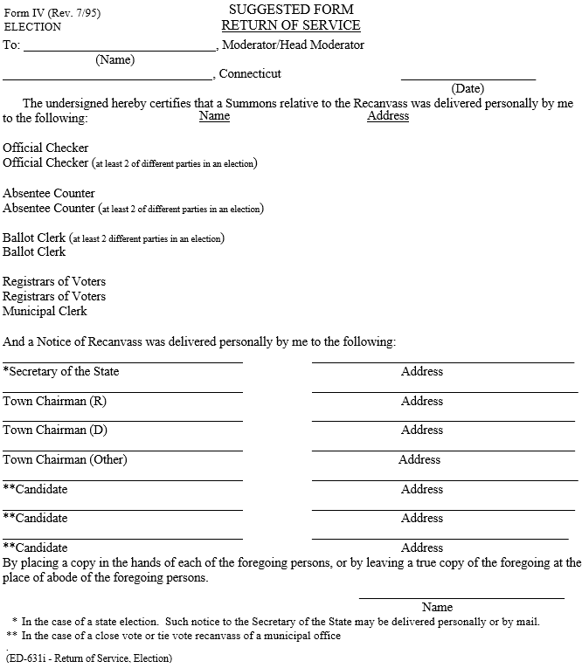
Recanvass Procedure Manual
Refer to the Recanvass Manual posted on SOTS website:
Recanvass Procedures
Forms
Notice of Recanvass
Summons (for recanvass workers)
Return of Delivery (of Summons) Notice
Recanvass Return Form
Return of Service Form (notice to Town Chairs, etc. of Recount Officials Summoned)
Also, refer to §§9-311, 9-370a, 9-445 & 9-446
Impound and security of election equipment and materials imperative.
Chain-of-Custody required for all election equipment and material.

Slide 23
Notice of Recanvass
Notices are to state date, time & place where the Recanvass will take place
Ensure that the location of the recanvass is identified with sufficient signage
to enable any member of the public to easily locate the building & room where the recanvass is taking place.
Send written notice to:
Town chairs of every political party involved in the Recanvass
Candidates subject to recanvass
In a close or tie vote for municipal office or election of members of a Town Committee each candidate is also given written notice
Counting officials to receive summons
Notify the Press, post details on the Town’s web site and the ROV’s website is suggested.

Slide 24
Recanvass Officials
Moderator (Head Moderator)
Registrar of voters
Minimum of two official checkers from opposing parties*
Minimum of two absentee ballot counters from opposing parties
Minimum of two ballot clerks from opposing parties *
NOTE: These officials should be chosen from the poll workers who worked Election Day, however you may substitute workers as needed.
The Town Clerk, although not a recanvass official, will be involved as they have some of the “Impounded” election materials needed for the Recanvass
*when practicable

Slide 25
Recanvass Day Suggestions
Arrive early and rested it can be a long day.
Have beverages and snacks for your workers. Providing lunch helps keep the day running smoothly.
Recanvass officials should arrive before the official start of the recanvass for instruction.
Set Recanvass officials up in teams of two prior to their arrival.
Swear in the Recanvass Officials. (REQUIRED)

Slide 26
OBSERVERS
Instruct Public Observers as to what they are allowed and not allowed to do.
Observers may be close enough to:
Observe but not interrupt the process
See ballots as they are counted
See tally sheets being marked and counted
See report forms
Verify seal numbers
They should present any questions they have to the ROV or Moderator not the Ballot counters
Be mindful of expected number of observers

Slide 27
Ballot Counting Rules
Voter Intent Governs
Run properly marked ballots through tabulator
Work in teams of at least 2 officials (not of same party affiliation)
Double check work done by other official (at least two sets of eyes)
Count only the votes for the contests subject to recanvass
Impartial judgement
Moderator makes final decision when voter intent is not clear.

Slide 28
Basic Ballot Counting Rules
Examine ballots - determine whether markings for the office being recanvassed are clear to be read by tabulator
Stack properly marked ballots into groups of 25/50 (recommended)
Process properly marked ballots through tabulator
Hand Count mismarked or improperly marked ballots
(including stickered ballots)
o Follow Hand Counting Ballots Procedures
Reseal into transfer bags and/or depository envelopes

Slide 29
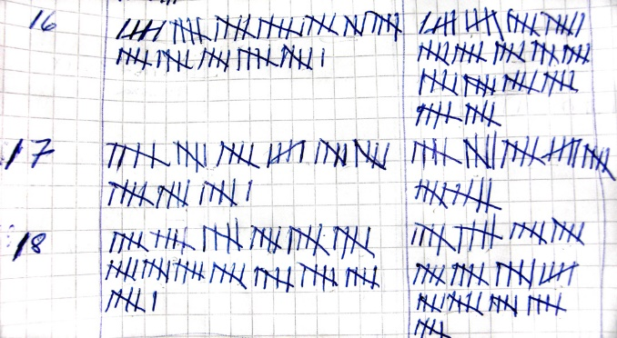
Basic Hand Counting Ballots Improperly Marked Ballots
Hand count the votes for the office(s) or question(s) subject to recount
Interpreting ballot markings for voter intent
Hash marks on tally worksheet indicating votes received
Reconcile hash mark sheets jointly
Record # of votes onto tally sheet
Reseal in labeled depository envelopes.

Slide 30
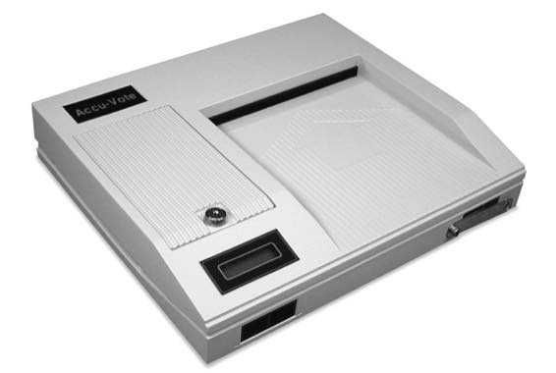
TABULATOR Counted Polling Place Ballots
Break the seal(s) on the ballot transfer case(s) carrying the tabulator counted ballots.
Working with one ballot bag at a time, remove the ballots from the ballot transfer case
ABANDONED Ballots – Simply consider abandoned ballots when comparing the # of ballots cast to the # of electors checked as voting.
SPOILED Ballots – Keep in depository envelope. Do nothing with them.
Follow “Basic Ballot Counting” Instructions

Slide 31
Absentee Ballot Handling (1 of 2)
Open depository envelope with discarded outer and inner envelopes & rejected absentee ballots
In the presence of the moderator and town clerk
Regarding Rejected Ballots – Simply ensure that they have been accounted for. Do not look at them.
Check all outer envelopes against:
inner envelopes
Verify that quantity of them is the same.
Clerk’s check list
Verify postmarks & addresses
Official check list markings “A”
Verify that # of outer & inner envelopes is same as # of persons checked as having voted by absentee ballot.

Slide 32
Absentee Ballot Handling (2 of 2)
Open depository envelope(s) containing tabulator counted absentee ballots
Follow Basic Ballot Counting Rules
Open depository envelope(s) containing hand counted absentee ballots
Follow Hand Counting Ballot Instructions
EDR Ballot Handling
Handle as closely as possible to Absentee Ballots

Slide 33
Write In Bin Ballots
Open depository envelopes containing Election Day write-in bin ballots.
Look at ballots for any defects or marking errors which might cause the tabulator to incorrectly read the ballot for the offices to be recanvassed.
If any marking error or defect is found in the office being recanvassed the ballot should be set aside so it can be hand-counted.
If there is a write-in for recanvassed contest set the ballot aside so it can be hand-counted.
Feed all other ballots from the write-in envelope into tabulator, so non-write-in votes can be tabulated.
Record votes on tally sheets
Reseal write-in ballots in labeled depository envelope

Slide 34
AUXILIARY Bin Ballots
Open depository envelopes containing the ballots from the auxiliary bin
Hand count the votes for the contests subject to the recanvass
Follow Hand Counting Procedures
Record votes on tally sheets
Reseal in labeled depository envelope.

Slide 35
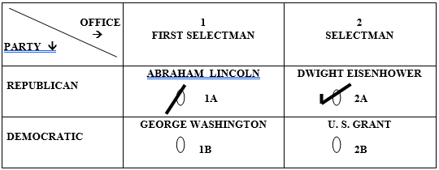
Interpreting Ballot Markings (1 of 7)
Slash Marks Through Ovals
Hand Count
Count Vote for Lincoln & Eisenhower

Slide 36
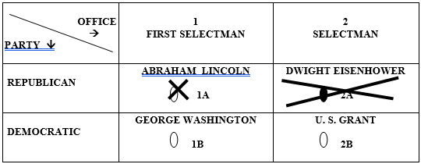
Interpreting Ballot Markings (2 of 7)
Invalid Correction
Hand Count
Count vote for Lincoln

Slide 37
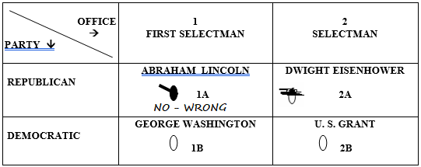
Interpreting Ballot Markings (3 of 7)
Invalid & Written Correction
Hand Count
Count Vote for Eisenhower

Slide 38
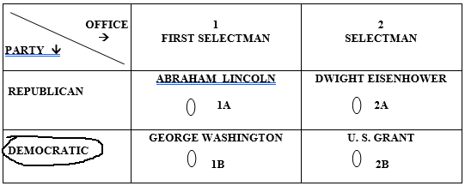
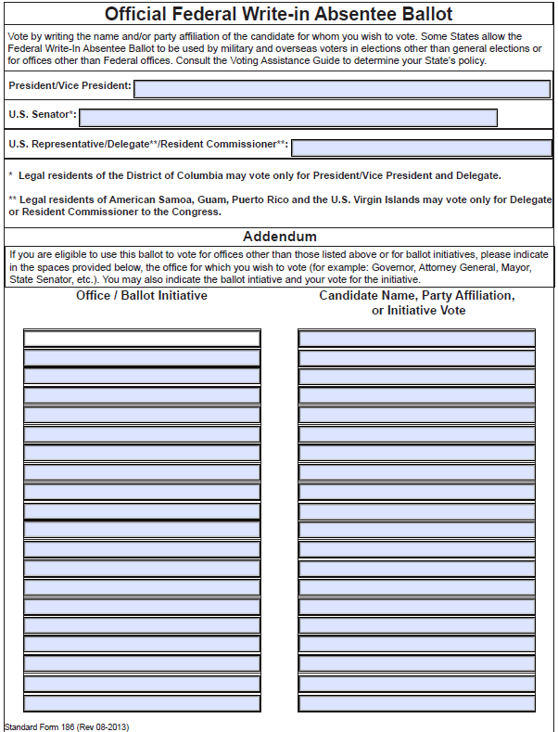
Interpreting Ballot Markings (4 of 7)
Party Designation is Disregarded/Ignored
NO Votes Counted
(NOTE: There is one exception - Party Designation is considered on Official BLANK Absentee Ballots)

Slide 39
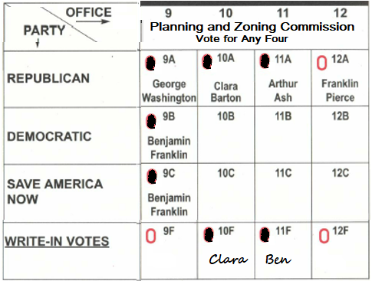
Interpreting Ballot Markings (5 of 7)
Determine if a True Overvote
More candidates selected than allowed?
This ballot is NOT a true Overvote
7 ovals filled in
4 candidates selected
Count Vote for
Washington, Barton,
Ash & Ben Franklin

Slide 40
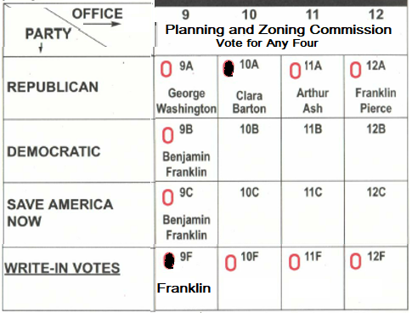
Interpreting Ballot Markings (6 of 7)
Intent of Voter Must be Clear
(Ben Franklin or Franklin Pierce), the write-in vote would not be counted
Clara Barton is the
only clear vote

Slide 41
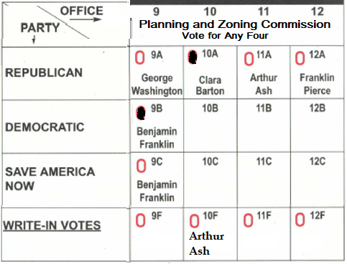
Interpreting Ballot Markings (7 of 7)
Consistency is important when determining voter’s intent.
Ovals are correctly filled in on ballot.
Oval not filled in for write-in
Count vote for
Clara, Benjamin & Arthur

Slide 42
Closing Recount (1 of 3 )
For Each Voting District
Print and sign 2 elections results tapes
1st tape connected to Zero tape
attach to Recanvass Moderator’s Return.
Announce tabulator results for contests subject to recanvass
Ignore results for offices not subject to recanvass
Post 2nd result tape for observers to view

Slide 43
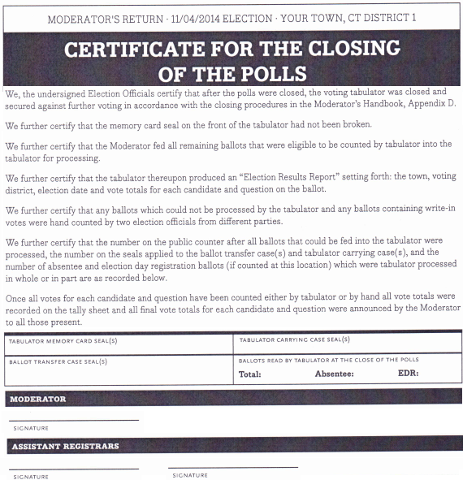
Closing Recount (2 of 3 )
After all votes subject to recanvass are counted:
Record results on proper tally sheets
Complete “Certificate of Closing Polls” form with moderator & at least two officials’ signatures.
Record seal numbers from tabulator(s) and ballot transfer cases
Complete Moderator’s Returns for office(s) subject to recanvass (this form is not in recanvass manual)
Announce results for contests subject to recanvass

Slide 44
Closing Recount (3 of 3 )
Put in ballot transfer case all tabulator counted ballots and sealed depository envelopes like they were on election night
Attach new seal
Record seal number on Moderator’s Return
Put tabulator w/recanvass memory card into tabulator case.
Attach new seal
Record seal number on Moderator’s Return
Put back into secure storage, as on Election Night, until 14 days after election (11/19) unless ordered otherwise.

Slide 45
DATES TO REMEMBER
Nov. 6 Return of Votes
Nov. 7 or 8 Meet with Clerk & Head Moderator to review Head Moderator’s Return
Nov. 8 Last Day to order a recount
Nov. 13 Last Day to conduct recount
Nov. 19 Tabulators to remain locked until this date
Jan. 6 Last Day to input Who Voted
???? Audit date to be announced by SOTS

